Slide 1
LECTURE. 14. Unit. 2.
Course Code. AD 212
Art, craft and Architecture
Introduction to Abstract Art
Pakistani Artist Ahmad Parvez

Slide 2
SUMMERY OF Lecture 13. unit. 2.
Introduction to Realism.
(Pakistani artists)
Anna Molka Ahmad
Ali Imam,
Iqbal Hussain,
Khalid Iqbal

Slide 3
In our lecture 13 unit. 2 we have discussed in detail Realism Movement in art in the world with the salient features of Realism.
Then we discussed some Pakistani artists who worked according to Realism or with its combination of a modern style.
We also discussed the work of great painter and pioneer of Fine arts in Pakistan.
Her life and her work has been shown to make the students familiar with her work.

Slide 4
Ali Imam: the work and life of Ali Imam was also discussed in detail.
Ali Imam who has produced beautiful paintings but also opened a significant school of art in Karachi.
Iqbal Hussain:
Iqbal Hussain’s realistic expressions of are depictions of his life experiences, which not only reflects his life but also his sensitivity and realistic approach in the depiction of women of Red light area.

Slide 5
KHALID IQBAL:
We also discussed the realistic impressionistic work of Khalid Iqbal. His landscapes of Punjab reflect his interest in the roots of Pakistan. He has painted simple landscapes with intricate details.
The purpose of this lecture was to make the students familiar with the work of some artists of Pakistan.

Slide 6
LECTURE. 14. UNIT. 2
Introduction to Abstraction.
(Pakistani artist)
Ahmad Pervaiz

Slide 7
INTRODUCTION TO ABSTRACTION:
"Of all the arts, abstract painting is the most difficult. It demands that you know how to draw well, that you have a heightened sensitivity for composition and for colours, and that you be a true poet. This last is essential." -- Wassily Kandinsky is a big name as far as abstract art is concerned. The great Cubists Picasso and Braque we have already discussed

Slide 8
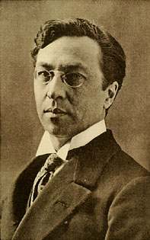
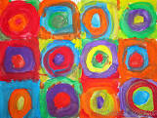
Wassily Kandinsky (1866 – 1944) was a Russian-French painter. His style of painting originally belonged to expressionism.

Slide 9
A further distinction tends to be made between abstract art which is geometric, such as the work of Mondrian, and abstract art that is more fluid (and where the apparent spontaneity often belies careful planning and execution), such as the abstract art of Kandinsky or Pollock.

Slide 10
Also generally classified with abstract art are figurative abstractions and paintings which represent things that aren't visual, such an emotion, sound, or spiritual experience. Figurative abstractions are abstractions or simplifications of reality, where detail is eliminated from recognizable objects leaving only the essence or some degree of recognizable form.

Slide 11
In Western art history, the break from the notion that a painting had to represent something happened in the early 20th century. Impressionism, Fauvism, Cubism and other art movements of the time all contributed by breaking the "rules" of art followed since The Renaissance. Impressionism saw painters not "finishing" their paintings. The Fauvists used colour in a non-realistic way. Cubism introduced the idea of painting an object from more than one view point. From all of these the idea developed that colour, line, form, and texture could be the "subject" of the painting.

Slide 12
Abstract Expressionism, which emerged in the 1940s, applied the principles of Expressionism to abstract painting. The action painting of Jackson Pollock, in which paint was dripped, dropped, smeared, spattered, or thrown on the canvas, is a good example.
In 1864 the critic Ernest Chesneau wrote that if the trend the Impressionists were setting continued, paintings would eventually consist of nothing but "two broadly brushed areas of colour". What would he have thought of the art being produced 100 years later?

Slide 13
In its purest form in Western art, an abstract art is one without a recognizable subject, one which doesn't relate to anything external or try to "look like" something. Instead the colour and form (and often the materials and support) are the subject of the abstract painting. It's completely non-objective or non-representational.

Slide 14
Important Abstract painters of the world Abstract Expressionism, which emerged in the 1940s, applied the principles of Expressionism to abstract painting. The action painting of Jackson Pollock, in which paint was dripped, dropped, smeared, spattered, or thrown on the canvas, is a good example.
In 1864 the critic Ernest Chesneau wrote that if the trend the Impressionists were setting continued, paintings would eventually consist of nothing but "two broadly brushed areas of colour". What would he have thought of the art being produced 100 years later?

Slide 15
Painting the Invisible: Paul Klee (1879-1940)
The art of Paul Klee defies easy categorization. During his career he experimented relentlessly with creating images in a wide variety of styles, some abstract, some less so. Visionary, subtle, whimsical, sometimes innocent, but always innovative, his prolific output has ensured that he remains one of the favorites of twentieth century abstract artists.

Slide 16
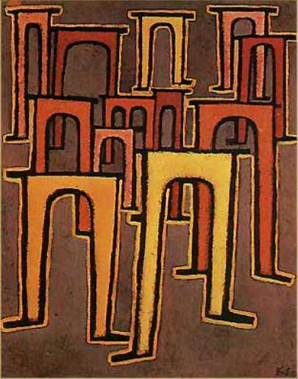

Slide 17
Hans Hofmann (1880-1966)
Artist and teacher, Hans Hofmann, occupied a unique place in the world of 20thcentury art as someone whose career spanned art movements from Cubism and Fauvism, through Surrealism to Abstract Expressionism. Hofmann knew artists such as Matisse, Picasso, Braque and Delaunay as well as Pollock, Krasner and Frankenthaler.

Slide 18
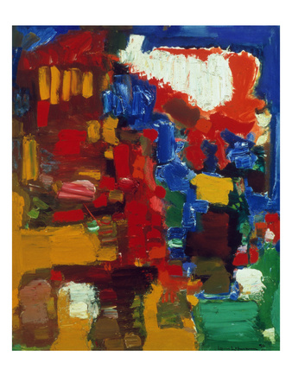

Slide 19
Jackson Pollock Paintings
Jackson Pollock paintings are some of the most recognizable and thrilling images produced in the 20th century. Pollock was dubbed ‘Jack the Dripper’ by Time magazine due to the unusual way he liked to drip and splatter paint onto his canvas. Some of the inspiration for his paintings came from the Native American sand art he saw as a child and his own method of working resembled a form of ritualized dance around the canvas which was laid out flat on the floor.

Slide 20
This fine art print is produced on Forest Stewardship Council certified paper, using post-consumer and sustainably sourced paper, and soy-based inks. The detailed proofing process and standardized printing plates of offset lithography ensure this print reproduction maintains vivid colors and faithfulness to the original work of art.

Slide 21
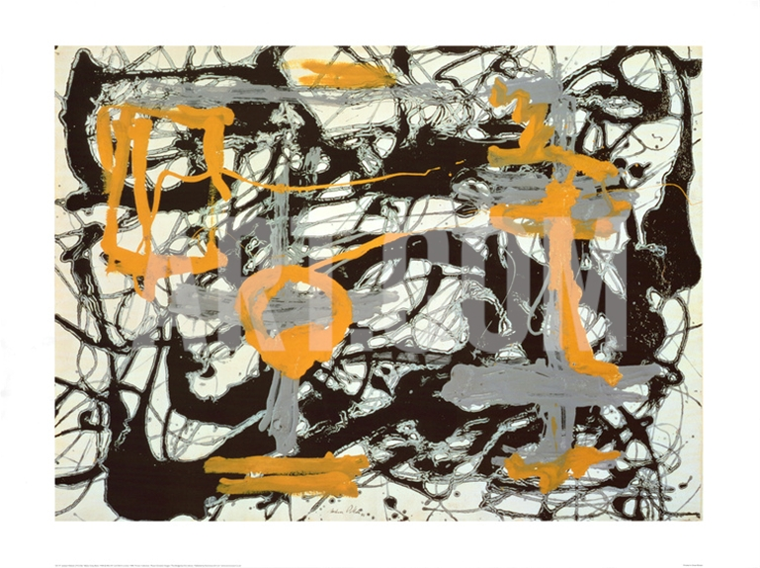

Slide 22
Clyfford Still (1904-1980)
Clyfford Still’s art is electrifying. It’s like a bolt of lightning both visually and in its impact on the viewer. There is a constant sense of revelation running through the work, an ongoing depiction of those powerful intricacies of nature that we inherently understand but can’t find words for.

Slide 23
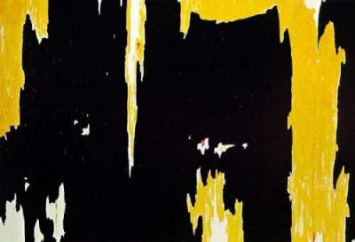

Slide 24
Ahmed Pervez
Ahmed Parvez (1926–1979) was born in Rawalpindi, Pakistan. He was one of the most remarkable artists produced by Pakistan and he received widespread acclaim in Pakistan and abroad. From his first solo exhibition in 1952 to his last in 1979, he passed through many phases as a painter, but his work remained marked with energy.

Slide 25
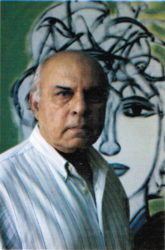
Before 1972, he spent about 12 years in Britain and exhibited successfully all over Europe; and also two years in USA, where his exhibition in Gallery International, New York, was very well received. He received the President’s Medal for Pride of Performance in 1978.

Slide 26
Postage stamp:
On 14 August 2006, Pakistan Post issued a Rs. 40 sheetlet to posthumously honour 10 Pakistani Painters. Besides Ahmed Pervez, the other 9 painters are: Laila Shahzada, Askari Mian Irani, Sadequain, Ali Imam, Shakir Ali, Anna Molka Ahmed, Zahoor ul Akhlaq, Zubeida Agha and Bashir Mirza.

Slide 27
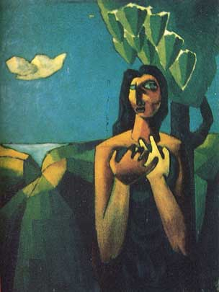

Slide 28
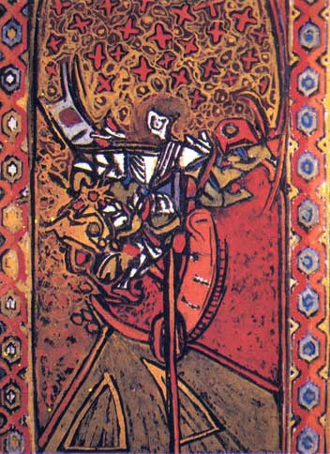

Slide 29
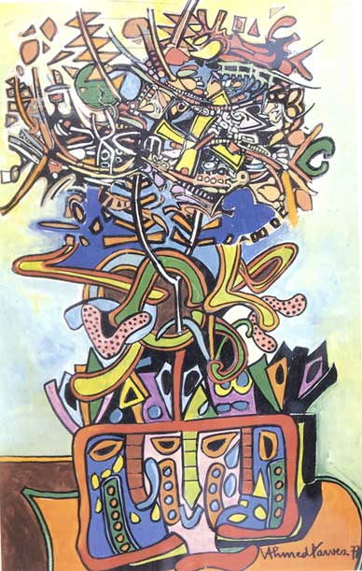

Slide 30
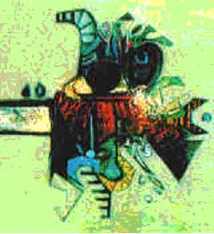

Slide 31
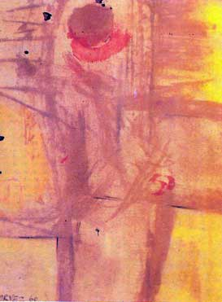

Slide 32
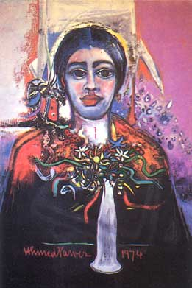

Slide 33
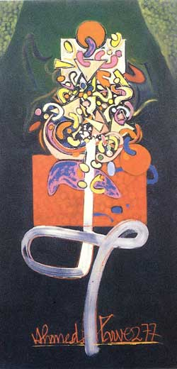

Slide 34
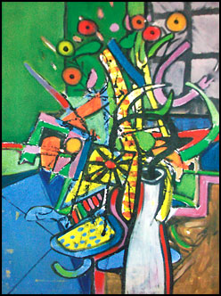
Ahmed Parvez rightly called himself an Van Gogh With A Twist ''organic'' painter, because like the great masters of art such as Bashir Mirza,

Slide 35
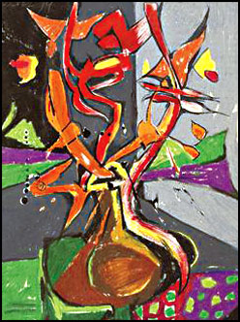
Ahmed Parvez regularly met with artists through Marjorie Hussain. An interview with her made one realize.

Slide 36
Ahmed Parvez began his success through the water colour medium and gouache. A piece that stands out to many of his viewers is one that has been executed with oil sticks and created in 1978. Parvez's paintings are epitomes of vibrancy; explosions of colour are contained within triangles

Slide 37
and jewel, toy-like shapes. The brilliant sun-like glowing qualities of the colours are merged with a mechanical design pattern. Initially advised by Dennis Bowen in 1959 to break up the elements of his work, Parvez since then began to add a radical sense of geometry to his work which is evident in his pieces. The pattern of fluorescent green, cobalt blue, bright orange and burn umber square checks on the top right hand side seem to

Slide 38
symbolise a window behind a vase, blurred with a multitude of colours from the sun.
Concentrating on arrangements of flowers in vases, his 'still-life' paintings radiate colour. The intensity of oil sticks truly captures the raw energy Parvez injects into his creations; the cadmium orange and reds would appear harsh if handled differently, yet they create an atmosphere of excitement which encapsulates the spontaneity of Parvez's character.

Slide 39
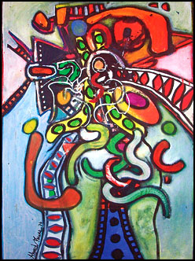
Beautiful combination of design and colour.

Slide 41
The flowers and leaves are crooked and end with sharp points yet the colouration of powder blue, leafy green and rich purple provide the composition with mystery and allow the viewer's focus to keep rotating around the piece. The flowers appear to be lilies in the arrangement. When considering the actual softness and delicacy of lilies to the bold contorted flowers Ahmed Parvez creates, the viewer may wonder how he could have called himself an "organic" non-representational painter

Slide 42
Interestingly enough Parvez's work has a detailed Mughal and Sindhi decorative influence. In his pieces, the red, green, purple and yellow colours dominate, projecting the oriental feel to his work. Perhaps because of the twisted element of Pakistani culture one can detect in his work, Ahmed Parvez rightly called himself an ''organic'' painter, because like the great masters of art such as Bashir Mirza, he stayed true to his roots and drew inspiration, especially colouration from the vibrancy of his country.

Slide 43
great masters of art such as Bashir Mirza, he stayed true to his roots and drew inspiration, especially coloration from the vibrancy of his country.
Parvez acknowledged that he owed much to his uncle and however futile his teachings in drawing a perfect circle were, he indirectly provided Parvez with a motive to break away from the 'classical interpretation' of art.

Slide 44
His gouache on paper, created in 1978, of a cadmium red mug-like vase with a flower arrangement which appears as exploding buds and 'bursting seeds', has a calligraphic feel to it as the flowers are shaped to appear as stretched and distorted alphabets. The coloration scheme in this painting reminded the writer of a conversation shared with Wahab Jaffer during an interview.

Slide 45
The artist had been reminiscing upon Parvez's teachings; he had shown Wahab Jaffer that inevitably a light blue background would immediately pick up the colours in the foreground. This draws a parallel with how a child will almost always colour the sky light blue in a landscape painting, accentuating the bright hues of the objects in the forefront. Similarly, the pastel feminine-like shades of blue, pink and light purple create a soft background which enables the virile oranges, greens and yellows to stand out and remind the viewer of the restless personality of Ahmed Parvez.

Slide 46
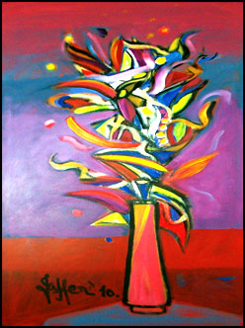

Slide 47
Ahmed Parvez regularly met with artists through Marjorie Hussain. An interview with her made one realize that Parvez did not just pursue art for a career or even for therapeutic reasons; his art communicated the unspoken. The spontaneity of coloration and the heightened pigments of his work revealed his fluctuating nature and how he valued every moment's gesture. Child-like yet dynamic and detailed, his work could apply to a multitude of adjectives. Having the opportunity to view his work at Wahab Jaffer's home made me realise that his art was meant to transcend time and communicate to many generations.

Slide 48
he colouration of the work from artists conveys a certain intellectualism, as their knowledge and control over the choice and blending of colours is a skill which is rarely found. Therefore, Ahmed Parvez's abstract and symbolic art are transported to another level because of his colours. They represent universal issues and this may be one of the many reasons behind why the artist received the President's Award for Pride of Performance. However he never failed to show his generosity in encouraging younger artists and his fellow peers and took delight in good work.

Slide 49
UNIT 2 GOALS
At the end of the unit students teachers will know how art is product of the particular culture, Key features of Islamic art, explains the significance of calligraphy in Islamic art. Will recognize work of artists. Will have the knowledge of Cubism, realism and abstraction.

Slide 50
UNIT 2 ESSENCIAL QUESTIONS
Does art reflect culture or shape it?
How is culture and tradition expressed through art.
What is Islamic art/ How can Islamic art be used in teaching Math?
How can writing convey its meaning through its appearance (beyond literal meaning)?
What are Cubism, Realism and Abstraction in art?

