Slide 1
LECTURE. 13. UNIT. 2
Introduction to Realism.
(Pakistani artists)
Anna Molka Ahmad
Ali Imam,
Iqbal Hussain,
Khalid Iqbal

Slide 2
SUMMERY OF PREVIOUS LECTURE 12
In our previous lecture we discussed definition of Cubism
The Life and work of two Pakistani Cubist Painters.
Shakir Ali
Mansoor Rahi
These two artists are the true representors of 20th century Modern art,
Who took their inspiration from Cubist painters Picasso and Braque.

Slide 3
Realism, in the arts, the accurate, detailed, unembellished depiction of nature or of contemporary life. Realism rejects imaginative idealization in favour of a close observation of outward appearances. As such, realism in its broad sense has comprised many artistic currents in different civilizations. In the visual arts, for example,

Slide 4
Realism (or naturalism) in the arts is the attempt to represent subject matter truthfully, without artificiality and avoiding artistic conventions, implausible, exotic and supernatural elements.
Realism has been prevalent in the arts at many periods, and is in large part a matter of technique and training, and the avoidance of stylization. In the visual arts, illusionistic realism is the accurate depiction of lifeforms, perspective, and the details of light and colour. Realist works of art may emphasize the ugly or sordid, such as works of social realism, regionalism, or Kitchen sink realism.

Slide 5
There have been various realism movements in the arts, such as the opera style of verismo, literary realism, theatrical realism and Italian neorealist cinema. The realism art movement in painting began in France in the 1850s, after the 1848 Revolution. The realist painters rejected Romanticism, which had dominated French literature and art since the late 18th century.

Slide 6
Anna Molka Ahmed, was a famous Pakistani artist and pioneer of fine arts in the country after its independence in 1947. She was a professor of fine arts at the University of the Punjab in Lahore. Anna Molka's father, painted in 1950 by Anna M

Slide 7
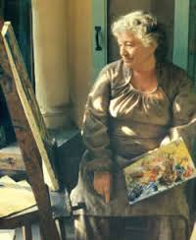

Slide 8
Prof Anna Molka Ahmed was a famous Pakistani artist and pioneer of fine arts in the country after the Partition.
She was a professor of fine arts at the University of the Punjab in Lahore. She was born to Jewish parents in London.
Her mother was Polish and father Russian. She studied painting, sculpture and design at St Martin School of Arts in London.

Slide 9
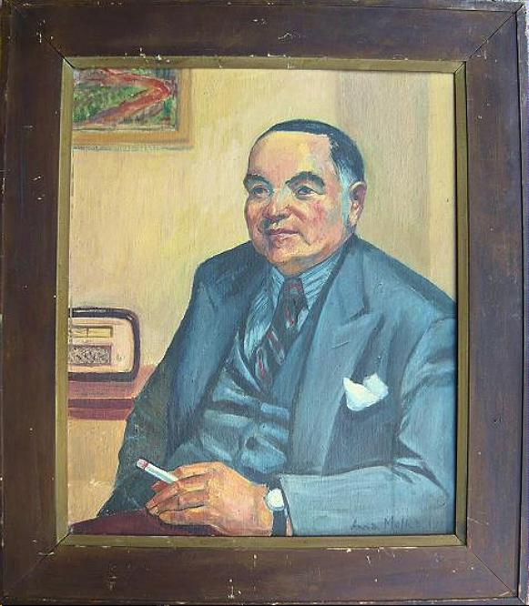
Anna Molka's father, painted in 1950 by Anna Molka

Slide 10
Awarded Tamgha-i-Imtiaz (1963), the highest civil award for her services in the field of fine arts education in the country.
Awarded President's Award for the Pride of Performance in 1969.
Khudeja Tul Kubra Medal

Slide 11
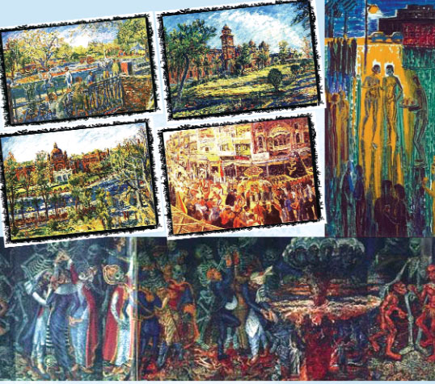

Slide 12
After marrying Sheikh Ahmed, a would-be Pakistani, in October 1939, she converted to Islam.
Although her marriage was over in 1951, she lived in Pakistan with her two daughters. She was awarded Tamgha-e-Imtiaz, the highest civil award, for her services in the field of fine arts education in the country.

Slide 13
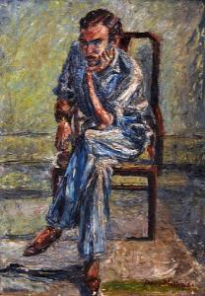

Slide 14
In 1940, Prof Em Anna Molka Ahmed set up the Department of Fine Arts, now the College of Arts and Design, at the University of the Punjab, which has now become a centre of excellence for fine arts in Pakistan.
Her students turned into famous artists at home, whereas many of them are recognised internationally.

Slide 15
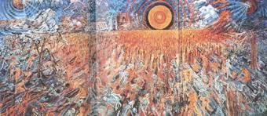

Slide 16
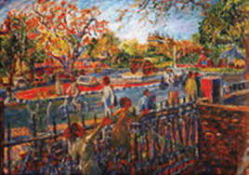

Slide 17
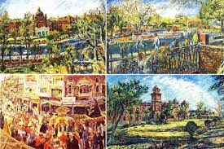

Slide 18
The Imam of Art
Shamim Akhter
Ali Imam, the Imam of art and artists of Pakistan passed away on May 23, 2002. To pay homage to Imam Saheb, Gallery 6 in Islamabad hosted two of his rare works of art. In Karachi, Shahnaz Imam, now the director/ curator of Indus Gallery paid tribute to her husband by holding a big exhibition of paintings by senior and prominent artists of Pakistan. She also produced a brochure on the occasion sketching the life and works of Imam Saheb by various writers.

Slide 19
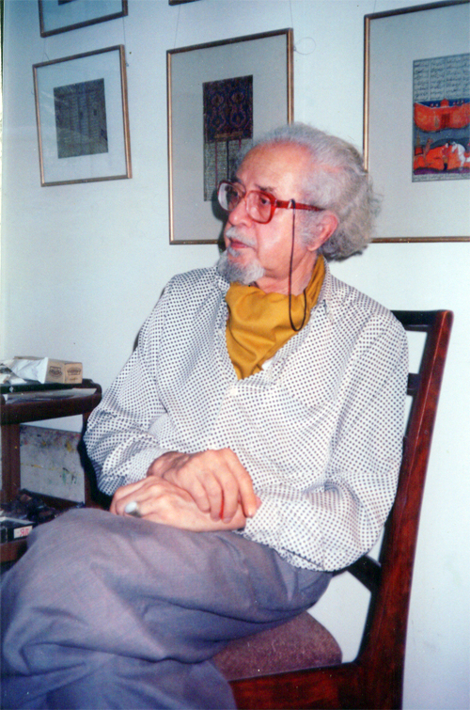

Slide 20
Pakistan Art Review also remembers the Great Guru and gives ample place to the man who dedicated his life to promote art and artists of Pakistan and opened the doors of Indus Gallery for modern art, thus paving the way for a proper art movement in Pakistan. This issue includes writings on Ali Imam by prominent writers and a personal note by his daughter and wife.

Slide 21
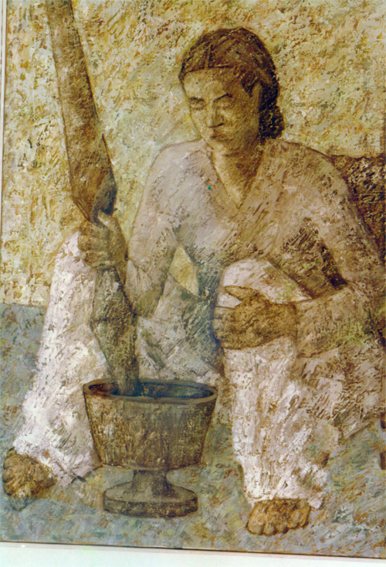

Slide 22
Ali Imam
Ali Imam was born in Narsinghpur, India. He graduated from Punjab University in 1949. His first solo was at Rawalpindi in 1952. Later he lived in London from 1956-67. Then he returned to Pakistan. Over a period of time, Ali Imam became an important art educationist in Karachi. He was the architect of the modern curriculum of The Central Institute of Arts and Crafts. In the 1970s he founded the Indus gallery, to create a buyer’s culture in the city where his student and peers could sell art and make it a viable career.

Slide 23
With all these preoccupations Ali Imam’s painting career took a back seat. Although he seldom painted, his work remains in great demand. His technique transformed a realistic form into an impressionistic image. Treated with outer layers of white pigment, an even tone of subdued colors defined the costumes and features. He died in 2002

Slide 24
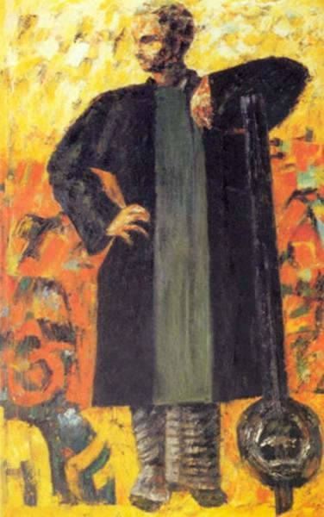

Slide 25
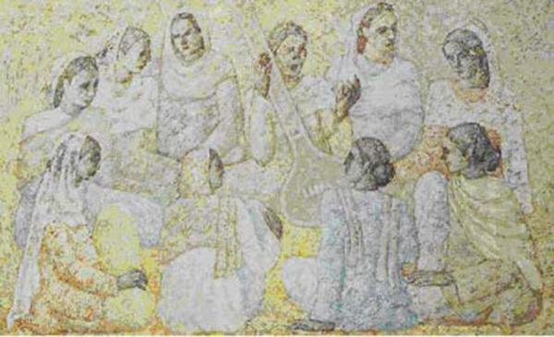

Slide 26
Iqbal Hussain:
After finnishing his studies at NCA in 1974, Mr. Hussain dedicated his career to painting women of his abode - the red light district of Lahore. He has continued to live in the district to be close with his people to whome he portrays in his paintings_ the men and mainly women, the denizens of the vicinity. The mostly neutral pallette and diffused light source hints at the sadness and less glamorous reality of Heera Mandi - the local name for the district. Mr. Hussain has a sensitive yet unapologetic approach, unwilling to simply gloss over the truth.

Slide 27
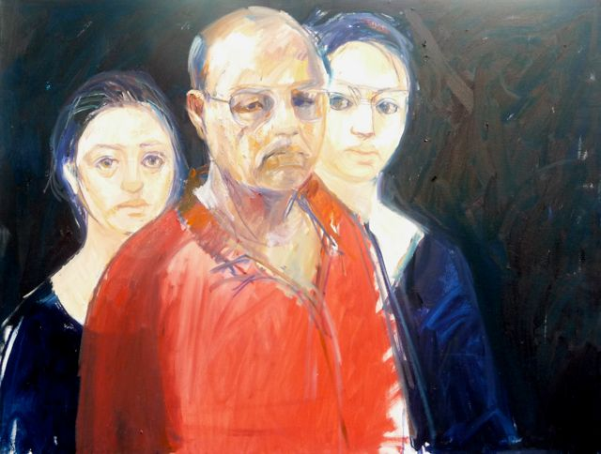

Slide 28
Preserving vanishing culture By Shamim Akhter
A constant painter of the spirit of old city of Lahore and the Red Light area, Iqbal Hussain was hosted by Ejaz Galleries, Lahore on October 20, 2011. Hussain graduated from National College of Arts, Lahore in 1974 and held his first exhibition in 1981; since then, with a wounded soul, he has been narrating his saga on canvas in morose hues.

Slide 29
His subjective experience has left a lasting impact on his conscious mind which he keeps expressing constantly. He has exposed all the facets of life in the red light area, a matriarchal society. That was a time when even talking about this segment of society was a taboo. Hassain raised his voice at that time; now it has become a household name courtesy the plays run on TV channels.

Slide 30
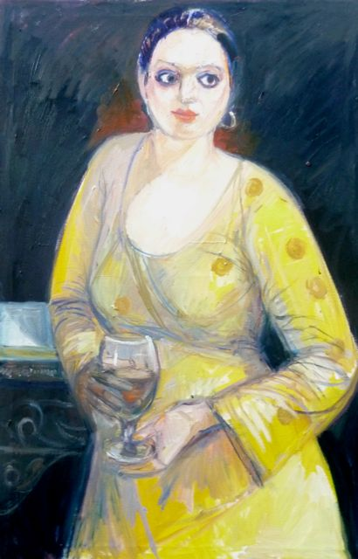

Slide 31
The other segment of his work consists of cityscapes, landscapes related with river Ravi and street scenes from Shahi Mohallah, and life of the leftover inhabitants of the Area and interiors of rooms of the dwellers. Most of the inhabitants have moved to the posh localities for better business. At his first solo show in Karachi, Hussain was interviewed extensively. Since then nothing has changed; neither his work nor the society he belongs to. Following is the reproduction of that interview.

Slide 32
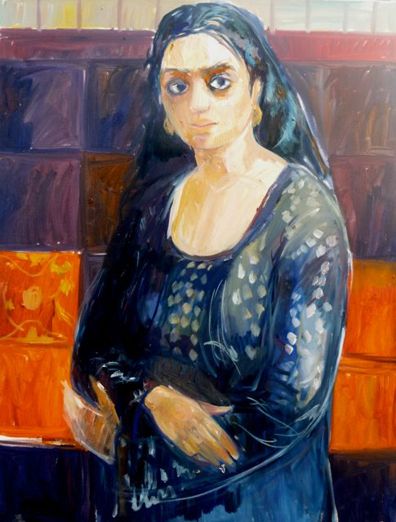

Slide 33
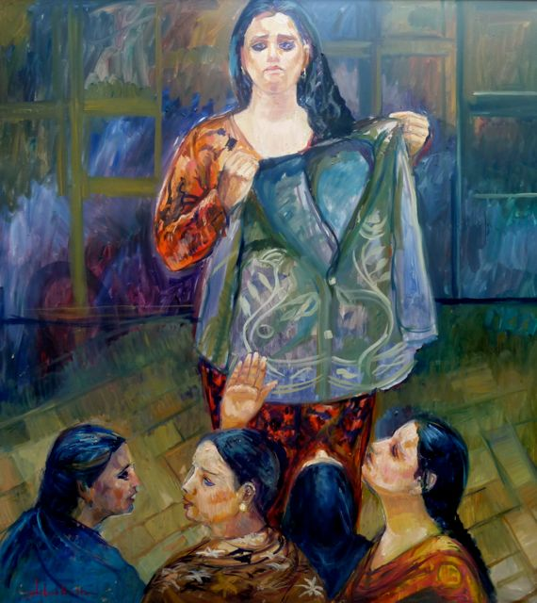

Slide 34
One sees on his canvases pretty young women in various postures with hope gleaming through their eyes, there are musician’s families, where walls of the room are decorated with certificates of appreciation, the top of a sideboard displaying trophies and shield won over the years. Hopeless faces of the family members of the musician are enough to explain that these awards are not a remedy for starvation. There was another pathetic story on one of the canvases.

Slide 35
A woman was sitting close to a written piece that said, “I am deaf and dumb. I have to feed my children. I am for hire for one hundred rupees.” Iqbal came across her when he was looking for a model. A French media team wanted to document him while painting. No local professional was ready to model for him because they did not want their faces to appear on TV even if it was a foreign one. The deaf and dump offered her services. She was ready to undress herself in front of the camera but Iqbal asked her not to do so.

Slide 36
His mural size canvas speaks of his vigour and velocity of expression of a living reality. He is the first artist in Pakistan to say through line and colour that these are human too. They are souls related with the profession of singing; dancing and body selling earlier confined in a certain locality popularly known as Heera Mandi- the Red Light area. But now they are scattered allover. Although all his figurative work is a social comment even when he is expressing their agonies, aspirations and way of life, at times Hussain specifically makes a comment on the hypocrisies of the self-acclaimed pious society.

Slide 37
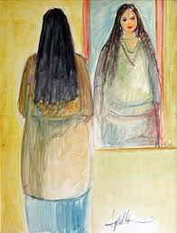

Slide 38
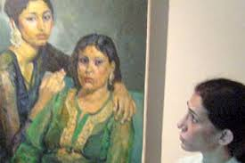

Slide 39
His expressive canvas with the image of a woman being dragged with her hair in the clutches of a law enforcing agent against a background of the red light area, even if not titled ‘Hadood Ordinance’ was self explanatory. This was a part of his displays at Canvas in 2004. Hussain has immortalized his life theme on his canvases. His images breathe with all the feelings that a prostitute individually experiences as well as their sufferings as a class. His self-portrait relates the story of a male member of the community. His eyes are full of resentment and contempt for the so call piety he sees around.

Slide 40
His canvases are not only different from but also much higher on the scale of expressiveness from the canvases of some artists who, after having a night or two in the area tackle the subject on their canvases. There is no shallowness about Hussain’s renditions. The beauty of his work is that he is merely stating a fact.

Slide 41
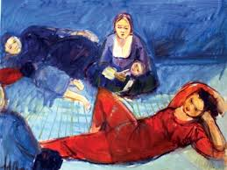

Slide 42
Besides the thematic paintings, his landscapes showed his love for certain locations. River Ravi is his constant spot from various angles. Whether it is a landscape or a portrait or a group of people or children, his canvases are marked with gloom and loneliness. Iqbal believes that it is not for the artist to speak about what he has painted. His line should be strong enough to convey his thought. It is for the viewing eye to search for meaning in it.

Slide 43
What did Hussain contribute to his community as an educated, conscientious person? He formed a mohalla committee and became its President. He noticed that whosoever came to that area, even a vegetable vender, tried to loot the women. Groceries were very highly priced as compared to other markets. Hussain`s committee members brought vegetables from main market and sold it for 5% profit only. On many occasions, they took a stand on police atrocities. Now Hussain is running a restaurant at Hira Mundi. The place thrives with foreign visitors including media persons.

Slide 44
A graduate from NCA, Lahore, Iqbal’s hold on line got him admitted in the college. Presently he is Assistant Professor in Fine Arts in his Alma Mater since 1976. He is an Executive Member of Artists Association of Punjab since 1981. He received Associate-ship of NCA in 1996. His first one-man show was held in 1981 at Punjab Arts Council, Lahore. He has 17 solo shows to his credit. His works were included in group shows held at Bangladesh, Delhi, Seoul, London, Paris, Brussels, Washington DC, California and Colorado. One of his paintings was auctioned at Sotheby’s in London. He is winner of numerous awards and prizes including UNESCO Prize.

Slide 45
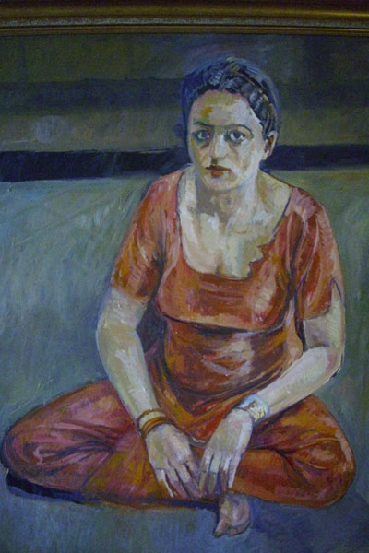

Slide 46
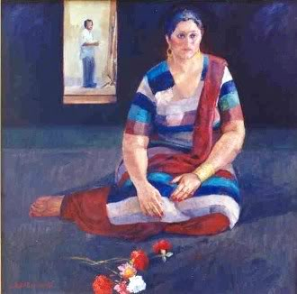

Slide 47
Joanna Bostook from St. Andrews Scotland did her thesis work on the works and life of Iqbal Hussain in 1993. Foreign press has given him vast coverage on various occasions. A documentary was made on his works by French Television BBC Cortia TV Singapore and shown allover the world. Vipro Radio & Television, Holland interviewed him for a broadcast.

Slide 48
His collections can be seen at Lahore Museum, Peshawar Museum, Lahore Art Gallery, Lahore; PM House and Governor House, Lahore; National Gallery Islamabad; American Consulate, Lahore; Delhi, Copenhagen, Germany, Luxembourg, USA, Yorkshire, Kenya, Switzerland, UK, and Paris. His views on painting are very well defined. He does not believe in the use of script on canvas. He says that only a weak line needs words for its explanation. Languages change with time. Future can turn today’s script into hieroglyphics. Canvases are to be seen and not to be read.

Slide 49
Born in 1950, and after graduating from National College of Art, Lahore, in 1974, Hussain did not change his premises and kept living with his mother and sister in the red light area. He said, “If I had moved out from Heera Mandi, I would have told lies to myself. I did not want to give others the pleasure of talking at my back; winking and elbowing while introducing me and later enjoying telling the new acquaintance about my birthplace. Of course, accepting such truths is painful; but this pain is endurable. I have suffered humiliation as a child because my mother had put me in school.

Slide 50
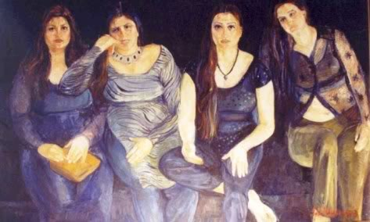

Slide 51
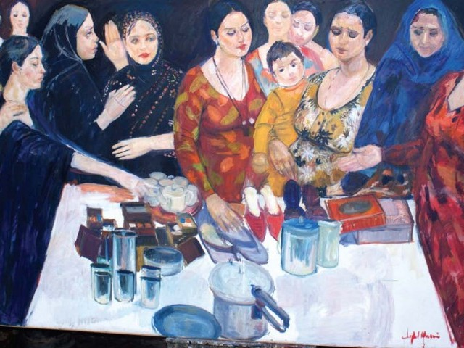

Slide 52
Iqbal said “I tell you, if I am given a chance to live another life, I will choose for myself the same life, same birthplace, same mother and sister. Honestly speaking, residents of Shahi Mohallah are better people. There are no lies about them. They are not cheats.” With a little smile, Iqbal Hussain added, “Don`t you think these singers and dancers are more matter of fact people? They call a candy a candy and hemlock, a hemlock. They do not coat hemlock with sugar and give it a nice name.”

Slide 53
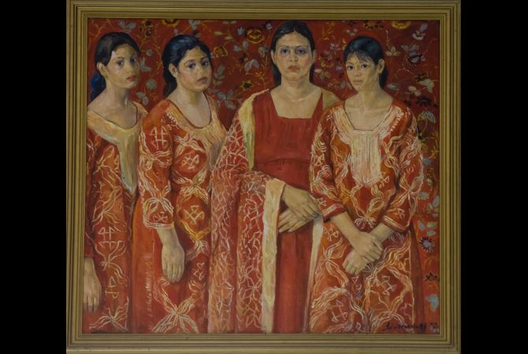

Slide 54
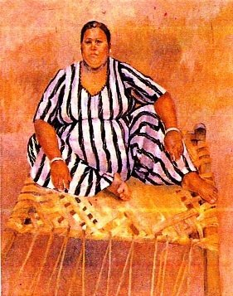

Slide 55
Khalid Iqbal: The father of modern realism in landscape painting in Pakistan Nadeem Alam
Landscape painting has always been a popular and undisputedly, the most acceptable genre of visual arts among all and sundry in Pakistan. Owing to its natural and gifted beauty, the plains of Punjab have invariably attracted the onlookers, as well as the painters, to pay homage to the enriched colours, captivating light and in-depth perspectives of orange and red horizons of dawn and dusk.

Slide 56
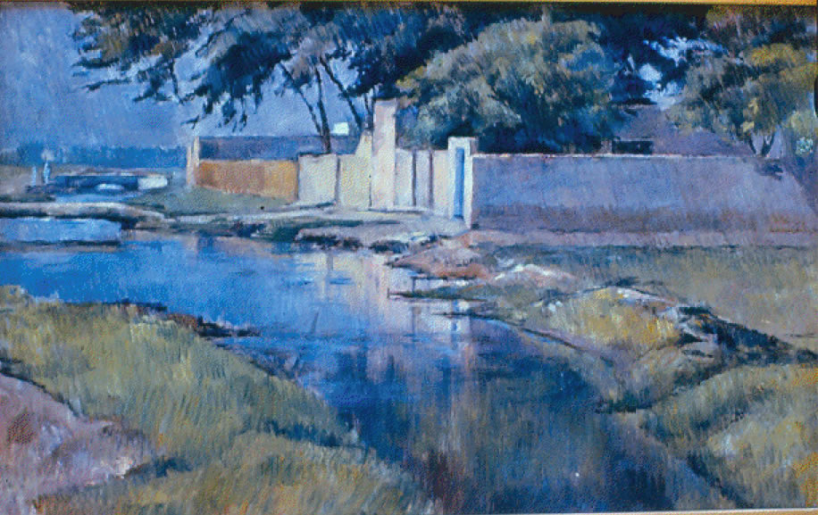
Typical evening evening landscape

Slide 57
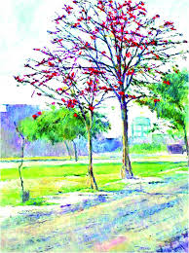

Slide 58
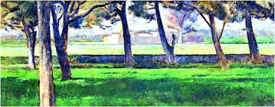

Slide 59
it was the company painters of the colonial era who brought the modern and realistic technique of landscape painting to the subcontinent preferably through the mediums of oil colour and watercolour. The realistic style owing to its capacity of imitating the naturalistic rendering of the seen-objects, received popularity and acceptance among the local artists and the genius of Allah Bakhsh responded to the depth and illusions created by the geometrically enhanced perspective, a new approach in for the regional painters and viewers.

Slide 60
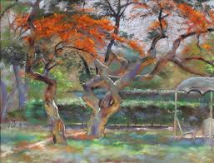

Slide 61
In the subcontinent, with the commencement of academic art in the newly established art institutions, many Western techniques in the landscape painting were introduced in terms of medium and style. During this period, the cityscape painting established its stronghold; Anna Molka and Naseem Hafeez Qazi captured the architectural patterns and the street-culture of the Old-city Lahore.

Slide 62
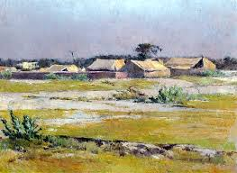

Slide 63
In this visual culture, a determined young painter, Khalid Iqbal came back to Lahore after studying at the Slade School of Arts, London under the scholarship and wisdom of Sir William Coldstream, who was a torchbearer of a relatively new visual idiom in the landscape painting in England;

Slide 64
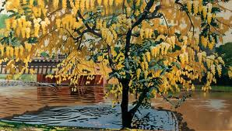

Slide 65
Khalid Iqbal was born on 23rd June 1929 at Simla, Jammu & Kashmir. In 1945, he did his O’ Level from St. Joseph’s Academy, Dheradun; the capital of the state of Uttarakhand in the northern part of India, located at about 236 km north of Indian capital New Delhi. By 1948, he was taking Art lessons from Sheikh Ahmad; the husband of Anna Molka Ahmad. In 1949, Khalid did his BA from Forman Christian (FC) College Lahore and joined Atchison College Lahore as an Art Teacher.

Slide 66
In 1952, he did a diploma in French from the Oriental College Lahore and the same year he went on to study fine arts at the renowned Slade School of Arts, University of London, UK. From 1956 to 1965, he served the Fine Arts Department of the University of the Punjab as a senior lecturer. In 1965,

Slide 67
In 1965, he joined the National College of Arts as Associate Professor and Head of the Fine Arts Department, and after almost a decade in 1974, he was promoted as the acting Principal of the NCA. He served the NCA until his retirement in 1981. At NCA, he was honoured with the Chair of Professor Emeritus in 1993. Khalid Iqbal has been conferred upon the Quaid-e Azam Award in painting in 1977 and the President’s Medal for Pride of Performance in 1980.

Slide 68
Khalid’s association with nature and vegetation can be traced back to his early childhood in Simla and then his academic years at Dheradun. Both locations were beautiful and matchless with the green-mountain backdrops of the Himalayas. In this perspective, it has remained an interesting fact that mostly in his painting career.

Slide 69
Khalid has been painting the dusty and hazy plains of Punjab with subdued colours and refracting sunlight. Khalid’s main emphasis has always been on how nature appears at the painter, rather how the painter sees her. This became his basic approach towards landscape painting, which is titled as the Modern Realism.

Slide 70
Modern Realism is based on the effect of light on the painter in terms of his or her perception of a particular spot where he or she stands to paint. Khalid Iqbal suggests that the observation and time-spending at the spot which the painter wants to paint, can help as well as affect the palette and the approach of the painter, even before he or she would commence the painting process. This theory inspired many of his students, especially Zulqarnain Haider, who very often, used to accompany his mentor at the same spot or place for painting landscapes.

Slide 71
SUMMERY OF LECTURE 13. unit. 2.
Introduction to Realism.
(Pakistani artists)
Anna Molka Ahmad
Ali Imam,
Iqbal Hussain,
Khalid Iqbal

