Slide 1
Lecture. 12. Unit. 2.
Summery of Lecture 11.
LECTURE. 11. UNIT. 2
Making Calligraphies using different tools and mediums. (Practical)
After this practical based lecture 10. Unit. 2.
In lecture 10 we discussed Important Pakistani Calligraphers and their work.
Although they were all Modern artists but they gave importance to Traditional script.

Slide 2
The work of Calligraphers of Pakistan that we discussed are
Anwar Jalal Shemza
Guljee
Sadeqain
Shakir Ali.
All these artist are well known for their love for Modern art and their love for Calligraphy.
We Discussed their life and work in detail.

Slide 3
LECTURE. 12. Unit. 2
Introduction to Cubism.
20th Century art in Pakistan
(Pakistani Artists Shakir Ali and Mansoor Rahi

Slide 4
CUBISM:
Within the first two decades of the 20th century, a new art movement began that was unlike any other—Cubism.
Started by Georges Braque and Pablo Picasso, most Cubist works are immediately recognizable due to their flattened, nearly two-dimensional appearance; an inclusion of geometric angles, lines, and shapes; and a fairly neutral color palette.

Slide 5
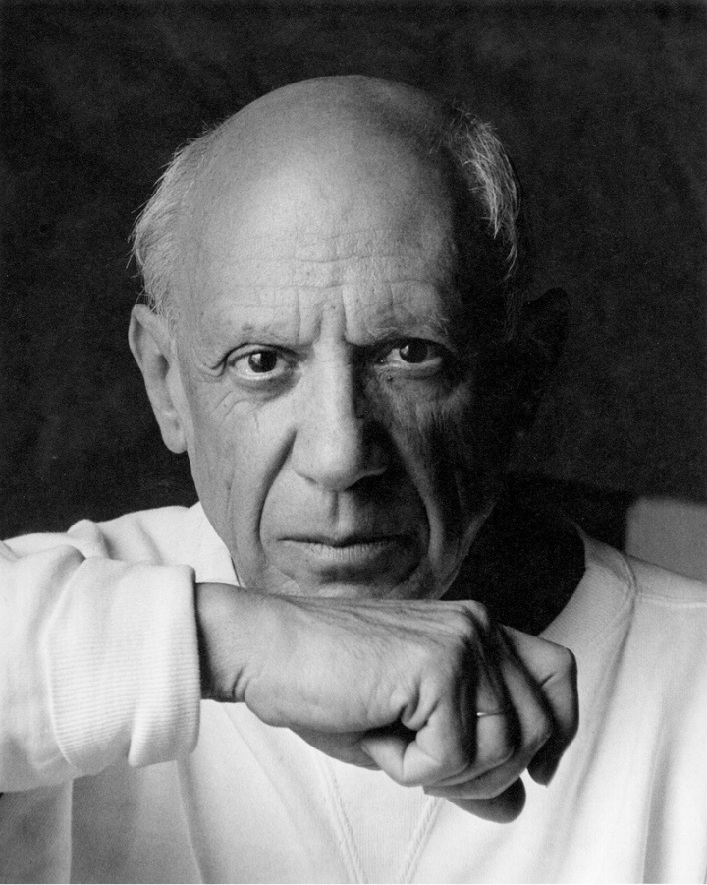
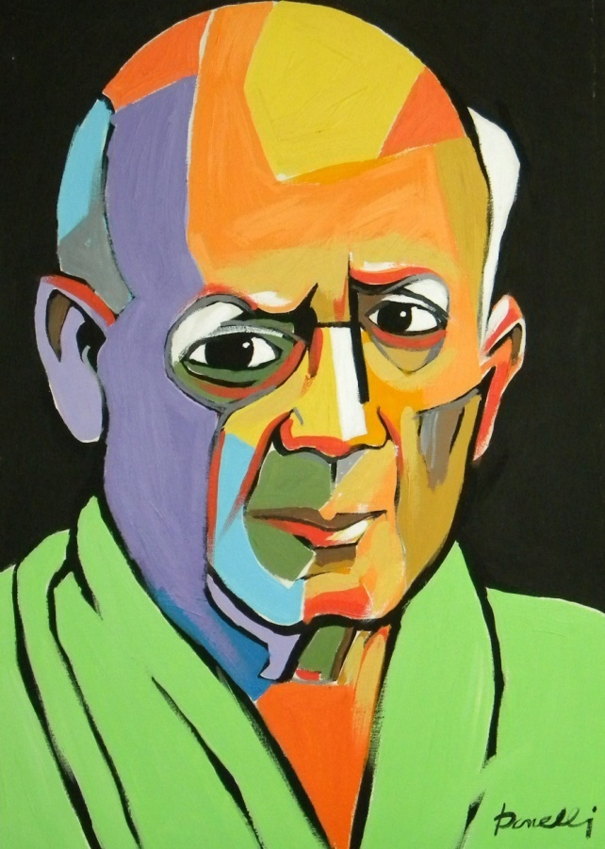

Slide 6
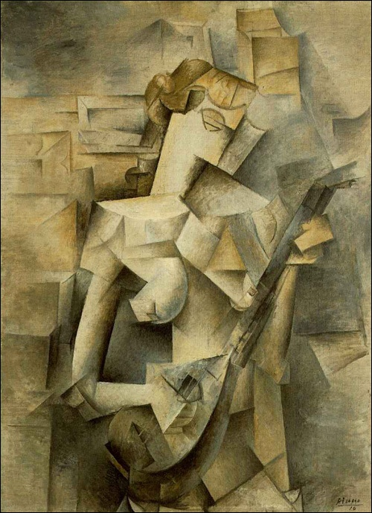

Slide 7
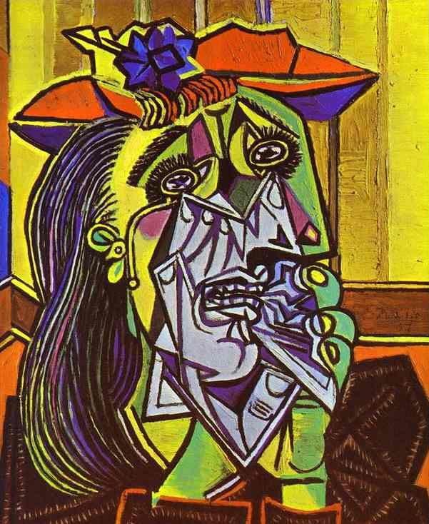

Slide 8
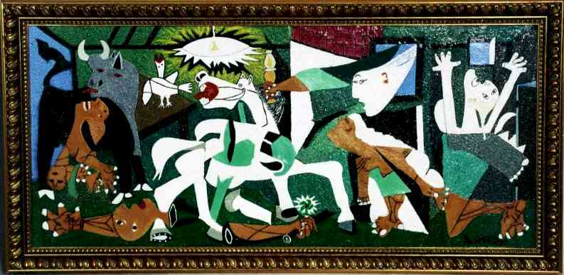

Slide 9
As the movement evolved, color, texture, and graphic elements (like text) were added, to the point where later Cubist works often appeared more like collage than anything else. But Cubism wasn’t just a specific “style” or “look”—it actually allowed artists an entirely different way of seeing and depicting real-life objects.

Slide 10
What is Cubism?
Unlike traditional still-lifes, landscapes, or portrait paintings, Cubist paintings aren’t meant to be realistic or life-like in any way. Instead, after looking at the subject from every possibly angle, the artist will piece together fragments from different vantage points into one painting.

Slide 11
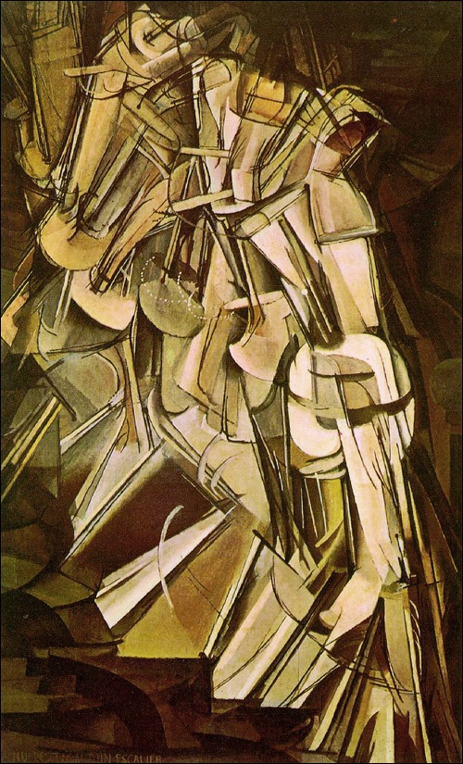

Slide 12
In doing this, the artist is attempting to give a fuller, more detailed explanation of the subject—breaking past barriers of space and time, like in the famous painting by Marcel Duchamp entitled Nude Descending a Staircase (seen above.)
This type of Cubism is called Analytic Cubism, and it’s usually what comes to mind when people think of Cubist artwork.

Slide 13
Synthetic Cubism on the other hand was a natural extension of Analytic Cubism. Instead of breaking a subject down into pieces, it involved assembling pieces already available into a collage. Here’s an example by Georges Braque, entitled Tenora.

Slide 14
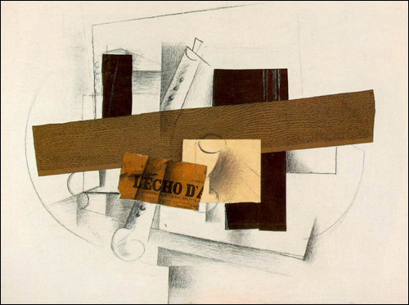
As you can see, Synthetic Cubism is still fairly geometric, and some pieces (like this one) incorporate traditional media as well as found objects.

Slide 15
Famous Cubist Artists
The most famous Cubist is probably Picasso, with Braque a distant second. . . even though he was just as instrumental as Picasso was in founding Cubism.
Paul Cézanne: (although not a part of the Cubist movement himself) is often credited with sparking Braque’s first attempts at painting a Cubist landscape. Cézanne’s paintings separated objects into basic shapes—cubes and spheres, mostly—which directly led to Cubism’s use of fractured, geometric planes.

Slide 16
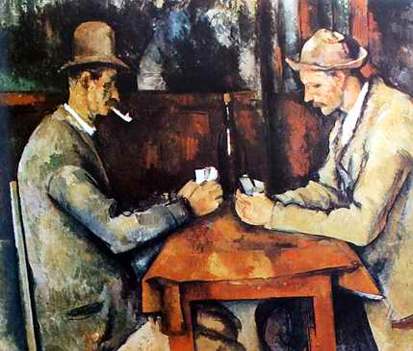

Slide 17
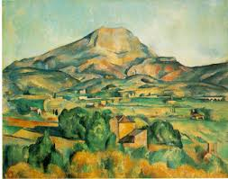

Slide 18
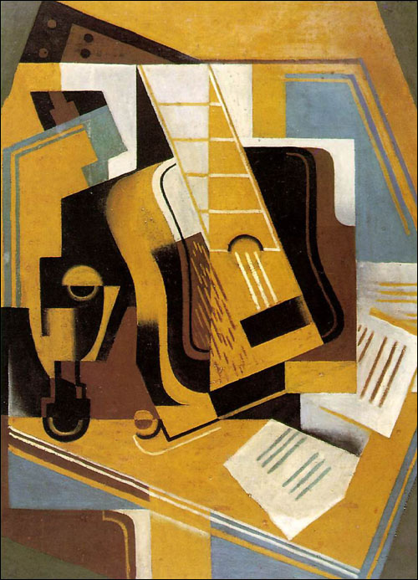

Slide 19
Other Cubist artists include Jaun Gris (whose work seems to almost bridge Cubism with Art Deco and artists like Marcel Duchamp (whose artwork actually spanned a variety of styles and movements). You can see some of the Art Deco similarities in The Guitar, by Jaun Gris, below.
Nowadays, Cubism seems like just another facet of abstract art, but in reality, it came first—and it directly influenced most of the abstract art of the 20th century. In fact, it’s nearly impossible to imagine the 20th century without Cubism, Picasso and the others. . .it would be a very different world of art than the one we know.

Slide 20
20th Century art in Pakistan. Cubism in Pakistan.
In the early post -1947 decades, the artists in Pakistan adopted Modernism not as perpetuation of the First World hegemony but as a metaphor for change and economic freedom. The society was no longer being viewed in stereotypes or idealised images, but as an evolving nation faced with the challenges of transition.

Slide 21
In 1947 Lahore boasted of two art institutions and an expanding artists’ community. Karachi had very little post-Partition art activity, which expanded and became enriched by the arrival of pioneering talent in the exodus of displaced people from all over the sub-continent.

Slide 22
In the early 1950s The Lahore Group initiated experimentation in the Modern idiom and had a seminal influence on contemporary Pakistani art. Ahmed Parvez, Shemza, Ali Imam, Moyene Najmi, Sheikh Safder and Qutub Sheikh were members of this informal group and like the Progressive group of Artists, were also inspired by the Paris School. These painters looked upon the new aesthetics of Modern Art as a manifestation of a technological and industrial progress leading to economic freedom, as it had brought to the west.

Slide 23
Modern Art also seemed to be the chosen visual language that was compatible with the national poet Iqbal’s philosophy of ‘khudi’ or ego as a dynamo that would propel man towards personal success. In this milieu traditional art seemed inadequate to articulate the dreams and fears of a generation poised to enter a new era of freedom.

Slide 24
The art that emerged from the studios of the Modernists, because of its economically advantaged status, came to dominate the national art scene by the 1960s. The art of the East Pakistani [now Bangladesh] painters had a tremendous impact on their counterparts in Lahore, Karachi, Rawalpindi and Peshawar, who had yet to reach that mature understanding of the discipline. Artists such as Zainul Abedin had already bridged the gulf between folk art and contemporary art.

Slide 25
Mansur Rahi, a student of Zainul Abedin, became one of the pioneer teachers at Karachi School of Art where his pedagogic influence on the young watercolorists heralded an aquarelle revival in the 1980s. Rahi became a faithful exponent of analytical cubism and developed his oeuvre under the influence of this style.

Slide 26
The Lahore Art Group was committed to modern art but before it could become a cohesive movement its activities were disrupted by political interference. After a gap, when they returned to mainstream art activity, their will had been blunted and the spirit lost.

Slide 27
The 60s also saw the American cultural impact on Pakistani urban centres. Films and publications were freely shown and distributed, and media were used to promote United States’ first art movement – Abstract Expressionism. Through visiting exhibitions and art historians, Pakistani artists received considerable exposure to abstract styles from America.

Slide 28
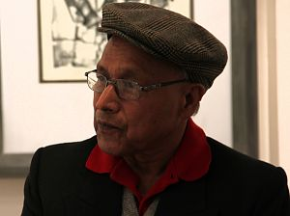
If we talk about Cubism in pakikstan there are two big names worth mentioning.
Shakir Ali and
Mansoor Rahi
Profession: Painter
Location: Islamabad
Born: 1938

Slide 29
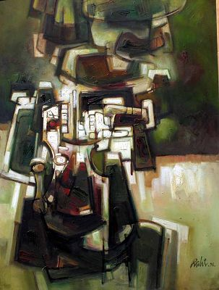

Slide 30
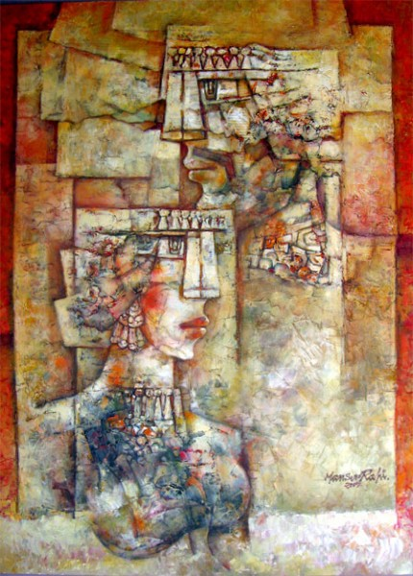
Purely structured with formally bold forms of mainly Human figure. Cubical Expression with rayonistic activity and Psychedelic tension of forms and colors which evolves in new form of illusion.

Slide 31
Mansoor Rahi has played an instrumental role in spreading art for the last four decades. His paintings are unique and take the viewers to a far off land. Mansoor Rahi’s paintings are intricate as they involve a lot of mathematics. It is an established fact that Mansoor Rahi does a lot of calculations before starting any of his paintings. The mastery is evident in his paintings, as he is adopted the cubist genre.

Slide 32
He has taken inspiration from giants like Picasso, Meero, Barque and Paul Klee. Rahi is the only artist who took the charge of introducing regular development in cubism after Picasso, who took noticeable development in cubism. This is statement of a writer about Rahi

Slide 33
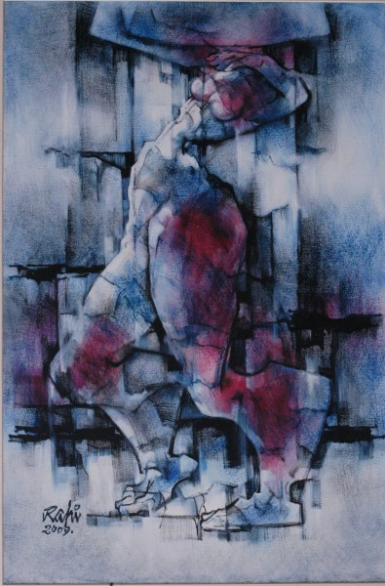

Slide 34
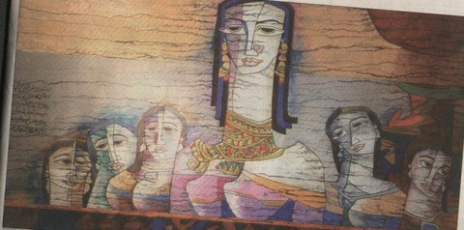
Mansoor Rahi has gained reputation in both national and international market. His work with the title of “Cubical Expressionism,” showcases a threshold of free expression. He has touched on many humanitarian global subjects such as the world food crisis, quest for peace and fear of nuclear war.

Slide 35
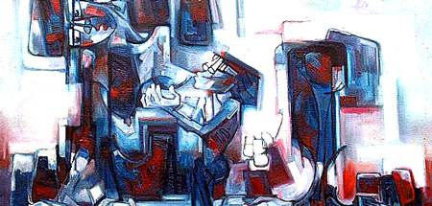
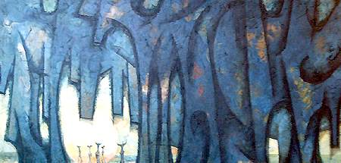

Slide 36
Rahi’s paintings not only create a mood of innovating new forms and illusion of values but also open a vision of free expression with spontaneous use of brush strokes. His present day work titled ‘Resurrect Rock Series’ in color and black and white starts in USA. It makes a change of vision by entering into classical realism from the non-evocative abstraction.

Slide 37
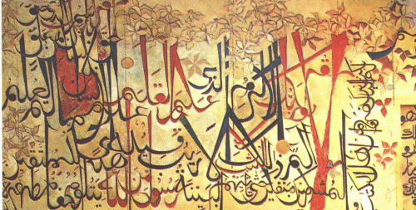
SHAKIR ALI:
Born in 1922, Pakistan
Shakir Ali has spent 12 years, 7 years in Bombay and 5 in London to learn classic and modern art. He came back to Pakistan in 1952.

Slide 38
Art for Shakir is a meant of expressing his own lonely personality. It is devoid of sensuousness and sentimentality, and possesses the distilled quality of brooding in in solitude on subjects from life, which only provide point of departure into the realm of line, tone values and color. His approach to his craft is essentially of virtuoso.

Slide 39
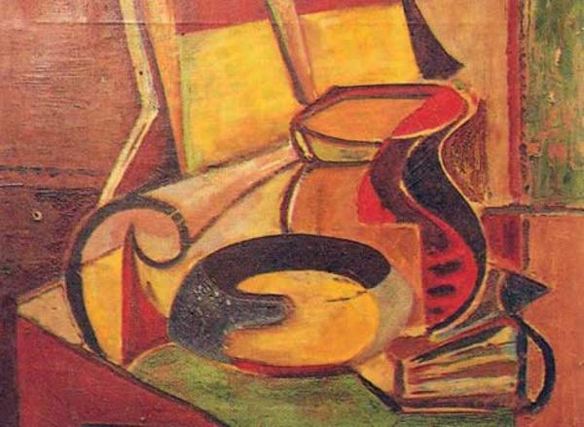

Slide 40
He treats line solely as a matter of Measure, short or long, of angles, obtuse or acute. He uses tone values or chiaroscuro as Weight and color as Quality. He uses these three formal elements in the construction of new order and creates image, which we call the subject.

Slide 41
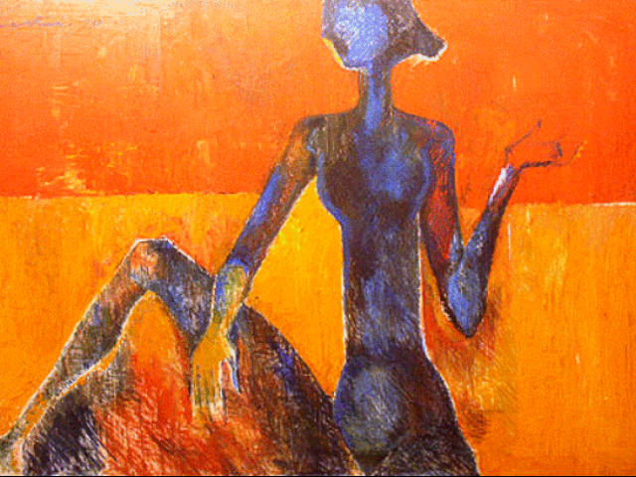

Slide 42
In the work of such artist, the appearance of recognizable object is cause for confusion among the viewers. Every object from organic world has whole range of associate properties, which exist for viewers, but may or may not be present in the mind of artist, when he is painting it. His aim appears to be to construct symphony in line, tone values and color, and open now perspective in the dimension of meaning.

Slide 43
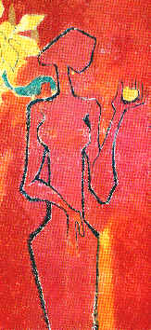

Slide 44
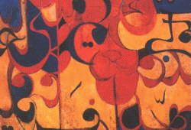

Slide 45
Shakir, in 1956, is held in high esteem, as an artist. His background, together with long time at National College of Arts, first as Head of Art Department and later as Principal, deservedly earn him a position of reverence. He has reached the stage, where he runs the risk of being praised, without being really understood or appreciated.

Slide 46
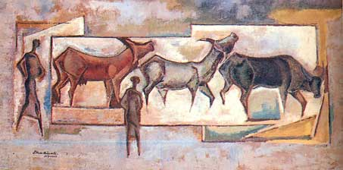

Slide 47
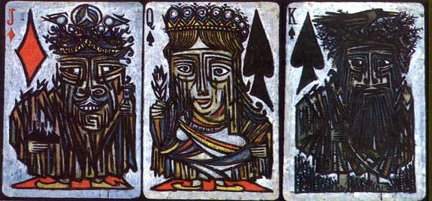

Slide 48
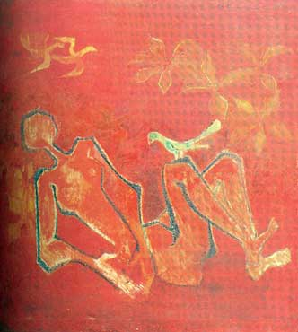

Slide 49
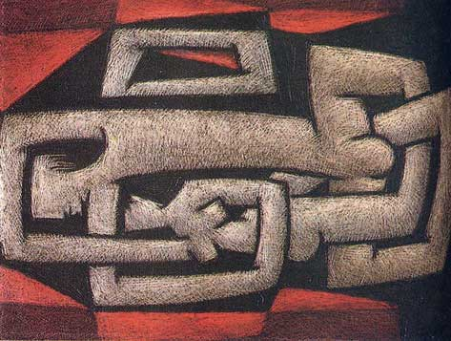

Slide 50
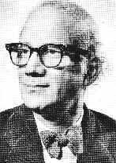

Slide 51
The work of these two modern artists reflects the talent that is possessed by this land of South Asia. They not only produced the magnificent miniatures on this land but have the capacity to produce modern art also.

Slide 52
THE SUMMERY OF TODAYS LECTURE:
Well I am very please to summarize the work of these two painters who are well known modern painters of Pakistan with International fame.
There work is inspired by Cubist movement of which two important leaders were Picasso and Braque.
I hope that you learnt a lot about these artist in this lecture.
In our next lecture we will discuss Realism movement of art in Pakistan. Thank You.

