Slide 1
LECTURE. 10. Unit. 2. PAKISTANI CALLIGRAPHERS
SUMMERY OF LECTURE. 9. UNIT. 2
Persian Artists and their Calligraphy
Persian calligraphy : is the calligraphy of the Persian writing system. It is one of the most revered arts throughout Persian history.
We discussed Six generes of Persian Calligraphy created by Ibn-i- Maqlah and his brother. namely "Tahqiq", "Reyhan", "Sols", "Naskh", "Toqi" and "Reqa".

Slide 2
Then we discussed Nastaleeq; Persian: (nastaʿlīq) is one of the main script styles used in writing the Perso-Arabic script, Then Cursive Nastaleeq was created. Modernist movement
Zendeh Roudi, Jalil Rasouli, Parviz Tanavoli, and Masih Zad use Persian calligraphy and Rumi poetry in dress designing.
We did a detailed study of prominent Iranian Calligraphers.

Slide 3
PAKISTANI CALLIGRAPHERS:
The Quran is written in Arabic, and the language’s flowing script is not just a way of writing, but also a form of art. Calligraphy grew in part because of religious restrictions on representational art and Muslim’s love of arabesque, the flowing repetition of multiplying and interlaced patterns, which represents the infinite. When created in calligraphy, a simple word or proverb can become an intricate, abstract design so complex as to be almost unreadable.

Slide 4
The traditional instrument of the Arabic calligrapher is a reed pen called the qalam, which is used by dipping into a variety of colored inks. Some calligraphers weave together letterforms or separate words using different colors; in some cases, gold or silver leaf is applied.

Slide 5
Calligraphy is often pen and ink on paper, but it can also be woven into painting, carvings, and other two- and three-dimensional works. Modern artists continue to experiment with new materials and techniques, but they all revolve around love and reverence for the written word.

Slide 6
Throughout Pakistan’s history, government and businesses have often hired artists to paint calligraphic murals for buildings. Usually the source material is Islamic literature, but sometimes it is secular poetry. By the 1970s, Calligraphy was so popular nearly every artist in Pakistan had worked in the art form. While Calligraphy’s popularity has declined since the 1980s, it continues to have a central role in Islamic culture and Pakistani visual arts.

Slide 7
Calligraphy In Pakistan
Islam and, through it, calligraphy came to the sub-continent through the conquest of Sindh by Mohammad Bin Qasim in 712 AD, and reached its peak during the reign of the Mughal emperors. The Taj Mahal, an Indian icon built by Mughal king Shah Jehan, is one testament to the beauty of Islamic art.

Slide 8
It is adorned with many passages of the Quran that relate to Paradise, thereby making the entire complex a metaphor for the heavens. In the area which now comprises Pakistan, Lahore undoubtedly has held the title of being the center of calligraphy in Pakistan.

Slide 9
According to Mrs Wahida Mansoor, a professor at the Indus Valley School of Art & Architecture, “Relative to western cultures, the east has always been about Naturalism, shunning the synthetic for what is sustainable and in harmony with nature. This art is a testament to that fact. All materials from the reed pen to the dyes used are environment-friendly

Slide 10
There is also an air of divinity in this art, e.g with its power to preserve knowledge and extend thought over time and space, ink is compared to the water of life that gives immortality, while human beings are likened to so many pens in Allah’s hand.”

Slide 11
Black has traditionally been the basic ink, however the range of colors used by calligraphers are extremely rich and varied. The colors which include gold, silver, blue, green, orange, violet, yellow, etc, have always been prepared from vegetable and mineral resources. Most inks are based on soot or lamp black mixed with water and gum Arabic.

Slide 12
However other ingredients used are tea, haldi, henna, pomegranate, beetroot, and even coffee. The final stage of the preparation involves straining the ink through silk. Also, the ink might be perfumed if desired.
This art is unique in a lot of other manners as well, right down to the margins. According to Mr Rashid Arshed, Head of Fine Arts Department at Indus Valley,

Slide 13
Unlike other arts, the margin is used differently in Calligraphy. It may include alongside the actual text a parallel text; or marginal motifs maybe transplanted into the text; or the reader’s attention maybe diverted by making the margin easy to read and the text very difficult. Or the margin may rob the text of its central position by framing it with script on all sides.”

Slide 14
In Pakistani calligraphy, the names of Allah or Muhammad (PBUH), the Kalima, “La Ilah Ha Illalah, Muhammadar Rasullulah” (I Swear That There Is No God But Allah And Mohammad Is His Messenger), and “Bis Millah Ar-Rahman Ar Raheem” (I Start With The Name Of Allah, The Beneficial & The Merciful) recur like a leitmotif.

Slide 15
They are drawn in green, blue, or red ink, or in any other chromatic scale likely to seize the attention, as if the calligrapher is trying to induce a mystical trance. Contrasting touches, the colors of diacritical signs and vowels, words or phrases given special emphasis by the calligrapher, all evoke the divine presence.
Usman Ghouri, an upcoming calligrapher, puts it succinctly: “When I calligraphy, I actually feel closer to Allah.”

Slide 16
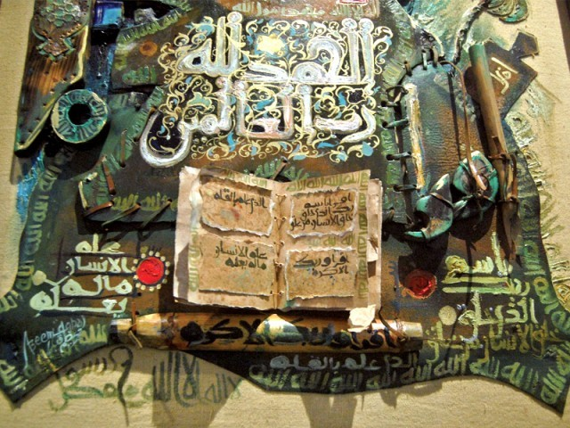
Calligraphy by Mohammad Azim

Slide 17
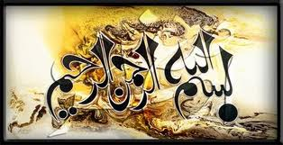

Slide 18
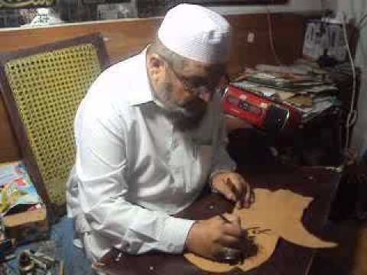

Slide 19
Anwar Jalal Shemza (14 July 1928 - 18 January 1985) was an artist and writer active in Pakistan and later the United Kingdom. Despite being better known as an artist, Shemza published several Urdu novels and books of poetry in the 1950s and wrote plays performed on Radio Pakistan. Shemza was initially influenced by Modernism most notably Paul Klee although later works also showed a traditional Islamic influence.

Slide 20
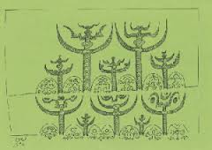

Slide 21
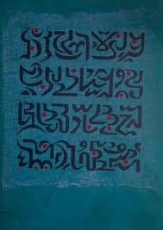

Slide 22
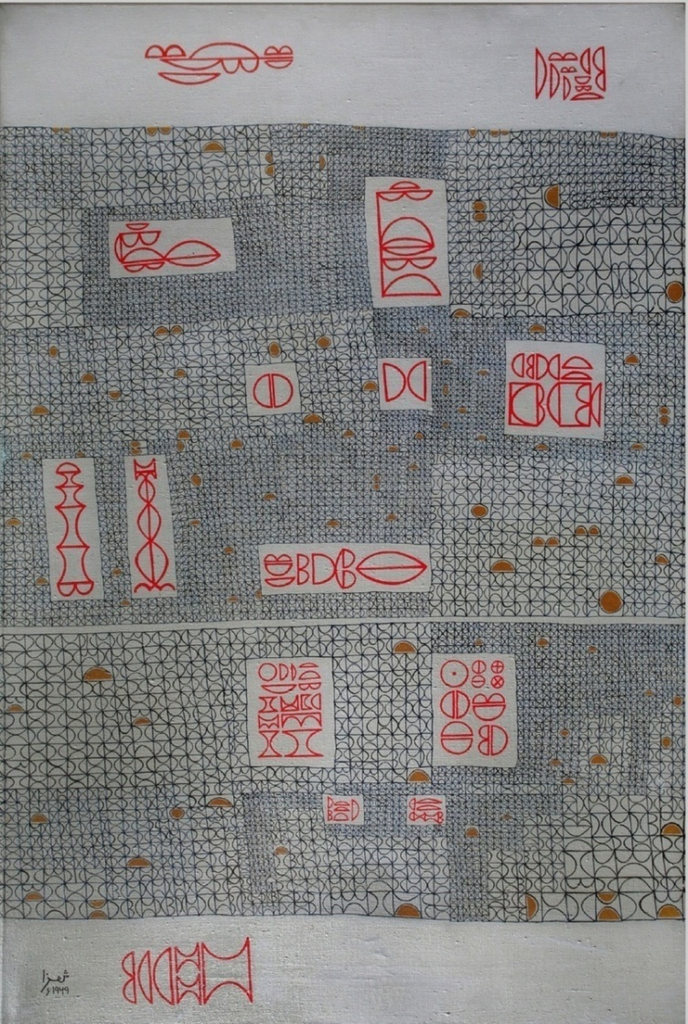
Anwar Jalal Shemza: Calligraphic Abstraction. Green Cardamom, London, 9th October 2009 to 6th November 2009

Slide 23
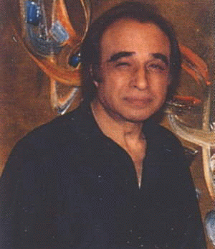
This is globally famous Pakistani artist.Imail Gul Gee (1926-2007). Ismail Gulgee was yet another award winning

Slide 24
Ismail Gulgee - The Gulgeez (October 25, 1926 – December 16, 2007) Pride of Performance, Sitara-e-Imtiaz (twice), Hilal-e-Imtiaz, was an award-winning, globally famous Pakistani artist born in Peshawar. He was a qualified engineer in the U.S. and self-taught abstract painter and portrait painter. Before 1959, as portraitist, he painted the entire Afghan Royal Family. From about 1960 on, he was noted as an abstract painter influenced by the tradition of Islamic calligraphy and by the American "action painting"

Slide 25
Gulgee was a gifted and consummately skilled naturalistic portrait painter who had enjoyed (according to Partha Mitter) "lavish state support" and plenty of elite commissions in this capacity. Nevertheless, he was perhaps best known worldwide for his abstract work, which was inspired by Islamic calligraphy and was also influenced by the "action paintin" movement of the 1950s and 1960s (Mitter notes that Elaine Hamilton was a strong influence in this direction).

Slide 26
This is perhaps a natural enough stylistic combination, since in both Islamic calligraphy and action painting a high value is placed on the unity and energy of gestural flow. As with the works of other action painters or abstract expressionists, Gulgee's canvases were often quite large. He was also known for using materials such as mirror glass and gold or silver leaf in his oil paintings, so that they were in fact mixed media pieces.

Slide 27
According to the Metropolitan Museum of Art (see external links): "Gulgee's calligraphy paintings are abstract and gestural interpretations of Arabic and Urdu letters. His sweeping layers of paint explore the formal qualities of oil paint while they make references to Islamic design elements."
Beginning in the 1960s (if not earlier), Gulgee also created sculptures, including bronze pieces that were (like so many of his paintings) calligraphic in form and inspiration, and sometimes specifically based on verses from the Quran.

Slide 28
His paintings were bright and full of color, but the paint was put on with great sensitivity, and paintings vibrate with intense feeling. Areas sing with luminous, thin color; thick blobs of paint pulsate with fiberglass tears, the brush swirls strong and free. The total effect used to be very free, yet considered and well thought out. They work enormously well, because it was all orchestrated with great care and concentration.
His son Amin Gulgee is also a famous artist.

Slide 29
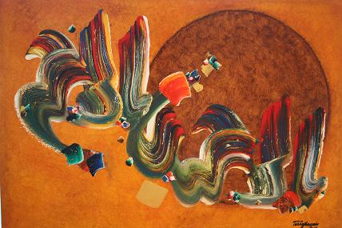

Slide 30
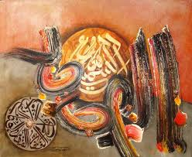

Slide 31
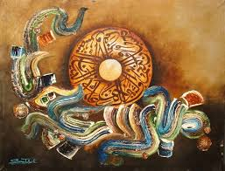

Slide 32
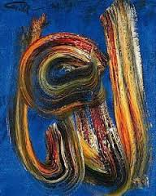

Slide 33
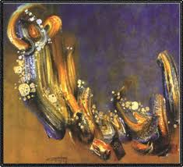

Slide 34
Syed Sadequain Ahmed Naqvi (Urdu:Tamgha-e-Imtiaz, Pride of Performance, Sitara-e-Imtiaz, also often referred to as Sadequain Naqqash, was a world-renowned Pakistani artist, best known for his skills as a calligrapher and a painter. He is considered as one of the finest painters and calligraphers Pakistan has ever produced.

Slide 35
Personal life
Sadequain was born in 1930, descending from a family of calligraphers. In late 1940s he joined the Progressive Writers and Artists Movement. His true talent was discovered by Huseyn Shaheed Suhrawardy who brought Sadequain into the limelight He also spent some time in Paris augmenting his skills. Sadequain received much praise for his calligraphic style, which is widely considered iconic by many critics of South Asian art.

Slide 36
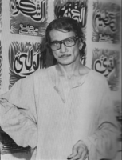

Slide 37
He carried the script with a flourish in all directions, giving it the 'power of space, vigor and volume'.
Before Sadeqain, few painters had experimented with the medium in Pakistan. Sadequain is commended for bringing calligraphy into a mainstream art form, as most of the known Pakistani artists have followed Sadequain and calligraphic art now dominates the art scene.

Slide 38
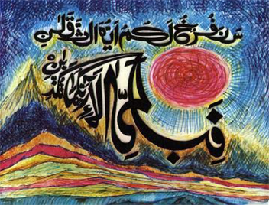

Slide 39
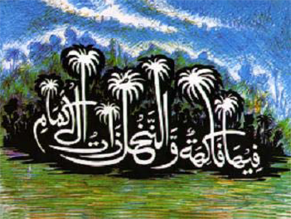

Slide 40
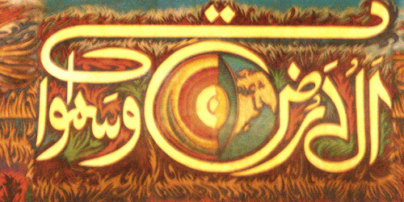

Slide 41
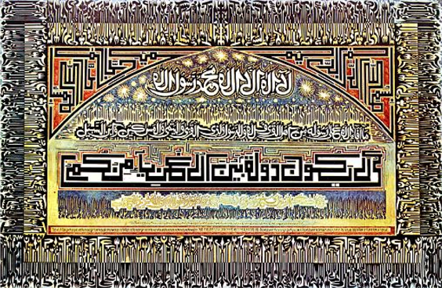

Slide 42
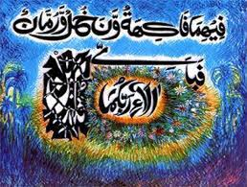

Slide 43
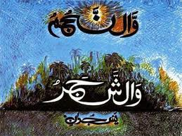

Slide 44
Sadequain also painted classical literature from the poetic verses of Ghalib, Iqbal and Faiz. He belonged to the school of thought which enriched realism with lyricism.
Sadequain Illustrated French Nobel Prize winning writer Albert Camus, Ghalib, Iqbal, and Faiz
He did thousands of drawings and gave them away to his admirers. He wrote and published hundreds of quartets

Slide 45
Sadequain was the most prolific painter of the post partition Pakistan. He was constantly at work and he worked on large scale. He repeatedly stated that he was not interested in decorating drawing rooms of rich and powerful. He worked on large murals for public buildings symbolic of the collective labor of humanity and his work was mostly donated to the public.
Sadequain in his own words was primarily a painter of figures with allegorical significance.

Slide 46
Shakir Ali
Shakir Ali (1916 – 1975) held sway over the Pakistani modernists for two decades, both with his work and his disposition. He was among the privileged few of his generation of painters who had firsthand experience of Modern Art in Paris. After studying art at J.J. School of Art, he attended Slade School in London, then worked in Paris with Andre L’Hote before he went to Prague.

Slide 47
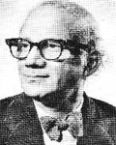

Slide 48
Shakir Ali began with a cubist preference and many of his themes borrowed from classical European myths like ‘Europa and the Bull’ and ‘Leda and the Swan’. As his style evolved, he pared down the human form to sharp angles and took up red as a dominant colour. Many of his paintings feature birds, which he looked upon as the symbol of personal freedom in a world of conventions.

Slide 49
He did some pioneering work in Arabic calligraphy in the 60s, in which the alphabetic form is used as a linear design using colour and visual rhythm to lend it a modern interpretation.
Shakir Ali was amongst the first artists to practice painterly calligraphy. He was Principal of the National College of Art, Lahore from 1961-73.

Slide 50
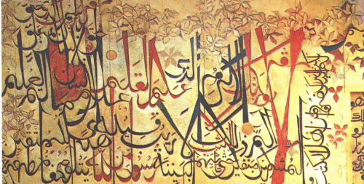

Slide 51
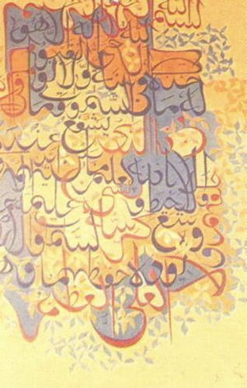
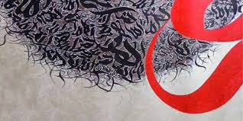

Slide 52
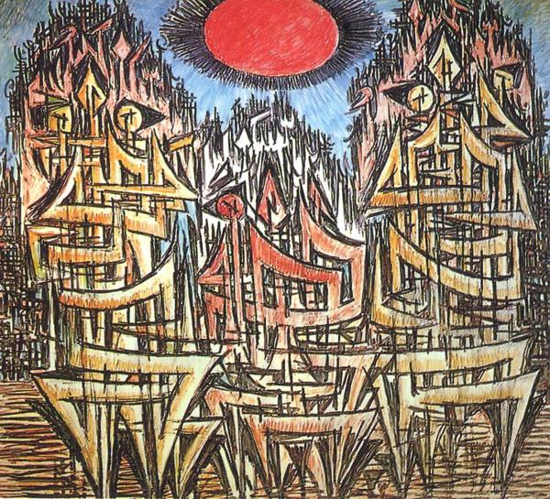

Slide 53
Summery of today's Lecture
We have discussed here three major calligraphers of Pakistan. Although there are many more who’s work is well known Internationally.
We have discussed in this lecture in detail the status of Calligraphy and its importance.

Slide 54
We have also discussed in detail the three famous artists who are internationally well known not only for their calligraphic work but are also famous for their interest in Modern art and production of work at a mass scale.
In our next Lecture 11 we will do some practical work related to calligraphy and produce some works for the final portfolio.
Thank You.

