Slide 1
Lecture # 9
SCIENCE 1
ASSOCIATE DEGREE IN EDUCATION
BIODIVERSITY, NATURAL SELECTION AND ADAPTATION

Slide 2
DIVERSITY
In this week, Students learn that adaptive characteristics of a species affect its chance for survival or possible extinction.
As they explore adaptation, they draw on their experience to provide examples of:
Biological adaptations that enhance survival and reproductive success in a particular environment
Adaptations, such as changes in structures behaviors
Physiology

Slide 3
Natural Selection
Student may have some difficulty understanding natural selection. The reason is that natural selection requires the integration of two distinct processes in evolution:
The random occurrence of new traits in a population
The non-random effects of these new traits on survival

Slide 4
Natural Selection continue …….
Student may view natural selection as a process that perfects organisms. However, it is actually the simple result of variation, differential reproduction, and heredity.
Alternatively, they may misinterpret natural selection as a random process because the genetic variation that occurs in a population is the result of random mutation.

Slide 5
Natural Selection continue …….
Be very clear when choosing your words. Continue to emphasize that selection acts on that variation in a non-random way:
Genetic variants that aid survival and reproduction are more likely to become common than variants that don’t.
Throughout this unit, keep an eye out for any indication that Student might be developing either of these two common misconceptions.

Slide 6
SPECIES: DARWIN’S FINCHES
Begin by asking Student where they think the biodiversity on Earth comes from
Have them use the knowledge they learned in unit 2 about ecosystems, resources, and populations
Also, ask them why some ecosystems have a large number of different species and others only have a few

Slide 7
SPECIES: DARWIN’S FINCHES continue……
Have them use their records of what they discovered in their plot of land in unit 2 and use their catalogue of the living things they found. Then introduce them to Carolos Linnaeus, a Swedish scientist who in the eighteenth century developed a classification system based on structural features
His classification system is still being used to bring order to the enormous diversity of living things. It is also used to define relationships among different organisms and identify new organisms as they are discovered
Give Student an example of how a local species found on their plot of land would be catalogued using Linnaeus’ taxonomy (species, genus, family, order, class, phylum, and kingdom)

Slide 8
SPECIES: DARWIN’S FINCHES continue……
Tell them that this week they will focus on ‘species’ and ask them what kinds of species they know. Collect their answers on the board; push them to go beyond mammals. If Student Teachers mix up species with sub-species (or breeds/races), do not correct them at this point.
Instead, show them a sheet of different cat or dog breeds and ask them how many different species are displayed. Tell them that organisms of the same species are capable of interbreeding.
Then discuss what they have identified as species before so they can correct their responses if needed.

Slide 9
SPECIES: DARWIN’S FINCHES continue……
Introduce your Student to Darwin and his study of the finches of Galapagos. You might want to spend a little time discussing Darwin and his life.
Then talk about what he did on his ship the Beagle before focusing on his famous work on the finches of Galapagos.
Provide your Students with an image of Galapagos finches and their beaks (you can use the one provided below or a similar one that you have in a textbook).
Tell them that these are all different species of finches found on Galapagos; however, they are all descendents of a finch found in South America.

Slide 10
SPECIES: DARWIN’S FINCHES continue……
Next, divide the class into at least three or four groups and assign each group one of the finches. Have each group research its habitat, identify its primary food, and describe its beak. Good examples for this task are the
large ground finch
vegetarian tree finch
woodpecker finch
cactus ground finch

Slide 11
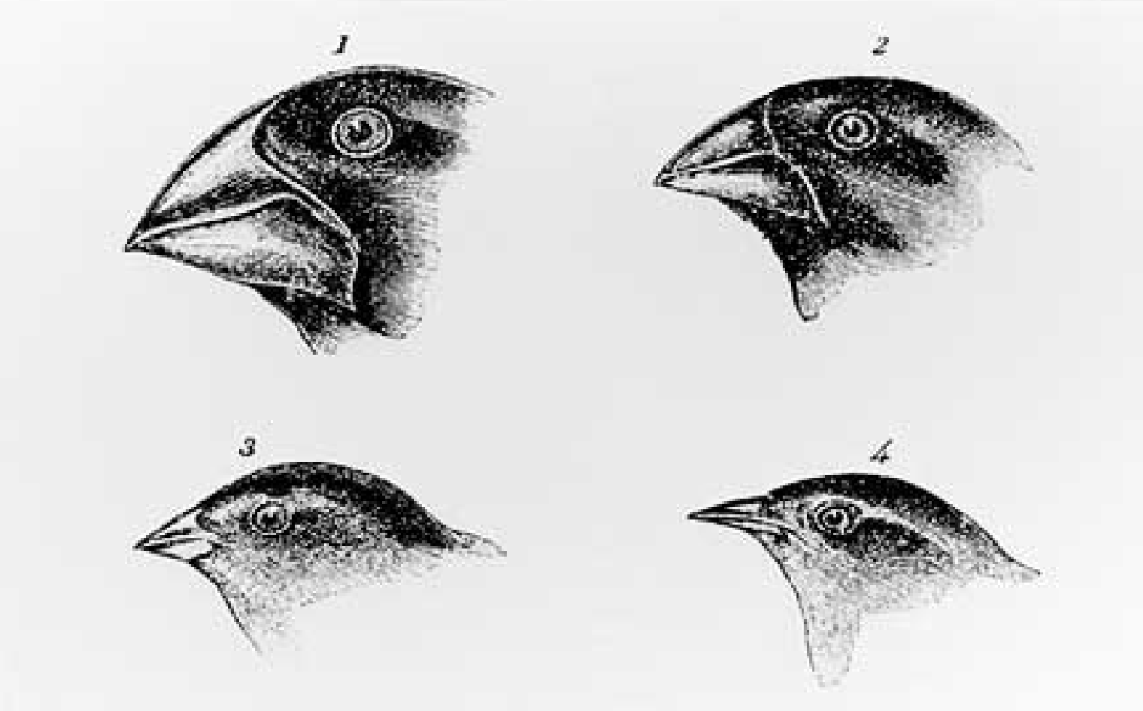
SPECIES: DARWIN’S FINCHES continue……

Slide 12
SPECIES: DARWIN’S FINCHES continue……
Invite each group of Students to research its finch species in great detail. Ask the groups to provide a summary that contains a description of:
the characteristics of the finch’s beak
the finch’s habitat and environmental conditions found on that island
the finch’s preferred food source

Slide 13
SPECIES: DARWIN’S FINCHES continue……
Ask Student to hypothesize about what has happened on Galapagos over time. How did so many species of finches develop on the Galapagos Islands?
Make sure they draw on information they have gathered about the finch’s ecosystem and its biology. Also, have them use their understanding of species and evolution to explain how the amazing diversity of finch species might have occurred.
Ask each group to present its findings and hypothesis. Make a summary on the board about the similarities and differences found. Discuss how each group’s findings can explain Darwin’s theory that natural selection is the mechanism of evolution.
Then talk about how natural selection is an example of the unity and diversity of life.

Slide 14
SPECIES: DARWIN’S FINCHES continue……
As an outcome of this brief study, your Student should be able to hypothesize that the finches settled on different islands for a reason: the distances between the islands were so vast that they could not easily fly away from the islands they settled on.
Therefore, because they were isolated on separate islands, they could not mate with finches on other islands. Over time, the finches on different islands developed different beak sizes and shapes that were best suited to the kinds of foods found on their island.
The result was speciation (the development of one or more new species from an existing species) of the original ancestral finch. Over time, 13 different species of finches developed.

