Slide 1
Lecture # 28
SCIENCE 1
ASSOCIATE DEGREE IN EDUCATION
DEFINING MATTER

Slide 2
DEFINING MATTER
Ask Students how they would describe matter. Have them describe what matter is and what it is not. It is appropriate for them to speculate and argue their point with their classmates.
Have them think about the activity from session 1 where they separated substances into smaller and smaller parts. (They might mention elements, atoms, or even subatomic particles.) What might that tell them about matter? Capture their thinking (also ‘wrong ideas’) on the board for later discussion and revision.
The majority of the class should conclude that all matter is made up of mass and that mass is composed of particles. Then introduce the model of the atom. (It is OK if they do not use the right terminology yet, as long as they have reached that conceptual understanding.)
For the model, you can use a physical model or a drawing. Introduce the atom and its subatomic particles (neutrons, protons, and electrons), including their respective electric charges)

Slide 3
Historic definition of matter
Provide Students with former hypotheses made by scientists over the centuries regarding matter and what matter is composed of You can begin, for instance, with the ancient Greek Empedocles.
He argued that all matter was composed of four elements: fire, air, water, and earth. In addition, he claimed that the ratio of those elements determined the property of the matter. Have them reflect on that statement.
Then have them discuss their understanding of the current model of the atom. You might want to establish a ‘class model’ using their ideas.

Slide 4
Scientific Knowledge
Use this exercise to model how the body of science knowledge is constantly changing. Inform Student Teachers again that science content is not static.
Established theories and broadly accepted ‘facts’ can change over time; the quest of science is ongoing even today. Have them discuss other examples where the established understanding has changed dramatically over time.
Use all science disciplines (a flat Earth, cause of disease, lightning, etc.).

Slide 5
Organization of matter
Ask Students to work in pairs and brainstorm a chart or some form of organization to capture and catalogue all matter on Earth.
Have them compare their ideas and the thinking behind their chosen organization. Introduce Mendeleev and how he created the period table of the elements.
Many consider this table the most important chemical document. The reason is that it allows you to quickly determine a significant amount of information about an element.
This information includes its atomic mass, atomic structure, and whether it is a metal, non-metal, or metalloid.

Slide 6
Periodic table
Give Students simple examples on how to read the periodic table. Start with the elements in the main group.
Describe how they are organized by their atomic number and what that means. Relate that information to the model of the atom.
Have them draw atoms of different elements for practice. They should draw the correct number of neutrons, protons, and electrons.
Electron shells and isotopes do not have to be discussed yet

Slide 7
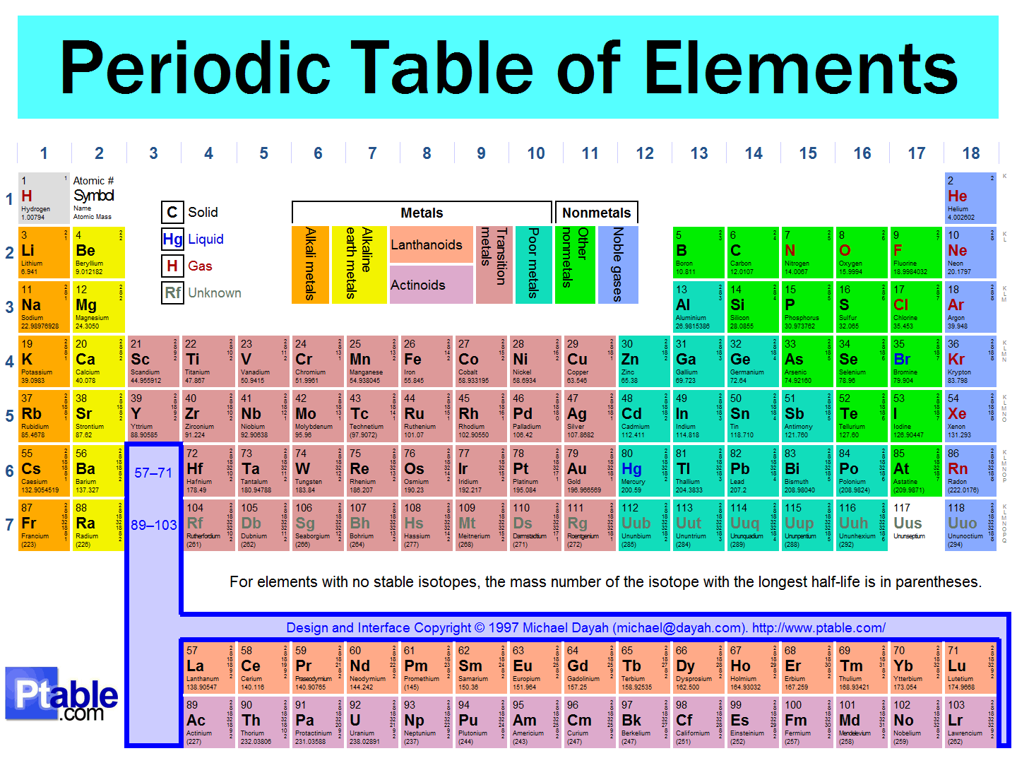
Periodic Table

Slide 8
Atomic weight
Then introduce them to the atomic weight of each element as well as some of the properties (metallic vs. non-metallic, the noble gases, etc.).
Demonstrate the patterns in the periodic table that capture those properties (for instance, the increase in atomic weight from top left to bottom right).
Ask Students whether they can explain the patterns, such as the increase of the atomic weight. In Science I, they don’t need to explain why certain elements are metals and others are non-metals, and so on. It is enough to just introduce them to the very basics.

Slide 9
Definition of an element
Ask Students what they think is an ‘element’. As a prompt, remind them of the separating activity in the previous session. Ask how much further they could theoretically separate matter.
They should realize that an element is the smallest form matter can be in. An element can’t be decomposed into any smaller substances.3 Elements are made up of atoms (of the same kind).
Ask them which elements they already know and where they appear in everyday life. Help them find each element they mention on the periodic table.
Focus the remainder of the lesson on interpreting the additional information contained in the periodic table

Slide 10
State of Matter
What are the three commonly known states of matter?
Give two examples of each of these states of matter.
Have you heard about 4th state of matter, what is it?
What is the most common reason for matter changing its state?
What is the type of matter that changes its form very easily?

Slide 11
