Slide 1
Lecture # 24
SCIENCE 1
ASSOCIATE DEGREE IN EDUCATION
Process Skills in Science

Slide 2
Process Skills
Asking questions
Problem solving
Making an argument
Defending an idea
Making and recording observations
Classification

Slide 3
Asking Good Scientific Questions
Ask several questions about a topic and let students ask as many questions as possible
Create environment in the classroom where students are encourage to ask questions
Break bigger questions into smaller questions.
Keep the language simple and understandable
Give logics, reasoning and chance to debate

Slide 4
“Fact” Questions
What data would your students collect to answer this question?
What would your hypothesis be?
How would your students collect data?
How would your students present data?
How would your students analyze data?
How would your students conclude data?

Slide 5
“Comparison” Questions
Why Comparison questions are important?
Encourage thinking process
Develop reasoning
Develop argument
Develop justification

Slide 6
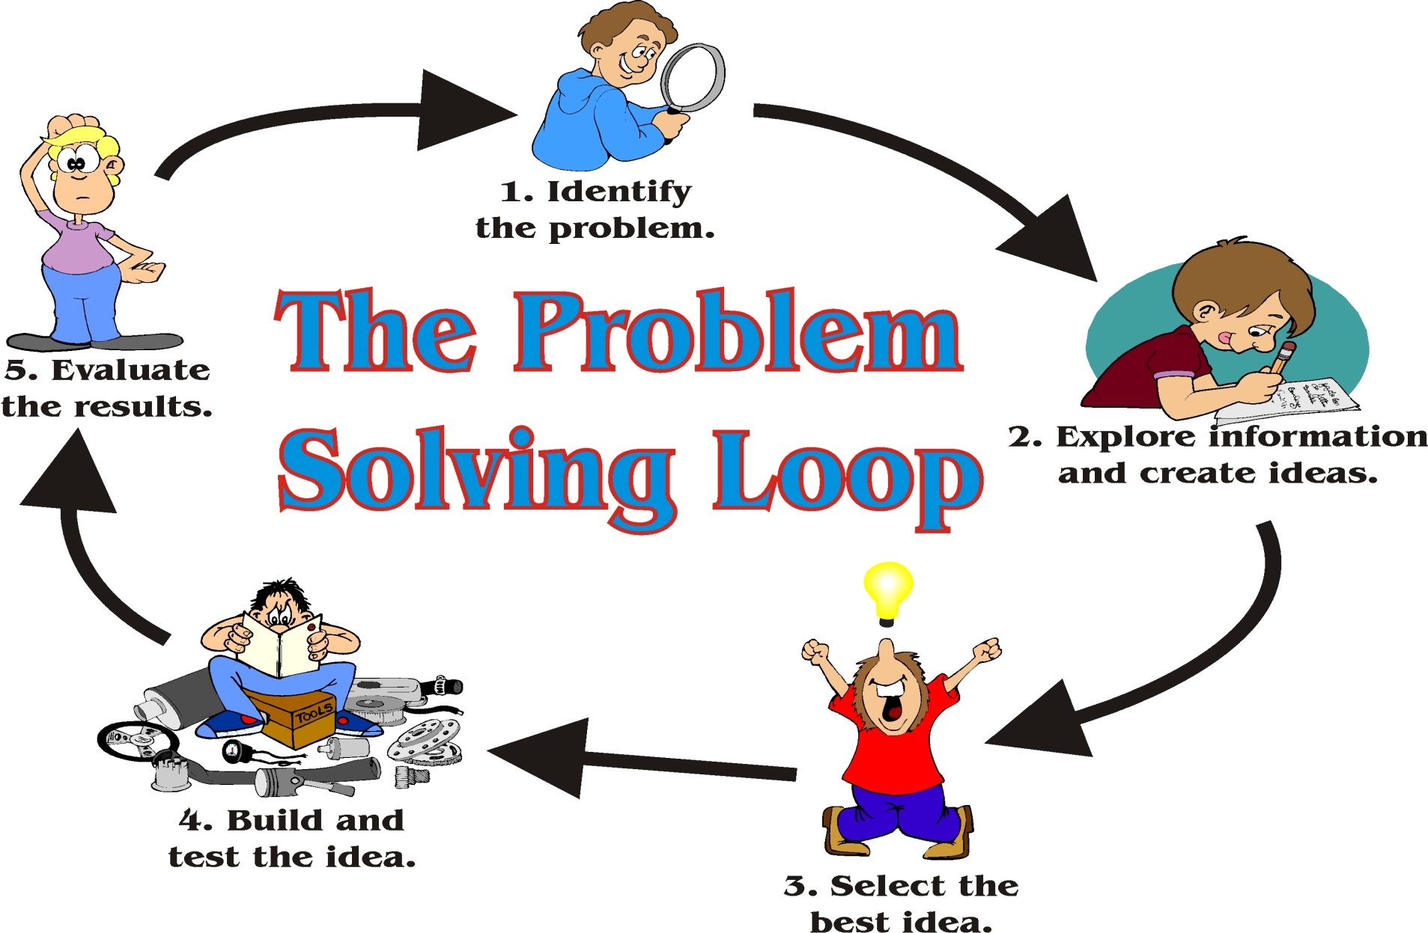
Credit/Reference: http://blog.careerfutura.com/wp-content/uploads/2013/12/problem-solving.jpg

Slide 7
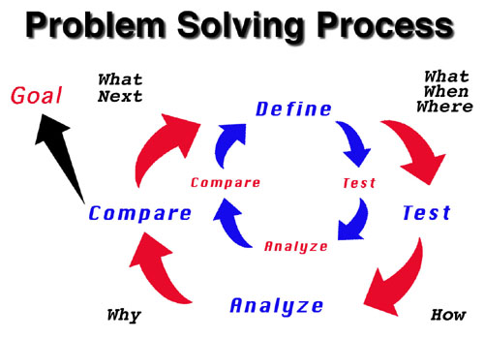
Credit/Reference: http://1.bp.blogspot.com/Problem+Solving+Process.jpg

Slide 8
SCIENTIFIC ARGUMENT
Argument is about making claims and providing justification for those claims.
When should students use arguments?
To refute claims made by other students
To defend their claims, designs, and questions
To prove a point

Slide 9
DEFENDING IDEA
The Research Question/Issue/Problem
Student’s Claim
Evidence
Reasoning

Slide 10
Classification?
Classification is the grouping of information or objects based on similarities
Think about classification that is used in everyday life
What would happen if grocery stores did not use a classification system?
What about libraries, movie stores, department stores, etc.?

Slide 11
Why Classify Organisms?
To represent relationships among organisms
To makes things easier to find, identify, and study
To understand our own evolution!

