Slide 1
Lecture # 20
SCIENCE 1
ASSOCIATE DEGREE IN EDUCATION
Force and Motion continue …….

Slide 2
Background information
Several forces are involved when the model is at rest and when it is moving. The model has weight, and the wound-up rubber band exerts tension on the axle. The weight is described in terms of the gravitational force. The weight of the car has to be overcome to get it to move.
Newton’s first law states that an object will remain at rest unless an unbalanced force acts on it. Also, an object will continue to move unless an unbalanced force acts on it. Inertia is the resistance to motion, and friction causes a moving object to slow down or stop.
A key idea here is the notion of unbalanced forces. In the model car example, several forces are involved. There is gravitational force, normal force, a tension force, a frictional force, and the force of air resistance, which in this case is negligible.

Slide 3
Background information continue ……
A force is a push or pull resulting from one object acting on another object. Forces have magnitude and direction. The gravitational force is gravity acting on the mass of the car.
The Earth, which is one object, is attracting the model car, which is another object. The direction of this force is downward towards the centre of the Earth.
At the same time, there is another force (normal force), which is the floor pushing upward on the wheels of the car. The tension force is the wound-up rubber band. It acts to turn the axle of the model car, causing the wheels to rotate and move the car forward. The magnitude and direction of this force overcome the downward force of gravity.
When the model car is moving, the force of friction eventually causes the model car to come to rest. Friction acts in the opposite direction of the movement of the car.

Slide 4
Background information continue ……
A tension force, or an applied force, (when the model car is pushed by hand or a magnet to illustrate that forces do not require physical contact) can overcome inertia. This results in unbalanced forces that cause the model car to move.
As the model moves, it experiences friction. The better the design of the model, where friction is diminished between the axle of the wheels and the structure holding the axle, the farther the model will travel.
Potentially, the model car could continue to move on and on in a frictionless world and never come to a stop. This is an essential point. Forces, such as friction, result in an unbalanced force that slow down the vehicle and eventually cause it to stop.

Slide 5
Analyzing and mapping forces and resulting motion
In the third session, introduce Students to free-body diagrams. These will help them better understand how to visually represent the magnitude of a force and the resulting magnitude and direction of the motion.
At this point, they should also understand the difference between a balanced and unbalanced force. They should be able to explain how unbalanced forces result in a change of motion.
For more advanced Students, add that a change of motion can either occur in the object’s speed or in the direction that it is moving. You could demonstrate this by having the moving model car hit an object that deflects its movement.

Slide 6
Analyzing and mapping forces and resulting motion
Begin again by discussing the forces that act on a stationary car: gravitational force and the normal force as the counter-force. (Both forces balance each other, so the car remains stationary.)
While they discuss the forces, introduce them to the free-body diagram by adding the forces as they name them.

Slide 7
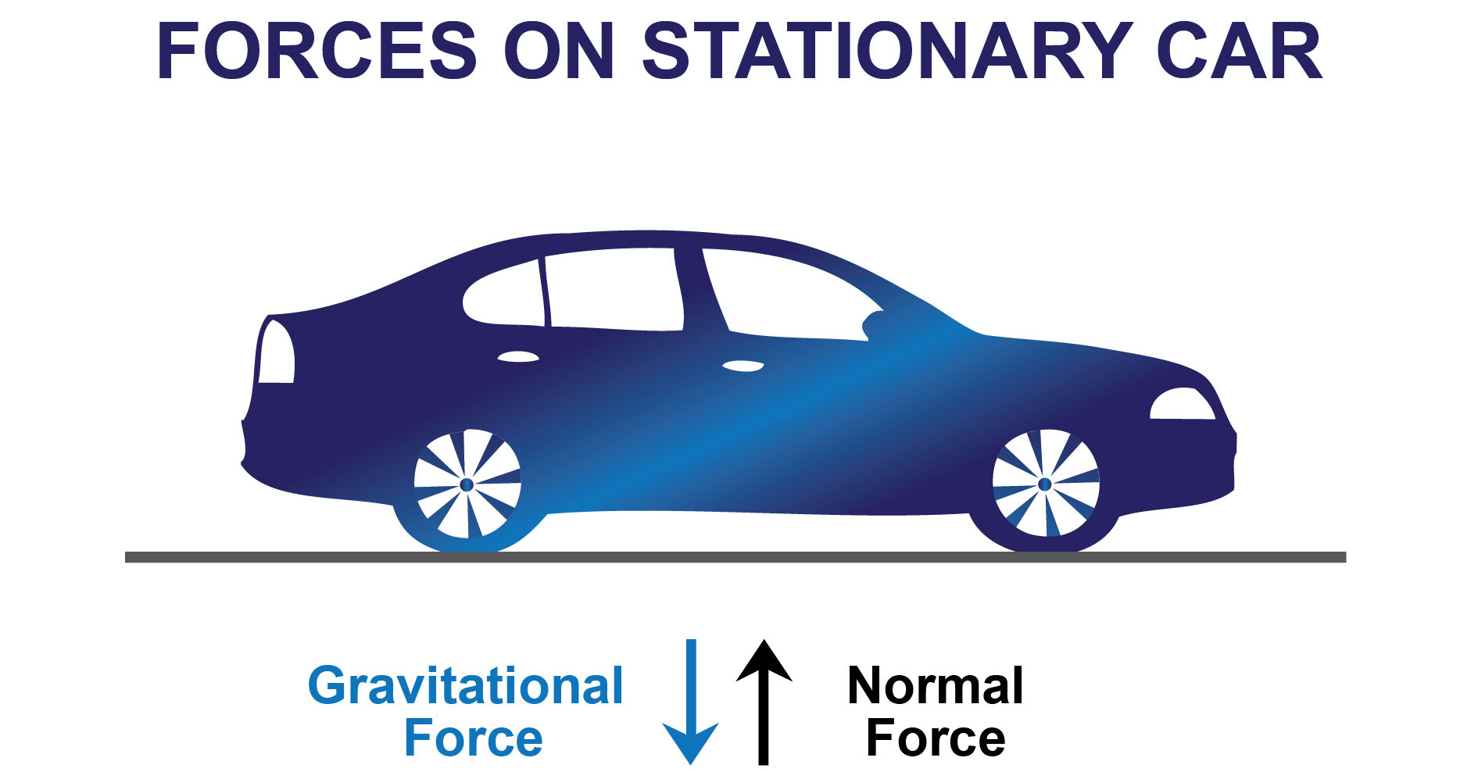
Sample Picture of Free Body Diagram of a stationary object (or an object travelling at a constant speed on a linear path).

Slide 8
Car-A sample tool
Then draw the car with a force (a push or the rubber tension) that sets the car in motion. As counter-forces, there is friction from the surfaces on the wheels, between the axles and the wheels, and so on, and air resistance (negligible).
These are unbalanced forces; the car is moving and eventually slows down.

Slide 9
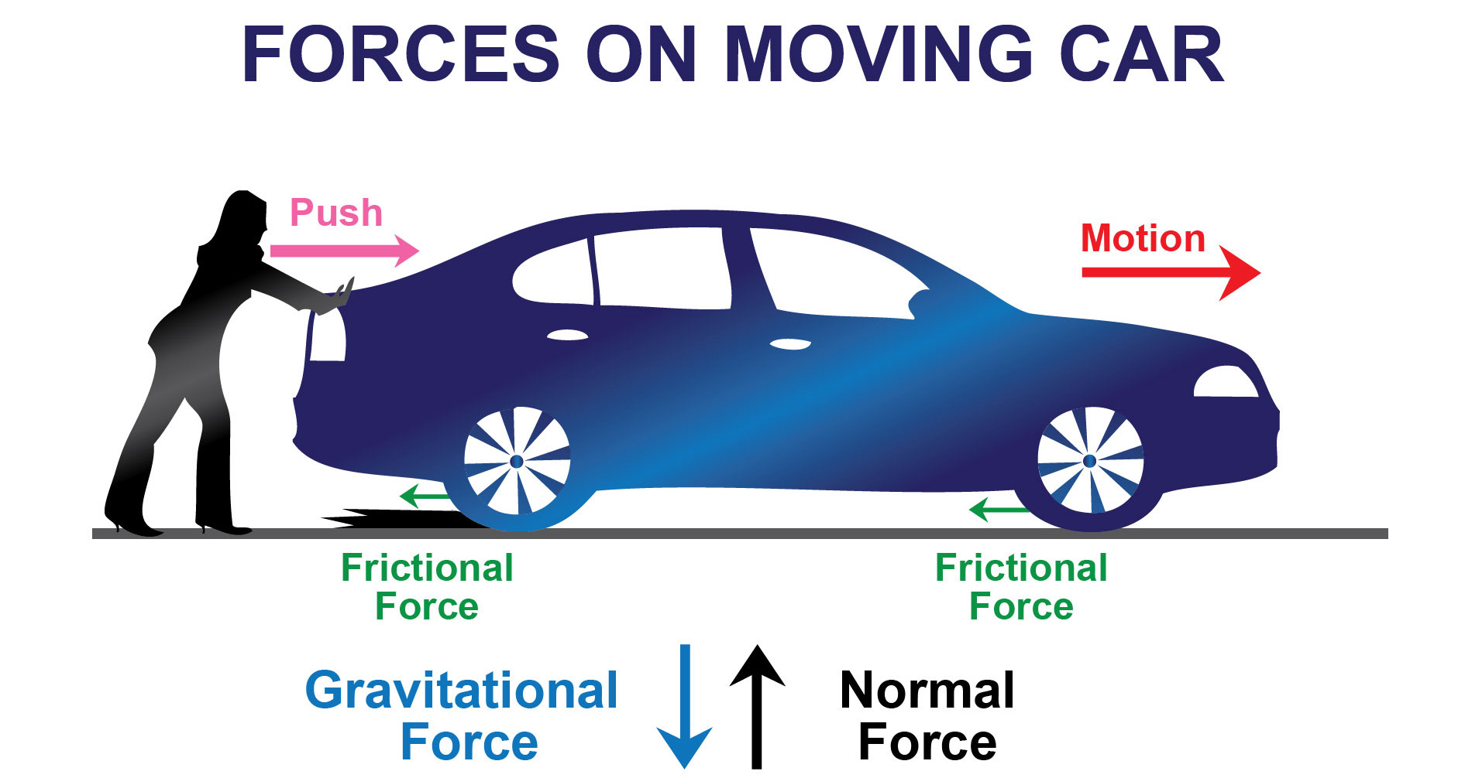
Sample Picture of Free Body Diagrams of a positive acceleration (push) resulting in motion.

Slide 10
Car-A sample tool
In addition, you can demonstrate that unbalanced forces can also cause a change in motion by changing the direction of movement. (For example, have the car roll down the ramp and then hit a brick at an angle at the bottom of the ramp.
This causes the car to ‘break off ’ the linear path it would have travelled without the brick.) Discuss and compare the forces and the result in motion in both scenarios (change of speed and change of motion).

Slide 11
Car-A sample tool
It is important that Students begin to understand that motion, or acceleration, is the result of an unbalanced force acting on an object.
The most common misconception is the idea that sustaining motion requires a continued force. If they voiced this misconception in the session 1 brainstorming, begin countering this false belief now in sessions 2 and 3.

Slide 12
Car-A sample tool
Draw their attention to the continuation of the movement of the car after the propulsion forces (rubber band, ramp, push with hand, etc.) are no longer applied.
They then should explain the continual movement of the model and why the model car eventually stops. In addition, they need to be made aware of the different forces acting on an object and how these forces interact (using free-body diagrams or force diagrams).

Slide 13
Car-A sample tool
They should realize that if an object is in motion and no new force acts on it (for instance, any friction), that object would continue to move in that direction (Newton’s first law).
Only quoting Newton’s laws of motion is not enough. Take every opportunity to discuss various scenarios. Have them account for all forces before they decide whether an object is changing its movement and how.
This will help them begin to change their thinking about the motion of objects and the forces acting on them.

Slide 14
Car-A sample tool
An object at rest tends to stay at rest. An object in motion tends to stay in motion with the same speed and in the same direction unless acted on by an unbalanced force.
You will continue this concept of motion in the next week.
Tell Students to hold on to their model cars because next week they will conduct more experiments to better understand force and motion.

