Slide 1
Lecture # 2
SCIENCE 1
ASSOCIATE DEGREE IN EDUCATION
TEACHING SCIENCE IN ELEMENTARY SCHOOL

Slide 2
LECTURE OUTCOME
Student Teachers should be able to:
discuss the nature of science and contrast science with other ways of knowing about the world
understand the differences among results, conclusions, and inferences
describe how science is a process rather than a product
provide examples for the impact of science in daily life and the environment.

Slide 3
FROM EXISTING PRACTICES TO NEW PEDAGOGIES (TEACHING SKILLS)
EXISTING TEACHING PRACTICES
Reading
Textbooks and solving problem sets in which only one defined correct answer is teacher verified
EXPECTED TEACHING PRACTICES
Make observations,
Develop questions and hypotheses,
Discuss ideas and thoughts with one another

Slide 4
STARTING POINT
Pose open-ended questions of a higher-thinking order that allow for various possible answers and discussion
Good questions can make you think for yourselves and want to know more rather than reciting a fact.
Those kinds of questions invite them to listen carefully to one another, to build on their peers’ ideas, or to challenge them if they disagree.

Slide 5
Starting point (continue….)
Science should not be presented as a discipline with a finite number of facts that need to be memorized.
Rather, it is a discipline that is constantly changing as new discoveries are made. New theories are established, and old ones are revised or dismissed.
Treating science like a pure delivery of facts rather than a process of inquiry does not do it justice

Slide 6
Starting point (continue….)
The appeal and fascination of science and science teaching lies in inquiring about the natural world.
Learning how to study, and making sense of all the wonderful phenomena happening around us.
Good science teaching uses this natural motivation and should be practiced throughout all grade levels.

Slide 7
QUESTIONS TO ASK YOURSELF
What are your expectations for the course?
What is your science background?
What interests (scares) you in science?
What do you think science is?
Do you think it is important to learn/teach science in (elementary) school? Why?
Are there differences (similarities) between teaching science and, for instance, teaching Urdu? Explain your opinion.
How did you experience science in school? What do you remember fondly?
What do you wish were different?

Slide 8
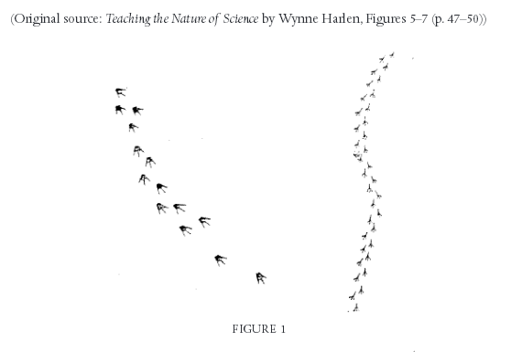
OBSERVATIONS VS INFERENCE

Slide 9
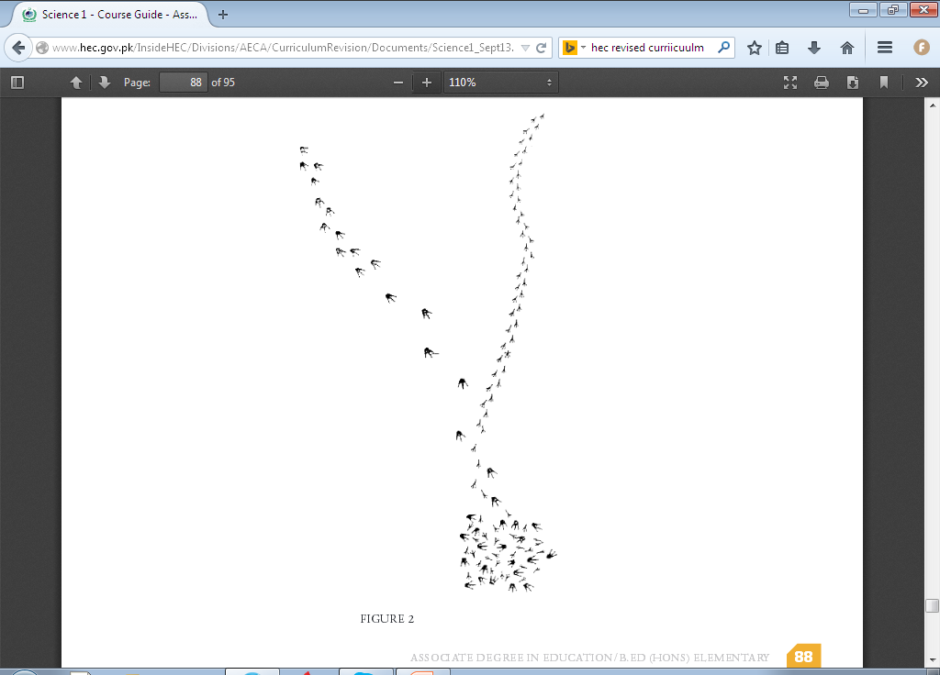
OBSERVATIONS VS INFERENCE (continue…..

Slide 10
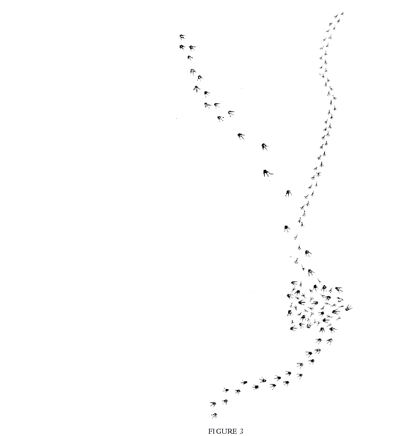
OBSERVATIONS VS INFERENCE (continue…..

Slide 11
REFLECTION ON THE ACTIVITY
How did you know that the shapes in the picture were bird prints?
How did you decide on your ending—for instance, that one of the birds ate the other? Are there any other possibilities? For example, is it possible that one flew away while the second stayed?
How do you know that the tracks were made at the same time? Is it possible that one set of tracks was made a number of years before the other set?
What do you conclude from this activity regarding the nature and characteristics of observation in science?

Slide 12
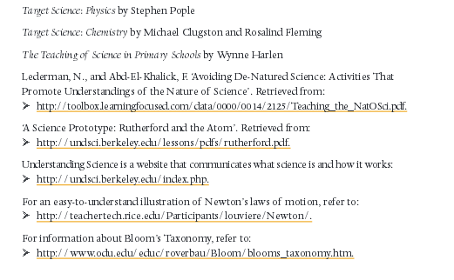
ADDITIONAL RESOURCES

