Slide 1
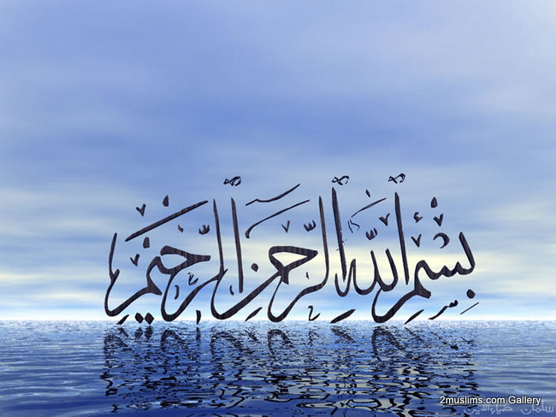

Slide 2
Islamic Studies course code 104
Associate Degree Education ADE/B.Ed(Hons)Elementary
Semester I

Slide 3

Lectuere#09

Slide 4
Introduction to Holy Quran and Quranic Studies
By Muhammad Imran

Slide 5
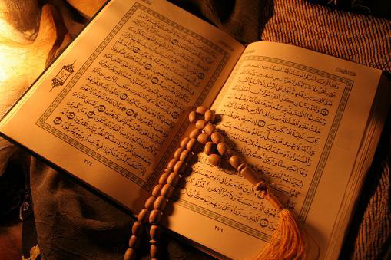
Out Lines
  Introduction to Quran
  Quranic studies
  History of Quran
  uloom-ul-Quran
  Characterestics of Quran

Slide 6
Introcuction to Holy Quran
Meaning of the word Quran
This word is derived from the
ق.ر.أ.Arabic roots
The word (qiraah) is also derived from the same roots. So the meaning of (qiraah) is reading and recitation. The word Qur’n in the tense of exaggeration. So the literal meaning of the word Qura’n is the widely read book. So:
Qira’ah means: reading and recitation.
And Qura’n means the widely read book.
No doubt that the holy Qura’n is recited widely..

Slide 7
Technically it means
One of the holy books of Allah which has been revealed to the holy prophet Muhammad (s.a.w.s.) in 23 years.
The revelation of the Qur’an started through Wahi (inspiration) from Allah (swt).
The first revelation came to the Prophet (pbuh) in Ghare Hera (cave Hera).

Slide 8
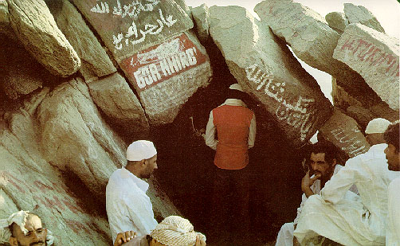
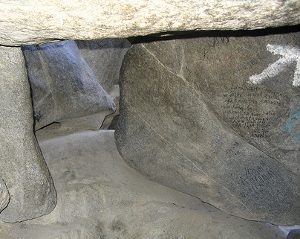
The Path to
Cave Hera
Cave Hera in
Jabl-e-Noor

Slide 9
First Revelation
Cave Hera is in Jabl-e-Noor (Noor Mountain) on the road to Mina about 3 miles to the East of Holy Macca.
The Prophet was about 40 years old when Angel Jibrail brought the first revelation from Allah (swt).
The first revealed verses of the Qur’an are the first 5 verses (Ayats) of Surah Al Alaq.

Slide 10
The first revealed verses of the Qur’an
اقْرَأْ بِاسْمِ رَبِّكَ الَّذِي خَلَقَ
1 READ in the name of thy Sustainer, who has-
خَلَقَ الْإِنسَانَ مِنْ عَلَقٍ
2 created man out of a germ-cell
اقْرَأْ وَرَبُّكَ الْأَكْرَمُ
3 Read - for thy Sustainer is the Most Bountiful One
الَّذِي عَلَّمَ بِالْقَلَمِ
4 who has taught [man] the use of the pen –
عَلَّمَ الْإِنسَانَ مَا لَمْ يَعْلَمْ
5 taught man what he did not know!

Slide 11
The period of Revelation
The period of revelation of the Qur’an is 22 years, 5 months and 14 days about 23 years.
The last verse was revealed shortly before the Prophets (pbuh) death in Arafat. It is the third verse of Surah Al Maidah.
The subject of the Qur’an is ''Man" (the one created in the best of form) and his ultimate goal in life.

Slide 12
Gradual revelation the Holy Quran
Two words used in the holy Qur’n in this regard; Inzal and Tanzeel.
Inzal means: transmission in one ocassionإنا أنزلناه فى ليلة القدر“ while Tanzeel means gradual revelation .“ونزَّلناه تنزيلا“
The holy Qura’n was transmitted twice;
Full transmission.
Gradual revelation.
From lawh-e-mahfooz to bait-ul-mamoor. (inzal)
From bait-ul-mamoor to the holy prophet (s.a.w.s.) (tanzeel)

Slide 13
Philosophy behind the gradual revelation
Muhammad (s.aw.s.) was ummy.
Difficult situation of revelation.
To console the prophet again and again.
To be according to the natural process.
Answers, predictions and incidetnts. They happened again and again.
Indirect revelation
No philosophy can be quoted exactly. It is a safe passage. It is called “tafweez” .
To show the angels the greatness of the holy Qur’n.
To show that it is preserved in many places.

Slide 14
Forms and Categories of revelation
Gabraeel (a.s.)حٖضرت جبرائیلؑ himself in his own appearance.
In the appearance of dihia kalbiوحية كلبى .
Only sounds.صلصلة الجرس (difficult form)
Direct conversation.in dreams, Awakening
Inspiration.
categories of revelation
Recited
the holy Qura’n.وحی متلو
Non recited:
hadees and hadees qudsiوحی غیرمتلو.

Slide 15
The Theme of the Quran
The theme of the Quran consists broadly of three fundamental beliefs. They are:
1. Tawhid - Allah and predestination
2. Risalah - Angels of Allah, Books of Allah and Messengers of Allah
3. Akhirah - Life after Death and the Day of Judgement

Slide 16
The Language of the Qur’an
The language of the Qur’an is pure and clear Arabic.
The Qur’an is divided into 30 parts (Parahs in Urdu or Juz in Arabic).
There are 114 chapters (Surahs) in the Qur’an.
There are 540 paragraphs (Rukoos) in the Qur’an.

Slide 17
Verses (Ayats) in the Quran
There are 6666 verses (Ayats) in the Qur’an.
There are 10 different kinds of verses (Ayats) in the Qur’an. They are:
1. Promise verses 1000
2. Warning verses 1000
3. Forbidden verses 1000
4. Order verses 1000

Slide 18
Famous Names of the Qur’an
Qur’an: Reading, recitation, collection 2/185, 17/9, it contains the best and most relevant of all previous messages
Furqan: Criterion between the right and wrong 25/1, 2/185, 36/2
Tanzil: Revelation, 26/192
Dhikr: Reminder, 15/9
Nur: Light, 4/174
Kitab: Book/scripture, 2/2

Slide 19
Verily this Qur’an shows the way to all that is most upright…17/9
Maw’idhah: Admonition. Shifaa’: Cure. Huda:
Guidance, Rahmah: Mercy, 10/57
Mubarak: Blessed. Musaddiq: Confirming the
truth of previous revelations, 6/92
Azeez: Sublime, Powerful, 41/41
Majeed: Holy, 85/21
Basheer: Herald of glad tidings. Nadheer:
Warner, 41/4

Slide 20
Kinds of Verses Contd…
5. Example verses 1000
6. Story verses 1000
7. Allowing as lawful 250
8. Prohibitory verses 250
9. Praise verses 100
10. Miscellaneous verses 66

Slide 21
The Qur’an Commands
The Qur’an commands the Muslims to offer Salah (Namaz) 700 times.
There are 14 verses (Ayats) in the Qur’an where prostration is a must whenever you recite or listen to those verses.
The Qur’an was revealed to the Prophet (pbuh) in two cities. Macca Al-Mukarramah and Madina Al-Munawwarah.

Slide 22
Prophets Mentioned in the Quran.
The names of 26 Prophets are mentioned in the Qur’an.
Prophet Musa (pbuh) is mentioned most in the Quran. He is mentioned 135 times.
Prophet Ibrahim (pbuh) is mentioned 67 times in the Qur’an.
Prophet Muhammad (pbuh) is mentioned 5 times in the Qur’an.

Slide 23
Angels Mentioned in the Qur’an
God Almighty's name ''Allah" is mentioned 2584 times in the Qur’an.
4 angels are mentioned in the Qur’an. They are:
1. Jibrail (pbuh)
2. Mikail (pbuh)
3. Haroot
4. Maroot

Slide 24
First Person to Memorize the Qur’an
The biggest chapter (Surah) in the Qur’an is Surah Al-Baqarah (the cow). It has 286 verses (Ayats).
The smallest chapters (Surahs) in the Qur’an are Surah Al-Asr, Al-Kauser and An-Nasr. They have 3 verses (Ayats).
The first person to memorize the Qur’an was Prophet Muhammad (pbuh).

Slide 25
Bismillah AlRahman AlRaheem
Surah Tauba (also called Surah Barat) does not begin with "Bismillah AlRahman AlRaheem" (In the name of Allah..).
In Surah Naml (chapter ant) ''Bismillah AlRahman AlRaheem" (In the name of Allah..) is mentioned twice.
By the time the Prophet (pbuh) passed away, 40 people (Huffaz) had already memorized the Quran.

Slide 26
Ummul Qur’an
6 chapters (Surahs) in the Qur’an are named after the Prophets. They are: 1. Surah Younus 2. Surah Hud 3. Surah Yousuf 4. Surah Ibrahim 5. Surah Nuh 6. Surah Muhammad
Surah Al-Fatiha is also called as "Ummul Qur’an" (the mother of the Qur’an). It is the first chapter (Surah) of the Qur’an.

Slide 27
The Zenith of the Qur’an
Surah Al-Baqarah is also called as "Sinamul Qur’an" (the zenith of the Qur’an). This Surah contains more commands than any other Surah.
Surah An-Nas is the last Surah of the Qur’an.

Slide 28
Unaltered and Undistorted
The Qur’an is the only revelation of Allah that exists unaltered and undistorted.
Allah the Almighty has taken the responsibility of preserving the Qur’an. He says in Surah Al-Hijr, Ayat-9
"Surely, We have revealed this reminder (zikr) and Lo, We verily are its Guardian".

Slide 29
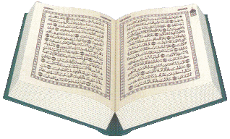
An Admonition to all Creatures
"Blessed is He Who sent down the criterion
to His servant, that it may be an
admonition to all creatures."
(Al Furqan)

Slide 30
Katibeen-Wahy (writers of revelation)
There were over thirty companions of Prophet Muhammad pbuh, who were assigned the duty of writing the Holy Qur’an as and when it was received by the Prophet. 5-6 of them were always present near the Prophet (24/7).
The writers of revelation were not allowed to write Hadith (Prophet’s sayings, actions, and approvals) or any thing else.

Slide 31
Some uloom-ul-quran
Shari’ah, Siyasah, Khilafah: Islamic legal, political, and caliphate system
Ibadaat: devotional deeds, including the five pillars of Islam
Akhlaq: Islamic ethical system
Mu’amalaat: Dealings with Muslims and non-Muslims, relationships with family, friends etc.
Etiquettes of eating, drinking, wedding, socializing, visiting, and fighting in self defence, and more…

Slide 32
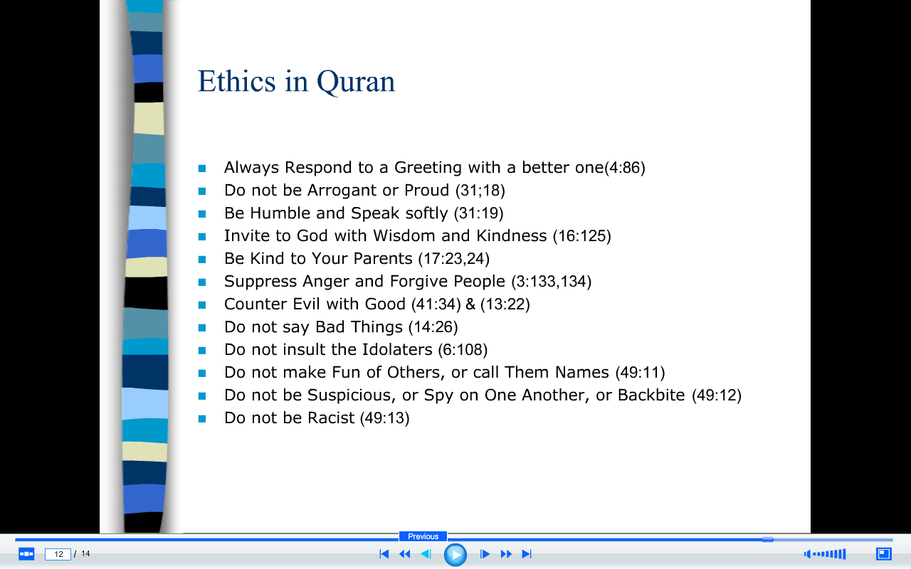

Slide 33
Authorship of The Qur’an
The first person who recited the Qur’an was prophet Muhammad pbuh, in 7th century C.E.
If someone authors a book, he/she will proudly claim the authorship, but the Prophet did not claim it, he said it is Allah’s words
Internal and external evidence has proven that there is no author but Allah swt (God): 96/1, 1/1, repeated 114 times, 57/16, 56/77-80, 25/1, 4/105, 2/185, 15/9, 16/44, 26/192-194

Slide 34
The Challenge of The Qur’an
“Say if all humankind and all Jinns were to gather together to produce the like of this Qur’an, they could not produce the like thereof, even if they backed up each other with help and support” 17/88
The style: Every verse gives the impression that it is from God: 49/13, 95/4, 51/49, 50/16
The word: Qul: Say, was repeated in 340 verses as a imperative command

Slide 35
The Quranic order
Tauqeefi
Nuzooli
The holy Qura’n was recorded only according to Tarteeb-e- Tauqeefi not Nuzooli. Because the compilation is according to lawh-e-Mahfooz while the revelation is according to the circumstances

Slide 36
Makki and Madni Surahs:
their definition.
Before and after the migration
their features.
Makki surahs Madni surahs
mostly brief mostly long
O people o believers
Beliefs injunctions.
Previous incidents. Jihad.

Slide 37
The Qur’an was recorded and memorized simultaneously
In Arabia, the people had the habit of memorizing due to their prevailing oral culture, so there were 100’s of 1000’s of people who had memorized the Holy Qur’an in the life time of Prophet Muhammad pbuh
That oral culture is continuing without any gap till today. There were millions of Muslims in every single frame of history in the Muslim world who had memorized the Holy Qur’an completely
Similarly, the written copies of the Qur’an without a single letter difference, were available everywhere

Slide 38
Compilation of the holy Quran
In dauri nabvi. His instructions and katibeen-e-wahi.
In the time of AbuBakar siddeeq (r.a.)
back ground for the compilation: (Reason for the compilation).
Yamama war and Hazrat Umar ‘s proposal.
Hazrat zaid bin sabit and the responsibility.
Steps taken for the compilation
Collection of the personal material.
Hazrat zaid’s verification and comparing with the manuscript he had.
Hazrat Umar and Hazrat zaid were hafizan-e-Qura’n.
Two witnesses

Slide 39
Important features of Umm
Important features of Umm.
The compiled manuscript was named as umm , which means mother or original thing.
According to tarteeb-e-tawqeefi.
Surahs were different units.
All the seven words were included.
Heiary script.
None abolished recitations

Slide 40
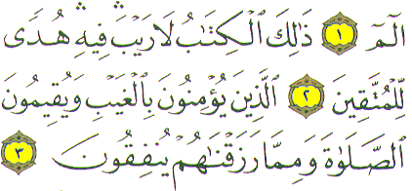
CHARACTERISTICS OF QURAN
-Belief in unseen or ghaib.
Its knowledge is definite and doubtless.

Slide 41

Eternal Knowledge
He is the First, the Last, the Most High and the Most near and He is the Knower of all things. Hadeed 57: 3

Slide 42

Comprehensive knowledge
Your God is only Allah, none has the right to be worshipped but He. He has full knowledge of all things. Taha 20:98

Slide 43

Protected Knowledge
Nay! This is a Glorious Quran, inscribed in the preserved tablet. Buruj 85: 22

Slide 44

Knowledge without contradictions.
Do they not then deliberate upon Quran? If it has been from other than Allah, they would surely have found therein many contradictions. Nisa 4:82

Slide 45

Quran is a Criterion to distinguish
Guidance and misguidance.
Iman & Kufr.
Islam & Jahiliyyah.
Acts which bring pleasure or displeasure of Allah.
Truth & falsehood.
Halal and Haram.
Tauhid and Shirk.

Slide 46
Quran recognizes the previous scriptures and protects their message.
Fundamentals of Deen are common.
Previous scriptures came for a limited time to a specific area and were altered.
Quran is the final and universal book.
We have sent down to you the Book confirming the scriptures before it and protector over these. Maida, 5:48.

Slide 47
The Rights Of Qur’an
Scholars say that to leave Qur’an is not to do any of these:
Believe in it
Read it
Understand it
Ponder its verses
Act upon it
Spread it
THE RIGHTS OF QUR’AN

Slide 48
Short Riview of Topic
  Introduction to Quran
  Quranic studies
  History of Quran
  uloom-ul-Quran
  Characterestics of Quran

Slide 49
Jwab dejie?
1.Introduce the Holy Quran?
2.The word Quran literally and technically means..................................?
3.What is the 1st and last reveal of Holy quran just recall the surah’s names?
4.Recall some Uloom ul quran?
5.Think about the numbers of the surah’s of Quran?
Notes:
Discuss as a class the idea that Arabian Polytheism is condemned as being sinful because it goes against Tawhid.

Slide 50


