Slide 1
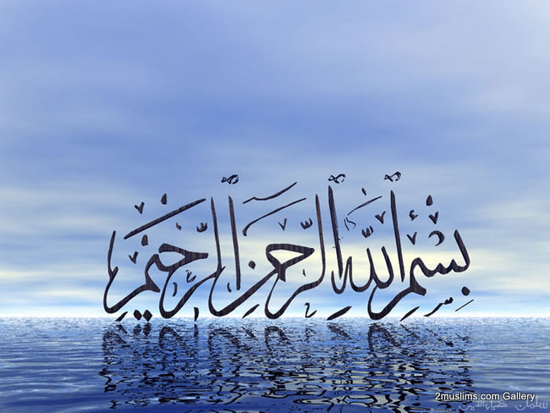

Slide 2
Islamic Studies course code 104
Associate Degree Education ADE/B.Ed(Hons)Elementary
Semester I

Slide 3

Lectuere#08

Slide 4
FIVE PILLARS OF ISLAM
5th Pillar Hajj-- Pilgrimage
By Muhammad Imran

Slide 5
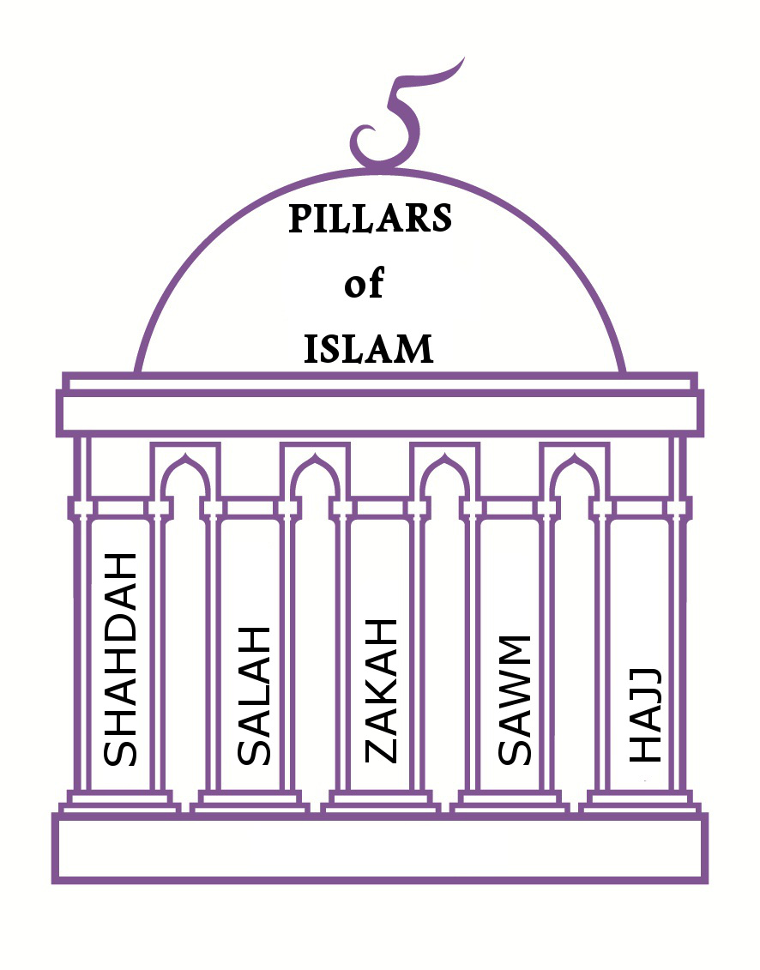

Slide 6
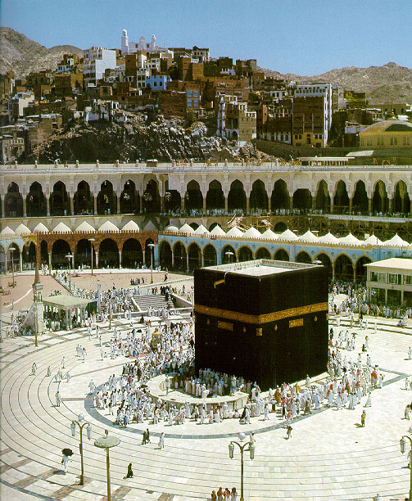
Pillars of Islam
Oneness of God and belief in the last prophet Muhammad PBUH
Prayer - five times a day/salat
Charity/Zakat
Fasting/sawm
Hajj (Pilgrimage)

Slide 7
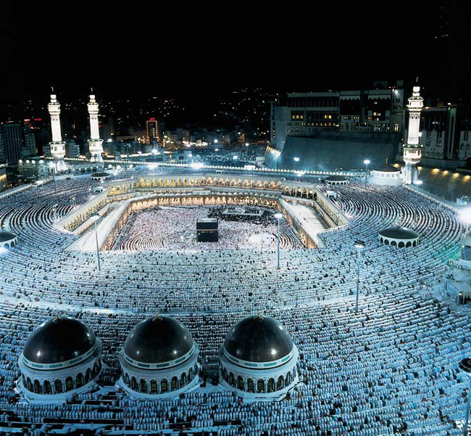
Hajj: PILGRIMAGE TO MECCA- 5th Pillar of Islam

Slide 8
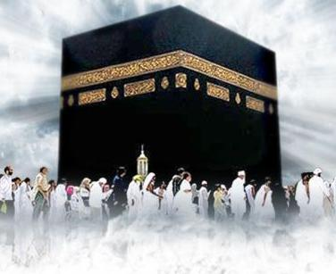
OUTLINES
  what is hajj?
  Significance of pilgrimage
  Quranic ayahs on hajj
  Ahadees on hajj
  Requirement for hajj
  Activities of hajj
  Attitude during th hajj
  Hajj at a galance
  Benefits of hajj
  Types of hajj
  Spiritual auspects of hajj

Slide 9
HAJJ (PILGRIMAGE)
DEFINITIONS:
الحج لغة: قصد الشيء المعظم وإتيانه
  Literally: "Hajj" means heading for an honorable person or place.
  وشرعا: قصد البيت الحرام والمشاعر العظام وإتيانها، في وقت مخصوص، على وجه مخصوص، وهوالصفة المعلومة في الشرع
  Legally: Hajj means worshipping Allah by performing the Hajj rituals, which are defined as specific acts performed at a specific time and place in a specific way.

Slide 10
What is Hajj?
Hajj is the fifth basic duty of Islam
Hajj is a visit to the Kabah in Makkah during the 12th Month of the Islamic calender – Dhul Hijjah
Hajj is an act of worship to please Allah
A Muslim tries to make pilgrimage at least once in a lifetime.

Slide 11
Significance of Pilgrimage
Hajj is the Fifth Pillar of Islam.
Hajj is performed in Mecca
Formally begins on the eighth day of the twelfth lunar month called the month of Zil-Hujj.
Islamic months are marked with the sighting of new moon and are called lunar months.
A religious ritual filled with Blessings for the millions annually,
It is compulsory upon every Muslim physically and financially capable of doing so to perform pilgrimage to Mecca in prescribed time
Provides Purification, Repentance & Spiritual Renewal
It instills Patience, Discipline, Quality and Unity

Slide 12
The Obligation of Hajj
إِنَّ أَوَّلَ بَيْتٍ وُضِعَ لِلنَّاسِ لَلَّذِي بِبَكَّةَ مُبَارَكًا وَهُدًى لِلْعَالَمِينَ
فِيهِ آيَاتٌ بَيِّنَاتٌ مَقَامُ إِبْرَاهِيمَ وَمَنْ دَخَلَهُ كَانَ آمِنًا وَلِلَّهِ عَلَى النَّاسِ حِجُّ الْبَيْتِ مَنِ اسْتَطَاعَ إِلَيْهِ سَبِيلًا وَمَنْ كَفَرَ فَإِنَّ اللَّهَ غَنِيٌّ عَنِ الْعَالَمِينَ
The first House (of worship) laid down for people is that at Bakka/Makkah: Full of blessing and of guidance for all worlds. In it are Manifest Signs; the Stand of Abraham; and he who enters it, he is secure. To Allah is a duty people owe; Pilgrimage to the House, on those who can afford the journey; but if any denies faith, Allah has no need from any of His creatures (3 / 96-97).

Slide 13

Ayat’s on Hajj-2
ِ
وَأَتِمُّوا الْحَجَّ وَالْعُمْرَةَ لِلَّه
And complete the Hajj and ‘Umra to (please) Allah.
(2/ 196)
“That, and he who glorifies Allah’s rituals, it is (a sign/part of) piety of the heart.”
Surat Al Hajj22:32

Slide 14
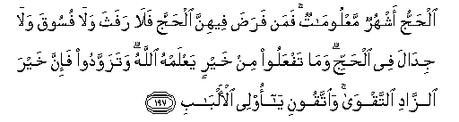
Ayat’s on Hajj-3
Hajj is (to be performed) during specific months. He who obliges to do the Hajj therein, Let there be no sexual (activity), nor disobedience, nor argumentation during the Hajj. And whatever good you do, Allah knows it. And take (your) provision for the journey, indeed, the best of provisions is piety. So fear Me, O’ you who have wise hearts (2:197)

Slide 15
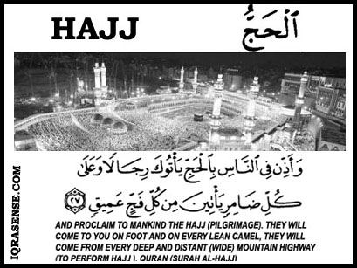
Ayat’s on Hajj-4

Slide 16
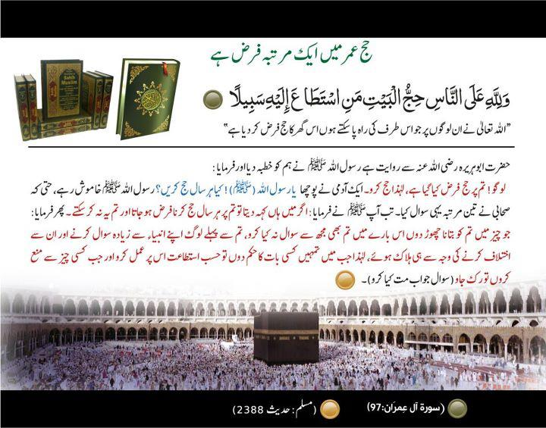
Ahadees on Hajj

Slide 17
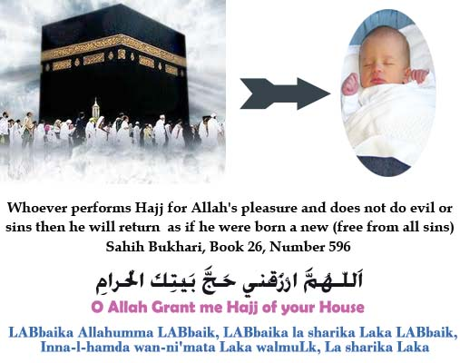

Slide 18
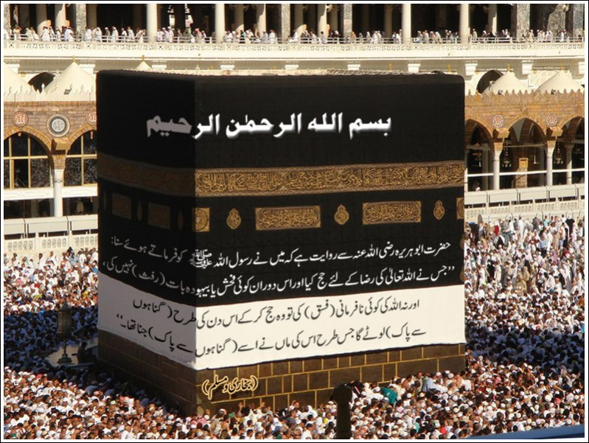

Slide 19
Requirements for Hajj Obligation
Islam
Maturation (age of puberty)
Reasoning and sanity
Freedom
Ability:
  Financially
  Physically

Slide 20
Attitude during Hajj
Halal and appropriate everything
Staying away from any sexual activity, any disobedience, argumentation, and all useless talk, let alone haram talk.
Humbleness and avoiding excessive ornaments
Volunteer additional ibadah and sacrifice as needed
To be pleased with difficulty, spending and sacrificing

Slide 21
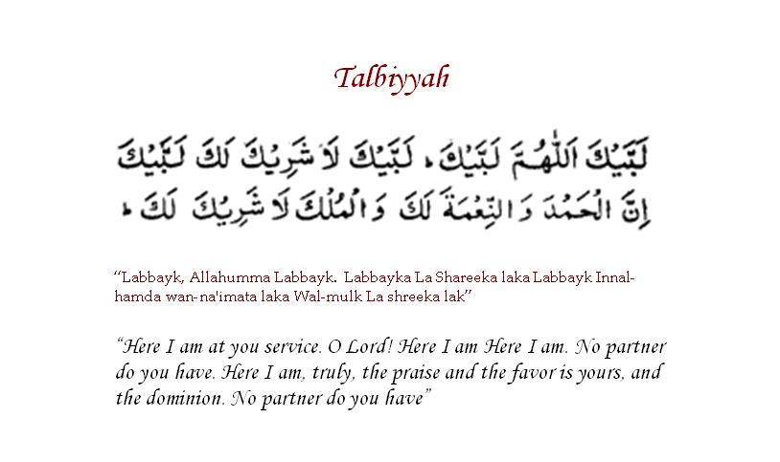

Slide 22
Activities of Hajj
Entrance into state of Ihram (self control)
Two pieces of unstitched white cloth for men
Stitched & Simple Clothing for women
Signifies equality of all before God
Stay in the state of Ihram for three days

Slide 23
Activities of Hajj --2
8 th day of ZIl Hujj travel to Mina for overnight camp.
9th day of Zil Hujj travel to Arafat to spend whole day in the open grounds
9th day of Zil Hujj leaves for Muzdallifa after evening prayer to spend night in the open grounds of Muzdalifa.
10th day of Zil Hujj come back to Mina and stone the Devils as symbol of rejection of evil deeds.
10th day of Zil Hujj sacrifice a sheep, cow or camel in remembrance of Abraham’s willingness to sacrifice his son.
11th and 12th zilahaj Rami jumraat.
TAWAF AL WIDA

Slide 24
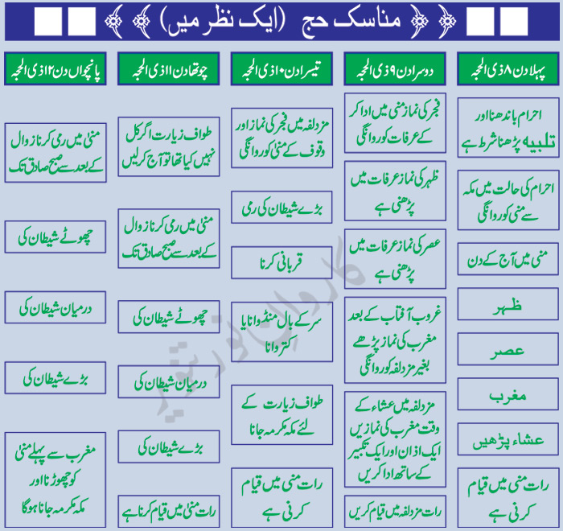

Slide 25
Hajj at a Glance
First Day:
Put on ihram again, and declare one’s intention of performing Hajj. Perform tawaf of the kabah and sa’y, if not performed earlier and leave for Mina early in the morning. Stay overnight in Mina. This day is known as the day of reflection.
Second Day:
Go to Arafat, stand here with devotion, until sunset, praying and asking God for forgiveness. This day is known as the day of forgiveness. In the evening move to Muzdalifah, rest there at night & collect small pebbles for stoning in Mina.
Third Day:
Go to Mina and throw small stones at the satan pillars. Offer sacrifice and have the hair shaved or trimmed. Go to Makkah perform tawaf then return to Mina. This day is known as the day of sacrifice.

Slide 26
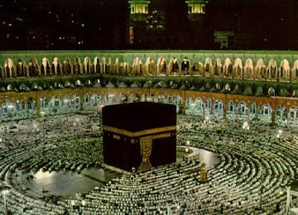
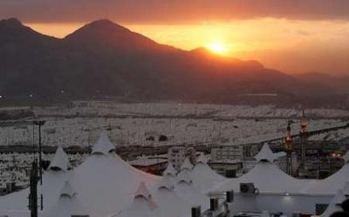
Fourth day:11 zilhaj
Stay in Mina and throw pebbles at Satan pillars. This day and the next two days are known as ‘the days of drying meat.’
Fifth day:12th zilhaj
Stay in Mina and throw pebbles at Satan pillars. Return the same day to Makkah and perform tawaf, then drink the water of Zamzam. This ends the Hajj.

Slide 27
Madinah
Visiting the Masjid of the Prophet is not required for the completion of Hajj but is highly recommended.

Slide 28
Visiting the grave of the Prophet
Lower your voice.
Say “assalamu alaika ya Rasoula Allah”
Acknowledge his service to his Ummah and his trustworthiness in conveying the message.
Pray to Allah to reward him highly for his dedication.
Move to the right, say salam to hazrat Abi Bakr(rz), acknowledge his role in support of Islam and of the Prophet and make Dua’ for him.
Move to the right and say the same for hazrat Umar(rz).

Slide 29
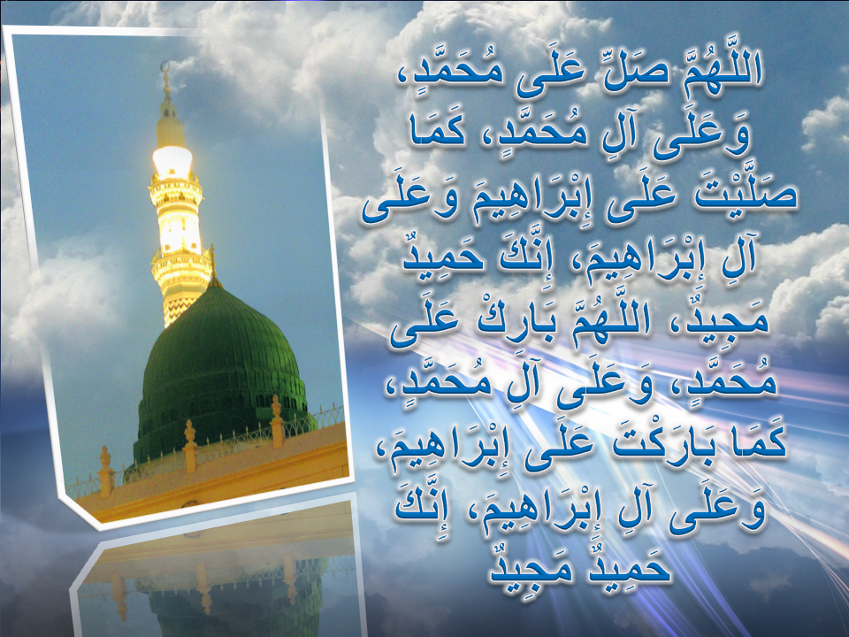

Slide 30
Benefits of Hajj
Completing Islam (the fifth pillar of Islam)
Leaving wealth and family for the pleasure of Allah
Patience, under all circumstances
Spending wealth earned from Halal means
Praising Allah a lot
It is a show of submission and servitude
Cooperation for goodness against evil
Knowing other Muslims from all over the world
Sharing with others (resources, knowledge, etc)
Total forgiveness for past sins

Slide 31
Spiritual Aspects of Hajj
Understanding of the essence of Ibadah: Khulus (sincerity, submission and devotion).
Longing for being in worship and in the presence of Allah
Determination to change your life style
Severing forbidden relations, associations and affiliations
Ending forbidden practices and traditions

Slide 32
Spiritual Aspects of Hajj-2
When purchasing Iharam, remember the shrouds
When leaving, remember departing this world
When at Arafah, remember the land and time of resurrection
When leaving Arafah, remember the al Hashr (people driven to their reckoning)

Slide 33
Short Riview of Topic
  what is hajj?
  Significance of pilgrimage
  Quranic ayahs on hajj
  Ahadees on hajj
  Requirement for hajj
  Activities of hajj
  Attitude during th hajj
  Hajj at a galance
  Benefits of hajj
  Types of hajj
  Spiritual auspects of hajj

Slide 34
Jwab dejie?
1.What is Hajj or pilgrimage?
2.The word Hajj means..................................?
3.Learn any one ayat of hadees about Hajj?
4.Recall some benefits of Hajj?
5.What is Talbiah?
6.What is Ahram ?
Notes:
Discuss as a class the idea that Arabian Polytheism is condemned as being sinful because it goes against Tawhid.

Slide 35
