Slide 1


Slide 2
Islamic Studies course code 104
Associate Degree Education ADE/B.Ed(Hons)Elementary
Semester I

Slide 3

Lectuere#07

Slide 4
FIVE PILLARS OF ISLAM
4th Pillar Zakat
By Muhammad Imran

Slide 5
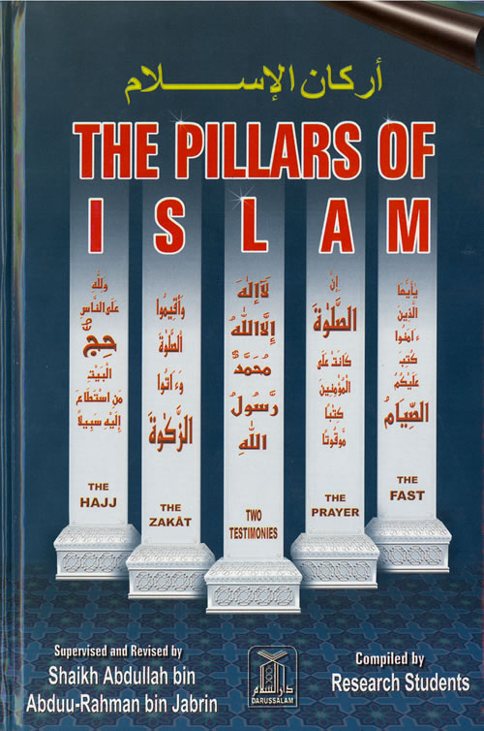

Slide 6

Almsgiving
  The Arabic word for this pillar is: “Zakat”

Slide 7
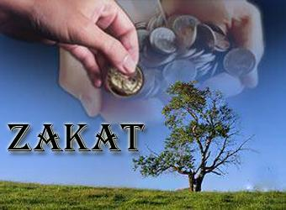
OUTLINES
  what is zakat
  Zakat meanings and explanation
  Quranic ayahs on Zakat
  Ahadees on Zakat
  Some objective of paying Zakat
  Why should a muslim pay Zakat?
  Who should give Zakat?
  Rate of Zakat?
  Nisabe Zakat
  Distribution of Zakat
  It is unlawful to pay Zakat?

Slide 8
What is “Zakat”?
Zakat, or almsgiving, is considered to be expression of devotion to God for Muslims. It represents the attempt to provide food and give financial support to the poorer individuals of society, and it offers a means for a Muslim to purify his or her wealth and acheive salvation in return.

Slide 9
MEANING
Of the 5 fundamentals of Islam, Zakat occupies the fourth position.
This word is derived from the verb “Zaka”, which means “it (a plant)grew”.
The second derivative of this word carries the sense of purification, example
“Qad aflaha man zakkaha”
(he is indeed successful who purifies himself).

Slide 10
Explanation
A major pillar on which the strcture of Islam stands is Zakat which can be defined as that portion of man’s wealth which is designed for the poor.
The Holy prophet(p.b.u.h)himself described:It(zakat) should be collected from the well-to-do and distributed to the poor.
Zakat was defined at Madina in the second year of Hijrat.

Slide 11
Importance of Zakat
After Salah, comes Zakah, which in its broadest sense includes any act of service to other men.
The two commandments to keep up prayer and go give Zakat are often mentioned 82 times in the Holy quran.
‘Man’, said the Prophet, ‘says: My wealth! My wealth!’ have you not any wealth except that which you wear and tear, eat and consume, give as alms and thus preserve?

Slide 12
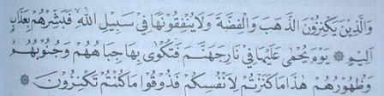
Ayahs on Zakat
Those who lay up treasures of gold and silver and spend them not in the way of God; give them the news of a painful punishment, on the Day when that (wealth) will be heated in hellfire, and their foreheads and their sides and their backs branded therewith: “This is the treasure which you laid up for yourselves! Taste, then, your hoarded treasure!”

Slide 13
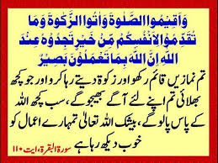

Slide 14
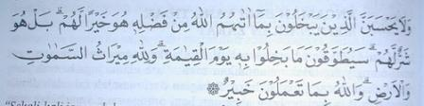
Ayahs on Zakat
Let not those who are miserly with what God has given them of His bounty think that this is good for them. Rather, it is bad for them. That which they withhold shall be hung around their necks on the Day of Arising. [3:180]

Slide 15
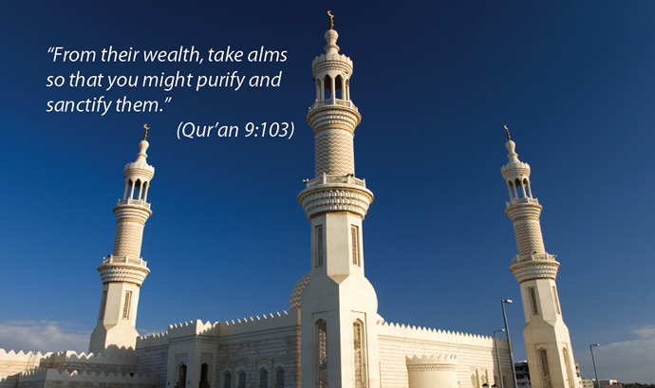
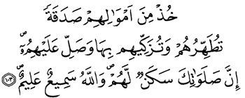

Slide 16
Ahadees on

Slide 17
AHAADIS ON ZAKAT
Bukhari and Muslim relate on the authority of Ibn ‘Abbas’ that the messenger of God (sallallahu alayhi wa salam) sent Mu’aaz to the Yemen he told him, “ You are going to a people who have a Scripture, so call them to testify that there is no deity but God, and that I am the Messenger of God. If they respond to this, then teach them that God has imposed five Salats upon them in everyday. If they respond to this, then teach them that God has imposed upon them a charity to be taken from the wealthy amongst them and given to their poor. If they respond to this, then beware of taking any more of their wealth! Beware also of the prayer of the oppressed, for there is no veil between such a prayer and God.”

Slide 18
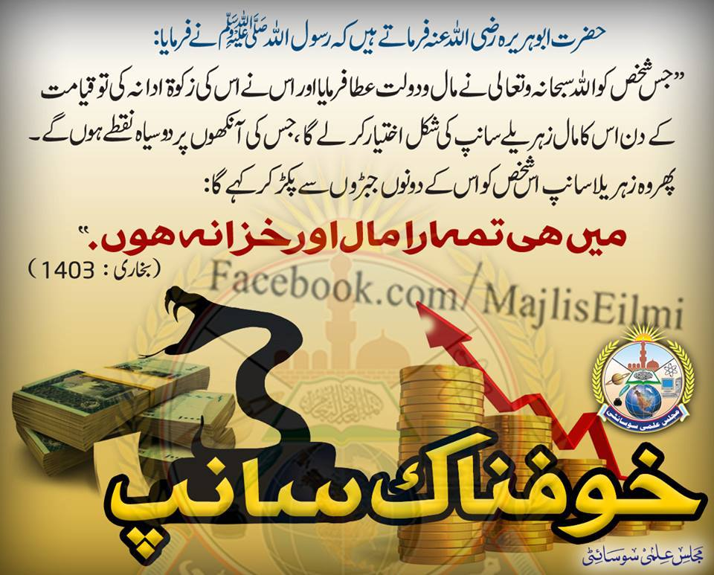
AHAADIS ON ZAKAT---2
Bukhari relates on the authority of Abu Hurayra that the Prophet (sallallahu alayhi wa sallam) said, “ whoever is given wealth by God and does not pay zakat due there upon shall find that on the Day of Arising it is made to appear to him as a hairless snake with two black specks, which chains him, and then seizes him by his jaw and says, “I am your wealth! I am your Treasure!” “Then he recited the verse, ‘Let not those who are miserly with what God has given them of His bounty think that this is good for them. Rather, it is bad for them. That which they withhold shall be hung around their necks on the Day of Arising.’ [3:180]

Slide 19
AHAADIS ON ZAKAT---3
The Prophet (pbuh) said: “Any owner of gold and silver who does not deliver from them their right, on the Day of Quiyamah, will be shaped as foils of fire. Then it will be heated in the fire of Hell; then with it he will be ironed on his side, his forehead, and his back” (narrated by Muslim)

Slide 20
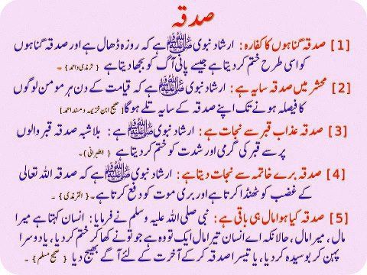

Slide 21
Some Objetives of paying Zakat
Zakat is wealth taken from the rich and given to the poor.
It makes wealth grow because the giving away of wealth is a sourse of purification.
It purifies the giver’s heart from greed and selfishness.
Zakat benefits for humanity.
A muslim performs his duty and discharges his obligation toward poor muslmis.

Slide 22
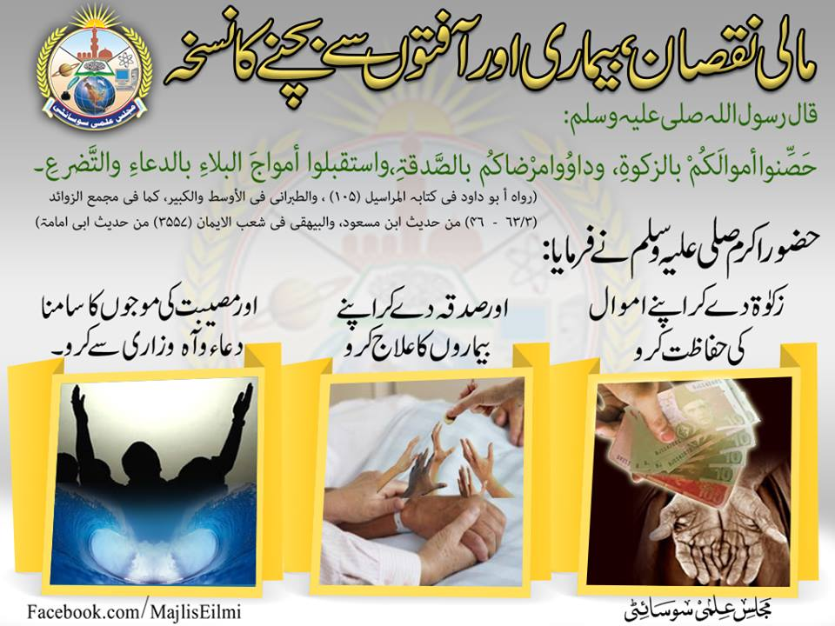
Protect your wealth by paying Zakat

Slide 23
Why should a muslim pay Zakat?
Spending the wealth for the sake of Allah purifies the heart of man of the love of material wealth.
The man who spends offers that as a humble gift before the Allah and thus affirms the truth that nothing is dearer to him in life than the love of Allah and that he is fully prepared to sacrifice everything for His sake.
There is no burden of obligation on one who receives Zakat, but sense of thankfulness and gratitude on the part of the giver.

Slide 24
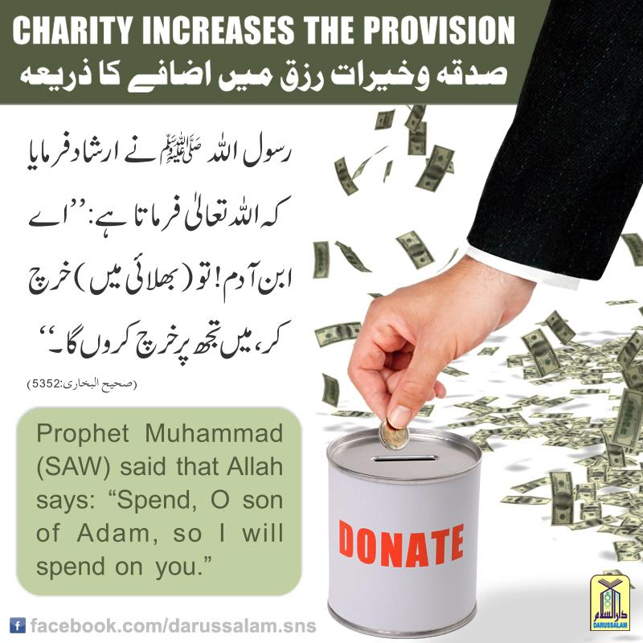

Slide 25
Who Should Give Zakat?
The obligation of Zakat is mandatory on every Muslim who possesses the minimum Nisaab, whether the person is man, woman, young, old.
Zakat is obligatory for a person who satisfies the following conditions:
He is muslim.

Slide 26
Who Should Give Zakat?2
He is a free person
He is the owner of nisab,the minimum required capital free from all needs of the person.
One full year has passed since he came to exclusively possesses the above mentioned capital

Slide 27
Zakat purifies the wealth
Allah (SWT) stated that:
"Of their goods take alms so that thou mightiest purify and sanctify them...“
(Al-Qur'an, 9: 103)

Slide 29
Nisab( the rate of Zakat)
The payment of Zakat is compulsory on every adult,free muslim who own property to the extent of the prescribed rate called Nisab.
Provided such property has remained in his ownership and possession uninterruptedly for full one year.
Zakat is payable on cash,gold and silver,jewellery,crops,animals,agricultural lands and all kinds of commercial goods.

Slide 30
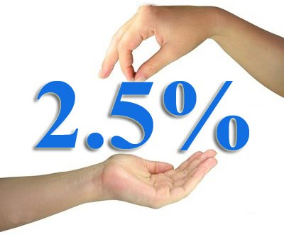
Rate of Zakat
On cash,gold and silver:Zakat is paid at a rate of 2.5%.
A person who possesses52 ½ toals of silver or 7 ½ of gold is liable to pay Zakat.
Produce from Mines:owner of the mines have to pay one.fifth of the produce of mines.This is called Khums.

Slide 31
Rate of Zakat----2
Land tax:The basis of this compulsory tax on the produce of agricultural lands called Ushr is to be be found in the Quran.
On sheeps and Goats:For every forty sheep or goats—one goat.
Bulls,cows,and Buffaloes:On the thirty to forty cattle one calf بچھڑا of one year.
On camels:On every five camels one goat or sheep.

Slide 32
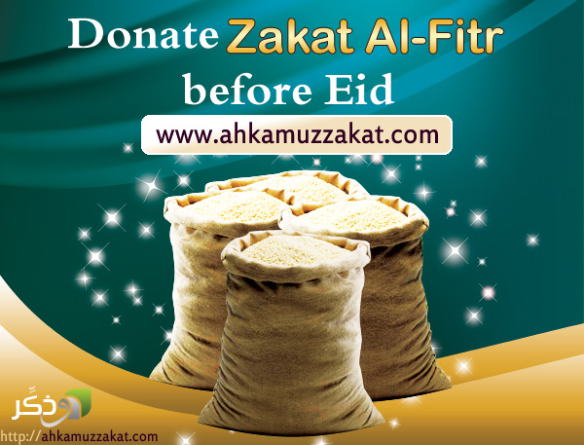
Sadaqah—tul-Fitr
Sadaqah—tul-Fitr:This obligatory charity is an act of worship on the completion of the month of Ramzan.It is obligatroy on al muslims on whom Zakat is compulsory.

Slide 33

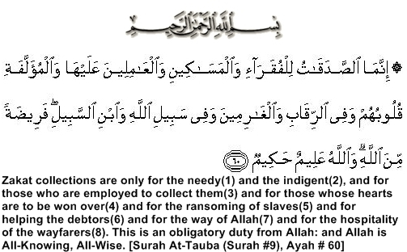
Distribution of Zakat

Slide 34
It is Unlawful to give Zakat to?
It is unlawful to give Zakat to the descendants of the Holy prophet(pbuh)خاندانِ رسالت مآب یعنی سادات کرام.
To one’s parents or to one’s children.
It cannot be given to non-muslims
Neither can it be given to a person as remuneration معاوضہ for services.

Slide 35
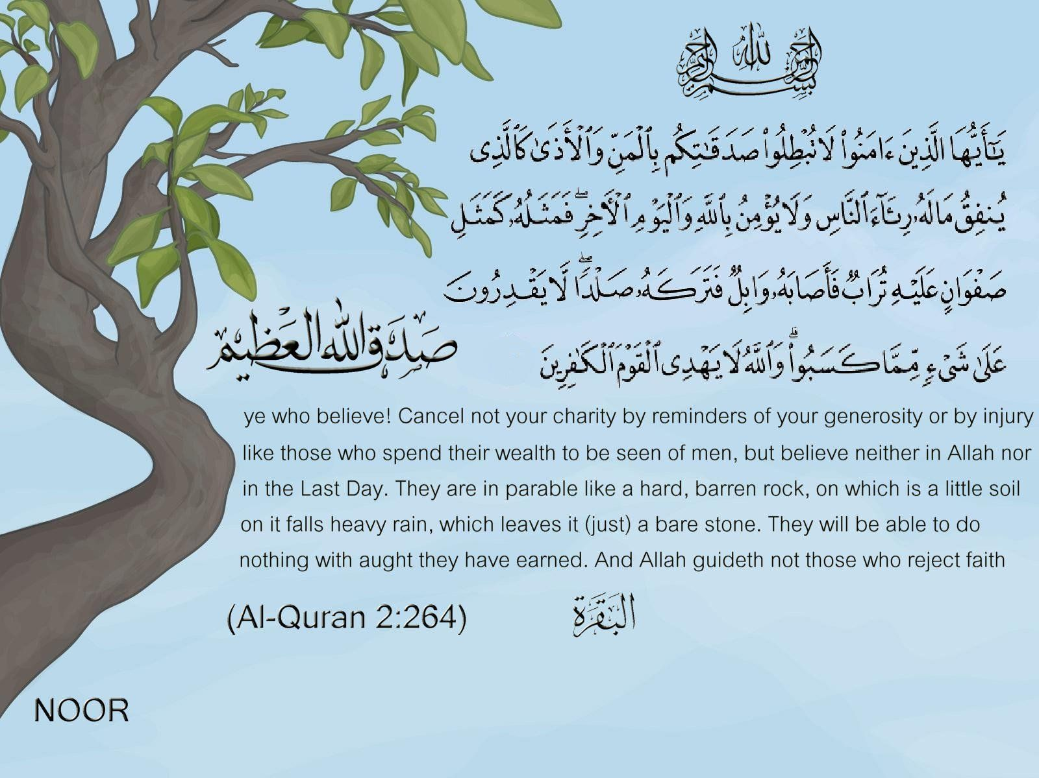
Don’t cancel your charity by reminders

Slide 36
Kya samjhe.....?ACTIVITY
1.Explain what is zakat?
2.The word Zakat means..................................?
3.Learn any one ayat of hadees about Zakat?
4.What is our beleif about giving Zakat?
5.What is Nisab?
6.Introduce the quranic distribution of Zakat ?
Notes:
Discuss as a class the idea that Arabian Polytheism is condemned as being sinful because it goes against Tawhid.

Slide 37
Short review of topic
  what is zakat
  Zakat meanings and explanation
  Quranic ayahs on Zakat
  Ahadees on Zakat
  Some objective of paying Zakat
  Why should a muslim pay Zakat?
  Who should give Zakat?
  Rate of Zakat?
  Nisabe Zakat
  Distribution of Zakat
  It is unlawful to pay Zakat?

Slide 38
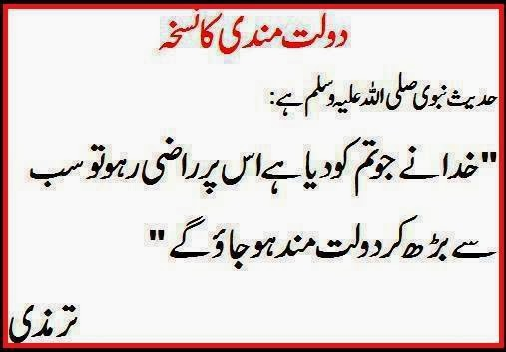

Slide 39
