Slide 1
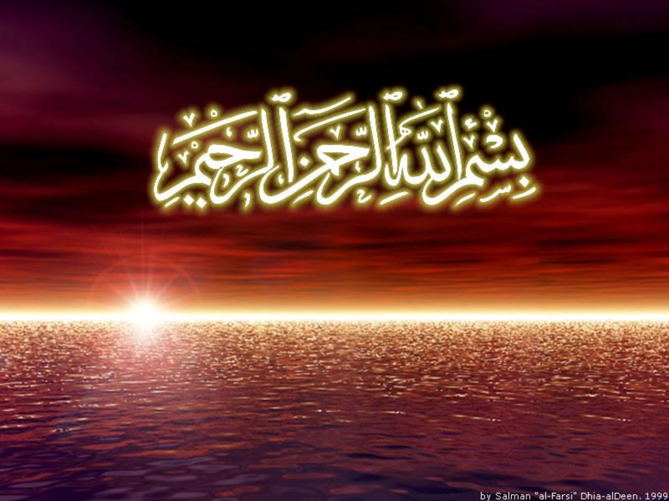

Slide 2
Islamic Studies course code 104
Associate Degree Education ADE/B.Ed(Hons)Elementary
Semester I

Slide 3

Lectuere#06

Slide 4
3. Sawm
The Pillars
of Islam
By Muhammad Imran

Slide 5
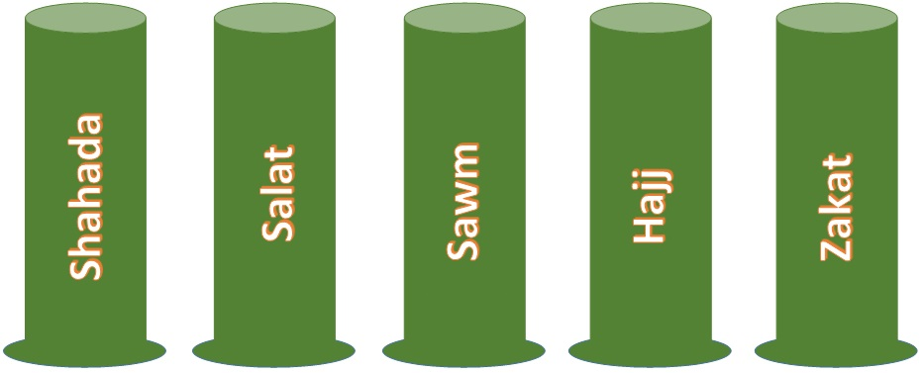
FIVE PILLARS OF ISLAM

Slide 6
OUTLINES
The Five Pillars:
  See esp. Qur’an 2:142-152, 183-203, 261-281
  Shahada – Declaration of Faith
  Salat – Ritual Prayer or Worship
  Zakat – Giving alms to the poor
  Sawm – Fasting during Ramadan
  Hajj – Pilgrimage to Makka
  Sawm the tird Piller of Islam
  Introduction and importance
  Why they are obligatory to every healthy muslim
  Dignity of month of Ramzan
  Ahkam o masael sawm
  Masnoon duaen and etc

Slide 7
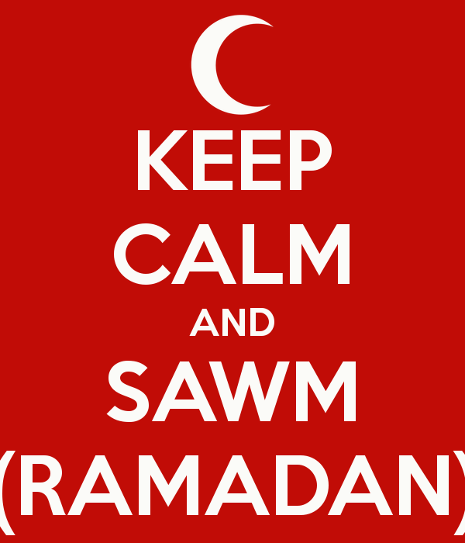

Slide 8
Introduction.
Food is an important part of every humans’ existence.
Without it we would die.
However, for several reasons people deny themselves food, and sometimes water too:

Slide 9
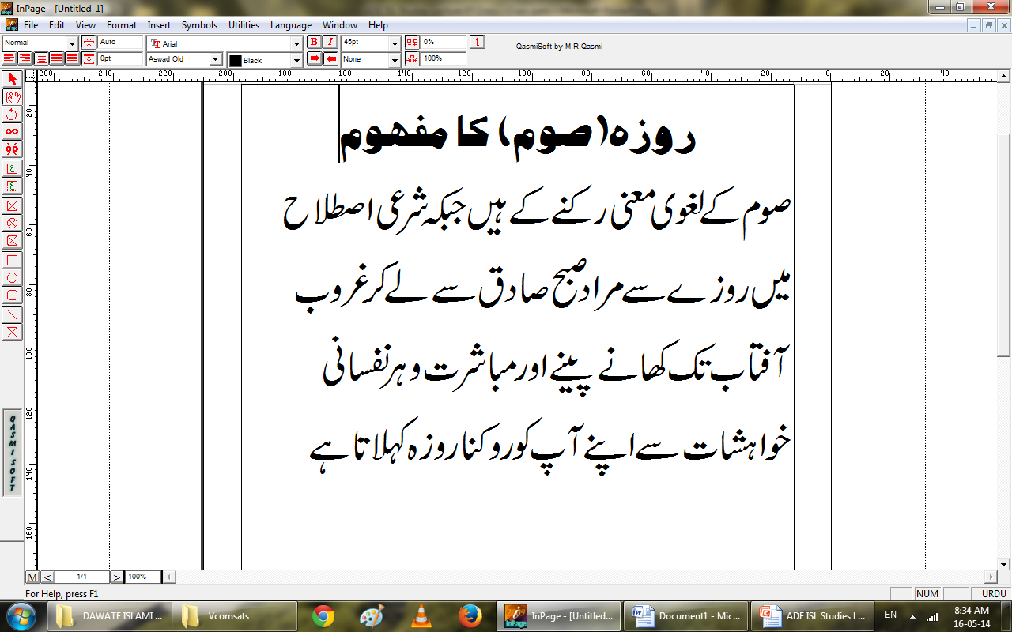

Slide 10
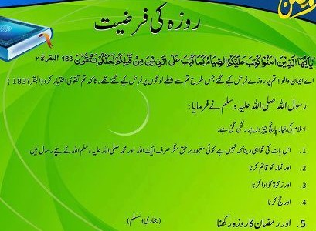

Slide 11
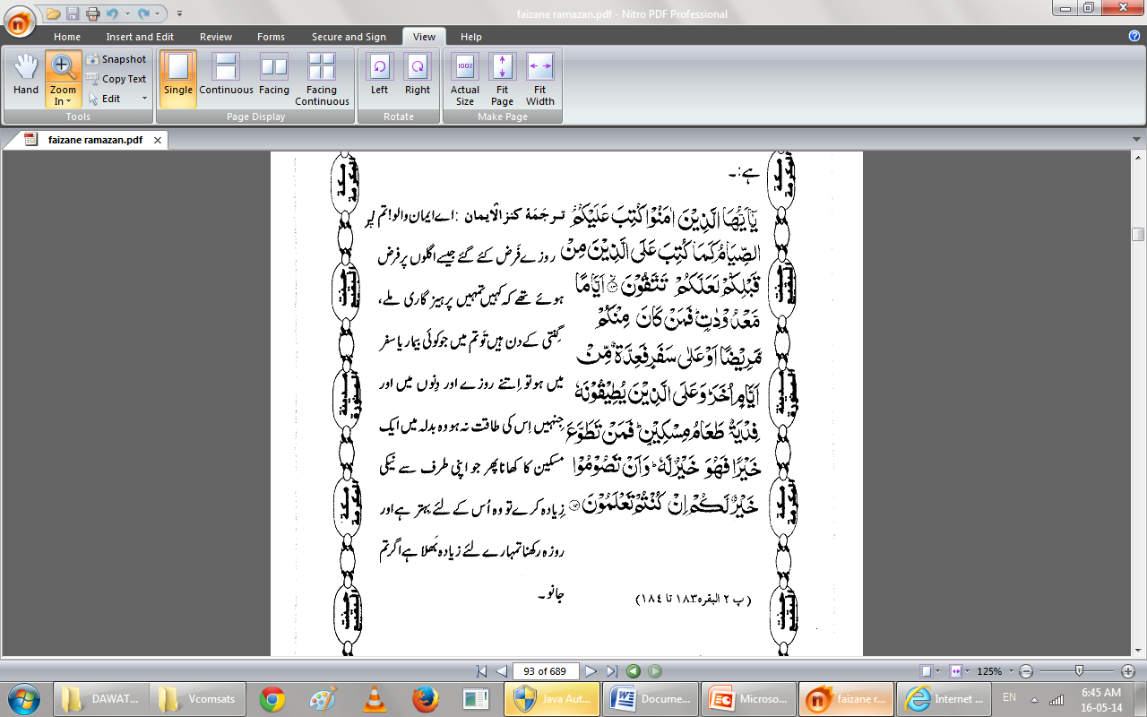

Slide 12
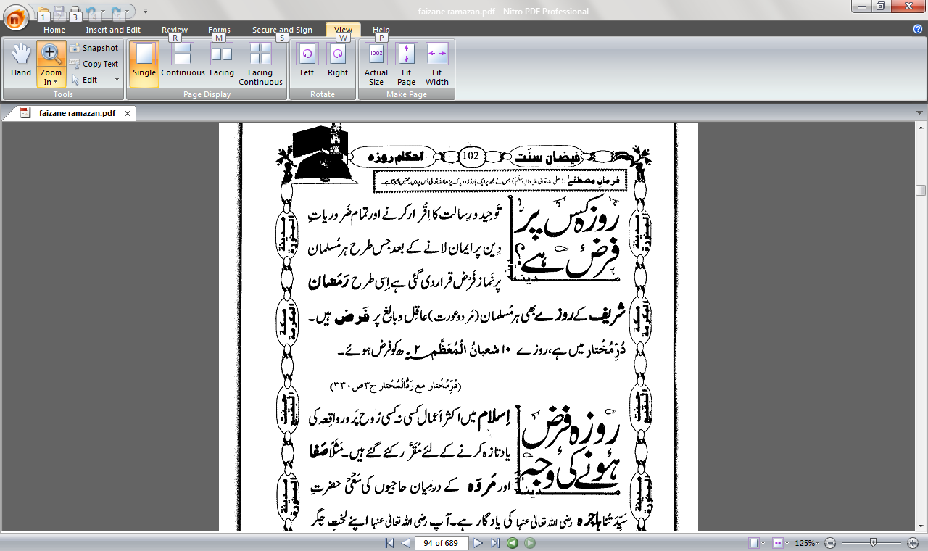

Slide 13
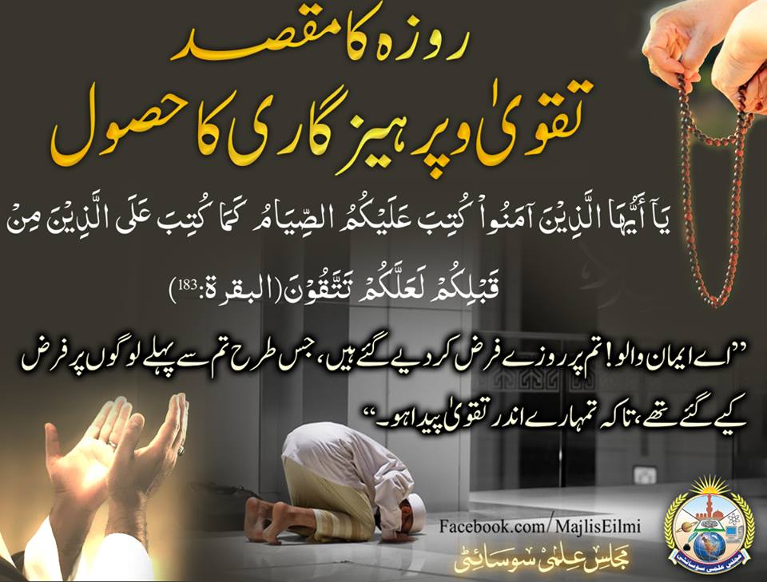

Slide 14
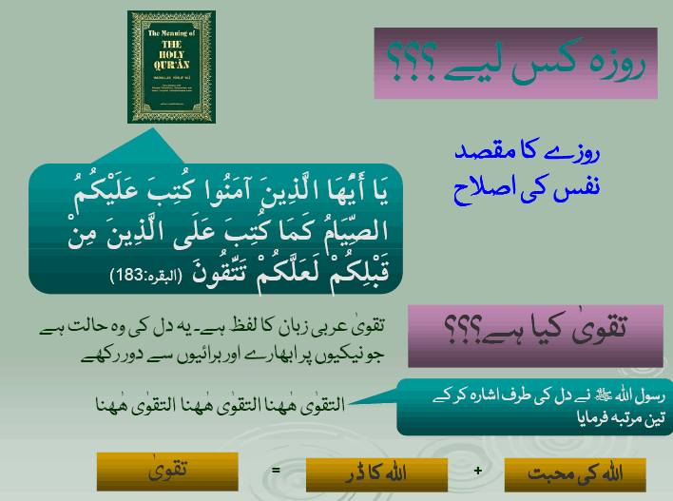

Slide 15
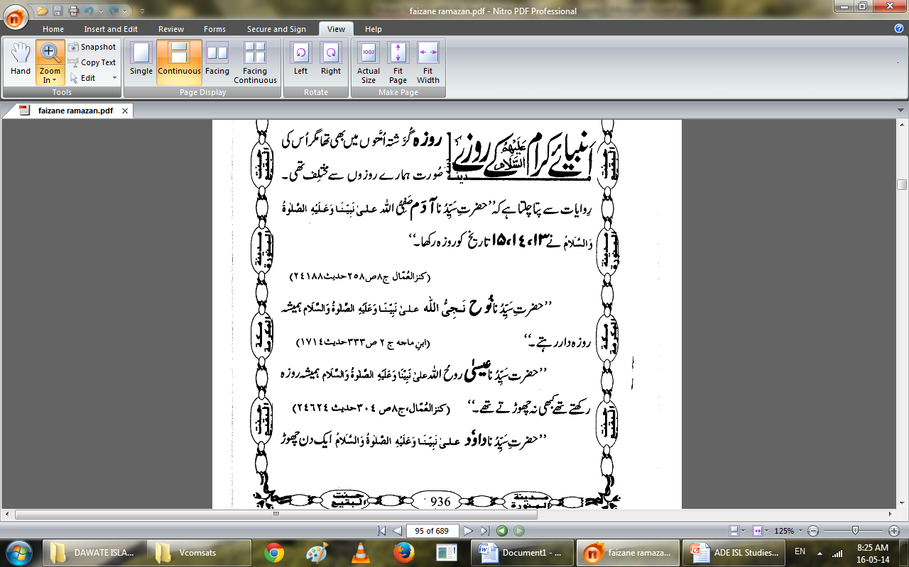

Slide 16
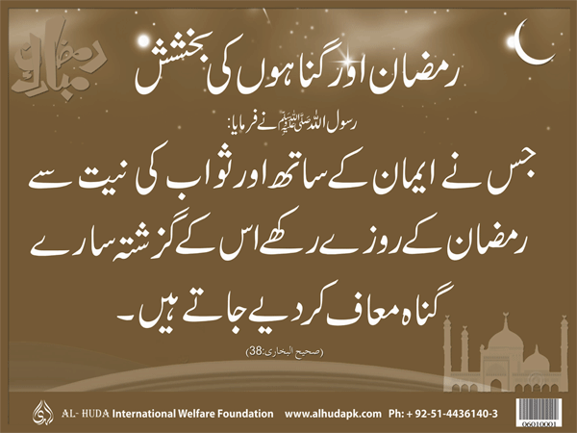

Slide 17
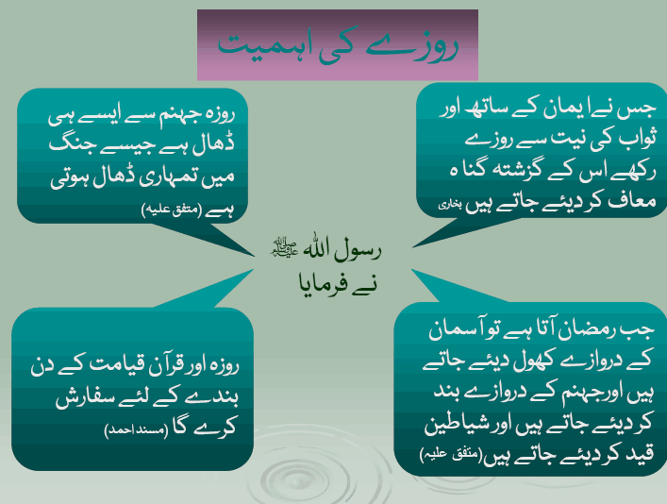

Slide 18
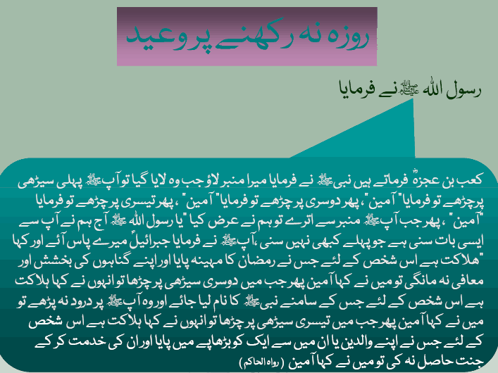

Slide 19
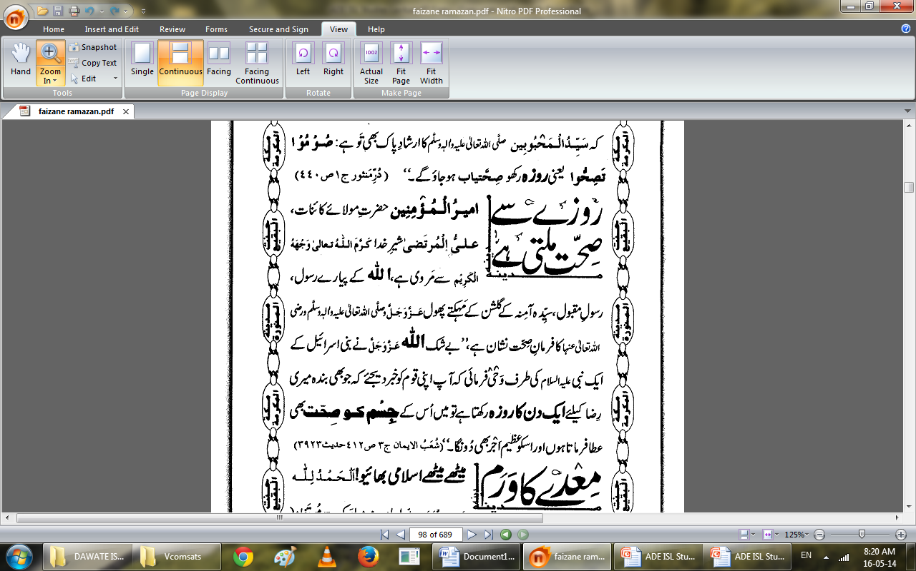

Slide 20
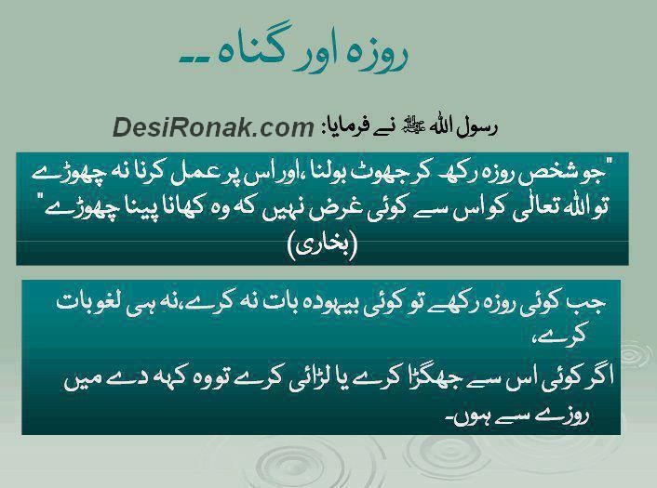

Slide 21
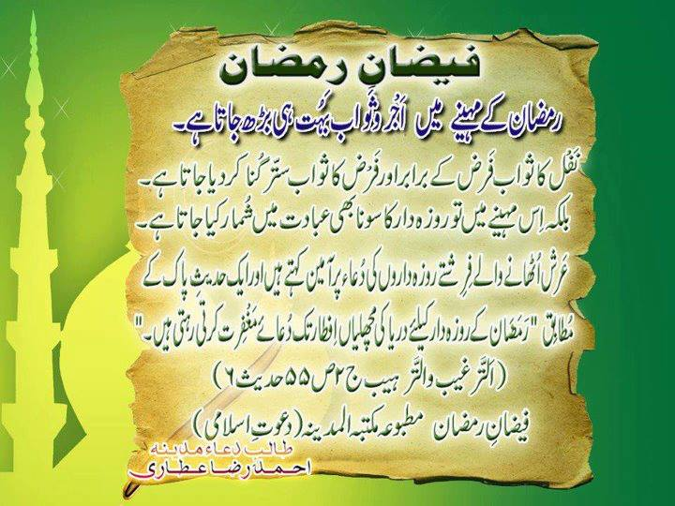

Slide 22
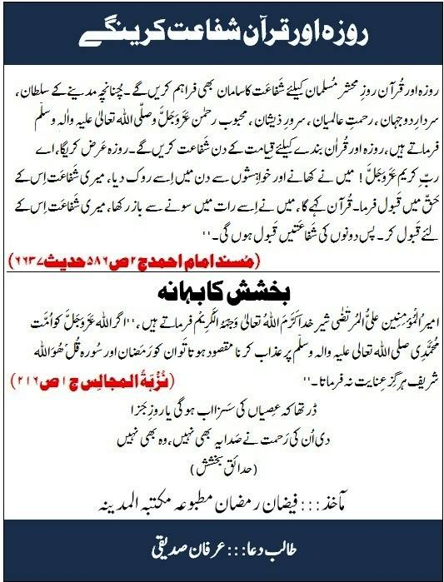

Slide 23
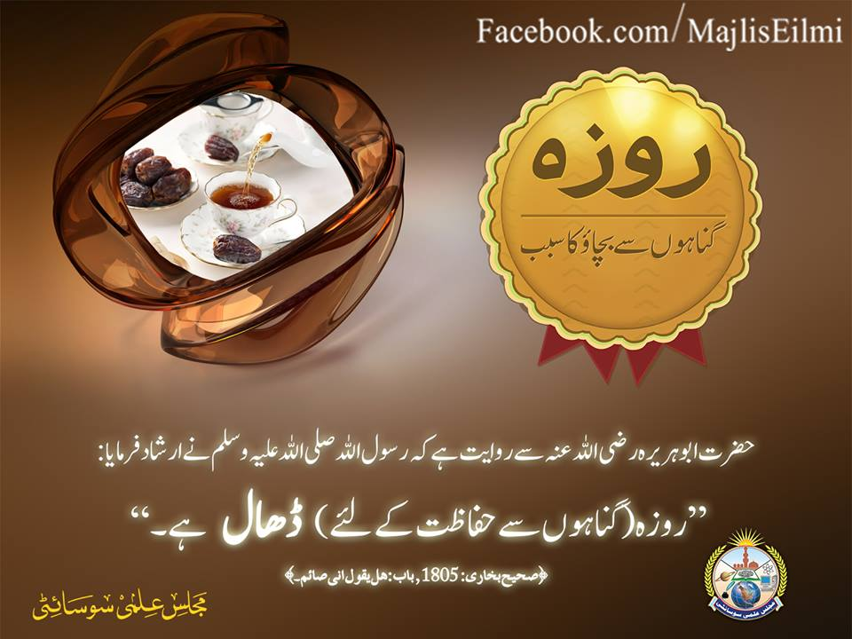

Slide 24
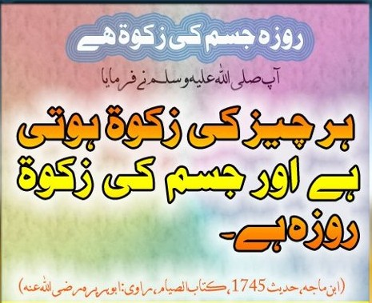

Slide 25
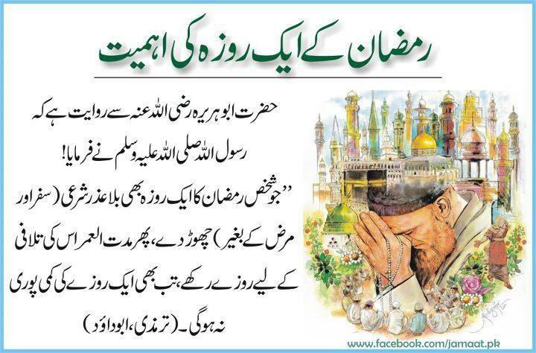

Slide 26
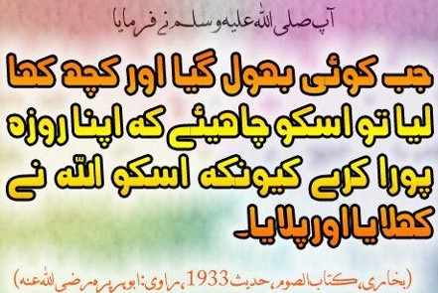

Slide 27
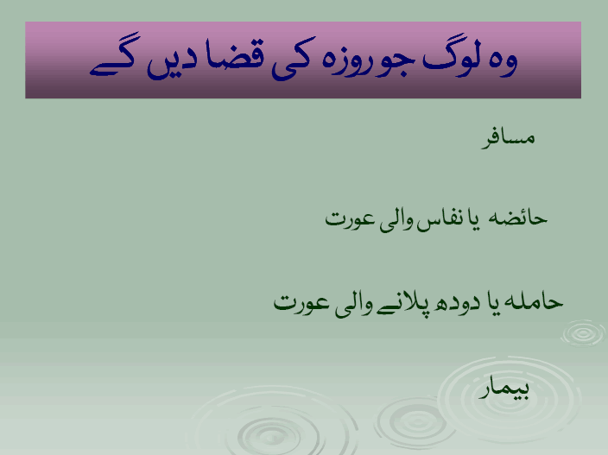

Slide 28
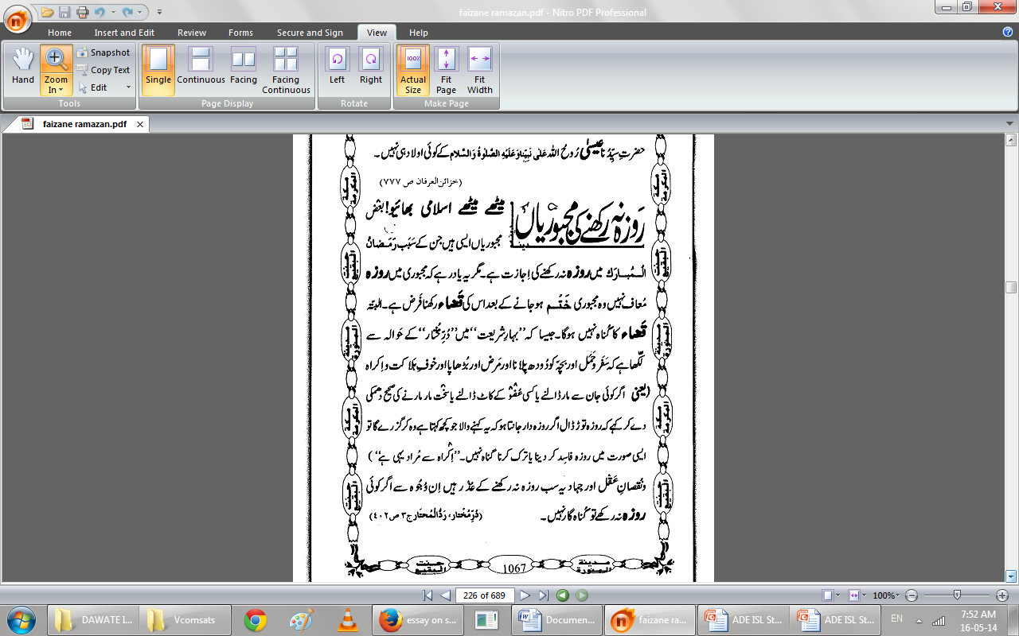

Slide 29
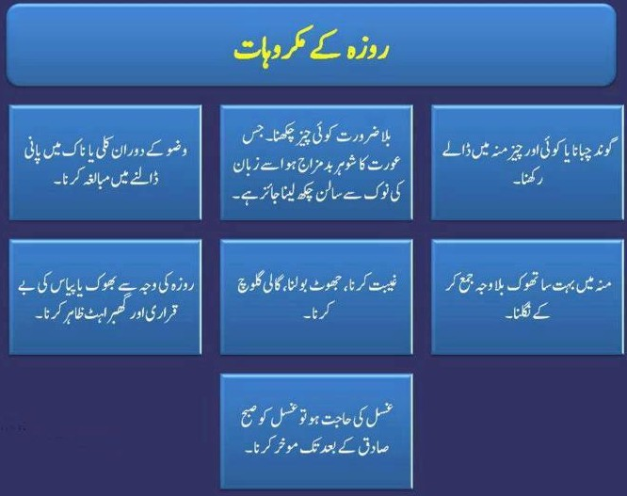

Slide 30
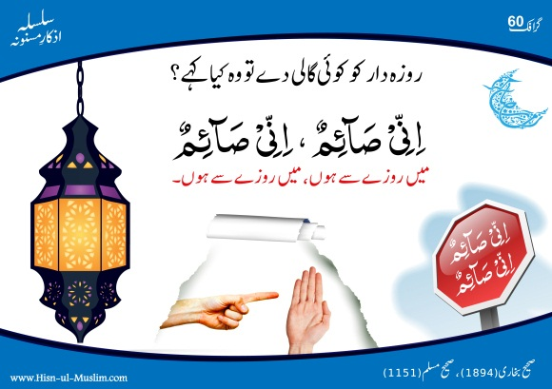

Slide 31
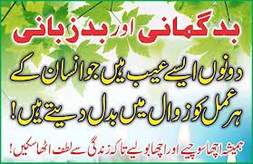

Slide 32
SUMMARY
The Five Pillars:
  See esp. Qur’an 2:142-152, 183-203, 261-281
  Shahada – Declaration of Faith
  Salat – Ritual Prayer or Worship
  Zakat – Giving alms to the poor
  Sawm – Fasting during Ramadan
  Hajj – Pilgrimage to Makka
  Sawm the tird Piller of Islam
  Introduction and importance
  Why they are obligatory to every healthy muslim
  Dignity of month of Ramzan
  Ahkam o masael sawm
  Masnoon duaen and etc

Slide 33
ZRA SOCHIYE.....?ACTIVITY
1.Discuss about the pillers of Islam?
2sawm means..................................?
3.Learn dua’s in your daily life mention in the slides?
4.What is sawm objectives?
5.Discus the dignityof month of Ramzan?
6.Reming some important ahkam o masael e sawm?
Notes:
Discuss as a class the idea that Arabian Polytheism is condemned as being sinful because it goes against Tawhid.

Slide 34
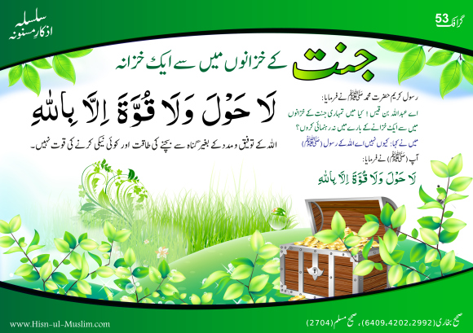

Slide 35

Jazak Allah

