Slide 1
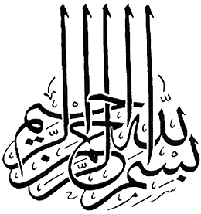

Slide 2
Islamic Studies course code 104
Associate Degree Education ADE/B.Ed(Hons)Elementary
Semester I

Slide 3
Fundamental Beliefs of Islam
By Muhammad Imran

Slide 4

Lectuere#04

Slide 5
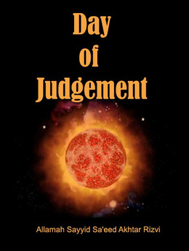

Slide 6
OUT LINES
Fifth belief in the Day of judgment
Introduction to this Faith
How its effect on human life
Signs of the Day of judgment
Stages to enter the Next world
Happening of Qyama
Stages of youm-e Hashar
Nabvi Duas for escapes&etc

Slide 7
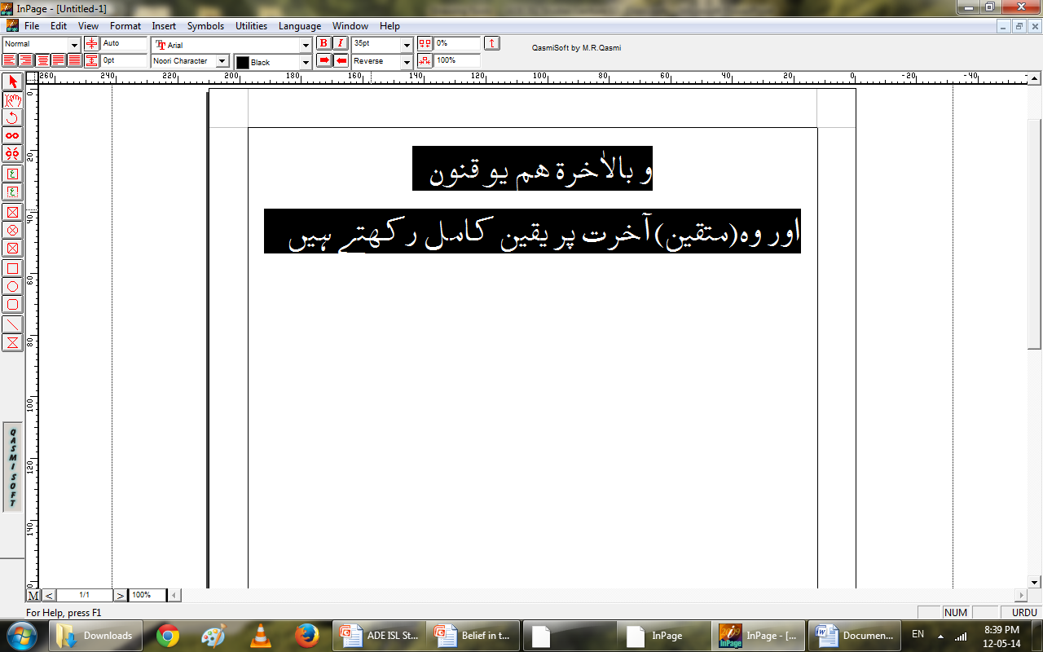
introduction
Belief in the Day of Judgment is one of the most important article of faith of a Muslim.
Allah say in Holy quran about those who have faith in Islam that among other beliefs they have faith in the belief of Akhirah.

Slide 8
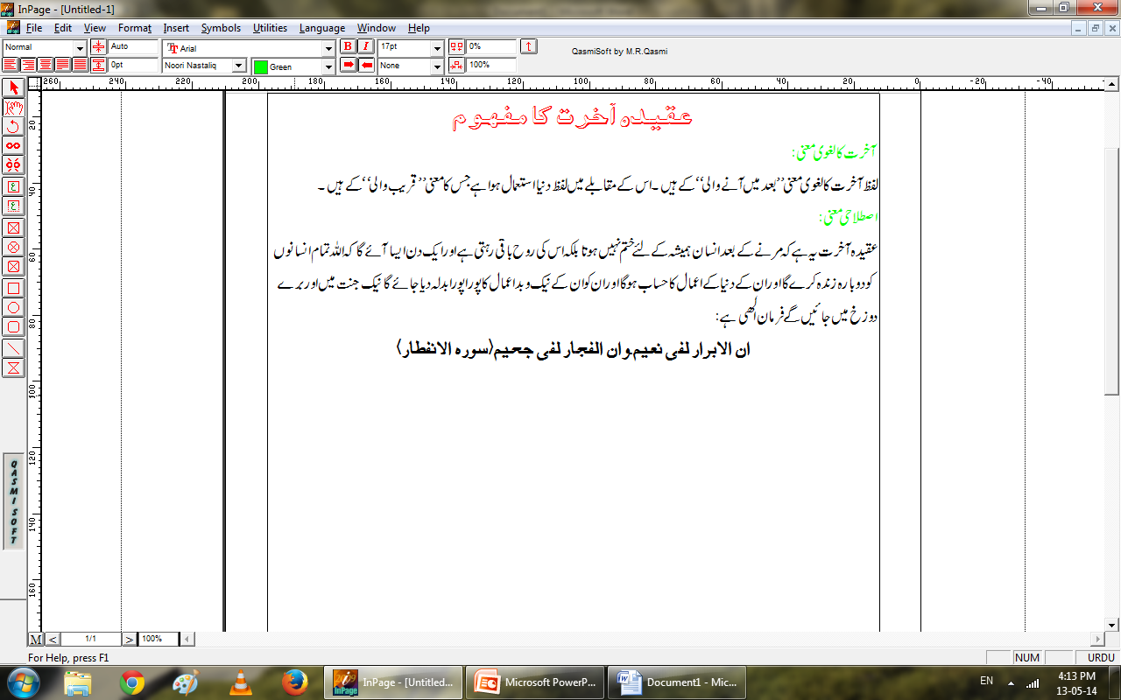
Faith about the Day of judgment

Slide 9
Signs of the Day of Judgment
Although the time of the Day of judgment is not known to any body except Allah,however our Holy prophet(p.b.u.h)has indicated a number of signs that indicate that he Last Day is approachings.some of these signs are:

Slide 10
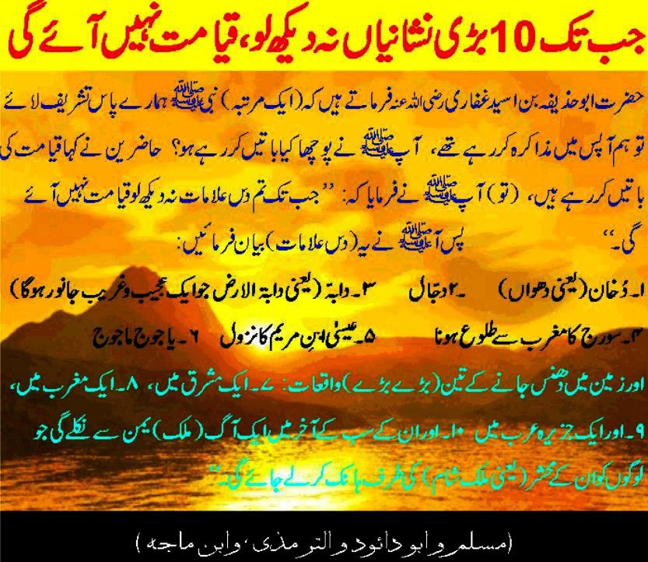

Slide 11
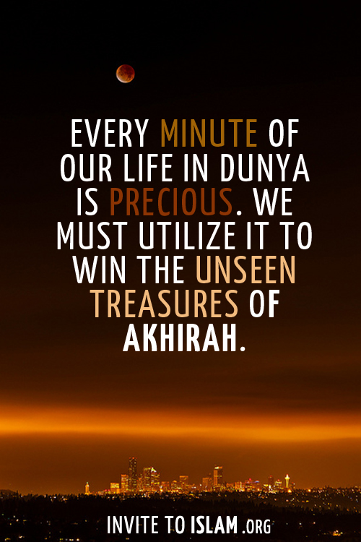

Slide 12
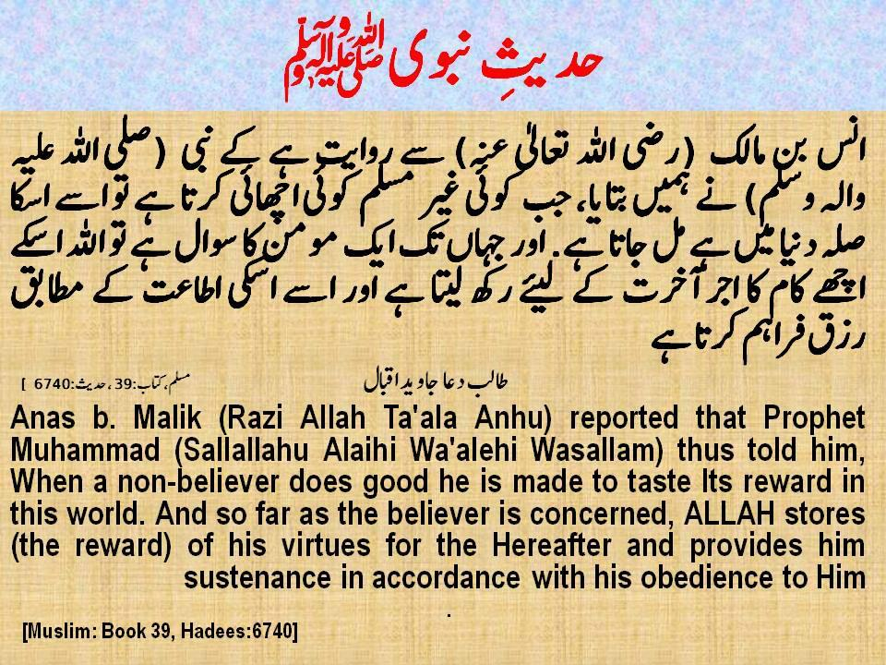

Slide 13
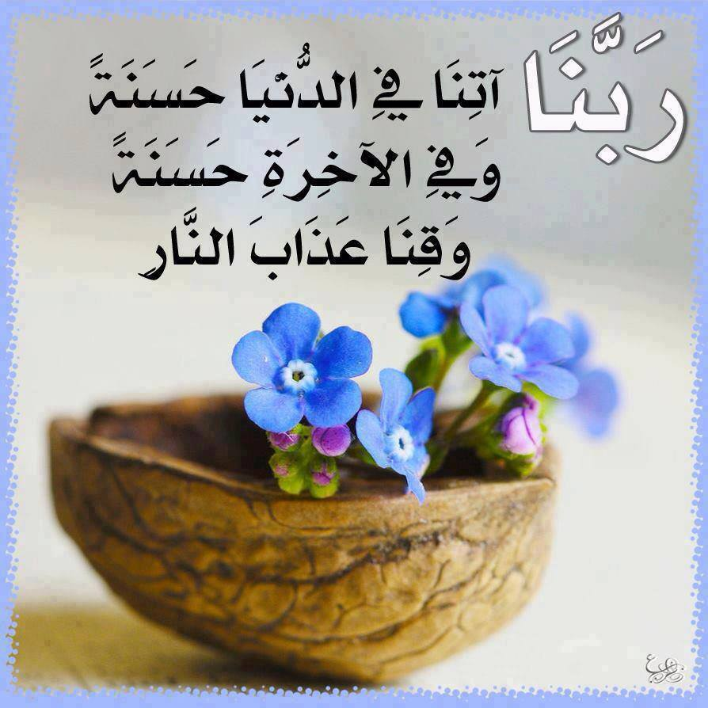

Slide 14
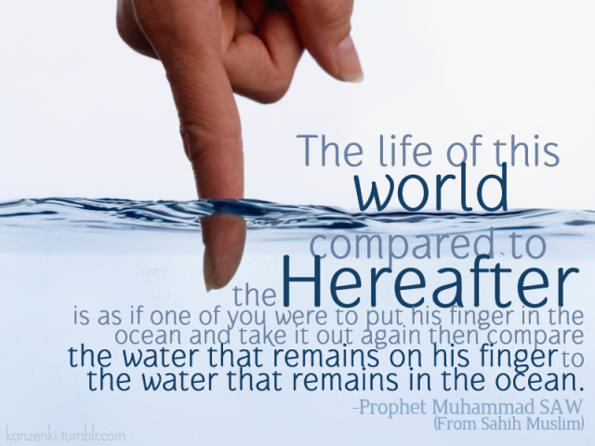
=

Slide 15
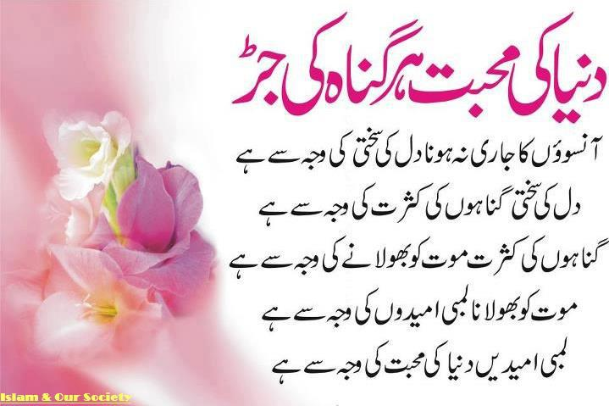

Slide 16
How does Faith in the Akhira effect Human life
Man develops hatred for evil
Bravery and Heroism
Patience and Perserverance
Infaq fi sabeel Allah
Sense of Responsibility
Sense of Sacrifice
Ikhlas and Honesty in Ibadah.

Slide 17
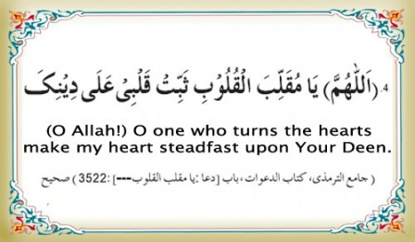

Slide 18
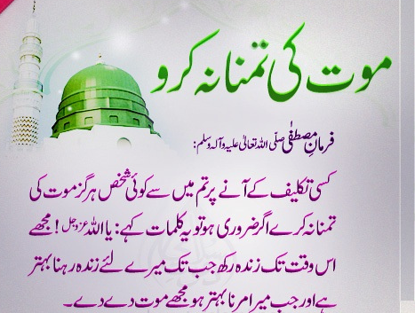

Slide 19
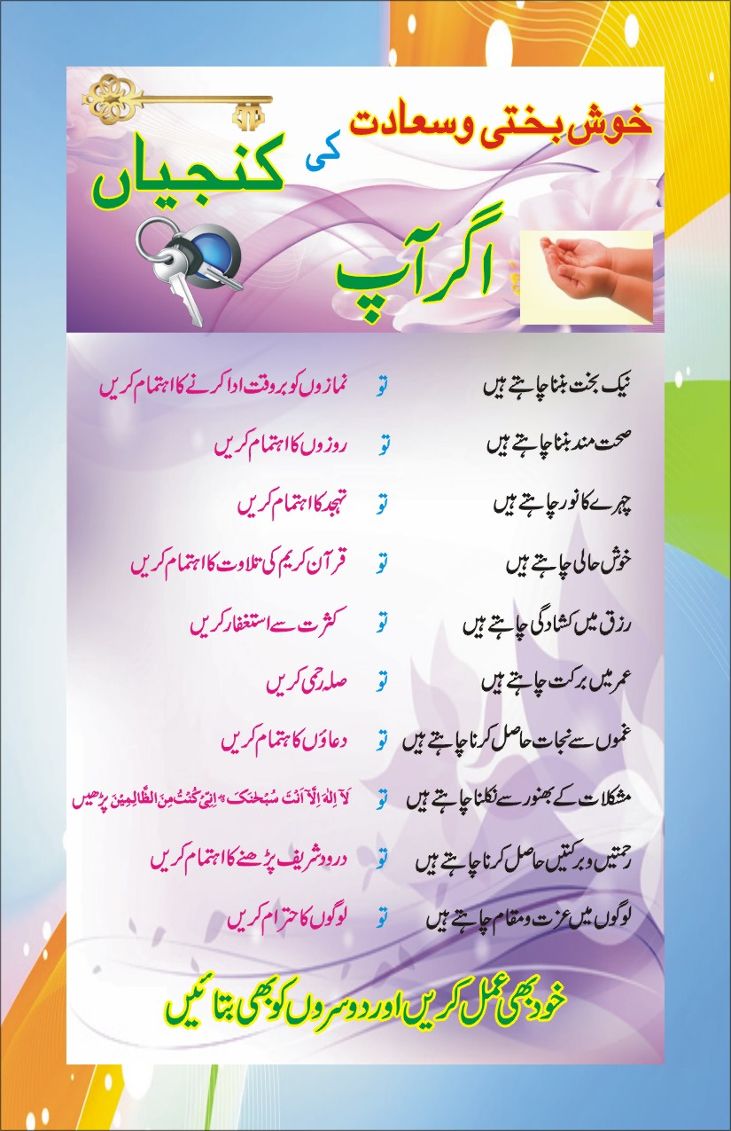

Slide 20
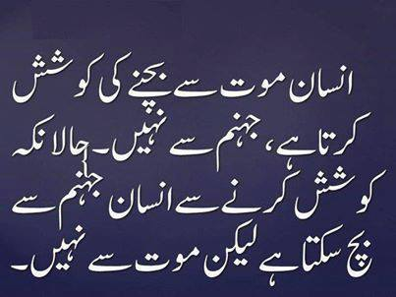

Slide 21
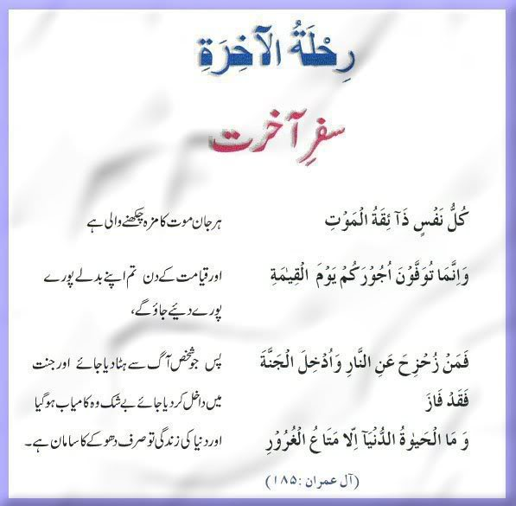

Slide 22
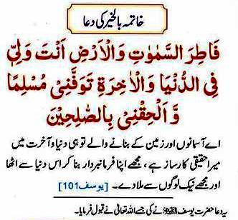

Slide 23
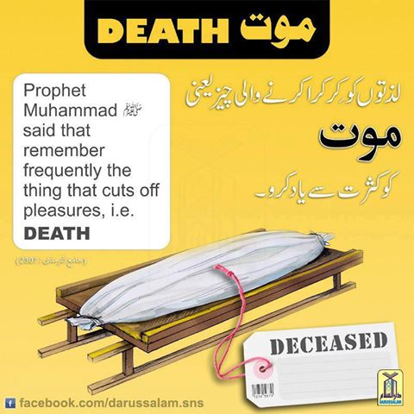

Slide 24
The Lesser Day of Judgment
Death and Sleep
Angels at the time of death
Devil at the time of death
Good end and bad end
The Souls Departure and Journey
Barzakh: Interval between this world and the next

Slide 25
The Grave
Questions of Munkar and Nakeer
Constriction and Expansion
Place in Paradise and place in Hell.
Salah, Sawm, Zakah, Kindness shield the believer from punishment
Surah mulk fazilat about azab.e.qabr

Slide 26
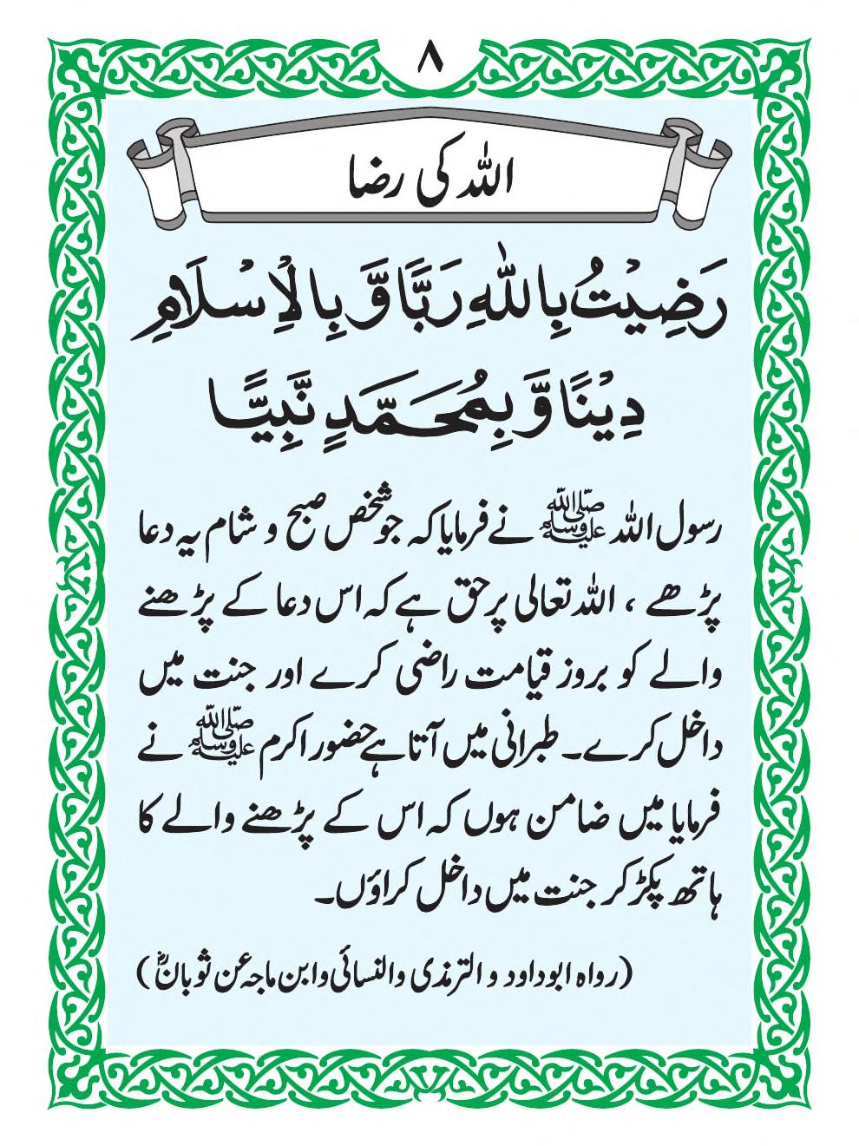

Slide 27
Qayama in the Quran
“Allah originates creation, then repeats it, then you return to Him.” (Quran 30:11)
“Verily, the Hour is surely coming, there is no doubt about it, yet most people do not believe.” (Quran 40:59)
“Verily, the Promise of Allah is true, so let not the life of this world deceptively seduce you.” (Quran 31:33)

Slide 28
The First Trumpet Blast
(soor-e-Israfeel)
Destruction (sura alqaria)
Comes Suddenly and Unexpectedly
Israfeel looking towards the Throne of Allah without blinking
Friday
Two Trumpet Blasts with period of 40 between

Slide 29
The Reckoning(Meezan)
The Books
Witnesses
Questioning
Weighing of Deeds
Perfect Justice
Each person responsible for their own sin
70,000 enter paradise without any reckoining
Concealing the sin of the sincere believer
Right hand or Left Hand receiving of book

Slide 30
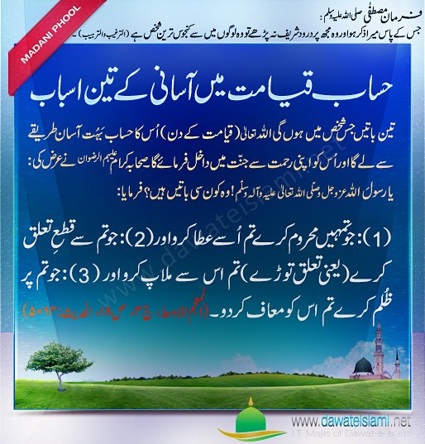

Slide 31
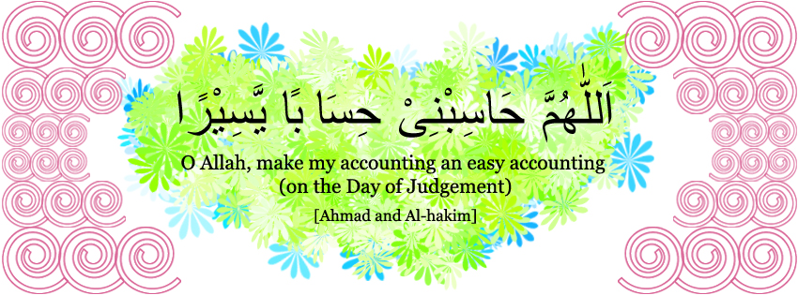
Dua for easy Hisab

Slide 32
The Balance
Vast Measuring Capacity
Precise
Deeds weighed
Person’s heart weighed
La ilaha illah Allah
Most heavy is good character
Reverence and Mentioning of Allah

Slide 33
The Cistern(Hoze-Kousar)
Prophet Mohammed (PBUH) given a huge vast cistern
Whiter than milk
Sweeter than honey
Fragrance better than Musk
Drinking cups like the stars
From a river called Al-Kawthar
A months journey

Slide 34
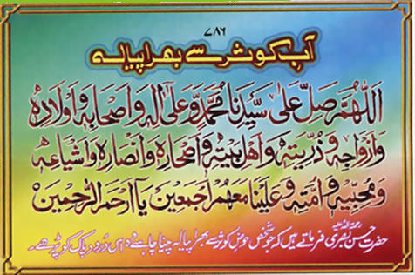

Slide 35
Bridge (Pul siraat)
People led by their false deities into the fire (sun, Pharaoh, etc.)
Believers waiting until they Recognize the Sign of their Lord
The Sirat (Bridge) passing over Hell

Slide 36
Hell-Fire
Paradise and Hell have already been created
19 stern angels act as keepers of Hell
Vast extent
Seven levels of Hell
Seven Gates of Hell
Punishments in Hell reflecting actions in this world

Slide 37
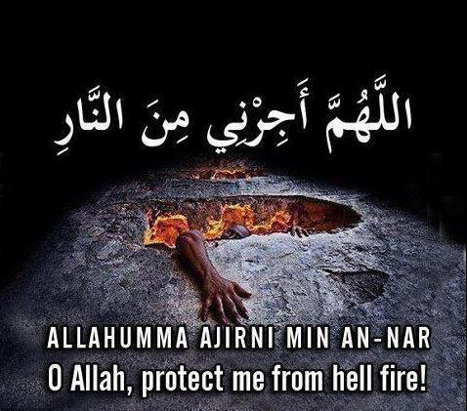
Dua to escape Hell-Fire

Slide 38
Paradise
Believers purified before entering Paradise
Poor generally enter Paradise before wealthy
The last person to enter Paradise
Eight gates of Paradise
100 levels in Paradise
Paradise out of the Grace and Magnanimity of Allah
Rivers, Palaces, Jewels, Raised Couches, No rancor in the hearts, eternal youth
Seeing Allah ultimate reward in Jannah

Slide 39
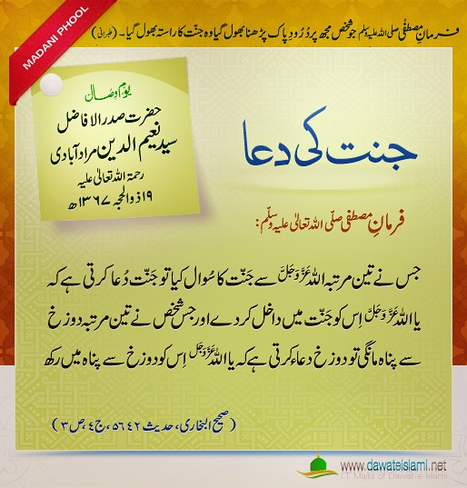
Dua For Paradise

Slide 40
ZRA SOCHIYE.....?ACTIVITY
1.Discuss about the beleif of Day of judgemnet in a group of 2 or 3 students?
2.The Day of judgment means..................................?
3.Learn dua’s in your daily life mention in the slides?
4.What is our beleif about Paradise &Hell?
5.What are the stages of Qayama?
6.Introduce the Hoze-kousar ?
7.what’s the teaching of islam about desire to death?
Notes:
Discuss as a class the idea that Arabian Polytheism is condemned as being sinful because it goes against Tawhid.

Slide 41
SUMMARY
Fifth belief in the Day of judgment
Introduction to this Faith
How its effect on human life
Signs of the Day of judgment
Stages to enter the Next world
Happening of Qyama
Stages of youm-e Hashar
Nabvi Duas for escapes&etc

Slide 43

Jazak Allah

