Slide 1
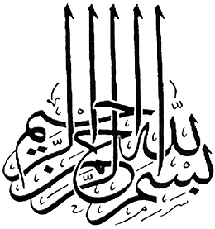

Slide 2
Islamic Studies
Associate Degree Education ADE/B.Ed(Hons)Elementary
Semester I

Slide 3

Lectuere#03
By Muhammad Imran

Slide 4
BELIEF in the Angels&Divine Books
Fundamental Beliefs of Islam

Slide 5

Outline
Introduction to Angels
Divine Purposes of Angels
Characteristics of the Angels
The Arch angels and their works
Quran and belief of Angels
Introduction to Divine Books
What is a muslim belief about Divine Books
Divine Books teachings
Quran and teachigs of Divine Books
What is our duty to Quran.

Slide 6
Why do we have to believe in Angels?
One of basic articles of faith:
  Belief in God
  His Angels
  His Books
  His Messengers
  the Last Day
Notes:
MUSLIM belief in the existence of the angels of Allah and that they over "honoured servants". They do not speak before HE does, and they act only by His command (21:26) Allah created them and they worshipped and obeyed HIM. According to the Holy Book and the Hadith of Muhammad, the immediate servant of Allah to carry out His will are the angels. In the Quran 66:6 we are told: "Angels, strong and severe, who resist not Allah in that He commandeth them, but do that which they are commanded."
Belief in Angels is one of the six articles of Islamic Faith.
Umar ibn Khattab (Allah be well pleased with him) said:
“As we were sitting one day before the Messenger of Allah (peace and blessings be upon him), a man suddenly appeared. He wore pure white clothes and his hair was dark black—yet there were no signs of travel on him, and none of us knew him.
He came and sat down in front of the Prophet (peace and blessings be upon him), placing his knees against his, and his hands on his thighs. He said, “O Muhammad! Tell me about Islam.”
The Messenger of Allah (peace and blessings be upon him) replied, “Islam is to bear witness that there is no god but God and that Muhammad is the Messenger of God; and to perform the prayer; pay zakat; fast Ramadan; and to perform Hajj to the House if you are able.”
The man said, “You have spoken the truth,” and we were surprised that he asked and then confirmed the answer.
Then, he asked, “Tell me about belief (iman).”
The Prophet (peace and blessings be upon him) replied, “It is to believe in Allah; His Angels; His Books; His Messengers; the Last Day; and in destiny—its good and bad.”

Slide 7
Introduction to this belief?
Malaikah is the plural of malak,meaning an angel.
Angels are also creations of Allah like human beings.
They are made of light(noor)
A muslim believes in Angels and has a firm faith in their existence.

Slide 8
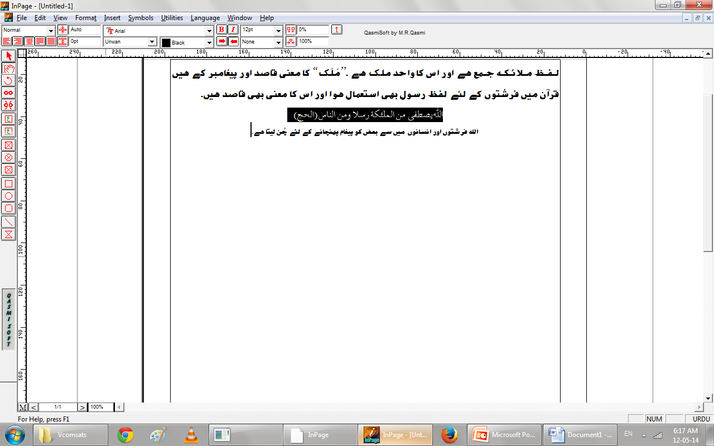
The Angels

Slide 9
What are Angels created from?
Allah created the angels from light as stated by Prophet Muhammad (peace be upon him): “The angels were created from light…(noor)”
For that reason:
  they can assume almost any form
  can be in multiple places at the same time
  travel a distance as fast as light or faster
For the same reason
  We cannot usually see them!
Notes:
Angels are created from light. The Arabic word for angel is malak. According to its root form, malak means messenger, deputy, envoy, superintendent, and a powerful person. The root meaning also implies descent from a high place. Angels build relations between the macrocosmic world and the material one, convey God's commands of, direct the acts and lives of beings (with God's permission), and represent their worship in their own realms.
Having refined or subtle bodies of light, angels move very rapidly and can be found in all realms of existence. They place themselves in our eyelids or in the bodies of other beings to observe the works of God. They also descend into the hearts of Prophets and saintly people to bring them inspiration. Such inspirations are usually from God, but sometimes they come from angels.
Some animals, like honeybees, act according to Divine inspiration. Science asserts that all animals are directed by impulses, but cannot explain what an impulse is and how it occurs. Scientists are trying to discover how migrating birds find their way, how young eels hatched in the waters of Europe find their way to their ancestral waters in the Pacific. Even if we attribute this to information coded in their DNA, this information is assuredly from God, Who knows everything, controls the universe, and assigns angels to direct these creatures' lives. If science says we must not question the existence of such invisible forces as the law of growth in living creatures, it is even more scientific to attribute such forces to angels, God's special servants.
Everything that exists, either as an individual or as a species, has a collective identity and performs a unique, universal function. Each flower displays a superlative design and symmetry and recites, in the tongue of its being, the Names of the Creator manifested on it. The entire Earth performs a universal glorification as though it were a single flower. The vast "ocean" of the heavens praises and glorifies the Majestic Maker of the universe through its suns, moons, and stars. Even inert material bodies, although outwardly inanimate and unconscious, perform a vital function in praising God. Angels represent these immaterial bodies in the world of the inner dimensions of things, and express their praise. In return, these immaterial bodies are the angels' representatives, dwellings, and mosques in this world.
Burda ornekler verilebilir:
Hz. Cebrail'in insan suretinde geldigi vakalar
Hz. Azrailin ayni anda pek cok ruhu kabzetmesi (isigin aynda yansimasi ornegi ile)

Slide 10
Why were Angels created for?
Angels were created for:
They are always doing the task assigned to them by Allah.
Working for His sake and Dignity.
Rendering service in His Name
Supervising through His view
Other duties e.t.c
Notes:
There are various classes of angels. One class is engaged in constant worship; another worships by working. These working angels have functions that resemble human occupations, like shepherds or farmers. In other words, the face of the Earth resembles a general farm, and an appointed angel oversees all of its animal species by the command of the All-Majestic Creator, by His permission and power and strength, and for His sake. Each animal species is overseen by a lesser angel appointed to act as its shepherd.
The face of the Earth is also an arable field in which all plants are sown. Another angel is appointed to oversee all of them in the Name of Almighty God and by His power. Lower ranking angels worship and glorify Almighty God by supervising particular plant species. Archangel Michael, upon him be peace, one of the bearers of God's Throne of Sustenance, [1] oversees the angels of the highest rank.
Angels who function as shepherds or farmers bear no resemblance to human shepherds or farmers, for their supervision is purely for God's sake, in His Name, and by His power and command. They observe the manifestations of God's Lordship in the species they are assigned to supervise, study the manifestations of Divine Power and Mercy in it, communicate Divine commands to it through inspiration, and arrange its voluntary actions.
Their supervision of plants, in particular, consists of representing in the angelic tongue the plants' glorification in the tongue of their being. In other words, these angels proclaim the praises and exaltations that all plants offer to the Majestic Creator through their lives. These angels also regulate and employ the plants' faculties correctly and direct them toward certain ends. Angels perform such services through their partial willpower and a kind of worship and adoration. [2] They do not originate or create their acts, for everything bears a stamp particular to the Creator of all things. Only God creates. In short, whatever angels do is worship, and it is therefore not like the ordinary acts of human beings.
Since there is one angel to represent every kind of creature and present its service and worship to the Divine Court, the Prophet's, upon him be peace and blessings, description of angels is entirely reasonable and true. According to him, there are angels with 40,000 heads, each with 40,000 mouths, and 40,000 praises sung by 40,000 tongues in each mouth.
This Prophetic tradition means that angels serve universal purposes, and that some natural creatures worship God with 40,000 heads in 40,000 ways. The firmament, for example, praises the Majestic Creator through its suns and stars; the Earth, although a single body, worships with many thousands of "heads" each with many thousands of "mouths" and each with many thousands of "tongues" Thus this tradition is considered to refer to the angel who represents the Earth in the world of the inner dimensions of things (the world of immaterial bodies).

Slide 11
What are their characteristics?
Angels are completely obedient, no free will as ours
Angels do not get hungry, thirsty, tired or bored. See [Qur'an 66:6]
They do not have gender (male or female). See [Qur'an 43:19]
They know as much as Allah teaches them.
They like to listen to the Qur'an.
They dislike bad smell and dirtiness.
Notes:
"They do not disobey Allah in what He commands them, but do as they are commanded. “[Qur'an 66:6]
"They say that the angels, who are servants to the Most Merciful, are females! Did they witness their creation? Their saying will be recorded, and they will be questioned about it!" [Qur'an 43:19]
The Majestic Maker of this huge palace of creation employs four classes of laborers: angels and other spirit beings; inanimate things and vegetable creations, which are quite important servants working without wages; animals, which serve unconsciously in return for a small wage of food and pleasure; and humanity, which works in awareness of the Majestic Creator's purposes. Men and women learn from everything, and supervise lower-ranking servants in return for wages (reward) here and in the Hereafter.
The first class consists of angels. These beings are never promoted for what they do, for each has a fixed, determined rank and receives a particular pleasure from the work itself as well as a radiance from worship. Their reward is found in their service. Just as we are nourished by and derive pleasure from air and water, light and food, angels are nourished by and receive pleasure from the lights of remembrance and glorification, worship and knowledge, and love of God. Since they are created of light, light sustains them. Even fragrant scents, which are close to light, are enjoyable nourishment for them. Indeed, pure spirits take pleasure in sweet scents.
Angles receive their own reward—elevated bliss—for carrying out the commands of the One Whom they worship, working for His sake, rendering service in His Name, and supervising through His view. They gain honor through their connection with Him, are refreshed by studying His Kingdom's material and immaterial dimensions, and are satisfied by observing His Grace and Majesty's manifestations. The resulting bliss is so elevated bliss that we cannot even begin to comprehend or perceive it.
Angels do not sin or disobey, for they do not have an evil-commanding soul that must be resisted. They have fixed stations, and so are neither promoted nor abased. They have no experience with such negative qualities as envy, rancor, enmity, and all the lusts and animal appetites found in human beings and jinn. They have no gender, do not eat or drink, and do not feel hunger, thirst, or tiredness. Although they receive no wages for their worship, they derive special pleasure from carrying out God's commands, delight in being near to Him, and receive spiritual pleasure from their worship. Praise, worship, recitation of God's Names, and glorification of Him are their nourishment, as are light and sweet fragrances.
On the other hand, we struggle with our evil-commanding soul and Satan. While angels invite us to true guidance, inspire us with belief and good conduct and virtue, and call us to resist the temptations of Satan and our evil-commanding selves, Satan and our evil-commanding selves try to seduce us. A person's life is the history of his or her continuous struggle between angelic inspiration and satanic temptation. This is why we can be elevated to the highest rank or abased to the lowest rank. Also, this is why the elect of humanity, the Prophets and great saints, are higher in rank than the greatest angels, and why ordinary believers are higher than common angels. Also, although angels have more knowledge of God and His Names and Attributes than we do, we are more comprehensive mirrors of God's Names and Attributes due to our developed human senses, our ability to reflect, and our complex nature.

Slide 12
Other Characteristics
Can take human form (Jibraeel)
Do not get bored or tired of worship and glorification of Allah.
The number of angels is known to Allah only.

Slide 13
Names of Some Angels
Hazrat Jibreel - Messenger Angel .
Hazrat Mika’eel – Delegated in weather and rain distribution
Hazat Israfeel – Blows the trumpet(soor) for the Last Day
Hazrat Izraeel Angels of Death (even angels die)
Malik – Keeper of Hell-Fire
Ridwan – Keeper of Paradise
Munkar and Nakeer – Interrogators in the grave

Slide 14
Attributes and Abilities
Honourable and Obedient
Modest and sensitive to the spiritually and physically impure
Can take different forms
Great Speed
Knowledge given not learned
Disciplined and Highly Organized
Protocol-oriented

Slide 15
What are their functions?
Worship and Praise God
Obey God and follow His commands
Bring messages from God
Help and protect the believers
Record good and bad deeds
Guard Hell and Paradaise
Serve believers in Paradise

Slide 16
Do Angels have wings?
According to the Qur'an, angels have wings. Allah says: "All praise is to Allah, the creator of the heavens and earth. The One who has made the angels messengers with wings two, three and four. He increases in His creation whatever He wants. Allah surely has power over everything." [Qur'an 35:1]
However those wings are not like wings as we know…

Slide 17
Are all angels the same?
There are various classes of angels.
Four of them are archangelas who are superior in rank to others :
Hazrat Jibreel - Messenger Angel .
Hazrat Mika’eel – Delegated in weather and rain distribution
Hazat Israfeel – Blows the trumpet(soor) for the Last Day
Hazrat Izraeel Angels of Death (even angels die)
Notes:
There are different kinds of angels. Besides those deputed to represent and supervise various species and present their worship to God, there are four Archangels and angels who carry God's Throne. [3] Other other groups of angels are known as Mala'-i A'la (the Highest Council), Nadiyy-i A'la (the Highest Assembly), and Rafiq-i A'la (the Highest Company). Specific angels have been appointed to Paradise and Hell. Angels who record a person's deeds are called Kiramun Katibun (the Noble Recorders), and, as stated in a hadith, 360 of them are responsible for each believer's life. They guard their charges, especially during infancy and old age, pray for them, and ask God to forgive them. Other angels help believers during times of war and attend assemblies that praise and glorify God, as well as study meetings held for God's sake and to benefit people.
Angels, particularly angels of mercy, do not enter houses containing statues or places where dogs are fed, and refrain from close contact with ritually impure people and menstruating women. They also avoid those with bad breath (derived from eating onions or garlic or from smoking), and do not visit those who sever relations with their parents and relatives.
Angels And Their Function
THEREis a host of angels in the kingdom of Allah. Prominent among them as stated in the Quran and Hadith are:
Jibrail or Gabriel
CHIEFamong the angels, archangel Jibrail is also called Ruh al Amin or the Faithful Spirit and Ruh al Qudus or the Holy Spirit.
Jibrail's main function is to communicate God's message to mortal prophets. He revealed to Adam the twenty-one leaves; taught him the cultivation of wheat, the working of iron and the letters of the alphabet and he took him to the site of Mecca where he taught him the rites of pilgrimage.
To Noah, he showed how to build the Ark. He saved Ibrahim from the flame. It as Jibrail who helped Moses to fight against the magicians of Egypt. He was also instrumental in the destruction of Pharao's army in the Red Sea. He appeared to Samuel and Daud to whom he taught the art of making coats-of-mail.
Mikail or Michael
GOD commands Mikail to look after the universe, the movement of stars and planets and all the galaxies, and the forces of nature. In Surah 2:98, Mikail is mentioned thus:
"Whoever is an enemy to Allah and His angels and apostles, to Jibrail and Mikail, verily Allah is an enemy to the unbelievers."
Azrail
AZRAILis also known malakal Maut or Angel of Death. In Kisas al ambiya there is an account of how Azrail became the Angel of Death. When Allah wanted to create man, He commanded Jibrail to snath from earth a handful of its main constituents.
By the will of God, the earth stirred and begged Jibrail not to take any part of it to create a khalifahon earth for fear that in the end it might rebel against Allah and be tortured in hell. So Jibrail returned commanded him again, he would execute it this time.
But Allah commanded Mikail and Israfil who also failed. It was Azrail who turned a deaf ear to the earth and did what was commanded of him. When Azrail brought the handful of earth to Allah, God said that it was Azrail who brought the elements to create Adam and it shall also be Azrail who will take away the lives of Adam and his generation.
Israfil
INthe Holy Quran, it is stated that when the time comes for the Day of Judgement, a trumpet will sound the blast to arouse men from the graves. It is the duty of Israfil to blow the trumpet. Surah 69: 13-20 describes what happens after the trumpet is blown thus:
"Then, when one blast is sounded on the trumpet, and the earth is moved and its mountains, and they are crushed to powder at one stroke; on that day shall the great Event come to pass, and the sky will be rent as sunder, for it will that Day be flimsy, and the angels will be on its sides and eight will, that Day bear the Throne of thy Lord above them. That day shall you be brought to Judgement: not one act of yours that you hide will be hidden."
The number of angels and their other functions are known only to Allah.
While Raqib and Atid record our words, Kiraman and Katibun write down the deeds of men. We are told that as soon as the deed is laid in the tomb, two angels namely Munkar and Nakir would appear to interrogate his deeds in this world and examine his faith with such questions as whom he worships as God; who his Prophet is; who his Iman is; etc...., etc....
Two other known angels are Zabaniyah or the Guardian of Hell and Ridzwan or Keeper of Paradise.
strengthen the rightenous servants god;
give them comfort in trails and tribulations;
carry out Divine punishment against the wicked;
intecede and pray for men on behalf of sinner and those on earth;
help in the spiritual progress of man;
prompt man to noble deeds; and
record the deeds of man.

Slide 18
Archangels - 1
4 archangels in Islam (also exist in Christian contexts and the Bible)
Hazrat Jibreel
  Responsible for revealing the Qur'an to Prophet Muhammad
  Known to communicate with (all of) the Prophets before
  Mentioned specifically in the Qur'an

Slide 19
Archangels - 2
Hazrat Meekaaeel
Carry out natural events (rain, wind, thunder…)
This archangel was mentioned in Qur'an
  "Say: Whoever is an enemy to Jibreel - for he brings down the
  (revelation) to your heart by God’s will, a confirmation of what
  went before, and guidance and glad tidings to those who
  believe - Whoever is an enemy to God, and His angels and
  prophets, to Jibreel and Mikaa’eel - Lo! God is an enemy to
  those who reject Faith." [Qur’an 2:97-98]

Slide 20
Archangels - 3
Hazrat Israfeel
Responsible for signaling the coming of Judgment Day by blowing the horn named Soor.
This is described in many places in Quran:
  -- The first blow will destroy everything [Quran 69:13]
  -- The second blow will bring all human beings back to life again (Resurrection)

Slide 21
Archangels - 4
Hazrat Izraeel (Angel of Death)
Responsible for taking the human soul
How can Hazrat Izraeel take the souls of many humans at once?
He is created from light so he can be in many places at once, just like the rays of the sun.
Notes:
Process depends on the person's record
Evil
The Angel of Death will look like a terrifying beast or demon
The soul is ripped out very painfully.
Righteous
Azrael appears as ‘the most pleasant sight’
Soul taken like a ‘drop of water dripping from glass’
D- ...ve Hz. Azrail (a.s.)
İnsan, hayata attığı ilk adımını -ki orası ana rahmidir- bir melek eşliğinde attığı gibi, bu hayattan ayrılık adına, ahiret alemine doğru attığı ilk adımını da yine bir melek eşliğinde atar. İnsana bu son anında eşlik etme de melâikeye ait vazifelerden biridir. Bu vazifeyi de en zirve noktada Hz. Azrail (a.s.) temsil etmektedir.
Bu sebepledir ki ona: "melekü'l-mevt" ölüm meleği adı verilir. Burada çokça sorulan bir soruya cevap vermek gerekiyor. Soruda şöyle deniliyor:
Azrail (a.s.) bir tane olduğu halde bir anda vefat eden bir sürü insanın ruhunu nasıl kabzediyor?
Önce bu soruda beşerî ölçü ve kıstasların bizleri yanılttığını görüyoruz. Meleğin insana benzetilmesi bir yanlışlık olduğu gibi, "Nomen"i "Fenomen"de görmek, ruhun fonksiyonunu cesedde aramak da birer yanlışlıktır. Buna binaen, sualin ortaya çıkmasına sebebiyet veren anlayış inhiraflarını ve terminolojik hataları izah etmeden soruyu cevaplandırmak, muvafık olmayacağından evvela inhiraf noktalarının aydınlatılmasına ihtiyaç var.
Melek, tabi bulunduğu alem itibariyle, hilkat ve mahiyeti, mükellefiyet ve vazifeleriyle tamamen farklı bir varlıktır. Onu, kendi alemine bakmadan, mahiyet ve vazifesini düşünmeden tahlil etmek, hakkında hükümler vermek, elbetteki hatalı olacaktır. Bu itibarla, evvela onun, bu yönleriyle tanınmasında zaruret var. Ayrıca soruya müstakil bir cevap teşkil etmesi açısından daha önce temas ettiğimiz bazı hususların tekrarı da gerekmektedir.
Melek, kuvvet demek olan "Melk"den veya elçilik manasına gelen "Mel'ek"den alınmıştır. Birincisi itibariyle çok kuvvetli, belki ayn-ı kuvvet manasına; ikincisi itibariyle de emr-i İlahinin âhize ve nâkilesi (alıcı-verici) olarak elçilik manâsına gelir.
Bu üstün vasıflar Cenâb-ı Hakk'ın yarattığı umum meleklerde bulunur. Bilhassa, vahyi getirmekle vazifelendirilenlerde bulunması zarurîdir. Bu üstün varlıklar, hayata-memata nezâret edenlerden alın da, arş-ı İlahi hamelesi ve Hakk divanının gözü hayret dolu vazifelilerine kadar geniş bir sahada, Allah'ın icraatına nezâret ve temaşa ile mükelleftirler.
Makro alemden mikro aleme kadar, bütün değişme ve tahavvüller, bütün terekküb (sentez) ve çözülmeler hep bu kuvvet ve elçilik temsilcisi meleklerin nezâretinde olduğu gibi, Allah'ın "kelam" sıfatından, beşere gelen teşriî emirler de, yine bu emin ve güçlü varlıklar tarafından temsil edilmektedir. Âlemşümul (evrensel) câzibe ve dâfia (çekme ve itme) kanunlarından, elektronların çekirdek etrafındaki muntazam hareketlerine kadar, bu ağır ve ince işlere nezâret, ne müthiş bir kuvvet istemekde ve ne emin elçiliğe vâbestedir!..
Melekler, o kadar eşya ve hadiselerin içindedirler ki, onlarsız ne bir yağmur damlası, ne de bir gök gürültüsü düşünmek mümkün değildir. İşte şeriat-ı fıtriyede (kâinatta cereyan eden kanunlar) bu şuurlu kuvvetler herşeyi elinde tutan Hakk'ın sonsuz kuvvetinin -kabiliyet ve istidatlarına göre- onlardaki tecellisinden ibaret olduğu gibi, bu büyük ve muhteşem tecellinin nokta-i mihrakiyesi olan, en değerli varlık insanoğlunun, hareket ve davranışlarını düzenlemek üzere, İlahi alemden esip esip gelen vahiy ve ilham meltemleri de, yine vahiy ve ilham sahibinin onlardaki tecellisinden başka birşey değildir.
Bu itibarla, yaratanla yaratık arasında vasıta olan ve yaratıcının muhteşem kudretine dayanarak, atomlardan nebülozlara kadar geniş bir sahada, melekûtî güç ve kuvvetin nezâret ve tasarrufunun vazifelileri olan melekleri beşere benzetmek ve beşer için zaruri olan bir kısım kayıtları onlar için de varid görmek, bir düşünce inhirafı ve bir cehalet ifadesidir.
Evet, eğer melek de, insanlar gibi sırtında maddi bir cesed taşıyıp da çözülme ve dağılmaya maruz kalsa ve her canlı gibi zaman tarafından aşındırılsaydı, onun hakkında vereceğimiz hükümlerde, insanı, bir ölçü, bir mikyas kabul etmek mümkün olurdu. Halbuki, bütün bu farklılıklar var; hem de iki sınıfın birbirine kıyas edilmesini imkansız kılacak kadar var!..
Melekler, yaratılış itibariyle de insandan farklıdırlar. Bu farklılık, onların çok geniş bir sahadaki mükellefiyetleriyle alakalı bulunmaktadır. Yaradılışlarındaki bu duruluk ve nurluluk, onları daha nüfuzlu ve daha seyyal kılmaktadır. Bir anda pek çok ruha aksetme, pek çok göz tarafından görülme ve birken çokluk cilvesiyle tezahür etme gibi hususiyetlere malik bulunan melâike, Hz. Aişe'nin (r.anha) naklettiği bir hadise göre nurdan yaratılmışlardır. Bu itibarla da, nurun hususiyetlerine mazhardırlar.
Kaldı ki, mahiyetleri latif olan melekler, güneş gibi maddi ve kesif şeylerden de çok farklıdırlar. Onların, değişik şekil ve suret almaları kabil olduğu gibi, bir anda değişik şekillerde görülmeleri de kabildir. Öteden beri dindarlar arasında, şimdi ise yaygınlaşmış şekliyle sosyete mahfillerinde, bu temessül keyfiyeti, o kadar bilinen bir mevzu haline gelmiştir ki, erbabınca, tecrübeye dayalı neticeler kadar kat'idir. Her gün, gazete ve mecmua haberlerinde, herhangi bir insan dublesi ve bir perispirinin, cismin bulunduğu yerden çok uzaklarda bulunması ve bulunduğu yerlerde iktidar ve tasarruf izhar etmesinden bahsedilmektedir ki meselenin aslı ne olursa olsun, ruh gibi latif varlıkların cisme nispetle daha seyyal, daha aktif ve daha muktedir olduğunu göstermektedir.
Bu madde ötesi seyyaliyet ve cevvaliyet cismin rağmına ikinci varlığın daha aktif olduğunu gösterdiği gibi, ruha nispeten daha cevval olan melâikenin tabiat kanunlarının üstündeki fonksiyonuna da işaret etmektedir.
Melâike ve ruhların temessülleri, öteden beri bilinen şeylerdir. Başta Nebiler olarak pek çok gönül erbabı bu mevzudaki müşahedelerini anlatmış ve avamdan pekçok kimseyi de buna şahid göstermişlerdir.
Cebrail'in (a.s.) değişik suretlerde görünmesi ve hangi hadise münasebetiyle gelmişse, o hadiseye göre şekil alması; mesela, vahiy esnasında elçilik vazifesine uygun bir şekilde (Buhari, Bedü'l-Halk 7; Müslim, İman 287); muharebe sırasında da bir muharib suretinde zuhur etmesi (Buhari, Cihad 18; Müslim, Cihad 66) gibi durumlar, hep temessüle misal olabilecek şeylerdir. Meleğin temessülü hem çok hem de umum melekler için vakidir. Cibril (a.s.) Hazreti Dıhye (r.a.) suretinde göründüğü (Buhari, İman 37, 34; Müslim, İman 5,7,8; Ebu Davut, Sünne 16) gibi, ismini bilemediğimiz bir başka melek de "Uhud" harbinin en hareketli anında Mus'ab b. Umeyr şekline girerek Rasulullah'ın (s.a.s) önünde akşama kadar harbeder.(İbni Sa'd, Tabakat 3/121) Keza, pek çok melekler, Zübeyr b. Avvam sûretinde, (Heysemi, Mecmau'z-Zevaid 6/83) Bedir harbine iştirak ederek mü'minlerin kuvve-i maneviyelerini takviyeye medar olurlar. Hakk dostlarının, buna benzer şekilde, gayb aleminin erleriyle temasları sayılamayacak kadar çoktur. Hele, rüyalar vasıtasıyla umum halka tezahürü, meselemize, inkara meydan bırakmayacak şekilde kuvvet kazandırmaktadır. Hemen hemen herkes bildiği ve tanıdığı ve kendisiyle yakından alakadar görünen bir ruhun, rüyalar vasıtasıyla kendisine yol gösterdiğine, ışık tuttuğuna şahid olmuştur. Ne var ki, bir kısım kimseler rüyaların ancak bir kısmı için bahis mevzuu olan "şuuraltı" meselesini ta'mim ederek bu işin de anlaşılmaz hale getirilmesine çalışmaktadırlar, veyl olsun cehalete!
Bu meselenin tamamını, melâike, temessül ve ruhlarla alakalı hususların tafsilen anlatıldığı bölüm ve yerlere havale ederek, netice olarak diyebiliriz ki, her varlık aynalarda misaliyle göründüğü gibi, melek de kendisine ayna olabilecek her yerde görünebilir, hem de maddi ve kesif cisimler gibi, sadece şekil olarak değil, ayniyle ve bütün fonksiyonlarıyla görülebilir...
a- Hz. Azrail Bütün Ruhları Nasıl Kabzediyor?
Hz. Azrail'in bir ferd olmasının, bütün ruhları kabzetmesine mâni bir yanı yoktur. Bulunduğu yerden bir şua gibi aksederek, istediği yere elini uzatabilir ve istenilen tasarrufta bulunabilir. (Meseleye daha önce aktardığımız, bilgilerle yaklaşalım) Ona, ne mesafelerin uzaklığı, ne de münasebet kurduğu şahısların çokluğu mani olamaz. Güneşin bir tek şey olmasına rağmen, kendisine bağrını açan ayinelerin kabiliyetlerine göre, her yerde görülüp hissedildiği ve tesirine şahid olunduğu gibi, tamamen nur ve nûrânî olan melekler, evleviyetle her yerde görünebilir ve icraatta bulunabilirler.. hayat üfleyebilir ve ruhları kabzedebilirler.
Kaldı ki, can alan ve ruhları kabzeden haddizatında Allah'dır (c.c.). Azrail'e (a.s.) gelince, Hakk'ın her işinde bir kısım nezâretçi ve alkışçıları olduğu gibi, ruhların kabzedilmesi işinde de o, bir nezâretçi ve alkışçıdır. Her yerde hazır ve nazır olan Yaratıcı, akla, hayale gelmez ve hesap altına girmez pekçok işi birden yaptığı gibi, milyarlarca varlığı aynı anda hem var hem de yok edebilir. İşte bu baş döndürücü kudret ve bütün eşyayı her an görüp bilen sonsuz ilimdir ki bazıları akıldan uzak görseler bile kâinatın zerreleri adedince işleri bir arada şaşırmadan görebilir ve her yerde ölenlerin ruhlarını da kabzedebilir.
Ayrıca, ruhları kabzetme işini ister Yüce Yaratıcı, isterse Azrail (a.s.) yapsın; her ruhu kabzedilecek zat, vadesi dolunca ona teveccüh eder ve ruhu kabzedilir. Bir fikir verebilmek için şöyle bir misal arzedebiliriz. Mesela: Aynı frekansda çalışan binlerce radyo gibi alıcılar düşünelim; bunların çalıştığı frekansda gönderme yapan bir "göndermeç" düğmesine dokunulduğu an, hepsine bir sinyal ve olursa mors alfabesinden bazı harfler duyulmağa başlar. Aynen onun gibi, acz, fakr ve ihtiyaç çehreleriyle, güçlü ve müstağni bir kapıya yüzleri dönük bulunan mahlukat, vade ve müddet bitimi düğmesiyle, hayat üfleyen ve hayat kabzeden Zat'a karşı ne zaman açılırsa, ya oldurucu veya öldürücü sinyalleri ruhunda duymaya başlar. Âciz beşer, bir telsiz şarteli veya bir bilgisayar tuşlarıyla, kilometrelerce ötedeki cihazlarla oynayabilirse, neden bizim kayıtlı bulunduğumuz kusur ve noksanlıklardan uzak olan Zat, bir anda, canlı makinalardan ibaret olan insan ruhuyla münasebet kurmasın, istediği zaman onun ruhunu alıp ve istediği zaman da devam ettiremesin?
Ruhların kabzedilmesi hususunda farklı mütalalar vardır:
1- Daha önce söylediğimiz gibi, her canlıya hayatı veren Allah'tır (c.c). Hayatı alan da yine O'dur. Buna göre Azrail (a.s.)'ın vazifesi sadece bu muhteşem icraata nezâret ve bu icraatı alkışlamaktır.
2- Allah'ın emri ve izniyle her ruhu Azrail (a.s)'in kabzetmesidir ki, bir ferdin tek başına bu kadar şeyi yapmasının mümkün olacağına dair bir kısım misaller vererek meseleyi daha önce aydınlatmaya çalışmıştık..
3- Kâinat çapında cereyan eden bütün işlere, bir temsilci başkanlığı altında pek çok melek nezâret ettiği gibi, ruhların kabzedilmesi vazifesinde de, Hz. Azrail (a.s)'a yardımcı olacak birçok melâike vardır ve bunlar sınıf sınıftırlar. Bir kısmı incitmeden, telaşlandırmadan, usulcacık kabzediciler; bir diğer sınıf ise, aldıkları ruhu bulutlar gibi semalarda yüzerek Yüceler Yücesine ulaştırıcıdırlar ki, Kur'an bu sınıfların hepsine işaret eder.
"O yerinden koparan ve derinden daldırıp çekenlere ve usulcacık çekip alanlara ve yüzüp yüzüp gidenlere kasem olsun." (Nâziat, 79/1-3)
Bu itibarla, ruhu kabzedilecek her ferde, ayrı ayrı gönderilecek pek çok melek vardır ve bunların hepsi Hz. Azrail'in (a.s) kumandası altındadır. O, Allah'ın (c.c) emriyle, iyi ve kötü ruhlara göre değişik melekler gönderir ve ruhları kabzettirir.
Netice olarak diyebiliriz ki, tereddüte düşüp de "Azrail bir tek olduğu halde bunca ruhu nasıl kabzediyor?" sorusuna sebebiyet veren, evvela bir anlayış inhirafıdır. Oysa ki, yukarıdaki misallerden de anlaşıldığı üzere, melek ne yaradılışı itibariyle, ne de mahiyetiyle asla insana benzememekte; insana benzemediği gibi, icraat itibariyle de tamamen ondan farklı bir durum arzetmektedir. O, tıpkı insan ruhu gibi temessül eder, bir anda pek çok yerde bulunabilir ve pek çok şeyle münasebet kurabilir. Günümüzde bir hayli yaygınlaşmış bulunan medyumluk, ruh çağırma ve görünmeyen varlıklarla münasebet kurma, hatta ispirtizma ve manyetizma gibi şeyler, fizik kanunlarını aşan ve onların ötesinde akıl almaz işler gören pek çok şuurlu ve müşahhas kanunların mevcudiyeti mevzuunda kanaat-ı katiyye verecek mahiyettedir. Binaenaleyh bu kabil varlıkların benzerleri olan melâike, bunların kat kat üstünde vazife görebilir ve tasarrufta bulunabilir. Hele hele, ruhların kabzedilmesi gibi bir vazifede, her canlı, hayat müddetinin bitimiyle bu vazifelilerle aynı frekansa girerse... Bir de mükelleflerin bir tane değil de, sayılmayacak kadar çok olduğunu ve her vefat edecek zata gidebilecek bir meleğin mevcudiyetini düşünürsek, tereddüte sebebiyet verecek bir hususun kalmadığını görürüz. Yine de herşeyin doğrusunu ancak Cenab-ı Hakk bilir...
b- Ruhları Kabzeden Meleklerin Farklı Görüntüleri
İster ruhları bizzat Hz. Azrail kabzetmiş olsun, isterse bu işi o, avane ve yardımcılarına yaptırıyor bulunsun netice değişmez ve her insan amelinin durumuna göre temessül eden bir melekle karşı karşıya kalır ve son nefesini bu halet içinde verir.
Eğer vefat eden, mü'min ve salih amel sahibi bir insan ise onun ruhunu almaya gelen melek "Hemen çekip alanlara" (Nâziat, 79/2) ayetinde işaret edildiği gibi neşe ve sürur dolu olarak gelir; huzur dolu bir atmosfer içinde o ruhu kabzeder. Ruhu kabzedilen insan, o halette iken bazen çok cüz'î bir acı hissetse bile ekseriyetle acı duymuş sayılmaz.. o mele-i âlânın müşahedesiyle kendinden geçer ve meleklerin teşyi ve karşılamalarıyla yüceler yücesi aleme doğru kanat çırpan ruhunu seyreder. (Allah'ım bize de böyle bir netice nasib eyle!)
Kafirler ise kendi amelleri cinsinden korkunç yapılı meleklerle karşılaşırlar. Son anda açılan gözleriyle gidecekleri yeri müşahede ederler ki, bu manzara onların içini korkuyla, endişeyle doldurur. "Andolsun söküp çıkaranlara" (Nâziat, 79/1) mealindeki ayette de buna işaret vardır.
Onların ruhu, su dolu büyük bir kovanın derin bir kuyudan çıkarılması gibi ağır ağır ve yine onların ruhu diken üzerine atılmış ipekli bir kumaşın sökülüp alınması gibi parçalana parçalana kabzedilecektir. Onlar binbir çeşit ızdırabı ruhlarında yaşayacak ve kapkaranlık bir ruhla bu dünyadan göçüp gideceklerdir. (Allah'ım bizi bu kötü akıbetten muhafaza eyle!)
Kafirlerin bu son durumlarını Kur'an şöyle dile getirir: "Görseydin o inkar edenleri; melekler onların canlarını alırken yüzlerine ve arkalarına vuruyorlar. 'Haydi kavurucu azabı tadın'(diyorlardı)" (Enfal, 8/50)
Bunun bir manası da şudur; o anda kafirlerin maruz kaldığı azabı tasavvur dahi edemezsin, öyle şedid ve öyle ızdırap vericidir ki..!
Halbuki mü'minin ruhu kabzedilirken, nasıl neşe ve sürur havası eserse, daha sonra meleklerin elinde, solması istenmeyen bir demet gül gibi elden ele dolaşarak mele-i âlâya yükselirken de aynı sürur ve neşe hissedilir. Ve uğradığı her yerde bu ruh, ilgi, alaka ve iltifat görür. Zaten o ölüm anında da gözünün alabildiği ölçüde, kalabalık bir melek topluluğu tarafından karşılanmıştır. Onun semaya doğru ilk kanat çırpışları nasıl başlamışsa kabirden haşre, haşirden sırata, oradan da Cennete uzanan yolculuğu yine aynı şekilde devam edecektir. Zira insan nasıl yaşarsa öyle ölür ve nasıl da ölürse öyle haşrolur.

Slide 22
Other Angels
Ridwan ➔ Gatekeeper of Heaven
Malik ➔ Gatekeeper of Hell
  "They [the people in Hell] will cry: ‘O Malik! Would that
  your Lord put an end to us!’..." [Qur’an 43:77]
Munkar and Nakir
  2 angels who interrogate a person in the grave about his good and bad deeds.

Slide 23
Other Angels
Kiraamen Kaatibeen (honorable recorders)
  2 angels on the right and left shoulders of each person
  The one on the right records the good deeds and the one on the left the bad ones. The one on the right is the commander.

Slide 24
Angels in Quran
ANGELS' PRAYER THAT BELIEVERS BE BROUGHT OUT OF
DARKNESS INTO THE LIGHT
  You who believe! Remember Allah much, and glorify Him in
  the morning and the evening. It is He Who calls down
  blessing on you, as do His angels, to bring you out of the
  darkness into the light. He is Most Merciful to the believers.
  (Surat al-Ahzab, 41-43)

Slide 25

Think...
05 minutes Activitiy
1.Discuss about the beleif of Angels in a group of 2 or 3 students?
2.Recall the names of Arhce angels and their duties?
3.What are their functions?
4.What are their attributes and abilities?
5.Why are Angels created for?
Notes:
Discuss as a class the idea that Arabian Polytheism is condemned as being sinful because it goes against Tawhid.

Slide 26
BELIEF in the ALLAH’S
Divine Books
Fundamental Beliefs of Islam

Slide 27
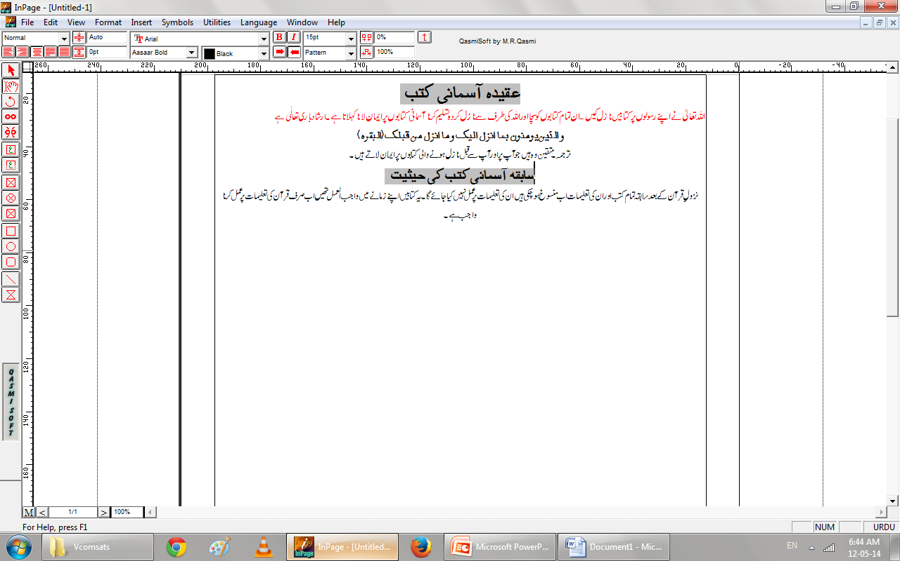
Introduction

Slide 28
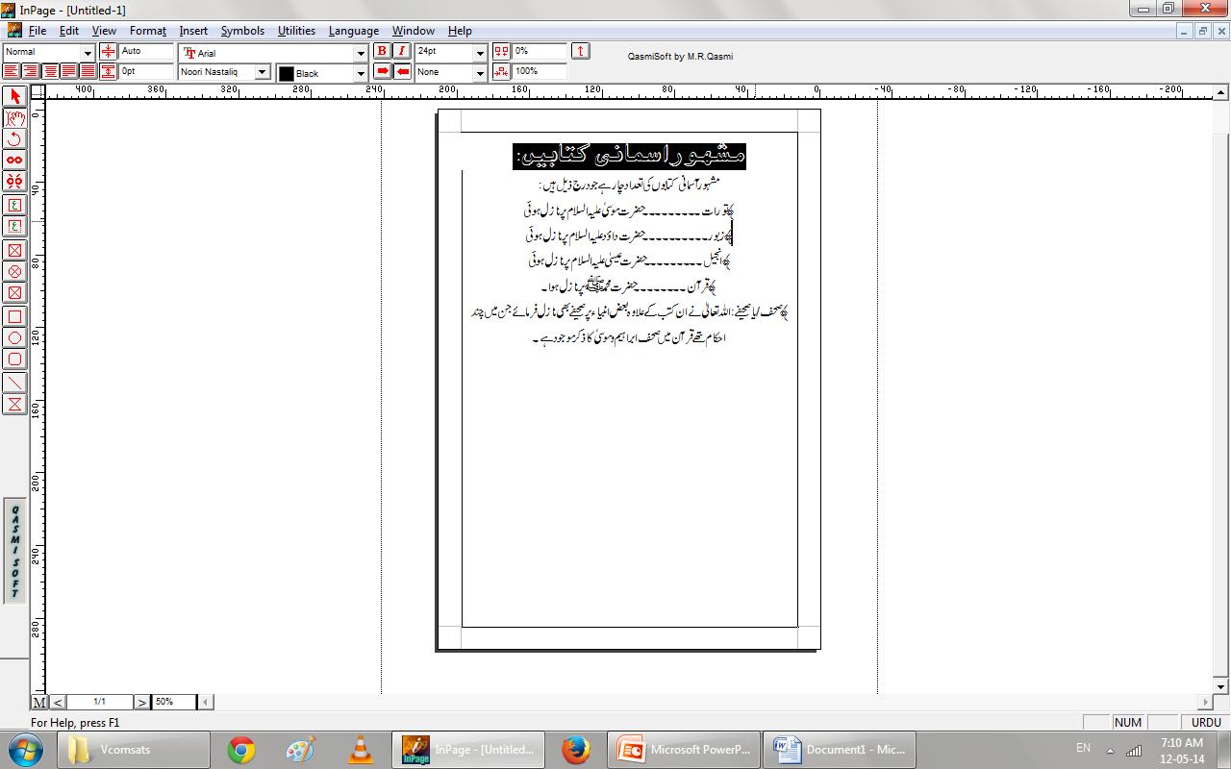
Famous Divine Books

Slide 29
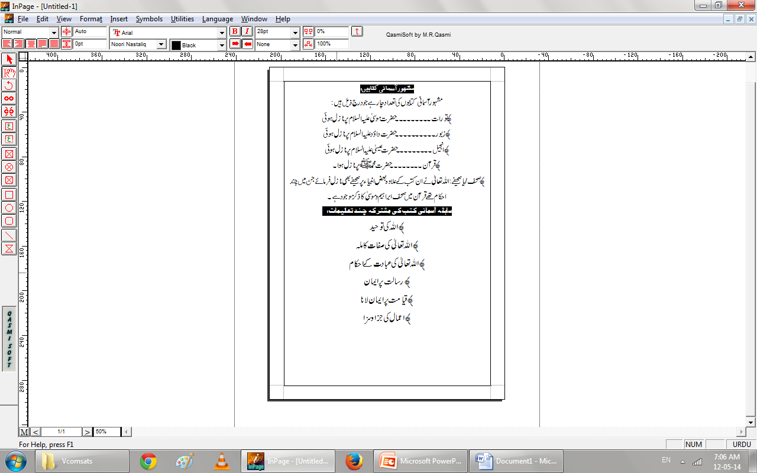
Common Teachings

Slide 30
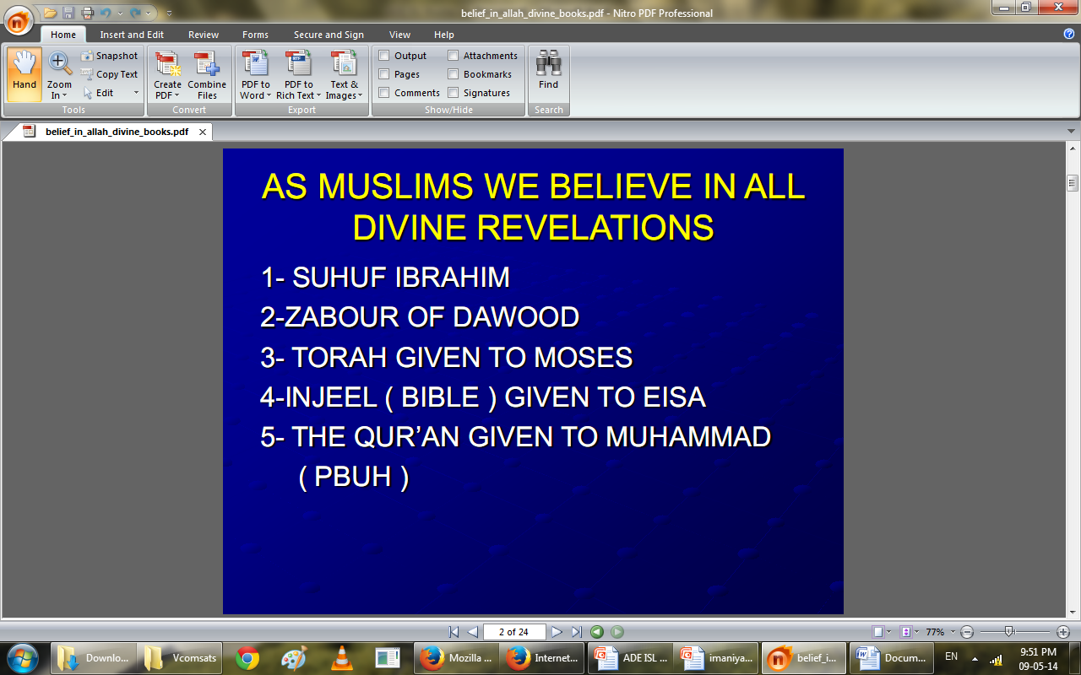
Faith of Muslims about Divine revelations

Slide 31
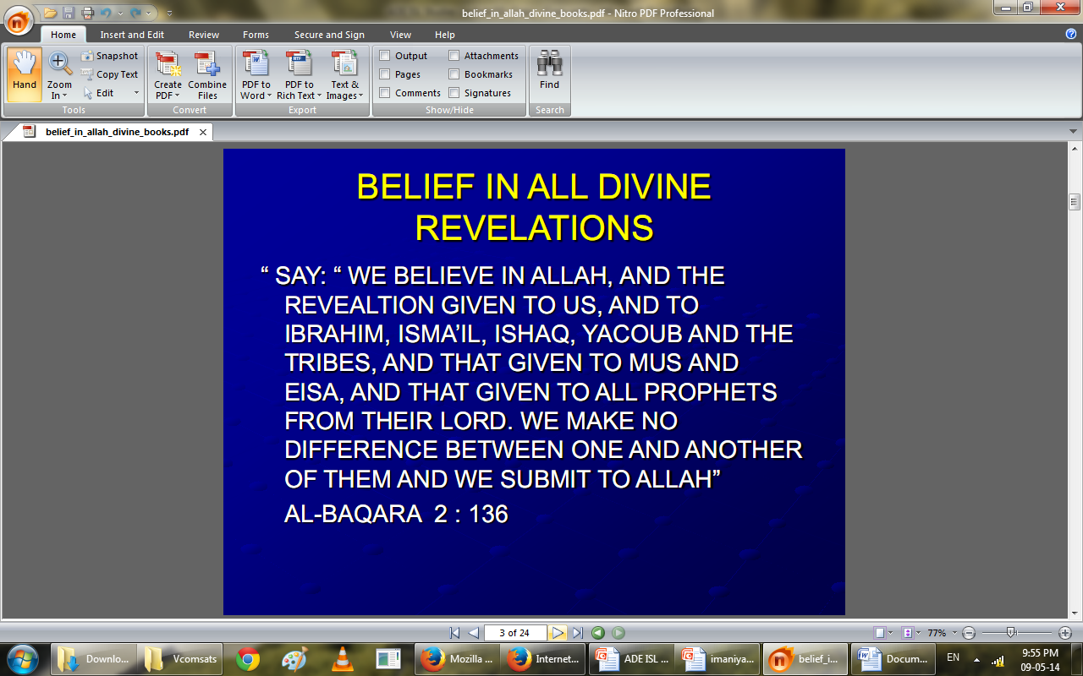
Belief in all Divine Revelations

Slide 32
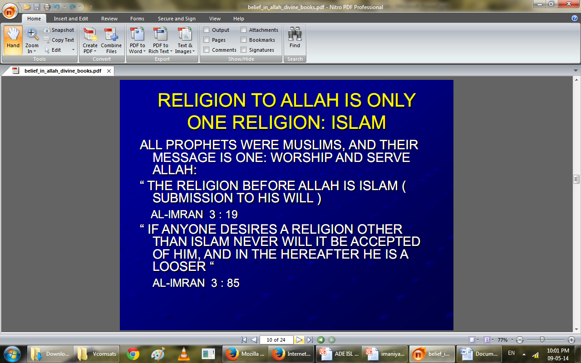
Islam

Slide 33
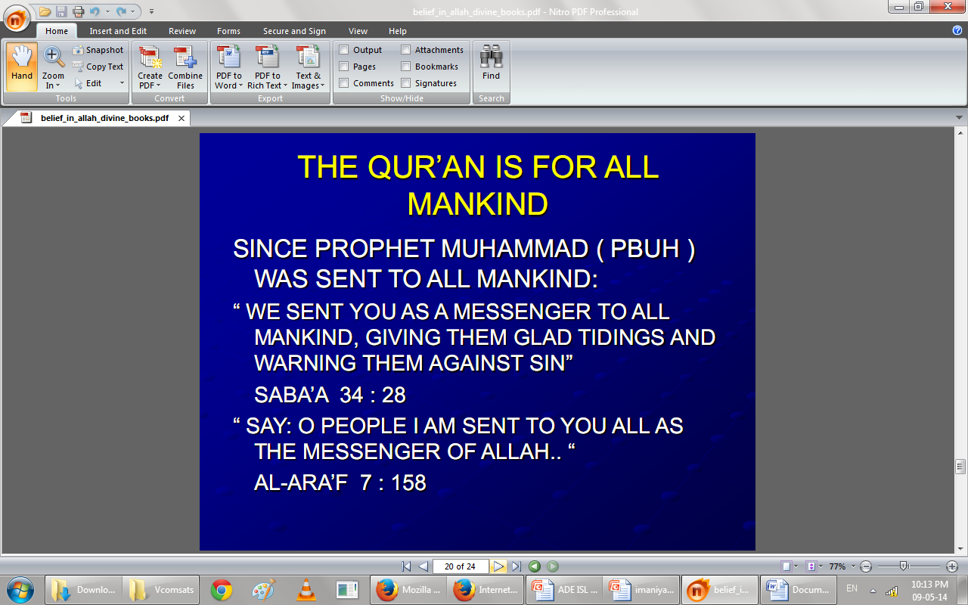

Slide 34
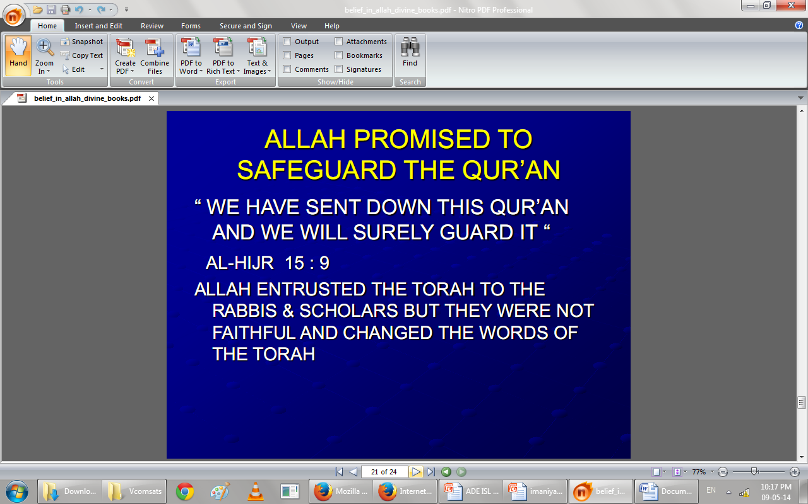

Slide 35
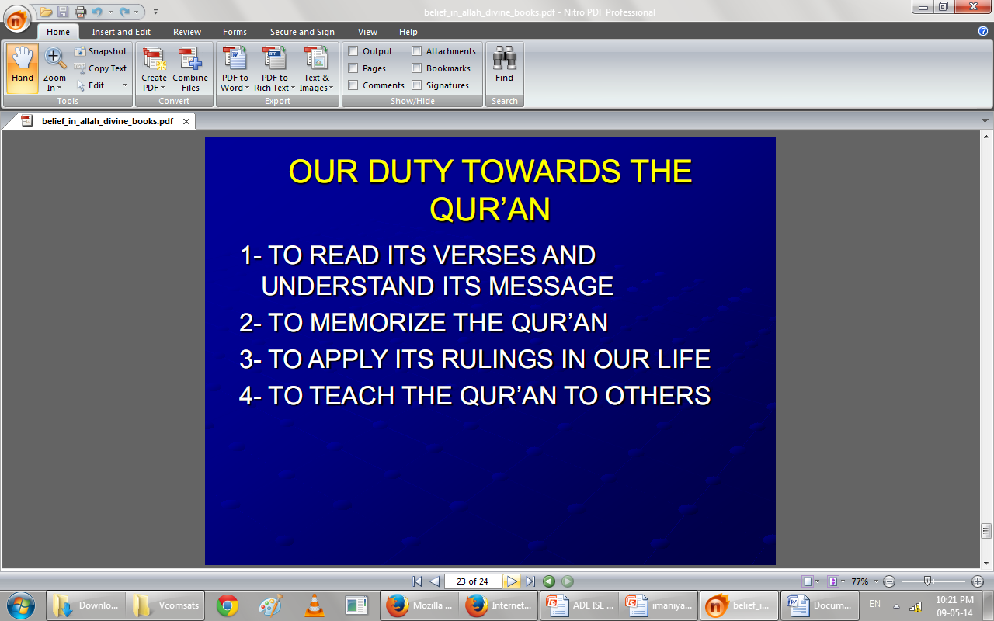

Slide 36
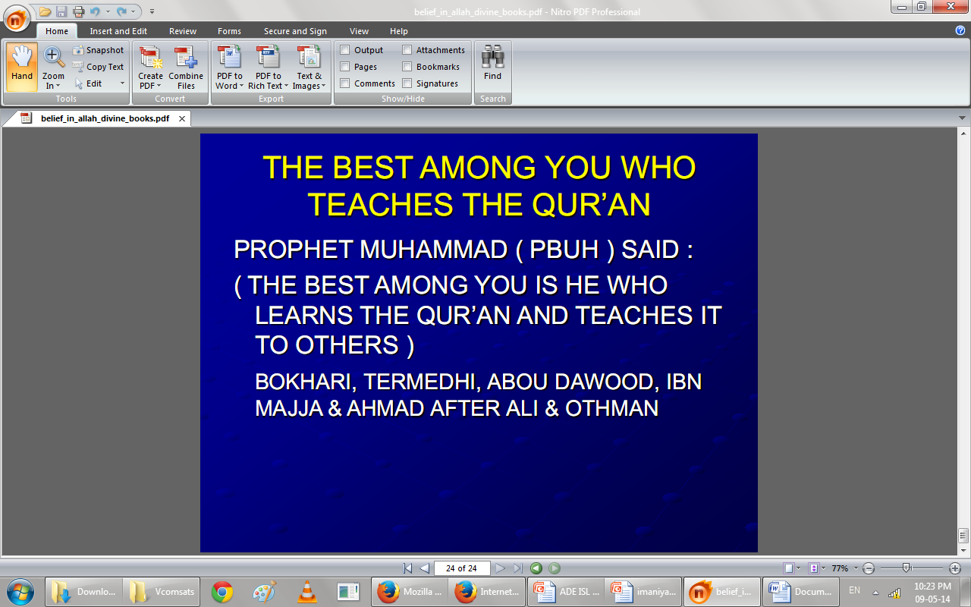

Slide 37
Short review
Torah (Tawrat).
Zabur.
Injeel.
Holy Quraan.
Suhuf Ibrahim.
Salient Characteristics Of Holy Quran:
Last Divine Revelation.
Protection of the Quraan.
Quraan a universal book.
The Quraan matchless style.
Living language.
Complete code of life.
Memorizing Quraan.

Slide 38
Think...
05 minutes Activitiy
1.Discuss about the beleif of Divine books in a group of 2 or 3 students?
2.Recall the names of Divine books with their Rasools?
3.What are the common teachings of Divine books?
4.Loudly say some properties of Holy Quran?
5.Why are you all think about dua given in last slide?
Notes:
Discuss as a class the idea that Arabian Polytheism is condemned as being sinful because it goes against Tawhid.

Slide 39
Summary
Introduction to Angels
Divine Purposes of Angels
Characteristics of the Angels
The Arch angels and their works
Quran and belief of Angels
Introduction to Divine Books
What is a muslim belief about Divine Books
Divine Books teachings
Quran and teachigs of Divine Books
What is our duty to Quran.

Slide 40
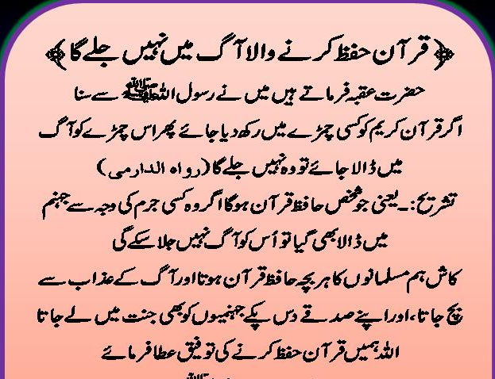

Slide 41
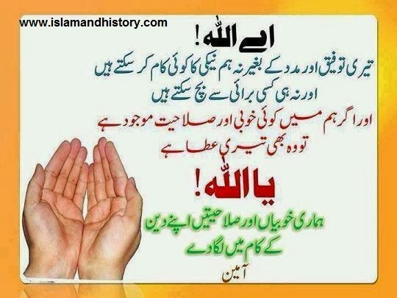

Slide 42

Jazak Allah

