Slide 1
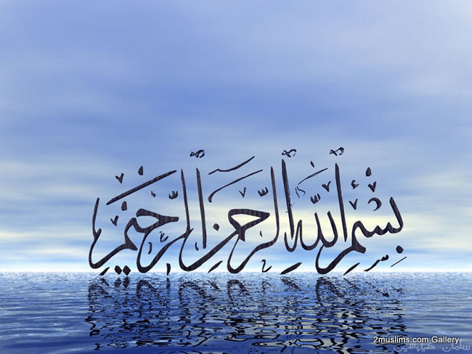

Slide 2
Islamic Studies course code 104
Associate Degree Education ADE/B.Ed(Hons)Elementary
Semester I

Slide 3

Lectuere#21

Slide 4
ISLAMIC HISTORY
By Muhammad Imran

Slide 5
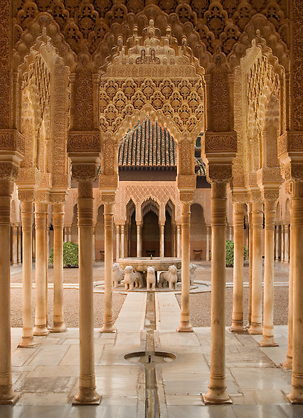
OUT LINES
Islamic glorious History
Period of Khlaft-E-Rashida
Period of Ummayyads
Period of Abbasids
Challenges face to
Mulsim Ummah

Slide 6
Introduction
Muslim Ummah has Glorious History which Produced;
  Great intelectutals,inventors, Generals,Reformers, Thinkers, Scientists, Scholars and Astronomers
Today Muslims face a Common Threat of their Survival
Rise and fall is a social phenomenon, may be Muslim Ummah is facing its logical correction

Slide 7
Basis for Unity
We are all Muslims, we believe in one God Almighty Allah, we believe in one Prophet Hazrat Muhammad (Sallallaho Alaihe wa Aal-e-hee Wasallam) and we all have the book of Allah i.e. Qur'an
Allah
Prophet
Quran

Slide 8
THE GLORIOUS PAST 00-100
Period of Nabuwat
Period of Khilafat
Hazrat Umer Farooq (R.A) Iran, Iraq, Palestine and Egypt were conquered.
Hazrat Usman (R.A) Afghanistan, Qabris, Tunis and Moroco were conquered.
Hazrat Ali (R.A)
  Jang-e-Nehrwan with Kharjis, Jang-e-Jaml with Hazrat Ayesha (R.A) and Jang-e-Safeen with Ameer Muawia.

Slide 9
Cont….
During the period of Hazrat Ameer Muawia Muslims got military strength. After Ameer Muawia long chain of government is being followed.
Muawia---Yazid---Muawia II---Merwan---Abdul Malik---Waleed Bin Malik
In the period of Waleed Bin Malik great victories came in part of Muslims.
  Muhammad Bin Qasim conquered Sindh
  Qateebah Bin Muslim Conquered Turkistan
  Tariq Bin Ziyad conquered Spain, Portugal
  Musa Bin Naseer conquered Undlus, Africa
After this Islam emerged as power and penetrated in whole world quickly.

Slide 10
100-500 AH
Period of Umer Bin Abdul Aziz
Hasham Bin Malik ruled over Central Asia, Roam
Periodof Khilafat-e-Bnu Abbas
  Haroon-ur-Rasheed laid stress on education and he developed schools and colleges to spread education. Muslims got strength in education in his period.

Slide 11
Cont….
Bring the period 300-400AH Khilafat was divided.
Aal-e-boya Iran
Fatimi Egypt
Ghazni Alpatagin
Banu Idrees Africa
Umvi Undlus
From 400-500 AH Shia-Suni split happened.

Slide 12
500-1000 AH
500-600 Crusades (Noor-ud-Din Zangi and Salah-u-Din Ayubi)
600-700 was a period of Tatars attacks and falloff Baghdad 1258
First Qibla captured by Crusaders
700-800 Ameer Taimoor-Mahood Garan accepted Islam. And havoc was turned
800-900 height of Ottoman Empire
Rule of Banu Abbass ended in 923 AH
900-1000 Saleem Usmani, Ottoman Empire

Slide 13
1000-1400 AH
1000-1100 period of fall
1100-1200 wars with Russia, Astria, Attack of Abdalli,Durrani on India
1200-1300 Egypt Vs Ottomans, rebellion in Bosnia, Napoleon’s attacks, Wahabiz at Hijaz
1300-1400 fall of Khilafat
Ist-World War,
2nd-World War

Slide 14
Cause of glory
Muslims enjoyed victories
They had strong military
They were at peak in education, justice and culture
They were one Ummah
They had strong economy and Jihad was basic tool of strong economy.

Slide 15

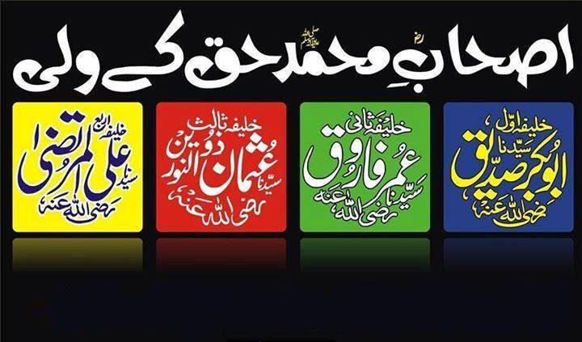

Slide 16
The Guided Khilafat
Hadhrat Abu Bakr ^{(ra)}
Hadhrat Umar Farooq ^{(ra)}
Hadrat Uthman Ghani ^{(ra)}
Hadrat Ali bin Abi Talib ^{(ra)}

Slide 17
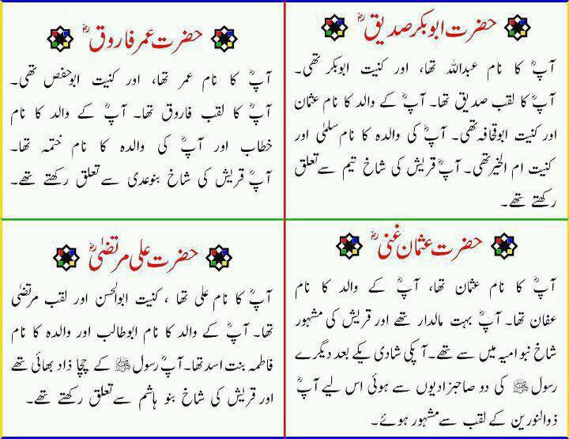
Hadhrat Abu Bakr ^{(ra)}
The First Successor of the Holy Prophet ^{(saw)}

Slide 18
General Information
Born 572 A.D. in Mecca
His name was Abdullah
Father: Abu Qahafah
Mother: Ummul Khair Salma
Wealthy merchant
Close friend of the Holy Prophet (saw)
Title: Siddiq
Accompanied the Holy Prophet (saw) during his migration from Mecca to Medina
Hadrat Abu Bakr ^{(ra)} passed away on August 23, 634 AD
He was one of the ten blessed ones to whom the Holy Prophet ^{(saw)} had given the glad tidings that they had been rewarded the Paradise.
He was khalifa for 2 years
Notes:
Called Abu Bakr because he was the father of Bakr

Slide 19
Acceptance of Islam
Hadhrat Abu Bakr ^{(ra)} was away when the Holy Prophet ^{(saw)} first made his claim of prophethood
Upon hearing rumors, he approached the Holy Prophet ^{(saw)}
When the Holy Prophet ^{(saw)} told him that he had received messages from God, Hadhrat Abu Bakr ^{(ra)}, without hesitation, accepted the claim of the Holy Prophet ^{(saw)} and became a Muslim
Notes:
It is the view of Hadhrat Khalifatul Masih II (ra) that upon Hadhrat Abu Bakr’s (ra) return to Makkah he began to hear stories about how the Holy Prophet (saw) had turned mad, announcing to people that angels were delivering him messages from God. Hadhrat Abu Bakr (ra) was a close friend of the Holy Prophet (saw) and knew that if he had actually made such claims they would most certainly be true, such was the absolute trust he placed in the Holy Prophet (saw). Hadhrat Abu Bakr (ra) proceeded to the home of the Holy Prophet (saw) and upon entering asked the Holy Prophet (saw) about what had taken place. So as to avoid any misunderstanding of what he was saying the Holy Prophet (saw) began to offer him a long explanation of what had happened but Hadhrat Abu Bakr (ra) stopped him and said that he wanted no explanation but only to know if an Angel had conveyed messages from God to him? Once again the Holy Prophet (saw) tried to offer a lengthy explanation but Hadhrat Abu Bakr (ra) again said that he had no need for such an explanation but only to know if God had communicated with him? The Holy Prophet (saw) answered him in the affirmative and Hadhrat Abu Bakr (ra) accepted the claims of the Holy Prophet (saw) without hesitation and affirmed his status as a Muslim ( ).

Slide 20
The Death of the Holy Prophet ^{(saw)}
Hadhrat Abu Bakr was away when the Holy Prophet ^{(saw)} died
There was a lot of confusion and grief after the death of the Holy Prophet ^{(saw)}
Hadhrat Umar ^{(ra)} said that whoever should say that the Prophet ^{(saw)} had died would lose his head
Hadhrat Abu Bakr cleared the confusion and united the Companions
Notes:
When the Holy Prophet died, the Companions became stupefied with grief. They could not move. Nor utter a word. Some were so deeply affected that they died a few days later, unable to bear the pangs of separation. Omar, of all persons, was so afflicted by grief that he made up his mind not to believe the Prophet had died. He unsheathed his sword and declared that whoever said the Prophet was dead would lose his head. He began to say the Holy Prophet had disappeared temporarily from their midst, even as Moses had disappeared on a Call from God. Moses returned to his people after forty days, so would the Holy Prophet. On return, the Holy Prophet would hold to account all those who had said unworthy things about him and had behaved hypocritically towards him. He would even put them to death or order their crucifixion. Omar was solemn and determined. None of the Companions dared to resist and deny what he said. Some were even persuaded by Omar's declaration. They began to think, the Prophet had not died. Because of this, their dejection changed to delight. The signs of it were on their faces. Those, who had their heads bowed with grief, who could also see far into the future, sent out one of them to fetch Abu Bakr. Abu Bakr was not in Medina when the Holy Prophet died. The Holy Prophet had permitted him to go, because his condition seemed to have improved. This Companion had hardly left the town when he saw Abu Bakr coming. On seeing Abu Bakr, the Companion could not contain himself. Tears rolled down. No word was necessary. Abu Bakr understood what had happened. He asked the Companion,
"Has the Prophet died? "In reply, the Companion not only confirmed the sad news but also told Abu Bakr what Omar had been saying that `whoever should say the Prophet had died would lose his head!' Abu Bakr heard this and at once made for the place where the Holy Prophet's dead body lay. He lifted the mantle from over him and knew at once that he had died. The pain of separation from his beloved friend and leader made his eyes wet. He bent low and kissed the Prophet's forehead and said: "By God, you will not suffer more than one death. The loss mankind have suffered by your death is greater than the loss they have suffered by the death of any other prophet. You need no praises, and mourning cannot reduce the pangs of separation. If we could but avert your end, we would have done so, with our lives."Abu Bakr said this, and covered the Prophet's face; then went to the spot where Omar was speaking to the Companions. Omar, of course, was telling them that the Prophet had not died; but had only disappeared temporarily. Abu Bakr asked Omar to stop for a time and let him speak to the assembly. Omar did not stop but went on. Abu Bakr turned to some of the Companions and started telling them, the Holy Prophet had really died. Other Companions turned to Abu Bakr and began to listen to him. Omar also was compelled to listen. Abu Bakr recited from the Holy Quran: "The Holy Prophet was but a prophet. There had been prophets before him and they had all died. If he also should die or be put to death, would they turn back upon him?" (Al-Imran: 145) "Thou (O Muhammad) are surely going to die and they surely are going to die." (Al-Zumar: 31) "O ye men, whoever amongst you worshipped Muhammad, let him know that Muhammad is dead, and whoever amongst you worshipped Allah, let him know that Allah is Living, there is no death for Him." (Bukhari, Volume 2, Chapter Manaqibe Abu Bakr)When Abu Bakr recited the verses of the Holy Quran and pointed to their meaning, the Companions realised what had happened. The Prophet had died. They began to cry. Omar is reported to have said that when Abu Bakr recited the verses out of the Holy Quran, and when their meaning suddenly dawned upon him, it seemed as though the verses had been revealed on that day, at that moment. His legs could no longer support him. He staggered and fell down in a paroxysm of grief.

Slide 21
The Death of the Holy Prophet ^{(saw)}
He quoted from the Quran and said:
  "The Holy Prophet was but a prophet. There had been prophets before him and they had all died. If he also should die or be put to death, would they turn back upon him?" (Al-Imran: 145)
  "Thou (O Muhammad) are surely going to die and they surely are going to die." (Al-Zumar: 31) “
  "O ye men, whoever amongst you worshipped Muhammad, let him know that Muhammad is dead, and whoever amongst you worshipped Allah, let him know that Allah is Living, there is no death for Him." (Bukhari, Volume 2, Chapter Manaqibe Abu Bakr)

Slide 22
Khilafat of Hadhrat Abu Bakr ^{(ra)}
He had to deal with several difficult problems after the death of the Holy Prophet ^{(saw)}
  1. Some of the tribes renounced Islam and started preparing to attack Medina. Hadrat Abu Bakr ^{(ra)} sent troops and succeeded in suppressing their rebellion.
  2. Many people refused to pay the Zakat. Hadrat Abu Bakr ^{(ra)} vowed to collect Zakat from every one and took all the necessary measures to achieve this goal.
  3. A number of people pretending to be prophets, started rebellions. They raised large armies and captured some of the Muslim territories. Hadrat Abu Bakr ^{(ra)} suppressed these rebellions.
Notes:
He had to deal with several difficult problems after the death of the Holy Prophet (saw)
1. Some of the tribes renounced Islam, simply because their tribal chiefs did not feel necessary to remain loyal to the successors for the Holy Prophet’’. Not only that but they started preparing to attack Medina to end the newly established institution of Khilafat. Hadrat Abu Bakr ra. After knowing their intentions, sent troops and succeeded in suppressing their rebellion.
Al-Qurtubi very poignantly points out that this very action of Hadhrat Abu Bakr (ra) was the highest display of courage, ‘Bravery is defined as having a firm and steadfast heart during times of hardship and calamities. And there was no calamity that was greater than the death of the Holy Prophet.’ Following this, there was a consensus. This is known as the first consensus amongst the Muslims. Hadhrat Abu Bakr (ra) was universally agreed upon by the Muhajirun and Ansar as the Khalifatul Rasul (the Successor to the Prophet). Commenting on this great day of blessing the Promised Messiah (as) writes, ‘As it happened at the time of Hadhrat Abu Bakr Siddiq (ra), the death of the Holy Prophet (saw) was considered untimely and many ignorant Bedouins turned apostate. The companions of the Holy Prophet (saw), too stricken with grief, became like those who lost their senses. Then Allah raised Abu Bakr Siddiq (ra) and showed for the second time the manifestation of His Power and thus Islam, which was about to fall, was supported by Him and He fulfilled this promise of His which was given [in the verse]: That is, after the fear we shall firmly re-establish them. That is what also happened at the time of Moses (as), when he died on his way from Egypt to Kin‘an before taking the Israelites to the intended destination in accordance with the promise. At his [Moses’] death the Israelites were plunged into deep mourning. It is written in the Torah that with the grief
at this untimely death [of Moses] and his sudden departure the Israelites wept for forty days. The same happened with Christ (as). At the time of the incident of the Crucifixion all his disciples scattered and even one of them apostatized.’ In another place the Promised Messiah (as) reaffirms that the position of Khalifah could have gone to none other than Hadhrat Abu Bakr, ‘And I have been told that the Siddique (Abu Bakr (ra)) was the greatest in rank and the highest in station of all of the Companions’.
After being elected Hadhrat Abu Bakr (ra) reluctantly, and under the persuasion of Hadhrat Umar (ra), climbed the pulpit. After a heart-rending introduction by Hadhrat Umar (ra), the Muslim world was treated to one of the most famous and meaningful speeches in the history of Islam. Although only a paragraph or so long, his humble statements would not only outline his Khilafah but that of those shining stars that followed him. He said the following, ‘O People, I have indeed been appointed over you, though I am not the best among you. If I do well then help me; and if I act wrongly then correct me. Truthfulness is synonymous with fulfilling the truth, and lying is tantamount to treachery. The weak among you is deemed strong by me, until I return to them what is rightfully theirs, Allah Willing. And the strong among you is deemed weak by me, until I rightfully take from them what is rightfully someone else’s, Allah Willing. No group of people abandons Jihad in the way of Allah, except that Allah makes them suffer humiliation. And wickedness does not become widespread among a people, except that Allah inflicts them with widespread calamity. Obey me so long as I obey Allah and His Messenger. And if I disobey Allah and His Messenger, then I have no right to your obedience. Stand up now and pray, may Allah have mercy on you’

Slide 23
Sevices of the Khilafat of Hadhrat Abu Bakr ^{(ra)}
During the last days of his life, the Holy Prophet ^{(saw)} had raised an army to be sent against the Romans
Due to the unstable conditions after the death of the Holy Prophet ^{(saw)}, some Companions suggested that the army be kept close to Medina.
But Hadrat Abu Bakr ^{(ra)} replied forcefully, “What authority has the Son of Abu Qahafah, to stop that which was started by the Holy Prophet ^{(saw)} ”.
The Muslim Army defeated the Roman forces and Persian forces, and the whole of Syria came under the control of the Islamic state.
Notes:
During the last days of his life, the Holy Prophet saw had raised an army to be sent against the Romans who had made some incursions into the Northern borders. This army was still in medina when the Holy Prophet saw passed away. As Hadrat Abu Bakr ra became Khalifah, the law and order situation within and outside the Medina became very delicate. In view of this grace danger, many Companions of Holy Prophet saw advised him not to send the army against Romans. But Hadrat Abu Bakr ra replied forcefully, “What authority has the Son of Abu Qahafah, to stop that which was started by the Holy Prophet saw. The Muslim army, under the command of Hadrat Khalid bin Walid ra, crushed a rebellion in Bahrain. Then the Persians were defeated, who had supported the rebels of Bahrain. The Muslim Army Also defeated the Roman forces in the battles of Ajnadan and Yarmuk, and thus the whole of Syria came under the control of the Islamic state.

Slide 24
Khilafat of Hadhrat Abu Bakr ^{(ra)}
He also collected all the pieces of writings of the Holy Quran in one place and re-organized the system of Huffaz, or those who memorize the Holy Quran.

Slide 25
Death of the First Khalifa
Hadhrat Abu bakr ^{(ra)} died in Madina in 13 A.H. and was burried by the side of the Holy Prophet (pbuh).At the time of his death he was 63.His Khilafat lasted for two years and four month.Before his death he nominated Hazrat Umar ^{(ra)} as the successor to the Khilafat from the shura of senior siahaba ^{(ra)}.His appointment was accepted by all the people.

Slide 26
Hadhrat Umar Farooq ^{(ra)}
The Second Successor of the Holy Prophet ^{(saw)}

Slide 27
General Information
Title: Ibn Al-Khattab (family name)
Born 581 A.D. in Mecca
From the family of Quresh
Initially, a fierce opponent of Islam and the Holy Prophet ^{(saw)}

Slide 28
Conversion to Islam
One day Hadhrat Umar ^{(ra)} took up his sword and left his house to kill the Holy Prophet ^{(saw)}. On his way, someone told him to first deal with his own sister and brother-in-law, who had already accepted Islam. He went straight to their house. He could hear the Holy Qur’an being recited inside the house. This made him so furious that he beat his brother-in-law, and wounded his sister who tried to protect her husband. His wounded sister said, ‘Umar! You may beat us as much as you like, but we are not going to give up our faith.’ This made Hadhrat Umar ^{(ra)} calm down and he asked them to recite a portion of the Holy Qur’an for him. He was so moved by the Qur’anic verses that his eyes filled with tears. He went straight to the Holy Prophet ^{(saw)} and accepted Islam.
Notes:
Have someone read
One day he took up his sword and left his house with intention of to kill the Holy Prophet ^{(saw)}. On his way, someone told him to first deal with his own sister and brother-in-law, who had already accepted Islam. He went straight to them and knocked at their door, he could hear the Holy Qur’an being recited inside the house. This made him furious and he started beating his brother-in-law, and wounded his sister who tried to protect her husband. His wounded sister said in a resolute voice, ‘Umar! You may beat us as much as you like, but we are not going to give up our faith. This made him calm down and he ask them to recite a portion of the Holy Qur’an for him. He was so moved by the Qur’anic verses that his eyes filled with tears. He went straight to the Holy Prophet saw and accepted Islam.

Slide 29
Expansion of the Muslim Empire
During his Khilafat, vast areas of Iran, Iraq, Syria, and Egypt came under the Muslim rule.
The city of Jerusalem in Palestine was conquered by Muslims in 17 Hijri

Slide 30
Main Achievements
Establishment of Majlis-e-Shura, a body of advisors to the Khalifah
Division of the whole Islamic state into provinces
Establishment of a finance department and building of schools and mosques in different parts of the state.
Introduction of Islamic calendar of Hijrah.
Notes:
Establishment of Majlis-e-Shura, a body of advisors to the Khalifah.
Division of the whole Islamic state into provinces to facilitate administration.
Establishment of a finance department and building of schools and mosques in different parts of the state.
Introduction of Islamic calendar of Hijrah.

Slide 31
Concern for His People
Hadrat ‘Umar (ra) was so anxious about the welfare of his people that he used to go around in disguise, in the city of Medina at night, to see if anyone was in need of help. Once, he observed a woman cooking something in a pot while her children were crying around her. He found out from woman that the children had been hungry for two days and that the pot was put on fire just to console them. He immediately brought all the necessary food items to the woman. On his way, one of his servants offered to carry the load but he stopped him saying: On the Day of Judgment you will not carry my load.
The woman, who had not seen Hadrat Umar ^{(ra)} before, was so pleased that she prayed aloud for him saying, “May Allah make you the Khalifah in place of Umar.” On hearing this Hadrat Umar ^{(ra)} started crying and without saying a word left the place.

Slide 32
Death of Hadhrat Umar ^{(ra)}
In 644 AD, Hadrat Umar ^{(ra)} was stabbed by a Persian slave, while he was offering his Prayers in the mosque. He passed away at the age of sixty three on 26th of Dhul Hijjah, 23 AH.
He was Khalifa for 10 years
He was also one of the ten blessed ones to whom the Holy Prophet ^{(saw)} had given the glad tidings that they had been rewarded Paradise.
Notes:
http://www.alislam.org/topics/khilafat/umar.html

Slide 33
Hadrat Uthman Ghani ^{ra}
The Third Successor of the Holy Prophet ^{(saw)}

Slide 34
General Information
Elected khalifa by the council appointed by Hadrat Umar ^{(ra)} a short time before his death
Belonged to Bani Umayya of the Quraish
One of the ten men that received glad tidings of paradise from Holy Prophet

Slide 35
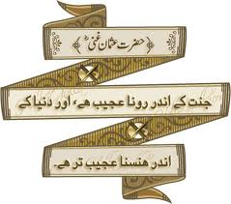
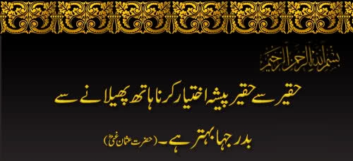
Ghani
Well-known for generosity to the poor

Slide 36
Acceptance of Islam
Accepted Islam after preaching from close friend Hadrat Abu Bakr ^{ra}
Fourth person to embrace Islam
Suffered due to persecution by uncle
Migrated to Abyssinia and then Medina

Slide 37
Dhunnurain
one with two lights
Married two of the Holy Prophet’s daughters:
  Ruqayyah ^{ra}
  Ummi Kulthum ^{ra}

Slide 38
Khilafat
Crushed rebellion in Iran
In the North, Romans defeated by Muslim force lead by Hadrat Amir Muawiah ^{ra}
Romans also prevented from invading Egypt
Iran, Asia Minor and Egypt came under Muslim control
navy and an Islamic fleet were established

Slide 39
Khilafat
Standard copies of the Holy Qur’an were prepared from the ones compiled by Hadrat Abu Bakr ^{(ra)} and sent to all the provinces of the state
last six years of his Khilafat passed in chaos and conflicts due to the conspiracies of certain groups
Notes:
Most important deed, spreading copies

Slide 40
Death
Hadrat Uthman ^{(ra)} was martyred on June 17, 656 AD while he was reciting the Holy Qur’an
He died at the age of eighty-two

Slide 41
Hadrat Ali bin Abi Talib ^{(ra)}
The Fourth Successor of the Holy Prophet ^{(saw)}

Slide 42
General Information
son of the Holy Prophet’s ^{(saw)} uncle Abu Talib
born in Mecca about twenty years after the birth of the Holy Prophet ^{(saw)}
Holy Prophet ^{(saw)} himself became his guardian
Hadrat Ali ^{(ra)} stayed in the bed of the Holy Prophet ^{(saw)} the night when the Holy Prophet ^{(saw)} left Mecca for Medina

Slide 43
General Information
Hadhrat Ali ^{(ra)} was a brave and skilled warrior
He participated in almost all battles with the Holy Prophet ^{(saw)}
He was married to Hadrat Fatimah ^{(ra)} who was the daughter of the Holy Prophet ^{(saw)}
One of the ten men that received glad tidings of paradise from Holy Prophet
Notes:
First child to accept Islam

Slide 44
Khilafat
On June 23, 656 AD, Hadrat Ali ^{(ra)} was chosen as the fourth successor of the Holy Prophet ^{(saw)}
The death of Hadrat Uthman ^{(ra)} resulted in complete disorder in the city of Medina.
Hadhrat Ali ^{(ra)} moved the capital of the Muslim State from Medina to Kufa in Iraq, which was a more central place

Slide 45
Khilafat
Face the demand of Muslims to immediately punish the murderers of Hadrat Uthman ^{(ra)}
announced that his top priority was to restore order in the state; only then he would be able to punish the assassins of Hadrat Uthman ^{(ra)}

Slide 46
Khilafat
Hadrat Talha ^{(ra)} and Hadrat Zubair ^{(ra)} disagreed with Hadhrat Ali ^{(ra)} and began to raise armies
Hadrat Aishah ^{(ra)} also joined Hadrat Talha ^{(ra)} and Hadrat Zubair ^{(ra)} , in an effort to punish the assassins. The three led a small army towards Basra, Iraq

Slide 47
Battle of Jamal (Camel)
battle took place between Hadrat Ali’s forces and the forces of Hadrat Aishah ^{(ra)}
Hadrat Talha ^{(ra)} and Hadrat Zubair ^{(ra)} left their forces even before the battle, and were killed by some other opponents.
Hadrat Aishah’s ^{(ra)} forces were defeated, but Hadrat Ali ^{(ra)} gave her due respect and took care of her safety.
Hadrat Aishah ^{(ra)} regretted throughout her life to have fought against Hadrat Ali ^{(ra)}.
Notes:
-tried to avoid battle but failed
-Camel bc Hadrat Aishah rode a camel in this battle
- He sent her back to Medina in the escort of her brother, Muhammad bin Abu Bakr ra

Slide 48
DISPUTE OF MURDER OF HAZRAT UTHMAN ^{(ra)}
Hadhrat Amir Muawiah ^{(ra)}, a member of the family of Hadhrat Uthman ^{(ra)}, and who fought against the Romans during the time of Hadhrat Uthman ^{(ra)} had not taken Bai’at at the hands of Hadhrat Ali ^{(ra)}
After the Battle of Jamal, Hadrat Ali ^{(ra)} urged Amir Muawiah ^{(ra)} to take Bai’at in the best interest of Islam. But Amir Muawiah ^{(ra)} refused and insisted that the death of Hadhrat Uthman ^{(ra)} must be avenged first.

Slide 49
Hadrat Ali ^{(ra)} and Amir Muawiah ^{(ra)}
Amir Muawiah ^{(ra)}, with the help of Amr Bin As ^{(ra)}, started raising an army.
Hadrat Ali ^{(ra)} had no choice but to fight Amir Muawiah ^{(ra)}.
In July, 567AD, the two armies met in a battle at Saffain. The battle ended with the agreement that the matter be decided by a committee containing Abu Musa al-Ash’ari ^{(ra)}, representing Hadrat Ali ^{(ra)}, and Amr Bin As ^{(ra)} representing Amir Muawia ^{(ra)}.
This agreement ended in failure because Amr Bin As ^{(ra)} did not follow the decision agreed upon

Slide 50
Khwarariji
‘The Outsiders’
A group of people who were basically against the decision of the committee. They separated and chose an independent Amir for themselves.
Hadrat Ali ^{(ra)} first tried to persuade them to follow him, but failed. This led to a fierce battle in which most of the Khawariji were killed.

Slide 51
Death--SHAHADAT
Khawariji planned to assassinate Hadrat Ali ^{(ra)}, Hadrat Amir Muawiah ^{(ra)} and Amr bin As ^{(ra)}.
The latter two escaped from the attempts on their lives. Hadrat Ali ^{(ra)} was fatally wounded by his attacker, while going to the mosque for Fajr prayer
Two days latter, he passed away on 20th Ramadan, 40 AH

Slide 52
Spread of Islam
Expansion under the Umayyads

Slide 53
The Umayyad
The Umayyad Dynasty, begun by hadhrat Muawiya ^{(ra)} the founder of the Dynasty. It lasted from 661-750.
During his Caliphate the political center of the Empire was transferred from Mecca to Damascus.
hazrat Muawiya ^{(ra)} adopted certain Byzantine administrative practices and employed former Byzantine officials and craftsmen.
Abd al-Malik, from 684 to 705, brought about many administrative changes in the Islamic empire.
Abdul Malik made the decision to establish Arabic as the language of administration, eliminating the Greek and Persian that had been retained since the Islamic conquest of Byzantine and Sassanid lands.
Abdul Malik started the process of translation of Greek, Persian and Latin knowledge into Arabic, although the actual development took place during the Abbasid Dynasty.

Slide 54
The Umayyad Empire
The Umayyads ruled until 750 CE providing the next 14 caliphs
The first caliph of the Umayyad Empire was hazrat Muawiya ^{(ra)} – when he took control he moved the capital of the Empire from Medina to Damascus in Syria where his supporters and armies were located
Once the Umayyads had control they began to conquer new lands
  The empire spanned parts of three continents: Africa, Asia, and Europe in less than 100 yrs.

Slide 55
The Expansion of the Empire
When the Umayyad’s took power in 661 CE the Empire’s eastern boundary extended into Persia and pushed the border further into Central Asia
The expansion began with hit and run raids attacking the cities of Bukhara and Smarkland – both major trade cities of the region (located in modern Uzbekistan

Slide 56
Umayyad Armies
Hit and run raids soon turned into organized compaigns for conquest which allowed them to control most of Central Asia by 700’s
By 710 they controlled North Africa from the Nile to the Iberian Peninsula
By 711 they moved North across the Mediterranean Sea and into the Iberian Peninsula (modern nations of Spain and Portugal)

Slide 57
Umayyad’s Success
The Umayyads’ ruled successfully for awhile:
  Expanded into a vast area of land
  They build Mosques (Dome of the Rock)
  Allowed their people to bring their problems to them and consulted advisers about their policies
  Had a postal service
  Arabic replaced Greek and Persian as the language of the captured territory
  Developed Arab coinage called the Dinar (gold) or Diraham (silver)

Slide 58
Challenges to Success
The Umayyad controlled a vast empire, and with so much land under their control they faced many challenges
  How would the Umayyads rule such a vast empire?
  How would the Caliphs communicate with their subjects hundreds of miles away?
  How would the subjects of the Ummayyads pay for goods?

Slide 59
Umayyad Government
In order to control the vast territory the Umayyads patterend their government on the bureaucracy used in the lands they won from the Byzantine Empire
The bureaucracy allowed the Umayyads to control the entire empire from the capital, Damascus
The caliphs appointed Emirs, or govenors, to rule the outlying provinces

Slide 60
Language
The population of the Umayyad empire was very diverse which was a challenge in uniting the population
Abd al-Malik, who became caliph in 685, declared Arabic as the language of the government for all Muslim lands

Slide 61
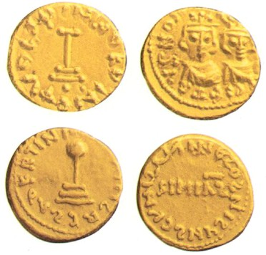
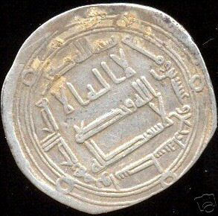
A Common Coinage
Trade was another issue the Umayyads faced
In 700 Abd al-Malik further unified the Empire by introducing a common coinage
The coins helped spread acceptance of Islam and the Arabic language
Commerce was also made easier

Slide 62
The Decline of the Umayyads
Over time the Umayyads started to neglect the rules of Islam
They did not base their laws on the Qur’an
Built lavish palaces outside of the towns where they spent their time hunting, drinking, or dancing surrounded by beautiful women, poets and musicians
The Umayyad clan was Sunni. Which meant they supported the election of caliphs. However, each Umayyad caliph named a relative as a successor before he died. This was creating a ruling family.

Slide 63
Unrest
The followers of the Umayyads became unhappy – especially the Shi’ites
Jews and Christians became unhappy: they didn’t like paying the more taxes than the Muslims
Persians didn’t like the substandard treatment
Umayyad soldiers no longer wanted to fight – they had become comfortable with their lives and family

Slide 64
The Abbasids opposed the Umayyads
One group of Muslims, the Abbasids, gained support from other Muslims who opposed the Umayyads
By 750 the combined forces devised a plan to overthrow the Umayyads
According to some historians, the Abbasids invited the Umayyad leaders to a meeting to talk about peace. At the meeting the Umayyad’s were murdered

Slide 65
Causes of Weakness
  Indulgence in luxury was rife due to increased wealth and supper abundance of slaves.
    During the era of Rightly Guided Caliphs the Caliphs functioned as equals living a life in simplicity.
    The emphasis on simplicity changed with the Umayyads who isolated themselves from the rest of the population.
    They took pleasure in the riches that flowed into the treasury in Damascus.
    They became less consultative and more authoritative.

Slide 66
Causes of Weakness
  Hazrat Muawiya ^{(ra)} caused a significant disturbance in the empire by naming his son, Yazid, as his successor.
  The ensuing controversy stemmed from the fact that the caliphate had traditionally been an elected office.
  Yazid was not a popular leader, and he reigned for only three years.
  The Shi'ites again vied for the caliphate starting a rebellion.
  Hazrat Ali's ^{(ra)} second son, hazrat Imam Hussein ^{(ra)}, whose subsequent death at the Battle of Karbala, in Iraq, is still commemorated by Shiite Muslims today.

Slide 67
The Collapse of the Umayyad Dynasty شہنشاھیت
The Umayyads' enemies formed a unified group to oppose the rulers. This group, led by descendants of Muhammad's uncle, Abbas, called themselves the Abbasids.
After several military conflicts between the two groups, the Abbasids succeeded in overthrowing the Umayyads in the battle of Zab 750, and installing their own caliph on the throne.
The Abbasids promised their supporters, many of whom were mawali, that all Muslims would be treated equally.

Slide 68
Spread of Islam
Expansion under the Abbasids

Slide 69
The Abbasid
The Abbasids symbolized their connection with their pre-Islamic predecessors by founding a new capital, Baghdad, near the old Sasanian capital.
Iraq was influenced by Persian history and culture, and moving the capital was part of the mawali demand for less Arab influence in the empire.
The city of Baghdad was constructed by al-Mansur on the Tigris River, in 762, to serve as the new Abbasid capital.

Slide 70
The Administrative Structure
The change in the location of the center to Baghdad brought Islamic civilization to the Persian administrative structures institutionalized by the Sasanide Empire.
Iranian imperial traditions of royal absolutism and bureaucratic specialization were brought to the Empire.
This was added to the Arab and Byzantine experiences that were adopted by the Umayyads.
Abbasid employed large number of converted Iranians into their elaborate administrative structure.
The Abbasids established the position of vizier in their administration. This change meant that caliphs under the Abbasids ended up in a much more ceremonial role than ever before, with the vizier in real power.

Slide 71
Administrative Structure Continued
The Abbasids exposure to the absolutist King adopted from the Sasanides carried the absolutist monarchy further than the Umayyads, isolating the Caliph except from his trusted ones.
The Abbasid Caliphs lived in luxurious palaces, they identified themselves not as the successors of the profit but “The Shadow of God on Earth.”
The Abbasids centralized political authority and the court system. The absolutist monarch played the role of the secular king and the head of judges.
This formula worked well and brought the Empire to 200 years of stability and prosperity, intellectual achievements, and general political stability based on the widespread acceptance to the benefits of the Caliph’s absolutism.

Slide 72
The Golden Age
In the ninth century two imperial powers stood opposite to each other Charlemagne in the West and Harun al-Rashid in the East.
Harun al-Rashid and Charlemagne were allies they exchanged letters of friendly relations.
During the reign of Harun al-Rashid Baghdad was the world center of wealth and international significance, standing against its rival of Byzantium.
Rashid’s era witnessed a the core of the development of Byzantine and Sasanide civilizations into a new awakening. This awakening was due in large measure to foreign influences.

Slide 73
The Golden Age
The Abbasid could rival their pre-Islamic predecessors in carrying and developing a civilization that was the most superior of its time.
Arab Muslims, who brought with him from the desert a keen curiosity to gathering knowledge adopted Aramaic civilization influenced by the Greeks in Syria and Persian civilization in Iraq.
The Arabic reading world was in position of the chief philosophical works of Aristotle, of chief Neo-Platonic Commentators and of most of the medical writings of Galen, as well as Persian and Indian sciences works.
This development was enhanced by The Caliphs generous patronage of artists and artisans of all kinds.
Economic prosperity and intellectual exchange was enhanced by the trade rout established by the great 7,000-mile Silk Road from Xi’an [Sian], China to Baghdad—then the two largest cities in the world—helped provide the wealth.

Slide 74
Translation دارالترجمۃ
The ensuing literary florescence was promoted by the capture of a group of Chinese papermakers at the Battle of Talas in 751.
The Abbasid encouraged translation from pre-Islamic languages, particularly Middle Persian, Greek, and Syriac.
This activity provided a channel through which older thought could enter and be reoriented by Islamic societies.
In the field of mathematics, al-Khwārizmī, from whose name the word algorithm is derived, creatively combined Hellenistic and Sanskritic concepts.
The word algebra derives from the title of his major work, Kitāb al-jabr wa al-muqābalah (“The Book of Integration and Equation”).
Encyclopedia Britanica “The Abbasides”

Slide 75
Tolerance and Pluralism
The Abbasids ability to expand and develop the Arab Islamic Civilization was mainly due to the principle of tolerance leading to the development of a pluralistic society.
The State was secular administering Jews, Christians, non believers, Zoroastrians and Muslims.
In Medina the Prophet started this process by making a defense alliance with the Jewish tribes that supported him. ( Mithaq al-Madina). The Abbasid followed this example.
Jewish scholars as masters of Arabic, Hebrew and Latin languages were seminal in the translation process.

Slide 76
Causes of glory Muslim Ummah
Muslims enjoyed victories
They had strong military
They were at peak in education, justice and culture
They were one Ummah
They had strong economy and Jihad was basic tool of strong economy.

Slide 77
Early Division
This difference in approaches on purely a political issue divided the Muslims permanently. (Political)
However, there were no differences among Muslims regarding Islamic Jurisprudence and worshipping (Ibadaat).
If some differences occasionally appeared among them, they never considered it as a difference that could divide Muslims.

Slide 78
Challenges faced by Muslim Ummah
Illiteracy
Terrorism
Poverty-HDI
Autocracy-SDI
Far behind in Science and Technology
No Veto Powers
Concentration of wealth
Redefining the role of women
Lack of Institutional Ijtehad
Occupied Lands
War ridden Economies

Slide 79
Challenges Faced by Muslim Ummah
Social Problems
  Nationalism and Sectarianism
  Jihad and Terrorism
  Absorption of Foreign Culture
  Clash of Civilization
Educational Decay
  Lack of Creativity and Innovation
  Failure to Promote Technical Education
  Failure to Educate Women

Slide 80
Causes of Debacles افراتفری، انتشار:
Forgetting Shariah
Materialism
Internal conflicts-Division
  Nationalism -Regionalism (Arab, Non Arab or Arab, African)
  Sectarian
Internal and International conspiracies
Illiteracy, poverty and conservatism
Leaving Jihad and spirituality

Slide 81
Responsibilities of Ummah:
Understanding, implementation and preaching of shariah- Religious
Establishment of Khilafat/Shariah-Political
Jihad-Economic
Ijtehad-Educational

Slide 82
Recommendations
Attainment of Veto power by Muslim countries
Islamic banking system, which ensures a system of interest and exploitation free principles
Effective Political role of OIC
Collective media of all countries to protect Muslim world
Common currency
Less reliance on USD
Common trade market
Common court of justice
Institutional Ijtehad
Development of Science and Technology

Slide 83
SUMMARY
Islamic glorious History
Period of Khlaft-E-Rashida
Period of Ummayyads
Period of Abbasids
Challenges face to
Mulsim Ummah

Slide 84
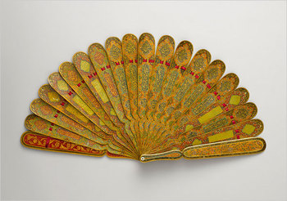
Short Activity
Introduce in your words the glorious islamic history?
Who are the Ummayyads?
Who are the Abbasids?
Recall the names of khulfa e rashideen?

Slide 85


