Slide 1


Slide 2
Islamic Studies course code 104
Associate Degree Education ADE/B.Ed(Hons)Elementary
Semester I

Slide 3

Lectuere#20

Slide 4
HUQOOQ.UL.IBAD AND LAST SERMON OF PROPHET MUHAMMAD (pbuh)
By Muhammad Imran

Slide 5
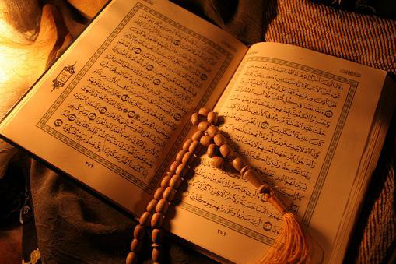
Out Lines
  Neighbors rights in Islam
  Teacher Dignity
  Teacher’s rights
  Rights of Non Muslims
  The Last Sermon of Prophet Muhammad(pbuh)and its Optimum.

Slide 6
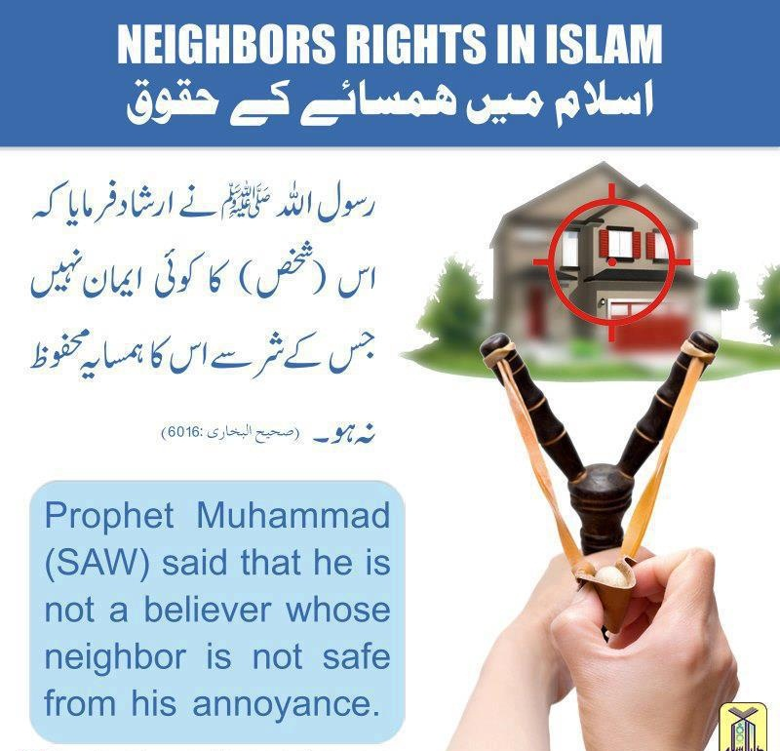

Slide 7
Who is "neighbor" in Islam?
Whoever lives with a man in a locality or city is a neighbor
Al-Auzai and Ibn Shihab said: "Forty houses in each direction"
Ali Ibn Abi Talib said: "Whoever hears the call (for prayer) is a neighbor"
Some scholars say:" Whoever hears the Iqama (call immediately preceding prayer, given within the mosque rather than from the minaret) is a neighbor of that mosque"

Slide 8
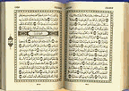
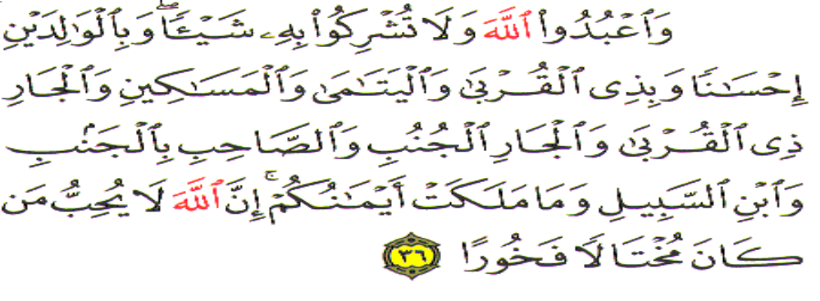
Neighbors in the Holy Quran
"Worship Allah and join none with Him in worship, and do good to parents, kinsfolk, orphans, Al-Masakin (the poor), the neighbor who is near of kin, the neighbor who is a stranger, the companion by your side, the wayfarer (you meet), and those (slaves) whom your right hands possess. Verily, Allah does not like such as are proud and boastful" ( Nisa,4:36)

Slide 9
Imam Qurtubi (R)
Allah (SWT) has ordered us, in His book through His Prophet, to:
Protect our neighbor,
To respect his rights
To care about his welfare.
He has mentioned the neighbor after the parents and the close relatives
He says, "neighbors who are near" and "neighbors who are strangers" meaning those who are not related to you.

Slide 10
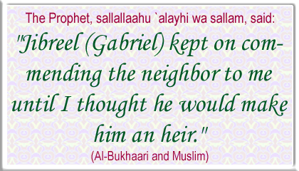

Slide 11
Protecting Neighbor is part of faith
Abu Huraira(RA) reported that the Prophet(SAW) said: "By Allah, he is not a believer! By Allah, he is not a believer! By Allah, he is not a believer.''
It was asked, "Who is that, O Messenger of Allah?''
He said, "One whose neighbor does not feel safe from his evil"
(Sahih Bikhari: Volume 8, Book 73, Good Manners and Form (Al-Adab), Number 45).

Slide 12
Examples of two women
Prophet Muhammad (SAW) was told of a woman who prayed during night and fasted a lot during day and gave alms generously, but whose neighbors complained of her abusive tongue. He said that she would be in Hellfire.
When Prophet Muhammad (SAW) was told of another woman who did not do all those extra acts of worship other than just compulsory (Wajib) but whose neighbors were happy with her, he said that she would be in Paradise.

Slide 13
Categories of Neighbors
Jabir (R.A.) relates that the Prophet (SAW) said:
Neighbors are of three kinds:
The neighbor with only one right is a non-Muslim neighbor with whom there are no family ties.
The neighbor with two rights is the neighbor who is also a Muslim (as such he has a claim as a neighbor as well as a fellow Muslim)
The neighbor with three rights is the neighbor who is a Muslim and a Relative - he has a claim as a neighbor, as a fellow Muslim and as a relative".

Slide 14
Good and Bad Neighbor
Saad Ibn Abi Waqqas (RA) narrated that our noble Prophet (SAW) said:" Four things bring happiness:
a righteous wife,
a spacious home,
a righteous neighbor and
a comfortable means of transport.
Four things contribute to misery:
A bad neighbor,
a bad wife,
a cramped home and
bad means of transport"
(Ibn Hibban: 1232)

Slide 15
Rights of the Neighbor
1- Returning his greetings and accepting his invitations.
2- Refraining from harming him
3- Bearing the harm of the neighbor,
Repel, by [means of] what is best, [theirevil)(23:96)
And whoever is patient and forgives - indeed, that is of the matters [requiring] determination. (42:43)
Al-Hasan said: “Being a good neighbor is not by refraining from harming; rather, being a good neighbor is to bear harm.”

Slide 16
Allah (SWT) loves one who shows tolerance towards neighbors
Abu Dharr (RA) reported that the Prophet (SAW) said Allah (SWT) loves a man who has a bad neighbor who annoys and disturbs him, but he bears it with patience and forbearance until Allah ends the matter either during his lifetime or upon the death of either of them." Ahmad and Tabarani.
One man came to Abdullah ibn 'Abbas(RA) and said to him: "A neighbor of mine causes me a lot of trouble, insults me and causes me inconvenience". Ibn Abbas replied: "If he disobeys Allah (by hurting you), Obey Allah (by being kind to him)." (Imam Ghazali, Ihyaa Ulum-ud-Din, Vol.2, p.212).

Slide 17
Pursuing and accomplishing needs:
Prophet (SAW) said: “He who spends the night satiated while knowing that his next door neighbor is hungry does not truly believe in me.”
Sometimes a Companion of the Prophet, , would receive a gift and then send it to his neighbor, who would send it to another neighbor, who would send it to another neighbor, and it would circulate around more than ten houses until it finally reached the first one again.
.” ‘Aaishah asked the messenger of Allah, , “I have two neighbors, to which of them should I offer a gift?' He replied:" To the one whose door is nearer to you.”

Slide 18
Accomplishing Needs
Abu Dharr, May Allah be pleased with him, reported: Prophet (SAW) commanded me thus,
"O Abu Dharr! Whenever you prepare a broth, put plenty of water in it, and give some of it to your neighbors".
Muslim # 6357
Abu Huraira (RA) reported that the Prophet(SAW) said: "No-one should prevent his neighbor from fixing a wooden peg in his wall." Bukhari

Slide 19
Concealing secrets and guarding honor
Neighbor may know some secret matters of his neighbor; he should accustom himself to concealing these secrets
His intention should be that if he does so Allah The Almighty would conceal his secrets in the worldly life and the Hereafter.
If he reveals such matters, then, he is subjecting himself to be repaid with the same kind of treatment. Allah The Almighty Says: And your Lord is not ever unjust to [His] servants.}[ 41:46]

Slide 20
Support your neighbor
Anas (RA) narrated that he heard our noble Prophet(SAW) saying: "By Him in Whose hand is my soul, no man truly believes until he loves for his neighbor –or his brother- what he loves for himself"
(Muslim:45,72)
Abu Huraira reported that the Prophet(SAW) used to say: "O Muslim women! No one should scorn the gift of a neighbor, even if it is (only) a sheep's foot"
(Bukhari: 6017)

Slide 21
Caring for the moral and religious status of the neighbours
On one occasion the Prophet (SAW) is reported to have said "What has happened to those, whom Allah has favored with the understanding of faith and religious knowledge, and they do nothing by way of teaching it to, their neighbors?
They neither give good counsel, nor discharge the duty of enjoining what is good and lawful, and forbidding what is bad and prohibiting.

Slide 22
Cont………
And what has happened to the uninformed ones that they make no effort to learn from their neighbors?
By Allah it is the duty of those who possess the knowledge to impart it to their neighbors - through good counsel and by enjoining what is lawful and forbidding what is prohibited.
In the same manner it is the duty of the ignorant and uninformed to acquire the knowledge from their neighbors and to take advice from them otherwise a severe punishment will befall them in their life"

Slide 23
Prophet (SAW) Directions:
“Do you know what a neighbor's rights are?
If he asks you for help, you should provide help for him,
If he falls ill you should visit him,
If something good happens to him you should congratulate him,
If something bad happens to him you should console him

Slide 24
Directions cont……
If he dies you should participate in his funeral procession.
You should not raise your building so high that you obstruct the blowing of wind to him unless he gives his permission
You should not hurt him with the smell of your cooking pot unless you send him some of the food
If you buy fruit send him some as a gift, otherwise you have to bring it into your house secretly and not allow your children to take it out to vex his children with it.( Reported by Mu'awiya Ibn Haidah )

Slide 25
Warning on violation of neighbor’s rights
Happiness, unity and the spread of love among the members of a society cannot be accomplished without observing these rights
Reality of many people is that these rights are being neglected, to the extent that they may not know the name of their next door neighbor
Some people usurp the rights of their neighbors and may even betray their neighbors and trifle with their honor
. The Prophet, , was asked: “What is the greatest sin?” In his answer he mentioned: “To commit adultery with your neighbor’s wife.”

Slide 26
Prophet Muhammad (Peace Be Upon Him) as a Teacher
Allah says in the Qur’an:
“It is He who has sent among the unlettered a Messenger from themselves reciting to them His verses and purifying them and teaching them the Book and wisdom although they were before in clear error”.
[Suratul Jumu'ah, Verse 2]
Allah sent Rasulullah (Peace Be Upon Him) to do four things:
Recite the verses of the Qur’an
Teach the Qur’an
Teach the Wisdom (sunnah)
Purify his followers

Slide 27
Prophet Muhammad (Peace Be Upon Him) as a Teacher
The leadership of Prophet Muhammad (PBUH) was most comprehensive and dynamic.
He was the model of virtue and spirituality.
He was a noble and compassionate teacher, a guide, and a reformer.
He always emphasized peace and harmonious relations instead of fight.
He built sacred bounds of brotherhood within the community

Slide 28
Prophet Muhammad (Peace Be Upon Him) as a Teacher
Rasulullah (Peace Be Upon Him) had amazing qualities of teaching that InshaAllah we can implement and follow as teachers, parents, siblings and any other roles we have in our communities.

Slide 29
Prophet Muhammad (Peace Be Upon Him) as a Teacher
Being concerned about the goodness for students
Kindness:
Rasulullah (Peace Be Upon Him) said, “Allah is Kind (Rafeeq) and He loves kindness, and confers upon kindness which He does not confer upon severity, and does not confer upon any thing besides it (kindness).” [Muslim]
We see his kindness throughout his life (Peace Be Upon Him)
When he would pass by children in the street he would play with them, unlike nowadays, where people think it is righteousness to never smile.
Anas ibn Malik (رضي الله عنه‏) ) narrated that whenever the Prophet (Peace Be Upon Him) would pass by children he would smile fondly and greet them. [Bukhari and Muslim].

Slide 30
Prophet Muhammad (Peace Be Upon Him) as a Teacher
The Prophet Muhammad (PBUH) did not just preach but went on to show mankind how to achieve success
His attitude towards the poor, needy and orphans or weak is sufficient proof for this. He was tolerant and gentle in his approach.
He legislated for fair and equal treatment of all human beings. In his last public sermon he said no human is superior to another except by piety.
He never turned down somebody whenever he is asked for something, even if he needs it himself.
He treated every one including his companions with dignity and respect.
His mercy did not leave out even the environment, he forbad people to misuse resources (water in particular)
He showed mankind how to achieve success in every aspect of life. He is certainly the best example for all human beings.

Slide 31
Some Principles followed by the Prophet Muhammad (Peace Be Upon Him)
To begin from the possible
To see advantage in disadvantage: The prophet Muhammad (PBUH) guided by the Qur’an, saw opportunities in every problem
To change the place of action
To make a friend out of an enemy (Qur’an 41:34)
A British orientalist remarked “He faced adversity with the determination to writing success out of failure”.
The power of peace is stronger than the power of violence
Not to be a dichotomous thinker
He always looked for a third option instead of focusing on 2 only.
To bring the battle in one’s own favorable field
Gradualism instead of radicalism
To be pragmatic in controversial matters

Slide 32
About respect of teacher
Story - Abdullah Ibn Abbas
Abdullah Ibn Abbas was the nephew of Prophet Muhammad (pbuh), the son of his uncle Abbas. When Abdullah was a youngster our Prophet would make dua for him asking Allah to give Abdullah a deep understanding of Islam and to let him understand things well.
There was a very close connection between our Prophet (pbuh) and Abdullah. Often as a child he spent time in the company of our Prophet (pbuh). When our Prophet passed away, Abdullah, who was only thirteen years old, was very sad.
Abdullah had a great zeal to learn about Islam so would sit in the company of the Sahabah, learning about Islam and about the teachings of our Prophet (pbuh). Often Abdullah would travel great distances even to learn a single hadith

Slide 33
Story of Abhullah ibn Abbas
In one visit, he went to see a Sahabi who was asleep at the time. Abdullah did not want to disturb the Sahabi so decided that he would wait outside until the Sahabi woke up. When the Sahabi woke up he was very surprised to see Abdullah waiting for him covered in dust. Abdullah had been waiting a quite a while.
The Sahabi asked, “Why did you not wake me up? You are the cousin of our Prophet (pbuh) and we would have come to see you if you had asked!”
Abdullah ibn Abbas explained that he was a student and the Sahabi was his teacher so he did not want to disturb or inconvenience him.
As time went on, Abdullah ibn Abbas became one of the most knowledgeable Sahabah and people would come from all over the world to learn from him. He was a great teacher from whom many people learned lost of information about Islam.

Slide 34
SomeRights of the Teacher
Never intrupt him between lectuere
Without his permission never talk
Never stand or sit in his place
Consider him like father
Never walk before him while your back towards him
Listen quitely his tips
Never be most frank with him
Always think that nobody like my teacher
Face his punishment or angerness with patience

Slide 35


Slide 36
General Rights of Non muslims
Preservation of Dignity as Human Beings
The Right to Freedom of Belief
The Right to Follow Their Religious Laws
: The Right to Justice(Islamic justice towards non-Muslims and justice as a right.)

Slide 37
General Rights of Non muslims-2
Security of Life, Property, and Honor
Receiving good treatment is the right of a non-Muslim under Islam, not just a matter of courtesy.
Poor and needy non-Muslims have the right to social security under Islamic Law.
: The right of non-Muslims to be protected against outside aggression in return for paying jizya.

Slide 38

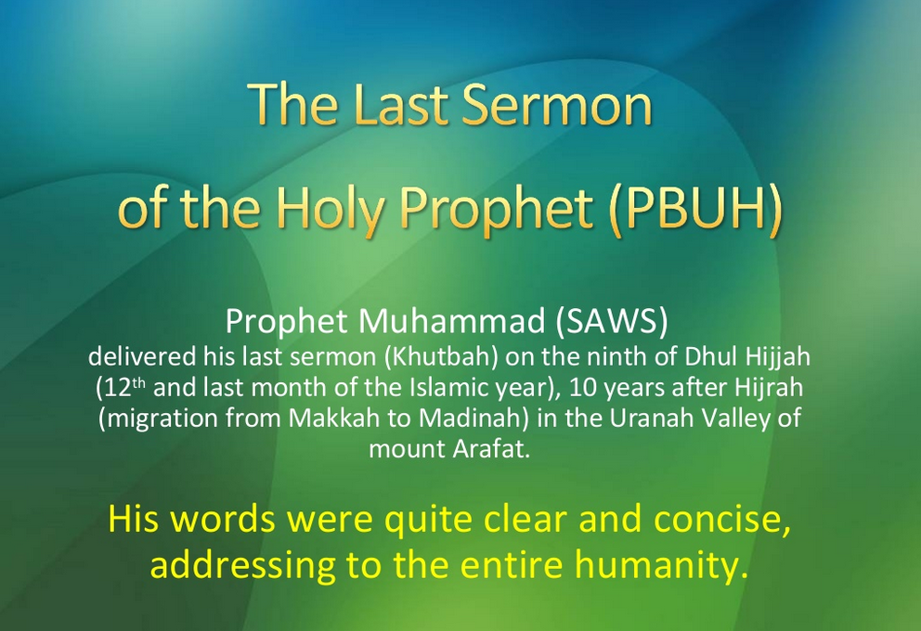

Slide 39
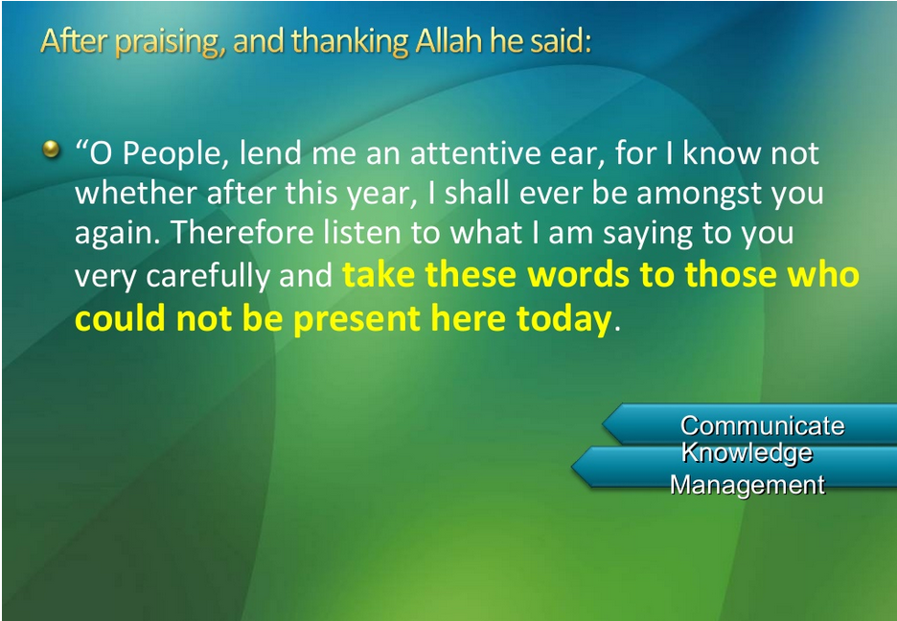

Slide 40

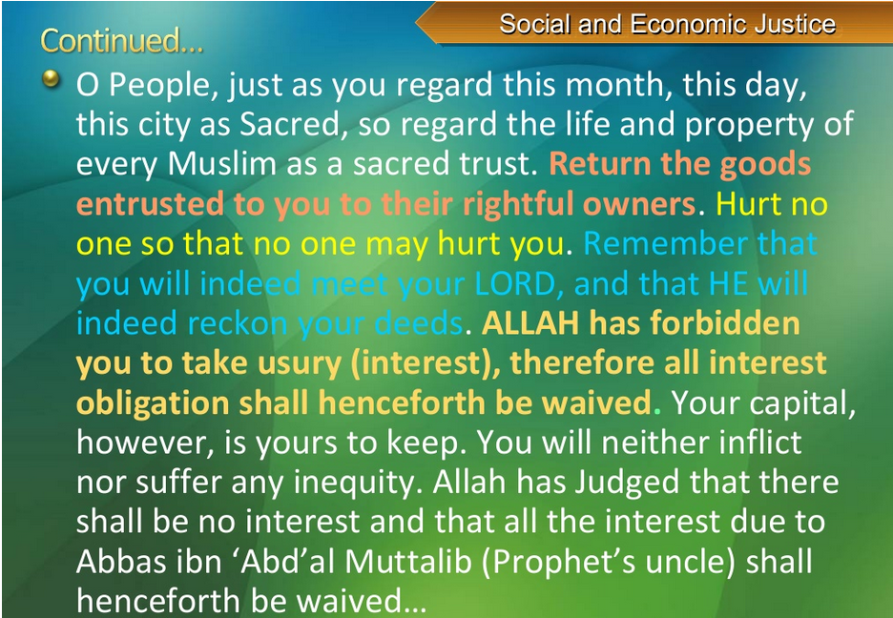

Slide 41
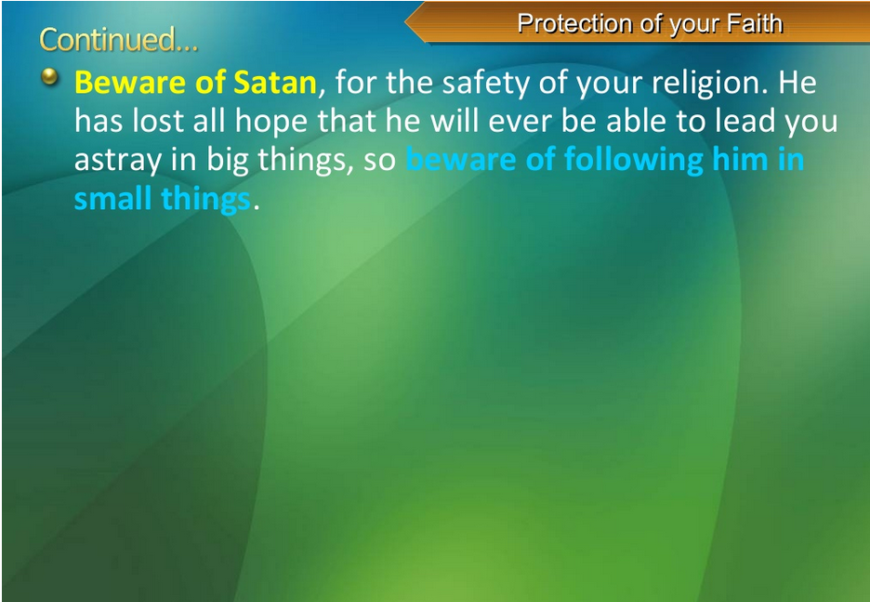


Slide 42

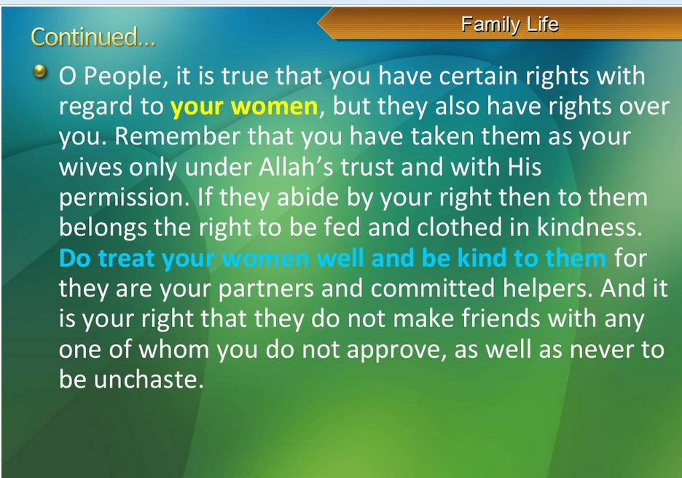

Slide 43
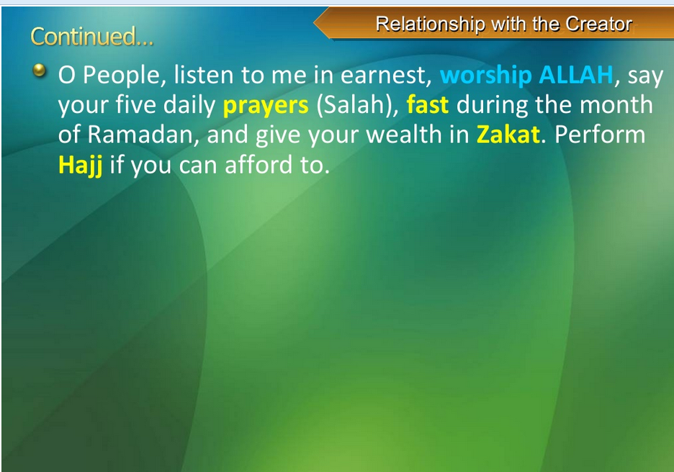

Slide 44

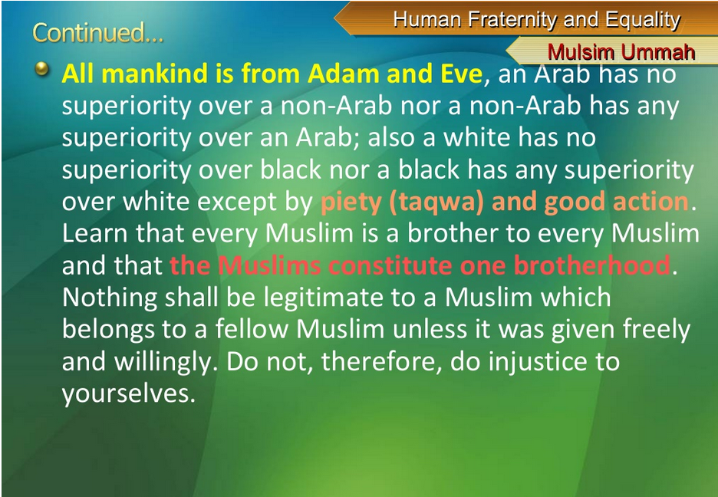

Slide 45
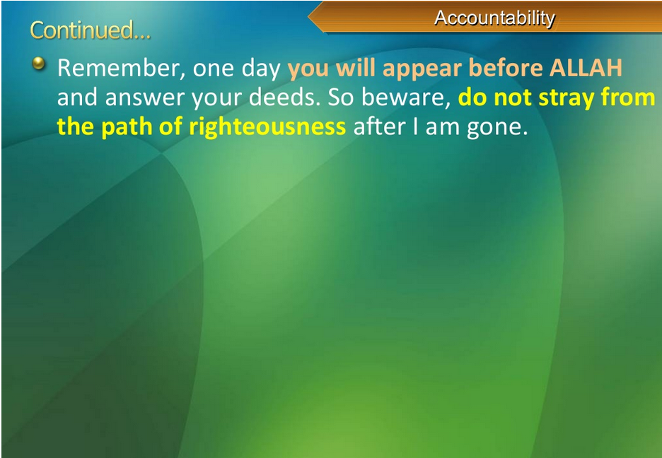

Slide 46
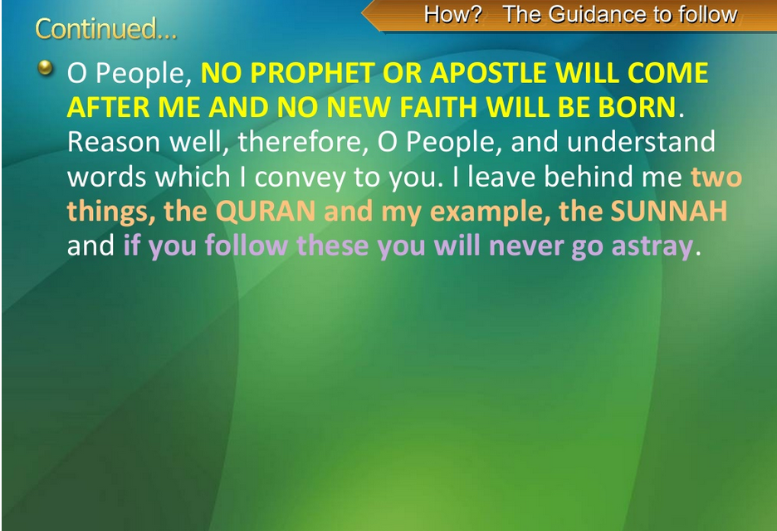


Slide 47
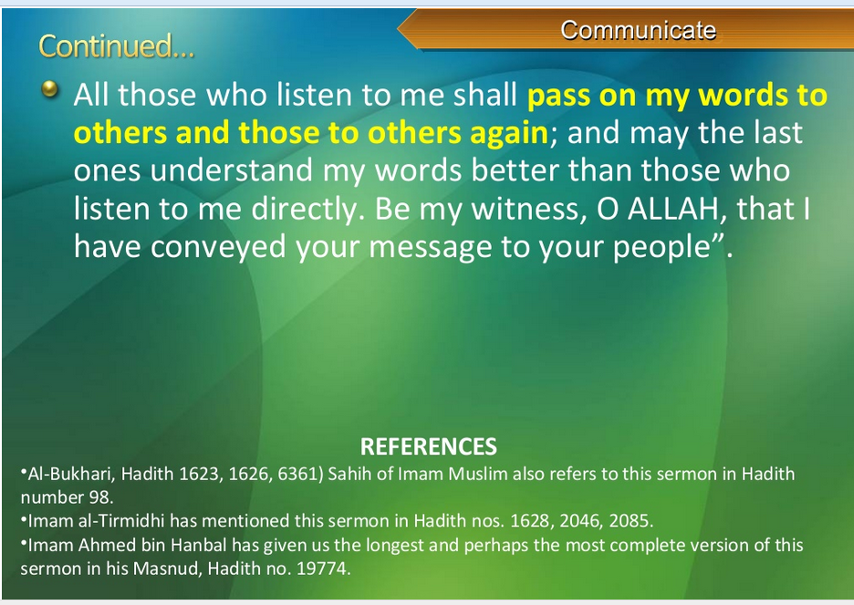

Slide 48
Out Lines
  Neighbors rights in Islam
  Teacher Dignity
  Teacher’s rights
  Rights of Non Muslims
  The Last Sermon of Prophet Muhammad(pbuh)and its Optimum.

Slide 49
Questions to you?
What is the meaning of huqooq.ul.ibad?
Discuss some rights of neighbors?
Explain the dignity of teacher after seeint slides?
Count any 5 ritghts of non muslim give them by Islam?
Memorize the lesssons of last sermon?

Slide 50


