Slide 1
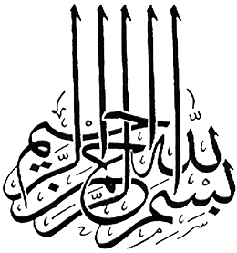

Slide 2
Islamic Studies
Associate Degree Education ADE/B.Ed(Hons)Elementary
Semester I

Slide 3
My Introduction
Muhammad Imran
  MA ISLAMIAT(PU)
  FAZIL ARABIC(BISE RWP)
  Master of Education(M.Ed)A.I.O.U
A.P/H.O.D ISLAMIC STUDIES
  PUNJAB COLLEGE OF COMMERCE
  RCC RAWALPINDI

Slide 4
Fundamental Beliefs of Islam
By Muhammad Imran

Slide 5

Lectuere#02

Slide 6
BELIEF in the PROPHETS

Slide 7

Outline
Prophets and Prophethood
Divine Purposes for Sending the Prophets
Characteristics of the Prophets
The essentials of Prophethood
How many Prophets have been sent to mankind?
Prophets Conveyed the Same Message
What is a ‘miracle’?
Why are Prophets human?
Were there any woman prophets?
Characteristics of Prophet Muhammad(p.b.u.h)and the Finality of Prophet Muhammad(p.b.u.h)

Slide 8
FAITH IN Allah’S PROPHETS:
Meaning of this belief:
-To believe that all the Prophets were true.
-They brought essentially that same religion Islam.
-The person who denies one of the Prophets is kafir.

Slide 9
Belief about all Prophets
-All the Prophets have not been mentioned in the Quran.
-There is no difference between our Prophet and the previous Prophets.
لانفرق بين أحد من رسله
(we do not differenciate one of the prophets from the other.)
تلك الرسل فضلنا بعضهم على بعض.

Slide 10
Risalatt (Prophethood)
Risalatt is the second most important belief of Islam after Tauheed. Risalatt means ‘transmitting the message’’.
In Islamic terminology Risalatt means transmitting the divine message to the people through His Prophets, they are called Rasool.
The divine message is given to them through revelation. The prophets do not say any thing from their own but only transmit the sharia.

Slide 11
Risalatt (Prophethood)--2
The Holy Quran says: ‘‘And Prophets do not say any thing from their own but what is revealed to them.’’’
The first prophet of Allah was Hazrat Adam and the last one was Hazrat Muhammad PBUH.
Now all human beings will have to carry on their lives according to the Shariah of Hazrat Muhammad PBUH till the Day of Judgment.

Slide 12
Risalatt (Prophethood)
Meaning
”رسالة“ (ر س ل)
it literally means to send.
Technically: To convey the message of Allah to his worshippers.
Difference B/W (Nabi) and (Rasool).

Slide 13
What is the difference between a Nabi and a rasool?
Some Messengers were Nabi’s only. However, some Messengers were Nabis and rasools.
A rasool was a messenger of Allah who was given a new Shariah (codes of law) from Him.
A Nabi was also the messenger of Allah, but he was not given any new Shariah and followed the shariah of an earlier rasool.

Slide 14
Prophets Conveyed the Same Message
All the prophets called humankind to Allah's unity.
In their teachings, differences might have happened in minor matters depending on the conditions of their peoples. However, all these teachings are the same in essence. E.g., stealing is evil and a sin in all; yet, the way a thief is punished might differ.
For We assuredly sent amongst every people an Messenger (with the command), ‘Serve Allah and eschew evil.’ (Quran 16:36)
Whenever people fell into darkness after a Prophet by forgetting, changing and distorting his message, Allah sent another one to enlighten them again. This continued until the coming of the Last Prophet.

Slide 15
Why are Prophets human?
If Prophets came from angels, people would object to this saying, “We cannot be like them so we cannot follow them.”
The Prophets’ being human helps convey the message easily and in a more understandable way.

Slide 16
Were there any woman prophets?
Prophets were from men.
“And before thee also the messengers We sent were but men, to whom We granted inspiration: if ye realise this not, ask of those who possess the Message.” [Qur’an 16:43]

Slide 17
Need of Prophet hood

Slide 18
Need and Significance of Risalat
وما خلقت الجن والإنس إلا ليعبدون
Human is bound to act according to the will of Allah.
Need of seeking the guidance to act accordingly.

Slide 19
Need of the Prophethood
To preach Allah’s injunctions: The very purpose of the man creation is to worship Allah.
The first need of Prophet was to explain before people the sharia.

Slide 20
Need of the Prophethood..2
2) To reform the society:
The Prophets were sent to reform the society. Allah had sent Prophets in every tribe and in every nation.

Slide 21
Need of the Prophethood---3
3) To practice the sharia:
The third important need of the Prophet is to practice himself all the sharia. The Prophet is a messenger no doubt but over and above he is a preacher, a guide, a teacher and an interpreter.
Allah says in Holy Quran: ‘‘And there is a great model for you in the person of Prophet of Allah Muhammad PBUH.’’

Slide 22
What is the Divine Purpose for Sending the Prophets?
The Prophets were sent
to illuminate the way of mankind
to guide people to the service of Allah
to teach people the meaning of creation
to teach Allah’s laws
to be examples
to establish the balance between this world and the next
to be Allah’s witnesses

Slide 23
Attributes Of Prophets Of Allah
Prophets are humanbeings.
Prophehood is bounty of Allah not right.
Innocency of prophets.
Revelation.
Odedience.

Slide 24
Functions &Charactristics of Prophets

Slide 25
Functions of Prophets
Speak according to
Revelation(Najam 2-3)
Human beings
(Kahf 110)
Means of Obedience
to Allah (Nisa 80;)
Explainer of Books
(Araf 157)
Teacher
(Juma 2)
Practical model
(Ale-imran 30-31;Ahzab 21)
Legislator & Judge
(Nisa 105)
Final Witness
(Nissa 165)

Slide 26
Prominent qualities of Prophets:
Human beings: To have the capabilities of good and bad to be models for the followers.
Best of all human beings: Even their enemies admitted reason for that.

Slide 27
Continued
Emergence of Miracles:
What is Miracle?
Knowledge through Revelation
Common Teachings:
Reason for that?

Slide 28

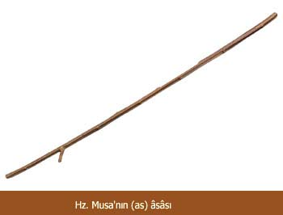
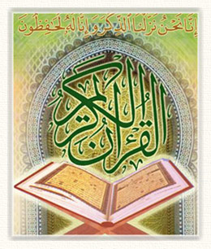
What is a ‘miracle’?
A miracle is an extraordinary event that Allah Almighty brings about at the hands of a Prophet to prove his Prophethood, strengthen the believers' faith, and break the unbelievers' obstinacy.
Examples:
  The Staff of Moses
  Healing of Jesus
  The Holy Qur’an

Slide 29
Characteristics of Prophets:
a) Humanity: Allah always sent a human being as his messenger to the mankind instead of sending angels or jinns.
b) Bounty of Allah: Prophethood can not be achieved by efforts but it is the bounty of Allah bestowed upon those whom Allah desire to bestow.
c) Knowledge bestowed by Allah: Another important attribute of the prophethood is that all they describe, all their preaching and all their instructions are divine one and revealed on them. They never present their personal views, wishes, desires and emotions.
d) Innocent: A Prophet never errs in his actions and in his conducts or in his judgment or thought nor his conduct or morality is open to slightest criticism. Their feelings, thoughts and actions are pure and safe from satanic temptation. All Prophet were innocent.

Slide 30
Some characteristics of the Prophets
The Prophets
depended on revelation
were sincere in every action
were very patient in faces of adversity
were very compassionate toward all living beings
called people wisely and with kindness
called humankind to Allah’s Unity

Slide 31
The essentials of Prophethood
The essentials of Prophet hood common to all of the Prophets are:
Truthfulness
Trustworthiness
Convey the message
Intellect
Infallibility

Slide 32
How many Prophets have been sent to mankind?
No region or people has been altogether deprived of Divine enlightenment through Allah’s chosen servants, His prophets.
Directly or indirectly, all people of all periods have, at some time in their history, known or been aware of a prophet and of his teaching.
There never was a people without a Warner having lived among them. (Quran 35:24)
And We assuredly sent among every people a Messenger. (Quran 16:36)
The Qur’an mentions 25 out of 124,000 prophets. We do not know exactly where and when many of them lived.
We did in times past send Messengers before you; of them there are some whose stories We have related to you, and some whose story We have not related to you. (Quran 40:78)

Slide 33
How many Prophets were sent to mankind?
Approximately 124,000 Prophets were sent to mankind.
Allah swt says in the Quran:
And We certainly sent into every nation a messenger.
he Quran:
And We certainly sent into every nation a messenger.

Slide 34
Prophets mentioned in the Qur’an
The Quran mentions 25 Prophets by name. These are:
Musa (Moses)
Harun (Aaron)
Dhu'l-kifl (Ezekiel)
Dawud (David)
Sulaiman (Solomon)
Ilias (Elias)
Al-Yasa (Elisha)
Yunus (Jonah)
Zakariyya (Zechariah)
Yahya (John)
Isa (Jesus)
Muhammad
(May the Peace and Blessings of Allah swt be upon them all)
Adam
Idris (Enoch)
Nuh (Noah)
Hud
Saleh
Ibrahim (Abraham)
Isma'il (Ishmael)
Ishaq (Isaac)
Lut (Lot)
Ya'qub (Jacob)
Yousef (Joseph)
Shu'aib
Ayyub (Job)
(May the Peace and Blessings of Allah swt be upon them all)

Slide 35
Which Revelations were revealed to each rasool?
1.The Tawrat (Torah) was revealed to Musa (as)
2.The Zabur was revealed to Dawood (as)
3.The lnjil (Bible) was revealed to lsa (as)
4.The Quran was revealed to Muhammed (pbuh)
Important Note:
There was also a Revelation given to Ibrahim (as) known as the Suhuf-e-lbrahim (Scrolls of Ibrahim)

Slide 36
Should Muslims still follow the Revelations prior to the Quran?
Accroding to Islamic Faith of Divine Books,
Only the Quran exists in its original form, unchanged.
The other divine books are not available in their original language and form. Even their original texts do not exist.
Their compilers have modified, changed and distorted Allah's words.
They mixed their words with Allah's words.
Even if they were available, the Quran supersedes all of the older revelations.

Slide 37
Who is the main Angel who delivers the Message to the Prophets?
The angels are most obedient creatures and their duty is to glorify and praise Allah.
The most prominent among the angels are Hazrat Jibrail. He brought the revelations from Allah to all the Prophets.

Slide 38

Think...
05 minutes Activitiy
1.Discuss about the beleif of Prophet hood in a group of 2 or 3 students?
2.Prophet hood(Risalat means..................................?
3.What is the difference between Rasool and Nabi?
4.What is our beleif about all Prophets?
5.What are the Divine Books?
6.Introduce the Holy Quran ?
Notes:
Discuss as a class the idea that Arabian Polytheism is condemned as being sinful because it goes against Tawhid.

Slide 39
Differences
(these are the prophets in which we have preferred some over other)
In spite of the equality there are some differences.
-For all the people - for certain people
-For all the times to come – for certain time
-For the whole world - for certain area

Slide 40
Salient features of Muhammad (S.A.W.S)
-The previous Prophets teachings disappeared or intermingled while the teachings of Muhammad ( S.A.W.S ) are preserved.
-Complete guideline by the last prophet while the others' teachings were changed by the coming Prophets. It finally completed by the last Prophet (S .A .W .S).

Slide 41
Salient features of Muhammad (S.A.W.S)--2
Completion of Prophet Hood.
Possessing a complete record of life
Comprehensiveness: in his life.
Complete guideline: In his practical life.

Slide 42
Continued
Universality: No boundaries of country, race or nation.
The Miracle of the Quran: in original form.
Protection of Ahadees.
Practicable teachings: because of availability of Ahadees.
Scientifically true teachings

Slide 43
Finality of Prophet Muhammad (PBUH)
Finality of Prophet Muhammad PBUH:
It means that the process of the Prophethood was started from Hazrat Adam reached to an end with the Prophethood of the Hazrat Muhammad PBUH and that no Prophet will come after him. The belief in the finality of Prophethood of Hazrat Muhammad PBUH is as important as other conviction of the faith in Islam.

Slide 44
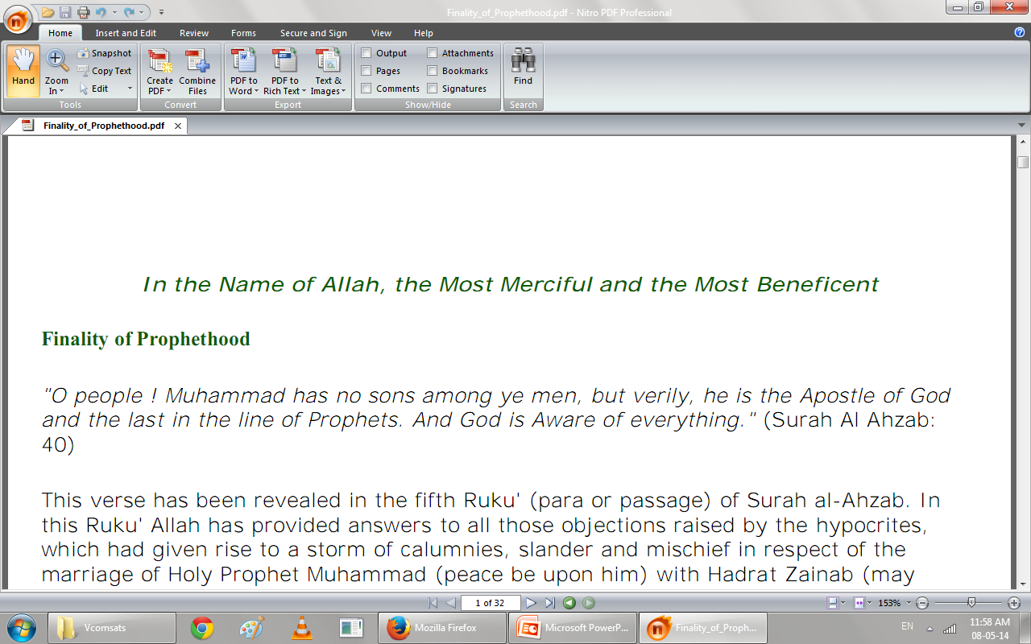
The finality of Prophet Hood:
Meaning of the finality of Prophethood.(lexical and terminological meanings)
There is no need of new prophet or Sharia till last day of universe.
Corruption in the previous teachings.
Incompletement of the previous teachings.
Non universality of the previous teachings.

Slide 45
Characteristics of Prophet Muhammad PBUH
Universality: The Prophets that were sent before Muhammad (SAW) were for a specific time and a specific nation. But Prophet Muhammad PBUH is for all times and for all nations till the day of judgment. In other words Prophethood of Muhammad PBUH is universal in nature.
Annulment of earlier Shariahs: Allah Almighty annulled all other shariahs of earlier Prophets through His beloved Prophet Hazrat Muhammad PBUH. Due to the universality of the Prophethood of Muhammad PBUH now only Shariah of Prophet Muhammad PBUH will prevail till the day of judgment.

Slide 46
Characteristics of Prophet Muhammad PBUH…..2
c) Perfection: Allah completed his religion on Prophet Muhammad PBUH and now there is no need of another religion. The religion of Prophet Muhammad PBUH is a complete religion which cover each and every aspect of life from cradle to the grave.
d) Finality of Prophet Muhammad PBUH: It means that the process of the Prophethood was started from Hazrat Adam reached to an end with the Prophethood of the Hazrat Muhammad PBUH and that no Prophet will come after him. The belief in the finality of Prophethood of Hazrat Muhammad PBUH is as important as other conviction of the faith in Islam.

Slide 47
Attributes Of Prophet Muhammad (S.A.W)
Universality.
Finality of Prophethood.
Comprehensiveness.
Perfection of Religion.
Abrogation of previous Religions.
Sirat-un-Nabi Complete code of life.

Slide 48
Our Obligation Of Belief In Prophethood
Love.
Obediencey.
Obeying the Prophet is obedient of Allah.
Success in obeying the Holy Prophet (S.A.W).

Slide 49
Namoos-e-Risaalat
Respect to the Holy Prophet (Namoos-e-Risaalat)
Meaning Of “Namoos” The meaning of Namoos is:
Respect.
Sanctity and Reverence.
The meaning of Namoos-e-Risaalt is to respect to
messengerhood, respect and reverence.

Slide 50
Meaning Of Risaalat
The meaning of Risaalat is derived from the Arabic root “r-s-l” which developed the following meanings:
To bring a message of great importance or great utility.
To impart Knowledge of something.

Slide 51
Namoos-e-Risaalat According To Holy Qur’an
Respect him.
Follow commands of Allah and of his Prophet(S.A.W).
Whatever he gives you, take it.
The reward of believing in prophethood.
Respect to Prophet Muhammad (S.A.W) by Sahabas.
Reactions upon Blasphemous Acts.

Slide 52
Summary
Prophets and Prophethood
Divine Purposes for Sending the Prophets
Characteristics of the Prophets
The essentials of Prophethood
How many Prophets have been sent to mankind?
Prophets Conveyed the Same Message
What is a ‘miracle’?
Why are Prophets human?
Were there any woman prophets?
Characteristics of Prophet Muhammad(p.b.u.h)
and the Finality of Prophet Muhammad(p.b.u.h)

Slide 53

Jazak Allah

