Slide 1


Slide 2
Islamic Studies course code 104
Associate Degree Education ADE/B.Ed(Hons)Elementary
Semester I

Slide 3

Lectuere19

Slide 4
Duties of a muslim rights of allah rights of men
حقوق اللٰہ،حقوق العباد
By:Muhammad Imran

Slide 5

Out lines
Duties of a Muslim in his life
Two major sections
The rights of Allah
The rights of Men
In this lectuer rights of parents,
Rights of children
Rights of wife
Rights of husband
Rights of relatives

Slide 6

The Rights of Allah

Slide 7
The Rights of Allah
Mu’adh bin Jabal said: “While I was riding upon a donkey with
the Prophet, he said to me;
‘O Mu’adh! Do you now what Allah’s right is upon His
worshippers, and what the worshipper’s right upon Allah is?’
I replied, ‘Allah and His messenger know better.’ He said,
’Allah’s right upon His worshipper is that they worship Him
without Associating anything with Him. The worshipper’s right
upon Allah is that He does not punish anyone who does not
associate anything with Him.’ I said, ‘Shall I tell this to the
people?’ He said, ‘Do not inform them since they may depend
on it.”
Bukhari and Muslim recorded it.
Notes:
On the day of judgment Allah will bring forward a man and ask him “If you had the world and everything it contained would you ransom it now to save you from the fire.” “Yes, my Lord” “I asked you for less than that. I asked that you should worship me and worship me alone and not ascribe partners to me.”

Slide 8
Al ibaadah
A collective term for everything that Allah loves and is please with, from the sayings and actions, inwardly and outwardly.
Ibaadah of belief
Ibaadah of the heart
Ibaadah of speech
Ibaadah of the the body
Ibaadah of Wealth etc.

Slide 9
What are the conditions for any deed to be accepted?
Sincerity
According to the guidance of the Prophet

Slide 10
The Categories of Shirk
Shirk in Ruboobeeyah (Lordship)
Shirk in the Asmaa was Siffaat (Names and Attributes)
Shirk in Ulooheeyah (worship)

Slide 11


Slide 12
Huqooq—ul-ebad
Rights of parents
Rights of children
Rights of wife and husband
Rights of relatives
Rights of neighbours
Rights of teacher
Rights of non muslims
Rights of slaves and others
Social rights of a muslim

Slide 13
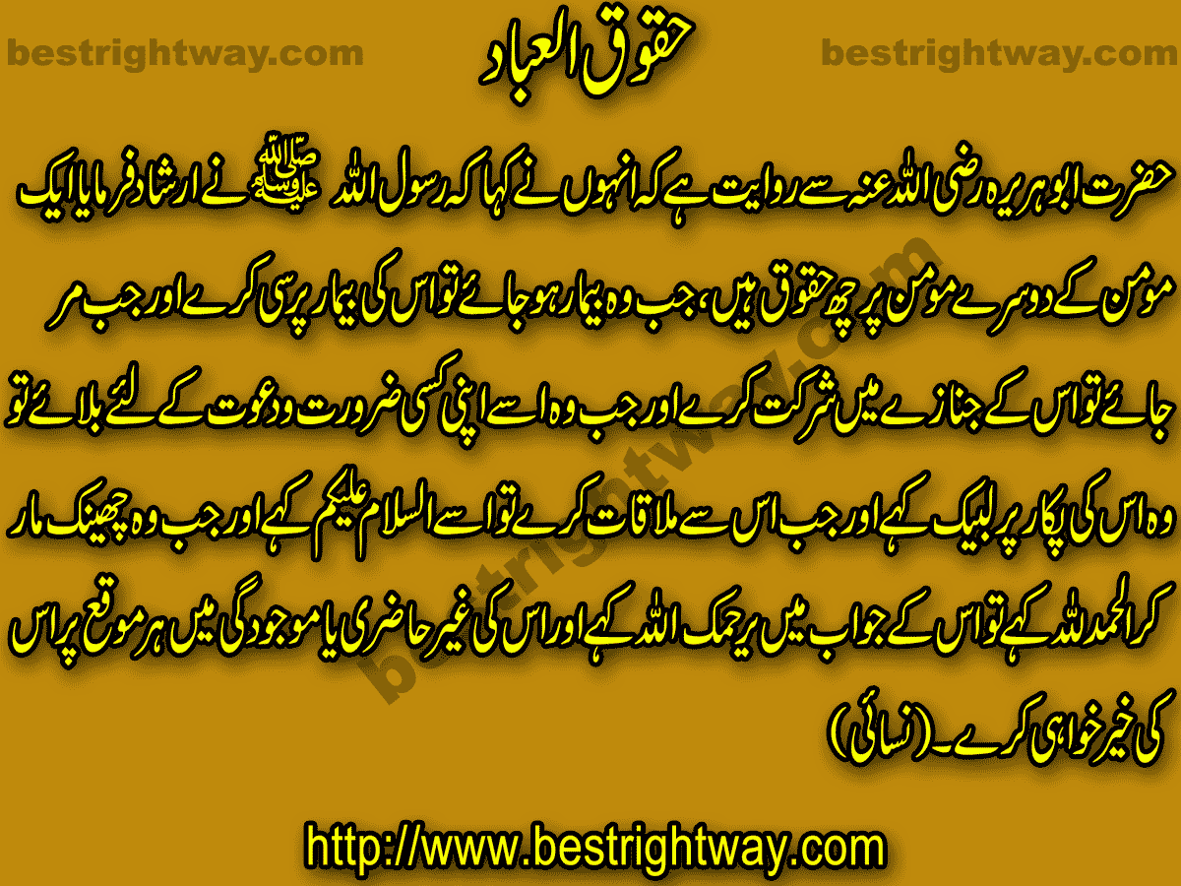
حقو ق العباد

Slide 14
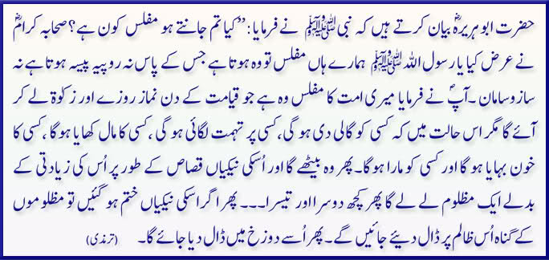

Slide 15
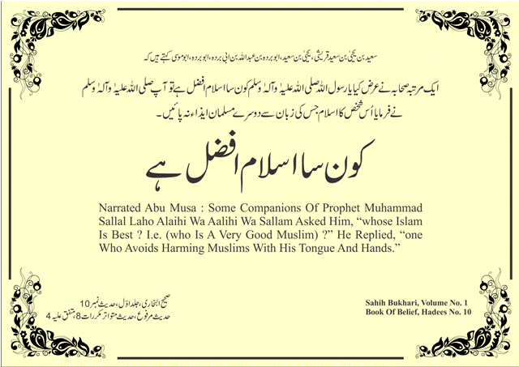

Slide 16


Slide 17
Don’t say uff to them
And your Lord has commanded that you shall not serve (any) but Him, and goodness to your parents. If either or both of them reach old age with you, say not to them (soA much as) “aah" nor scold them, and speak to them a kind word.
(Quran 17:23)

Slide 18
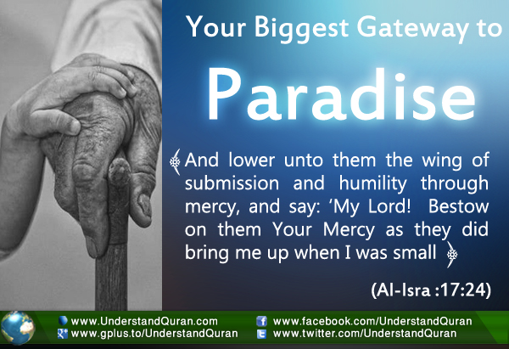
Dua for them

Slide 19
Duaربنااغفرلی ۔۔۔۔
And We have enjoined man in respect of his parents-- his mother bears him with pain upon pain and his weaning takes two years-- saying: Be grateful to Me and to both your parents; to Me is the eventual coming.
(Quran 31:14)

Slide 20
"Paradise lies under the feet of the mother.“ prophet Muhammad (saw)

Slide 21
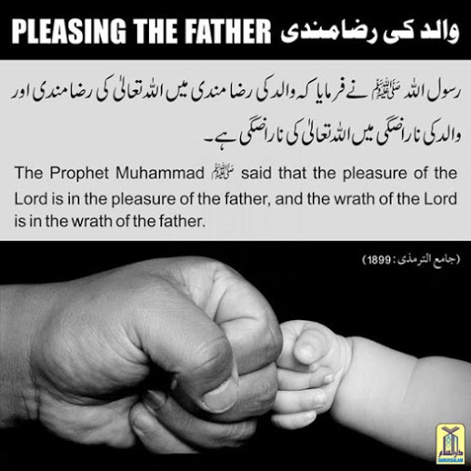

Slide 22
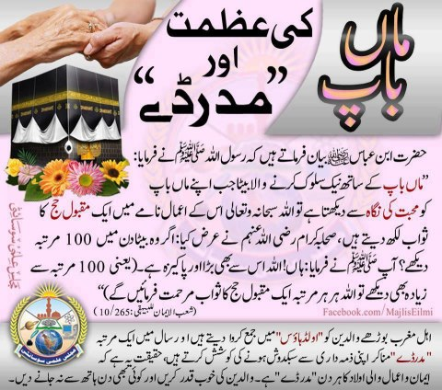

Slide 23
Reward to look
"If a person looks with love at his parents, God writes in his favor the reward equal to the performance of one Hajj.(pilgrimage)“
prophet Muhammad (saw)

Slide 24
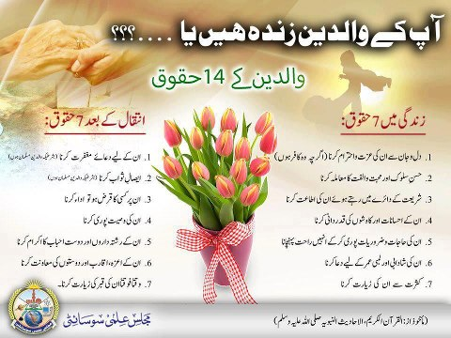
Parents 14 righths

Slide 25
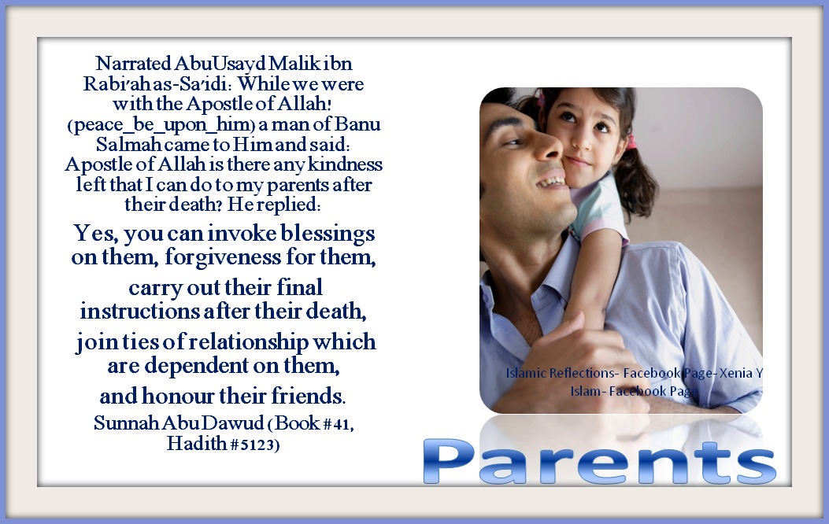
After death their rights

Slide 26


Slide 27
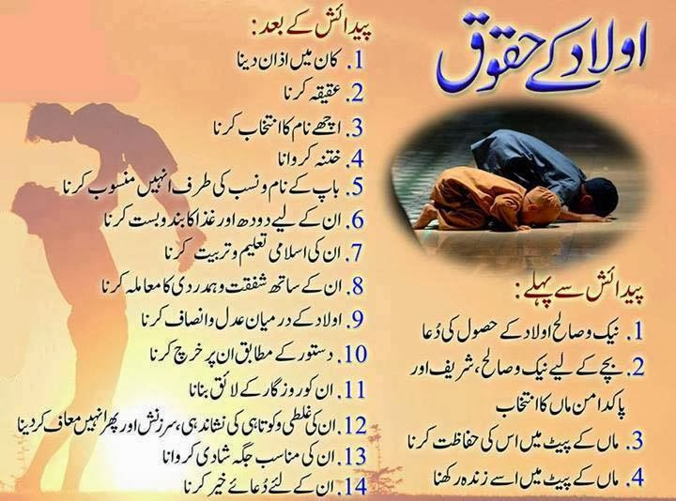

Slide 28

Parents should understand children…
Parents enjoy a very respectable position in their children’s life. That is reason enough to be close, to try to know ,to try to understand what it feels like to be a child or a teenager

Slide 29
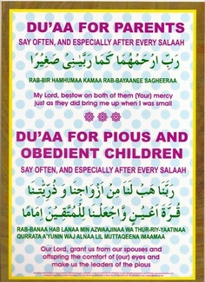
qurani
Dua for pious children

Slide 30
Rights of children
The ritghts of children on their parents are:
Right of a comfortable life
Right of living
Right of procurement of basic needs of life e.g clothing,shelter,and medical aid.
Proper instructions and guidence
Equality among them
Equiped them with education religious and formal both types.

Slide 31
Care them like flowers
Parents are to children what gardeners are to flowers. The flower has to blossom one day to beautify the garden…but it does need that gentle touch of love and care you know
Allah’s Apostle said, “When night falls (or it is evening), keep your children close to you for the devils spread out at that time. But when an hour of the night elapses, you can let them free. Close the doors and mention the Name of Allah, for Shaytaan (Satan) does not open a closed door.” — Bukhari 4:523, Narrated Jabir bin Abdullah

Slide 32
An earnest advice
Put in the best effort and give them the best in education and the best in discipline...
Aspire and strive to give the best rather than having your aspirations fulfilled through them….

Slide 33
Be gentle, Yet caring
Use your controlled temper to discipline,
to teach Islam,
to protect them from harm and
to make them righteous &good Muslims…

Slide 34

Some things are not taught, but are inspired and most things are learnt through inspiration…So try to practice what you preach, even if your children are not watching you…
Abu Hurayrah (May Allah be pleased with him) once saw two men. He asked one of them, “How is this man related to you?” He replied, “He is my father.” Abu Hurayrah said, “Do not call him by his name, do not walk in front of him and do not sit before he does-Bukhari, Vol 1, pg 19

Slide 35

Aim at the ultimate goal….
Remember that this life is but a transient and our hereafter is our permanent abode….
The best gift a parent can give his child is a beautiful mind that thinks and acts the way Allah(SWT) loves…

Slide 36


Slide 37


Slide 38
Role of Husband
Husbands are to be “God conscious” and treat their wives with the respect and dignity they deserve because God is watching over them (Sur 4:1)
They should be God fearing (Sur 3:102, 33:70)
Must be committed to his wife and to
provide for the family
The groom also expresses qubul

Slide 39
Women in Medieval Times
Women were basically treated like domesticated pets
Had to take care of all household responsibilities
Worked in fields and helped their husbands
Marriage was compulsory
Treated with little or no respect

Slide 40
Women in Arabia before Islam
Women were not equal to men when it came to issues such as marriage, inheritance or education
Women had no legal rights
Female infants were buried alive
Polygamy was widespread

Slide 41
The Qur’an defines woman’s role
Made women feel more secure in society
Killing infant girls was forbidden
Gave women birthrights
Divorced woman was entitled to financial support from her ex-husband
Khul is the ending of marriage at the wife’s request

Slide 42
Different but complementary roles
Quran portrays men and women equal although they still have corresponding functions
Woman is the work of art of Allah’s formations
Woman’s basis of self-respect is equal to man
Both can choose the path they want to follow
Value is equal, qualities differ
Laws such as woman’s rights to owning property, divorce, inheriting family values, owning businesses, and getting an education have existed in Islam since the Prophet’s (PBUH) time
Role model woman should be kind and committed
Muslim women are entitled to the same rights as Western women, although it doesn’t always appear that way

Slide 43
Who is superior? Man or Woman?
Although they are both viewed equally, women have different responsibilities in life
Both are superior in Islam
At the same time, women are treated as delicate figures
Technically speaking, the man is responsible for providing for the family and the woman is responsible for taking care of her home

Slide 44
Man’s treatment of his wife
As mentioned earlier in this presentation, the Prophet (PBUH) urged men to treat women with respect
The Prophet (PBUH) said, “The best among you is the one who is best towards his wives.”
“Whoever takes care of two girls until they reach adulthood, he and I will come like this on the Day of Resurrection,” and he held his fingers together

Slide 45


Slide 46
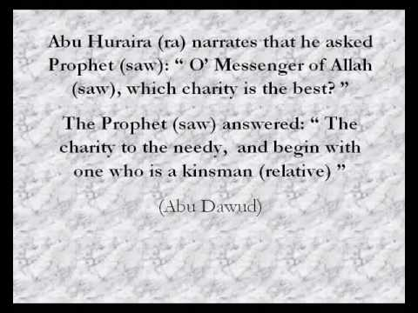
Charity begins at home

Slide 47
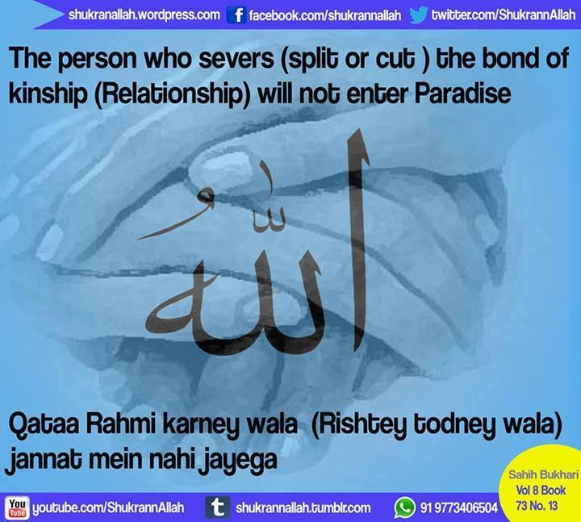

Slide 48
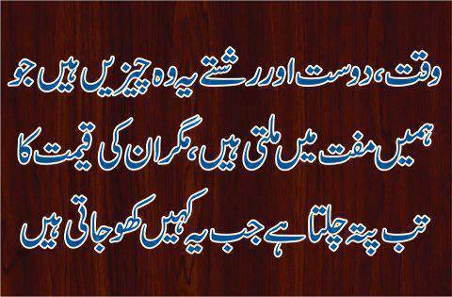

Slide 49
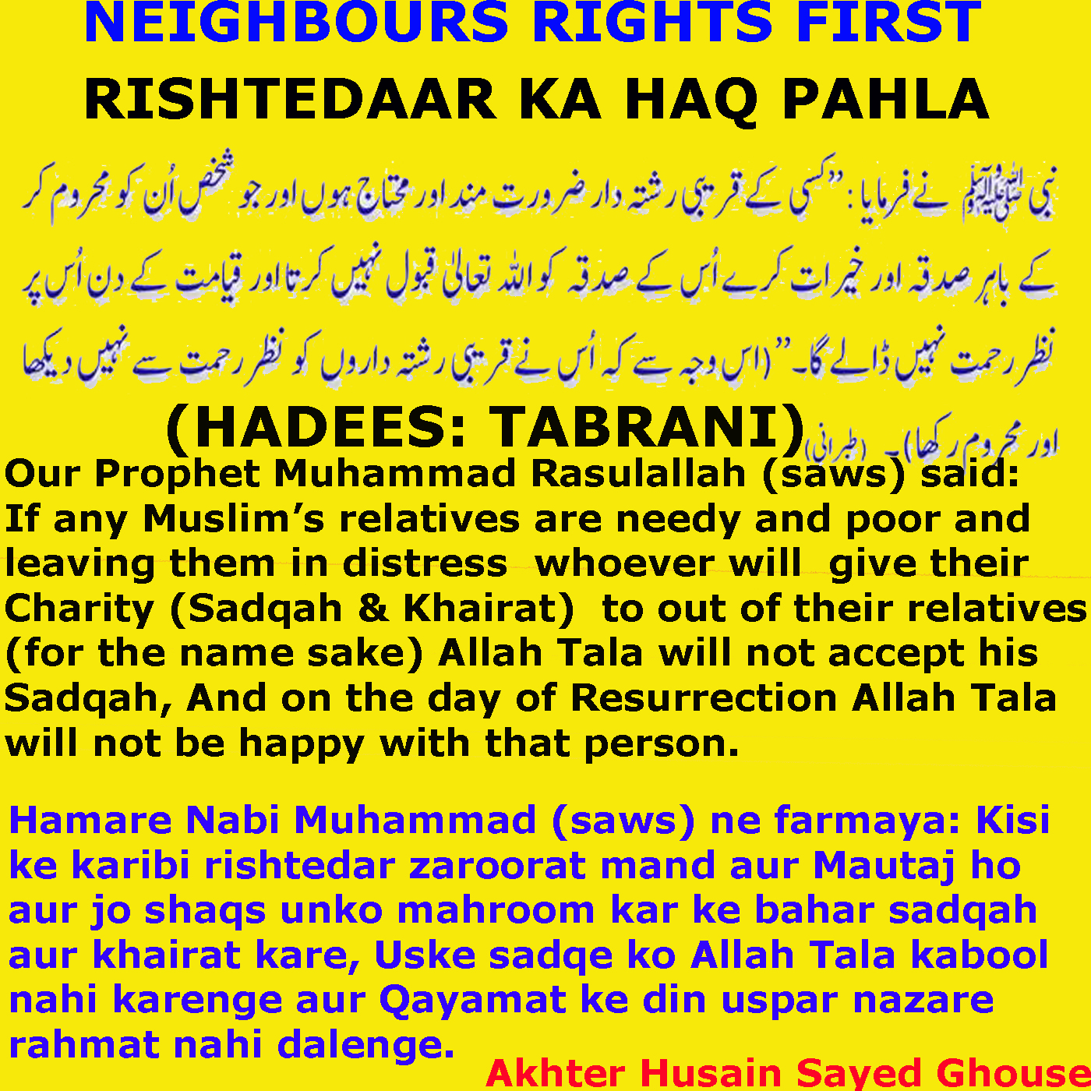

Slide 50
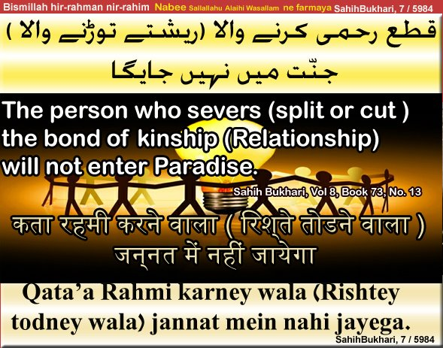

Slide 51
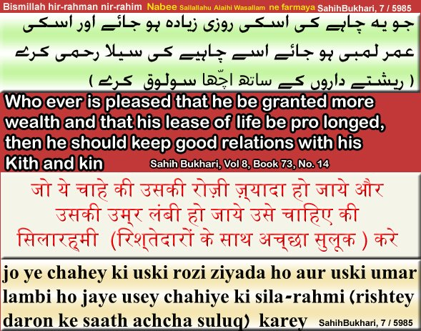
جویہ چاہے کہ اس کی روزی میں اضافہ ہو اور اس کی عمر لمبی ہو جائے تو اسے چاہئے کہ صلہ رحمی کر ے یعنی رشتہ داروں کے ساتھ حسن سلوک کرے۔

Slide 52
summary
Duties of a Muslim in his life
Two major sections
The rights of Allah
The rights of Men
In this lectuer rights of parents,
Rights of children
Rights of wife
Rights of husband
Rights of relatives

Slide 53

Describe the duties of a Muslim?
What are rights of Allah?
What are rights of Men?
Do you obey your parents?
Do you stand in contact with your relatives?
Women rights in Islam say something about it?

Slide 54


Slide 55



