Slide 1


Slide 2
Islamic Studies course code 104
Associate Degree Education ADE/B.Ed(Hons)Elementary
Semester I

Slide 3

Lectuere18

Slide 4
Social System of
Islam and islamic Ethical Values
By: Muhammad Imran

Slide 5

Out Lines
Family system in Islam
Elements of Family
Ethics
Ethical values of Islam

Slide 6
What is Family in Islam?
A human social group whose members are bound together by the bond of blood ties or marital relationships.
They share:
  Moral and legal recognition
  Rights and responsibilities
  Methodology for safeguarding both the individual and the extended family group

Slide 7
Sacred Rights of the Family
“O Mankind! Be mindful of your Lord Who created you from a single self and created its mate from it and then disseminated many men and women from the two of them. Be conscious of God, in Whose name you make demands on one another and also in respect of your families. God watches over you continually.” (4:3)

Slide 8
Structure of Muslim Family
It is the firm structure of Islamic family life resting on the following four pillars that makes these values so enduring and enables them to outlive Western practices.
They are based on Qur'anic regulations and the traditions from the life of the Prophet Muhammad (peace be upon him), handed down from generation to generation.

Slide 9
Importance of family life
1. Family life as a cradle of human society providing a secure, healthy and encouraging home for parents and the growing children.
2. Family life as guardian of the natural erotic desires of men and women, leading this powerful urge into wholesome channels.
3. Family life as the very breeding-place for human virtues like love, kindness, mercy.
4. Family life as the most secure refuge against inward and outward troubles.

Slide 10
The role of family in Islam
Islam considers the role of family as the unit of society. The Muslim family is the miniature of the whole Muslim society. The Muslim marriage is a contract in which both wife and husband have rights and duties. It is the husband’s duty to support his family completely, even if his wife is rich and economically independent. The wife has not to worry about earning a living.

Slide 11
Before Birth
“Do not kill your children because of poverty” (6:151) or “in dread of poverty” (17:31).
Protection of the fetus through complete maintenance of the mother.
Health of the fetus through prohibition of intoxicants and harmful food products.

Slide 12
The New Arrival
Born in “fitra,” which is the pure and natural state of submission to God
A pleasant name
Paternity and lineage: “Call them by their fathers’ names…” (33:5)
A festive occasion marked with charity, usually as almsgiving and a communal meal sponsored by the father.

Slide 13
The First Seven Years
The full period of breast-feeding is 2 years, during which full maintenance of the mother is guaranteed, even if divorced.
Respect to parents and elders: training in social relations.
In the event of divorce, custody is usually given to the mother.
The maintenance of orphans is the financial responsibility of paternal relatives

Slide 14
The Second Seven Years
Training the spirit through prayer
Training the body through fasting
Training the mind through memorizing
  the Quran
At 10 years:
  instructed to complete the 5 daily prayers
  separated from siblings to sleep

Slide 15
The Responsibility
“Oh you who have believed – protect yourselves and your families from the fire…” (66:6)
“Instruct your family to perform the prayer, and be constant in it…. The [best] outcome is for [those of] God consciousness.” (20:132)

Slide 16
Pubertyبلوغت
Full accountability (adulthood)
Maintenance of the prayer
Complete fasting in Ramadan
Modesty in clothing
Requirements of personal hygiene
“[Those who can should] marry.…God will enrich them of his bounty….Those who can’t find the means to marry should be abstinent until God enriches them...” (24:32-33)

Slide 17
Marriage
Neither a sacrament nor a simple civil contract, but with aspects of both.
Parental approval, social recognition.
Prohibited for marriage are parents, offspring, siblings, paternal and maternal aunts and uncles, the previous spouses of the parents or offspring, the parent-in-law, the step-children. (see 4:22-23)
Divorce is permitted in the case of irreconcilable differences.

Slide 18
Married Life
Man is responsible to provide for and guide the family.
Woman is responsible to protect the husband’s property and his exclusive rights to her sexuality.
Both are responsible for the upbringing of children and maintenance of the home.

Slide 19
Parenthood
Say, “Come and I will tell you what your Lord has made forbidden for you: that you do not associate anything with Him; that you are good to your parents; that you do not kill your children because of poverty – We will provide for you and them…” (6:151)
“Worship God and do not associate anything with Him. Be good to your parents and relatives and orphans and the poor…” (4:36)
Respect and deference
  Neither categorical submissiveness
  Nor irresponsible disregard/impertinence

Slide 20
Neighbors
Muhammad said, “Do you know what the rights of a neighbor are? Help him if he asks your help; give him relief if he seeks your relief; lend him if he needs a loan; show him concern if he is distressed; nurse him when he is ill; attend his funeral if he dies; congratulate him if he meets any good; sympathize with him if any calamity befalls him; do not block his air by raising your building high… do not harass him; give him a share when you buy fruits and if you do not give him, bring your things unnoticed to your house and don’t let your children show off to their children.”

Slide 21
Old Age
“We have enjoined every one to look after his parents…” (31:14)
“We have instructed man to be kind to his parents…” (46:15)
“… when they attain old age…never say to them ‘uff’ nor scold either of them. Speak to them gently. Serve them with tenderness and humility…” (17:23-25)
Muhammad said, “Disgrace, disgrace, disgrace to one whose parents grow old and he shall not enter Paradise.”

Slide 22
Death
Burial is usually the same day after washing the body, wrapping it in cloth and saying the funeral prayer.
After bills are paid, wealth is automatically divided among immediate and extended family, without contest. (see 4:11-12)
Up to 1/3 of his wealth can be bequeathed to those not automatically covered in the inheritance laws.
Three days mourning period, then life goes on.

Slide 23
What Is Ethics?
In order to understand what ethics is, and what it might look like, it's important to distinguish the difference between ethics and values .
Ethics is about the way we treat one another and is an action concept that dictates how we choose to live our lives. The ultimate true test of our character is when we are willing to do the right thing even when it is not in our best interest to do so.

Slide 24
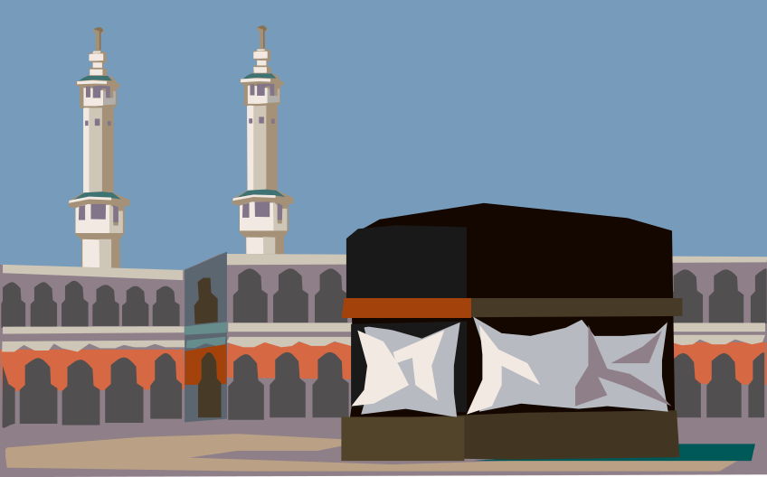
VALUES
Refers to our core beliefs or desires , the things we value the most. Our values shape our attitudes and determines how we will behave in certain situations.

Slide 25
Ethics from Islamic Perspective
Ethics, like other Islamic sciences, takes its origin form the Quran. The Quran lays down the foundation of a religious system on purely ethical principles, hence there is not much to distinguish between Islam as such and Islamic ethics.
The Muslims started the study of Ethics along with the study of the Quran.

Slide 26
Cont. Ethics from Islamic Perspective
Ethics in Islam is nothing but the body of injunction laid down in the Quran for the practical conduct of life and fully exemplified in the practice of the Holy Prophet throughout his life.
Within an Islamic Context, the term most closely related to ethics is khuluq in the Quran which has been guided by principles from the Quran and the Sunnah.

Slide 27
Cont. Ethics from Islamic Perspective
The Quran addresses the Prophet.
“Thou has been created with an excellent character”
وانک لعلٰى خلق عظيم
The Prophet highlighted one of his main objective is to perfecting good morals
“I have been sent for the purpose of perfecting good morals”.
بعثت لاتمم مكارم الاخلاق
INCEIF
27

Slide 28
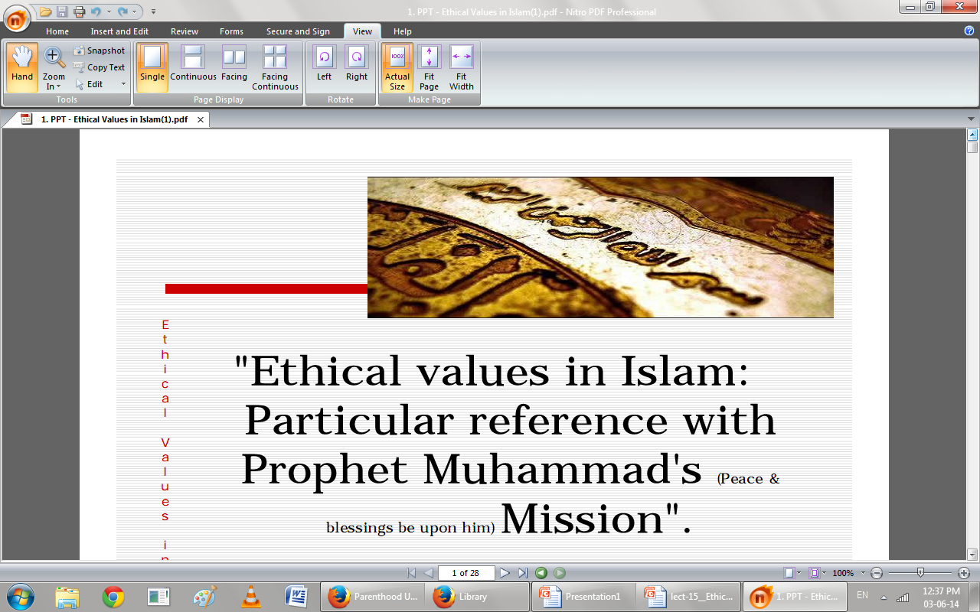

Slide 29
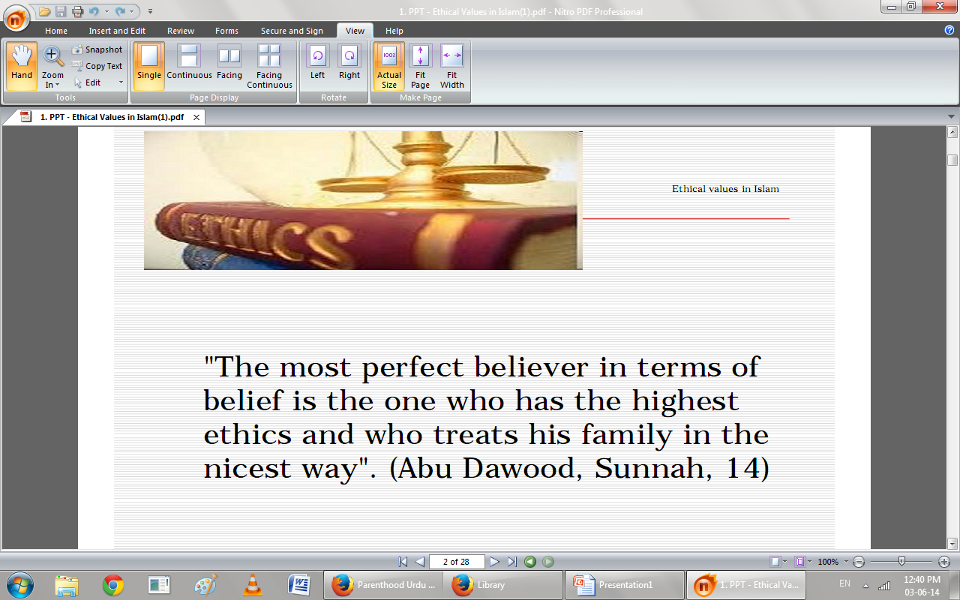

Slide 30
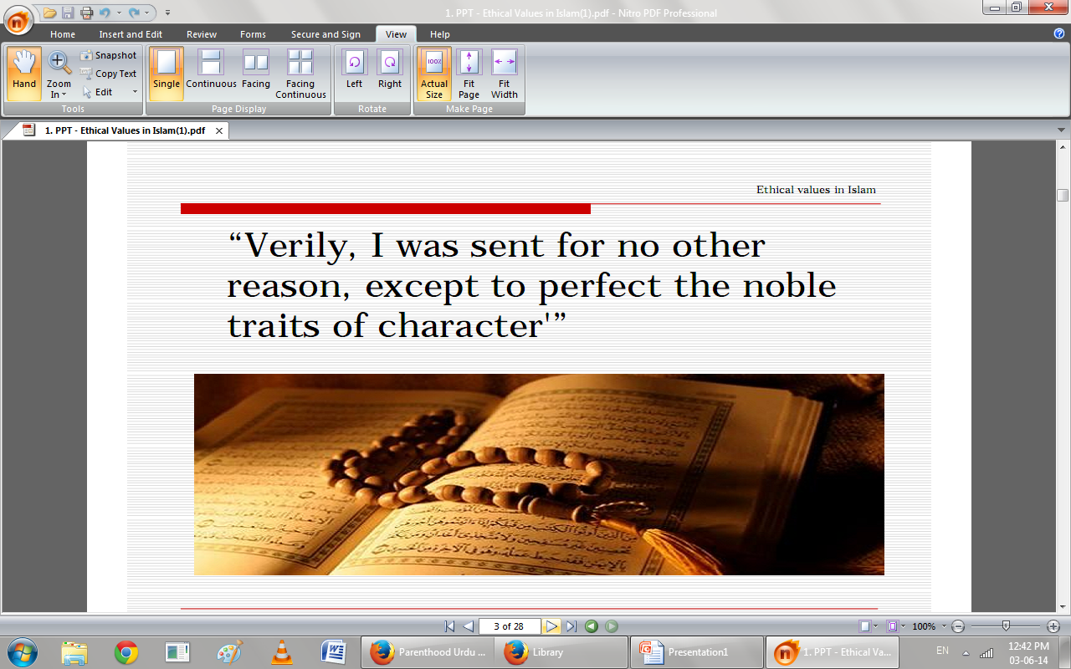

Slide 31
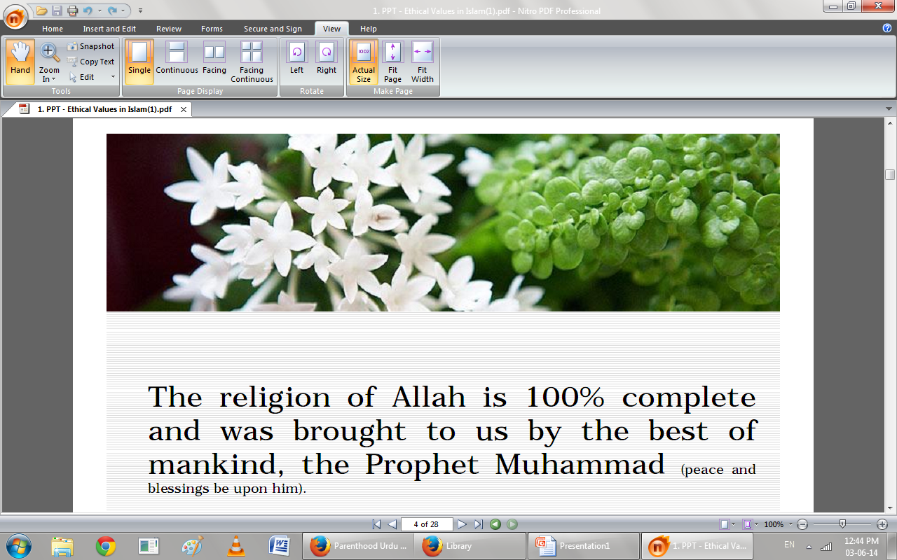

Slide 32
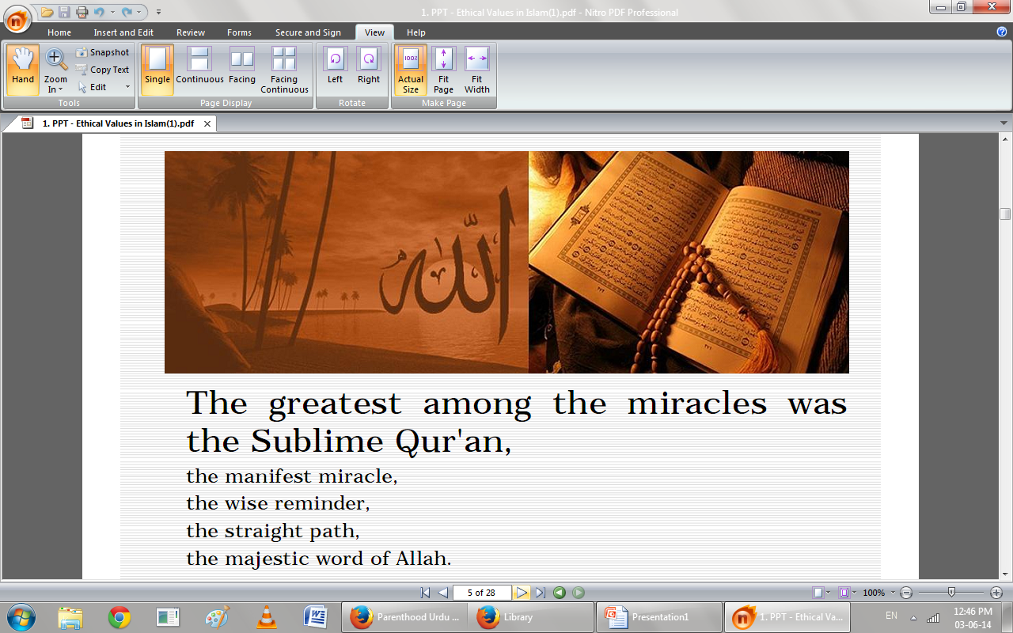

Slide 33
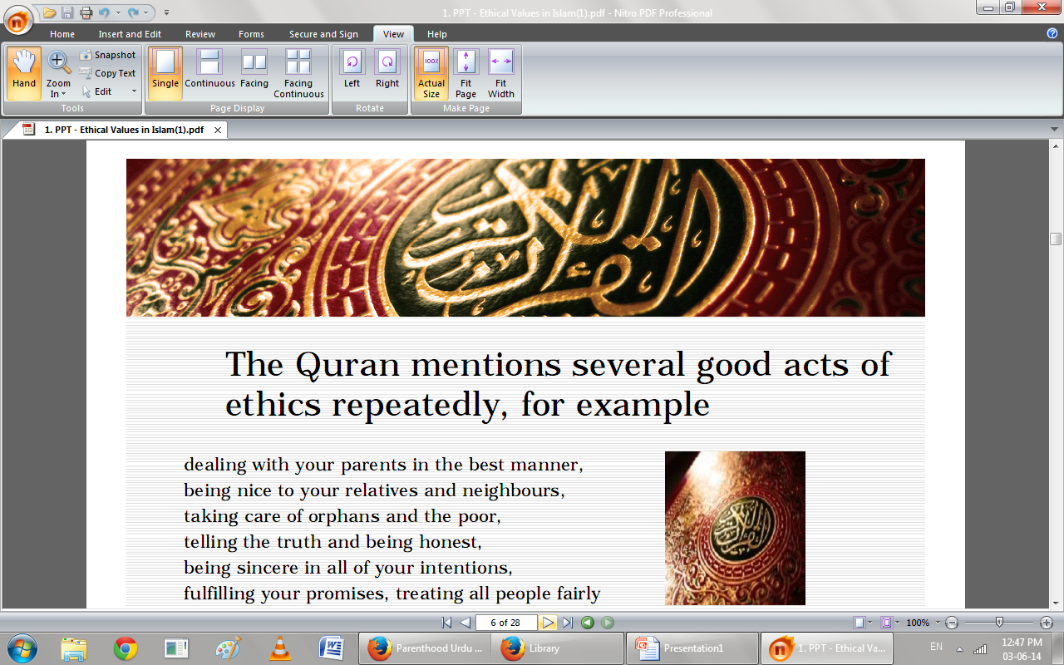

Slide 34
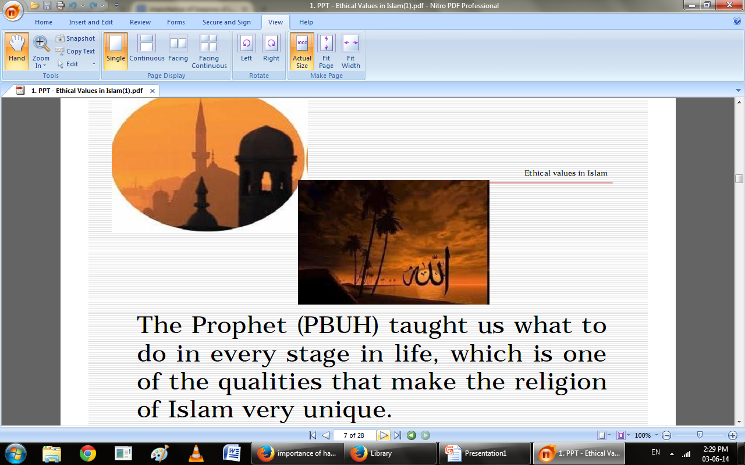

Slide 35
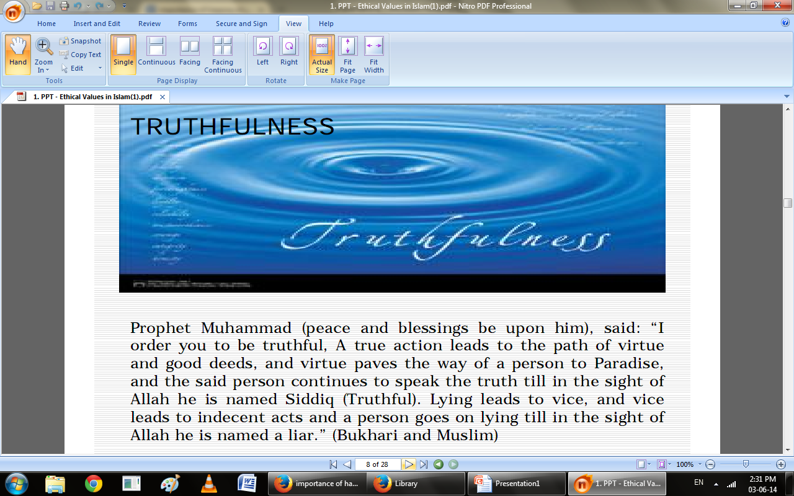

Slide 36
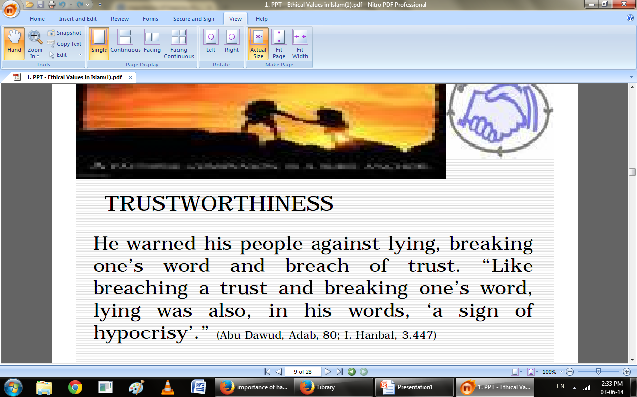

Slide 37
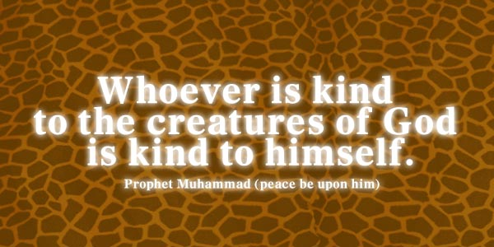

Slide 38
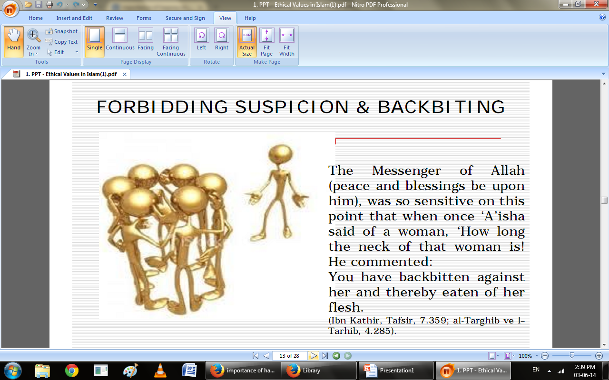

Slide 39
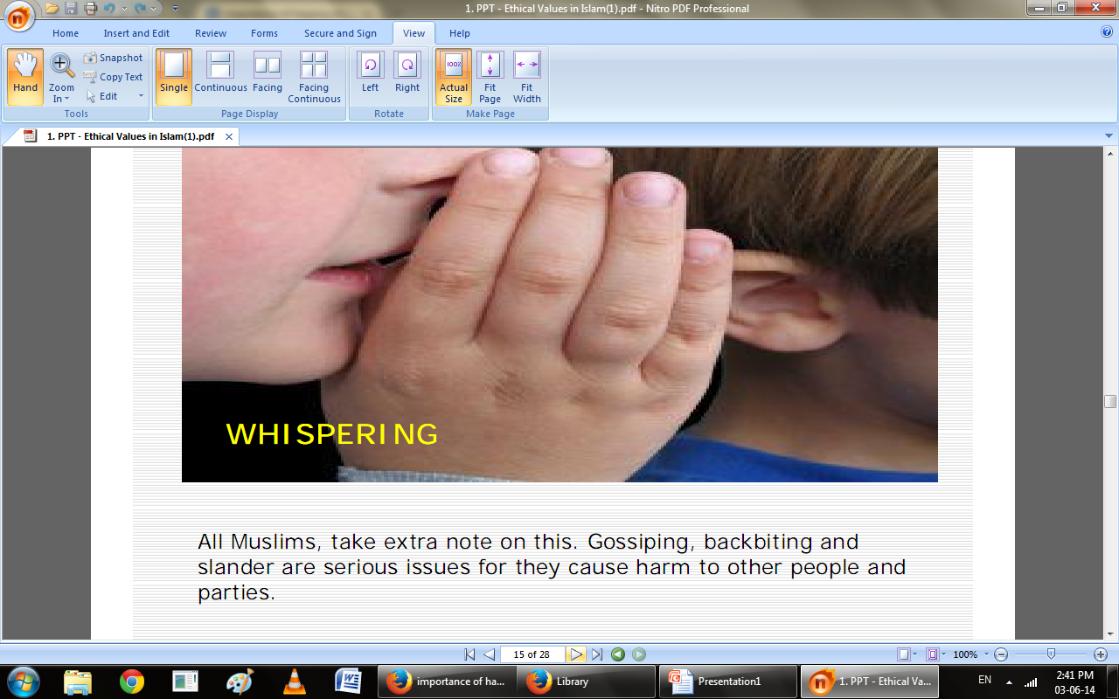

Slide 40
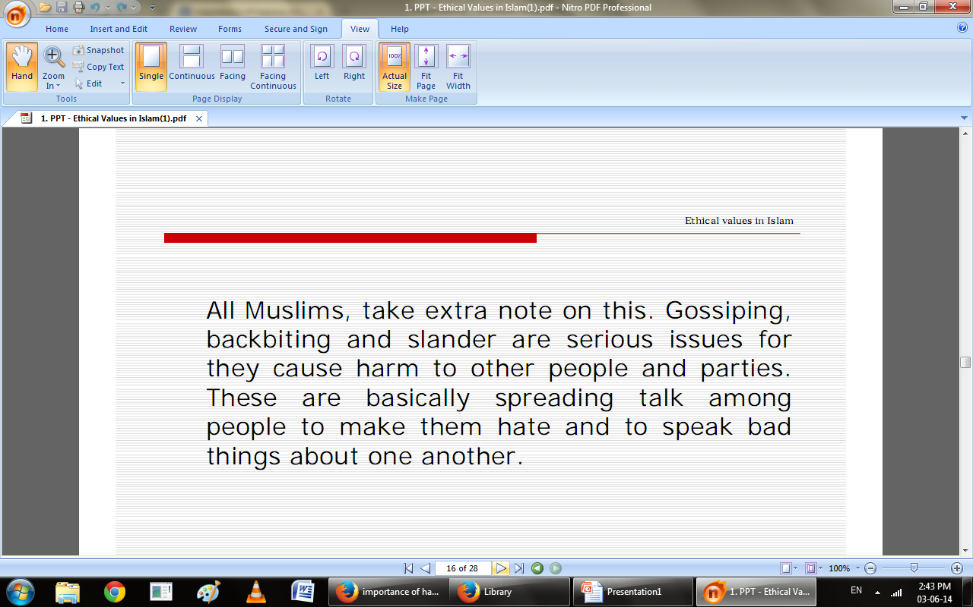

Slide 41
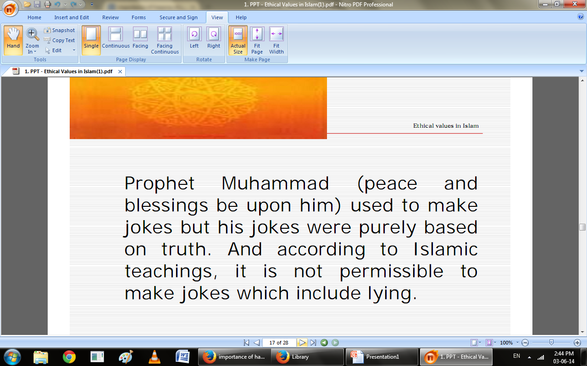

Slide 42
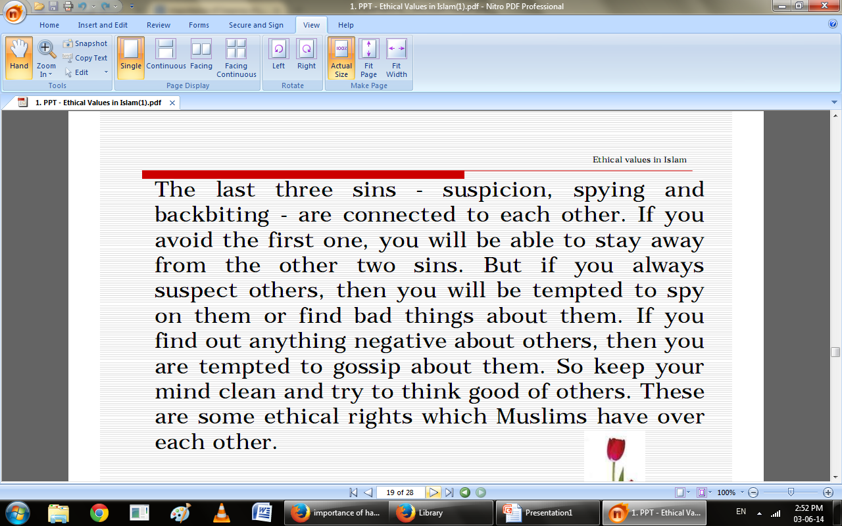

Slide 43
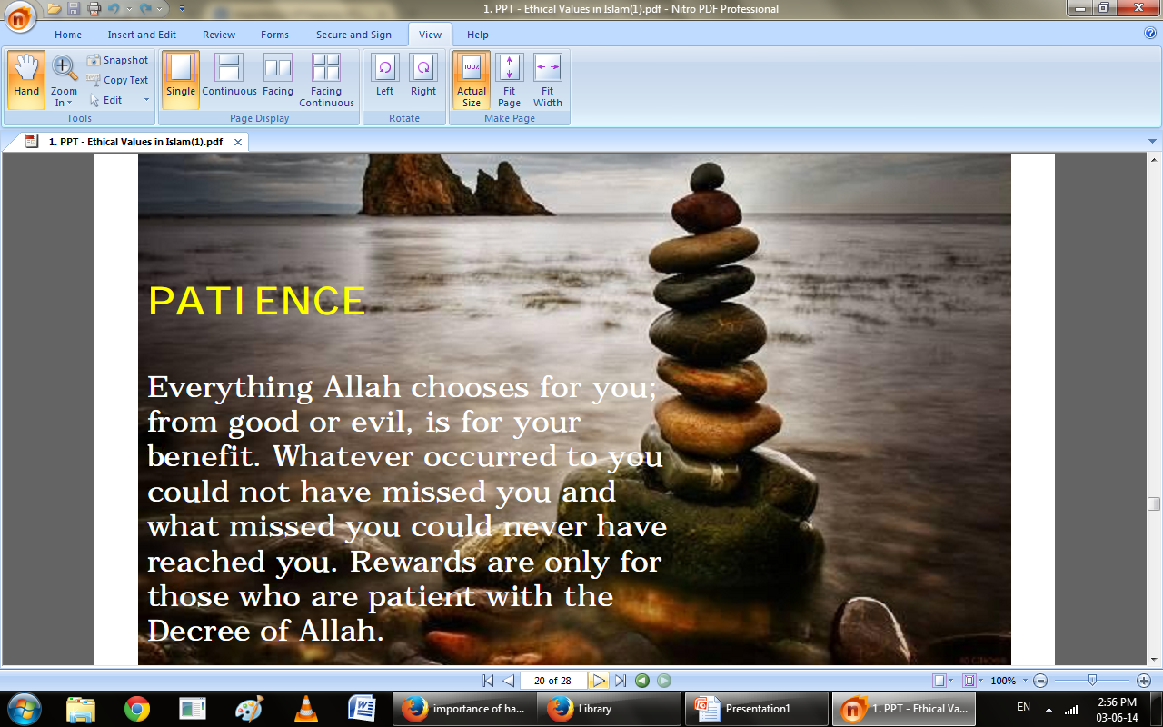

Slide 44
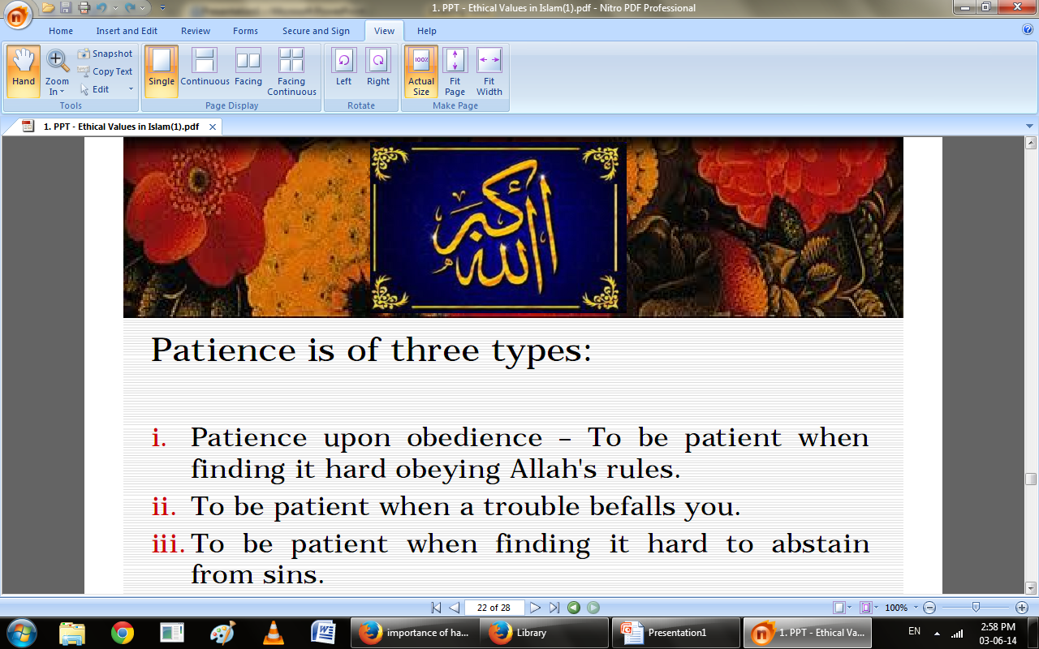

Slide 45
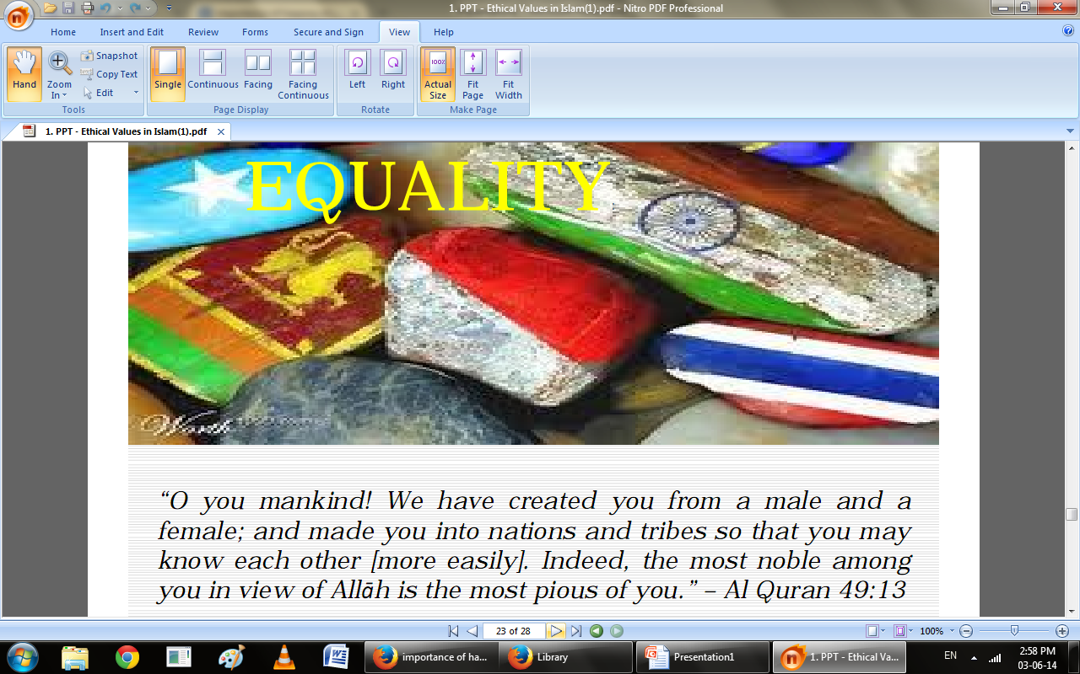
Equality

Slide 46
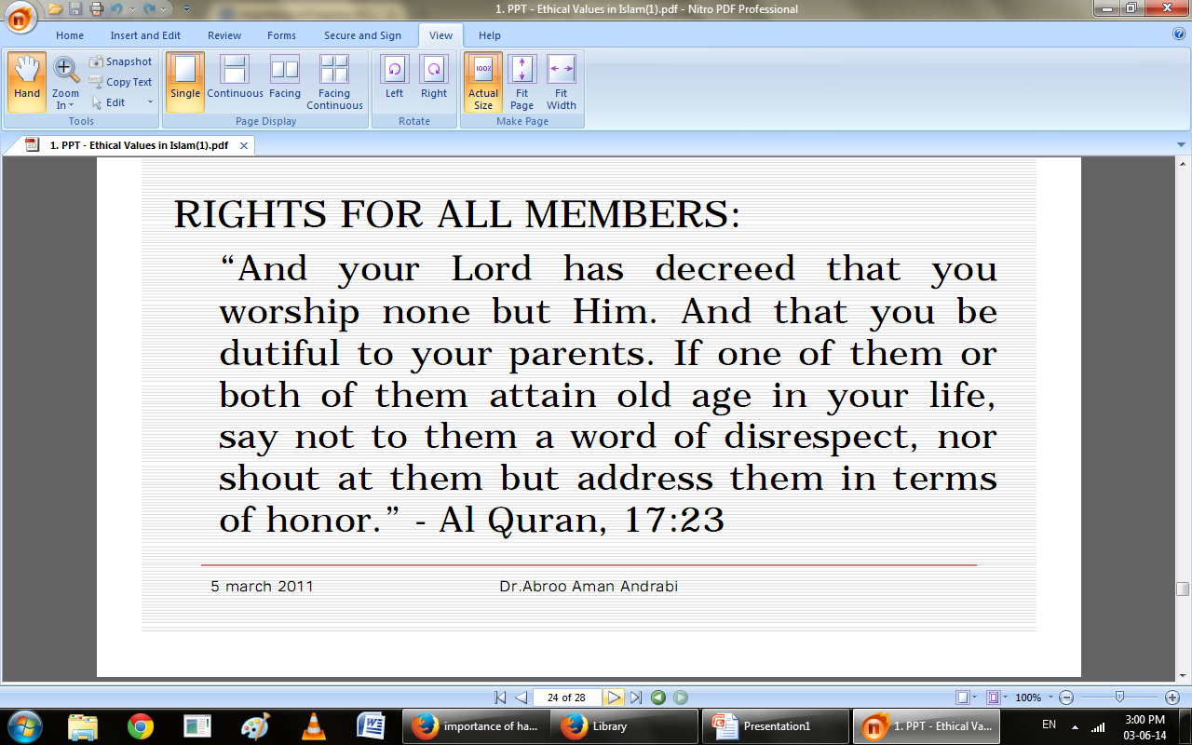

Slide 47
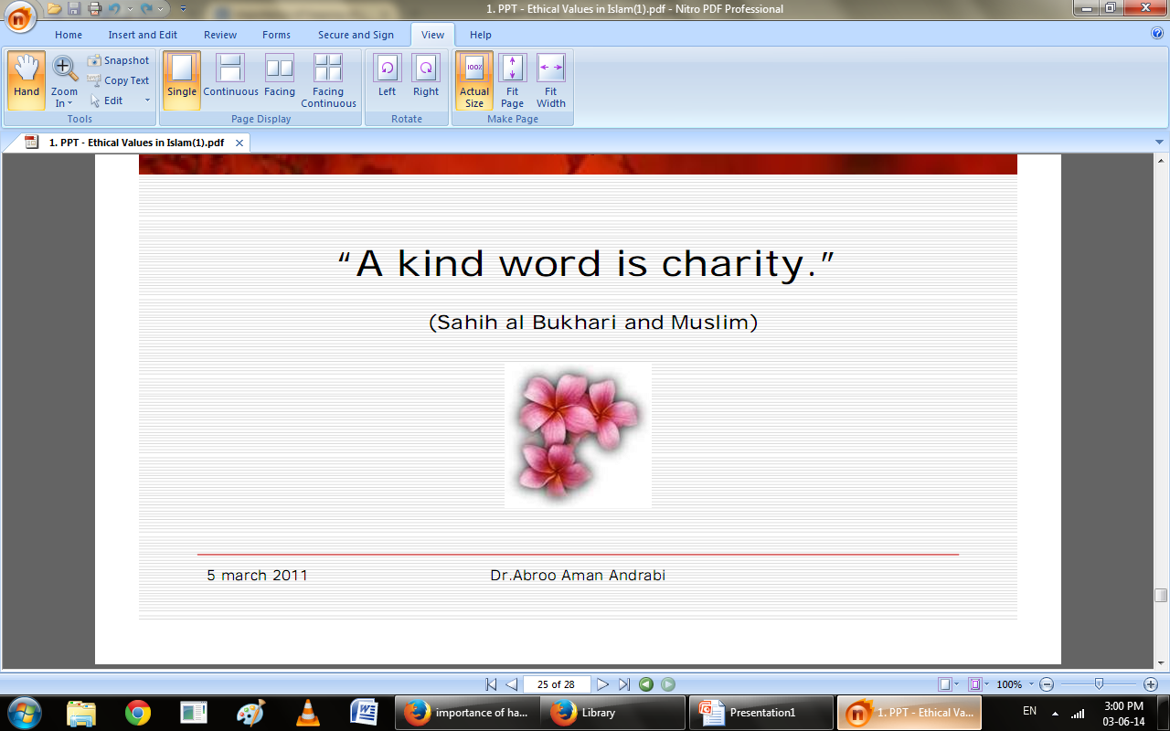

Slide 48
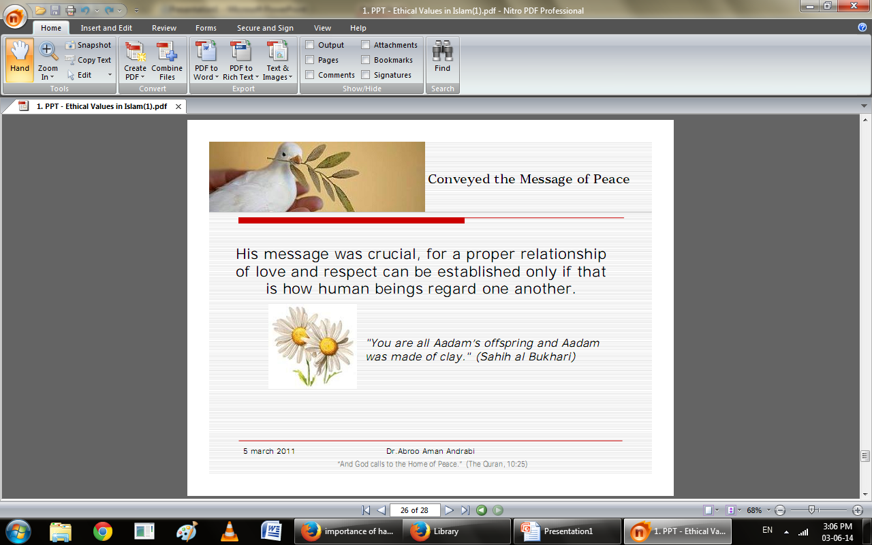

Slide 49
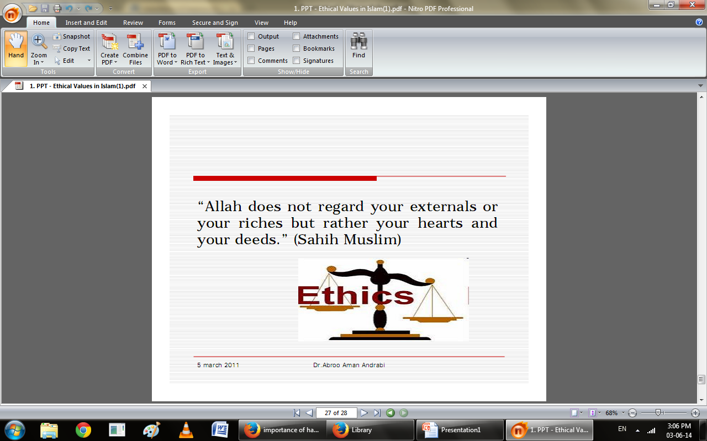

Slide 50
Summary
Family system in Islam
Elements of Family
Ethics
Ethical values of Islam

Slide 51

What is the definition of Family system?
Importance of Family system?
What is the literal meaning of Ethics Values?
Recall some Ethical Values according to Islam?

Slide 52
