Slide 1
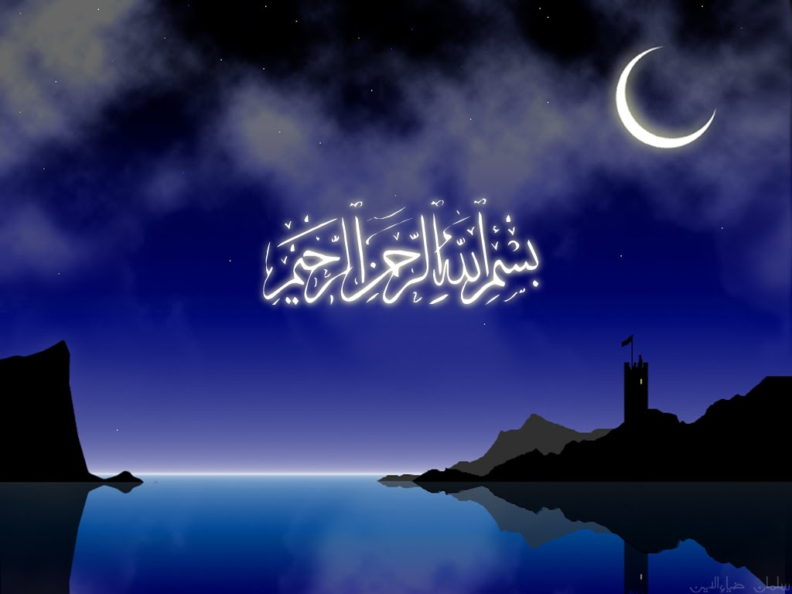

Slide 2
Islamic Studies course code 104
Associate Degree Education ADE/B.Ed(Hons)Elementary
Semester I

Slide 3

Lectuere 17

Slide 4
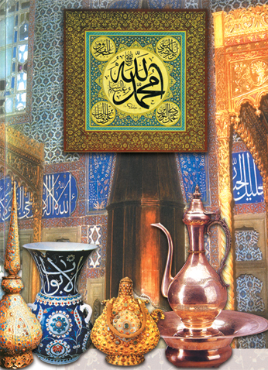
Islamic culture and Civilization
پیشکش:محمد عمران

Slide 5
Outlines:
Islamic civilization&culture
Historical Development
Of Islamic Civilization
Characteristics of Islamic
Culture and Civilization
Their contamporary
issues .

Slide 6
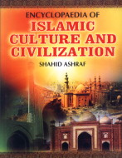
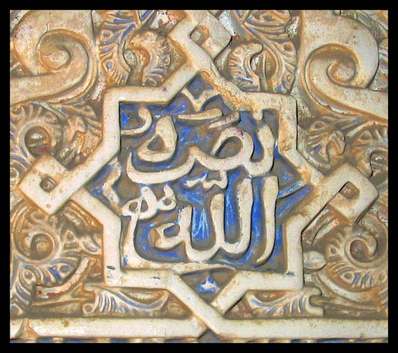
Culture - Definition
Culture reflelect criteria for evaluating human activity.In general it discuss the whole product of an individual or group social activities.It include technology,art,science, as well as the different domains of human life.

Slide 7
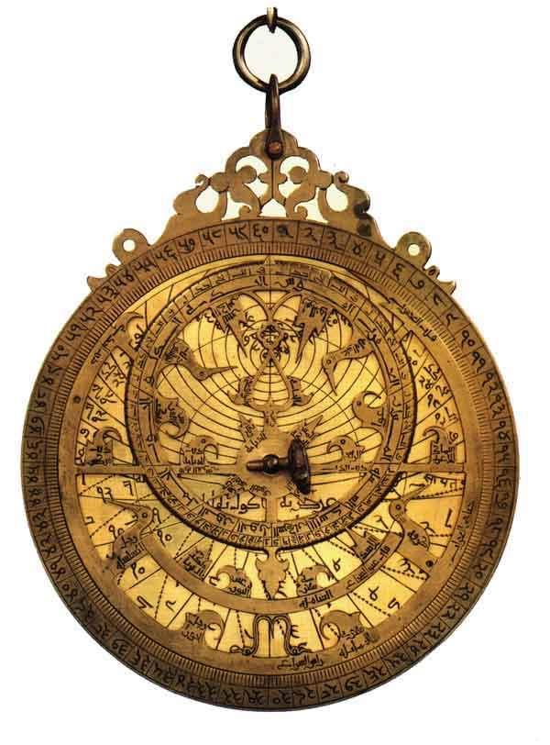
: Culture of Islam

Slide 8
Philosophy, Science, and History
The Arab world was aware of Greek thought and had been in the process of translating and preserving these works for years. This becomes very important later on when this knowledge is rediscovered by Europe during The Renaissance.
The knowledge of the Muslim world was preserved in Baghdad in a library known as the House of Wisdom.

Slide 9
Preservation of Knowledge
Muslim scholars helped to preserve the knowledge of Greece and Rome by translating works and making them available to other scholars.
  It is because of this that European scholars were able to rediscover the works of Aristotle and other Greek philosophers.
  In the twelfth century these works were translated into Latin .
  The discovery of paper-making technology from China made this much easier.

Slide 10
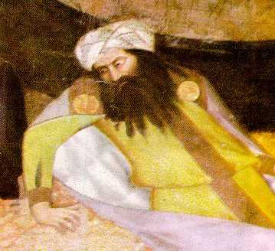
Islamic Advancements
Muslims scholars not only preserved works of Greek philosophy, they also interpreted the works and wrote extensive commentary on them.
  The Muslim philosopher Ibn-Rushd wrote on nearly all of Aristotle’s works.

Slide 11
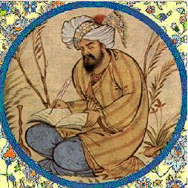
Literature
Many Muslims consider the Quran to be the greatest work of Muslim literature, but there was a strong oral tradition prior to the Quran which continued to have influence.
The poet Omar Khayyam. He was a twelfth century Persian poet, mathematician, and astronomer.
  The wrote about many different themes and his poems were recorded by his friends after his death.

Slide 12
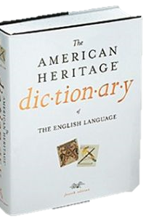
Civilization - Definition
‘An advanced state of intellectual, cultural, and material development in human society, marked by progress in the arts and sciences…’
  American Heritage Dictionary

Slide 13
A more complete definition - Civilization
Technologically advanced
Morally & Ethically advanced

Slide 14
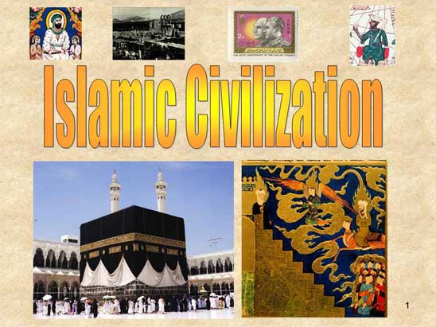

Slide 15
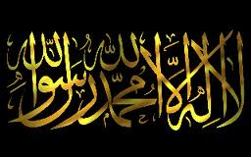
Fountain of Islamic civilization

Slide 16
Islamic Society
Islam is considered more than just a religion, it is seen as a way of life that encompasses politics, economics, and social life.
According to the Quran, all people were equal in the eyes of Allah, but in reality, the Muslim Empires did not follow this ideal. There was a well developed upper and lower class.
Non-Muslims were not considered equal to Muslims and slavery was widespread (as in the rest of the ancient world). Slaves were usually non-Muslims because Islamic law made it illegal for one Muslim to enslave another.
  Slaves served in the military or served as domestic servants.
  Slaves could sometimes purchase their freedom and it was considered a good act to free ones slaves.

Slide 17
Muslim Civilization helped Renaissanceحیاتِ نو
"It is highly probable that, but for the Arabs (Muslims), modern European civilization would never have arisen at all,"
Sir Thomas Arnold and Alfred Guillaume -"The Legacy of Islam."1997

Slide 18
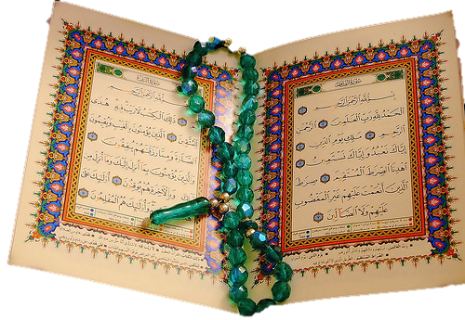
Factors Motivating Muslims
To Research, Invent & Enlight the world
The Quran
Life of
Prophet Muhammad
(peace be upon him)

Slide 19
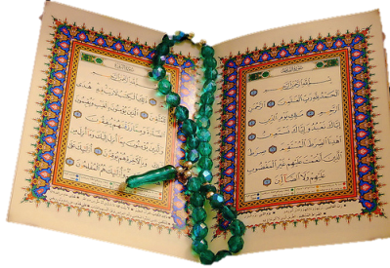
Quran’s encouragement to seek knowledge
First word revealed in the Quran = Read (Iqra)
  750 + verses in the Quran that encourages humans to: Ponder, think, contemplate, reflect, research…

Slide 20
Quran – Ponder تدبر
Say, `Ponder over what is happening in the heavens and the earth.'
(Quran 10:101)

Slide 21

Quran - Think
Those who remember Allah (always, and in prayers) standing, sitting, and lying down on their sides, and think deeply about the creation of the heavens and the earth…’
(Quran 3.191)

Slide 22
Prophet Muhammad Said:
(Peace be upon him)
“The seeking of knowledge is obligatory for every Muslim…”
(Al-Tirmidhi Hadith 218)

Slide 23
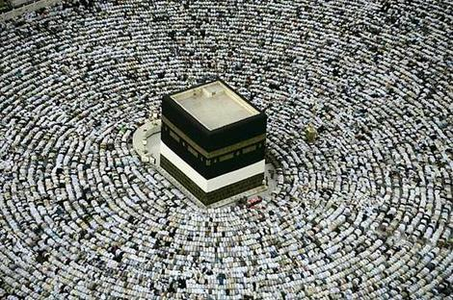
Necessity for Muslims to Develop new Technology
As Muslims started to migrate to different region, they need to accurately find the direction towards Makkah, Saudi Arabic.
They developed scientific instruments to fulfill this need.
Direction of Makkah during Prayer

Slide 24
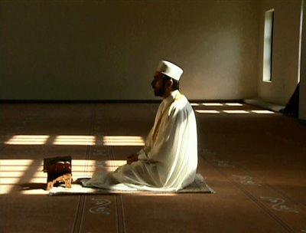
Solar Calendar
Calculate the times of the 5 prayers
As Muslims started to migrate to different region, they need to accurately calculate the TIMES of the 5 daily prayers.
They developed scientific instruments to fulfill this need.

Slide 25
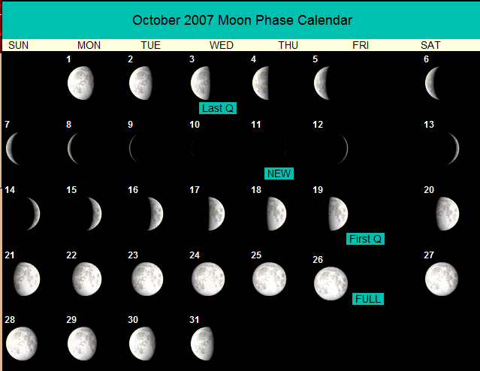
Lunar Calendar
To calculate the start of Islamic months

Slide 26
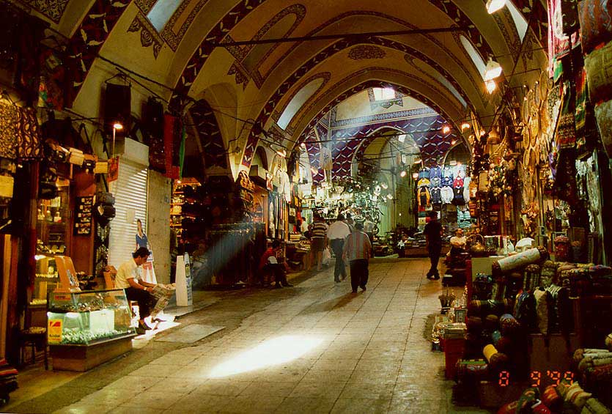
The Bazaar
The covered market was a central part of each Muslim city.
There were high standards for business and sanitation.
It was a place where people could acquire both goods and services.

Slide 27
Agriculture
While cities were expanding a vast majority of the people still lived in the country and made their living in agriculture.
Originally the land was owned by peasants, but was eventually bought by aristocrats and was worked by slave labor.

Slide 28
The Role of Women
Originally, the Quran granted women spiritual and social equality with men. Both men and women were to be friends and protectors of one another.
Women could earn a living and own and inherit property. They played a prominent role in the rise of Islam.
Men and Women had assigned social duties, but most societies in which Islam arose were male dominated

Slide 29
Speaking on Muslim Contributions..
Extreme sides are taken
  Total exclusion of Muslim contributions in Western textbooks
  All inventions were made by Muslims

Slide 30
Human Civilization
Western
Chinese
Islamic
Greek
Persian
Roman
Byzantine
Indian

Slide 31
Human Civilization
Language
Religions
Social Customs
Architecture
Science and Innovations
Cuisine
Transportation
Industry and Agriculture

Slide 32
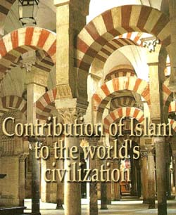

Slide 33
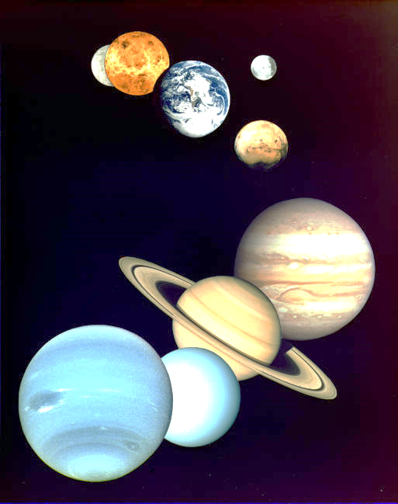
Astronomy

Slide 34
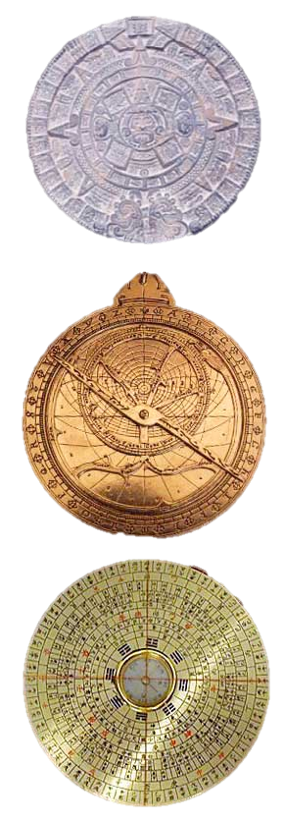
The Astrolabe: It was used to chart the precise time of sunrises and sunsets, and to determine the period for fasting during the month of Ramadan. Also to calculate the distances between the various planets and stars.
Navigational tools: Compass and Astrolabe. Enabled long journey navigation. Eventually discovery of the new world.
Al-Biruni, (973 CE) discussed the possibility of the earth’s rotation on its own axis – a theory proven by Galileo six centuries later.

Slide 35
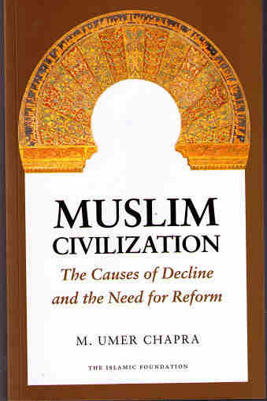
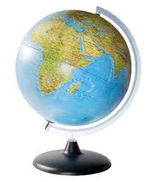
Geography

Slide 36
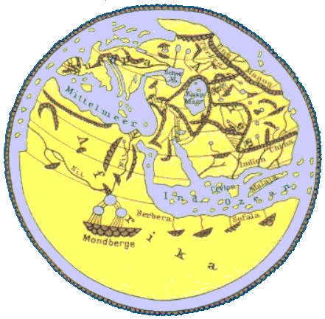
Al-Idrisi
1100 CE
‘The compilation of Al-Idrisi marks an era in the history of science… (Idrisis’s) descriptions of many parts of the earth are still authoritative. For three centuries geographers copied his maps without alteration. The relative position of the lakes which form the Nile, as delineated in his work, does not differ greatly from that established by Baker and Stanley more than seven hundred years afterwards…’
[S. P. Scott (1904), History of the Moorish Empire, pp. 461-2]

Slide 37
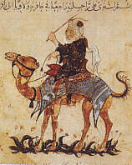
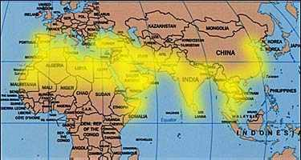
Navigation & Geography
Ibn Battuta (1304-1369 CE), an Arab, covered over seventy five thousand miles.
His wanderings, over a period of decades at a time, took him to Turkey, Bulgaria, Russia, Persia, and central Asia.
He spent several years in India, and from there was appointed ambassador to the emperor of China.
Ibn Battuta’s book, Rihla (journey), is filled with information on the politics, social conditions, and economics of the places he visited.

Slide 38

Medical Sciences
Notes:
The purpose of this presentation is not to boost that we are better than you or to put any other civilization, nation or race down, but just to share the great accomplishment that Muslims also provided to the world civilization.
The Renaissance gave rise to the industrial revolution and the industrial revolution eventually gave rise to the modern technological age that we are living in. But what gave rise to the Renaissance?

Slide 39
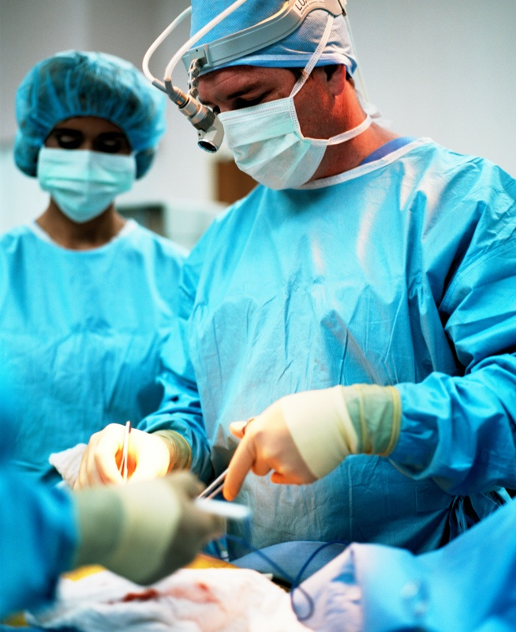
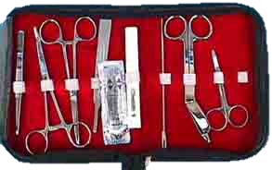
Abu al-Qasim al-Zahrawi – 11th century Spain
Father of Modern Surgery
Invented many of the surgical instruments still used today

Slide 40
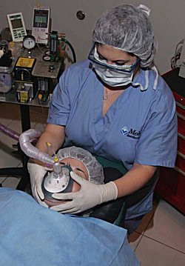
Abu al-Qasim al-Zahrawi – 11th century spain
Father of Modern Surgery
1) The use of anesthesia in surgery.
2) The cauterizing of wounds.
3) The discovery that epidemics arise from contagion through touch and air.

Slide 41
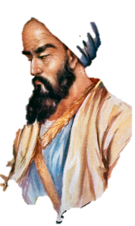

Ar-Razi – 9th Century
Father of Pediatrics
“His writings on smallpox and measles show originality and accuracy, and his essay on infectious diseases was the first scientific treatise on the subject." –
[The Bulletin of the World Health Organization (May 1970)]

Slide 42
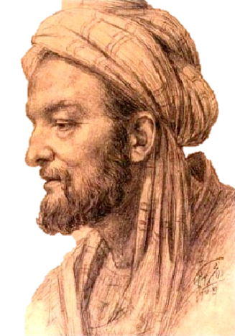
Ibn Sina – 980 CE
Father of Medicine
Father of Clinical Pharmacology
Father of Medicine
  Cas Lek Cesk (1980). "The father of medicine, Avicenna, in our science and culture: Abu Ali ibn Sina (980-1037)", Becka J. 119 (1), p. 17-23.
Father of Clinical Pharmacology
  D. Craig Brater and Walter J. Daly (2000), "Clinical pharmacology in the Middle Ages: Principles that presage the 21st century", Clinical Pharmacology & Therapeutics 67 (5), p. 447-450 [448-449].

Slide 43
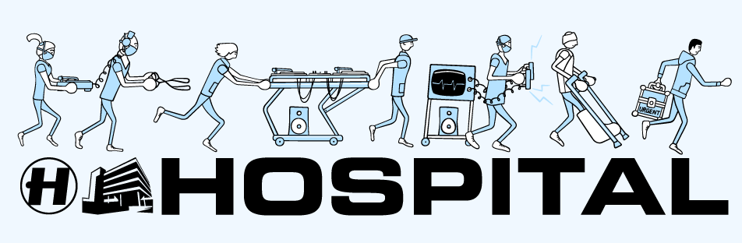

Slide 44
Ancient ‘Hospitals’ – healing places
Ancient healing places:
  healing temples, sleep temples, hospices, asylums, lazarets and leper-houses, all of which in ancient times were more concerned with isolating the sick and the mad from society
  Micheau, Francoise, "The Scientific Institutions in the Medieval Near East", pp. 991–2 , in (Morelon & Rashed 1996, pp. 985-1007)

Slide 45
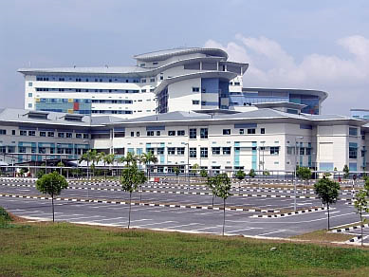
First True Hospitals
Built by Muslims

Slide 46

Public Hospitals
Built by Muslims – 1000 yrs ago
Free for all
Separate sections for males and females
Hospital clothes
Specialized units
  Internal medicine
  Orthopedics
  Ophthalmology
  Psychiatry
Physicians in every specialty – on duty – all shifts
Nurses
Assistants

Slide 47
Residency Program
Introduced by Muslims

Slide 48
Doctors – Residency program
Special training for all doctors before starting of practice
Need to pass formal, oral exam in front of specialists
Need to obtain license before practice
913 CE – Baghdad – Caliph al-Muqaddir
  Re-examined – re-certified all doctors in the city due to one medical error, that killed a patient.

Slide 49
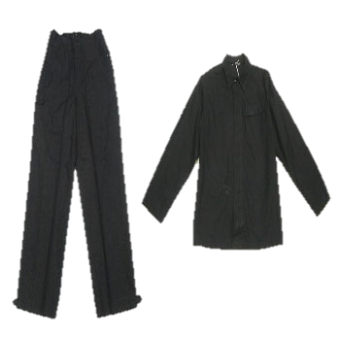
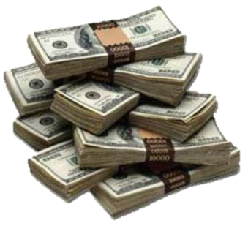
When leaving hospital
New set of clothes were given
FREE Money
  until patients becomes better and start working

Slide 50

Al-Adadi Hospital
Baghdad – 981 CE
Ar-Razi
  Placed pieces of meats in different locations
  Place where meat remained the freshest = built hospital
    Pharmacy
    Library
    Stores
    Garden with fruits and vegetables

Slide 51
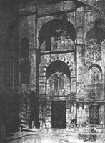
Al-Mansouri Hospital -
Cairo – 1248 CE
8000 Beds
Specialized Wards
Free for all
No limit for inpatient stay
Physicians held accountable for negligence
Physicians only get paid if patients were properly treated or cured.

Slide 52
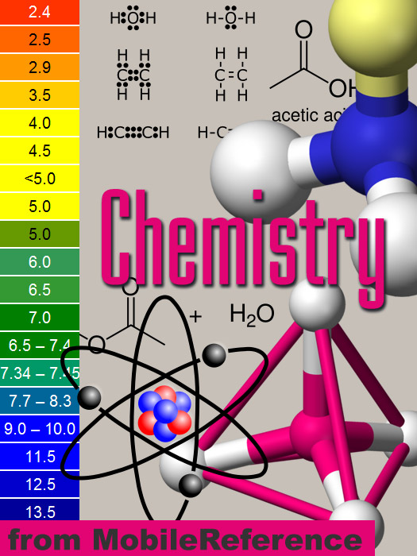
Chemistry

Slide 53
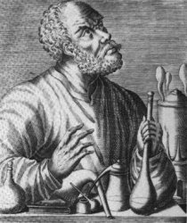
Jabir Ibn Haiyan - 721-815 CE
Father of Chemistry
Invented
25 + laboratory instruments.
Discovered Acids
  Sulfuric acid
  Hydrochloric acid
  Nitric acid
Discovered elements
  Arsenic
  Antimony
  Bismuth

Slide 54

Sociology

Slide 55

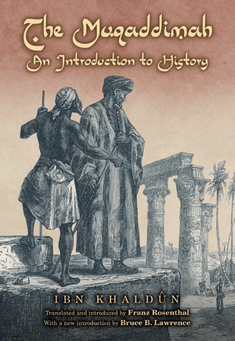
Ibn – Khaldun – 1332-1406
Father of Modern Sociology
Al-Muqaddamah - An Introduction to History
“Undoubtedly the greatest work of its kind that has ever been created by any mind in any time and any place…the most comprehensive and illuminating analysis of how human affairs work that has been made anywhere”.
[Arnold J Toynbee Observer]

Slide 56

Physics

Slide 57

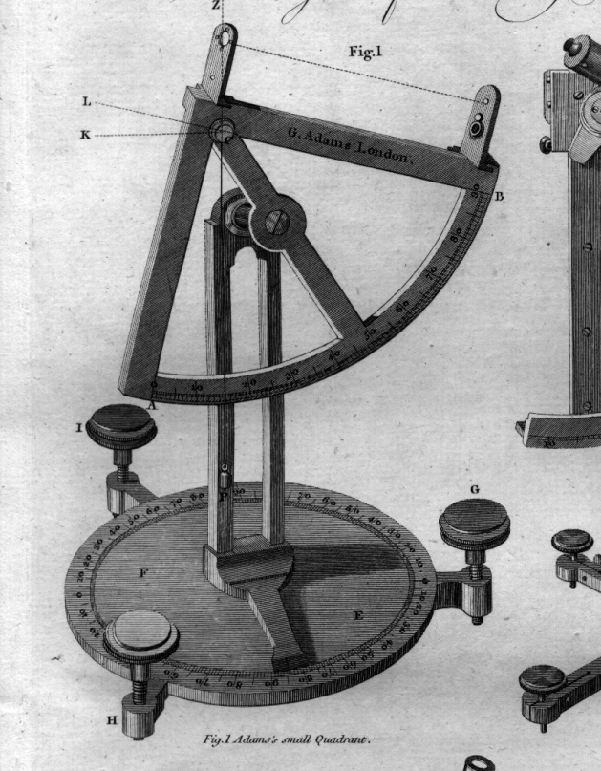
Ibn al-Haytham 965-1039 CE
Founder of Optics
Study of Light
Wrote - Book of Optics
Ranked with Newton’s Philosophiae Naturalis Principia Mathematica as the most influential book on Physics
Pioneer of the modern scientific method

Slide 58
Ibn Haythan
Formulated: Scientific Method
Scientific Method
Observation
Statement of problem
Formulation of hypothesis
Testing of hypothesis using experimentation
Analysis of experimental results
Interpretation of data and
Formulation of conclusion
Publication of findings

Slide 59


Ibn Al-Haytham
Best Idea in 1000 years!
Scientific method and scientific skepticism as the most influential idea of the second millennium! (1000 CE – 1999 CE)
Powers, Richard (April 18, 1999), "Best Idea; Eyes Wide Open” [New York Times]
http://www.nytimes.com/library/magazine/millennium/m1/powers.html

Slide 60
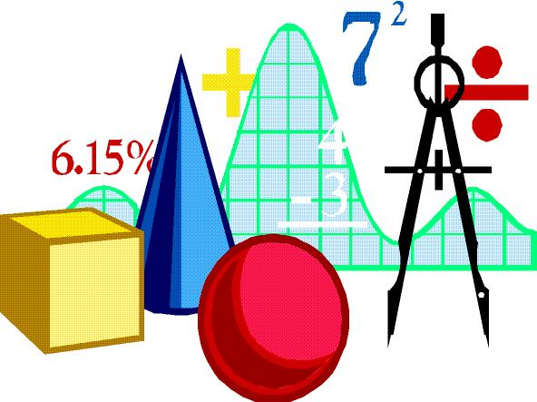
Mathematics

Slide 61

Arabic Numerals
Introduce by Muslims
Introduced by Muslims to the West

Slide 62
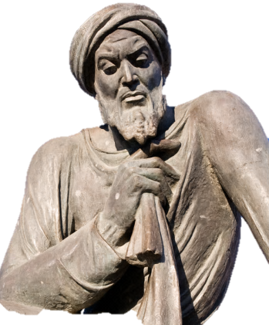
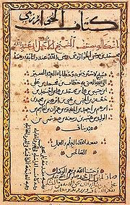
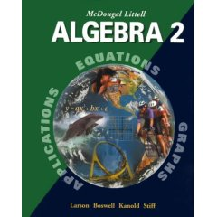
Al-Khwārizmī – 820 CE
Father of Algebra, Algorithm

Slide 63

Education

Slide 64
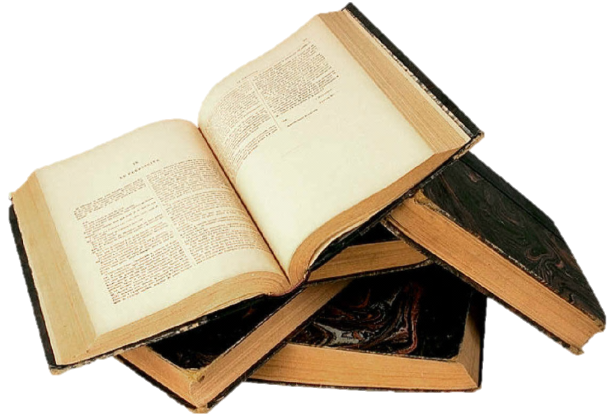
Prophet Muhammad Said:
(Peace be upon him)
“The seeking of knowledge is obligatory for every Muslim…”
(Al-Tirmidhi Hadith 218)

Slide 65
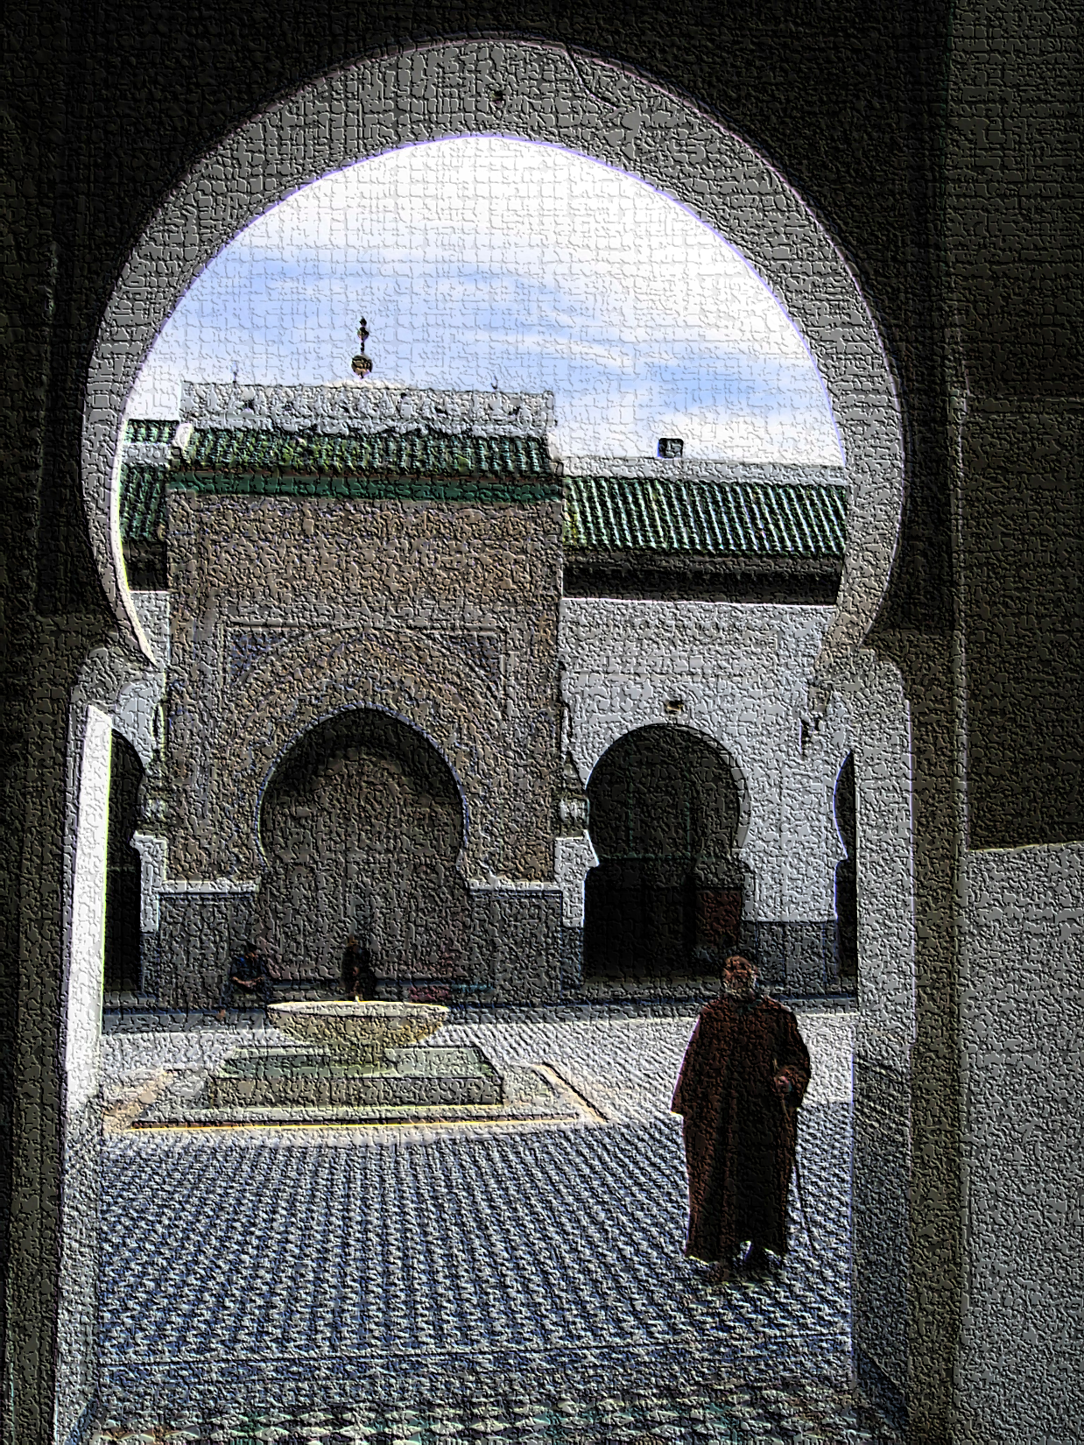
World Oldest University
Built by Muslims – 859 CE
University of Al-Karaouine
Fes, Morocco – 859 CE
Built by Fatima al-Fihri
The Guinness Book Of Records, Published 1998, ISBN 0-5535-7895-2, P.242

Slide 66
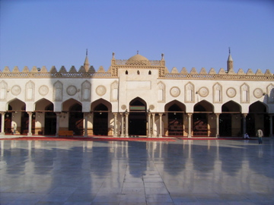
Al-Azhar University
2nd oldest in the world
Cairo, Egypt – 975 CE

Slide 67
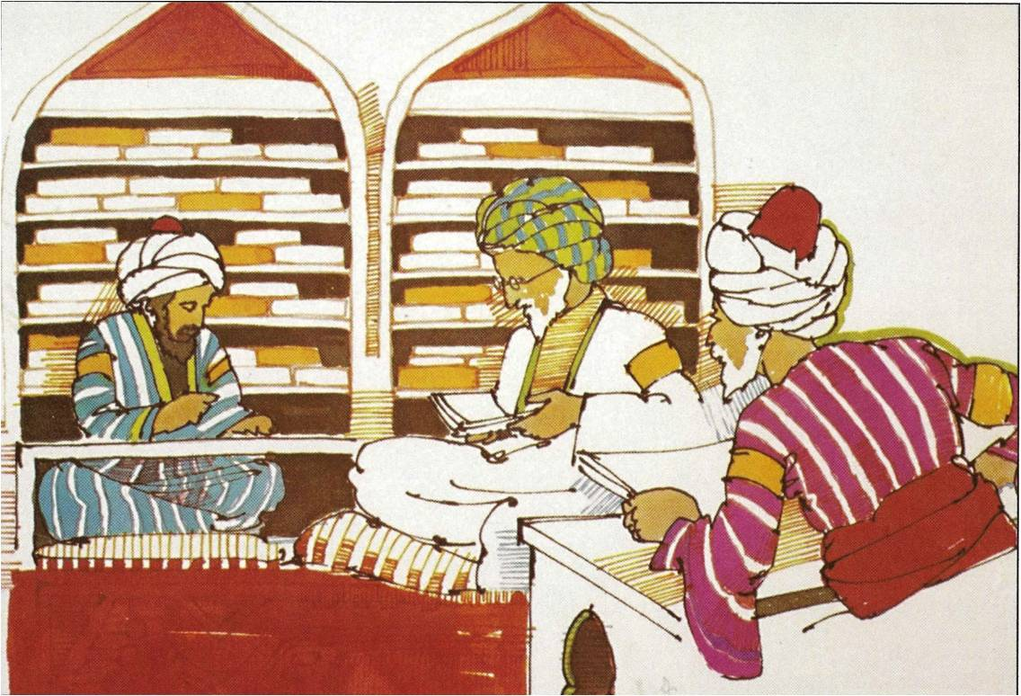
Libraries

Slide 68

Islamic Libraries
Collection of ancient manuscripts
Translating work of Greek, Roman scholars
Lending to public
Books catalogued
Concept of Muslim libraries copied by Christian monks
  Introduced to the western = today’s libraries
--------------
Micheau, Francoise, "The Scientific Institutions in the Medieval Near East", pp. 988–991 in Morelon, Régis & Roshdi Rashed (1996), Encyclopedia of the History of Arabic Science, vol. 3, Routledge, ISBN 0415124107

Slide 69
Libraries
Daar al-Hikmah – House of Wisdom – Cairo –
  18,000 ancient books
Bayt al-Hikman – House of Wisdom – Baghdad
  Haroon Rasheed – Defeated Roman king
    Reward – Muslims will translate all the books in possession of the Romans
Al-Hakam – Spain
  400,000 books
Bani Ammaar – Tripoli – Libya
  1 million books

Slide 70
What happened to these libraries?
Tartars conquered Baghdad – destroyed books – 1258 CE
Crusaders – Destroyed libraries in Jerusalem, Gaza, Tripoli
Spanish Inquisition – 1 million books burned in one day in Granada

Slide 71
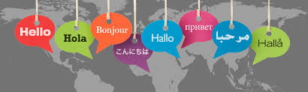
Language

Slide 72

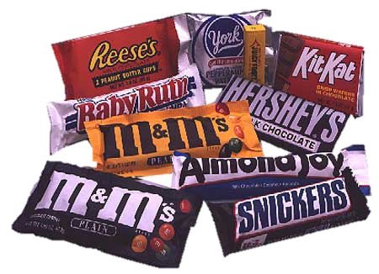

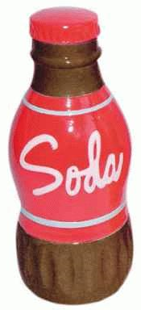

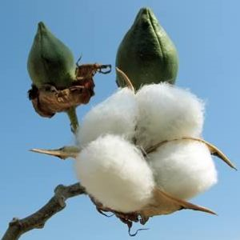
What do these things have in common?
Coffee
Orange
candy
soda
Algebra
Cotton

Slide 73
They are all derived from…
Arabic words

Slide 74

Arabic words in other languages
1000 plus in English
1000 plus in Spanish
1000 plus in Portuguese
French
Sicilian

Slide 75

Architecture

Slide 76

ARCHITECTURE
Taj Mahal - India

Slide 77

Blue Mosque
Istanbul - Turkey

Slide 78

AlHambra Palace
Granada - Spain

Slide 79

Cities

Slide 80

City of Cordoba
Spain – 1000 years ago
Lighted Streets
  10 miles radius outside the city
  Paved Streets
Garbage was regularly picked from streets
City surrounded by Gardens
One million citizens
  London, Paris – 25, 000 citizens

Slide 81
City of Cordoba
Spain – 1000 years ago
100% Literacy rate
50 Hospitals
80 schools
  FREE education
600 Mosques
900 Baths

Slide 82

What can Islam offer today?
Spiritual enhancement of the society
Moral enhancement of the society
Economic enhancement of the society
Physical enhancement of the society

Slide 83

Islam Provides
Solutions to Societies Problems معاشرتی برائیوں کے حل
  Obesity
  Racism
  Homicidesقتل
  Rapes
  Downed economy
  Drugs – intoxicants
  Divorce
  Theft
  Suicides
  Violence

Slide 84
Islam for Today
"I have always held the religion of Muhammad in high estimation because of its wonderful vitality. it is the only religion which appears to me to possess that assimilating capacity to the changing phase of existence which can make itself appeal to every age.
I have prophesied about the faith of Muhammad that it would be acceptable to the Europe of tomorrow as it is beginning to be acceptable to the Europe of today.“
H.G.Wells – The Genuine Islam, Vol. 1, No. 8 1936

Slide 85
Summary
Islamic civilization&culture
Historical Development
Of Islamic Civilization
Characteristics of Islamic
Culture and Civilization
Their contamporary
issues .

Slide 86
Activity for you
What is the meanings of culture?
What is the meaning of civilization?
The fountain of Muslim civilization is ?
Basic concepts of Islamic cluture and civilization are taken from?
In muslim rule what is the condition of Hospital?and How tho facilitate the patient?

Slide 87


