Slide 1
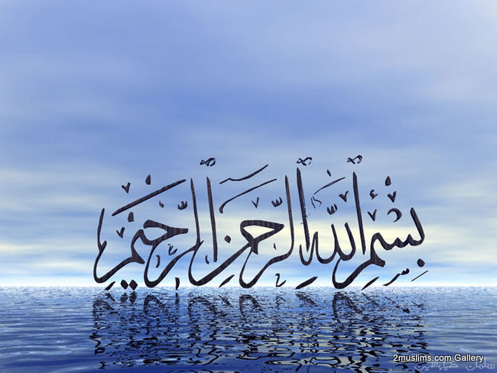

Slide 2
Islamic Studies course code 104
Associate Degree Education ADE/B.Ed(Hons)Elementary
Semester I

Slide 3

Lectuere#16

Slide 4
Islamic Economic System
By Muhammad Imran

Slide 5
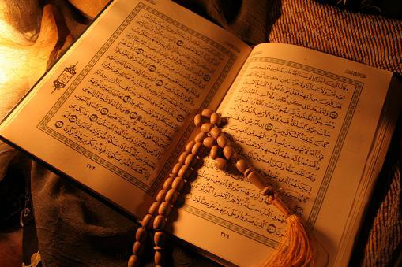
Out Lines
  Basic concepts of Islamic Economic System
  Means of Distribution of Wealth in Islamic Economics
  Islmaic Concept of Riba
  Islamic Ways of Trade&Commerce

Slide 6
Definition of Economics
Economics is the social science that studies the allocation of scarceقلیل resources to satisfy unlimited wants.

Slide 7
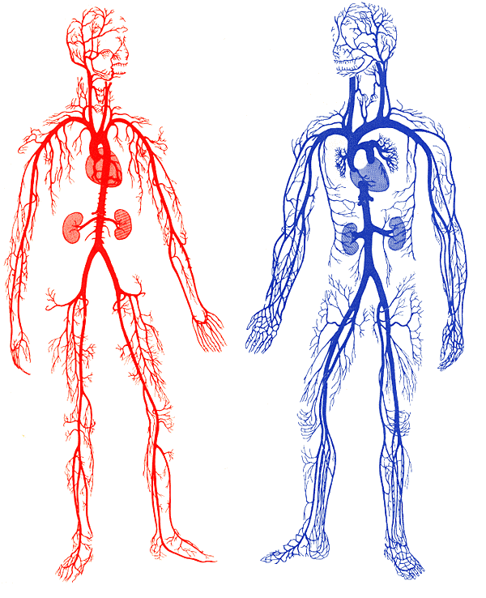
Economics: A life blood system of Society
Individual
Distribution
(Arteries)
State
Collection &
Re-distribution
(Veins)

Slide 8
Definition of Islamic Economics
Islamic Economics is a social science which studies the economic problems of people imbued with the values of Islam.
It is the study of social science which enables people to perform their obligation to Allah and to their society

Slide 9
Cont. Definition of Islamic Economics
It studies man not only as an isolated individual but of a social individual having;
faith,
ethics (believing in the six articles, his deeds is accountable to Allah as it is guided by Shari’ah.
he is also required to propagate good doing and prohibit bad doing al-Amr bil Maruf wa al-Nahy anil Munkar in the society (watch his business ethics)

Slide 10
Islamic Economic
Akhirah: the hereafter for accountability, and for getting the outcome of all deeds including economic activities, in an eternal life.
Economic and Non-Economic well-being for leading a good life and discharging socio-Islamic obligations in this world and for achieving the home of hereafter.
Notes:
Among these, the last provides a framework for economic achievements, and the first and the third require all economic activities to be in conformity with the Islamic norms and values, which have been revealed through the institution of the risalah. Any research in Islamic economics has to be based on these philosophical foundations

Slide 11
ECONOMIC PHILOSOPHY OF ISLAM
  no concept of Riba
  because it encourages
    concentration of wealth in few hands
    creation of monopolies
    greed and selfishness leading to injustice and oppression

Slide 12
ISLAMIC MODEL OF DISTRIBUTION OF WEALTH
    Based on two underlying principles
      Importance of economic goals
      Real nature of wealth and property
    economic activities of man are lawful, meritorious and at times obligatory and necessary
    however economic activity is not the basic problem and therefore economic progress is not the be-all and end-all of human existence

Slide 13
OBJECTIVES OF DISTRIBUTION OF WEALTH
Establishment of a practicable Economic system
Islam accepts the following thing within a certain limits:
laws of demand and supply
motive of personal profit
market forces
natural relation of employer and employee

Slide 14
2. Enabling every one to get what is rightfully due to him:-
A: Elementary level of deserving wealth: Factors of production
B: Secondary level of deserving wealth: poor
In the second verse:

Slide 15
3 Eradicating the Concentration of Wealth through:
Prohibition of hoarding, interest, gambling, speculation, Uqood Fasidah, and Gharar
Holy Quran Says in Al Hashr 7:

Slide 16
Devine Economic Plan
Wealth is a test
Anam 165/Nahal 71
Not related to efforts
Zumr 49
وَاللّهُ فَضَّلَ بَعْضَكُمْ عَلَى بَعْضٍ فِي الْرِّزْقِ
And Allah has made some of you excel others in wealth. (Nahal 71)
وَهُوَ الَّذِي جَعَلَكُمْ خَلاَئِفَ الأَرْضِ وَرَفَعَ بَعْضَكُمْ فَوْقَ بَعْضٍ دَرَجَاتٍ لِّيَبْلُوَكُمْ فِي مَا آتَاكُمْ
And Allah has made you successors in the land and raised some of you above others in different levels, to test you for what is given to you. (Araf 165)
فَإِذَا مَسَّ الْإِنسَانَ ضُرٌّ دَعَانَا ثُمَّ إِذَا خَوَّلْنَاهُ نِعْمَةً مِّنَّا قَالَ إِنَّمَا أُوتِيتُهُ عَلَى عِلْمٍ بَلْ هِيَ فِتْنَةٌ وَلَكِنَّ أَكْثَرَهُمْ لَا يَعْلَمُونَ
When a man gets in trouble he cries for help of Allah, and when he is granted favors, he says “I have got it due to my knowledge”. In fact wealth is a trial but most of people do not know. (Zumr 49)

Slide 17
Distribution Channels (عبادت)
Compulsory
واجبات
Marriage payment and
penalties on certain faults
Taxes (تيكس)
Taxes imposed by state to
provide basic needs of its citizens
Zakat (زكاة)
Payable on wealth of individual
% of contribution
Inheritance (وراثت)
Strictly in accordance with injunction of Quran
Voluntary Charity (انفاق)
Entire wealth in access of basic needs

Slide 18
Dimensions of
Islamic Economic System
Legal System
Limited Capitalism
(surplus wealth for personal use)
Spiritual System
Spiritual Socialism
(human rights on surplus wealth)
Restricting
evils/crimes
Elevating ethical/
spiritual values
Inter-dependent &
Inter-connected (Synthesis)
Restricts luxury &
wealth accumulation
Channels excess
wealth to needy
Immune System
(Regulatory)
Treatment system
(Repair/Maintenance)
Primary focus of Islam is on the spiritual System (test of Taqwa/free will)
Legal system provides only safety valve for safeguarding basic human rights
Keeping excess wealth and generating income from it is allowed legally but spiritually is it detested.

Slide 19
Three economic modes of Muslims
Moral
(Height of spiritual
living)
Hallal means of living
Distribution of entire excess wealth
Hardy any situation of Zakat
Simple lifestyle
Legal
(Minimum threshold of living)
Hallal means of living
Pays Zakat and other compulsory dues
Charity (infaq) up to the level of Taqwa
Modest lifestyle
Illegal
(State of practical kufr)
No distinction of hallal/harram
Does not care to pays Zakat/other dues
Charity for image building
Extravagant and luxurious lifestyle
Stinginess/wealth piling up

Slide 20
Final outcome
لِيُنفِقْ ذُو سَعَةٍ مِّن سَعَتِهِ وَمَن قُدِرَ عَلَيْهِ رِزْقُهُ فَلْيُنفِقْ مِمَّا آتَاهُ اللَّهُ لَا يُكَلِّفُ اللَّهُ نَفْسًا إِلَّا مَا آتَاهَا سَيَجْعَلُ اللَّهُ بَعْدَ عُسْرٍ يُسْرًا (7) وَكَأَيِّن مِّن قَرْيَةٍ عَتَتْ عَنْ أَمْرِ رَبِّهَا وَرُسُلِهِ فَحَاسَبْنَاهَا حِسَابًا شَدِيدًا وَعَذَّبْنَاهَا عَذَابًا نُّكْرًا (8) فَذَاقَتْ وَبَالَ أَمْرِهَا وَكَانَ عَاقِبَةُ أَمْرِهَا خُسْرًا (9) أَعَدَّ اللَّهُ لَهُمْ عَذَابًا شَدِيدًا فَاتَّقُوا اللَّهَ يَا أُوْلِي الْأَلْبَابِ الَّذِينَ آمَنُوا قَدْ أَنزَلَ اللَّهُ إِلَيْكُمْ ذِكْرًا
*****
Let the man of means spend according to his means: and the man whose resources are restricted, let him spend according to what Allah has given him. Allah puts no burden on any person beyond what He has given him. After a difficulty, Allah will soon grant relief. And how many a community revolted against the ordinance of its Lord and His messengers and We took detailed accountability of their deeds and punished them severely. Then did they taste the evil result of their conduct, and the End of their conduct was great loss.
(Talaq 7-10)

Slide 21
Outcome of modern economic system
وَآتِ ذَا الْقُرْبَى حَقَّهُ وَالْمِسْكِينَ وَابْنَ السَّبِيلِ وَلاَ تُبَذِّرْ تَبْذِيرًا (26) إِنَّ الْمُبَذِّرِينَ كَانُواْ إِخْوَانَ الشَّيَاطِينِ وَكَانَ الشَّيْطَانُ لِرَبِّهِ كَفُورًا
*****
And give to the relatives due and to the needy and the wayfarer, and do not squander wastefully. Surely the squanderers are the fellows of the devils and the satan is ever ungrateful to his Lord.
(Isra 26-27)

Slide 22
Outcome of modern economic system
Explosion of
Debt
سودى كاروبار كا جال
Explosion of
Over-supply
كثرت ترسيل
Explosion of
Competition
اندهى مقابله بازى
Explosion of
Over-production
كثرت بيداوار
Explosion of
Over-utilization
كثرت استمال
Explosion of
Over-wastage
كثرت ضياع

Slide 23
Mirror view before/After Implementation
Before (Savageجنگلی Society)
After (Natural Society)
Tyranny
Savagery
Cut-throat competition
Self-centeredness
Criminality
Robbery
Theft
Racism
Piety
Courage
Happiness
Justice
Content
Satisfaction
Chastity
Humility
Exploitation
Non-contributory
/Contributory
Social Security
Plan
(Surplus Pool)
Intellect
Compassion
Care of kin
Affection
Sincerity
Freedom
Fortitude
Munificence
Zeal & Endeavor
Harmony
Cowardice
Ignorance
Tensions
Fear
Hunger
Servitude
Debt
Threats
Deprivation

Slide 24

Summary of natural economic System of Islam
Islamic view is that “real economy” controls, and the money is only a “supportive function”. Protects labour/work.
Stop earning money through money and compels people to work and invest money in business ventures
Eliminates sources of unearned income (interest/speculation)
No protection to capital and uses wealth in real economic activities integrated with physical laws of nature.
Collect zakat (wealth tax) no tax on income or consumption.
It is responsibility of individuals for meeting needs of poor and social welfare of society
State is responsible for meeting basic needs of citizens and taking administration/legal measure for checking concentration of wealth in few hands.
Business in Islam is not an grabbing the opportunity but a “Ibadah” covered under the ethos of Islamic principles of life.

Slide 25
Penalties on various crimes
Level
Crime
Action
Moral
various
Disliking/Curse of Allah
❶
Social
Sex
100 Lashes
❷
Political
Killing
Revenge (Qasas)
❸
Economic
Interest
War with
Allah & Rasul
❹

Slide 26
Story of Past Rebels
“Tower of Babel”
فَكَأَيِّن مِّن قَرْيَةٍ أَهْلَكْنَاهَا وَهِيَ ظَالِمَةٌ فَهِيَ خَاوِيَةٌ عَلَى عُرُوشِهَا وَبِئْرٍ مُّعَطَّلَةٍ وَقَصْرٍ مَّشِيدٍ
X
How many populations have We destroyed, which were given to wrong-doing? They tumbled down on their roofs. And how many wells are lying idle and neglected, and castles lofty and well-built? (Hajj 45)
X
Period of Namrood (let us revolt) 2500 BC

Slide 27
How Islam views the
Economic Problems?
Scarcity محدود وسائلof Resources
Unlimited Wants &
Choice

Slide 28
Resources in Islam
Allah (swt) Has created resources in abundant.
However recourses in the eyes of man’s is scarce/limited due why?
due to lack of means to reach this resources (which is the results of man’s choice such as lack of knowledge, skills, etc.)

Slide 29
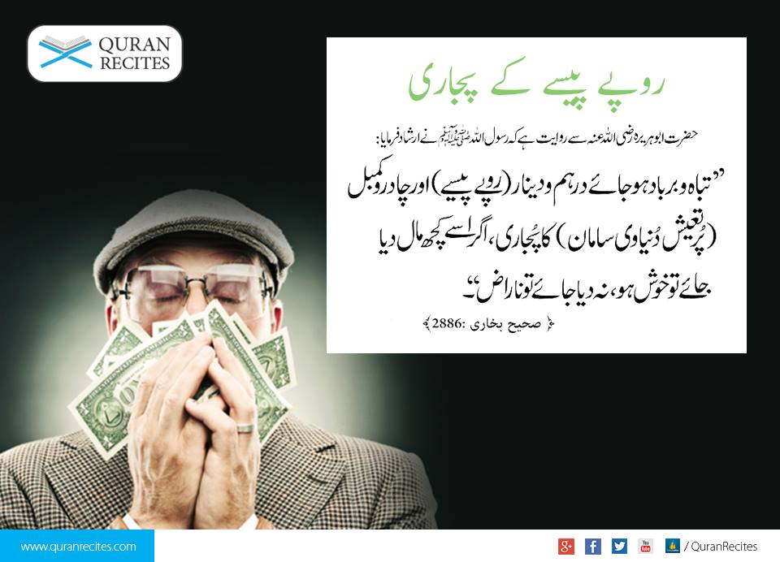
Unlimited Wants
Islam recognizes that human desires are unlimited. This is explained in the Quran and in the Hadith.

Slide 30
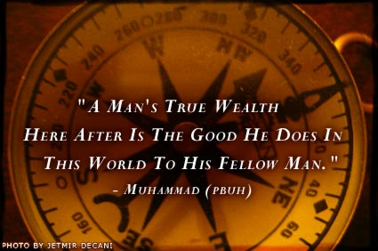
Cont. Man’s Unlimited Wants
يَحْسَبُ أَنَّ مَالَهُ أَخْلَدَهُ
Thinking that his wealth would make him last for ever!(104:3)

Slide 31
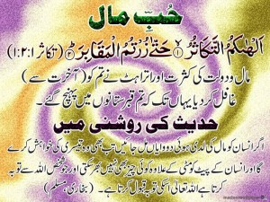
Man is greedy
قال رسول الله (ص):
« لو أن ابن آدم أعطي واديا من ذهب أحب إليه ثانيا ، ولو أعطي ثانيا أحب إليه ثالثا ، ولا يملأ جوف ابن آدم إلا التراب ، ويتوب الله على من تاب »
“If man is given a valley of gold, certainly, he wants the second and third one and he will …..” Hadith

Slide 32
Choice in Islam
Hence scarcity of means necessitates choice which can provide higher values but at same time performing one’s mission in this life.
Choice in Islam should be ranking according to need fulfillment and not to greediness

Slide 33
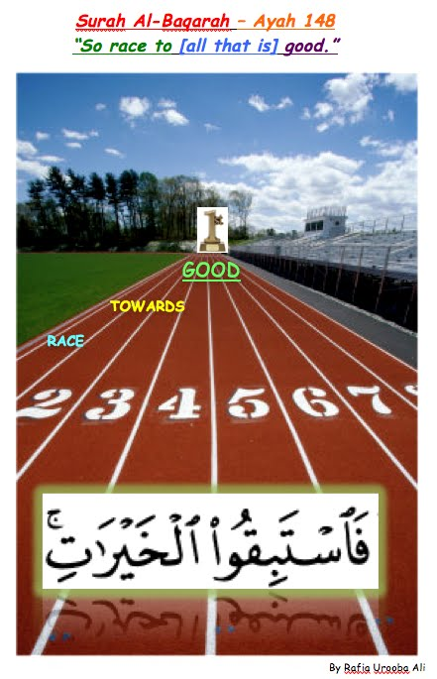

Slide 34
When a man dies he will be asked on four:
1- His youth how he spend it?
2- His age how he spend it?
3. His wealth how he acquires it? &
4. How he spends it?
Cont. Acquiring Wealth in Islam
عن ابي الدرداء قال قال رسول الله صلى الله عليه وسلم لن يزول قدما عبد يوم القيامة حتى يسأل عن أربع عن شبابه فيما ابلاه وعن عمره فيما افناه وعن ماله من اين اكتسبه وفيما أنفقه

Slide 35
separation between religion and other aspects of life,
- materialistic,
- individualistic,
- less socio economic justice
- less public relations,
- less concern with the hereafter life
SECULAR WORLDVIEW
(Man’s Way of Life)

Slide 36
belief in a dual worldviews: this world & the hereafter
- religion is part of his/her daily life
- maslahah of the ummah (public benefit),
- accountability,
- trustworthiness,
- transparency etc.
ISLAMIC WORLDVIEW
(Man’s Way of Life)

Slide 37
Islamic WORLDVIEW
To understand the Islamic worldview let us first define the followings:
1. Islam, Iman, A’mal, Ihsan.
2. Relationship between Allah, man, nature, religion.
3. The nature and characteristics of man; man’s role as ‘abd and khalifah

Slide 38
Cont. The Islamic Worldview

Slide 39
Islam abhors DEBT and strongly discourages it
Prophet (PBUH) said: "Whoever asks for money while he has what suffices him has asked for a lot of Hellfire's embers." People asked him, "What is the sufficient amount of money above which one should not ask?" He said, "The amount he needs for his lunch and dinner." (Abu Dawud)
He also said: "Whoever asks people for their money to increase his wealth, has asked for embers, so let him ask a little or a lot”.
A man came to the Prophet (PBUH) and said, "O Messenger of Allah! If I was killed in Allah's cause, observing patience, awaiting Allah's reward, attacking, not retreating, would Allah forgive my sins?" The Prophet (PBUH) said, "Yes, except for the debt." The Prophet (PBUH) said, "A believer's soul is attached to his debt till it is paid.“
A dead person was brought to the Prophet so that he might lead the funeral prayer for him. He (PBUH) asked, "Is he in debt?" When the people replied in the negative, he led the funeral prayer. Another dead person was brought and he asked, "Is he in debt?" They said, "Yes." He (refused to lead the prayer and) said, "Lead the prayer of your friend." Abu Qatada said, "O Allah's Apostle! I undertake to pay his debt." Allah's Apostle then led his funeral prayer. No. 2154 (Sahih Bokhari)

Slide 40
Islam prohibits and strongly CONDEMNS
usury or RIBA.
Allah will deprive usury of all blessing, but will increase benefits of charity" (Baqra 276);
If you do not stop taking usury, then be ready for a war with Allâh and His Messenger (Baqra 279)
Abdullah ibn Hanjalah related that the Prophet said: A dirham of Riba (interest) knowingly taken by a man is a sin worse than committing Zina (fornication) 36 times (Ahmad, Daraqutni).
Narrated Jabir ibn Abdullah: Allah's Messenger cursed the accepter of interest and its payer, and one who records it, and the two witnesses; and he said: They are all equal (Muslim).
Hazrat Abu Hurairah r.a. reported that the Prophet said : A time will certainly come when none will remain who will not devour usury. If he does not devour it, its vapors will fall on him [Ahmed,Abu Dawood,Nisai,Ibn Majah]

Slide 41

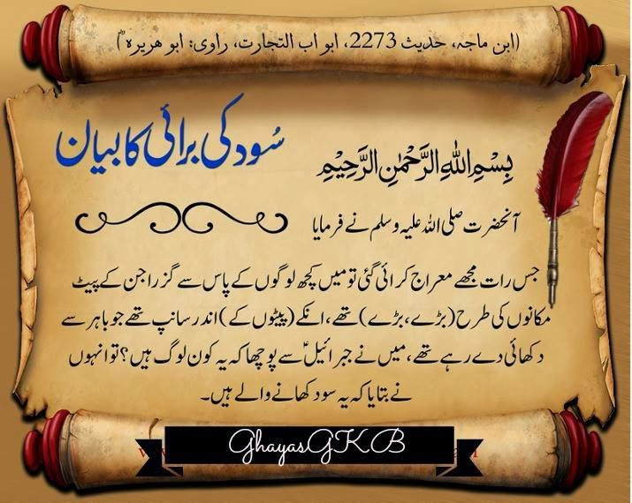

Slide 42
THE MEANING OF RIBA
Riba means addition, increase.
Riba literally means to increase, to grow to rise, to add, however, not every increase or growth which has been prohibited by Islam
Riba technically refers to the premium that must be paid by the borrower to the lender along with the principal amount as a condition for the loan or for an extension in its maturity.

Slide 43
Interest or Al-RIBA as it is used in the Arabic language means to excess or increase. In the Islamic terminology interest means effortless profit or that profit which comes free from compensation or that extra earning obtained that is free of exchange.

Slide 44
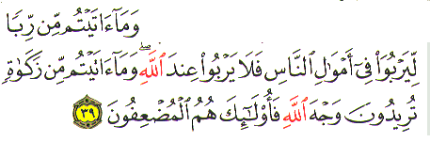
First Revelation about Riba
  “That which you give as interest to increase the peoples' wealth increases not with God; but that which you give in charity, seeking the goodwill of God, multiplies manifold.” (Surah Rome, Verse 39)
Notes:
Another verse of Quran which prohibits riba is in Surat Al- Baqarah, Ayat 276
The fact stated in this verse is a truism from a moral and spiritual as well from an economic and social viewpoint. For, although wealth apparently multiplies through interest and shrinks as a result of charity, in actual fact the opposite is the case. By God’s decree, the law of nature is such that interest not only serves as a strain on moral and spiritual well- being and social and economic growth, it also causes actual regression and decline. Charity, however leads to the growth and expansion of man’s moral and spiritual qualities and to the growth of human society and economic. Charity here includes such acts as lending money to people with stipulation that they should return it if they can, and at their convenience).
The second verse is from Surah-e Al Imran, Ayat 130.
The major cause of setback suffered at Uhud was that precisely at the moment of their victory the Muslims succumbed to the desire for wordily possessions, and and turned to collecting booty rather than completing their task of crushing the enemy. Hence God thought fit to raise a barrier against this excessive adoration of money, and to urge them to give up usury which keeps man constantly absorbed in considering ways and means of amassing wealth and generally whets his appetite for money.

Slide 45
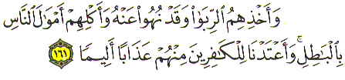
Second Revelation
  “And for their taking interest even though it was forbidden for them, and their wrongful appropriation of other peoples' property. We have prepared for those among them who reject faith a grievous punishment ” (Surah al-Nisa', verse 161)
Notes:
Another verse of Quran which prohibits riba is in Surat Al- Baqarah, Ayat 276
The fact stated in this verse is a truism from a moral and spiritual as well from an economic and social viewpoint. For, although wealth apparently multiplies through interest and shrinks as a result of charity, in actual fact the opposite is the case. By God’s decree, the law of nature is such that interest not only serves as a strain on moral and spiritual well- being and social and economic growth, it also causes actual regression and decline. Charity, however leads to the growth and expansion of man’s moral and spiritual qualities and to the growth of human society and economic. Charity here includes such acts as lending money to people with stipulation that they should return it if they can, and at their convenience).
The second verse is from Surah-e Al Imran, Ayat 130.
The major cause of setback suffered at Uhud was that precisely at the moment of their victory the Muslims succumbed to the desire for wordily possessions, and and turned to collecting booty rather than completing their task of crushing the enemy. Hence God thought fit to raise a barrier against this excessive adoration of money, and to urge them to give up usury which keeps man constantly absorbed in considering ways and means of amassing wealth and generally whets his appetite for money.

Slide 46
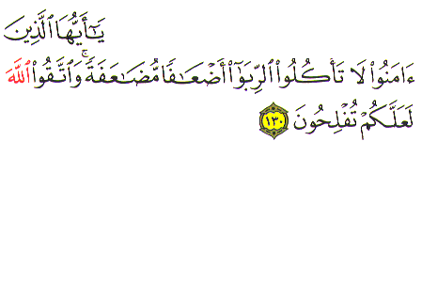
Third Revelation
  “Believers! Do not swallow riba, doubled and redoubled, and be mindful of Allah so that you may attain true success” ( Al Imran, Ayat 130)
Notes:
Another verse of Quran which prohibits riba is in Surat Al- Baqarah, Ayat 276
The fact stated in this verse is a truism from a moral and spiritual as well from an economic and social viewpoint. For, although wealth apparently multiplies through interest and shrinks as a result of charity, in actual fact the opposite is the case. By God’s decree, the law of nature is such that interest not only serves as a strain on moral and spiritual well- being and social and economic growth, it also causes actual regression and decline. Charity, however leads to the growth and expansion of man’s moral and spiritual qualities and to the growth of human society and economic. Charity here includes such acts as lending money to people with stipulation that they should return it if they can, and at their convenience).
The second verse is from Surah-e Al Imran, Ayat 130.
The major cause of setback suffered at Uhud was that precisely at the moment of their victory the Muslims succumbed to the desire for wordily possessions, and and turned to collecting booty rather than completing their task of crushing the enemy. Hence God thought fit to raise a barrier against this excessive adoration of money, and to urge them to give up usury which keeps man constantly absorbed in considering ways and means of amassing wealth and generally whets his appetite for money.

Slide 47
Ahadees on riba
1. From Abu Hurayra: The Prophet, peace be on him, 'said: "Riba has
seventy segments, the least serious being equivalent to a man
committing adultery with his own mother." (Ibn Maja, vol. 2, p. 764:2274).
2. From Abu Hurayra: The Prophet, peace be on him, said: "There will
certainly come a time for mankind when everyone will take riba and if he
does not do so; its dust will reach him". (Ibn Maja, vol. 2, p. 765:2278,

Slide 48
3. From Abu Hurayra: The Prophet, peace be on him, said: "God would be
justified in not allowing four persons to enter paradise or to taste its blessings:
he who drinks habitually
, he who takes riba,
he who eats an
orphan's property without right, and he who is undutiful to his parents".
(Mustadrak al-Hakim, vol. 2, p. 37).

Slide 49
PROFIT | RIBA
Halal | Haram
Derive from trading | Derive from debt (al-nasiah) and trading (al-fadl)
The buyer purchases the items he needs and the seller gets profit for the time, labour and brains he employs in providing that items to the buyers. | The debtors cannot settle the transaction on equal terms with the creditor because of his weaker position.
The profit which the debtor make on money of the creditors has after all its own limits. | There is no limit to the interest the creditor may charge on his money.
The transaction in trade comes to an end as soon as the items and its price change hands. After this the buyer is not required to return anything to the seller. | The debtor has to spend it first and the reproduce it and return it, to the creditor along with the interest. Thus the debtor runs a double risk.

Slide 50
Riba’ vs Trade
Wisdom behind prohibition of riba’
Elimination of injustice and encourage cooperation
Spirit of brotherhood
Riba’ is not trading:
Money loaned for self-generating or self-expanding value is not sale
Growth or increase in money is inequitable
One party receives an increase without equivalent return to the other party
In sale, there is productive exchange such as goods for goods and money for goods

Slide 51
Real Solution of Problem of Interest
1. Discrimination between Halal (permitted things being lawful) and Haram (forbidden things being unlawful).
2. Equitable distribution of wealth through Zakat, Sadaqat.
3. Provision of basic necessities of life for every citizen .
4. Prohibition of hoarding of wealth and promotion of its circulation in productive channels.
5. Elimination of interest.

Slide 52
Steps for healing the money system
Limit growth and focus on wellbeing
Limit Debt & encourage entrepreneurs
Introduce zero rated debts
Impose Charge on money holding
Make speculation a criminal offence
Incentivise productive work and investment;
Tax Unearned Gains
Replace labor for energy use
Strengthen the social fabric of family and community
Lease land for living/business purposes

Slide 53
Action at personal level
Adopt simple lifestyle (Resource conservation & sharing)
Get out of interest/speculation based investments
Fully utilize goods before replacement
Eliminate morbid craving for extravagant gadgetry
Get rid of fashion (a bio-economic disease of the human mind )
Demand durable goods to be made still more durable by being designed so as to be repairable.
Get closer to the nature as possible
Join hands to fight for reform at state level

Slide 54
Optimum
  Basic concepts of Islamic Economic System
  Means of Distribution of Wealth in Islamic Economics
  Islmaic Concept of Riba
  Islamic Ways of Trade&Commerce

Slide 55
Activity
Define Economic in your own words?
What is the basic concept of distribution of wealth in Islam?
Explain the Islamic concept of Riba?
Discuss any three steps for healing the mony system?

Slide 56


