Slide 1
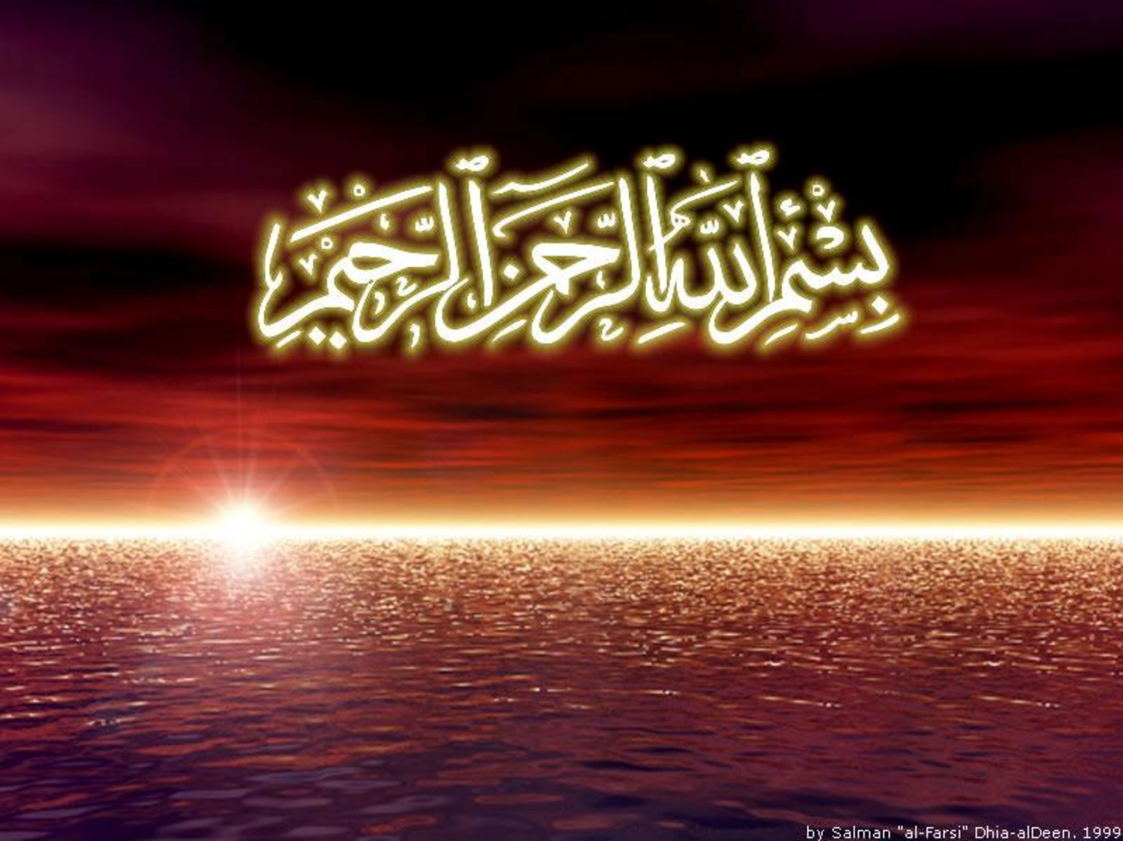

Slide 2
Islamic Studies course code 104
Associate Degree Education ADE/B.Ed(Hons)Elementary
Semester I

Slide 3

Lectuere15

Slide 4
Islam and Science
پیشکش:محمد عمران

Slide 5
Outlines:
Defining Science and Hikmah
Basic concepts of Islam&Scinence
Contribution of Quran to science
Contribution to modern science by Muslim scientists
Down fall of Islamic era of science
Action plan to revert the present situation

Slide 6
Science or Hikma
Study of nature
Islam stresses to explore nature (Tahqeeq and Tasqeer)
Expect us to know the force behind nature
Once this is realized the concept of Creation (Maqlooq) and Creator (Qaleq) become obvious
Knowledge of nature brings you closure to Allah

Slide 7
Science
After the birth of Mohammad (SAS) science took a different course
Revelation of Al-Quran-ul-Hakeem changed the thinking process of mankind
Islam brought science from imaginary philosophical concept to modern experimental and practical stage, so call Modern Science

Slide 8
Science
Al-Quran initiated a different thinking process in Muslim Scholars (Hukma or Muslim Scientists)
Reaching precision and accuracy was their measurement
They developed the method of investigation (Scientific Method)

Slide 9
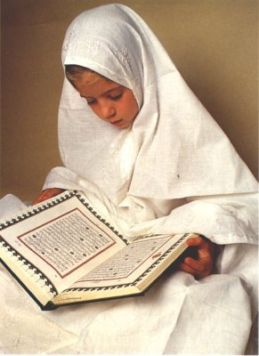
Islamic era of Science
Birth of Prophet Muhammad (PBUH)
(570 AD – 632 AD)
Begins with revelation of Quran (610 AD)

Slide 10
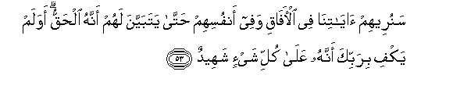
Islam and Modern Scientific Methods
The Challenge of Quran
Soon we will show them our signs in the (furthest)
regions (of the earth), and in their own souls until
it manifests truth on them.
(Sura Fussilat 41:53)

Slide 11
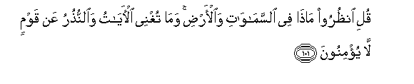
Importance of observation in Quran
Say : “Behold all that is In the heavens and on earth”
(Sura Yunus 10:101)

Slide 12
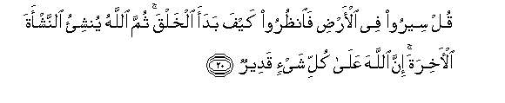
Say: “Travel through the earth And see how God did
Originate creation; so will God produce a later creation:
For God has Power over all Things
(Sura Ankabut 29:20)

Slide 13
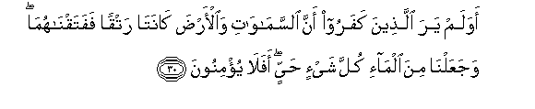
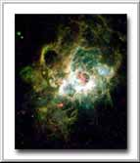
Quran gives many Scientific facts
Do not the Unbelievers see That the heavens
And the earth Were joined together (as one Unit
Of Creation),
(Sura Anbiyaa 21:30)

Slide 14


Expansion of the Universe
And the heaven, we have built it with power.
Verily, we are expanding it.
(Sura Al Zariyat 51:47)

Slide 15
“From 8th century to 12th century, Arabic was the scientific language”.
- British Research 4:1
“Muslim scholars introduced precise observation, controlled experiment and careful records”.
-Will Durant

Slide 16
What is Islam?
A religion that began with the prophet Muhammad in the 7th century
Muhammad believed he was a messenger sent by God
Muslims follow the teachings of the holy book, the Qur’an
Muslims pray in the direction of Mecca, the centre for Islamic worship
Islam spread rapidly throughout the Middle East and beyond

Slide 17
Science and Learning in Medievalقرون وسطیٰ
Islam
Early Islamic teaching encouraged the pursuit of all knowledge that helped to improve people’s lives
Arabic became the international language of scholarship
Muslims translated important works from ancient Greece and Egypt
Huge libraries were established in big cities like Baghdad, Cairo and Damascus

Slide 18
Chemistry and Alchemy
Chemistry was not seen as a separate science, but was an important part of other industries and crafts
Islamic scientists developed new experimental techniques and methods such as distillation
Alchemy was important as a science of the cosmos and the soul

Slide 19
Mathematics
Islamic mathematicians built on the work of Greek, Indian, Persian and Chinese mathematicians
Islamic mathematicians were interested in different number systems
Developed algebra and geometry which was important in architecture and other technologies

Slide 20
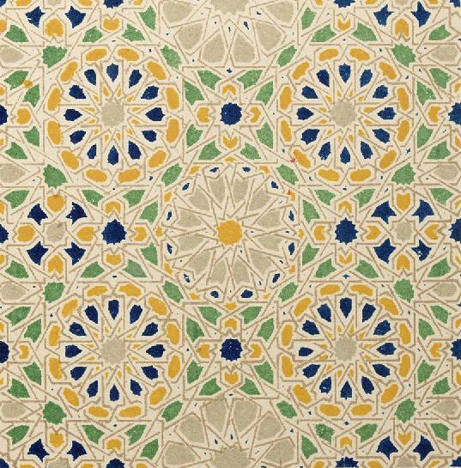
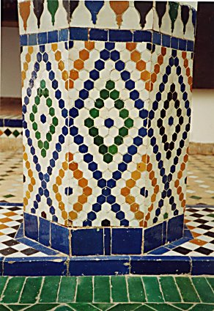
Islamic tile patterns used to decorate buildings

Slide 21
Medicine and surgery
Islamic medicine was based on the Greek model of the four elements and ‘humours’
Disease was thought of as an imbalance of ‘humours’
Pharmacy, combining herbal medicine and alchemy, was important
Islamic law forbade dissections

Slide 22
Technology
Arab lands were often dry and harsh environments
Improvements in water technology were important for agriculture
Other industries included manufacture of paper, machinery and scientific instruments

Slide 23
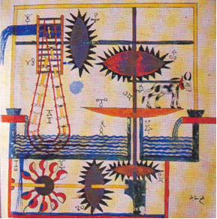
Water raising machine from Al-Jazari manuscript
http://www.muslimheritage.com/ImageLibrary/

Slide 24
Questions
Is there any conflict between science and religion? And can one replace the other?
Does the word Scientist equates a non believer ? Or Is being scientific contradicts being religious?
Is religion just a group of myths, which was meant to suit the time it was revealed or is it a logical, intellectual, sensible curriculum.

Slide 25
The Answers
Religions are originating from the same source.
Miracles were one of the most important tools that GOD supported HIS messengers to convince people.
In the Quran, GOD has approached human beings through a different pathway: logic, practicality, precision and employment of mind.
What is my key point of my discussion? ”The Quran mentioned scientific facts 1432 years ago, that we, human beings and in the 20th century, proved to be correct”.

Slide 26
First five verses revealed in Quran
“Read in the name of your LORD (GOD) WHO has created (all that exists),
HE (GOD) has created man from a clot (a piece of thick coagulated blood),
READ and your LORD (GOD) is the most Generous, WHO (GOD) has taught (the writing) by the pen,
HE (GOD) has taught mankind that which they knew not” (Quran 96: 1-5)

Slide 27
Origin of Universe
Modern Science
Quran
Moderncosmology: indicates that, at one point in time, the whole universe an opaque highly dense and hot gaseous composition).
The earth and the heavens above (the sun, the moon, stars, planets, galaxies, etc.) were formed from this same ‘smoke,’ ? They were one connected entity then separated from each other (The First Three Minutes, a Modern View of the Origin of the Universe, Weinberg, pp. 94-105.)
”….Then HE (GOD) turned to the heaven when it was smoke...” (Quran, 41:11).
”Have not those who disbelieved known that the sky and the earth were one connected entity, then WE (GOD) separated them?...” (Quran, 21:30)

Slide 28
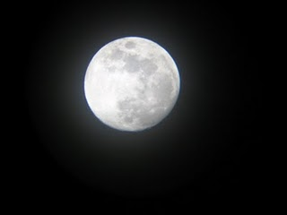
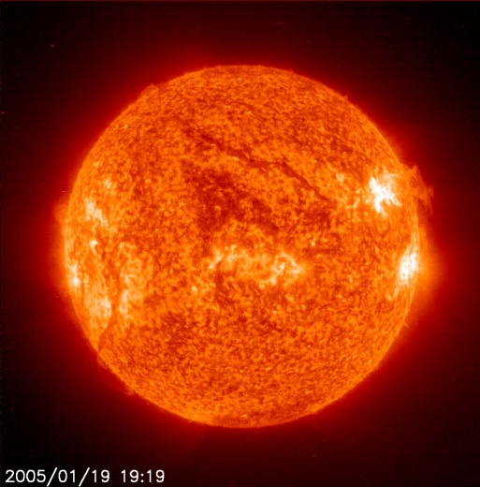
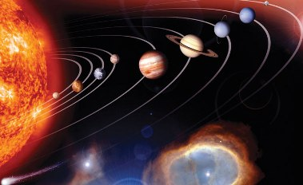
Astronomy
Modern Science
Quran
Moon is a dark body reflects light but does not produce heat whereas the sun produces both light and heat .
“See you not how ALLAH (GOD) has created the seven skies one above another, and has made the moon a light therein and made the sun a glowing lamp? (71: 15-16)

Slide 29
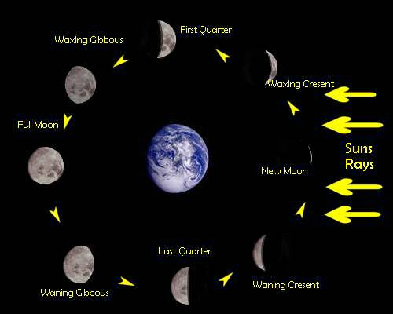
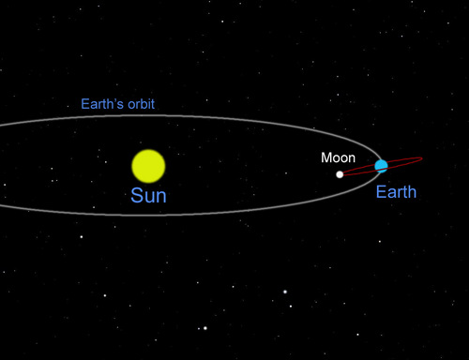
Astronomy
Modern Science
Quran
“And the moon, WE (GOD) have measured for it mansions (to traverse), till it returns like the old dried, curved date stalk.
It is not for the sun to overtake the moon, nor does the night outstrips the day and they all float, each in an orbit.” (Quran 36: 39-40)
The sun and moon each rotates in its own orbit.
The moon starts as a crescent then becomes full moon and then half moon then crescent again.

Slide 30
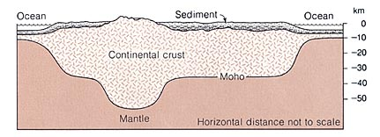
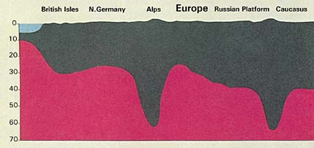
Geography/ Geology
Modern Science
Quran
Mountains :
Shaped like a peg = have underlying roots deeply embedded in the ground which can reach several times their heights.
Modern theory of plate tectonics: mountains work as stabilizers for the earth. (Professor Emeritus Frank , President of the National Academy of Sciences, Washington, DC).
“Have WE (GOD) not made the earth as a bed, and the mountains as pegs? ” (Quran, 78:6-7)
And HE (GOD) has set firm mountains in the earth so that it would not shake ... (Quran, 16:15)

Slide 31
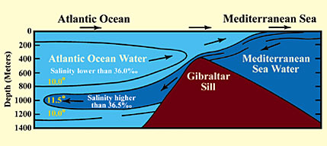
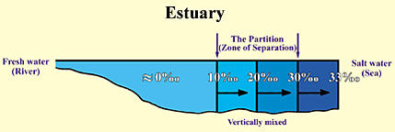
Chemistry
Modern Science
Quran
At the meeting point of 2 seas/ oceans (or a river and a sea) there is a barrier because of own temperature, salinity, and density).
Example, Mediterranean water enters the Atlantic over the Gibraltar and moves several hundred kilometres into the Atlantic at a depth of about 1000 meters with its own warm, saline, and less dense characteristics (Principles of Oceanography, Davis, pp. 92-93.)
“HE (GOD) has set free the two seas meeting together. There is a barrier between them. They do not transgress”. (Quran, 55:19-20) .
“HE (GOD) is the one who has set free the two kinds of water, one sweet and palatable, and the other salty and bitter. And HE (GOD) has made between them a barrier and a forbidding partition”. (Quran, 25:53).

Slide 32
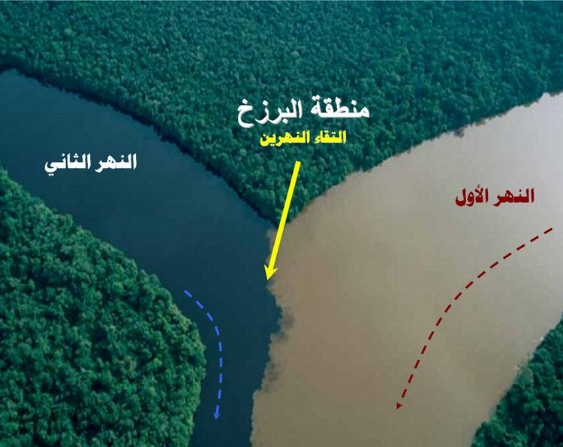

Slide 33
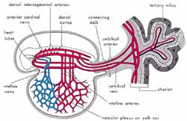
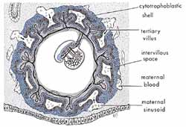
Embryology
Modern Science
Quran
Blood Clot (relatively large amounts of blood present in the embryo during this stage, does not circulate until the end of 3/52).
Suspended structure In the mum’s womb.
(The Developing Human, Moore and Persaud, 5th ed., p. 65. (2) The Developing Human, Moore and Persaud, 5th ed., p. 8. (3) The Developing Human, Moore and Persaud, 5th ed., p. 9
“WE (GOD) made him (human being) as a drop in (of blood) a place of settlement, firmly fixed. Then We made the drop into an Alaqah (suspended structure)” (Quran, 23:12-14)

Slide 34
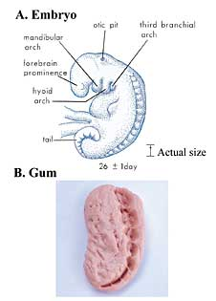
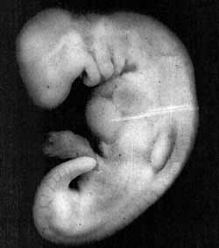
The formation of embryo
Modern Science
Quran
“Chewed Substance.” Ex. Chewed gum >> Teeth marks resembles somites at the back of the embryo (The Developing Human, Moore and Persaud, 5th ed., p. 65. (2) The Developing Human, Moore and Persaud, 5th ed., p. 8. (3) The Developing Human, Moore and Persaud, 5th ed., p. 9)
“……..then We made the alaqah into a Mudghah” (chewed substance) (Quran, 23:12-14)

Slide 35
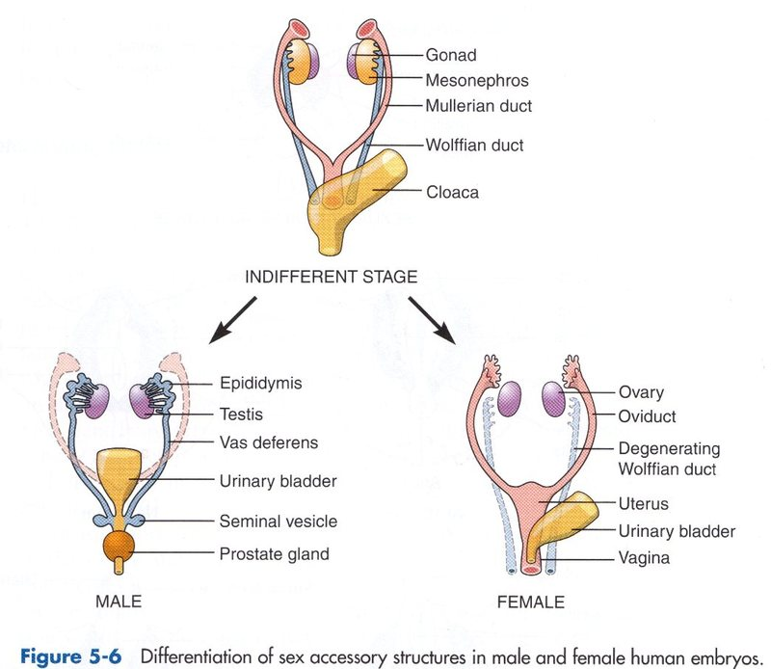
Embryology
Quran
Modern Science
“So let mankind see from what they were created, They were created from water gushing forth (Semen), coming out from in between the backbone and ribs” (Quran 86: 5-7)

Slide 36
Creation
Modern Science
Quran
Creates
But :
Reproduction
Effect on other creation
Excreta
“Is not HE (GOD) who created the heavens and the earth, ABLE to create the like of them? Yes, indeed! HE (GOD) the ALL KNOWING SUPREME CREATOR”

Slide 37
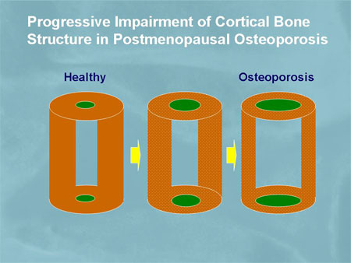
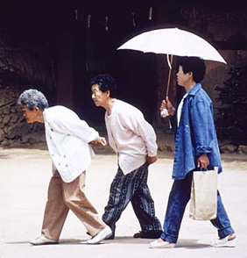
Medicine
Modern Science
Quran
Osteoporosis: (Thin Bone):
The wall (cortex) of long bones becomes thinner inner diameter of the bone increases;
why? Resistance to bending forces ͚ (R)3 of a cylinder.
The vertebrae collapse and person becomes shorter again.
“…and whom we grant long life, WE (GOD) reverse him in creation, Will they not (human beings) then understand (our/ GOD’s signs)? (Quran 36: 68)

Slide 38
Medicine
Modern Science
Quran
Proved that :
Menstrual blood is harmful for a man.
Premenstrual tension
“They ask you (Mohammed PBUH)حیٖض about menstruation(in females). Say: “It is harmful for a man, therefore , avoid females during the time of the menses and don’t approach them till they get purified (have a shower/ bath)”.

Slide 39
Breast Feeding
Modern Science
Quran
Breast Feeding : (Paediatric Clinic of North America):
Do better in schools.
Better long term health.
Protects against certain neoplasms, Ex Lymphoma.
“The mothers will breast feed their children for two whole years, (that is) for those (parents) who desire to complete the term of breast feeding” (Quran 1: 233).

Slide 40
Verses in the Quran that values Science and Scientist
“Are they equal those who got the knowledge and those who did not get the knowledge”
“…Those who fear (watch and consider to please HIM all the time) GOD are those who have got the knowledge”
“Say, My LORD Give me more knowledge”
“Verily, WE (GOD) honoured the children of Adam (Human beings) i.e. by giving the blessing of having the most capable brain of all creatures”.
“ On top of a knowledgeable person, there is a more knowledgeable one”.
The scientist passes by 3 storeys, when he achieves the first storey he shows off, when he achieves the 2nd he becomes humble and when he reaches the 3rd storey he realises that he still knows nothing (said by the 4th follower of the Profit PBUH)

Slide 41
Conclusion
GOD approached human beings through a scientific pathway to address their minds.
GOD told us WHAT and we found out WHY and HOW, which proves HIS existence and supported our faith.
Faith makes ethics for science and science helps to reach faith.
Science tagged with faith is unlikely to go astray.

Slide 42
Quran and Science
پیشکش:محمد عمران

Slide 43
The holy Quran says
(And he is the one who created the night, daylight, sun and the moon, all are swimming in an orbit).

Slide 44
Science
Modern science informed us that the moon is moving around the Earth in an oval, or elliptical orbit. Also the Earth and the rest of the planets, revolve in oval, or elliptical orbit around the sun.

Slide 45
UNIVERSE
"He created the heavens and the earth in true proportions. He makes the night overlap the day, and the day overlap the night. He has subjected the sun and the moon to His law; each one follows a course for a time appointed..." (39:5).

Slide 46
SCIENCE
Scientific discoveries have proved that we live in a huge universe that depends on revolution

Slide 47
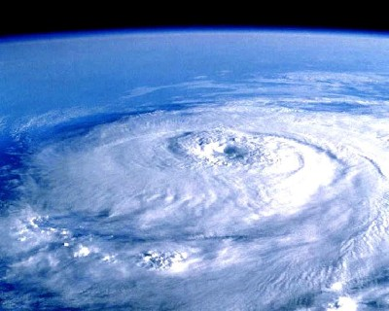
Earth
And send the winds fertilizing (to fill heavily the clouds with water), then cause the water (rain) to descend from the sky, and We give it to you to drink, and it is not you who are the owners of its stores (15:22)

Slide 48
science
The winds carry water particles which are rich in salt up into the atmosphere; these particles which are called 'aerosols' function as water traps and form cloud drops by collecting around the water vapor themselves.

Slide 49
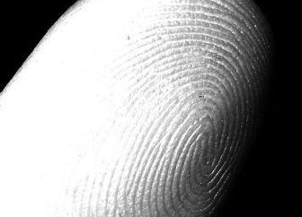
Quran says about the finger prints
Nay, We are able to put together in perfect order the every tips of his fingers. (Quran 75:4)

Slide 50
Science proved
Every one's finger print is unique to himself, every person who is alive or who has ever lived in this world, has a set of unique finger prints, that is why the finger prints are accepted as a very important identity exclusive to the owner, and it is used for this purpose around the World.

Slide 51
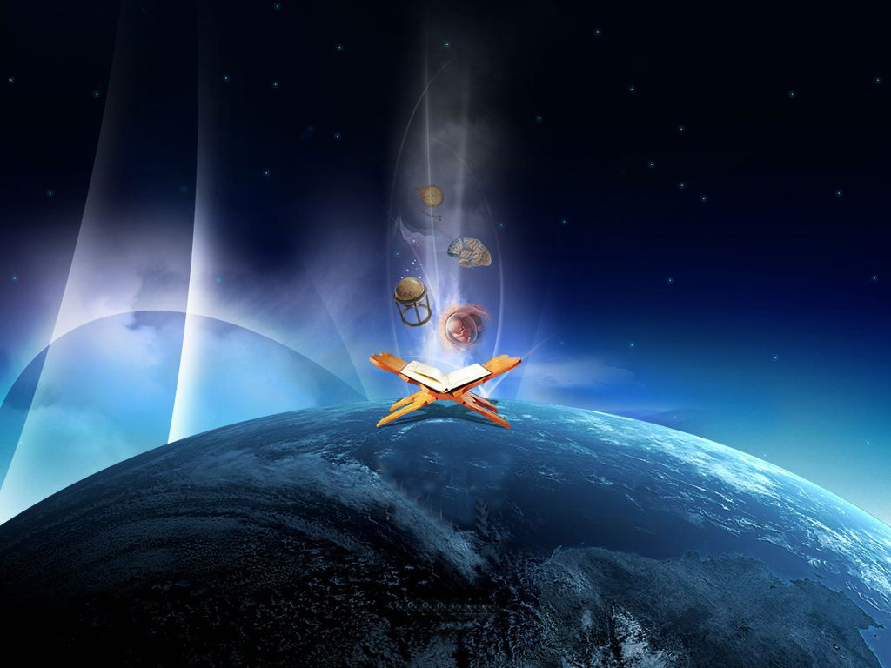
MUSLIM CONTRIBUTION TO SCIENCE

Slide 52
The sciences of the Arabic-Islamic world underwent remarkable development during the 8th to 13th centuries C.E., a flowering of knowledge and intellect that later spread throughout Europe and greatly influenced both medical practice and education.

Slide 53
Muslims have had such a great contribution to science that if it weren’t for them neither the Reneissance nor the Scientific Revolution would have been possible. Despite this, due to a concious act of ignorance and neglect their names and great inventions have been written out of science and history books.

Slide 54

Genreral types of science
biology
chemistry
geography
physics
math
Notes:
There was many types of science in the golden age for muslim

Slide 55
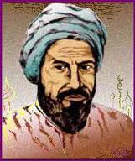
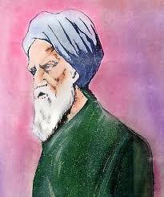
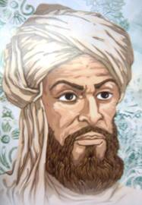
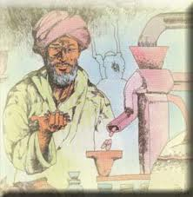
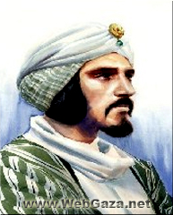

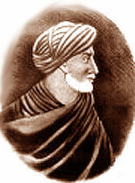
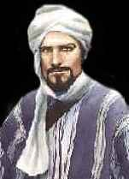
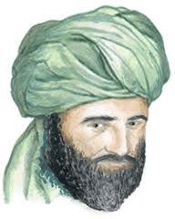
Muslim scientists
biology
Chemistry
geography
physics
Math
Notes:
Muslim scientists in chemistry are Jabir ibn Hayyan , Al-Kindi
in biology are Ibn Sirin , Ibn Tufail,
in math are Muhammad ibn Mūsā al-Khwārizmī , Muhammad ibn Mūsā al-Khwārizmī
in geography are Ibn Battuta , Muhammad al-Idrisi
in physics are Ibn al-Haytham , Ibn al-Nafis

Slide 56
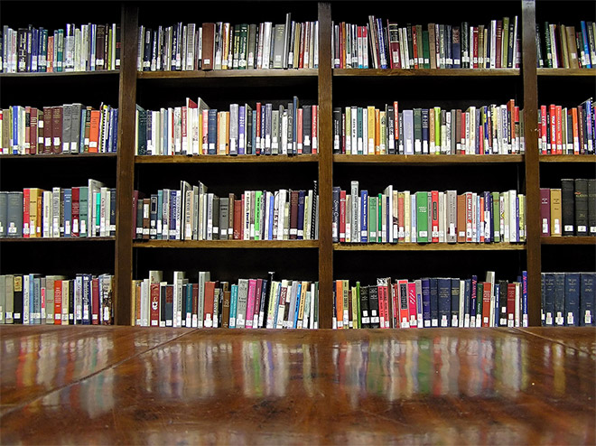
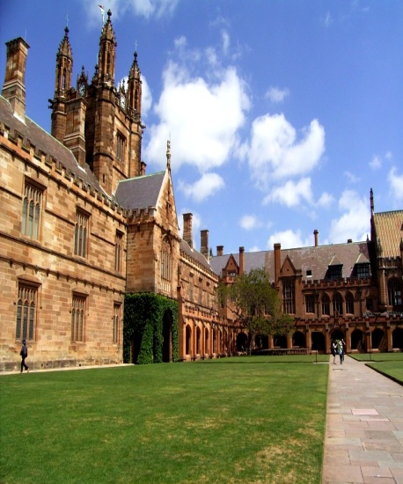
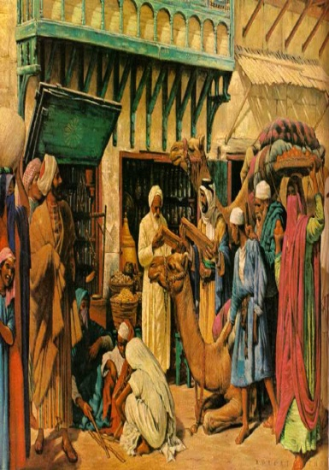
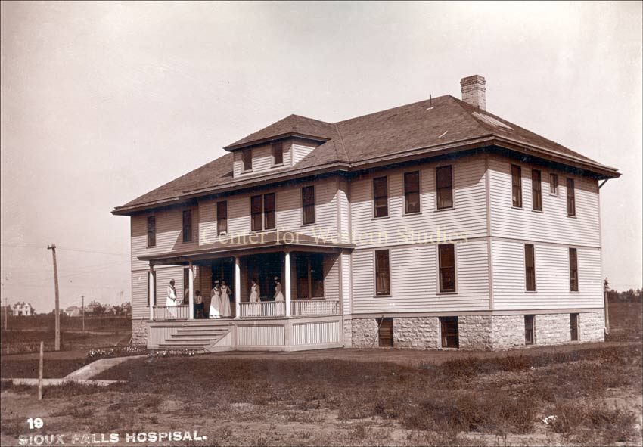
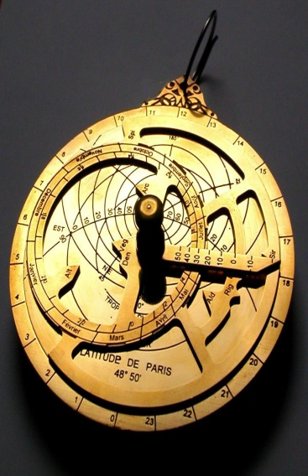
The first
the first library was built in the Islamic world
The first university was built by Fatima al-Fihri
the first pharmacy was built in Baghdad.
the first astrolabe was built by Muhammad al-Fazari.
the first hospital built in Baghdad

Slide 57
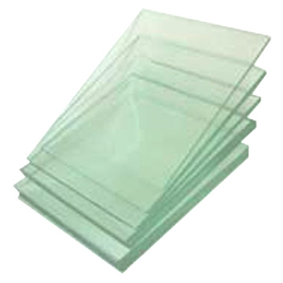
In the year 700, an early industrial factory complex for Islamic pottery and glass production was built in Ar-Raqqah, Syria. Extensive experimentation was carried out at the complex, which was two kilometres in length, and a variety of innovative high-purity glass were developed there. Two other similar complexes were also built, and nearly three hundred new chemical recipes for glass were produced at all three sites.

Slide 58
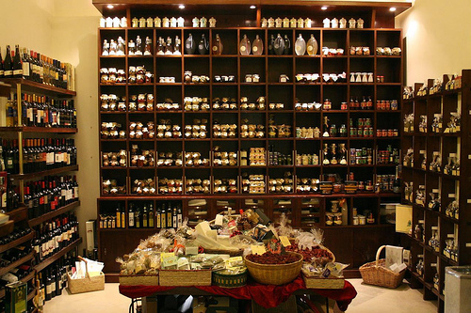
The first (pharmacist) shops were also opened in the Islamic world.
In 754, the first pharmacy and drugstores were opened in Baghdad.

Slide 59
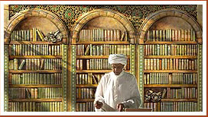
In 763, The House of Wisdom was founded and the translation movement was started by the Abbasid caliph Harun al-Rashid. The caliph would pay it’s weight in gold for every translated book.
In 763, the first Bimaristan (hospital) opened in Baghdad during the Caliphate of Harun al-Rashid.

Slide 60
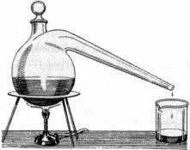
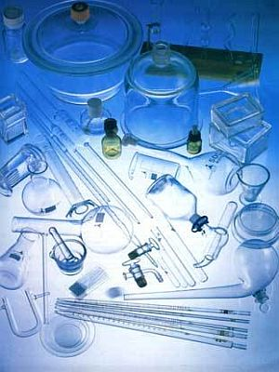
In 780, Jabir ibn Hayyan, a Muslim chemist who is considered by many to be the father of chemistry, introduced the experimental scientific method for chemistry, as well as laboratory apparatus such as the alembic, still and retort, and chemical processes such as pure distillation, liquefaction, crystallisation, and filtration.
He also invented more than twenty types of laboratory apparatus, leading to the discovery of many chemical substances. He also developed recipes for stained glass and described lustre-painting on glass.

Slide 61
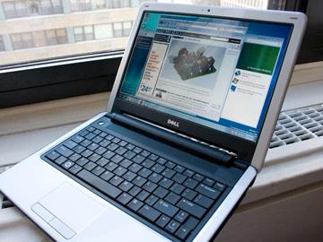
Muhammad bin Musa al-Khwarizmi founded the algorithm. Without algorithms we would not have had computers.

Slide 62
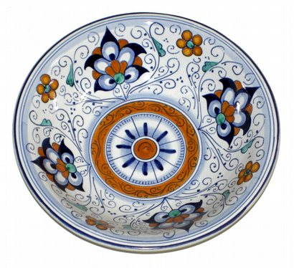
In 800, Tin-opacified glazing was developed by Islamic potters.
Tin-glazing is the process of giving ceramic items a tin-based glaze which is white, shiny and opaque.

Slide 63


In 810, Abbas Ibn Firnas was born. He was the first to make glass from stones (quartz).He made the earliest recorded attempt at controlled flight, devised means of manufacturing colorless glass, and developed a process for cutting rock crystal.
Another invention was an artificial weather simulation room, in which spectators were astonished by artificial thunder and lightning.

Slide 64

In 820, Amr ibn Bahr al-Jahiz wrote a number of works on zoology, Arabic grammar, rhetoric, and lexicography. His most famous work is the Book of Animals, in which he first discussed food chains.

Slide 65

In 820, Muhammad ibn Musa al-Khwarizmi wrote The Compendious Book on Calculation by Completion and Balancing, more briefly referred to al-jabr, or algebra.
Algebra gave mathematics a whole new development path so much broader in concept to that which had existed before, and provided a vehicle for future development of the subject.

Slide 66


He also classified natural and derivative (artificial) chemical substances which was the early form of the periodic table of elements.
In 865 Muhammad ibn Zakariya Razi was born. In his Secretum secretorum, he described a variety of tools for melting substances and the preparation of drugs.

Slide 67


In 1000 Abu al-Qasim al-Zahrawi published his 30-volume medical encyclopedia, the Al-Tasrif, which remained a standard textbook in Muslim and European universities until the 16th century.
The book first introduced many surgical instruments and a variety of other instruments. He also invented the plaster cast cotton dressing, oral anaesthesia, inhalational anaesthetic, and anaesthetic sponge.

Slide 68


In 875 Abbas Ibn Firn
Abbas Ibn Firnas ( Armen Firman) 810-887 CE
Izn-Rand Onda, al-Andalus (today's Ronda, Spain)as reportedly successfully employed an ornithopterآغاز for manned flight.

Slide 69

In 880, Al-Dinawari, the founder of Arabic botany, wrote the Book of Plants, which describes at least 637 plants; it discusses the phases of plant growth and the production of flowers and fruit.

Slide 70

In 925, Kerosene was produced from the distillation of petroleum and was first described by al-Razi in Baghdad. He also described the first kerosene lamps (naffatah) used for heating and lighting in his Kitab al-Asrar (Book of Secrets).

Slide 71




In 1000 in Al-Andalus, Ibn Khalaf al-Muradi invented complex gearing, Epicyclic gearing, segmental gearing, and the geared mechanical clock. Muslim engineers also invented the Weight-driven mechanical clock.

Slide 72


Ibn al-Haytham proved that light travels in straight lines using the scientific method by carrying out various experiments with lenses, mirrors, refraction, and reflection in his Book of Optics (1021). He was considered the father of optics and pioneer of scientific method.
His Book of Optics correctly explains light and vision, and introduces experimental scientific method, laying the foundations for experimental physics.
Ibn al-Haytham also gave the first clear description and correct analysis of the camera obscura and pinhole camera and built the world's first camera obscura.

Slide 73


In 1025 Avicenna published his 14-volume encyclopedia, The Canon of Medicine, which remained a standard text at European universities until the 17th century.
Its contributions include the discovery of contagious disease, and introduction of experimental medicine, clinical trials, and clinical pharmacology. It also discusses neuropsychiatry, the idea of a syndrome, and early cancer therapy.

Slide 74

In 1030, Abu Rayhan al-Biruni stated that light has a finite speed, and he was the first to theorize that the speed of light is much faster than the speed of sound.

Slide 75


In the 12th century,, Muhammad al-Idrisi produced a world map and the first known globe. His Tabula Rogeriana was the most accurate world map in his time and was used extensively for several centuries through to the explorations during the European Age of Discovery.

Slide 76


In 1259 The Maragheh observatory was founded by Nasir al-Din al-Tusi. It was the first example of the observatory as a research institute.

Slide 77



In 1260, the first portable hand cannons (midfa) loaded with explosive gunpowder, the first example of a handgun and portable firearm, were used by the Egyptians to repel the Mongols at the Battle of Ain Jalut. The cannons had an explosive gunpowder composition almost identical to the ideal compositions for modern explosive gunpowder. They were also the first to use dissolved talc for fire protection, and they wore fireproof clothing, to which Gunpowder cartridges were attached.

Slide 78

In 1300, when the Black Death bubonic plague reached al-Andalus, Ibn Khatima discovered that infectious diseases are caused by microorganisms which enter the human body.

Slide 79

In 1720, the Ottoman dockyard architect Ibrahim Efendi invented a submarine called the tahtelbahir. The Ottoman writer Seyyid Vehbi, in his Surname-i-Humayun, compared this submarine to an alligator.

Slide 80
Fortunately, now in the 21st century the West and the Muslims are starting to rediscover this golden age of Islamic Science and many documentaries and books are being produced on this subject.
Some of those documentaries are:
BBC- Science and Islam:The language of science
BBC- Science and Islam:The Empire of Reason
BBC- Science and Islam:The Power of Doubt
BBC- What the anciens did for us:The Islamic World
BBC-An Islamic History of Europe
Channel 4- When the Moors ruled in Europe

Slide 81
Why did the “Golden Age”looking to come to an end?
Religious divisions caused problems by the end of the 11th century
Conservative theologians imposed a return to orthodox beliefs and rejected ‘foreign sciences’
The European crusades and attacks by the Mongols weakened the empire

Slide 82

Crusaders besieging Damascus
http://www.imagesonline.bl.uk/britishlibrary/

Slide 83
summary:
Defining Science and Hikmah
Basic concepts of Islam&Scinence
Contribution of Quran to science
Contribution to modern science by Muslim scientists
Down fall of Islamic era of science
Action plan to revert the present situation

Slide 84
ZRA SOCHIYE.....?ACTIVITY
1.Discuss about islam and science?
What is the difference between islam and science?
Learn the name of some muslim scientists?
Recall the inventions of muslim scientists?
What is the down fall to muslim world about research?
Notes:
Discuss as a class the idea that Arabian Polytheism is condemned as being sinful because it goes against Tawhid.

Slide 85

Jazak Allah

