Slide 1
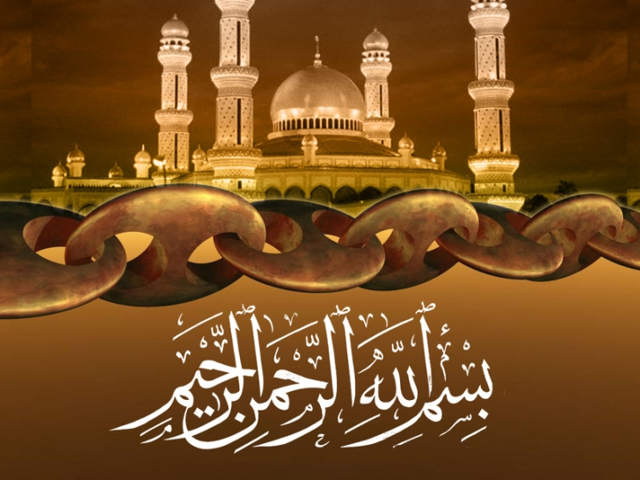

Slide 2
Islamic Studies course code 104
Associate Degree Education ADE/B.Ed(Hons)Elementary
Semester I

Slide 3

Lectuere#14
By :Muhammad Imran

Slide 4

The Seerat of Holy prophet Muhammad pbuh.

Slide 5
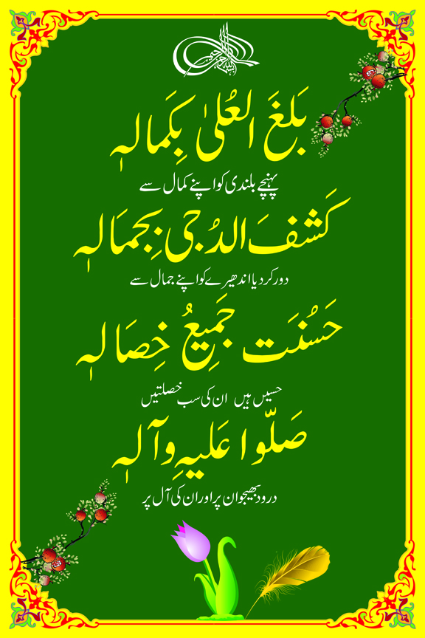

Slide 6
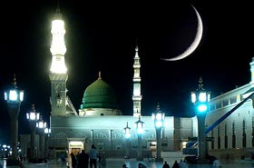
Main out Lines
Personality and the character of Holy prophet pbuh.
Some Teaching and practices of the holy prophet.
What is our duty after knowing his seerat
Seerat Lessons.

Slide 7
Personality And Character of MUHAMMAD ^{(pbuh) seerat e mustafa pbuh.}
The Holy Prophet^{(pbuh)}was very particular with
regard to the fulfilling of covenants
He paid special deference to those who
devoted their time and substance to the
service of mankind
He was particularly considerate towards
those who from lack of cultural training did
not know how to behave
He was particularly considerate towards
those who from lack of cultural training did
not know how to behave

Slide 8
Appearance
He did not speak unnecessarily and what he said was always to the point and without any padding.
Muhammad (pbuh) was of a height a little above the average.
He was fair of complexion and altogether very handsome.
At times he would make his meaning clear by slowly repeating what he had said.
His laugh was mostly a smile.
He kept his feelings under firm control.

Slide 9
Dress
His dress generally consisted of a shirt, tamad (trousers), a sheet thrown round the shoulders and a turban.
His blanket had several patches (Tirmidhi).
He had very few spare clothes, but he kept them spotlessly clean (Bukhari).
Once he enquired of a person in dirty clothes whether he had any income. Upon getting a reply in the affirmative, he observed, "When Allah has blessed you with His bounty, your appearance should reflect it." [Abu Dawood]

Slide 10
House & Belongings!!!
  His house was but a hut with walls of unbaked clay and a thatched roof of palm leaves covered by camel skin. It contained
    a rope cot,
    a pillow stuffed with palm leaves ,
    the skin of some animal spread on the floor and a water
    bag of leather
    and some weapons.
  These were all his earthly belongings, besides
  a camel,
  a horse, and
  an ass and
  some land which he had acquired in the later part of his life (Bukhari, Muslim, Abu Dawood).

Slide 11
Extremely humble!
Though virtual king of Arabia and an apostle of Allah, he never assumed an air of superiority.
He used to invite people be they slaves, servants or the poorest believers, to partake with him of his scanty meals. [Tirmidhi]
He did not like people to get up for him and used to say, "Let him who likes people to stand up in his honour, he should seek a place in hell." [Abu Dawud]

Slide 12
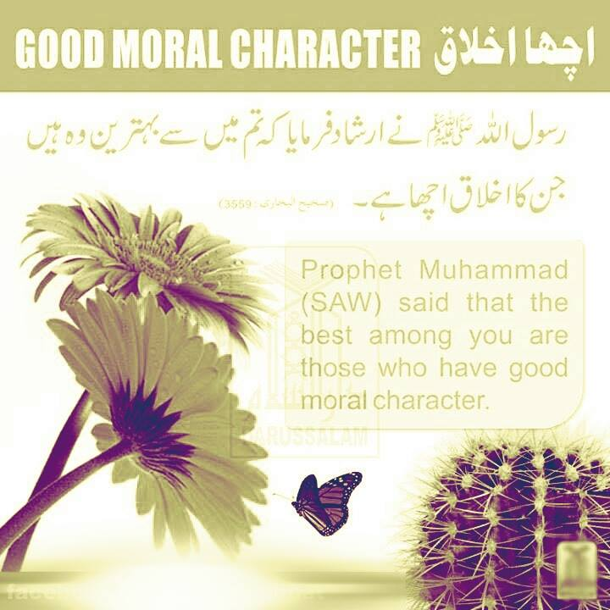

Slide 13
At home!
His wife A'isha (ra) said,
"He always joined in household work and would at times mend his clothes, repair his shoes and sweep the floor. He would milk, tether, and feed his animals and do the household shopping.“
[Qazi Iyaz: Shifa; Sahih Bukhari]

Slide 14
Spend his time…
According to the demands on him for:
offering worship to Allah
public affairs, and
personal matters. All his activities were full of supplications and prayers.
His Love, Devotion, Dedication is transparent.
A full 300 page-books is there just on the prayers he used to recite.

Slide 15
His Behavior
By nature he was gentle and kind-hearted, always inclined to be gracious and to overlook the faults of others.
Politeness and courtesy,
compassion and tenderness,
simplicity and humility,
sympathy and sincerity
were some of the keynotes of his character.

Slide 16
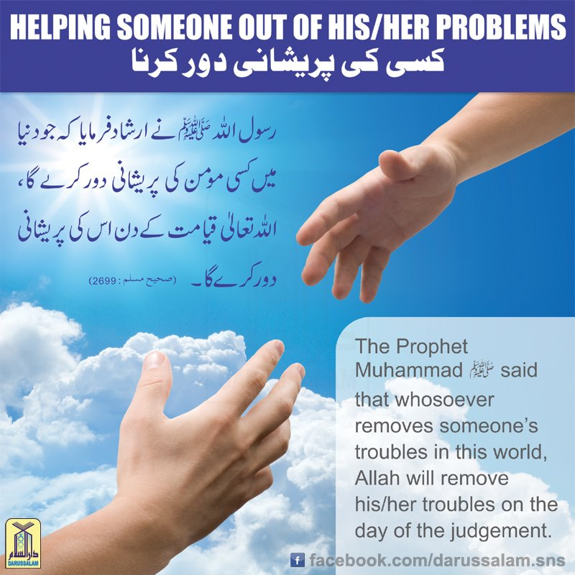

Slide 17

His Character
About himself the Prophet (pbuh) said
“Allah has sent me as an apostle so that I may demonstrate perfection of character, refinement of manners and loftiness of deportment.
" [Malik]

Slide 18
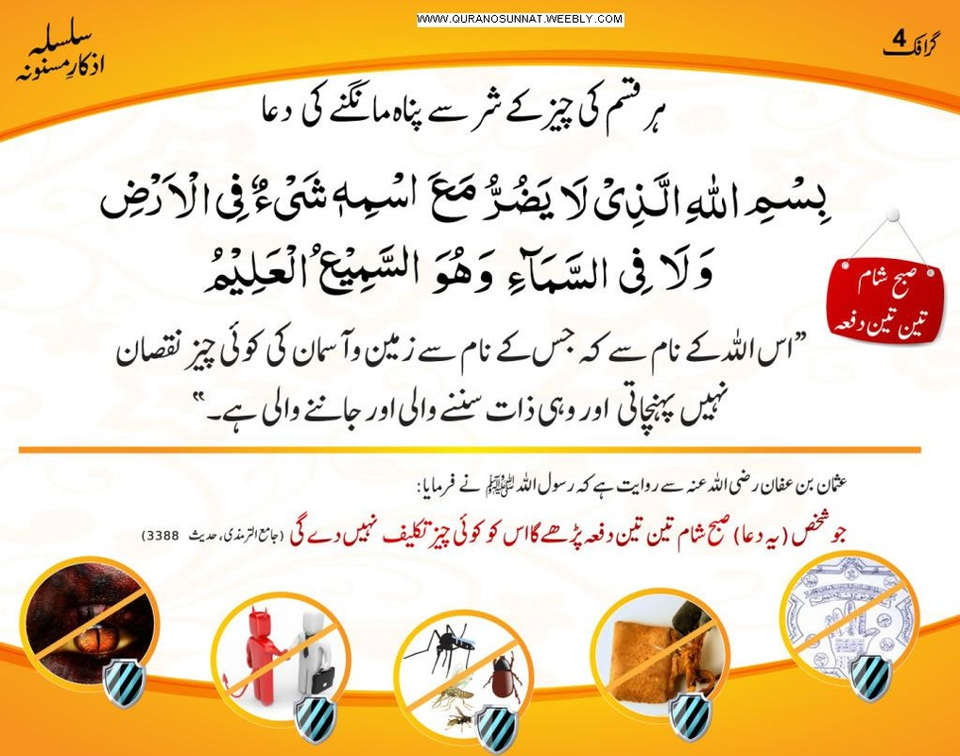
Supplicationsمناجات …
MIRACULOUS ASPECT
Establish / Correct the relationship with God
Maintain it
Millions of Muslims throughout centuries have been reciting these everyday.
Of course, they want to follow him in all aspects (name, dress, beard, living style…).

Slide 19
His Behavior
The Prophet (pbuh) said: “He is a bad person in the sight of Allah
* who does not behave courteously, and
* people shun his company because of his bad manners.
[Sahih Bukhari]

Slide 20

Messenger of Mercy
We have sent you except as a mercy for the worlds (al-Qur’an)
Extremely kind and merciful for believers
Even for his enemies - After Makkah’s victory

Slide 21
Kindness to Animals
"Indeed, there is heavenly reward for every act of kindness done to a living animal.“
If he saw any animal over-loaded he would pull up the owner and say, "Fear Allah in your treatment of animals."

Slide 22
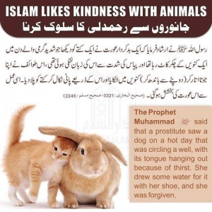

Slide 23
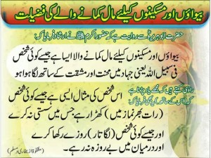
Love for the poor
He said: "He is not a perfect Muslim who eats his fill and lets his neighbour go hungry."
To his wife he said, "O A'isha, love the poor and let them come to you and Allah will draw you near to Himself." [Sahih Bukhari]

Slide 24
The FASTEST Growing Religion in the world:
  Not by Sword or Money !
  “Today it is 'perhaps' the fastest growing religion in US” (Maston Speight, Director of the office of Christian Muslim relations of the national council of churches of Christ of the USA)
  'World's fastest growing religion' (Robert Morey, Director of research and education foundation, Austin, TX) in spite of the Muslims powerlessness and decadence in the past 2 centuries.
  'In modern times it has made great gains in Africa' (The 1990 Almanac, Houghton Mifflin Company, Boston) .

Slide 25
Equality in Islam (POLICY)
  O' Mankind! We created you from a single (pair) of a male and a female, and made you into nations and tribes, that ye may know each other (not that ye may despise each other). Verily the most honored of you in the sight of God is (he who is) the most righteous of you. Quran 49:13
  God looks not to your FIGURES nor to your WEALTH but to your HEARTS and to your DEEDS - Prophet MUHAMMAD(pbuh) (pbuh) (Peace be upon him)

Slide 26
Equality in Islam (PROGRAM)
  Group prayers - a part of the program
  5 times a day for every locality
  Once a week for the whole city
  Once a year for the whole Muslim world i.e. pilgrimage to Makkah.
  Where everybody prays shoulder to shoulder.

Slide 27
Important lessons derived from the Life of Prophet pbuh

Slide 28
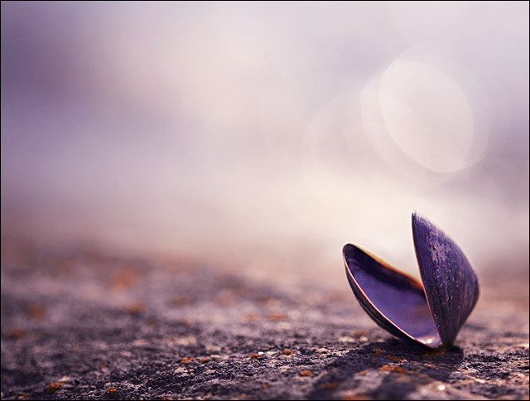
When losing a Tooth, remember the Prophet's (Peace be upon him) tooth in the battle of Uhud.
REMEMBER....

Slide 29

When you bleeding, from any part of the body, remember the Prophet's (Peace be upon him) body covered in blood on his return from Ta'if.
REMEMBER....

Slide 30

When going against a
Sunnah, remember the Prophet's (Peace be upon him) intercession, (Ummati, Ummati, Ummati) (My Ummah).
REMEMBER....

Slide 31

When being troubled by neighbours, remember the old woman who would empty rubbish on the Prophet (Peace be upon him) .
REMEMBER....

Slide 32

When losing a child, remember the Prophet's
(Peace be upon him) son, Ibrahim.
REMEMBER

Slide 33

REMEMBER....
When sponsoring
an orphan,
remember the Prophet's (Peace be upon him) sponsor for Zaid ibn Haritha.

Slide 34

When fearing an enemy, remember the Prophet's
(Peace be upon him) saying to
Abu Bakr in Mount Thour .
God Bless You My Dear. Ameen
REMEMBER

Slide 35
our Responsibility
Our beloved prophet ^{Sa} was Hazrat Muhammed ^{Sa} put all his strength in following Allah’s command and spreading Islam.
He loved no one more than his ummah. He wishes desperately for all of us to go to Paradise. Therefore, it is our responsibility to send durood and salaam upon him. We can never reciprocate the love he has for us but this is the least we can do.

Slide 36
SUPREME SUCCESSFUL MAN IN THE HISTORY OF HUMAN
It is a well-known fact that the Prophet of Islam (PBUH) was the supremely successful man in the entire human history
According to the Holy Quran, he was a good example for all mankind
He has shown us the way of achieving supreme success in this world
Prophet Muhammad (pbuh) manifested represents an exhaustive embodiment of the sublime Divine Message that he communicated in order to deliver the human race from the swamp of darkness and polytheism to the paradise of light and monotheism.

Slide 37
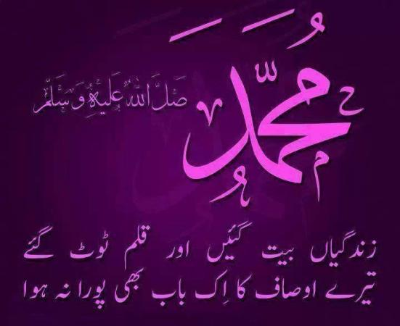

Slide 38
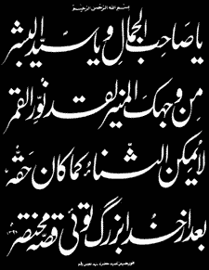

Slide 39
Review
Personality and the character of Holy prophet pbuh.
Some Teaching and practices of the holy prophet.
What is our duty after knowing his seerat
Seerat Lessons.

Slide 40
Jwab dejie?
1.What is the important of seerat?
2.Who is the supreme successful personality in the the history of human and why?
3.Do you learn something from the prophet seerat?
4.Recall some practices of the holy prophet pbuh?
Notes:
Discuss as a class the idea that Arabian Polytheism is condemned as being sinful because it goes against Tawhid.

Slide 41
