Slide 1



Slide 2
Islamic Studies course code 104
Associate Degree Education ADE/B.Ed(Hons)Elementary
Semester I

Slide 3

Lectuere#12
By :Muhammad Imran

Slide 4

History and imPortance of Hadees

Slide 5


Slide 6
Main out Lines
What is Hadees?
The difference between Quran and Hadees
Hadeeth in the Light of Quran
Definition of Hadeeth in Islamic Shariah
(Definition, Collection )
The Books of Hadeeth
What is Sunnah ?
Importance of Hadees?
Types of hadees.
Sunnah and Hadees
Legal position of Sunnah?

Slide 7

HISTORY & IMPORTANCE
OF HADITH

Slide 8
The Definition of Hadeeth
Allah has sent Prophet Muhammad(Sallaahu alaihi wa sallam) with the guidance and religion of truth that it may prevail over all falsehood
Furthermore he has been commanded to present all the religion of Islam to mankind.
So, Allah Subhanu wa ta’ala revealed to him the Book(the Quran) and the Wisdom (Hikmah/Sunnah) and commanded him to explain the people what has been sent down to them, in order for them to ponder over, act upon and benefit from.

Slide 9
The Definition of Hadeeth-2
Thus, Quran and Sunnah are the two sources by which Allah Subhanahu wa Ta’ala has provided and established the Hujjah(proof) against His slaves and upon these 2 sources is built the ruling of belief and action. [i.e., what beliefs and actions consititue the Shariah(Divine Law)]
The Quran is the Speech of Allah. The words of Quran are set in text and meaning exactly the way Allah revealed onto the heart of the Messenger of Allah(sallallaahualaihi wa sallam) i.e., it is connected to Allah in both text and meaning.
The Hadeeth of Prophet(sallallahu alaihi wa sallam) is related to the prophet(sallaahu alaihi wa sallam) in text and meaning.
Except Hadees E Qudsee which is related in Meaning to Allah but in text to Prophet(sallallahu alaihi wa sallam).

Slide 10
What is “Hadith” ?
…(Plural is “Ahadith” - it means) :
“the news , the report ..or .. narration“
It is usually used to refer to the report or sayings, transmitted through a chain of people, and originated from or upto the Prophet Muhammad (pbuh).
Thus a “Hadith” contains the “Sunnah”

Slide 11
Impotance of Hadith
Primary source of Islamic law after Quran
Used together with Quran in derivation of Islamic law
Explains matters in which Quran remained silent or a detailed description was not given
e.g. Performance of salah , Rate of Zakat

Slide 12

Difference between Quran and Hadith

Slide 13
Quran
Speech of Allah sent down upon the prophet Muhammad pbuh through the angel Gabriel in its precise meaning and wording transmitted to us by numerous persons both verbally and in writting
It is inimitable and unique
Protected by God-mentioned in the Quran

Slide 14
Hadith
Linguistic meaning of Hadith are news, reports or narrations
In Islamic context a particular report (verbal and written) about the sunnah of the Prophet Muhammad
What is Sunnah?
  Literal meaning is the road or practice
  Religious context what has been described by Prophet Muhammad and what he said and did in continuous manner so that others follow.

Slide 15
continued
Saying of Prophet Muhammad pbuh
Action of Prophet Muhammad pbuh
Approval (silent) of Prophet Muhammad pbuh in other actions (companions)
Action on the Prophet Muhammad pbuh that are related to Islam and the Prophet pbuh wanted us to act upon directly or indirectly by mentioning the virtue of such act

Slide 16
Hadith Qudsi
Meaning from Allah while wording from the Prophet Muhammad pbuh
Communicated from Allah through revelation or in dreams then communicated by Prophet Muhammad pbuh in his own words
Prophet relates to the people what Allah has said or did (does) but not a part of Quran

Slide 17
Continued
Hadith:
  Abu Hurairah reported that Allah’s messenger said “Allah mighty and exalted is He;
  said if my servant like to meet me I like to meet him, if he dislike me to meet I dislike to meet him.

Slide 18
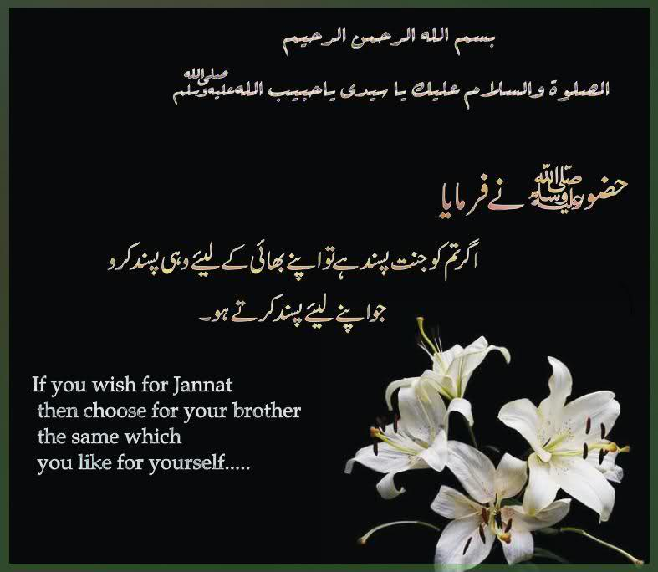
Example of Hadees Qoliقولی

Slide 19
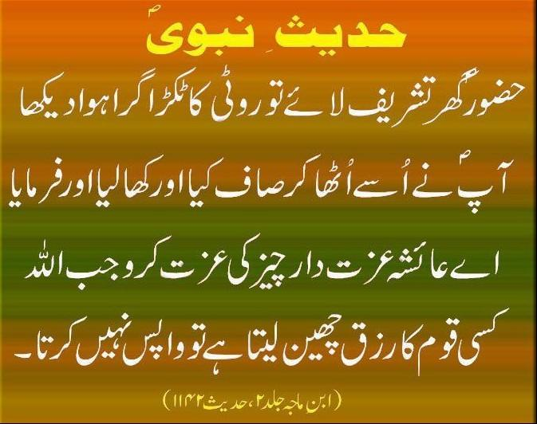
Example of Hadees e Fialiفعلی

Slide 20

Example of Hadees Qusdi حدیث قدسی

Slide 21
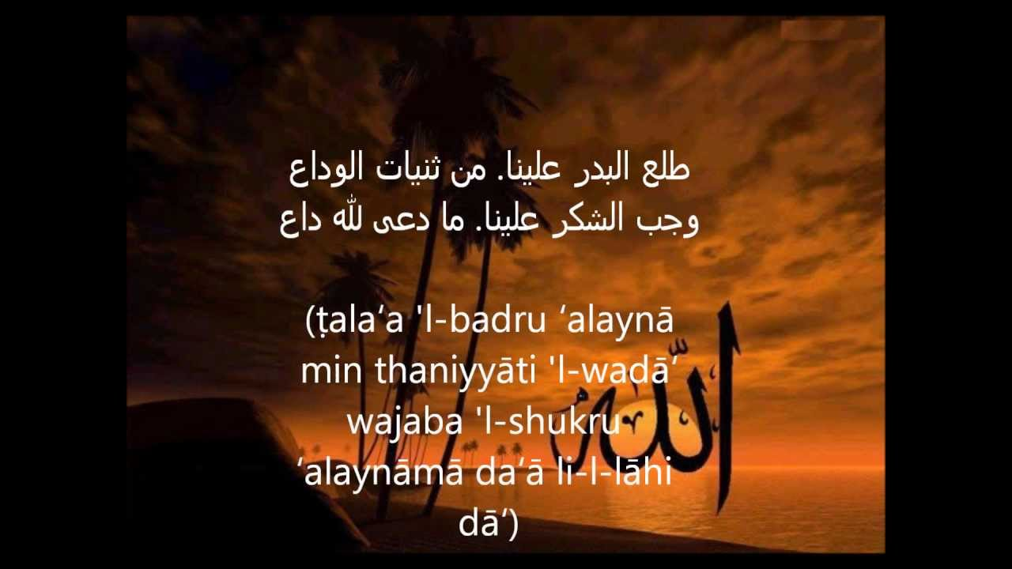
Example of Hadees Taqririتقریری

Slide 22
Importance of Hadees in the light of Quran
يَـٰٓأَيُّہَا ٱلَّذِينَ ءَامَنُوٓاْ أَطِيعُواْ ٱللَّهَ وَأَطِيعُواْ ٱلرَّسُولَ وَأُوْلِى ٱلۡأَمۡرِ مِنكُمۡ‌ۖ فَإِن تَنَـٰزَعۡتُمۡ فِى شَىۡءٍ۬ فَرُدُّوهُ إِلَى ٱللَّهِ وَٱلرَّسُولِ إِن كُنتُمۡ تُؤۡمِنُونَ بِٱللَّهِ وَٱلۡيَوۡمِ ٱلۡأَخِرِ‌ۚ ذَٲلِكَ خَيۡرٌ۬ وَأَحۡسَنُ تَأۡوِيلاً
O You who believe ! Obey Allah, and obey the Messenger, and those charged with authority from among you. If you differ in anything among yourselves, refer it back to Allah and to His Messenger, if you do believe in Allah and the Last day : That is best and most suitable for final determination. Qur’an : An-Nisa’ : 4 :59

Slide 23
Qur’an : Al-Ahzab : 33 : 21
لَّقَدۡ كَانَ لَكُمۡ فِى رَسُولِ ٱللَّهِ أُسۡوَةٌ حَسَنَةٌ۬ لِّمَن كَانَ يَرۡجُواْ ٱللَّهَ وَٱلۡيَوۡمَ ٱلۡأَخِرَ وَذَكَرَ ٱللَّهَ كَثِيرً۬ا
Verily, in the Messenger of Allah you have a good example for everyone who looks forward (with hope and awe) to Allah and the Last day, and who engages in the remembrance of Allah unceasingly.

Slide 24
Qur’an : An-Najm : 53 : 3-4
وَمَا يَنطِقُ عَنِ ٱلۡهَوَىٰ
﻿﻿ إِنۡ هُوَ إِلَّا وَحۡىٌ۬ يُوحَىٰ
﻿﻿ عَلَّمَهُ ۥ شَدِيدُ ٱلۡقُوَى
……and neither does he speak out of his own desire : that (which he conveys to you) is but (a divine) inspiration with which he is being inspired - something that a very mighty one has imparted to him………..

Slide 25
Qur’an : Al-Hashr : 59 : 7
وَمَآ ءَاتَٮٰكُمُ ٱلرَّسُولُ فَخُذُوهُ وَمَا نَہَٮٰكُمۡ عَنۡهُ فَٱنتَهُواْ‌ۚ وَٱتَّقُواْ ٱللَّهَ‌ۖ إِنَّ ٱللَّهَ شَدِيدُ ٱلۡعِقَابِ
Hence, accept (willingly) whatever the Messenger gives you (thereof), and refrain from (demanding) anything that he withholds from you; and remain conscious of Allah : for verily, Allah is severe in retribution.

Slide 26
Qur’an : An-Nisa : 4 : 64
وَمَآ أَرۡسَلۡنَا مِن رَّسُولٍ إِلَّا لِيُطَاعَ بِإِذۡنِ ٱللَّهِ‌ۚ
For We have never sent any Messenger except that he should be heeded (obeyed) by Allah’s leave”.

Slide 27
Qur’an : An-Nisa : 4 : 65
فَلَا وَرَبِّكَ لَا يُؤۡمِنُونَ حَتَّىٰ يُحَكِّمُوكَ فِيمَا شَجَرَ بَيۡنَهُمۡ ثُمَّ لَا يَجِدُواْ فِىٓ أَنفُسِہِمۡ حَرَجً۬ا مِّمَّا قَضَيۡتَ وَيُسَلِّمُواْ تَسۡلِيمً۬ا
But nay. By thy Sustainer! They do not [really] believe unless they make thee [O Prophet] the judge of all on which they disagree among themselves, and then find in their hearts no resistance against thy decision, but accept it in full submission.”

Slide 28
Hadees imporance accroding Prophet (pbuh)
Prophet Muhammad (pbuh) said :
“…...I leave behind me two things, whomsoever hold fast to these two, they will never be led astray : (these are) the Book of Allah and the Sunnah (Way) of His Messenger….”
(Hadith reported by Malik)

Slide 29
What is “Sunnah” ?
…(it means) :
“the way ... or ... the law “
It is usually used to indicate the practice or the teachings of our Prophet Muhammad (pbuh) and are divided into :
Qau-liyyah (sayings) Taqririyyah (consent)
Fi’liyyah (actions) Hammiyyah (resolve)

Slide 30
The “Sunnah” explains or elaborates the “Qur’an”
“ .....and be constant in ‘as-Solah’ (that is the fixed obligatory daily prayer)…”
(Qur’an : al-Baqarah : 2 : 43)
But the Qur’an does not provide the detail, thus the Prophet (pbuh) said :
“Establish ‘as-Solah’ as you see me do”
(Hadith reported by Bukhary)

Slide 31
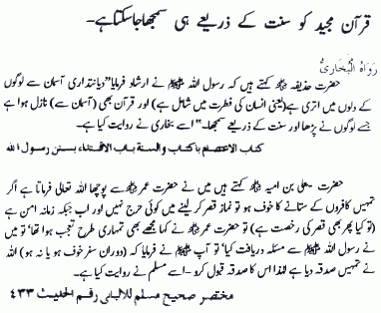
Importannce of Sunnah

Slide 32
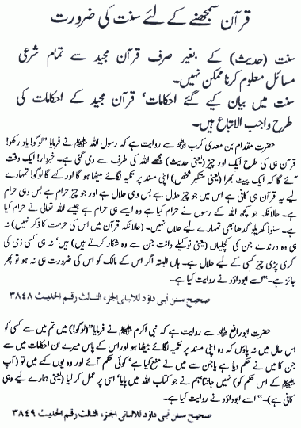

Slide 33
Teaching of “Sunnah” during the Prophet’s time.
Prophet (pbuh) taught by :
(1) Verbal teaching
(2) Written medium
(dictation to scribes)
(3) Practical demonstration

Slide 34


Slide 35
How AHADITH WERE PRESERVED
The prophet (s.a.w.w)and his position according to the Quran.
Teaching of ahadith by the Prophet(s.a.w.w)
Measures taken by the Prophet (s.a.w.w) for the diffusion of Sunnah
Sunnah received by the companions
Companions learning of ahadith
Recording of ahadith in the life of the Prophet (s.a.w.w)
Some misunderstandings about recording of ahadith

Slide 36
DURING
HOLY PROPHET(S.A.W)’S LIFETIME
As Prophet(s.a.w) was alive muslims(with an exception of some companions) didn’t felt the need to write down ahadith and muslims directly approached Prophet(s.a.w) to solve their matters.
Prominent Compilations:
Musnad by Aeisha(r.a),musnad by Abu Bakr(r.a),Collection of Ali(r.a) etc.

Slide 37
Was “Hadith” ever written down during the Prophet’s time ?
“An Ansarite complained to the Prophet (pbuh) that he had weak memory and that he easily forgot the Prophet’s instructive discourses. The Prophet (pbuh) replied “Take the aid of thy right hand (i.e. write it down).”
(Hadith reported by at-Tirmidzi)

Slide 38
Was “Hadith” ever written down during the Prophet’s time ?
Abdallah ibn ‘Amr ibn al-’As, a young Meccan had a habit of writings down all that the Prophet used to say. Abdallah went to the Prophet and asked him if one could note all that he said. He replied :”Yes”. Abdallah persisted :”Even when thou art happy and satisfied, even when thou art annoyed ?” The Prophet said : “Of course, by Allah ! Nothing that comes out of this mouth is ever a lie.” (Hadith reported by at-Tirmidzi)

Slide 39
During
the time of Companions
Islam was widely spread and new converts wanted to hear about Prophet(s.a.w) from close companions who had now spread wide and far in all parts of empire
Cailph Umar bin Abdul aziz wrote to governor of madina to write down all traditions of Holy Prophet(s.a.w)
Prominent compilations:
Works of Shihab-al-zuheri , Collection of Abu Bakr Al-Hazim

Slide 40
During the time of
followers of Companions
(101-200a.h)
Hanafi and Maliki schools of legal thought were formulated during this period in the light of ahadith
Prominent Compilations:
Al-Muwatta By Imam Malik , Al-Maghazi by Waqidi,etc.Al Asaar by imam Azam Abu Hanifa.

Slide 41
During the time of
followers of Followers
(201-300a.h)
Six most authentic books of traditions were compiled:
Sahih Bukhari
Sahih Muslim
Sunan of Abu-Daud
Sunan of Ibn-e-Maja
Sunan of Nisai
Jami Tirmidhi

Slide 42


Slide 43
Summary
What is Hadees?
The difference between Quran and Hadees
Hadeeth in the Light of Quran
Definition of Hadeeth in Islamic Shariah
(Definition, Collection )
The Books of Hadeeth
What is Sunnah ?
Importance of Hadees?
Types of hadees.
Sunnah and Hadees
Legal position of Sunnah?

Slide 44
Ap k karne k kam? short Activitiy
1.What is Hadees menanings and importance?
2. .what are the types of Hadees?
3what is th need of Hadees?
4.Names of Sihah-e-Sitta?
what you know about collction of Hadees?
Notes:
Discuss as a class the idea that Arabian Polytheism is condemned as being sinful because it goes against Tawhid.

Slide 45


Slide 46


