Slide 1


Slide 2
Islamic Studies course code 104
Associate Degree Education ADE/B.Ed(Hons)Elementary
Semester I

Slide 3

Lectuere#11
By :Muhammad Imran

Slide 4
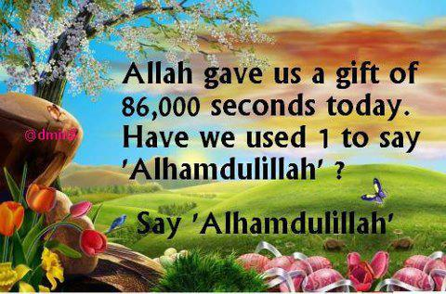

Slide 5
Study of Selected Text of Holy Quran
Surah Al-Muminoon related to characateristics of faithful verse nmber1to11
Surah Al-Hujurat related to Adab Al-Nabi(pbuh)verse
1to 18
Surah Al-saf related to Tafakar,Tadababar verse1to14
Surah Al-Ihzab related to Adab-ul-Nabi(pubh) different selected verses

Slide 6
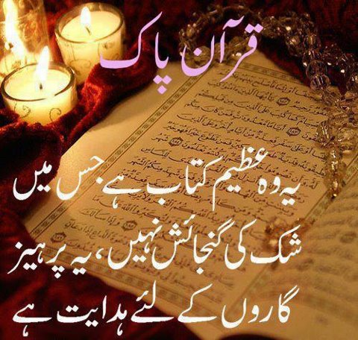
Out Lines
  Explain slected text surah’s ayat one by one .
  Slected Quranic text related to surah’s topics
  Short detail of relevent ayat
  Care fully listen because it is part of quran

Slide 7


Slide 8
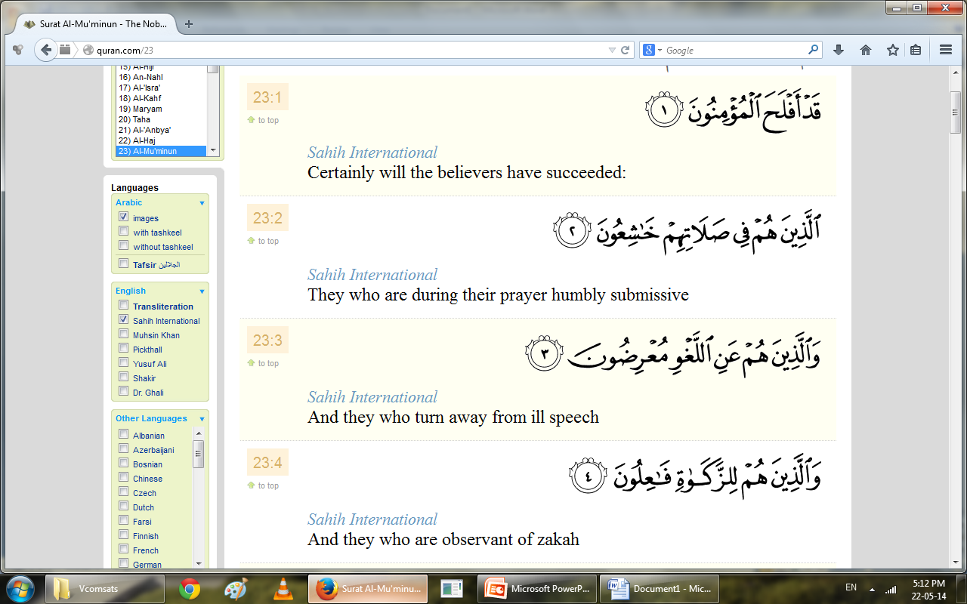
Surah Al-Muminoon related to characateristics of faithful verse nmber1to11

Slide 9


Slide 10
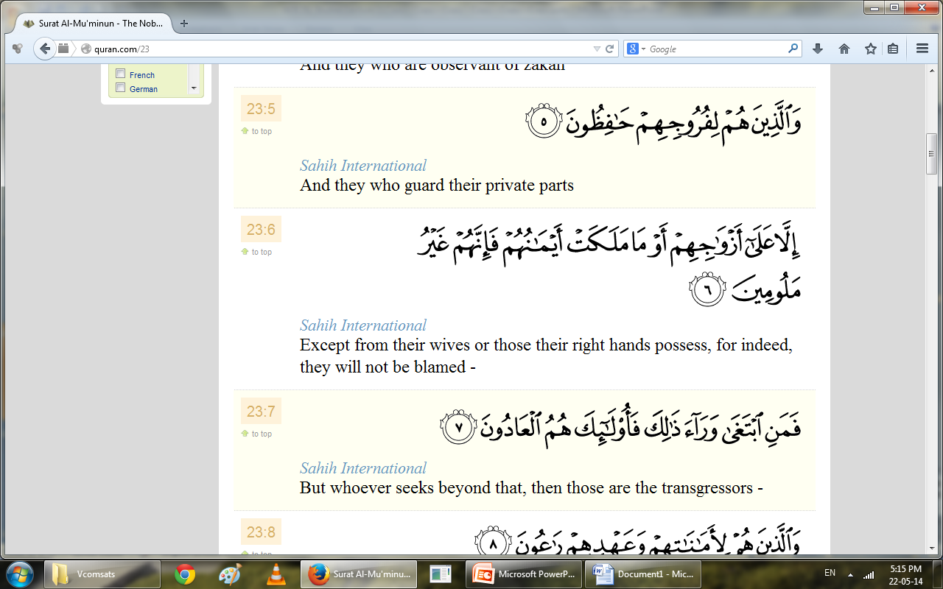
Surah Al-Muminoon related to characateristics of faithful verse nmber1to11

Slide 11
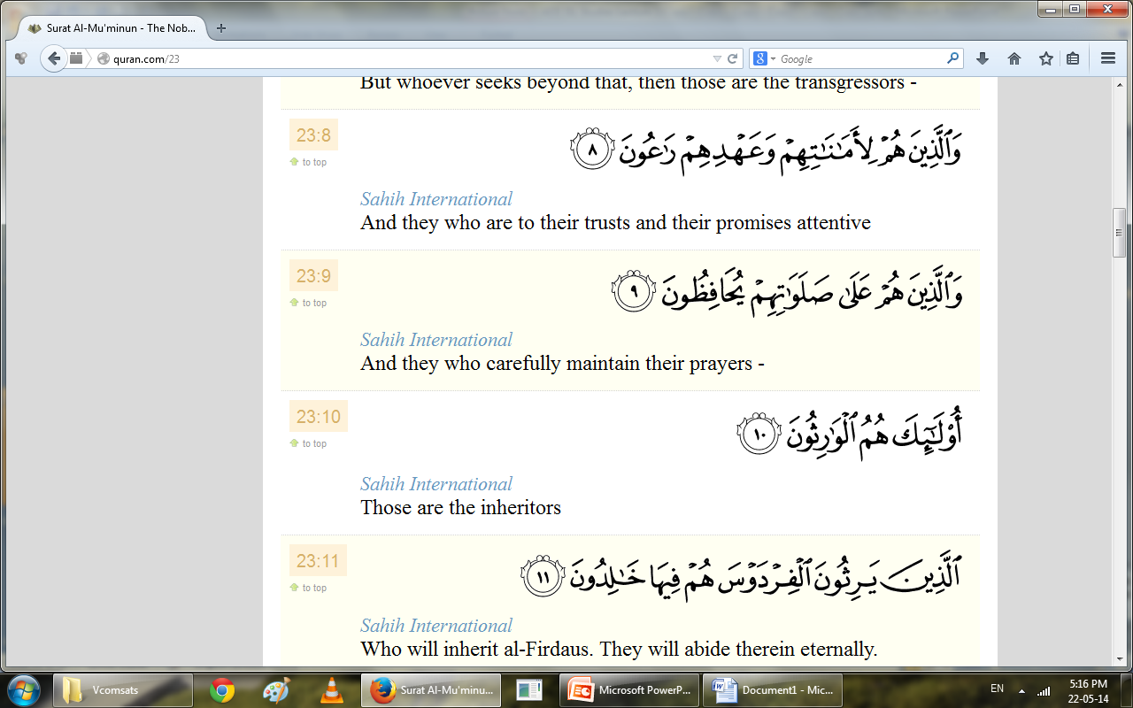
Surah Al-Muminoon related to characateristics of faithful verse nmber1to11

Slide 13
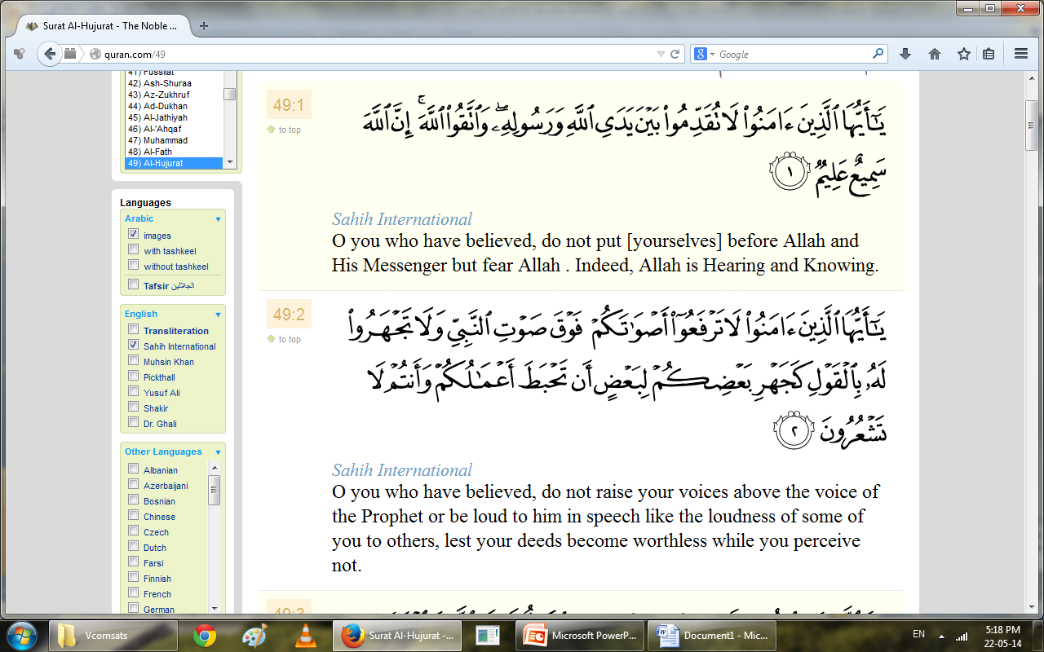
Surah Al-Hujurat related to Adab Al-Nabi(pbuh)verse 1to 18

Slide 14
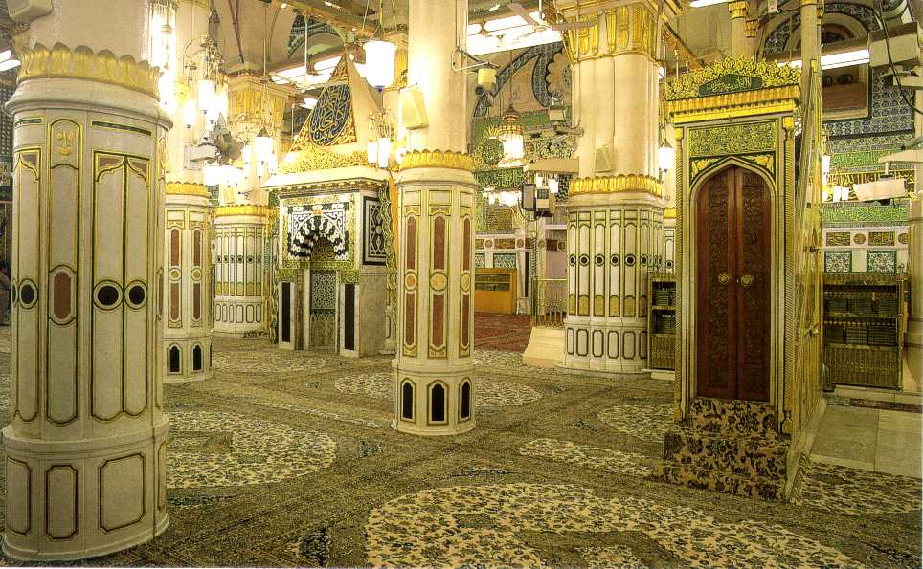

Slide 15
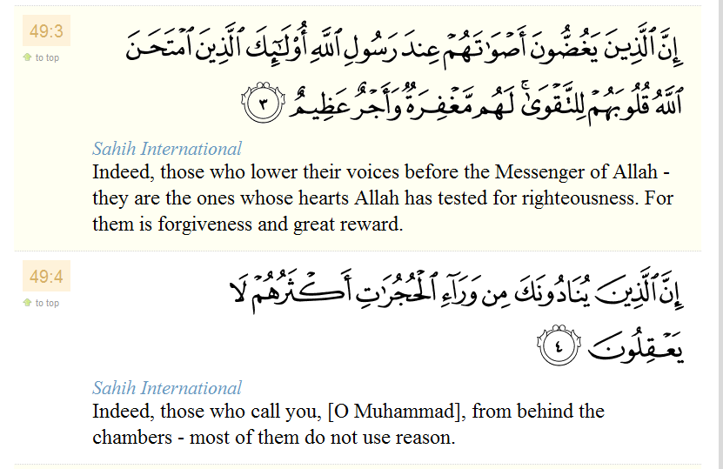
Surah Al-Hujurat related to Adab Al-Nabi(pbuh)verse 1to 18

Slide 16
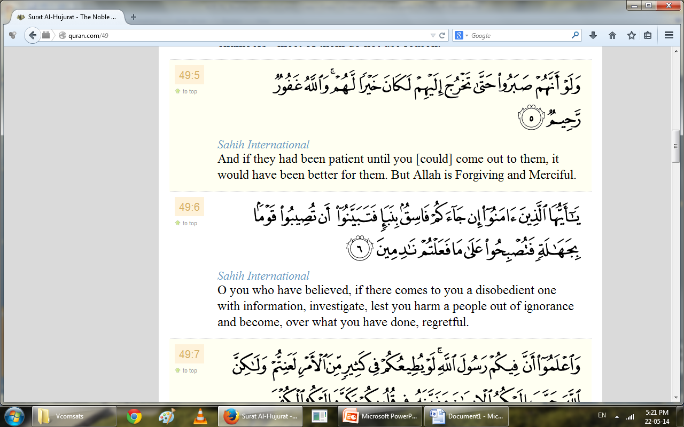
Surah Al-Hujurat related to Adab Al-Nabi(pbuh)verse 1to 18

Slide 17
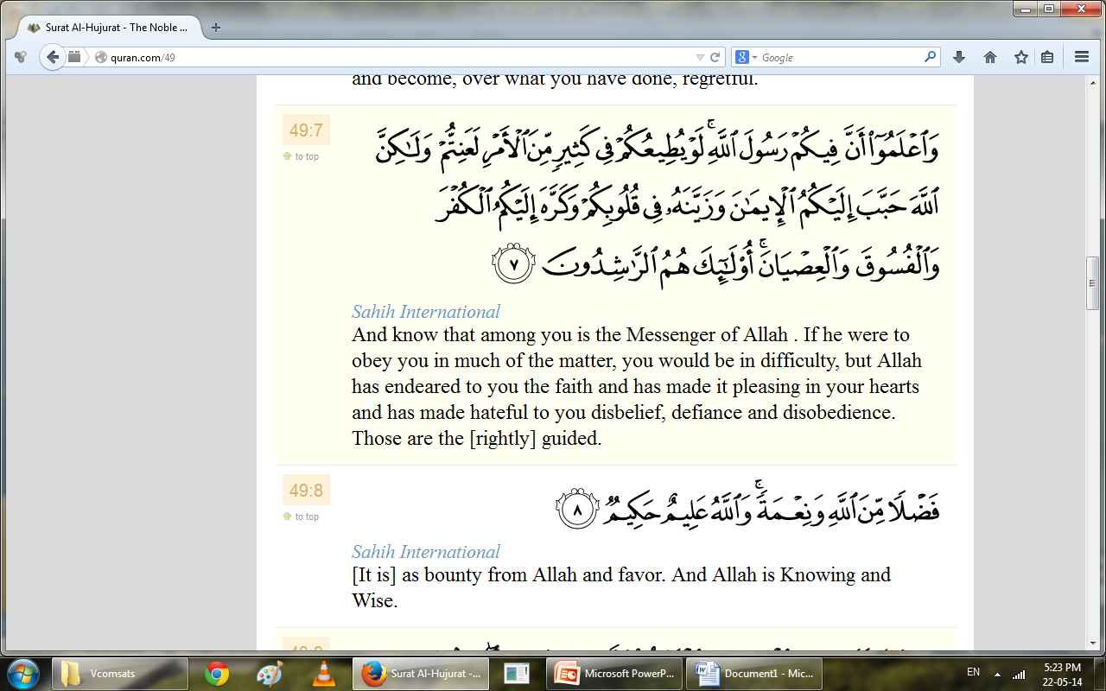
Surah Al-Hujurat related to Adab Al-Nabi(pbuh)verse 1to 18

Slide 18
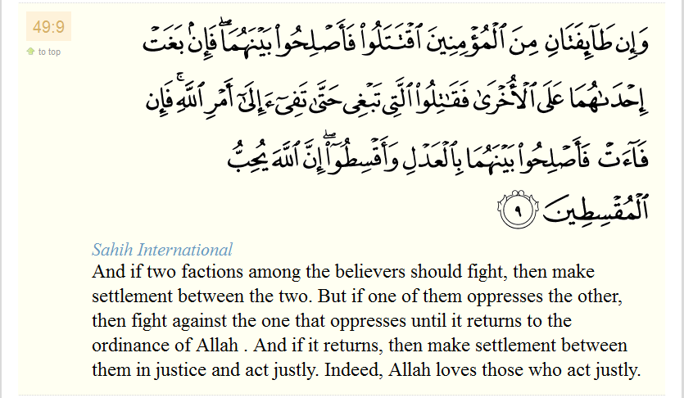
Surah Al-Hujurat related to Adab Al-Nabi(pbuh)verse 1to 18

Slide 19
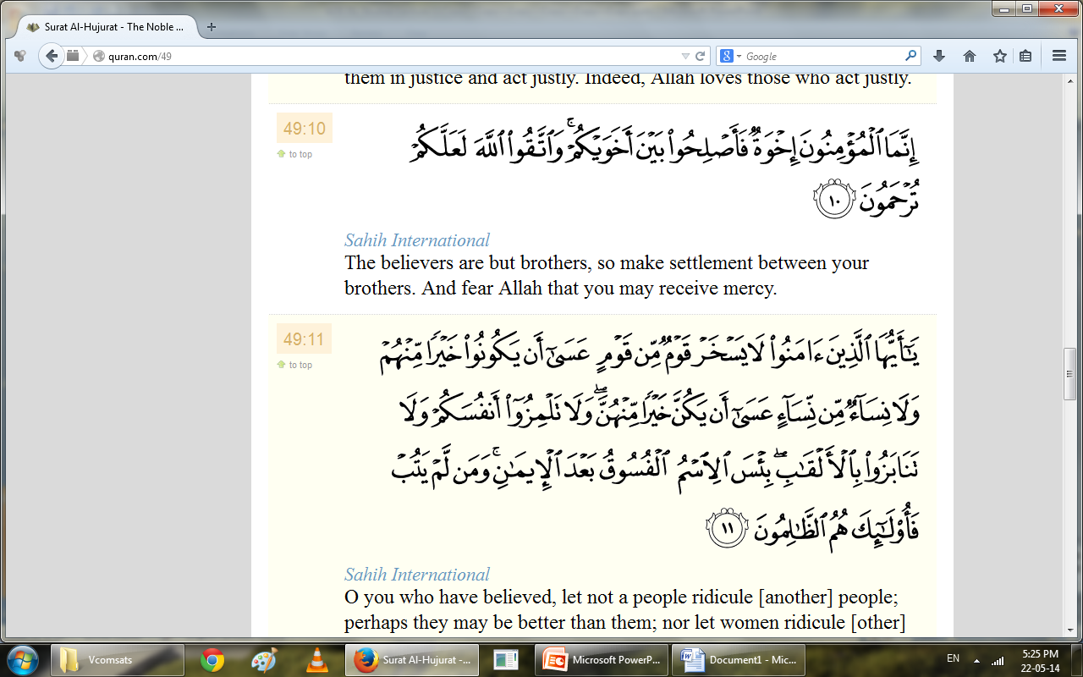
Surah Al-Hujurat related to Adab Al-Nabi(pbuh)verse 1to 18

Slide 20
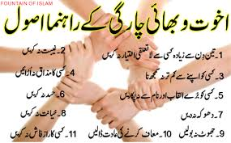

Slide 21
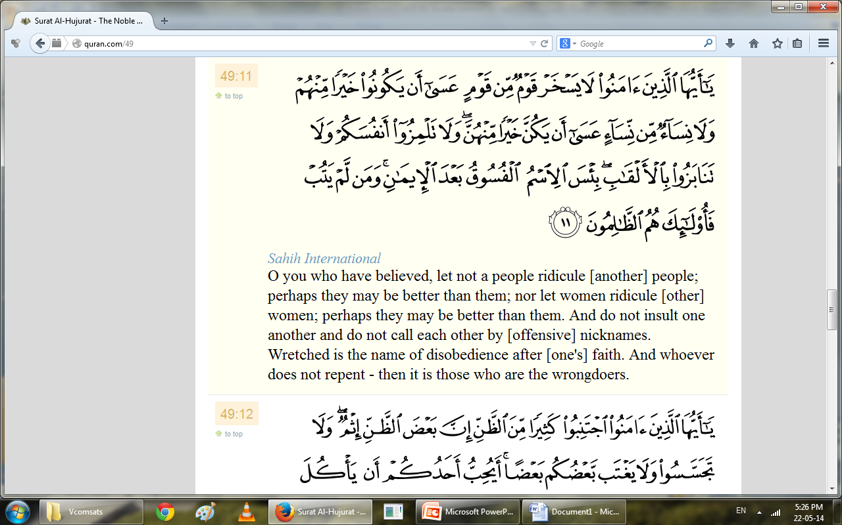
Surah Al-Hujurat related to Adab Al-Nabi(pbuh)verse 1to 18

Slide 22
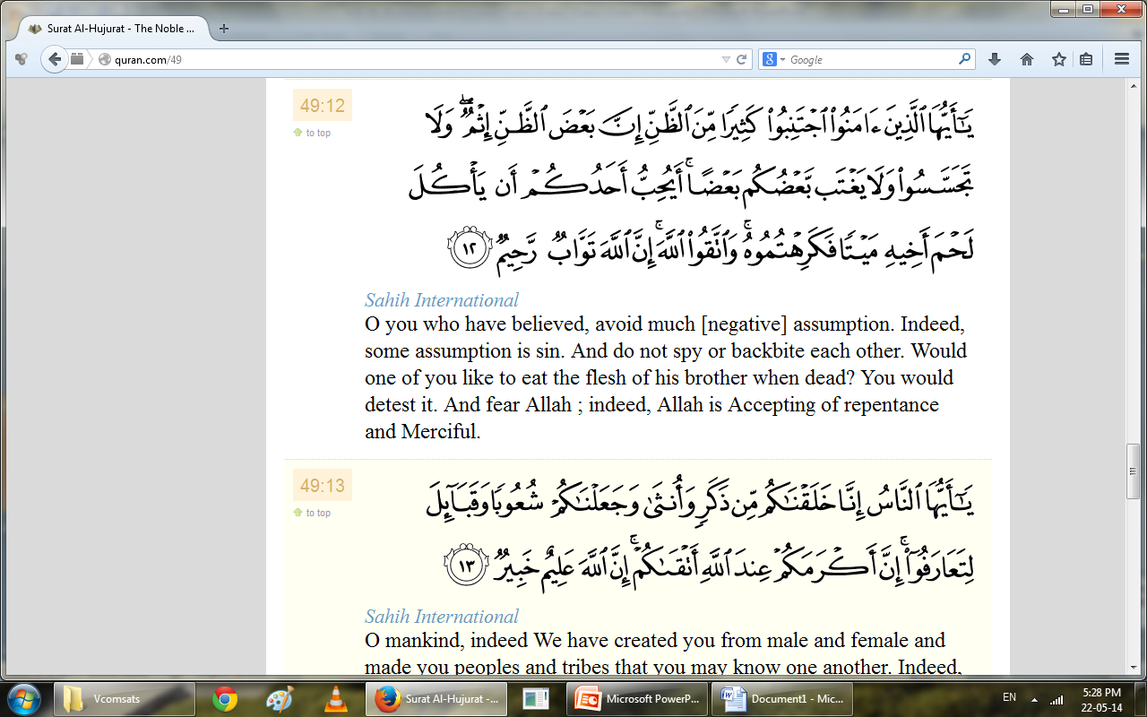
Surah Al-Hujurat related to Adab Al-Nabi(pbuh)verse 1to 18

Slide 23
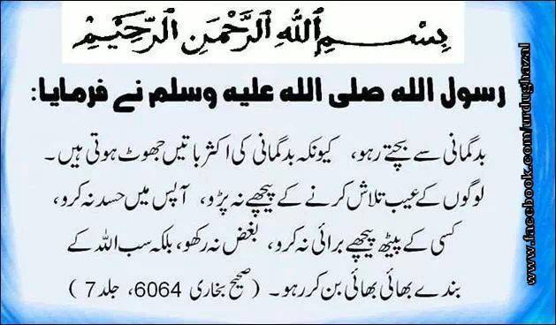

Slide 24
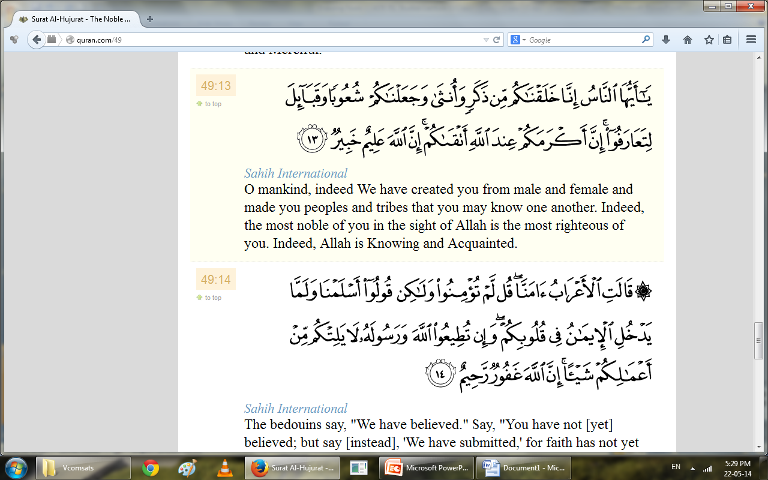
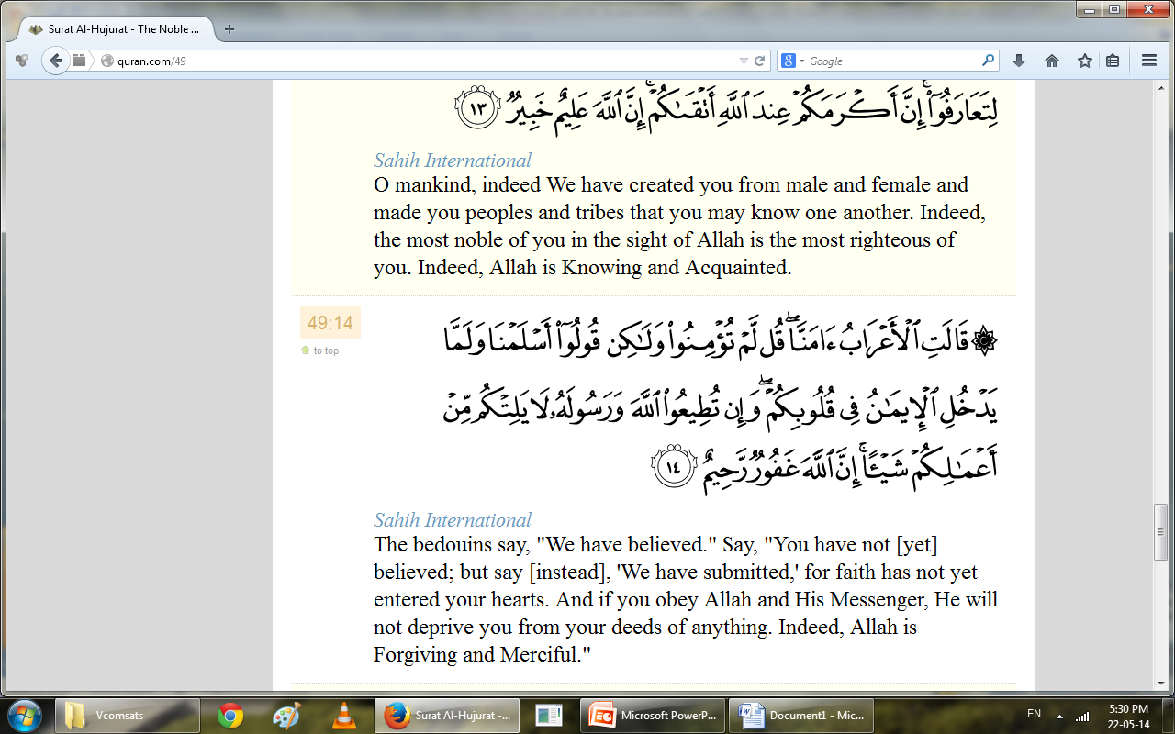
Surah Al-Hujurat related to Adab Al-Nabi(pbuh)verse 1to 18

Slide 25
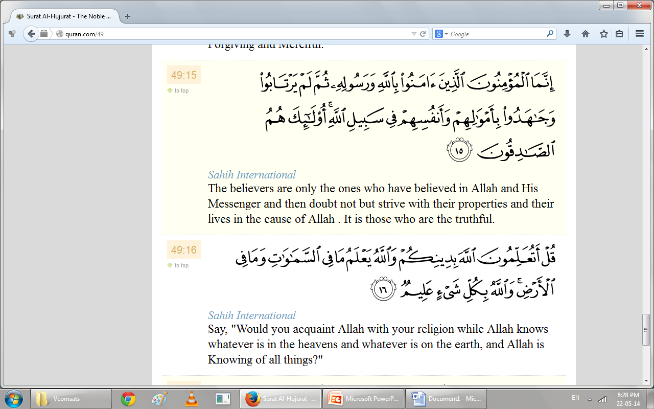
Surah Al-Hujurat related to Adab Al-Nabi(pbuh)verse 1to 18

Slide 26
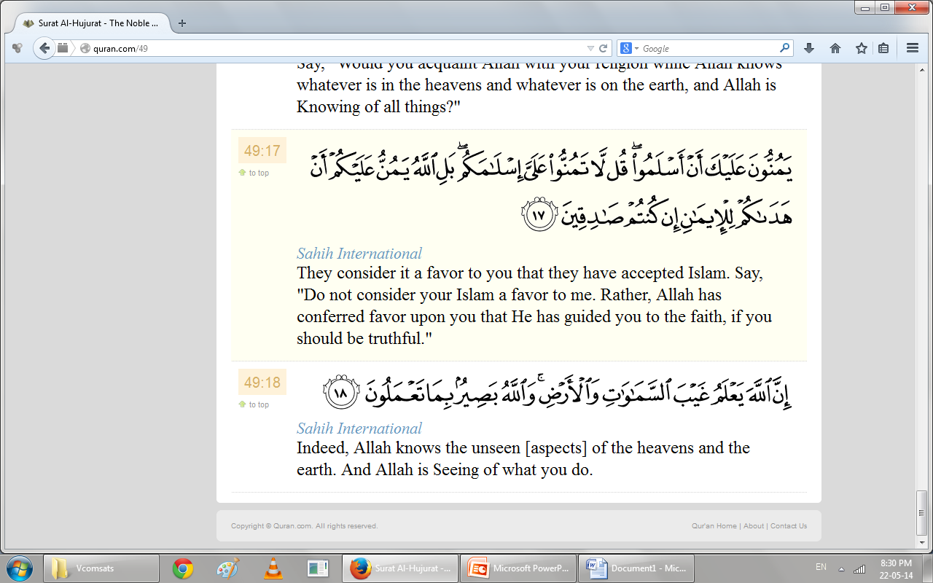
Surah Al-Hujurat related to Adab Al-Nabi(pbuh)verse 1to 18

Slide 28
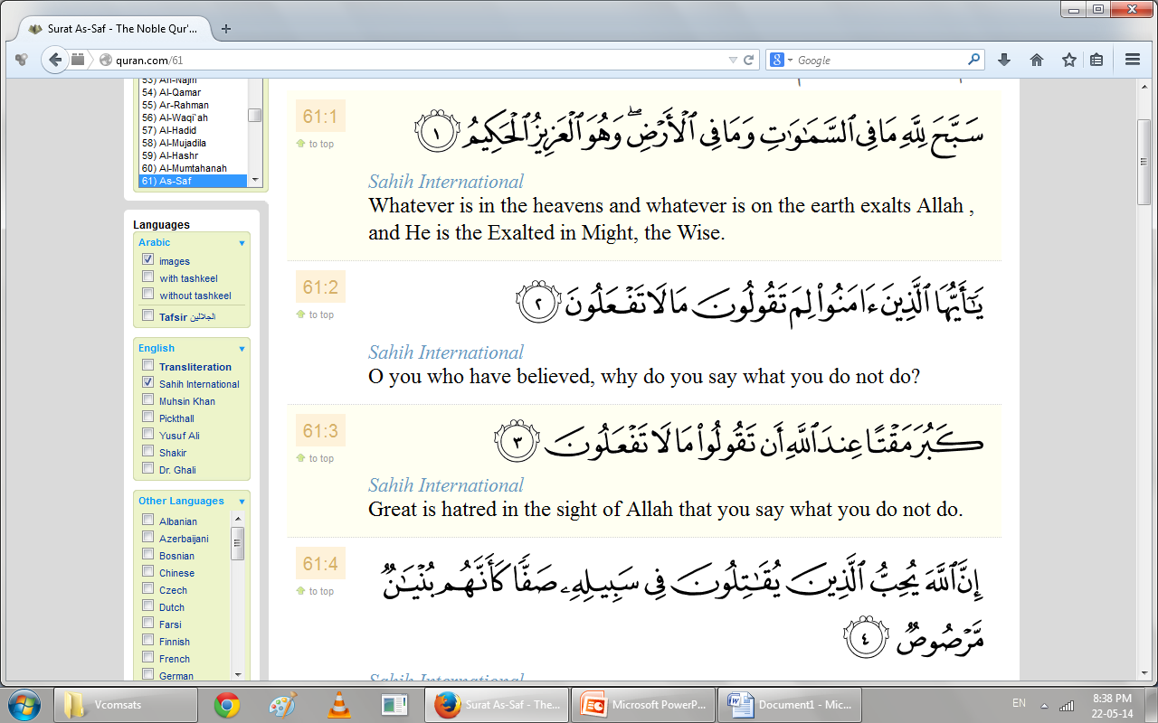
Surah Al-saf related to Tafakar,Tadababar verse1to14

Slide 29
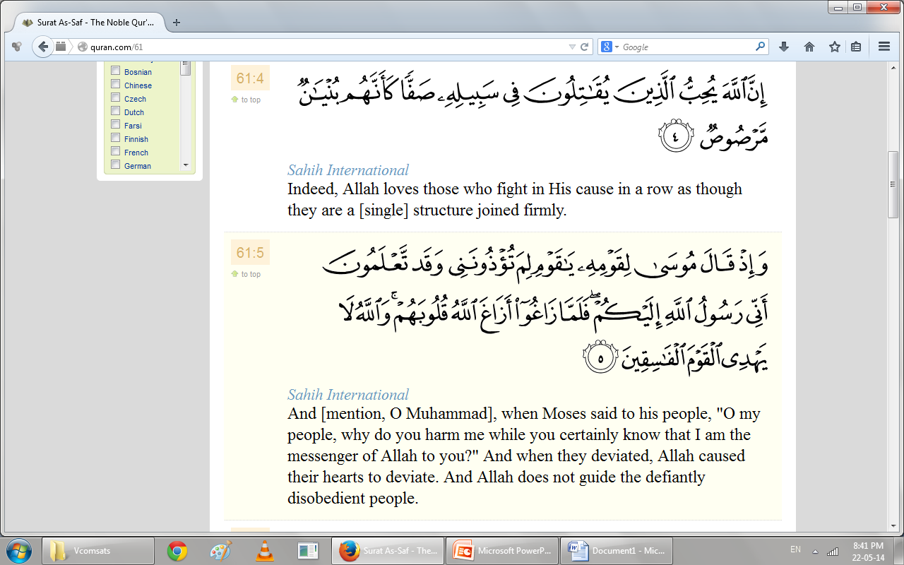
Surah Al-saf related to Tafakar,Tadababar verse1to14

Slide 30
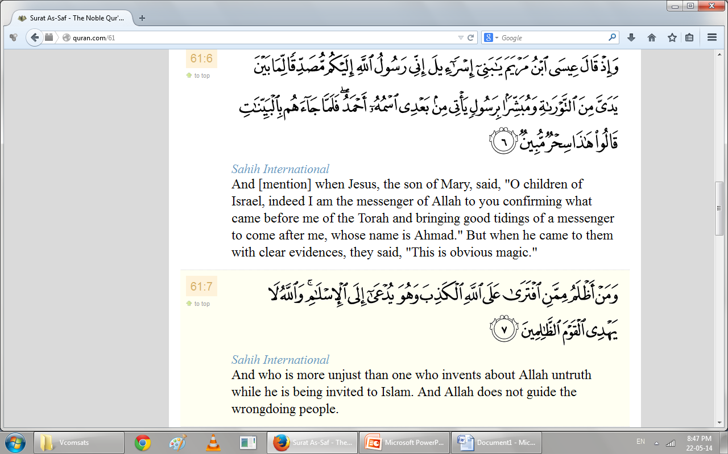
Surah Al-saf related to Tafakar,Tadababar verse1to14

Slide 31
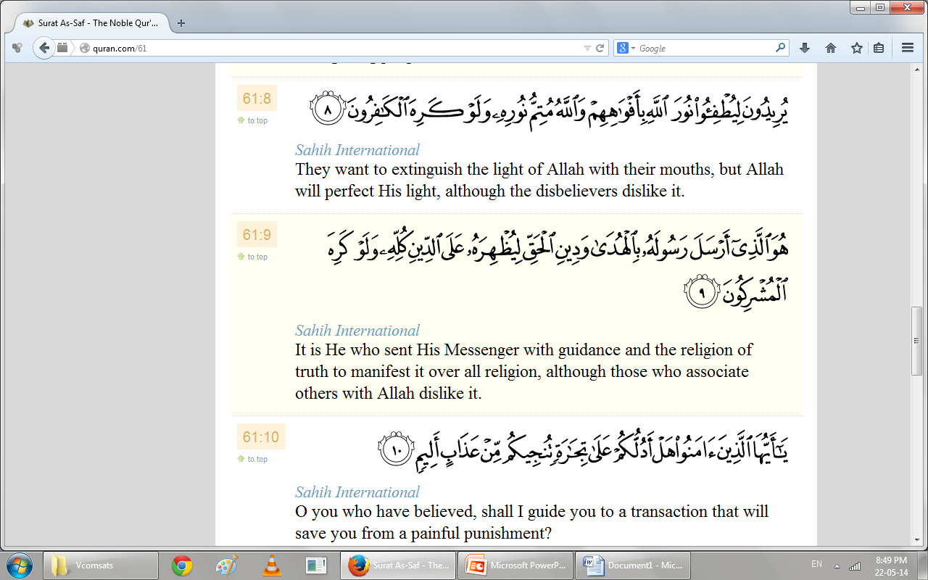
Surah Al-saf related to Tafakar,Tadababar verse1to14

Slide 32
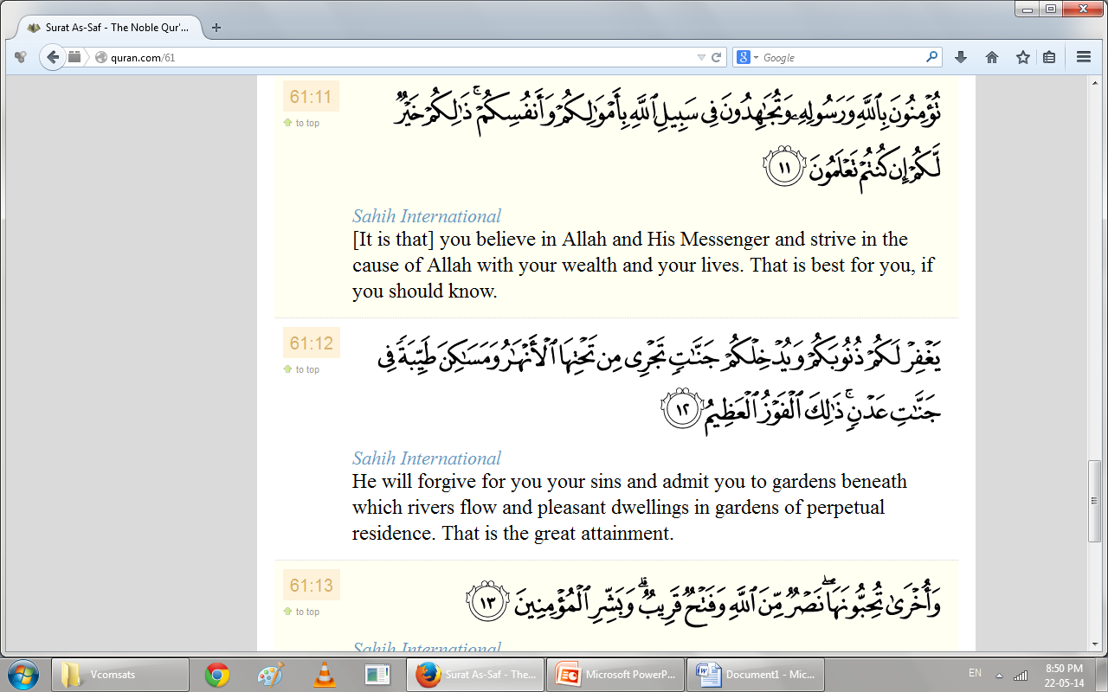
Surah Al-saf related to Tafakar,Tadababar verse1to14

Slide 33
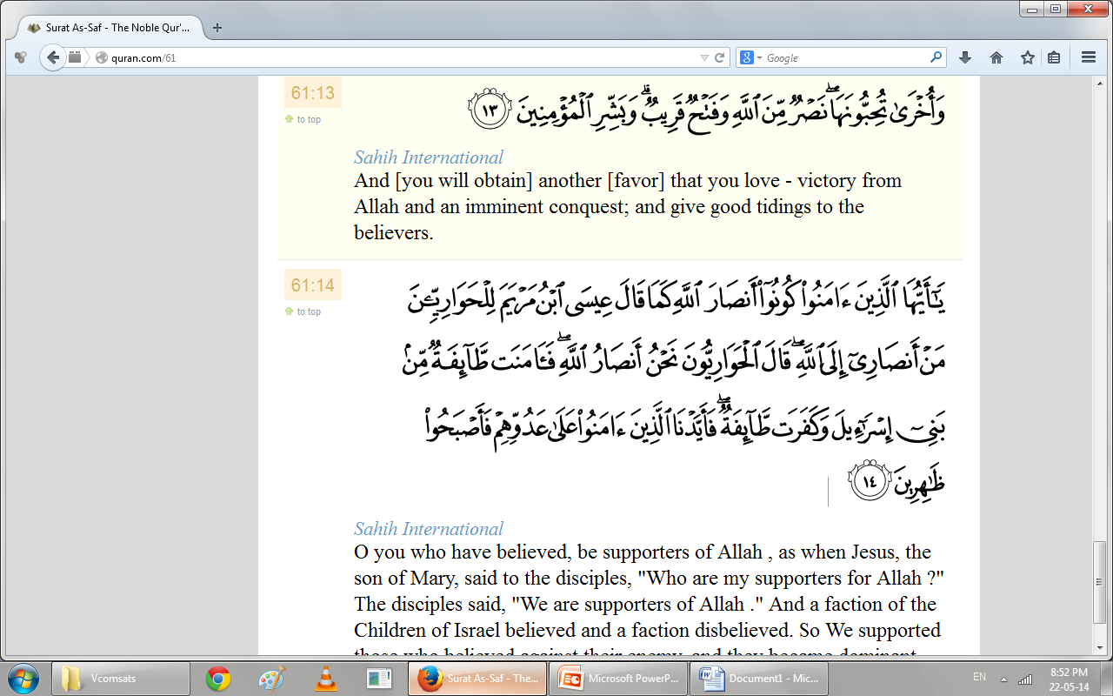
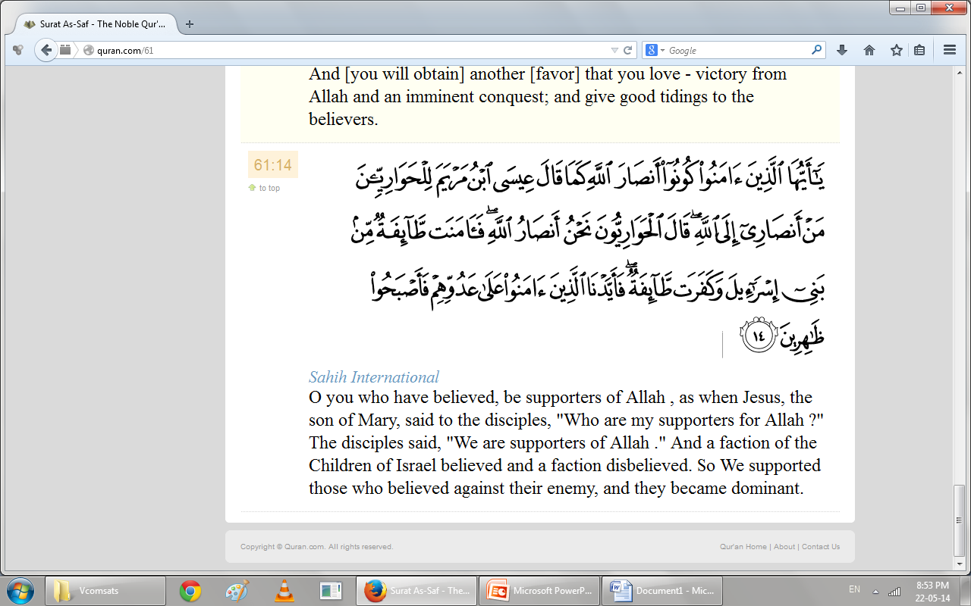
Surah Al-saf related to Tafakar,Tadababar verse1to14

Slide 35
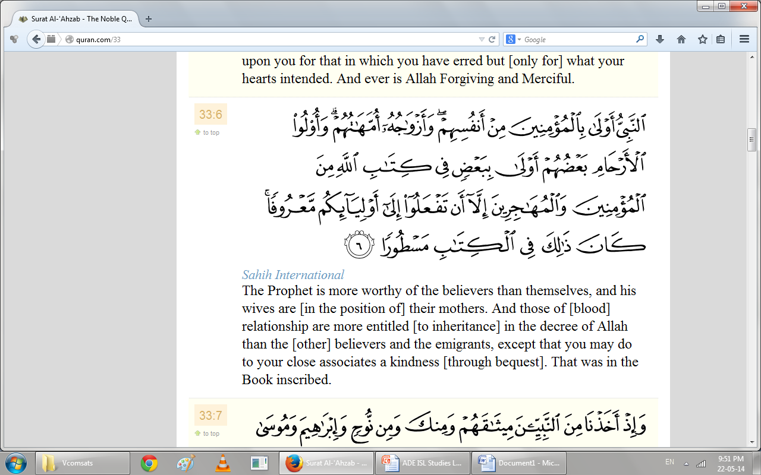
Surah Al-Ihzab related to Adab-ul-Nabi(pubh) verse6

Slide 36
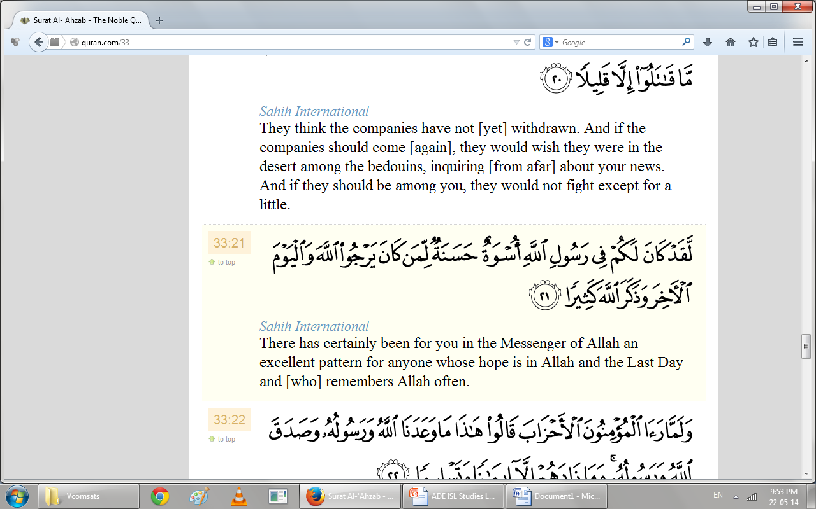
21
Surah Al-Ihzab related to Adab-ul-Nabi(pubh) verse21

Slide 37
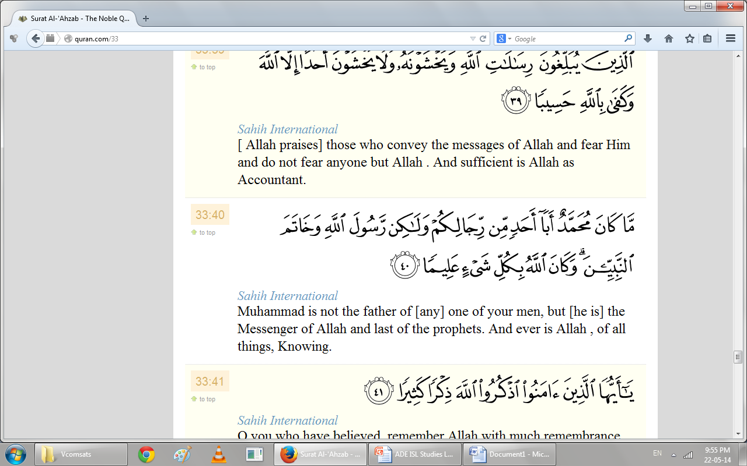
40
Surah Al-Ihzab related to Adab-ul-Nabi(pubh) verse40

Slide 38
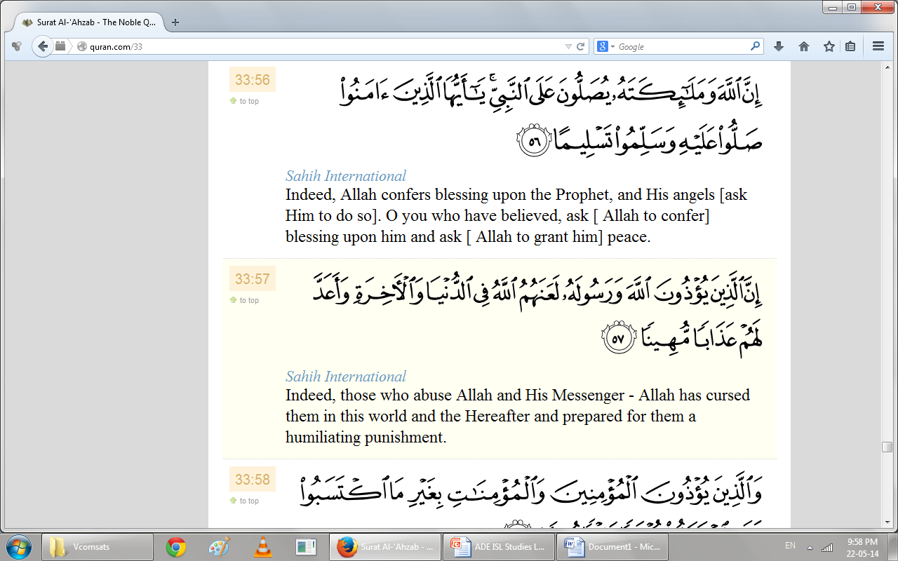
56-57
Surah Al-Ihzab related to Adab-ul-Nabi(pubh) verse56-57

Slide 39


Slide 40
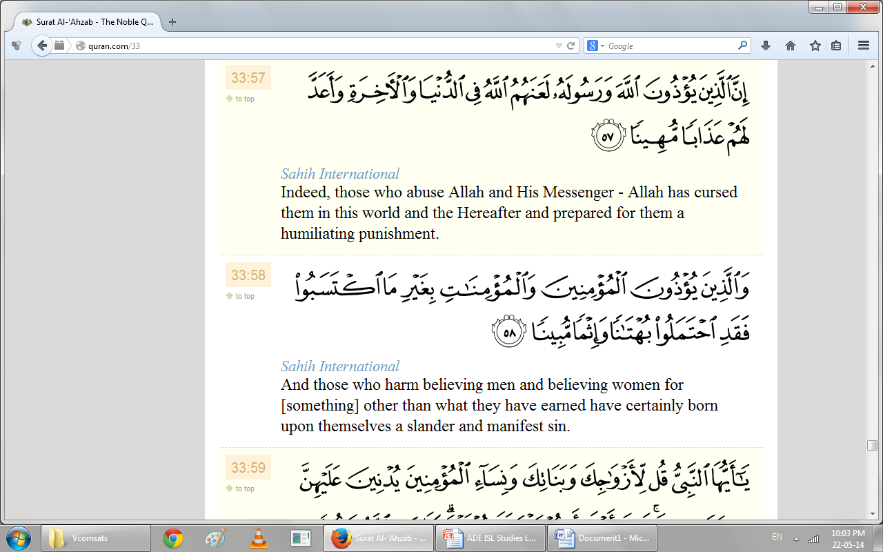
Surah Al-Ihzab related to Adab-ul-Nabi(pubh) verse58

Slide 41
Summary
  Explain slected text surah’s ayat one by one .
  Slected Quranic text related to surah’s topics
  Short detail of relevent ayat
  Care fully listen because it is part of quran

Slide 42
Ap k karne k kam? short Activitiy
1.What you learn after knowin about surah Al-muminoon selected text given in lectuere?
2. .What you learn after knowin about surah Al-saf selected text given in lectuere?
3.What you learn after knowin about surah Al-hujurat selected text given in lectuere?
4.What you learn after knowin about surah Al-Ihzab selected text given in lectuere?
Do you have finished the Nazra Quran if not then what is thinking just do it.
Notes:
Discuss as a class the idea that Arabian Polytheism is condemned as being sinful because it goes against Tawhid.

Slide 43


Slide 44
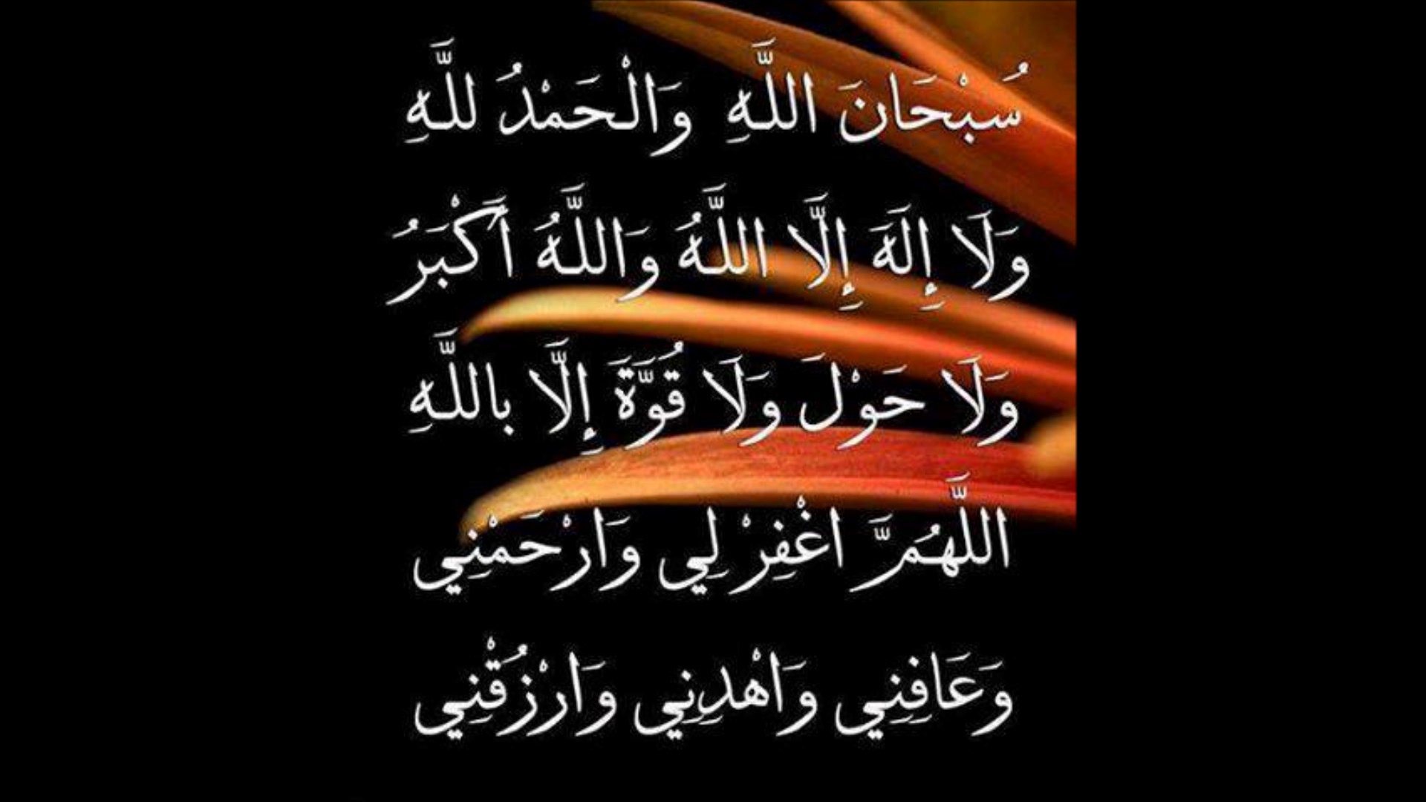

Slide 45


