Slide 1


Slide 2
Islamic Studies course code 104
Associate Degree Education ADE/B.Ed(Hons)Elementary
Semester I

Slide 3

Lectuere#10
By :Muhammad Imran

Slide 4
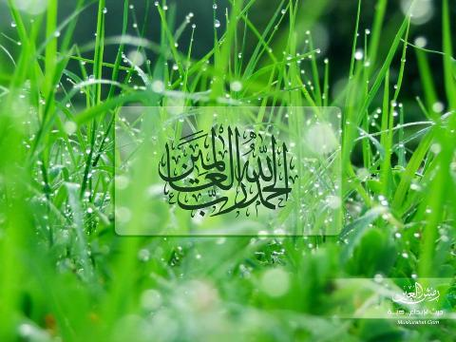

Slide 5
Study of Selected Text of Holy Quran
Verses of Surah Al-Baqra related to Faith.
(verse no 284-285)
Verses of Surah Al.Inaam related to Ihkam.
(verse no 284-285)
Verses of surah Al-Furqan related to social ethics
(verse no 63-77)
Verses of Surah Al-Hashar related to thinking Day of judgment.
(verse no 18-19-20)

Slide 6

Out Lines
  Explain slected text surah’s ayat one by one .
  Slected Quranic text related to surah’s topics
  Short detail of relevent ayat
  Care fully listen because it is part of quran

Slide 7


Slide 8
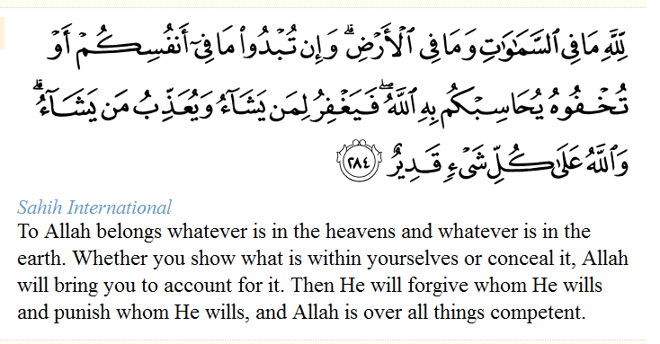
Surah Al-Baqrah verse number 284to286 related to Faith

Slide 9
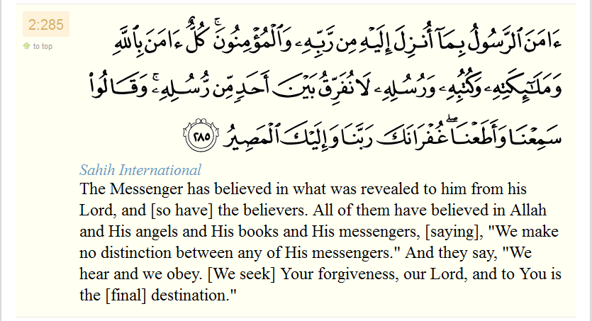
Surah Al-Baqrah verse number 284to286 related to Faith

Slide 10
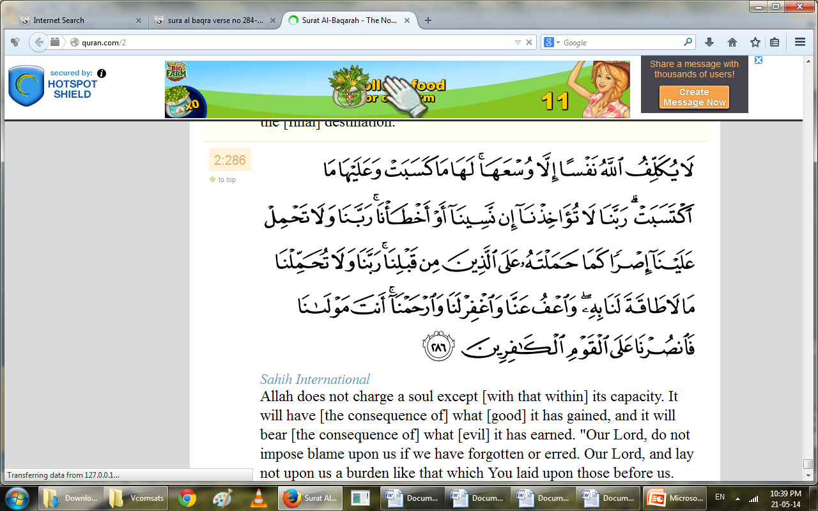
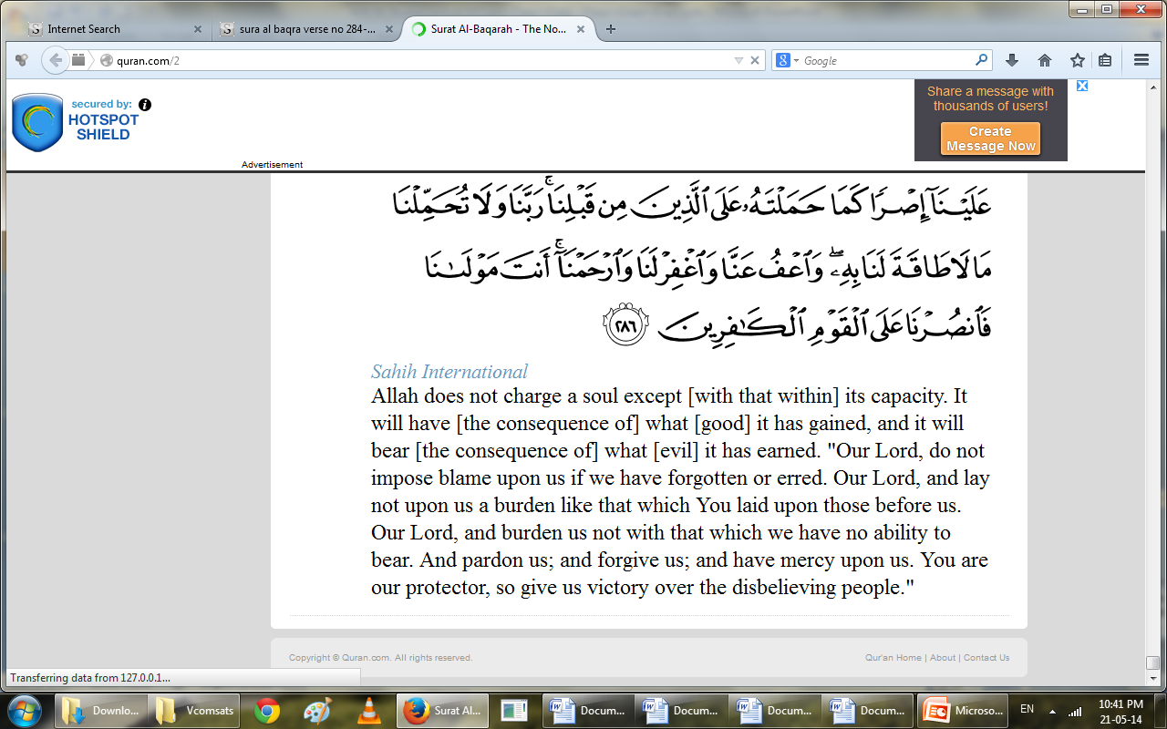
Surah Al-Baqrah verse number 284to286 related to Faith

Slide 12
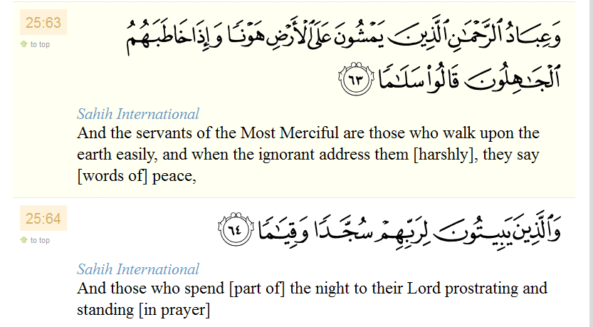
Surah Al-Furqn verse no 63to77related to Social ethics

Slide 13
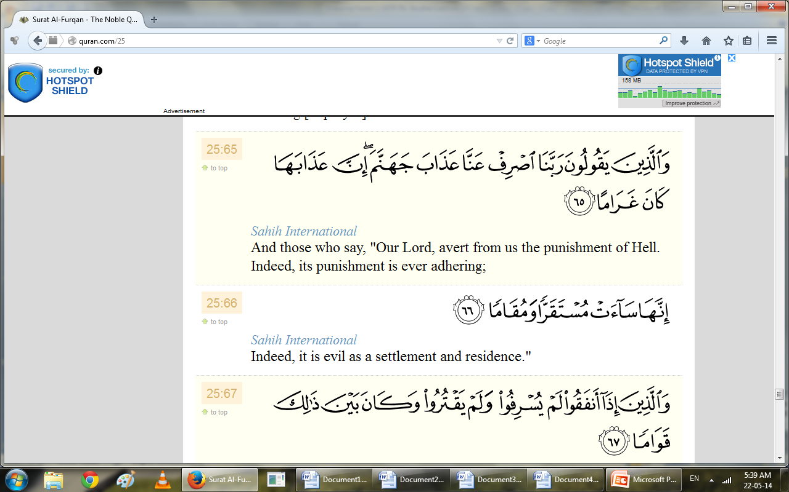
Surah Al-Furqn verse no 63to77related to Social ethics

Slide 14
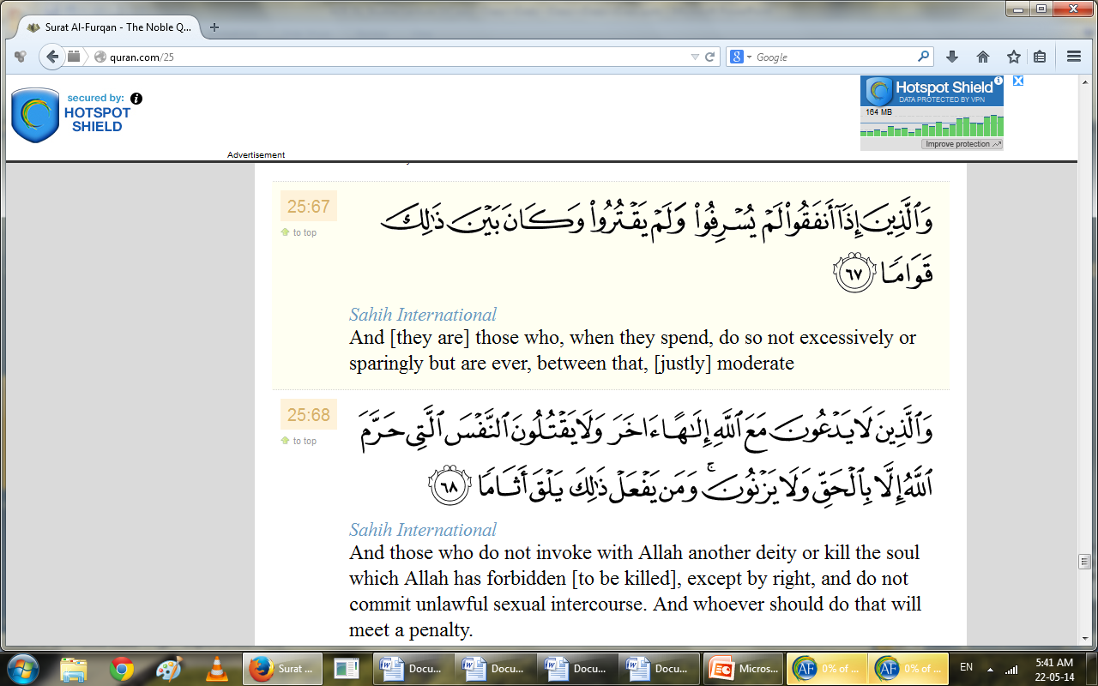
Surah Al-Furqn verse no 63to77related to Social ethics

Slide 15
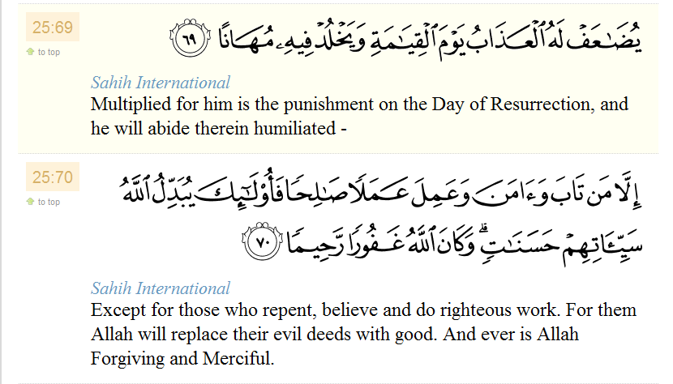
Surah Al-Furqn verse no 63to77related to Social ethics

Slide 16
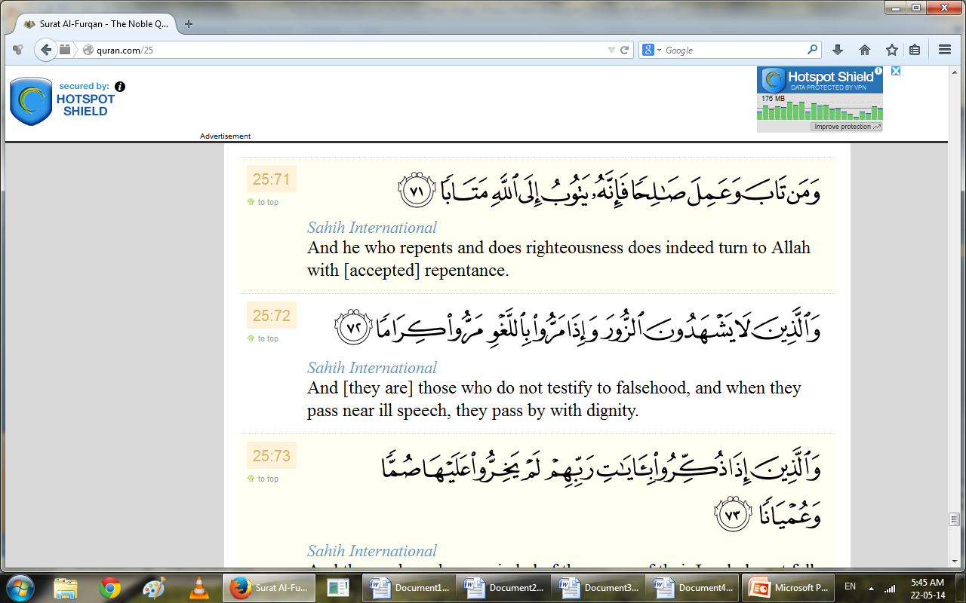
Surah Al-Furqn verse no 63to77related to Social ethics

Slide 17
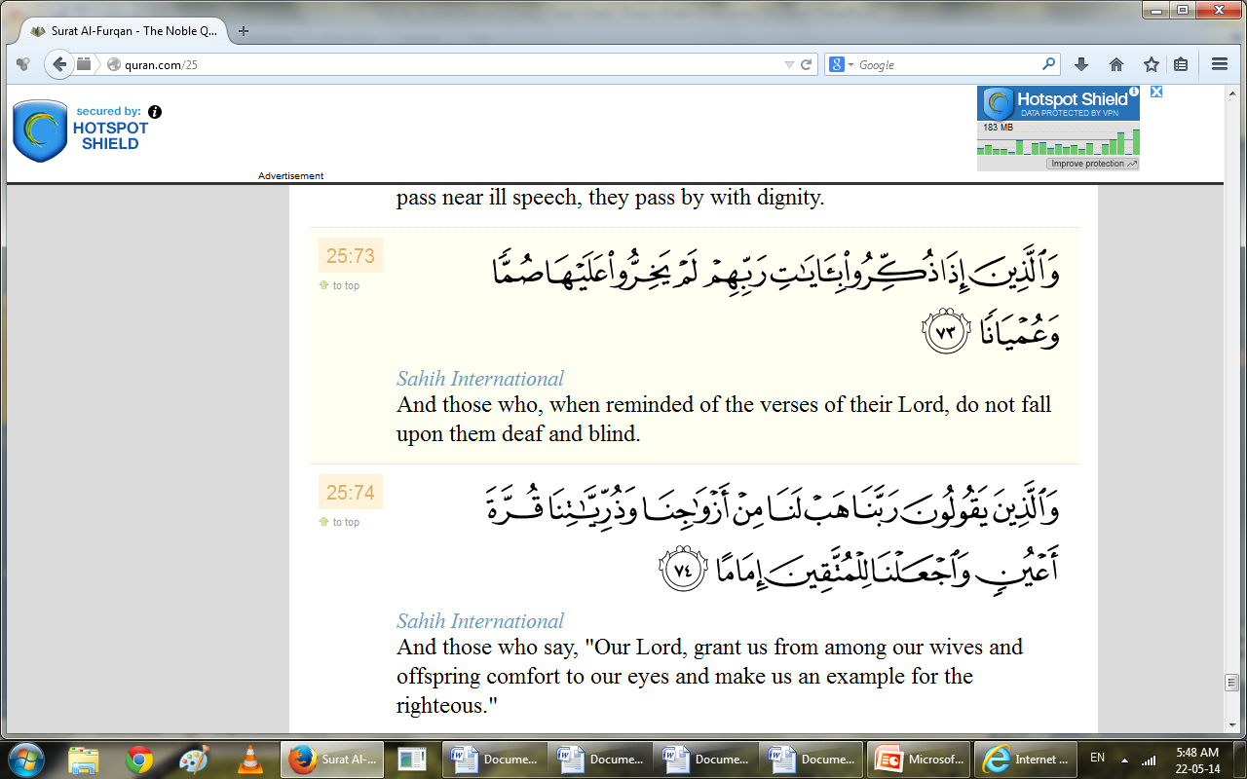
Surah Al-Furqn verse no 63to77related to Social ethics

Slide 18
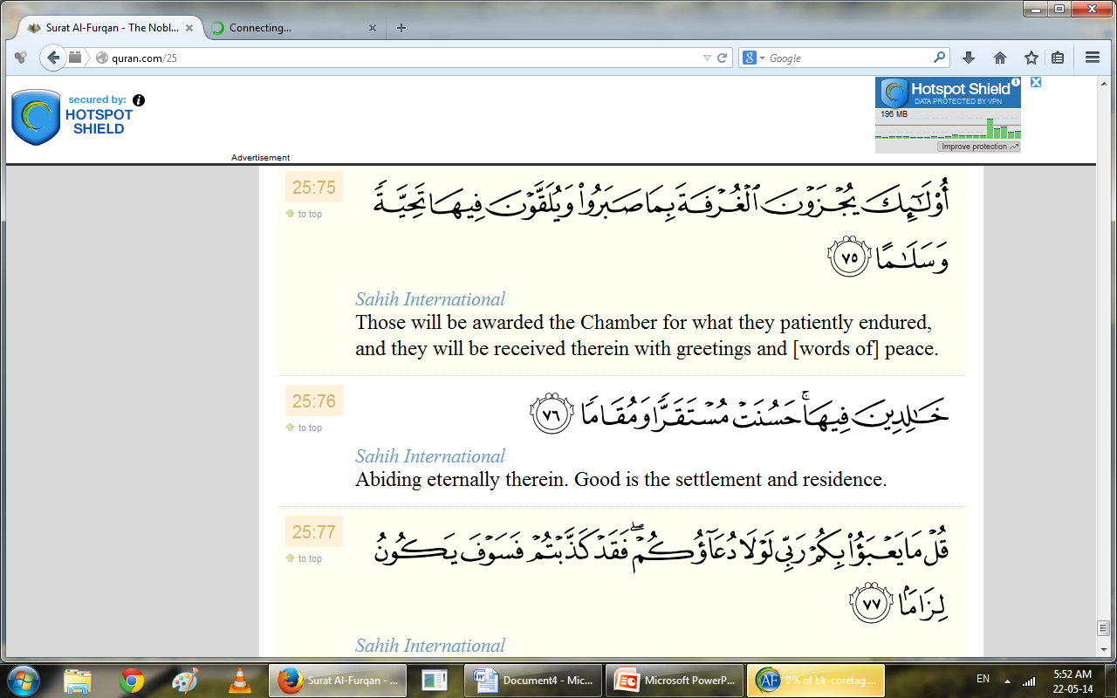
Surah Al-Furqn verse no 63to77related to Social ethics

Slide 19
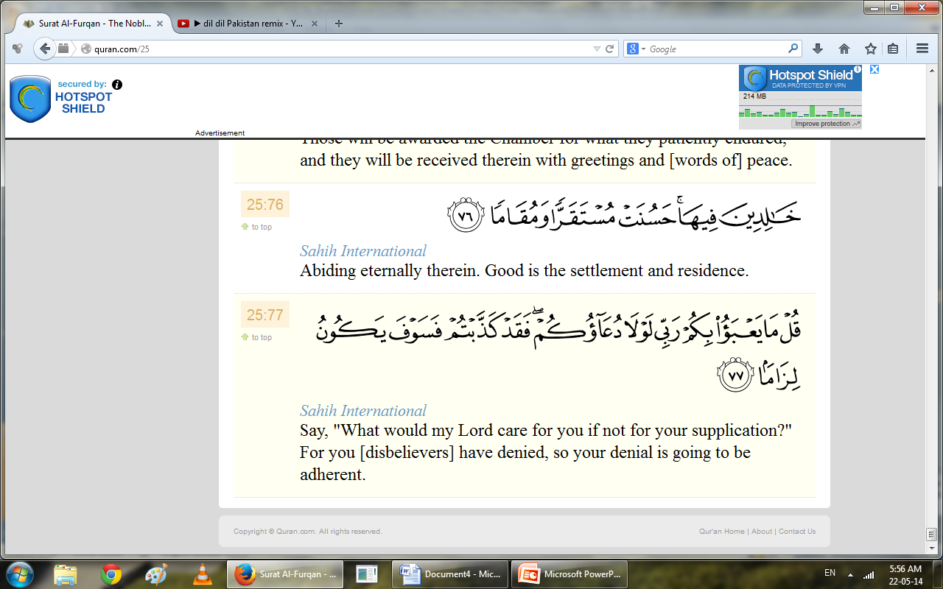
Surah Al-Furqn verse no 63to77related to Social ethics

Slide 21
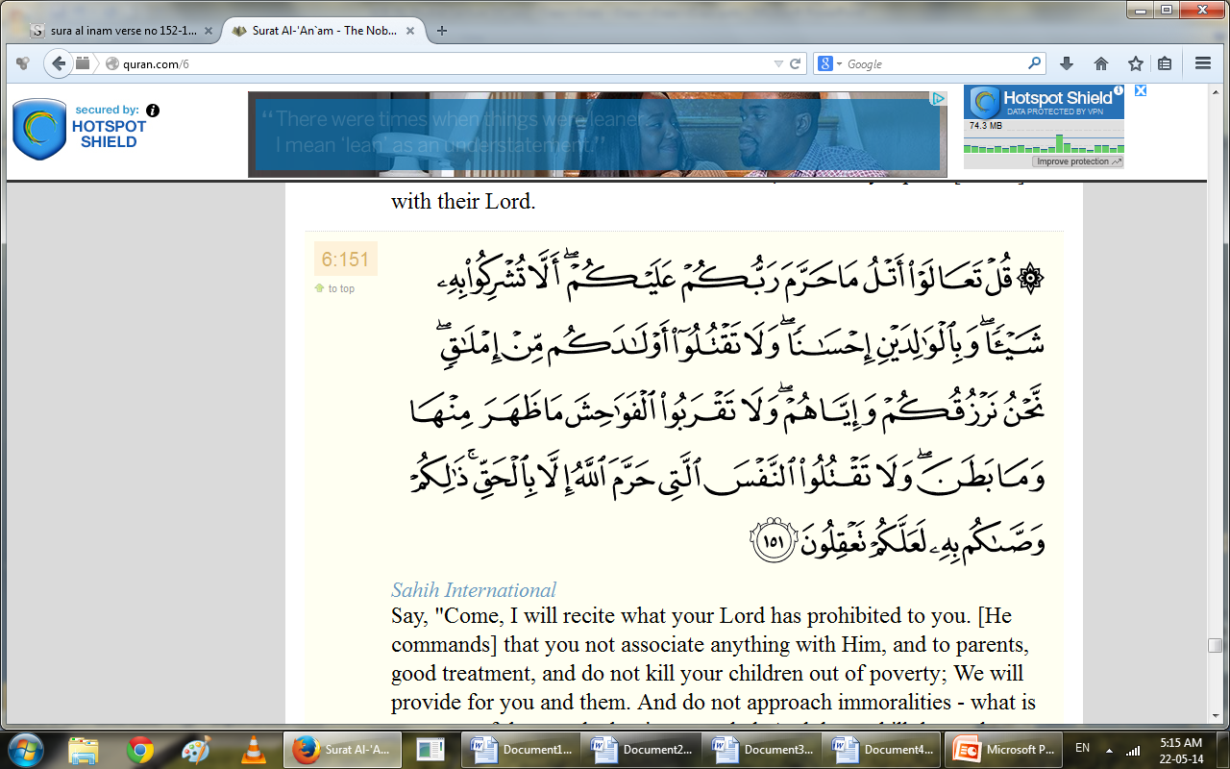
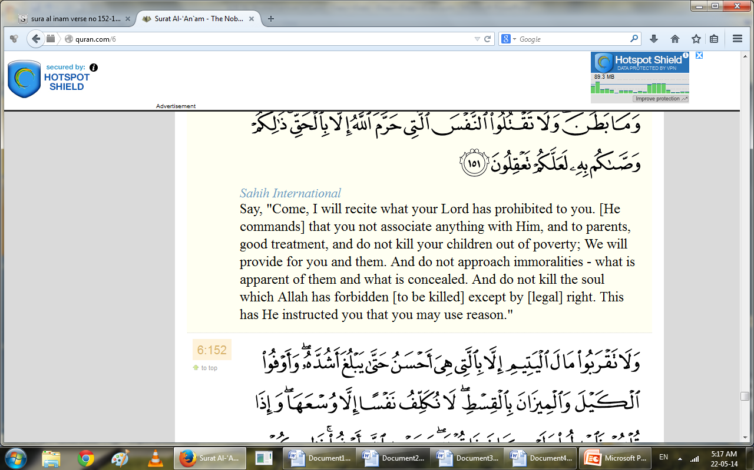
SurahAl-Inaam verse number
151to 153 related to Ihkam

Slide 22
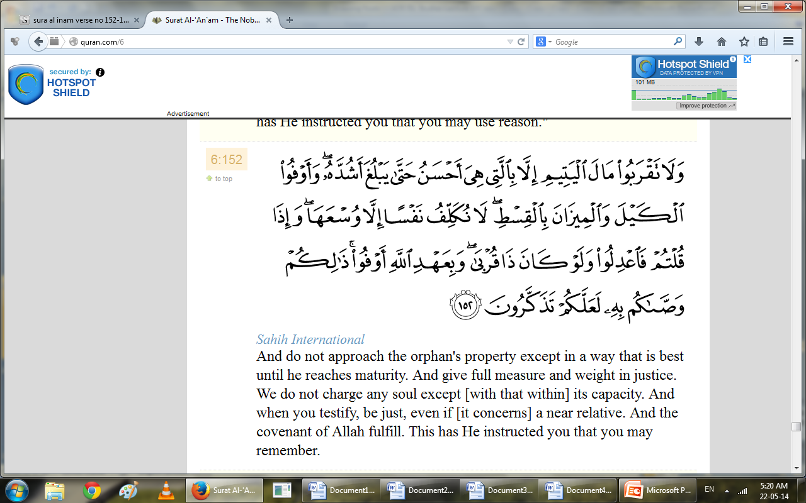
SurahAl-Inaam verse number
151to 153 related to Ihkam

Slide 23
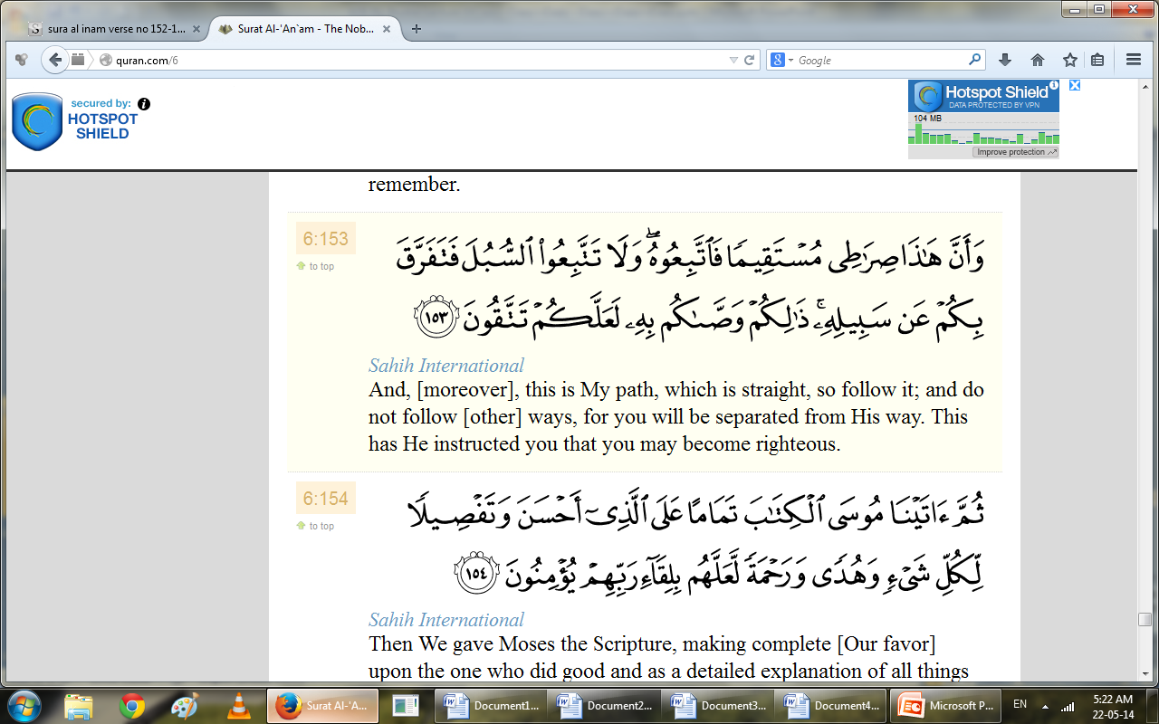
SurahAl-Inaam verse number
151to 153 related to Ihkam

Slide 25
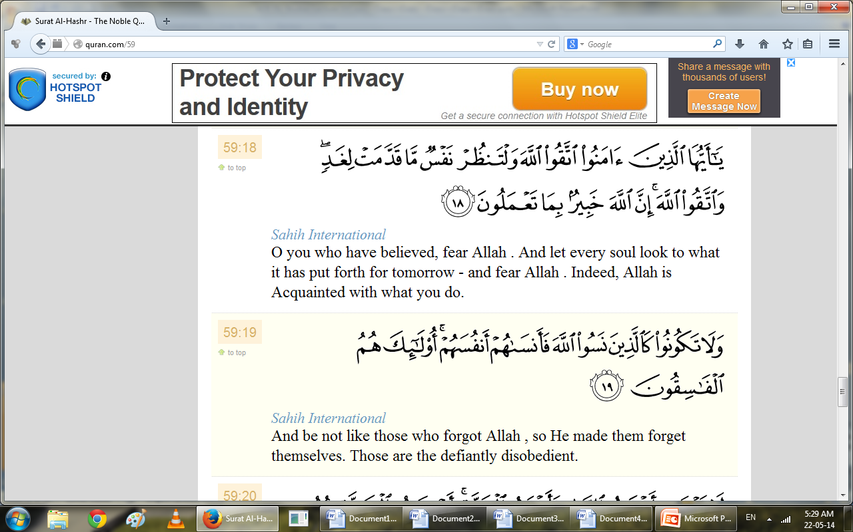
Sura Al-Hashar(18-19-20)related to thinking Day of judgment

Slide 26
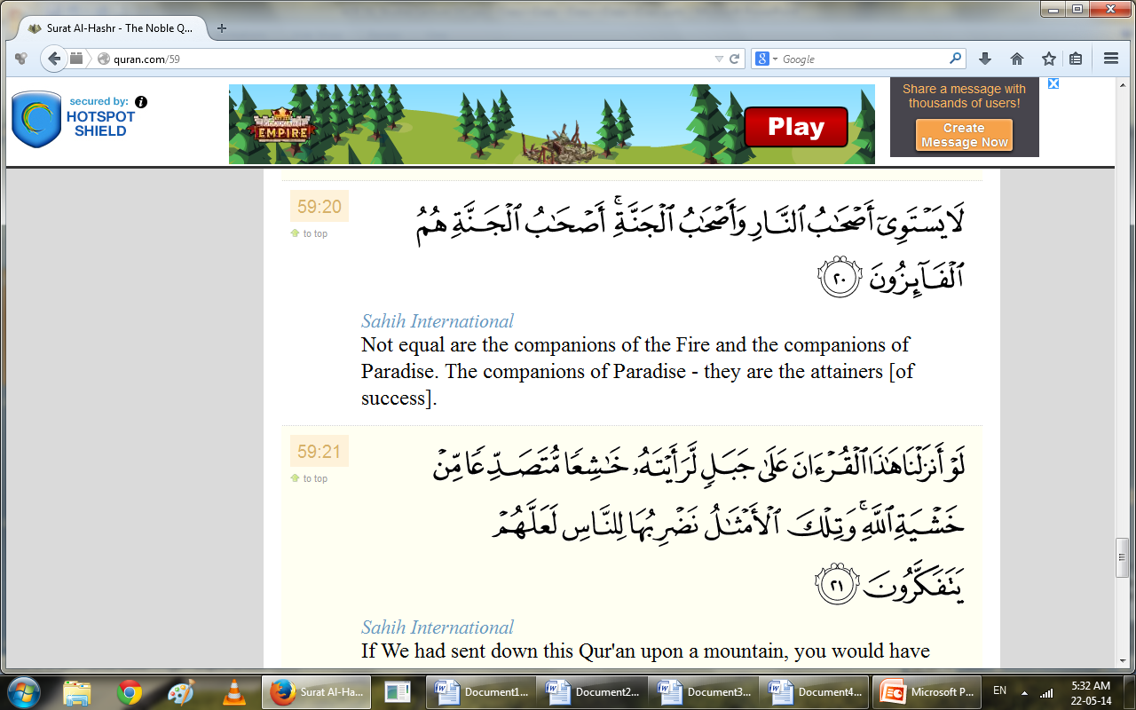
Sura Al-Hashar(18-19-20)related to thinking Day of judgment

Slide 27
Summary
  Explain slected text surah’s ayat one by one .
  Slected Quranic text related to surah’s topics
  Short detail of relevent ayat
  Care fully listen because it is part of quran

Slide 28
Ap k karne k kam? short Activitiy
1.What you learn after knowin about surah Al-Baqra selected text given in lectuere?
2. .What you learn after knowin about surah Al-Furqan selected text given in lectuere?
3.What you learn after knowin about surah Al-Inaam selected text given in lectuere?
4.What you learn after knowin about surah Al-Hashar selected text given in lectuere?
Notes:
Discuss as a class the idea that Arabian Polytheism is condemned as being sinful because it goes against Tawhid.

Slide 29


