Slide 1

General Mathematics
ADE 101
Unit 2
LECTURE No. 9
Patterns as Fundamental to Understand Algebra

Slide 2
Use of Patterns
Patterns are an effective way
to demonstrate the relationship between variables. Providing students with opportunities to analyze, model and extend patterns will help prepare them for algebra in higher grades.

Slide 3
Today’s Objectives
Students and Teachers will be able to
Identify the number pattern involving different operations on number and repeat the sequence of number accordingly.
Understand the number pattern given and guess the missing numbers.

Slide 4
What is Pattern
Something which repeat in the same order is called pattern.
Types:
Number pattern are of two types
Repeating
Growing
Usually number patterns are growing patterns.

Slide 5
Activity
Make a pattern by adding 5 to the previous number and get the picture.
30
5
25
10
15
20

Slide 6

Find Out the missing number
2
4
8
12

Slide 7
Find Out the missing number
51
52
54
57

Slide 8
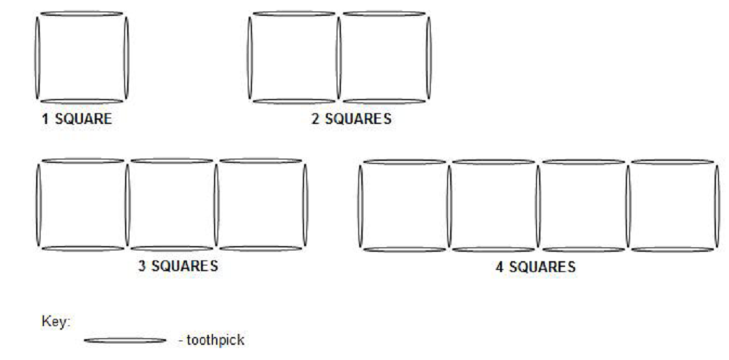
Activity
Use toothpicks to make the continuous squares

Slide 9
Activity
Students should first identify that the number of squares starts with 1 and increases by 1. They will then determine that the number of toothpicks starts with 4 and increases by 3. This means that each new square in the pattern must be constructed using only 3 additional toothpicks. Based on this identified relationship students must construct each new square by starting with one side of a pre-existing square.

Slide 10
Activity
Tell students that a statue is shaped like a tower and is made of a single column of cubes A painter has been hired to paint all the cube faces that are visible. This would include the side and top faces as well. The bottom face of each cube is not visible. Students may build the model using multilink cubes or blocks. Ask students to create a table of values to record the number of faces that need to be painted on towers 1, 2, 3, 4 and 5 blocks high. Ask students to find the number of faces that would have to be painted for a tower containing 10 blocks. 20 blocks.

Slide 11
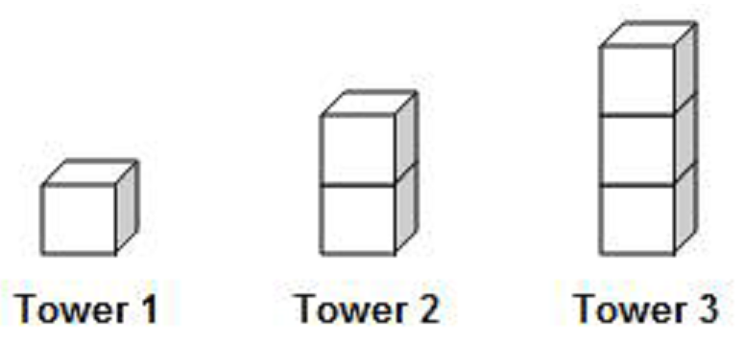

Slide 12
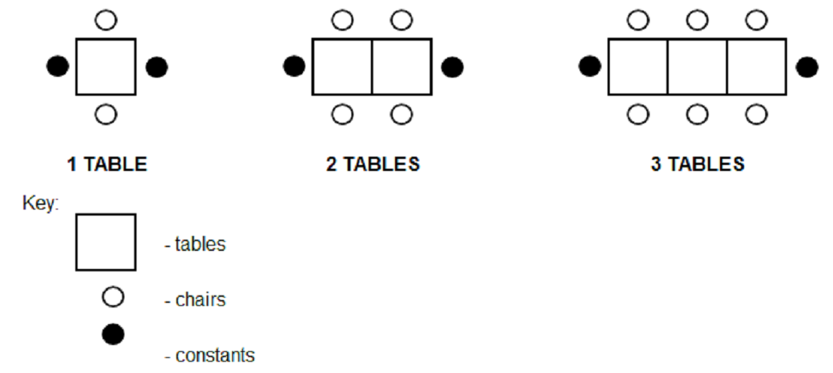
Activity
Four students could be seated around a square table, with one on each side. Tables could be added with another chair on either side in the pattern shown below.

Slide 13
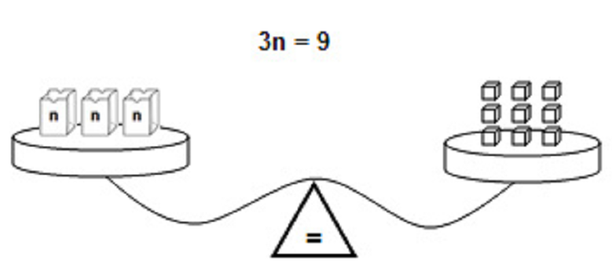
Model a simple equation on a pan balance such as 3n = 9.
Students can now add a constant amount to each side. No matter how much they add, the scale will remain balanced as long as they add the same amount on each side. This will help the student observe how the equality of the two pans (sides of the equation) is preserved.

Slide 14
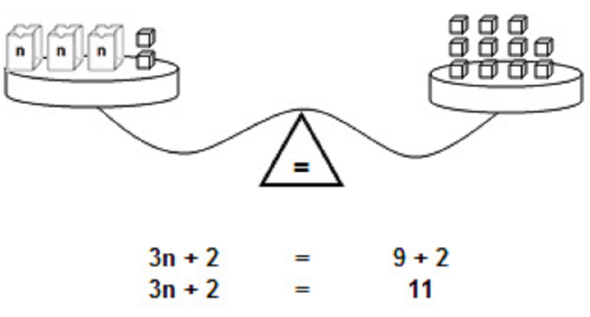

Slide 15
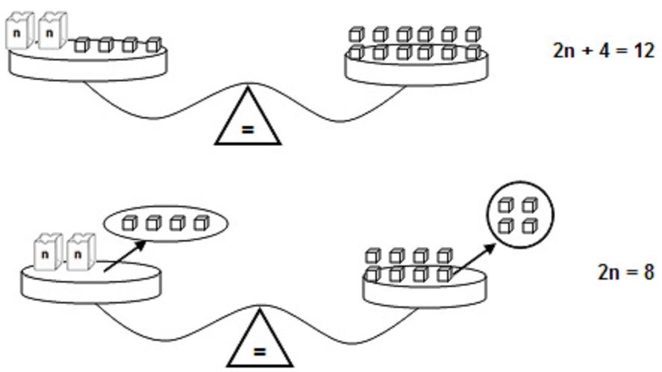

Slide 17
+
+
=

Slide 18
Definitions
Variable
A variable is a letter or symbol that represents a number (unknown quantity).
8 + n = 12

Slide 19
Definitions
A variable can use any letter of the alphabet.
    n + 5
    x – 7
    w - 25

Slide 20
Definitions
Algebraic expression – a group of numbers, symbols, and variables that express an operation or a series of operations.
      m + 8
      r – 3

Slide 21
Words That Lead to Addition
Sum
More than
Increased
Plus
Altogether

Slide 22
Words That Lead to Subtraction
Decreased
Less
Difference
Minus
How many more

Slide 23
Write Algebraic Expressions
for These Word Phrases
Ten more than a number
A number decrease by 5
6 less than a number
A number increased by 8
The sum of a number & 9
4 more than a number

Slide 24
Write Algebraic Expressions
for These Word Phrases
A number s plus 2
A number decrease by 1
31 less than a number
A number b increased by 7
The sum of a number & 6
9 more than a number

Slide 25
Write an Algebraic Expression for These Situations
Scott’s brother is 2 years younger than Scott
The sum of two numbers is 12
The difference between two numbers is 5

Slide 26
Evaluate each algebraic expression when x = 10
x + 8
x + 49
x + x
x - x
x - 7
42 - x

Slide 27
Complete This Table
n | n - 3
5
10
21
32

Slide 28
Complete This Table
x | x + 6
5
10
21
32

Slide 29
Ask students to match each of the following situations with the correct expression:
Harry is twice as old as Noel 4n + 2
Susan has a bag of candy and gave away four 2n
Margot has four packages of hockey
cards and two individual cards n + 2
Harry is two years older than Noel 4 – n
Susan has 4 dolls and gives some away n – 4

Slide 30
Assignment
Write an algebraic expression to represent each pattern rule below:
Double a number
Five more than a number
Three less than a number
A number less than ten
Six more than twice a number
One less than triple a number

Slide 31
Thank You

