Slide 1

General Mathematics
Program: Associate Degree in Education
Course Code: ADE101
Credit Hours: 3 (3,0)
Course Lecturer: Ms. Fehmida Haroon
Review Unit I

Slide 2
What is Addition?
Addition is the result of the joining or combination of two quantities.

Slide 3
Sign of Addition:
Sign of addition is denoted by “+”.
Sign of Equality:
Sign of equality is denoted by “=”.

Slide 4
What is Subtraction?
Subtraction is the result after having had some quantity taken away or separated. Subtraction can also be the difference when two quantities are compared.

Slide 5
Sign of Subtraction:
is denoted by “–”.

Slide 6
What is Multiplication
Sign of multiplication is denoted by “x”.

Slide 7
What is Division
Sign of division is denoted by “÷”.

Slide 8
Fraction is to be considered as parts of things
What is Fraction

Slide 9
Types of Fractions
0
1/2
1
2
Zero Fraction: when top number is zero and bottom number is any number.
Proper Fraction: If top number is smaller than the bottom number the fraction is called proper fraction. This fraction is greater than zero but smaller than one.
  If top number is equal to bottom number than fraction is always one.
Improper fraction: if the top number is greater than the bottom number, a fraction is called improper fraction.

Slide 10
Concept of Tenth’s and Hundredth's
1
10
100
1000

Slide 11
Decimal number is whole number. fractions

Slide 12
Easiest Common Divisor (ECD)

Slide 13
Least Common Multiple (LCM)
Method I

Slide 14
Least Common Multiple (LCM)
Method 2

Slide 15
Highest Common Divisor (HCD)
8,24
9,12

Slide 16

What is percentage?
Percentage is special fraction.
Symbol of Percent?

Slide 17
Ratios
are the comparison of two or more numbers.
Symbol of Ratio

Slide 18
Rate
40 miles/hour 10 meters/second $12/day 5o games/year

Slide 19
Proportions
Two equal ratios form a proportion.

Slide 20
Integers
Integers are whole numbers that describe opposite ideas in mathematics.
Integers can either be negative(-), positive(+) or zero.
The integer zero is neutral. It is neither positive nor negative, but is an integer.
Integers can be represented on a number line, which can help us understand the valve of the integer.

Slide 21
Rules For Adding Integers
Positive Integers
To add two positive integers you add the magnitude and keep the positive sign.
Negative Integers
To add two negative integers you add the magnitude and keep the negative sign.
A Negative and a Positive Integer
To add a positive and a negative integer you subtract the magnitudes and keep the sign of the integer with the largest magnitude.

Slide 22
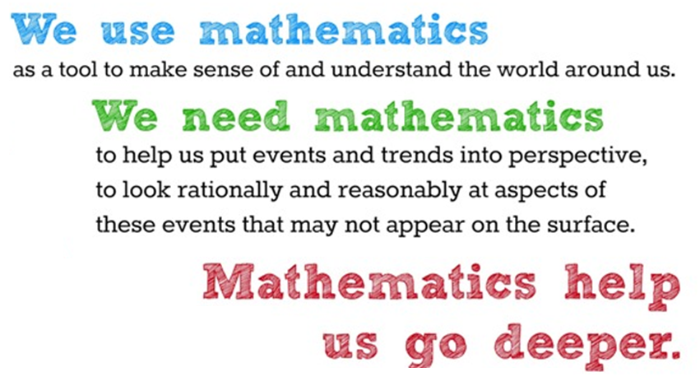

Slide 23
Word Problems
Q. No. 1
Mount Everest is 8848 m high, while mount K-2 is 8611 m high. How much higher is Everest than K-2? What is the height of the two mountains together?

Slide 24
Word Problems
Q. No. 2
In one day, a factory makes 425 school bags. How many
bags will they manufacture in 24 days?

Slide 25
Word Problems
Q. No. 3
How many packs of 4 biscuits can be made with 735 biscuits to be distributed among some children? How many will be leftover?

Slide 26
Word Problems
Q. No. 4
How many packs of 4 biscuits can be made with 735 biscuits to be distributed among some children? How many will be leftover?

Slide 27
Word Problems
Q. No. 5
Mrs. Shah earns Rs.8500 every month from her work as a computer operator if her boss gives her a 10% increase in salary, how much will she now earns every month and how much will she earn every year?

Slide 28
Word Problems
Q. No. 6
3 people, A, B and C, shares $416 among themselves. A receives $169 and B receives $156. Find the ratio in which sum of amount is shared?

Slide 29
Word Problems
Q. No. 7
3 partners of a firm divide the profit of $6720 among themselves in the ratio 2:3:7. What is the biggest share of the profit?

Slide 30
Word Problems
Q. No. 8
The temperature of a piece of meat was -8⁰C when it was taken out of a freezer. After several minutes of warming, its temperature rose by 17⁰C. What was the new temperature of the piece of meat?

Slide 31
Mathematics is not only for solving number.
It‘s also for dividing sorrow, subtracting sadness, adding happiness and multiplying love and forgiveness.

Slide 32
Thank You

