Slide 1

General Mathematics
ADE 101
LECTURE No. 7
Integers & Operations on Integers

Slide 2
Today’s Objectives
Students and Teachers will be able to
Understand integers
Compare two integers
Apply operations on integers

Slide 3
KNOWLEDGE TEST

Slide 4
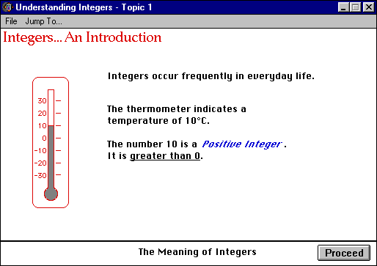

Slide 5
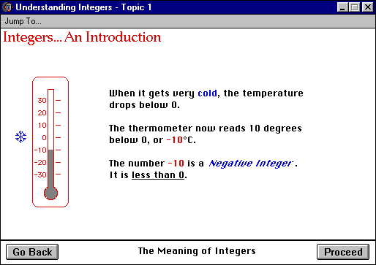

Slide 6
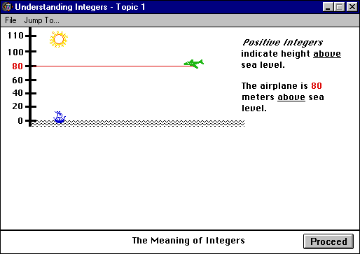

Slide 7
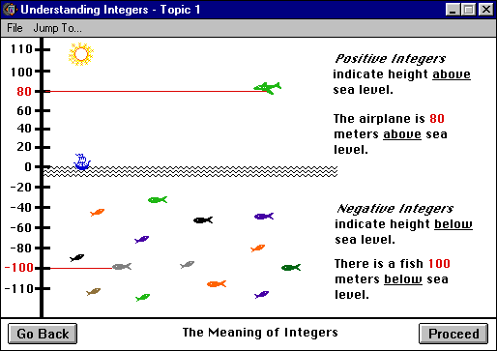

Slide 8
Integers
Integers are whole numbers that describe opposite ideas in mathematics.
Integers can either be negative(-), positive(+) or zero.
The integer zero is neutral. It is neither positive nor negative, but is an integer.
Integers can be represented on a number line, which can help us understand the valve of the integer.

Slide 9
Positive Integers
Are to the right of zero
Are valued greater than zero.
The sign for a positive integer is (+), however the sign is not always needed.
Meaning +3 is the same value as 3.

Slide 10
Negative Integers
Are to the left of zero
Are valued less than zero.
The sign for a negative integer is (-). This sign is always needed.

Slide 11
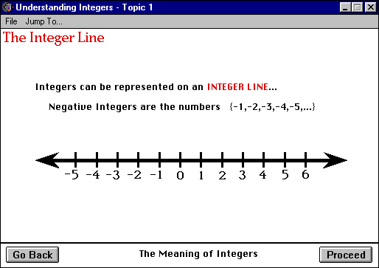

Slide 12
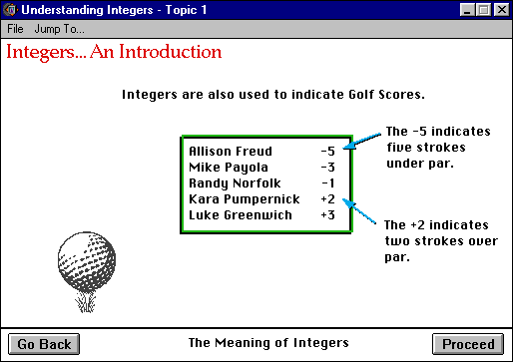

Slide 13
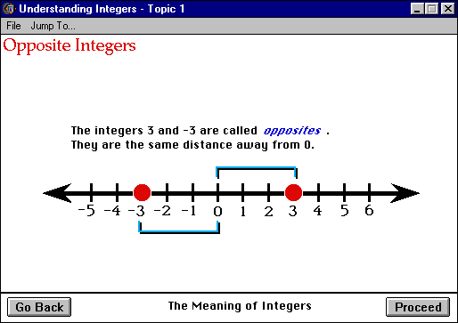
The “net worth” of opposite integers is zero.

Slide 14
Opposite Integers
Opposite integers always have a “net worth” of 0. This is called the ZERO PRINCIPAL.
Opposite integer have the same “absolute value”, meaning the distance from the points on a number line to zero is the same.
This can be referred to as the integers magnitude.

Slide 15
Movement on a Number Line
Magnitude and Direction
Every integer represents a magnitude and a direction.
The integer +3 describes a movement of 3 units in a positive direction.(right)
The sign (+) tells you the direction.
The number (3) indicates how far to move or the Magnitude ( a movement of 3 units)
+ 3
Direction
Magnitude

Slide 16
Comparing Integers
Which integer has a higher value?
-4 or -8

Slide 17
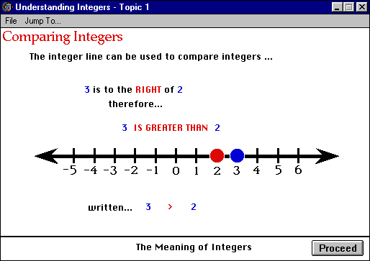

Slide 18
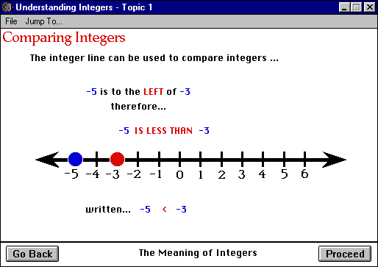

Slide 19
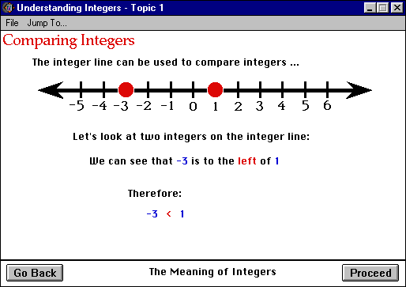
-3 is smaller than 1

Slide 20
Comparing Integers
-5 ___ -8
0 ___ -3
3 ___ +2

Slide 21
Addition and Subtraction of two Integers
“+” Have “– ” Owe
12+7=
12-7=
-12+7=
-12-7=

Slide 22
Addition and Subtraction of two Integers
When there are two signs between two integers;

Slide 23
Rules For Adding Integers
Positive Integers
To add two positive integers you add the magnitude and keep the positive sign.
Negative Integers
To add two negative integers you add the magnitude and keep the negative sign.
A Negative and a Positive Integer
To add a positive and a negative integer you subtract the magnitudes and keep the sign of the integer with the largest magnitude.

Slide 24
Multiplication and Division of two Integers

Slide 25
Rules for
Multiplication and Division of two Integers

Slide 26
Multiplying Integers
FACTOR | FACTOR | PRODUCT
+ | + | +
_ | _ | +
_ | + | _
+ | _ | _

Slide 27
Dividing Integers
DIVIDEND | DIVISOR | QUOTIENT
+ | + | +
_ | _ | +
_ | + | _
+ | _ | _

Slide 28
Assignment
(-8) – (-3) =
(+4) – (-5) =
(-4) – (-5) =
(+1) – (-6) =
(-5) – (+6) =
(-2) – (-3) =
(-20) – (-10) =
(+30) – (-3) =
(-20) – (-30) =

Slide 29
Assignment
(-3) – (-2) =
(+6) – (-2) =
(-1) – (-4) =
(+3) – (-2) =
(-5) – (+2) =
(-2) – (-4) =
(-30) – (-20) =
(+50) – (-10) =
(-20) – (-30) =

Slide 30
Assignment
(-5) + (+2) =
(+6) + (-2) =
(-2) – (-6) =
(+7) + (-2) =
(-5) + (+2) =
(+8) + (-4) =
(-3) – (+6) =
(+50) – (-10) =
(-20) + (-30) =

Slide 31
Assignment
(-5) + (+2) = -3
(+6) + (-2) = +4
(-2) – (-6) = +4
(+7) + (-2) = +5
(-5) + (+2) = -3
(+8) + (-4) = +4
(-3) – (+6) = -9
(+50) – (-10) = +60
(-20) + (-30) = -50

Slide 32
Assignment
(+3) x (-2) =
(-2) x (-2) =
(+5) x (-2) =
(-3) x (+2) =
(+3) x (+4) =
(+3) x (-2) =

Slide 33
Assignment
(-91) x (-101) =
(+152) x (-21) =
(-19) x (+203) =
(-69) x (-102) =
(-62) x (-11) =
(-128) x (+12) =

Slide 34
Assignment
(-91) x (-101) =
(+152) x (-21) =
(-19) x (+203) =
(-69) x (-102) =
(-62) x (-11) =
(-128) x (+12) =

Slide 35
Thank You

