Slide 1

General Mathematics
ADE 101
LECTURE No. 4
Decimals, Mixed Numbers
Concept of GCF and LCM

Slide 2
Today’s Objectives
Students and Teachers will be able to
Get the concept of place value
Understand decimals and mixed numbers
Learn LCM and HCD

Slide 3
KNOWLEDGE TEST

Slide 4
Building Blocks

Slide 5
Place Value
1 |  | 3 |  | One's Place
10 |  | 5 |  | Ten's Place
100 |  | 2 |  | Hundred's Place
1000 |  |  |  | Thousand's Place
H
T
O
2 5 3

Slide 6
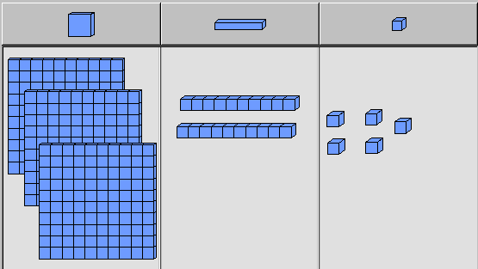
Place Value
Use Blocks to represent a number
325

Slide 7
Concept of Tenth’s and Hundredth's
0
1
2
3
4
5

Slide 8
Concept of Tenth’s and Hundredth's
1
10
100
1000

Slide 9
1.0
1 whole

Slide 10
0.1
one tenth
1/10

Slide 11
0.01
one
hundredth
1/100

Slide 12
Example

Slide 13
Decimal number is whole number. fractions

Slide 14
Converting Base Ten Fractions

Slide 15
Converting Base Ten Fractions

Slide 16
Convert Decimal into Fraction
0.5
0.29
0.345
0.5746

Slide 17
Converting Fraction into Decimals

Slide 18
Converting Fraction into Decimals

Slide 19
Mixed Numbers
0
1
2
Improper Fractions
0
1
2

Slide 20
Mixed Numbers
0
1
2

Slide 21
Mixed Numbers
0
1
2

Slide 22
Mixed number is the combination of whole number and a proper fraction.

Slide 23
Procedure to Convert Mixed Numbers into Improper Fractions

Slide 24
Procedure to Convert Mixed Numbers into Improper Fractions

Slide 25
Easiest Common Divisor (ECD)

Slide 26
Least Common Multiple (LCM)
Method I

Slide 27
Least Common Multiple (LCM)
Method 2

Slide 28
Highest Common Divisor (HCD)
3,4
8,24
9,12

Slide 29
Highest Common Divisor (HCD)

Slide 30
Assignments

Slide 31
Assignments

Slide 32
Thank You

