Slide 1

General Mathematics
ADE 101
LECTURE No. 32
Review

Slide 2
Effective Mathematics Teaching and Learning
Mathematics classrooms must be challenging and engaging environments for all students, where students learn significant mathematics.
Students are called to engage in solving rich and relevant problems. These problems offer several entry points so that all students can achieve, given sufficient time and support.
Lessons are structured to build on students’ prior knowledge.

Slide 3
Models help students explore concepts and build understanding
Models provide a context for students to solve problems and explain reasoning
Models provide opportunities for students to generalize conceptual understanding

Slide 4
Students develop their own varied solutions to problems and thus develop a deeper understanding of the mathematics involved.
Students consolidate their knowledge through shared and independent practice.
Teachers select and/or organize students’ solutions for sharing to highlight the mathematics learning.
Teachers need specific mathematics knowledge and mathematics pedagogy to teach effectively.

Slide 5
Subtraction
Subtraction begins by children literally taking away with objects.
This then progresses to counting backwards on the number line.
FIND THE DIFFERENCE SHOULD BE INTRODUCED HERE!
Children SHOULD then progress to counting FORWARD on the number line.

Slide 6
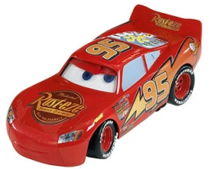
Subtraction
Using objects.
take away
makes

Slide 7
Subtraction
Number Line
“What is 23 take away 8?”
-1
-1
-1
-1
-1
-1
-1
-1
15
16
17
18
19
20
21
22
23

Slide 8
Subtraction
Number Line Stage 2
“What is 23 take away 8?”
-5
-3
15
16
17
18
19
20
21
22
23

Slide 9
Division
Sharing Or Grouping
These tend to be the classic early models of division. They are slightly different.
I will model the difference on the flip chart.

Slide 10
Division
Sharing With Objects, Grouping With Cups
It can help for children’s general development to experience both models of early division.
Sharing can be easily be modelled with counters, sweets and the like.

Slide 11
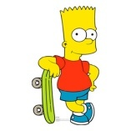


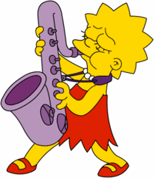


Division
Sharing With Objects
It can help for children’s general development to experience both models of early division.
Sharing can be easily be modelled with counters, sweets and the like.
For example: 32 ÷ 6.

Slide 12
Division
Grouping With Cups
This involves how many groups of the divisor can be made.
For example: 32 ÷ 6.
(This is best done with a practical model)

Slide 13
Work out the total number of shapes:

Slide 14
Work out the total
Circle = 1
Rectangles = 4
Triangles = 5
Squares = 9
TOTAL = 19

Slide 15
Work out the total
15

Slide 16
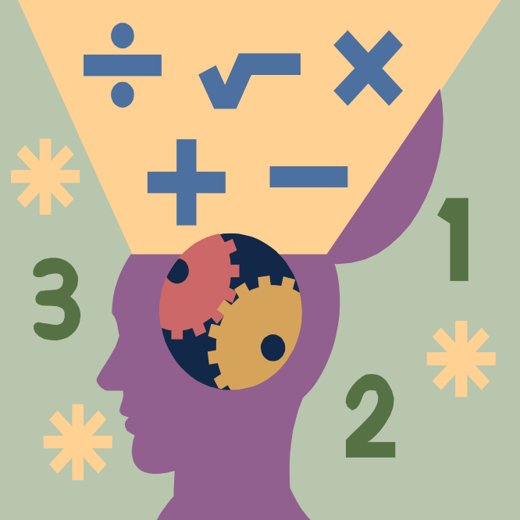
Models that Make Math Meaningful

Slide 17

Fraction Models
Models for Multiplication
Models for Division
Decimals, Ratio & Percent

Slide 18
Sketch what you first see
One-half
Two-thirds
Three-fourths
Three-fifths
One-sixth
Two and a quarter
Two and two-thirds

Slide 19
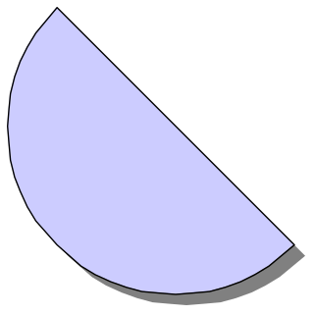
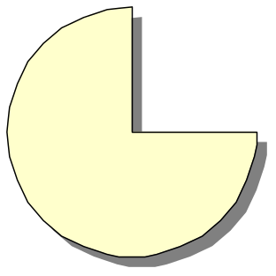
Sketch what you first see
One-half
Two-thirds
Three-fourths

Slide 20
Sketch what you first see
Three-fifths
One-sixth

Slide 21
Sketch what you first see
Two and a quarter
Two and two-thirds

Slide 22
What fraction is blue?

Slide 23
Part of a Set
3 of 13 pieces

Slide 24
Part of an Area
6 of 36 triangles

Slide 25
Part of an Area
1 of 6 hexagons

Slide 26
Part of an area
Blue is 1/3 of largest piece

Slide 27

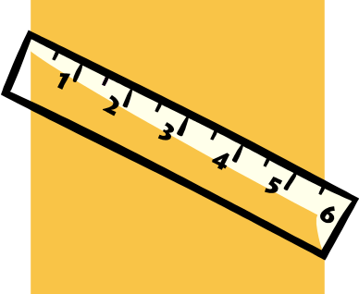
Fraction Models
Part of a Whole
Set
Area or region
  Circles
  Clocks
  Rectangles
  Pattern blocks
  Strips
Length
  Number line
  Ruler

Slide 28
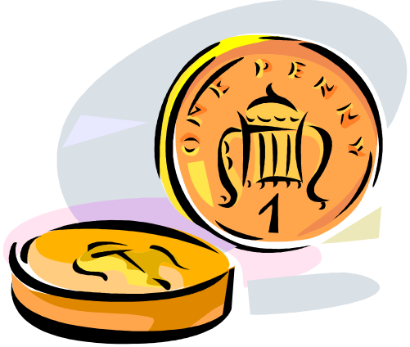

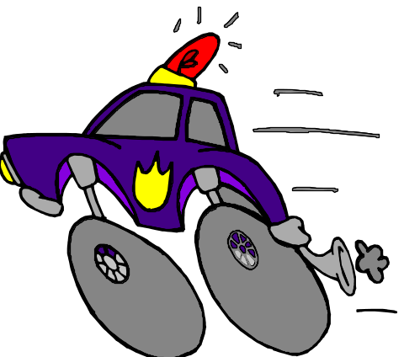

Other Meanings for Fractions
Part-whole
  Values - eg, money
Division
Ratio
Rate
Wins
Losses

Slide 29
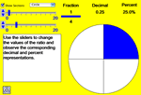

Web Resources
Fraction model applet
Equivalent fractions
Fraction game

Slide 30
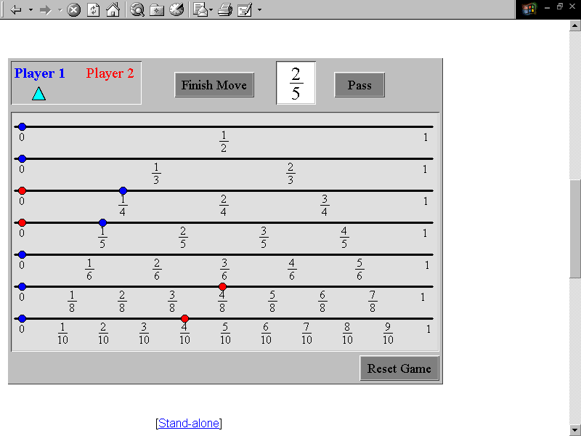
Playing Fraction Tracks
Notes:
PURPOSE : Show how a game can engage students in using their understanding of concepts
SPEAKING POINTS
This task motivates students to think about the relationship of different fractions to the unit whole, compare fractional parts of a whole, and find equivalent fractions.
The goal is to move all of one’s markers to the right side of the fraction track board. On each move, the player is allowed to move one or more of the blue markers along the track so that all of the markers moved are equivalent to the amount shown in the fraction box. Clicking on “Finish Move” either lets the other player take a turn or returns all of the markers to their original position if the move was not correct.
REFERENCES
Principles and Standards, pp. 194-199

Slide 31
Make a triangle that is:
¼ green and ¾ red
1/3 red and 2/3 green

Slide 32
Computational Fluency
7 x 20 is 140 and 7 x 8 is 56 56 + 140 is 196
I thought seven
25’s - that’s 175.
Then I need seven 3’s or 21. So the answer is 175 + 21 = 196
7 x 28
I did 7 x 30 first. That’s 210. Then take off seven 2’s or 14. So it’s 196.
Notes:
PURPOSE: An example of students’ strategies developing different models for multiplication that support the development of computational fluency
SPEAKING POINTS
Students exhibit computational fluency when they have flexibility in the computational methods they choose, understand and can explain the methods, and efficiently produce accurate answers. These methods for students in grades 3-5 should be based on the structure of the base-ten number system, properties of multiplication, and division and number relationships.
Fluency with whole-number computation depends on fluency with basic number combinations single-digit addition and multiplication pairs and their counterparts for subtraction and division. Fluency develops from understanding the meaning of the four operations and focusing on the development of strategies based on understanding.
REFERENCES
Principles and Standards: pp. 148-156

Slide 33
Using Base Ten Blocks to Multiply
24
x 3
12
60
72

Slide 34
Make an Array
24
x 3
12
60
72

Slide 35
Draw a picture that shows

Slide 36
Array
2 of 3 rows
3 of 4 in each row

Slide 37
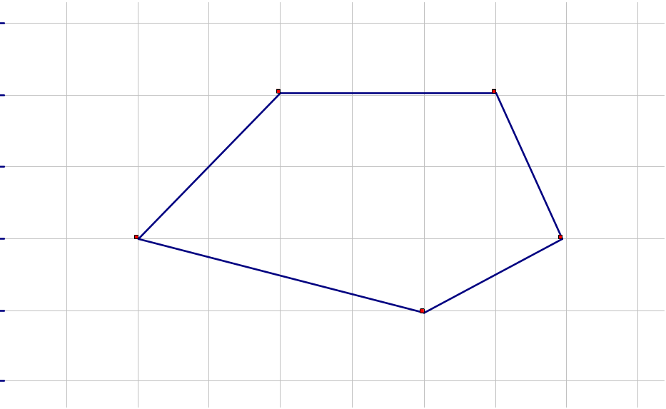
Side trip to Geometry - Area
Counting squares on a grid
What’s the area?

Slide 38
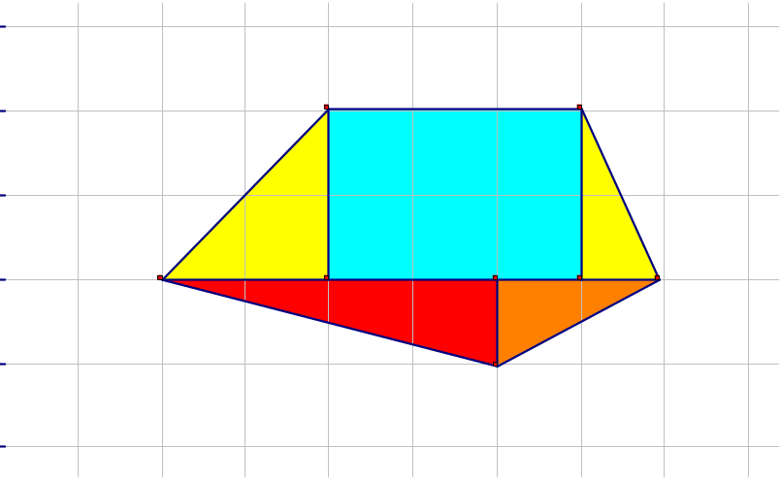
Break it up
Yellow (L) = ½ x 4 = 2
Blue = 2 x 3 = 6
Yellow (R) = ½ x 2 = 1
Orange = ½ x 2 = 1
Red = ½ x 4 = 2
2 + 6 + 1 + 1 + 2
= 12 square units

Slide 39
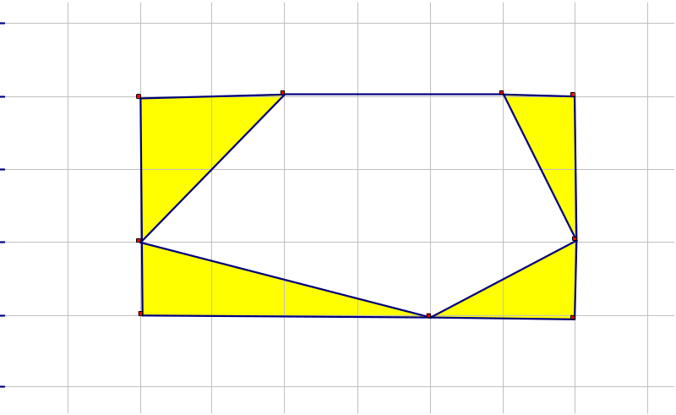
Make a Rectangle
Area of rectangle
= 3 x 6 = 18 squares
Areas of triangles
UL: ½ x 4 = 2
UR: ½ x 2 = 1
LL: ½ x 4 = 2
LR: ½ x 2 = 1
Total = 6 squares
Area of pentagon
= 18 – 6 = 12 sq.

Slide 40
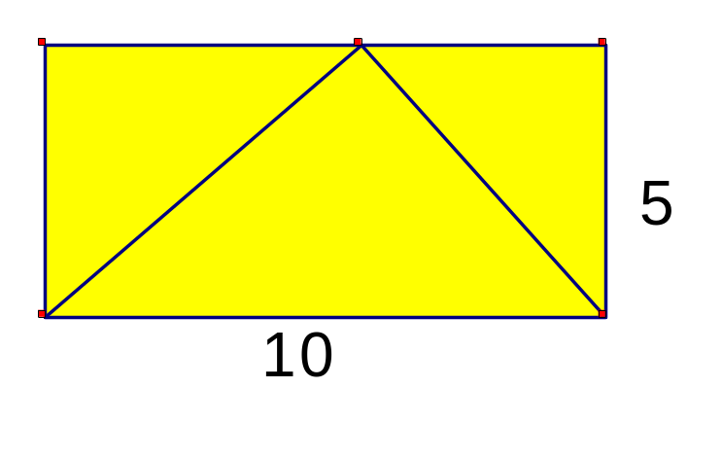
So?
Find the area of a triangle with base 10 and height 5.
Area = (10 x 5) / 2
= 25 sq. units

Slide 41
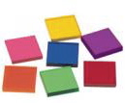
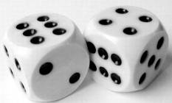
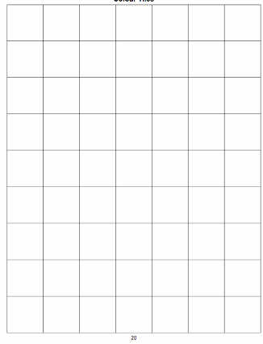
Warm Up – Race to Take Up Space
Goal: To cover the game board with rectangles
Players: 2 (individual) to 4 (teams of 2)
Materials: 7x9 square tiles grid game board, 32 same-
colour square tiles per player, 2 dice
How to Play:
Take turns rolling the dice to get 2 numbers.
Multiply the 2 dice numbers to calculate the area of a
rectangle (e.g., 4, 6 → area = 24 square units).
Construct a rectangle of the area calculated, using
square tiles of the same colour.
Place your rectangle on the game board.
Lose a turn if the rectangle you constructed cannot
be placed on the empty space on the game board.
The game ends when no more rectangles can be
placed on the game board. Which player is left with the most tiles?

Slide 42
Working on It – Carpet Problem
Hello students,
The carpet you have been asking for arrives tonight. Please clear a space in your room today that will fit this new carpet. The perimeter of the carpet is 12 m.
From your principal
What is the problem to solve?
Why is this problem a problem?
Show two different ways to solve this carpet problem.
How do you know we have all the possible solutions?

Slide 43
Warm Up – The Size of Things
How do the areas of the items compare?
How do you know?
1. Examine the cards in the envelope on your table.
Order the items on the cards from smallest to largest area.
How do you know that your order is accurate?
3. Compare the order of your cards with that of another group at your table.
4. Discuss any differences you observe.
a five-dollar bill
a credit card
a cheque
an envelope

Slide 44
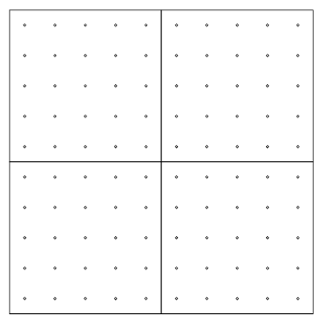
Working on It – 4 Square Units Problem
Show as many polygons as possible
that have an area of 4 square units.
a) Create your polygons on a geoboard.
b) Record them on square dot paper.
c) Label the polygons by the number of sides (e.g., triangle, rectangle, quadrilateral, octagon).
d) Show how you know that each of your polygons are 4 square units.

Slide 45
Working on It continued
What could a polygon look like that is
a) 1 square unit?
b) 2 square units?
a) one square unit
b) two square units
2. a) What is the area of this polygon?
b) How can you reason about
half-square units?

Slide 46
Working on It continued
Show as many polygons as possible that have an area of 4 square units.
  Create your polygons on a geoboard.
  Record them on square dot paper.
  Label the polygons by the number of sides (e.g., triangle, rectangle, quadrilateral, octagon).
  Show how you know that each of your polygons is 4 square units.

Slide 47
Constructing a Collective Thinkpad
Bansho as Assessment for Learning
Organize student solutions to make explicit the mathematics inherent in this problem. Solutions that show similar mathematical thinking are arranged vertically to look like a concrete bar graph.
Squares
Rectangles
Polygons (composed of rectangles): octagons, hexagons, and so on
Parallelograms, and so on
Triangles
Polygons (composed of other polygons): hexagons, and so on

Slide 48
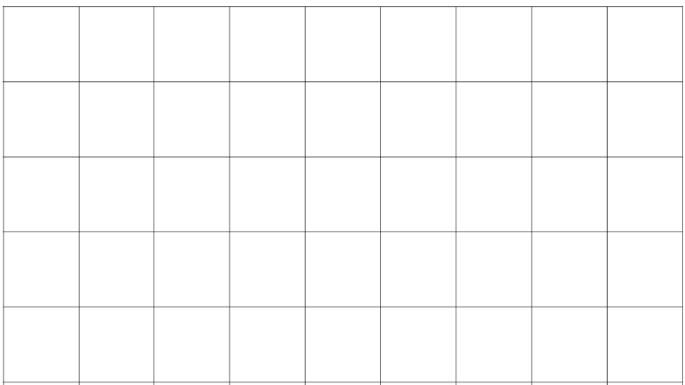
Warm Up – Composite Shape Problem
What could a composite shape look like that …
has an area of 4 square units?
is composed of 3 rectangles (Grade 5)?
is composed of at least one rectangle, one triangle, and one parallelogram (Grade 6)?
1. Draw and describe at least one composite shape that meets these criteria.
2. Explain the strategies you used to create each composite shape.
3. Justify how your composite shape meets the criteria listed in the problem.

Slide 49
Working on It – L-shaped Problem
4 cm
1. What is the area of this shape?
a) Show at least 2 different
solutions.
b) Explain the strategies used.
2. For Grade 5:
a) Use only rectangles.
b) What is the relationship between the side lengths and
the area of the rectangle?
For Grade 6:
a) Use only triangles.
b) What is the relationship between the area of a rectangle and the area of a triangle?
8 cm
4 cm
6 cm

Slide 50

“Understanding is the key to remembering what is learned and being able to use it flexibly.

Slide 51
Thank You

