Slide 1

General Mathematics
ADE 101
Unit 4
LECTURE No. 31
MEAN MEDIAN MODE AND RANGE

Slide 2
Today’s Objectives
Students and Teachers will be able to
UNDERSTAND WHAT IS MEAN,MEDIAN, MODE AND RANGE
CALCULATE MEAN,MEDIAN,MODE AND RANGE

Slide 3
Knowledge Test

Slide 4
These are Amar’s science test scores
86
97
84
73
88
63
97
100
95

Slide 5
What can you tell us about these numbers?
86
97
84
73
63
88
97
100
95

Slide 6

Let's define these words &
learn how to find them.

Slide 7
Measures of Central Tendency
Circle the measures of central tendency below.
(Hint: There are only 3 measures of central tendency.)
Mode
Mean
Range
Median

Slide 8


Slide 9
What is the MEAN?
How do we find it?
The mean is the numerical average of the data set.
The mean is found by adding all the values in the set, then dividing the sum by the number of values.

Slide 10
Lets find AMAR’s MEAN science test score?
97
84
Add all
the values.
88
100
95
63
Divide the sum
by the number
of values.
73
783
9
86
÷
+
97
The mean is 87
783

Slide 11
What is the MEDIAN?
How do we find it?
The MEDIAN is the number that is in the middle of a set of data
Arrange the numbers in the set in order from least to greatest.
Then find the number that is in the middle.

Slide 12
Arrange values from least to greatest
63
73
88
95
97
10
84
86
97
Find the number that is in the middle.
The median is 88.
Half the numbers are
less than the median.
Half the numbers are
greater than the median.

Slide 13

Median
Sounds like
MEDIUM
Think middle when you hear median.
large
medium
small

Slide 14
How do we find the MEDIAN when two numbers are in the middle?
1. Add the two numbers.
2. Then divide by 2.

Slide 15
Arrange values from least to greatest
63
88
95
97
100
73
84
97
There are two numbers in the middle.
Add the 2 numbers.
Divide by 2.
88 + 95 = 183
183
÷
2
The median is
91.5

Slide 16
What is the MODE?
How do we find it?
The MODE is the piece of data that occurs most frequently in the data set.
A set of data can have:
  One mode
  More than one mode
  No mode

Slide 17
Arranging values from least to greatest
makes it easier to find the mode.
63
73
88
95
97
100
84
86
97
Find the number that appears more or most frequently.
The value 97 appears twice.
All other numbers appear just once.
97 is the MODE

Slide 18
MODE
A Hint for remembering the MODE…
The first two letters give you a hint… MOde
Most Often
MODE
MOST OFTEN

Slide 19
Which set of data has ONE MODE?
9, 11, 16, 6, 7, 17, 18
A
B
18, 7, 10, 7, 18
C
9, 11, 16, 8, 16

Slide 20
Which set of data has NO MODE?
9, 11, 16, 6, 7, 17, 18
A
B
18, 7, 10, 7, 18
C
13, 12, 12, 11, 12

Slide 21
Which set of data has
MORE THAN ONE MODE?
9, 11, 16, 8, 16
A
B
9, 11, 16, 6, 7, 17, 18
C
18, 7, 10, 7, 18

Slide 22
What is the RANGE?
How do we find it?
The RANGE is the difference between the lowest and highest values.
largest number
smallest number
-
RANGE

Slide 23
Arranging values from least to greatest
makes it easier to find the RANGE.
63
95
97
97
73
84
86
88
Subtract the lowest value from the highest.
97
63
34
34 is the RANGE
or spread
of this set of data

Slide 24
What is the RANGE of this set of data?
48
86
84
99
97
71
88

Slide 25
What is the RANGE of this set of data?
48
71
84
86
88
97
99
99
48
51

Slide 26
What is the RANGE of this set of data?
17
48
46
33
15
67
85

Slide 27
What is the RANGE of this set of data?
15
17
33
46
48
67
85
85
15
70

Slide 28
What is the RANGE of this set of data?
267
119
357
329
401
227
483

Slide 29
What is the RANGE of this set of data?
119
227
267
329
357
401
483
483
119
364

Slide 30



Mean
This one is the requires more work than the others.
Median
Right in the MIDDLE.
This one is the easiest to find— Just LOOK.
Mode

Slide 31
Matching!
Mean
Middle
Median
Difference
Mode
Most
Range
Average

Slide 34
Problem 1
Children | Ages
Andrew | 13
Robin | 6
Betty | 7
Orlando | 6
Amy | 13
Mean = 9
Median = 7
Mode = 6 and 13
Range = 7

Slide 35
Problem 2
Homerooms | Pizza Orders
Moore | 13
Ragland | 7
McNeill | 17
Pettus | 19
Powell | 7
McConahey | 15
Crews | 11
Clarke | 7
Mean = 12
Median = 12
Mode = 7
Range = 12

Slide 36
Problem 3
Visitors to the Art Museum (thousands)
3 11 5 4 5 3 6 3 12 2 2 4
Mean = 5,000
Median = 4,000
Mode = 3,000
Range = 10,000

Slide 37
Problem 4
Snowfall in Inches
2 6 5 4
3 0 1
Mean | 3 inches
Median | 3 inches
Mode | none
Range | 6 inches

Slide 38
Problem 5
Quiz Grades
72 60 80 68
72 86
Mean | 73
Median | 72
Mode | 72
Range | 26

Slide 39
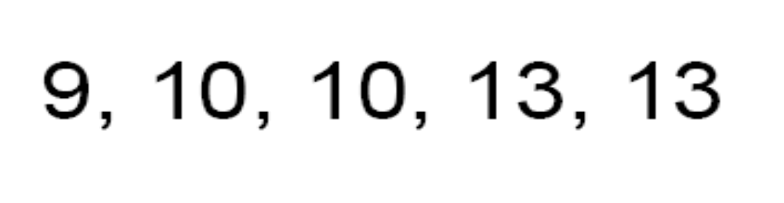
Find the….
Mean
Median
Mode

Slide 40
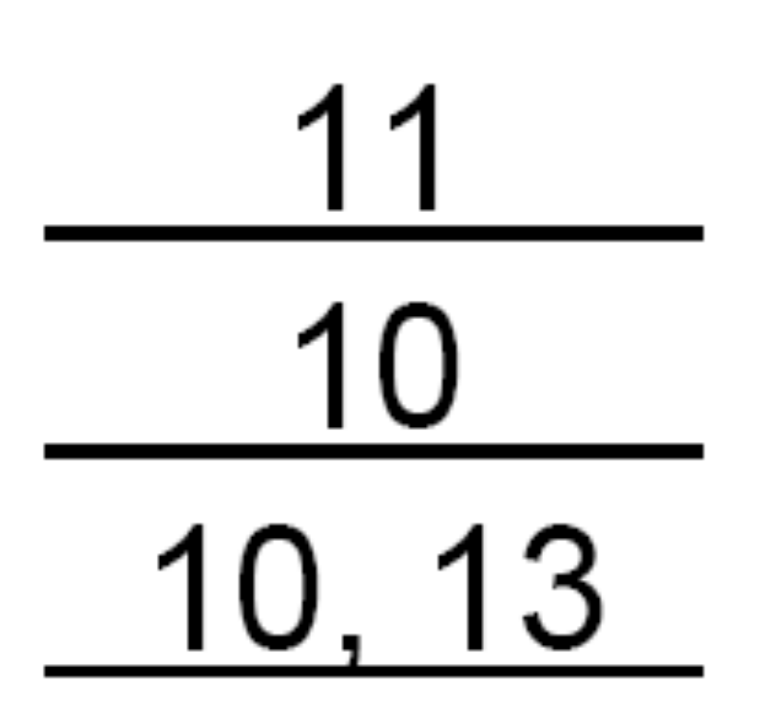
Mean
Median
Mode

Slide 41
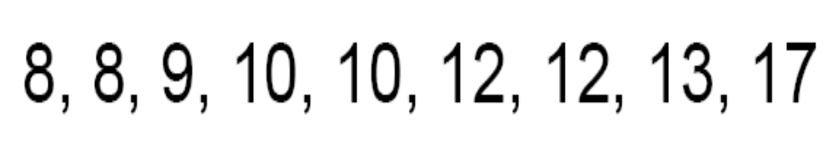
Find the….
Mean
Median
Mode

Slide 42
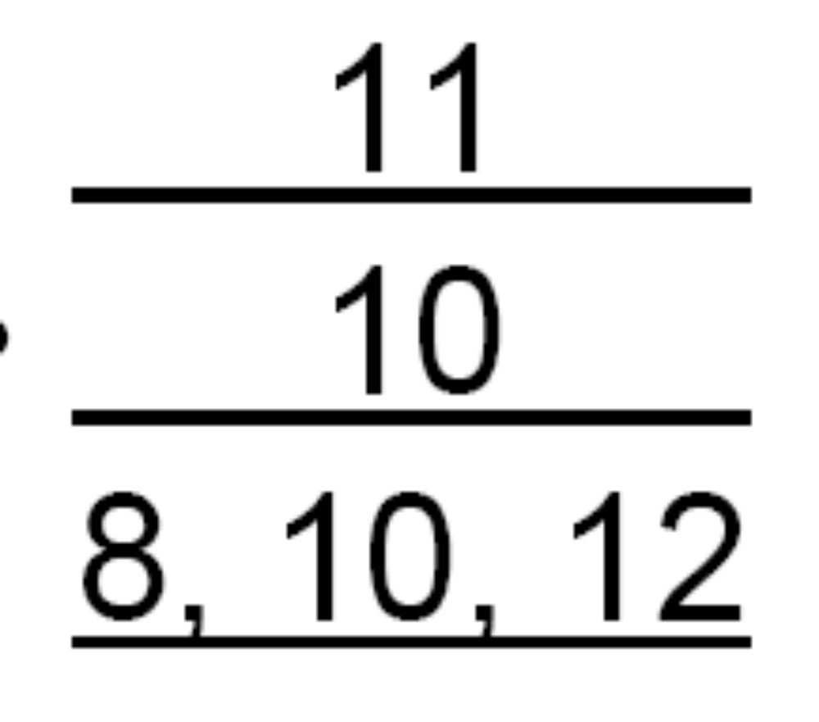
Mean
Median
Mode

Slide 43
Find the….
Mean
Median
Mode
& Range

Slide 44
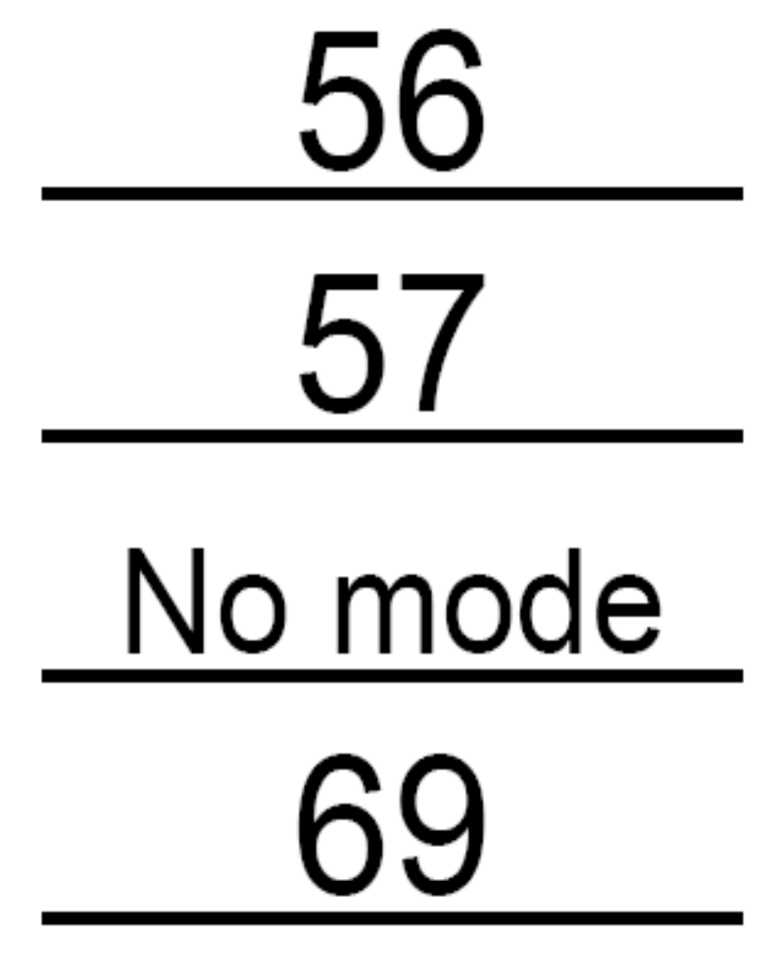
Mean
Median
Mode
Range

Slide 45
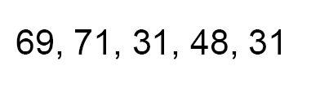
Find the….
Mean
Median
Mode
& Range

Slide 46
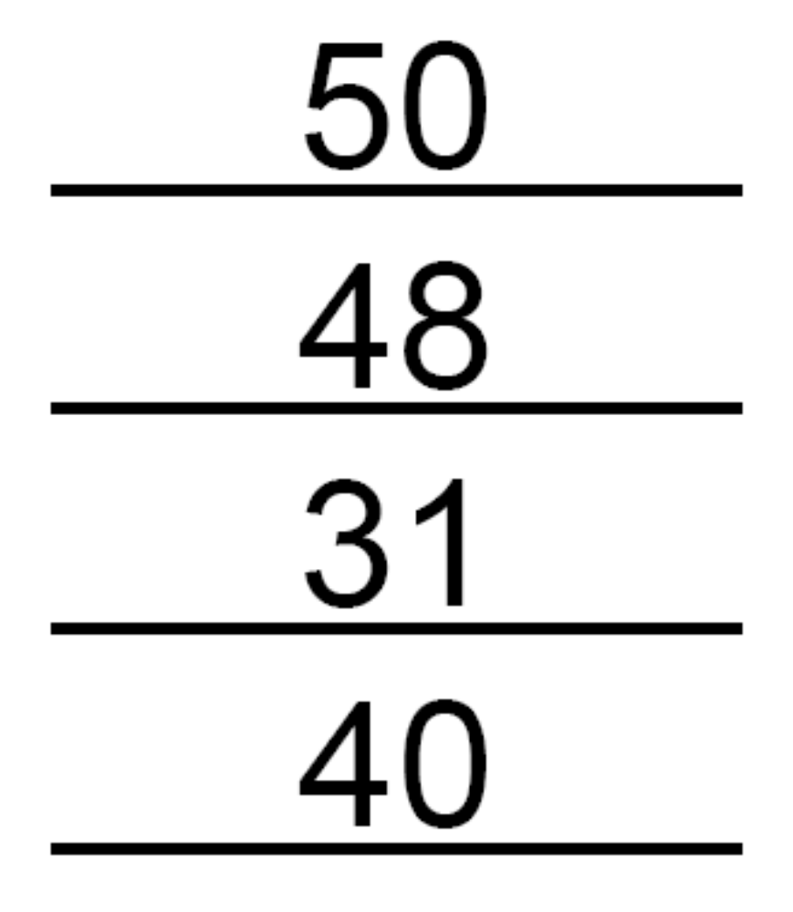
Mean
Median
Mode
Range

Slide 47

Find the….
Mean
Median
Mode
& Range

Slide 48
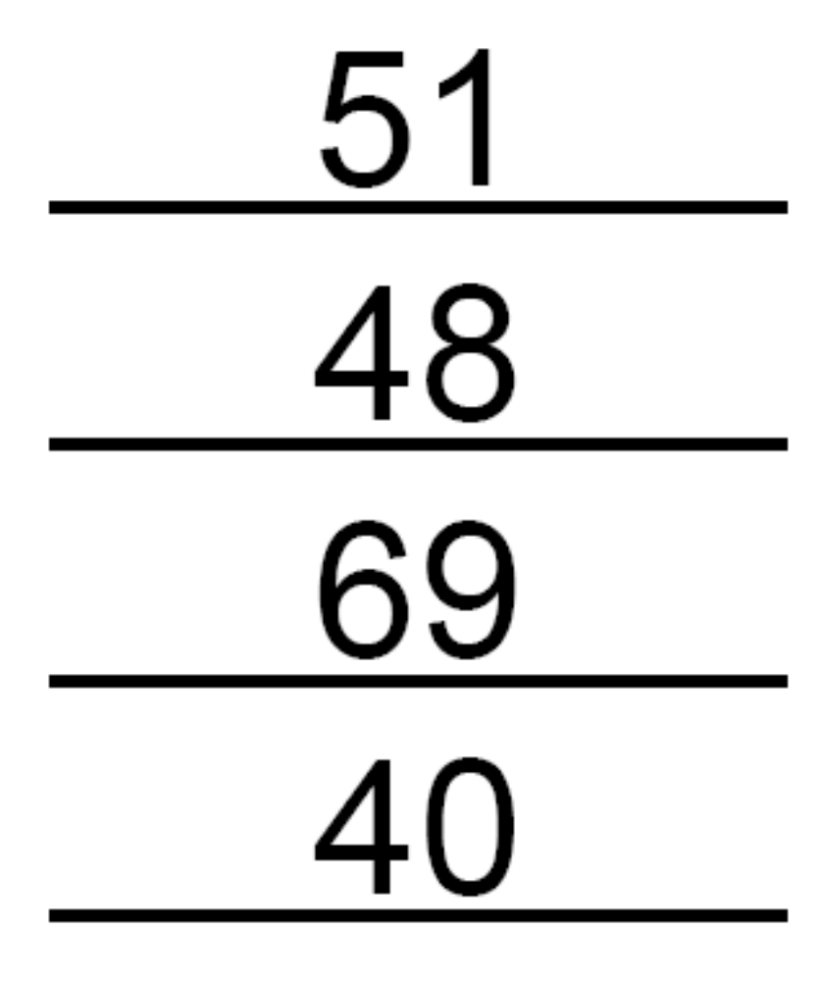
Mean
Median
Mode
Range

Slide 49
Thank You

