Slide 1

General Mathematics
ADE 101
Unit 4
LECTURE No. 30
FREQUENCY TABLE AND HISTOGRAM

Slide 2
Today’s Objectives
Students and Teachers will be able to
Learn about the formation of frequency table
Represent frequency distribution on histogram

Slide 3
Knowledge Test

Slide 4
Warm Up
Create a bar graph of the data
Favorite rides at fair:
Ferris wheel = 5,
loop the loop = 4,
merry-go-round = 3, bumper cars = 7,
sit and spin = 9

Slide 5
Students in Mr. Ray’s class recorded their fingerprint patterns. Which type of pattern do most students in Mr. Ray’s class have?
whorl loop whorl loop
arch arch loop whorl
loop arch whorl arch
arch whorl arch loop
Make a tally table to organize the data.

Slide 6
Reading Math
A group of four tally marks with a line through it means five. t llll = 5 llll llll = 10

Slide 7
Students in Mr. Ray’s class recorded their fingerprint patterns. Which type of pattern do more students in Mr. Ray’s class have?
whorl loop whorl loop
arch arch loop whorl
loop arch whorl arch
arch whorl arch loop
Step 1: Make a column for each fingerprint pattern.
Step 2: For each fingerprint, make a tally mark in the appropriate column.
Number of Fingerprint Patterns
Whorl | Arch | Loop
Most students in Mr. Ray’s class have an arch fingerprint.
l l l l l l l l l l l l l

Slide 8
Check It Out
Students in Ms. Sara’s class recorded their fingerprint patterns. Which type of pattern do more students in Ms. Gracie’s class have?
whorl loop whorl loop
arch whorl loop whorl
loop whorl whorl arch
arch whorl arch loop
Make a tally table to organize the data.

Slide 9
Check It Out
Students in Ms. Sara’s class recorded their fingerprint patterns. Which type of pattern do more students in Ms. Gracie’s class have?
whorl loop whorl loop
arch whorl loop whorl
loop whorl whorl arch
arch whorl arch loop
Step 1: Make a column for each fingerprint pattern.
Step 2: For each fingerprint, make a tally mark in the appropriate column.
Number of Fingerprint Patterns
Whorl | Arch | Loop
Most students in Ms. Gracie’s class have a whorl fingerprint.
l l l l l l l l l l l l l l

Slide 10
A line plot uses a number line and x’s or other symbols to show frequencies of values.

Slide 11
Students collected tennis balls for a project. The number of balls collected by the students is recorded in the table. Make a line plot of the data.
Tennis Balls Collected
10 | 14 | 11 | 16 | 11 | 10
14 | 10 | 15 | 15 | 10 | 11
Step 1: Draw a number line.
x x x x
x x x
Step 2: For each tennis ball, use an x on the number line to represent how many were collected.
x x
x x
x
5 6 7 8 9 10 11 12 13 14 15 16

Slide 12
Check It Out
Students collected aluminum cans for a project. The number of cans collected by the students is recorded in the table. Make a line plot of the data.
Cans Collected
5 | 7 | 11 | 14 | 11 | 5
7 | 14 | 14 | 5 | 15 | 11
Step 1: Draw a number line.
x x x x
x x x
Step 2: For each aluminum can, use an x on the number line to represent how many were collected.
x x
x x
x
5 6 7 8 9 10 11 12 13 14 15 16

Slide 13
Frequency Tables
Statistics deals with collecting, organizing, and interpreting data. Data are pieces of information, which are often numerical. Large amounts of data can be organized in a frequency table. A frequency table shows the number of pieces of data that fall within given intervals.

Slide 14
A frequency table tells the number of times an event, category, or group occurs.

Slide 15
Make a frequency table
STEP-1
Choose an appropriate interval and scale. Should include the least and the greatest value.
STEP 2
Draw a table with 3 columns and label the columns.
STEP 3
Complete the table.

Slide 16
Frequency Tables
Words to Know
Shows the number of pieces of data that fall within given intervals.
Price $ | Tally | Frequency
1-25 |  | 4
26-50 |  | 11
51-75 |  | 7
76-100 |  | 13
Scale- includes the least value and greatest value
Interval- Separates the scale into equal parts

Slide 17
Making a Frequency Table with Intervals
Use the data in the table to make a frequency table with intervals.
Pages Read per Student Last Weekend
12 | 15 | 40 | 19 | 7
5 | 22 | 34 | 37 | 18

Slide 18
Use the data in the table to make a frequency table with intervals
Pages Read per Student Last Weekend
Number | 1–10 | 11–20 | 21–30 | 31–40
Frequency
2 4 1 3
Step 1: Choose equal intervals.
Step 2: Find the number of data values in each interval. Write these numbers in the “Frequency” row.
This table shows that 2 students read between 1 and 10 pages, 4 students read between 11 and 20 pages, 1 person read between 21 and 30 pages, and 3 people read between 31 and 40 pages last weekend.

Slide 19
Use the data in the table to make a frequency table with intervals.
Number of Miles Driven per Person on Saturday
17 | 29 | 9 | 19 | 7
5 | 27 | 34 | 21 | 38

Slide 20
Use the data in the table to make a frequency table with intervals.
Number of Miles Driven per Person on Saturday
Number | 1–10 | 11–20 | 21–30 | 31–40
Frequency
3 2 3 2
Step 1: Choose equal intervals.
Step 2: Find the number of data values in each interval. Write these numbers in the “Frequency” row.
This table shows that 3 people drove between 1 and 10 miles, 2 people drove between 11 and 20 miles, 3 people drove between 21 and 30 miles, and 2 people drove between 31 and 40 miles on Saturday.

Slide 21
Example
Scores | Tally | Frequency
Winning Score
20 34 23 34
31 35 27 49
30 52 37 20
55 20 42 39
46 38 38 27
20 - 29
6
30 - 39
9
40 - 49
3
50 - 59
2

Slide 22
Histogram
Histogram is a bar graph that shows the frequency of data within equal intervals.
There is no space in between the bars.

Slide 23
A Histogram is a bar graph that shows the number of data items that occur within each interval.

Slide 24
How to make a histogram?

Slide 25
The table below shows the number of hours students watch TV in one week Make a histogram of all the data.
Number of hours of TV
III | 6 | II | 1
IIII - IIII | 7 | IIII | 2
III | 8 | IIII - IIII | 3
IIII | 9 | IIII - I | 4
 |  | IIII - III | 5

Slide 26
Step 1
Make a frequency table of the data. Be sure to use equal intervals
Frequency | Number of hours of TV
15 | 1-3
17 | 4-6
16 | 7-9
Number of hours of TV
III | 6 | II | 1
IIII - IIII | 7 | IIII | 2
III | 8 | IIII - IIII | 3
IIII | 9 | IIII - I | 4
 |  | IIII - III | 5

Slide 27
Step 2
Choose an appropriate scale and interval for the vertical axis. The greatest value on the scale should be at least as great as the greatest frequency.
Frequency | Number of hours of TV
15 | 1-3
17 | 4-6
16 | 7-9

Slide 28
Step 3
Draw a bar for each interval. The height of the bar is the frequency for that interval. Bars must touch but not overlap.
Label the axes and give the graph title
Frequency | Number of hours of TV
15 | 1-3
17 | 4-6
16 | 7-9

Slide 30
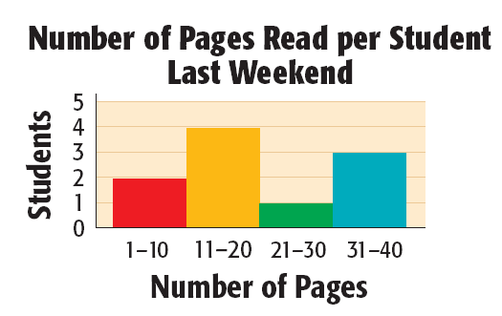
Use the frequency table to make a histogram.
Step 1: Choose an appropriate scale and interval.
Step 2: Draw a bar for the number of students in each interval. The bars should touch but not overlap.
Step 3: Title the graph and label the axes.

Slide 31
Use the frequency table to make a histogram.
Step 1: Choose an appropriate scale and interval.
Step 2: Draw a bar for the number of students in each interval. The bars should touch but not overlap.
Step 3: Title the graph and label the axes.
Number of Pages Read per Student Last Weekend
Students
Number of Pages

Slide 32
1. Students listed the number of days they spent on vacation in one year. Make a tally table with intervals of 5.
2, 18, 5, 15, 7, 10, 1, 10, 4
16, 7, 11, 17, 3, 8, 14, 13, 10
Number of Days Spent on Vacation
1–5 | 6–10 | 11–15 | 16–20
|||| | |||| | | |||| | |||

Slide 33
2. Use your tally table from problem 1 to make a frequency table.
Number of Days Spent on Vacation
Number of Days | Frequency
1–5 | 5
6–10 | 6
11–15 | 4
16–20 | 3

Slide 34
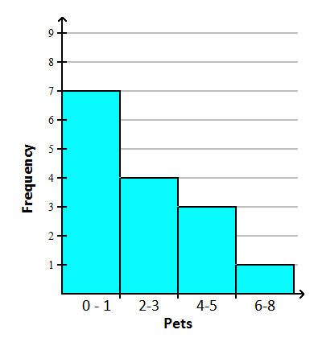
Histograms
Histograms are used to organize and interpret data.
Histograms are often used with frequency tables to give a more visual view of the data.
Each bar represents an interval that contains data.
The height of the bar indicates the frequency of the data.
Interval | Tally | Frequency
0-1
2-3
4-5
6-7

Slide 35
Create a frequency table
A professional football team scored the following number of points in games last season. Create a frequency table that reflects this information.
17, 24, 13, 16, 34, 38, 27, 13, 24, 13, 7, 0, 13, 10, 14, 0, 26, 23, 31, 7
First decide what intervals to use in your frequency table.
Scores | Tally Marks | Frequency

Slide 36
Create a frequency table
A professional football team scored the following number of points in games last season. Create a frequency table that reflects this information.
17, 24, 13, 16, 34, 38, 27, 13, 24, 13, 7, 0, 13, 10, 14, 0, 26, 23, 31, 7
First decide what intervals to use in your frequency table.
Scores | Tally Marks | Frequency
0 – 9 | |||| | 4
10 – 19 | |||| ||| | 8
20 – 29 | |||| | 5
30 – 39 | ||| | 3

Slide 37
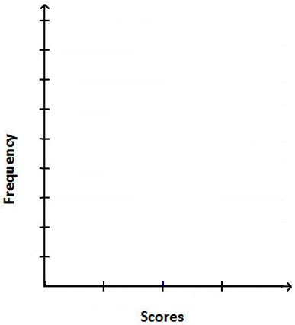
Build the histogram
Use the frequency table to help build the histogram.
17, 24, 13, 16, 34, 38, 27, 13, 24, 13, 7, 0, 13, 10, 14, 0, 26, 23, 31, 7
Scores | Tally Marks | Frequency
0 −9 | |||| | 4
10 − 19 | |||| ||| | 8
20 − 29 | |||| | 5
30 − 39 | ||| | 3

Slide 38
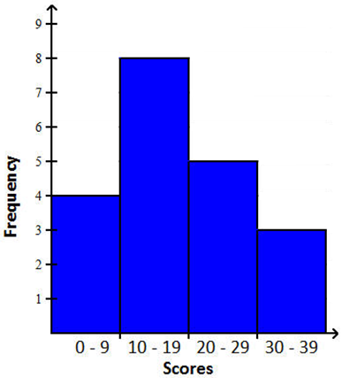
Build the histogram
Use the frequency table to help build the histogram.
17, 24, 13, 16, 34, 38, 27, 13, 24, 13, 7, 0, 13, 10, 14, 0, 26, 23, 31, 7
Scores | Tally Marks | Frequency
0 −9 | |||| | 4
10 − 19 | |||| ||| | 8
20 − 29 | |||| | 5
30 − 39 | ||| | 3

Slide 39
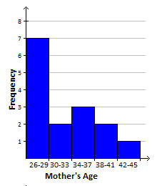
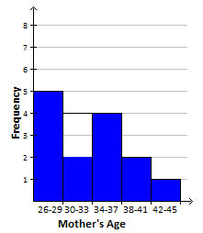
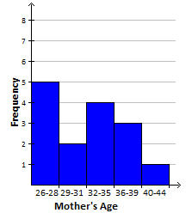
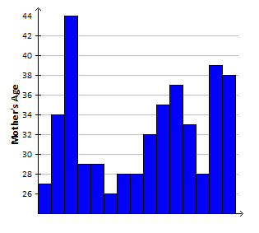
Which histogram matches the data listed below?
The mothers’ ages of students in Mrs. Washington’s kindergarten class are listed below.
27, 34, 44, 29, 29, 26, 28, 28, 32, 35, 37, 33, 28, 39, 38
a. b.
c. d.

Slide 40
Thank You

