Slide 1

General Mathematics
ADE 101
LECTURE No. 3
Fractions and Operations on Fractions

Slide 2
Today’s Objectives
Students and Teachers will be able to
Understand Fractions
Learn about Types of Fractions
Apply Operations on Fractions

Slide 3
KNOWLEDGE TEST

Slide 4
FRACTIONS

Slide 5

Abdullah uses fractions to split up his pizzas
How many parts will he cut it into if he is sharing with his brother Ayan?

Slide 6
Abdullah splits the pizza into two equal parts.
Each part is a fraction.
We call these parts halves.
It is important that they are equal.

Slide 7
FRACTION IS TO BE CONSIDERED AS PARTS OF THINGS

Slide 8
Which of these shapes are split into halves?

Slide 9
One half can be written like this
As you can see fractions are made up of 2 different parts.
One part on the top and
A line
between them
One part on the bottom

Slide 10
The top and bottom parts of the fraction have different meanings.
The top number is the number of parts we have
The bottom number is the total number of parts

Slide 11
Another name for these parts is
The numerator
The denominator

Slide 12
The numerator is the top part.
It shows how many parts of the whole we are talking about.
The denominator is the
bottom part.
It shows how many parts the whole has been split into.

Slide 13
1/4
1/4
3
4
1/4

Slide 14
1/4
3
1/4
4
1/4

Slide 15
Which number is circled?
3
= numerator
4

Slide 16
Which number is circled?
3
4
= denominator

Slide 17
What fraction of the rectangle is blue?
4
6

Slide 18
What fraction of the rectangle is blue?
2
6

Slide 19
What fraction of the pie is blue?
4
4

Slide 20
What fraction of the pie is blue?
3
4

Slide 21
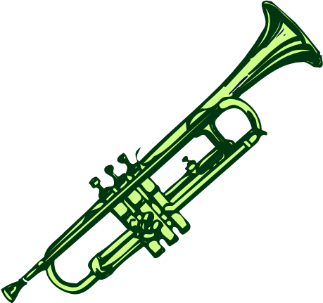
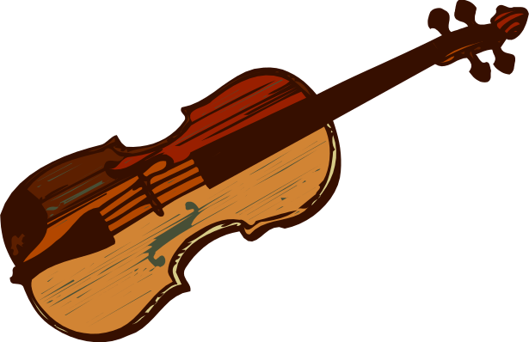

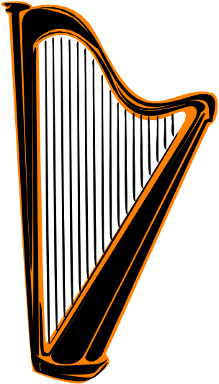
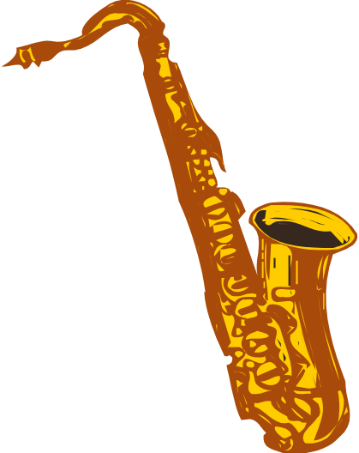
What fraction of the musical instruments have strings?
2
5

Slide 22


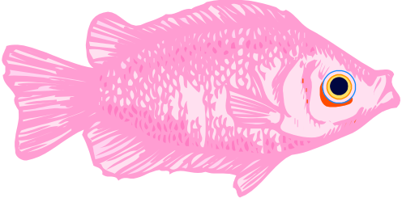


What fraction of the fish have stripes?
3
5

Slide 23
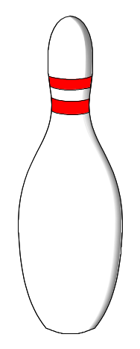
What fraction of the pins are knocked down?
3
10

Slide 24
You have math's tests out of 10 questions 6 are correct.
?
?
?
?
?
?
?
?
?
?
You are getting 6/10.

Slide 25
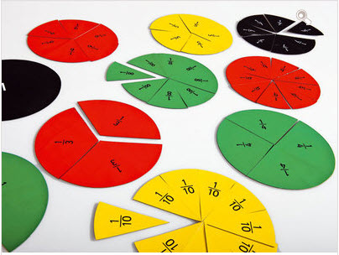
Activity

Slide 26
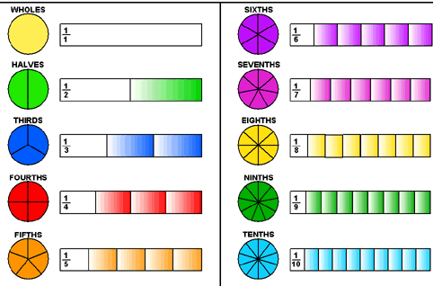
Results

Slide 27
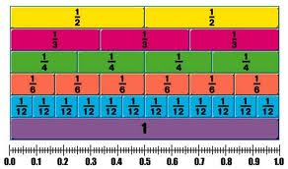

Slide 28
Types of Fractions
0
1/2
1
2
Zero Fraction: when top number is zero and bottom number is any number.
Proper Fraction: If top number is smaller than the bottom number the fraction is called proper fraction. This fraction is greater than zero but smaller than one.
  If top number is equal to bottom number than fraction is always one.
Improper fraction: if the top number is greater than the bottom number, a fraction is called improper fraction.

Slide 29
Types of Fractions

Slide 30
Zero Fraction < Proper Fraction < Whole < Improper fraction

Slide 31
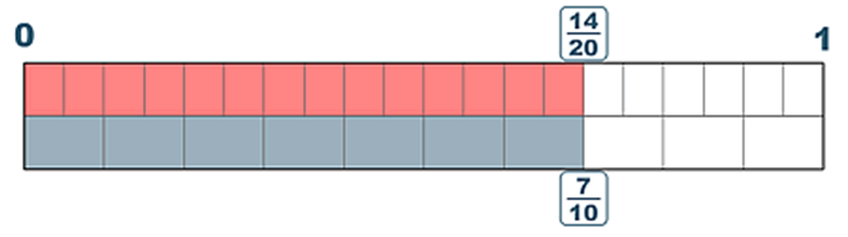
Journey line

Slide 32
Simplifying Fractions
1
2

Slide 33
Simplifying Fractions
3
6
Therefore
1
3
=
2
6

Slide 34
Procedure to simplify fractions

Slide 35
Adding and Subtracting Fractions with same bottom numbers

Slide 36
Adding and Subtracting Fractions with different bottom numbers

Slide 37
Multiplication of Fractions

Slide 38
Reciprocal of Fractions

Slide 39
Division of Fractions

Slide 41
Assignment No. 1
Write down the type of fractions

Slide 42
Assignment No. 2
Solve the following fractions

