Slide 1

General Mathematics
ADE 101
Unit 4
LECTURE No. 29
Representation of data using bar graphs and line graphs

Slide 2
Today’s Objectives
Students and Teachers will be able to
Learn how to represent data using graphs
Find the line graph and bar graph

Slide 3
Knowledge Test

Slide 4

What Is Data?
Data is information.
An example:
In my fifth grade class we took a pizza lovers survey.
We learned that ten kids liked pepperoni pizza best.
Nine kids liked sausage pizza best.
Seven kids liked cheese pizza best.
This information is called DATA.
Notes:
What is data?

Slide 5

What Is Data?
If a mom was planning a pizza party for the class, she would need the pizza lovers survey DATA.
I need to order 10 pepperoni, 9 sausage and 7 cheese pizzas.

Slide 6

What Is Data?
Your report card is another example of Data.
Math: 88%
Reading: 94%
Science: 75%
Social Studies: 80%
Language Arts: 55%
My Language Arts teacher may not like me.
Notes:
What is Data?

Slide 7




Data Is Everywhere.
TV
Newspaper
Books
There is way too much data in school!

Slide 8
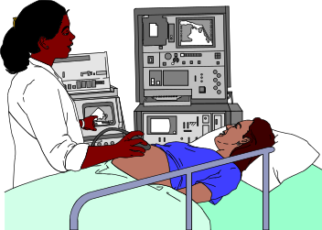


How Do People Use Data?
The data from the test will help us cure your disease.
We use data to make money.
Data is needed to build things.

Slide 9
Data Can Be Confusing.
34
55
32
$134.00
$231.00
$450.95
$319.63
$750.90
88%
97%
76%
85%
100%

Slide 10
We Use Graphs to Organize Data.
I know my parents will want to talk to my Language Arts teacher.

Slide 11
Graphs Make Data Easier to Understand.
Below is data without a graph.
Animals on the farm
Cows | 124
Chickens | 450
Turkeys | 388
Horses | 56
Mules | 110

Slide 12
Data WITH A Graph.
Cows | 124
Chickens | 450
Turkeys | 388
Horses | 56
Mules | 110

Slide 13
Let’s Learn About Graphs.
There are many different types of graphs.
Let’s learn about two kinds.
The bar graph
2. The line graph

Slide 14

Different Types of Graphs Can Show the Same Data.
Awesome! These graphs show the same data!
Bar Graph
Line Graph

Slide 15
Check Out the Bar Graph.
Y axis
X axis

Slide 16
Check Out the Line Graph.
Y axis
X axis

Slide 17
How To Read A Bar Graph.
My Grades
90
55

Slide 18
Learn More About Bar Graphs.

Slide 19

A Challenge
Which bar on the graph represents 45 feet?
Feet

Slide 20
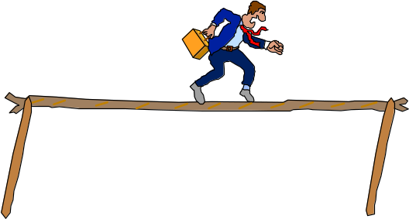
Another Challenge
Feet

Slide 21
Let’s Test Your Skills
At Elm Street School students have computer class once a week. The chart shows the number of minutes each class spends in the computer lab.
Class | 3rd grade | 4th grade | 5th grade | 6th grade
Number of minutes | 25 | 30 | 35 | 45
Which is the most appropriate graph of the information shown in the chart?
Graph A
Graph B

Slide 22
What Is Wrong With Graph B?
At Elm Street School students have computer class once a week. The chart shows the number of minutes each class spends in the computer lab.
Class | 3rd grade | 4th grade | 5th grade | 6th grade
Number of minutes | 25 | 30 | 35 | 45
Which is the most appropriate graph of the information shown in the chart?
Graph A
Graph B

Slide 23
Today I want you to help me make a graph.
I want to make a graph that shows the change in temperature throughout the day yesterday.
What kind of graphs could we make to show this?

Slide 24


Bar Graph vs Line Graph
What is the difference between a bar graph and a line graph?

Slide 25
Line Graph
A line graph is a graph used to show change over time!!
What can time be measured in???
Seconds - Minutes - Hours – Days - Weeks - Months – Years - Decades - Centuries - etc.

Slide 26



When to use a line graph?
Would we use a line graph in the following situations:
To show how many people like pizza in this class?
NO
To show how much it rained each month this year?
YES- because months and years deal with time.
To show how many people live in East Meadow?
NO

Slide 27
Birthdays?
Would we use a line graph to show when our birthdays are?
Our birthday does deal with time doesn’t it? (months/years)
But, our birthday is constant, meaning it never changes.
A line graph shows change in time, so we would not use it for this type of graph.

Slide 28
How do we make a line graph?
A line graph ALWAYS has a title!
A line graph has two different axis’s
An axis is either the horizontal line (called x) or the vertical line (called y) that form the base lines of a graph.
Y
X

Slide 29
YOU TELL ME….
What color is the y-axis?
Y
X
What color is the x-axis?

Slide 30
X-axis and Y-axis
When you are making a line graph, the x-axis is always horizontal, and the y-axis is always vertical.
The x and y-axis usually starts with zero on a line graph
It is important to make sure that the intervals on our y-axis are always equal.
What do I mean by this?

Slide 31
Intervals
When we are setting up a line graph, we need to decide what intervals we want to use.
If we are graphing the temperature for a year, do we want to put 365 days on the graph, and 100 different temperatures?
When we see a horizontal flat line, that means that there was no change during a specific time period.

Slide 32

Plotting a Line graph
When we are plotting a line graph, it is important to read what information is on each axis.
There must be a label on each axis that describes the information.
Much like a bar graph, we look at the x-axis first in order to plot our points.
Time in minutes

Slide 33
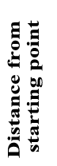
Is this an acceptable graph?
Car Trip
Time

Slide 34
What information do you need to interpret a graph?
The graph we just looked at does not have any numbers on the x-axis or the y-axis.
Can we still draw conclusions and answer questions about that graph?
How many times did the driver stop driving during the trip?
Car Trip
Time

Slide 35
Practice With Graphs
Please study the graphs that you have and answer the questions.
Then we will discuss the your answers.

Slide 37
Q & A
About how much money in total did this person spend on Monday and Thursday? How do you know?
Which day did this person spend the most money? How do you know?
This person spent the most money on Wednesday. I know this because the graph is the highest on Wednesday.
This person spent about $9.00 on Monday and Thursday. I know this because I looked at where the line was for Monday and Thursday and added the two amounts.

Slide 39
Q & A
How many days did this person travel less than 30 miles?
Which day did the driver travel the least amount of miles?
Why might someone want to keep track of their miles for the week?
5 days
Sunday
To figure out how much gas they need a week.

Slide 40
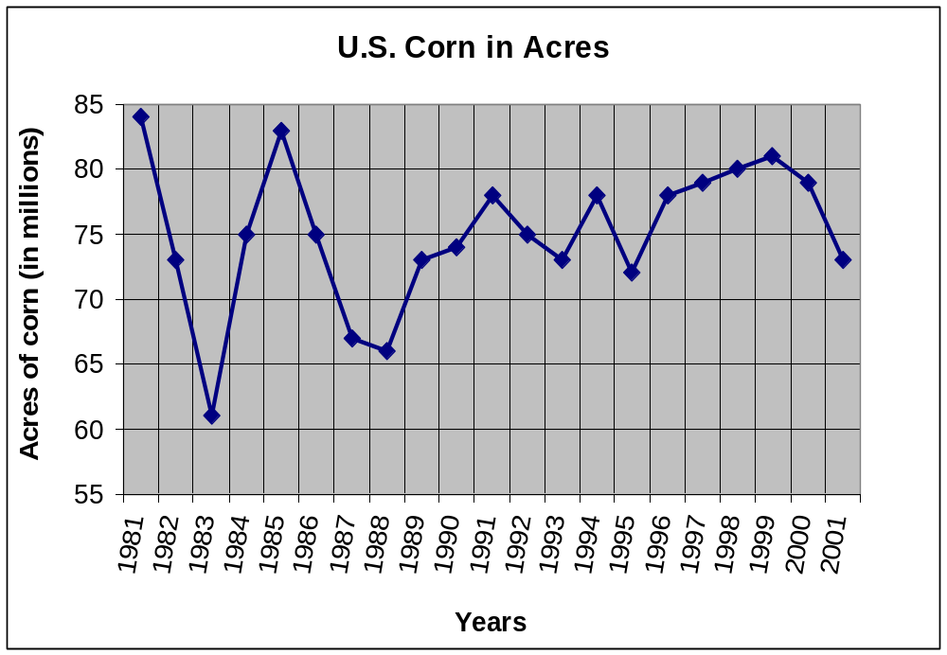

Slide 41
Q & A
About how much corn did the U.S. have in 1991?
What does the y-axis represent in the graph?
Can you think of another title for this graph?
About 77 million acres
Acres of corn in millions.
The rise and fall of corn
in the U.S.

Slide 45
Bar Graph
A bar graph can be used to display and compare data
The scale should include all the data values and be easily divided into equal intervals.

Slide 46
How to interpret a Bar Graph?
The bar graph shows Mr. Snowden’s students by gender and band membership.
How many of Mr. Snowden’s students are band members?
How many of Mr. Snowden’s students are not band members?

Slide 47
Double Bar Graph
Can be used to compare two related sets of data

Slide 48
How to make a Double-Bar Graph?
Choose a scale and interval for the vertical axis.
Draw a pair of bars for each country’s data. Use different colors to show males and females.
Label the axes and give the graph a title.
Make a key to show what each bar represents.

Slide 49
The table shows the highway speed limits on interstate roads within three states
Rural | Urban | State
70 mi/h | 65mi/h | Florida
70 mi/h | 70 mi/h | Texas
65 mi/h | 55mi/h | Vermont

Slide 50
Step 1
Choose a scale and interval for the vertical axis.
Rural | Urban | State
70 mi/h | 65mi/h | Florida
70 mi/h | 70 mi/h | Texas
65 mi/h | 55mi/h | Vermont

Slide 51
Step 2
Draw a pair of bars for each state’s data. Use different colors to show urban and rural.
Rural | Urban | State
70 mi/h | 65mi/h | Florida
70 mi/h | 70 mi/h | Texas
65 mi/h | 55mi/h | Vermont

Slide 52
Step 3 and 4
Speed Limit on Interstate Roads
Label the axes and give the graph a title.
Make a key to show what each bar represents
Urban
Rural
Speed Limit (mi/h)

Slide 53
Can you now make a bar graph, double bar Graph ?

Slide 54
The list below shows the results of a typing test in words per minute. Make a histogram of the data.
62, 55, 68, 47, 50, 41, 62, 39, 54, 70, 56, 70, 56, 47, 71, 55, 60, 42

Slide 55
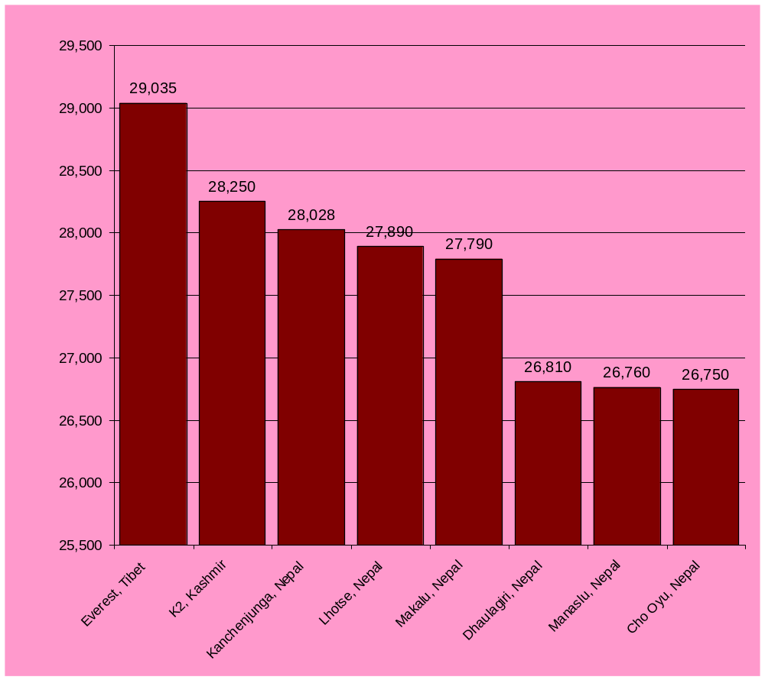

Slide 56
Thank You

