Slide 1

General Mathematics
ADE 101
Unit 3
LECTURE No. 26
SURFACE AREA AND VOLUME OF CYLINDER

Slide 2
Today’s Objectives
Students and Teachers will be able to
Learn about the Surface Area And Circumference of a Circle
Find the Surface Area and Volume of the Cylinder

Slide 3
Knowledge Test

Slide 5
The circumference of a circle is the perimeter of the circle.

Slide 6
Imagine that the circle is straightening itself out.

Slide 10
The length of this line segment is the circumference of the circle.
314 cm

Slide 12
The circumference is the same length as 3 diameters plus .14 of another diameter.

Slide 13
So, circumference = diameter x 3.14

Slide 18
Does this look familiar?

Slide 19
Remember, area is always measured in square units.

Slide 20
Remember that the area of a rectangle is length x width because you’re calculating the total number of squares inside of the rectangle.
2
4

Slide 21
That’s fine and dandy, but a circle is not a polygon. It does not have straight sides; it has curves.

Slide 22
How are we going to get around these curves?

Slide 23
Imagine chopping up the circle as if it were a pizza.

Slide 24
Now, let’s rearrange our “pizza” into another shape.

Slide 33
Area = Base x Height
Height
Base

Slide 34
To find the area of the circle (which is now a parallelogram), we just need to multiply the Base by the Height.
Height
Base

Slide 35
The height of this “parallelogram” is really the radius of the circle.
Radius
Base

Slide 36
The Base is really 1/2 of the circumference.
Radius
1/2 of Circumference

Slide 37
The circumference is really Diameter x π
Radius
1/2 of Diameter x π

Slide 38
1/2 of a Diameter is really a Radius.
Radius
Radius x π

Slide 39
So if we multiply the Base x Height
Height
Base

Slide 40
We are really multiplying
Radius x Radius x π
Radius
Radius x π

Slide 41
1) Now let’s try this formula. Find the area of this circle.
5 cm

Slide 42
5 x 5 x 3.14 = 78.5 square cm
5 cm

Slide 43
2) Find the area of this circle.
6 cm

Slide 44
6 x 6 x 3.14 = 113.04 square cm
6 cm

Slide 45
3) Find the area of this circle.
9 cm

Slide 46
9 x 9 x 3.14 = 254.34 square cm
9 cm

Slide 47
5) Find the area of this circle.
14 cm

Slide 48
7 x 7 x 3.14 = 153.86 cm²
Make sure that you use the radius of the circle.
14 cm

Slide 49
Cylinder

Slide 50
Volume of a Cylinder
Label the BASE and HEIGHT of the cylinder below:
Height of the Cylinder!
Base of the Cylinder!

Slide 51
Volume of a Cylinder
For the Volume of a Cylinder we can write:
  V = B(h)
  OR
  V = πr²(h)

Slide 52
Volume of Cylinders
18 cm
5 cm

Slide 54
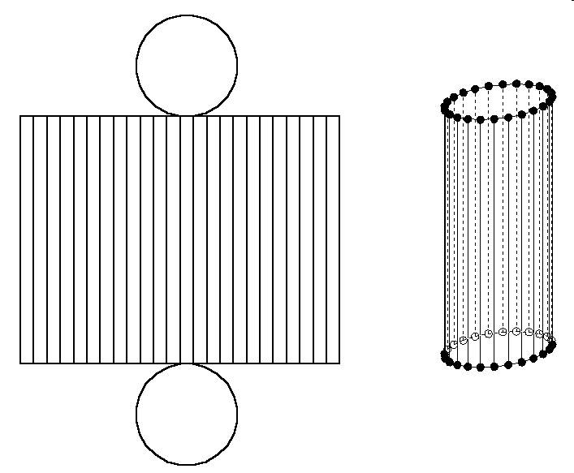
Parts of a cylinder
A cylinder has 2 main parts.
A rectangle
and
A circle – well, 2 circles really.
Put together they make a cylinder.

Slide 55
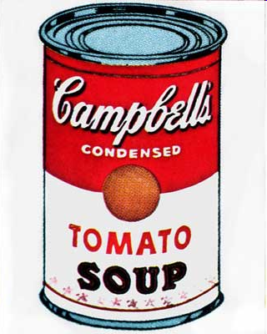
The Soup Can
Think of the Cylinder as a soup can.
You have the top and bottom lid (circles) and you have the label (a rectangle – wrapped around the can).
The lids and the label are related.
The circumference of the lid is the same as the length of the label.

Slide 56
Surface Area of a Cylinder
Draw the shapes that make up the surface area of a cylinder.
Circle
Rectangle
Circle

Slide 57
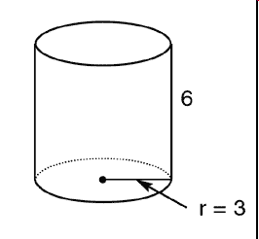
Area of the Circles
Formula for Area of Circle
A= π r²
= 3.14 x 3²
= 3.14 x 9
= 28.26
But there are 2 of them so
28.26 x 2 = 56.52 units squared

Slide 58
The Rectangle
This has 2 steps. To find the area we need base and height. Height is given (6) but the base is not as easy.
Notice that the base is the same as the distance around the circle (or the Circumference).

Slide 59
Find Circumference
Formula is
C = π x d
= 3.14 x 6 (radius doubled)
= 18.84
Now use that as your base.
A = b x h
= 18.84 x 6 (the height given)
= 113.04 units squared

Slide 60
Add them together
Now add the area of the circles and the area of the rectangle together.
56.52 + 113.04 = 169.56 units squared
The total Surface Area!

Slide 61
Formula
SA = (π d x h) + 2 (π r²)
Label Lids (2)
Area of Rectangle Area of Circles

Slide 62
Surface Area of Cylinders
Face #1 = Circle
Face #2 = Circle
Face #3 = Rectangle
18 cm
5 cm
Surface Area

Slide 63
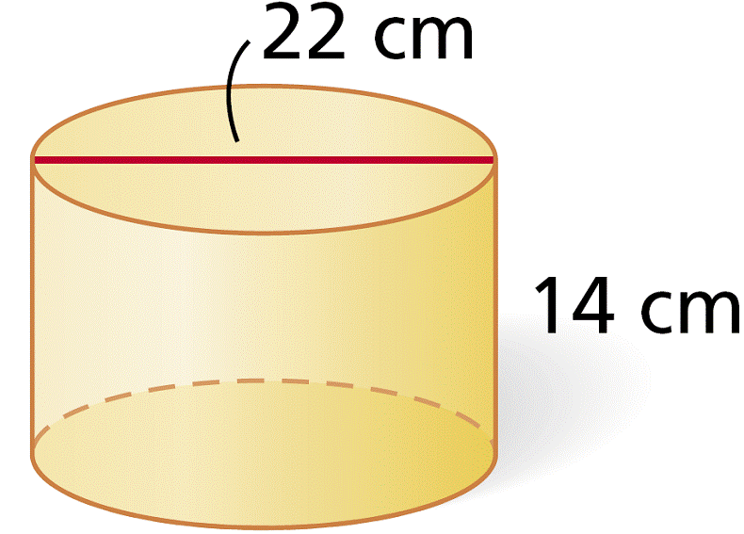
Practice
Be sure you know the difference between a radius and a diameter!
SA = (π d x h) + 2 (π r²)
= (3.14 x 22 x 14) + 2 (3.14 x 11²)
= (367.12) + 2 (3.14 x 121)
= (367.12) + 2 (379.94)
= (367.12) + (759.88)
= 1127 cm²

Slide 64
More Practice!
SA = (π d x h) + 2 (π r²)
= (3.14 x 11 x 7) + 2 ( 3.14 x 5.5²)
= (241.78) + 2 (3.14 x 30.25)
= (241.78) + 2 (3.14 x 94.99)
= (241.78) + 2 (298.27)
= (241.78) + (596.54)
= 838.32 cm²
11 cm
7 cm

Slide 65
Thank You

