Slide 1

General Mathematics
ADE 101
Unit 3
LECTURE No. 25
Surface Area And Volume Of Cube And Cuboid

Slide 2
Today’s Objectives
Students and Teachers will be able to
Learn about the surface Area and volume
Find the surface Area and volume of cube and cuboid

Slide 3
Knowledge Test

Slide 5
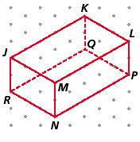
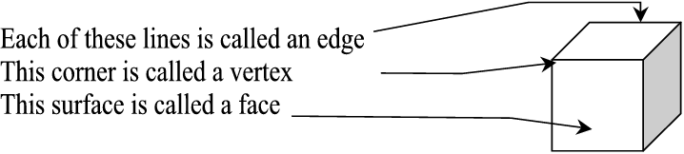
Three-dimensional figures have faces, edges, and vertices. A face - is a flat surface, and edge - is where two faces meet, and a vertex - is where three or more edges meet.
How many faces do most three-dimensional figures have?

Slide 6
DESCRIPTION:
Take your pencil box out. Keep it in front of you and do as directed.
Move your finger along the edges as shown by the red path on the slide.
How many edges are there in your box?
Put a dot, using your pen at the corners of your box.
How many ink dots did you put?

Slide 7
Place your hands on the top and bottom surface of your box.
Now, place your hands on the right and left, vertical surfaces, of your box.
Now, place your hands on the front and back side vertical surfaces of your box.
BACK
FRONT

Slide 8
b
l
b
l
DIMENSIONS
h
h
h
h
l
b
b
l
LENGTH , BREADTH AND HEIGHT are called the
“three dimensions” of the cuboids.
LENGTH , BREADTH AND HEIGHT [3 dimensions ] gives the complete description of the cuboids.

Slide 9
Take 18x16 sheet.
Mark 4x4 squares at 4 corners.
How do I make a OPEN cuboid of l=10cm, b=8 cm and h=4cm?
10 cm
Cut those squares
from the 4 corners.
4 cm
8 cm
Join the adjacent
sides of the squares,
vertically up, to get the
open box 10x8x4

Slide 10
Cuboids

Slide 11
SURFACE AREA OF A CUBOID
To find the surface area of a shape, we calculate the total area of all of the faces.
A cuboid has 6 faces.
The top and the bottom of the cuboid have the same area.
Notes:
11
Discuss the meaning of surface area. The important thing to remember is that although surface area is found for three-dimensional shapes, surface area only has two dimensions. It is therefore measured in square units.

Slide 12
SURFACE AREA OF A CUBOID
To find the surface area of a shape, we calculate the total area of all of the faces.
A cuboid has 6 faces.
The front and the back of the cuboid have the same area.
Notes:
12

Slide 13
SURFACE AREA OF A CUBOID
To find the surface area of a shape, we calculate the total area of all of the faces.
A cuboid has 6 faces.
The left hand side and the right hand side of the cuboid have the same area.
Notes:
13

Slide 14
SURFACE AREA OF A CUBOID
To find the surface area of a shape, we calculate the total area of all of the faces.
Can you work out the surface area of this cubiod?
5 cm
8 cm
The area of the top = 8 × 5
= 40 cm²
7 cm
The area of the front = 7 × 5
= 35 cm²
The area of the side = 7 × 8
= 56 cm²
Notes:
14

Slide 15
SURFACE AREA OF A CUBOID
To find the surface area of a shape, we calculate the total area of all of the faces.
5 cm
So the total surface area =
8 cm
2 × 40 cm²
Top and bottom
7 cm
+ 2 × 35 cm²
Front and back
+ 2 × 56 cm²
Left and right side
= 80 + 70 + 112 = 262 cm²
Notes:
15
Stress the importance to work systematically when finding the surface area to ensure that no faces have been left out.
We can also work out the surface area of a cuboid by drawing its net (see slide 51). This may be easier for some pupils because they would be able to see every face rather than visualizing it.

Slide 16
FORMULA FOR THE SURFACE AREA OF A CUBOID
We can find the formula for the surface area of a cuboid as follows.
Surface area of a cuboid =
w
l
2 × lw
Top and bottom
+ 2 × hw
Front and back
h
+ 2 × lh
Left and right side
= 2lw + 2hw + 2lh
Notes:
16
Pupils should write this formula down.

Slide 17
TOTAL SURFACE AREA OF CUBOIDS
BACK
FRONT
Areas of the top and bottom surfaces = 2.l.b
Areas of the right and left, vertical surfaces = 2.b.h
Areas of the front and back side vertical surfaces = 2.h. l
b
l
Total surface area of cuboids
= 2.l.b + 2.b.h + 2.h. l
= 2[ l.b + b.h + h. l ]
b
l
h
h
h
h
l
b
b
l

Slide 18
CUBOID PROBLEM
This cuboid is made from alternate purple and green centimetre cubes.
What is its surface area?
Surface area
= 2 × 3 × 4 + 2 × 3 × 5 + 2 × 4 × 5
= 24 + 30 + 40
= 94 cm²
How much of the surface area is green?
48 cm²
Notes:
18
Discuss how to work out the surface area that is green.
Ask pupils how we could write the proportion of the surface area that is green as a fraction, as a decimal and as a percentage.

Slide 19
For a plane figure we measure perimeter and area.
Perimeter = 12 units
Area = 8 square units
Let us cut – open this box and measure the total surface area of this box.
1 cm
1 cm
1 cm
1 cm
1 cm
1 cm
1 cm
1 cm
1 cm
1 cm
For a geometrical object we measure
total surface area and volume.
1 cm
1 cm
1 cm
1 cm
1 cm
1 cm
1 cm
1 cm

Slide 20
The total surface area of a cuboids is the area of its 6 rectangular faces.
6x4 square units
6x6 square units
6x4 square
units
6x6 square units
6x4 square
units
6x4 square units

Slide 21
SURFACE AREA OF A CUBE
How can we find the surface area of a cube of length x?
All six faces of a cube have the same area.
The area of each face is x × x = x²
Therefore,
x
Surface area of a cube = 6x²
Notes:
21
As pupils to use this formula to find the surface area of a cube of side length 5 cm.
6 × 5² = 6 × 25 = 150 cm².
Repeat for other numbers.
As a more challenging question tell pupils that a cube has a surface area of 96 cm². Ask them how we could work out its side length using inverse operations.

Slide 22
What is Volume?
The volume of a three-dimensional figure is the amount of space within it.
Measured in Units Cubed (e.g. cm3)

Slide 23
VOLUME
The amount of space that a three-dimensional object takes up is called its volume.
Volume is measured in cubic units.
For example, we can use mm³, cm³, m³ or km³.
The ³ tells us that there are three dimensions, length, width and height.
Liquid volume or capacity is measured in ml, l, pints or gallons.
Notes:
Link:
S7 Measures – units of volume and capacity

Slide 24
Look at this cuboid
Now imagine it is full of cubic centimetres
6 cm
1 cm³
4 cm
10 cm
Can you see that there are 10 × 4 = 40 cubic centimetres on the bottom layer?
There are 6 layers of 40 cubes making 40 × 6 = 240 cm³

Slide 25
UNITS IN DIFFERENT DIMENSIONS
1 cm
1 cm
1 cm
The length of the line segment is 5 units.
1 cm
LINEAR UNITS
CUBIC UNITS
The volume of the cuboid is 18 cubic units.
1 cm
The area of the rectangle is 8 square units.
1 cm
1 cm
1 cm
SQUARE UNITS
1 cm
1 cm
1 cm
1 cm
1 cm
1 cm
1 cm
1 cm
1 cm
1 cm
1 cm
1 cm
1 cm
1 cm
1 cm
1 cm

Slide 26
Volume of a cuboid
We can find the volume of a cuboid by multiplying the area of the base by the height.
The area of the base
= length × width
So,
height, h
Volume of a cuboid
= length × width × height
= lwh
length, l
width, w

Slide 27


CUBE
Here is a 3-dimensional view of a cube. The view on the left is the cube. The view on the right shows the base of the cube. The formula for the volume of a cube:
V = Bh
V = lwh

Slide 28
What is the volume of a cube of side 2 cm ?
Volume of a cube = l ³ = 2 ³ = 8cm ³
Visualization:-
2 cm
Visualization:-
4 cm
2 cm
2 cm
What is the volume of cuboid
2cm x 3cm x 4cm ?
Volume of a cuboid = l b h
= 2 x 3 x 4
= 24 cm ³
3 cm
2 cm

Slide 29
Let us go back and look at what we did here
6 cm
height
4 cm
breadth
10 cm
length
When we worked out the volume we multiplied the length by the breadth and then by the height
Volume of a cuboid = length × breadth × height
or
V = l b h

Slide 30
Lets us look again at the same cuboid and this time try the formula
6 cm
4 cm
10 cm
V = l b h
= 10 × 4 × 6 cm³
= 240 cm³
You will see that this is the same answer as we got before

Slide 31
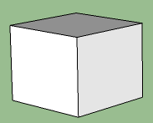
Capacity
Length = 5.53cm
Find the Capacity of this cube
Length = 5.53cm
V = Ah
= (5.53 x 5.53) x 5.53
= 169.11cm3 (1cm3 = 1ml)
Capacity = 169.11ml

Slide 32
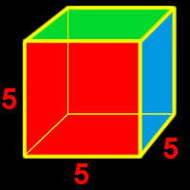
FIND THE VOLUME OF THE CUBE
V = Bh or V =lwh
V = 5 · 5 · 5 or 5³
V = 125 units³
The volume of the cube is 125 units³. Volume is measured in cubic units.

Slide 33
Making cuboids
The following cuboid is made out of interlocking cubes.
How many cubes does it contain?

Slide 34
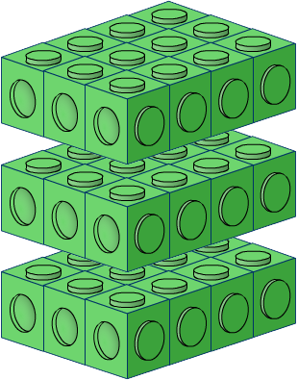
Making cuboids
We can work this out by dividing the cuboid into layers.
The number of cubes in each layer can be found by multiplying the number of cubes along the length by the number of cubes along the width.
3 × 4 = 12 cubes in each layer
There are three layers altogether so the total number of cubes in the cuboid = 3 × 12 = 36 cubes

Slide 35
Volume of a cuboid
What is the volume of this cuboid?
Volume of cuboid
= length × width × height
5 cm
= 5 × 8 × 13
8 cm
13 cm
= 520 cm³

Slide 36
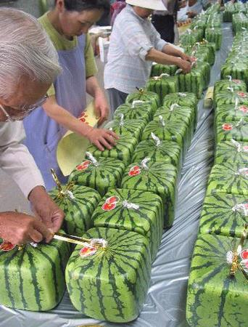
Why the formers
of Japan grew
watermelons in the
shape of cuboids ?

Slide 37

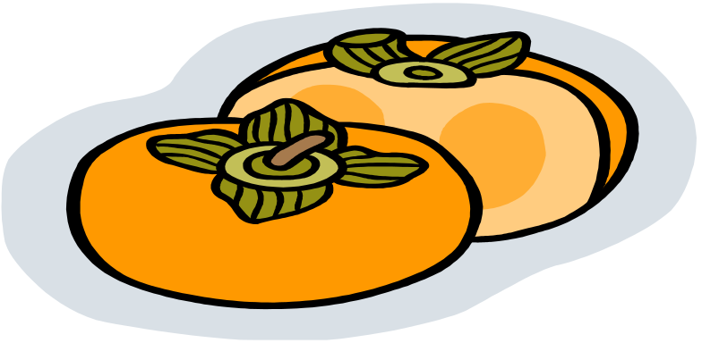
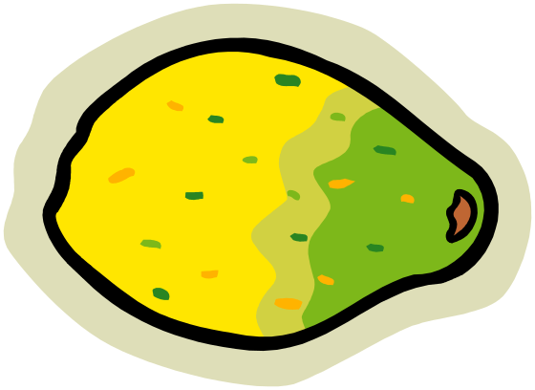
Why the formers of Japan grew watermelons in the shape of cuboids ?
Huge Watermelons in cuboids shape facilitates efficient storage and refrigeration!!
Good enough! For the same reason our “tea pack” and “match box” come in this shape.
“Storage
Friendly
shapes !!”
“godly shapes !!”

Slide 38
I want to make a cuboid of l=10cm, b=8 cm and h=4cm? How much paper do I need?
Total surface area of a cuboids is
= 2 lb + 2 bh + 2 hl
= 2 ( lb + bh + hl )
Total surface Area = 2 ( 10x8 + 8x5 + 10x5)
=2 ( 80 + 40 + 50 )
= 2 (170 )
= 340 sq cm

Slide 39
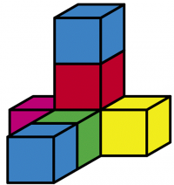
Next, we are going to make a three-dimensional figure using lock blocks and then draw our figure and determine how many blocks are used to make the figure.

Slide 40

A die is a cube molded from hard plastic. The edge of a typical die measure 0.62 inches. Dice are usually produced in a mold which holds 100 die at a time. To the nearest cubic inch, how much plastic is needed to fill this large mold?
When working with word problems, be sure to read carefully to determine what the question wants you to find. This question clearly indicates that you are to compute the volume by stating “to the nearest cubic inch.”
Volume of one die = lwh = (.62)(.62)(.62) = 0.238 cubic inches
For 100 dice = 23.8 = 24 cubic inches

Slide 41
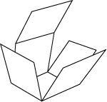
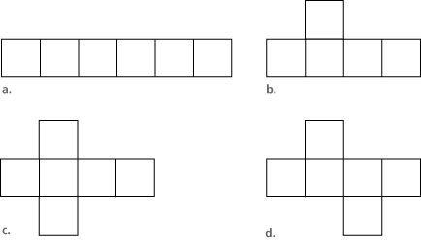
When you flatten-out a three-dimensional object the diagram is called a net. Which of the following answers is the correct net for the cube. Choose a, b, c, or d.

