Slide 1

General Mathematics
ADE 101
Unit 3
LECTURE No. 24
AREA

Slide 2
Today’s Objectives
Students and Teachers will be able to
Learn about the Area
Find the Area of Square, Rectangle and Triangle

Slide 3
Knowledge Test

Slide 4
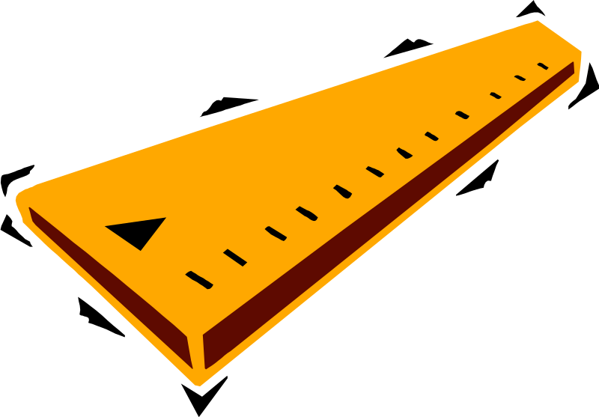
Length
Definition:
The measure of the distance across an figure.

Slide 6
Area
Area is the amount of surface space that a flat object has.
Area is reported in the amount of square units.

Slide 7
Area
Definition:
The number of square units needed to cover a surface. (INSIDE)
Length x width

Slide 8
Area of a Square
You find the area of a square by multiplying the side by itself.
3

Slide 9
Find the area of these squares.
25
5
12
16
8

Slide 10
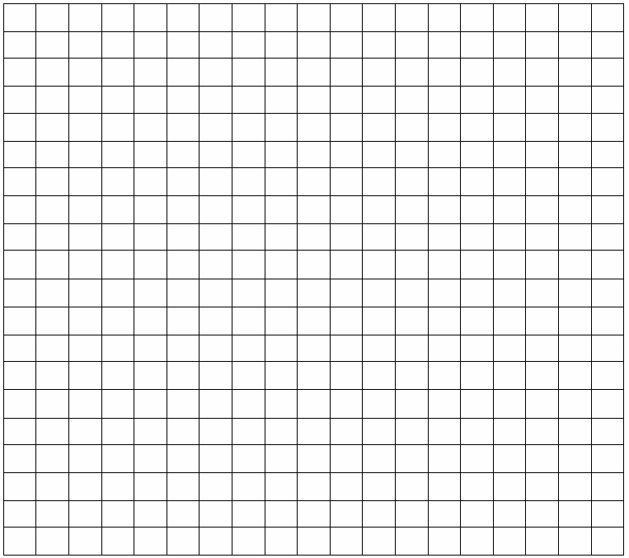
The rectangle is made of 6 rows of 8 squares.
To work out the number of squares
we times 6 by 8.
Counting each square can take a long time. Does anyone know a quicker way?
The area of the shape is 48cm².

Slide 11
Find the area of these rectangles.
1
6
2
2
3
5
4
3

Slide 12
18cm²
20cm²
What is the area of each of these shapes? Your teacher will give you copy of the worksheet.
30cm²
14cm²
22cm²

Slide 13
We can work out the area of a rectangle
without the grid.
length
Area = length x width
width

Slide 14
Area of a Rectangle
2
4
The area of a rectangle is determined by multiplying length x width.
2 x 4 = ______

Slide 15
Area of a Square or Rectangle
2
4
2 x 4 = 8

Slide 16
Now work out the area of these rectangles.
They are not drawn to scale.
7cm
5cm
35cm²
5cm
20cm²
4cm
9cm
36cm²
12.5cm
4cm
2cm
25cm²

Slide 17

To find out how much shape is inside we can
count the squares.
The area of a shape is the amount of space inside it.
The area of the shape is 18cm².

Slide 19
Area of a Triangle
Sometimes it makes it easier to remember
if you can imagine it like this:
A triangle is half of a rectangle or square. This is because the base (4) x the height (3) would be the same as the length x the width of a rectangle.
3
4

Slide 21
Area of a Triangle
3
4
Finding the area of a triangle is different.
Area of a triangle = ½ (base x height)
***(Base x height) is the same as (length x width).***

Slide 22
Base
Definition:
A side or face of a figure on which the figure stands.

Slide 23
Height
Definition:
The distance from the bottom to the top of a figure.

Slide 24

Width
Definition:
How wide a figure is from side to side.

Slide 25
Find the area of these triangles
3
4
7
5
8
2
3
6

Slide 26
4cm
Total area = 40 + 32 = 72 cm²
2cm
To find the area of this shape we have to split it up into two rectangles.
4cm
Area =
4 x 10
10cm
Area =
4 x 8
8cm
40cm²
32cm²
8cm
A shape that is made from other shapes is known as a composite shape.

Slide 27
Find the area and perimeter of each of these shapes? Your teacher will give you copy of the worksheet.
5cm
2cm
4cm
9cm
5cm
2cm
4cm
2cm
11cm
5cm
5cm
4cm
3cm
4cm
3cm
3cm
4cm
6cm
7cm
7cm
6cm
11cm

Slide 28
5cm
2cm
Area =
5 x 9
Area =
4 x 5
4cm
9cm
5cm
45cm²
20cm²
4cm
2cm
5cm
Total area = 45 + 20 = 65 cm²

Slide 29
12cm²
What is the area of each of these shapes? Your teacher will give you copy of the worksheet.
26cm²
26cm²

Slide 30
Total area = 10 + 36 = 46 cm²
2cm
11cm
5cm
Area =
2 x 5
4cm
10cm²
Area =
6 x 6
6cm
36cm²
6cm

Slide 31
Total area = 28 + 16 + 21 = 65 cm²
There is another way of doing this question.
Area =
4 x 7
Area =
4 x 4
28cm²
16cm²
4cm
3cm
3cm
3cm
Area =
3 x 7
4cm
7cm
7cm
21cm²
11cm

Slide 32
Total area = 77 – 12 = 65 cm²
Area =
3 x 4
12cm²
4cm
3cm
3cm
3cm
4cm
7cm
7cm
Area =
7 x 11
77cm²
11cm

Slide 33
Find out the area of given shapes

Slide 34
Find out the area of given shapes

Slide 35
5cm
ASSIGNMENT
Find out the area of given shapes
2cm
2cm
4cm
9cm
5cm
5cm
4cm
11cm
4cm
2cm
5cm
6cm
4cm
3cm
3cm
3cm
6cm
7cm
4cm
7cm
11cm

