Slide 1

General Mathematics
ADE 101
Unit 3
LECTURE No. 23
PERIMETER

Slide 2
Today’s Objectives
Students and Teachers will be able to
Learn about the Perimeter
Find the Perimeter of Simple Polygons

Slide 3
Knowledge Test

Slide 4

Length
Definition:
The measure of the distance across an figure.

Slide 6
Perimeter
The distance around the outside of a rectangle.

Slide 8
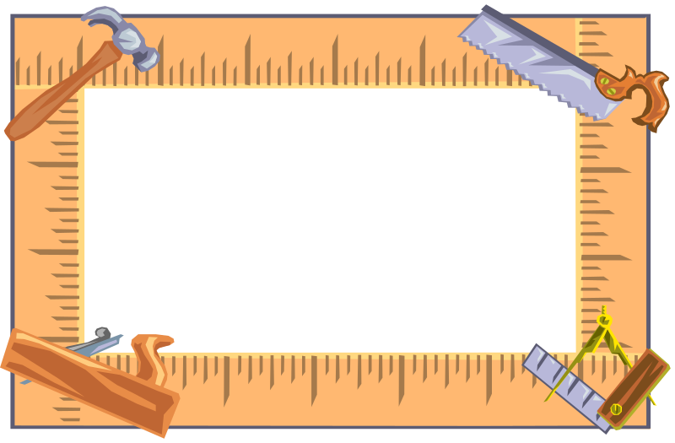
Perimeter
Definition:
The sum of the length of all the sides of a polygon.

Slide 9
Perimeter
Perimeter is the distance around the outside edge of a flat object.
Perimeter is reported as a total number of linear units.

Slide 10
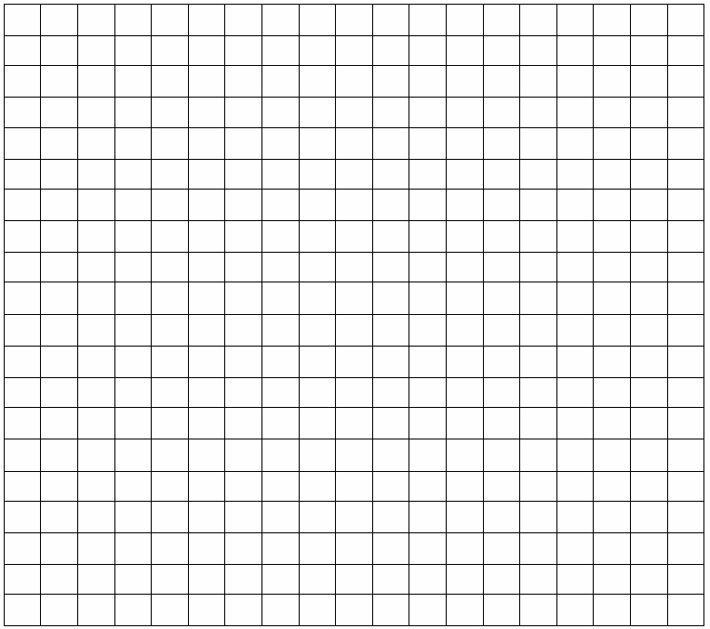
First we need to find he length of each side by
counting the squares.
8 cm
The distance around the outside of a shape is called the perimeter.
6 cm
6 cm
8 cm
The perimeter of the shape is 8 + 6 + 8 + 6 = 28cm.

Slide 11
Perimeter
The distance around the outside of a rectangle.
length
width
width
length
Perimeter = (2 x L) + (2 x W)

Slide 12
Try to find the perimeter of these rectangles.
1
6
2
2
3
5
4
3

Slide 13
Perimeter of a Rectangle
2
4
To calculate the perimeter of an object or space, you will need to add the length and width, then multiply by 2.
( 2 + 4 ) x 2 = ______
It means the same as: (2 + 4) + (2 + 4) = ________

Slide 14
Perimeter of a Square
To find the perimeter of a square, multiply the side by 4.
3 x 4 = ___
3

Slide 15
Find the perimeter of these squares.
25
5
12
16
8

Slide 16
18cm
18cm
What is the perimeter of each of these shapes?
22cm
18cm
26cm

Slide 17
Perimeter
Measure each side of the triangle then add them together.

Slide 18
Perimeter of a Triangle
3
5
4
To calculate the perimeter of a triangle
you will need to add the sides.
3 + 4 + 5 = ______

Slide 19
Find the perimeter of these triangles.
5
3
5
5
4
10
3
3
5
8
3
6

Slide 20
Now find the perimeter of these shapes. They are not drawn to scale.
4cm
4cm
3cm
5cm
3cm
3cm
3cm
3cm
7cm
7cm
3cm
3cm
3cm
3cm
4cm
4cm
3cm
3cm
Perimeter = 18cm
Perimeter = 22cm
Perimeter = 28cm

Slide 21
Find the perimeter of each of these shapes?
5cm
2cm
4cm
9cm
5cm
2cm
4cm
2cm
11cm
5cm
5cm
4cm
3cm
4cm
3cm
3cm
4cm
6cm
7cm
7cm
6cm
11cm

Slide 22
5cm
2cm
4cm
9cm
5cm
4cm
Perimeter = 36 cm
2cm
5cm

Slide 23
Perimeter = 34 cm
2cm
11cm
5cm
4cm
6cm
6cm

Slide 24
Perimeter = 42 cm
4cm
3cm
3cm
3cm
4cm
7cm
7cm
11cm

Slide 25
Perimeter = 42 cm
4cm
3cm
3cm
3cm
4cm
7cm
7cm
11cm

Slide 26
Tricky Perimeters
(Look carefully.)
3
You will need to remember which sides to add and the values for each side.
2
2
2
2

Slide 27
Perimeter
Do you have to measure every side to find the perimeter of these shapes?

Slide 28
Perimeter Word Problems

Slide 29
A regular pentagon has one side 25cm long.
How long is the perimeter of this shape?

Slide 30
A regular hexagon has a perimeter of 300cm.
How long is the length of one side?

Slide 31
What is the perimeter of a square of side 20cm?

Slide 32
If the perimeter of square is
200cm. What is the length of one of the sides?

Slide 33
What is the perimeter of an equilateral triangle of side 5cm?

Slide 34
A regular heptagon has a side length of 26cm. What is it’s perimeter?

Slide 35
A rectangle has a perimeter of 68cm.
It’s short side is 10cm. What is the length of the long side?

Slide 36
5cm
ASSIGNMENT
2cm
2cm
4cm
9cm
5cm
5cm
4cm
11cm
4cm
2cm
6cm
5cm
4cm
3cm
3cm
3cm
6cm
7cm
4cm
7cm
11cm

