Slide 1

General Mathematics
ADE 101
Unit 3
LECTURE No. 22
QUADRILATERALS

Slide 2
Today’s Objectives
Students and Teachers will be able to
Learn about the quadrilaterals
Understand the different types of quadrilaterals

Slide 3
Knowledge Test

Slide 4
Quadrilateral
A quadrilateral is a polygon with 4 sides.

Slide 6
Square
Still has two pairs of parallel sides.
Has four congruent sides
Has four right angles

Slide 7
Property of Quadrilaterals
The sum of all the angles equals 360º degrees.
90º
90º
90º
90º
90º
+
90º
90º
90º
360º

Slide 9
Types of Quadrilaterals
Rectangle: Quadrilateral with two pairs of equal sides and four right angles (90 degrees)
Indicates equal sides
Box indicates 90⁰ angle

Slide 10
Property of Quadrilaterals
The sum of all the angles equals 360º degrees.
90º
90º
90º
90º
90º
+
90º
90º
90º
360º

Slide 12
Rhombus
Still has two pairs of parallel sides; with opposite sides congruent.
4 in.
4 in.
4 in.
4 in.

Slide 13
Property of Quadrilaterals
The sum of all the angles equals 360º degrees.
65º
65º
115º
65º
115º
+
115º
65º
115º
360º

Slide 14
What is the missing angle?
65º
?
65º
65º
115º
65º
115º
+
?
360º

Slide 16
Types of Quadrilaterals
Trapezoid: Quadrilateral with one pair of parallel sides
Parallel sides never meet.

Slide 17
Property of Quadrilaterals
The sum of all the angles equals 360º degrees.
70º
70º
70º
70º
110º
+
110º
110º
110º
360º

Slide 18
Trapezoid
has one pair of parallel sides.
trapezoids
Isosceles trapezoid
(Each of these examples shown has top and bottom sides parallel.)

Slide 20
Types of Quadrilaterals
Parallelogram: Quadrilateral with opposite sides that are parallel and of equal length and opposite angles are equal
Indicates equal sides

Slide 21
Parallelogram
Two pairs of parallel sides
opposite sides are actually congruent.

Slide 22
Types of Quadrilaterals
Irregular shapes: Quadrilateral with no equal sides and no equal angles

Slide 23
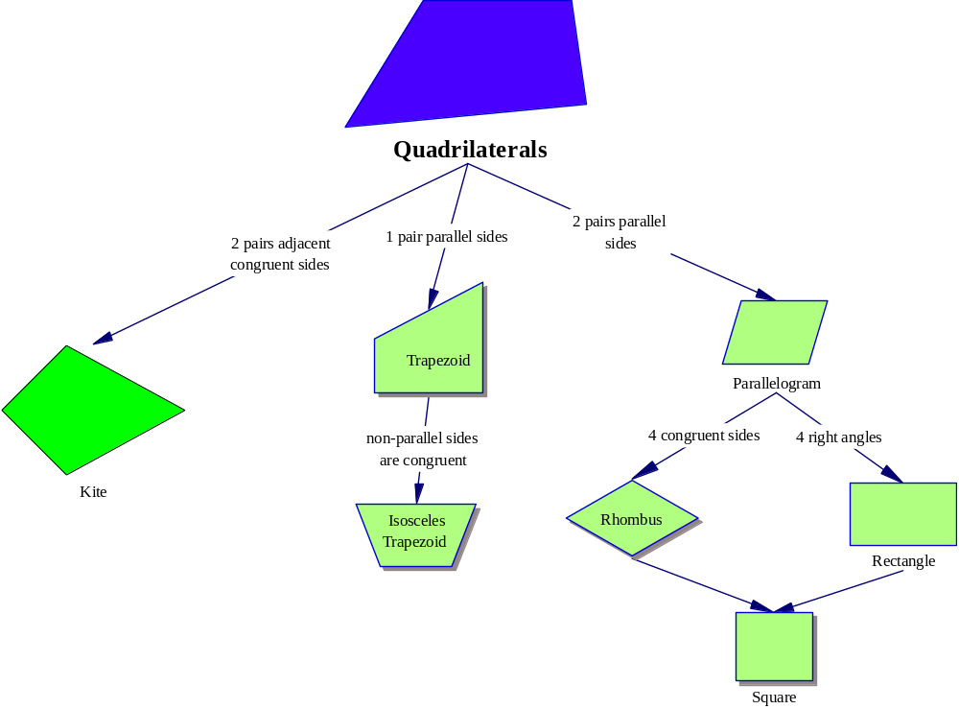

Slide 24
An kite is a quadrilateral with NO parallel sides but 2 pairs of adjacent congruent sides.

Slide 25
Example of a Kite
4 in.
2 in.
4 in.
2 in.

Slide 26
Name the Quadrilaterals
1
3
2
rectangle
irregular
rhombus
4
5
6
parallelogram
trapezoid
square

Slide 27
Interior Angles
Interior angles: An interior angle (or internal angle) is an angle formed by two sides of a simple polygon that share an endpoint
Interior angles of a quadrilateral always equal 360 degrees

Slide 28
Foldable
1. Take out a piece of notebook paper and make a hot dog fold over from the right side over to the pink line.

Slide 29
Foldable
The fold crease
2. Now, divide the right hand section into 5 sections by drawing 4 evenly spaced lines.
3. Use scissors to cut along your drawn line, but ONLY to the crease!

Slide 30
Foldable
The fold crease
4. Write QUADRILATERALS down the left hand side
QUADRILATERALS

Slide 31
The fold crease
Foldable
Parallelogram
5. Fold over the top cut section and write PARALLELOGRAM on the outside.
QUADRILATERALS
6. Reopen the fold.

Slide 32
Foldable
1. Opposite angles are congruent.
2. Consecutive angles are supplementary.
3. Opposite sides are congruent.
4. Diagonals bisect each other.
5. Diagonals make 2 congruent triangles.
7. On the left hand section, draw a parallelogram.
QUADRILATERALS
8. On the right hand side, list all of the properties of a parallelogram.

Slide 33
Foldable
1. Opposite angles are congruent.
2. Consecutive angles are supplementary.
3. Opposite sides are congruent.
4. Diagonals bisect each other.
5. Diagonals make 2 congruent triangles.
* Fold over the second cut section and write RECTANGLE on the outside.
RECTANGLE
QUADRILATERALS
* Reopen the fold.

Slide 34
Foldable
1. Opposite angles are congruent.
2. Consecutive angles are supplementary.
3. Opposite sides are congruent.
4. Diagonals bisect each other.
5. Diagonals make 2 congruent triangles.
* On the left hand section, draw a rectangle.
1.Is a special type of parallelogram.
2. Has 4 right angles
3. Diagonals are congruent.
QUADRILATERALS
* On the right hand side, list all of the properties of a rectangle.

Slide 35
Foldable
1. Opposite angles are congruent.
2. Consecutive angles are supplementary.
3. Opposite sides are congruent.
4. Diagonals bisect each other.
5. Diagonals make 2 congruent triangles.
* Fold over the third cut section and write RHOMBUS on the outside.
1.Is a special type of parallelogram.
2. Has 4 right angles
3. Diagonals are congruent.
QUADRILATERALS
RHOMBUS
* Reopen the fold.

Slide 36
Foldable
1. Opposite angles are congruent.
2. Consecutive angles are supplementary.
3. Opposite sides are congruent.
4. Diagonals bisect each other.
5. Diagonals make 2 congruent triangles.
* On the left hand section, draw a rhombus.
1.Is a special type of parallelogram.
2. Has 4 right angles
3. Diagonals are congruent.
QUADRILATERALS
1. Is A Special type of Parallelogram
2. Has 4 Congruent sides
3. Diagonals are perpendicular.
4. Diagonals bisect opposite angles
* On the right hand side, list all of the properties of a rhombus.

Slide 37
Foldable
1. Opposite angles are congruent.
2. Consecutive angles are supplementary.
3. Opposite sides are congruent.
4. Diagonals bisect each other.
5. Diagonals make 2 congruent triangles.
* Fold over the third cut section and write SQUARE on the outside.
1.Is a special type of parallelogram.
2. Has 4 right angles
3. Diagonals are congruent.
QUADRILATERALS
1. Is A Special type of Parallelogram
2. Has 4 Congruent sides
3. Diagonals are perpendicular.
4. Diagonals bisect opposite angles
* Reopen the fold.
SQUARE

Slide 38
Foldable
1. Opposite angles are congruent.
2. Consecutive angles are supplementary.
3. Opposite sides are congruent.
4. Diagonals bisect each other.
5. Diagonals make 2 congruent triangles.
* On the left hand section, draw a square.
1.Is a special type of parallelogram.
2. Has 4 right angles
3. Diagonals are congruent.
QUADRILATERALS
1. Is A Special type of Parallelogram
2. Has 4 Congruent sides
3. Diagonals are perpendicular.
4. Diagonals bisect opposite angles
* On the right hand side, list all of the properties of a square.
1. Is a parallelogram, rectangle, and rhombus
2. 4 congruent sides and 4 congruent Foldable
(right) angles
* Place in your notebook and save for tomorrow.

