Slide 1

General Mathematics
ADE 101
Unit 3
LECTURE No. 21
TRIANGLES

Slide 2
Today’s Objectives
Students and Teachers will be able to
Learn about the triangles
Understand the different types of triangles

Slide 3
Knowledge Test

Slide 4
Triangle

Slide 5
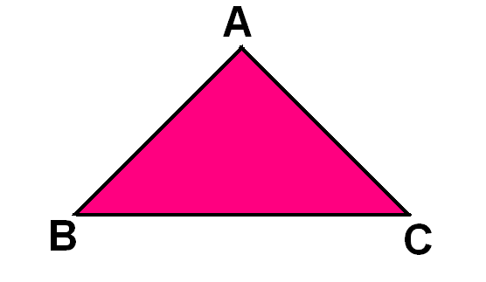
We get a TRIANGLE by joining three non collinear points .

Slide 6
What is a TRIANGLE ?
A closed figure formed by joining three line segments is called a TRIANGLE .

Slide 7
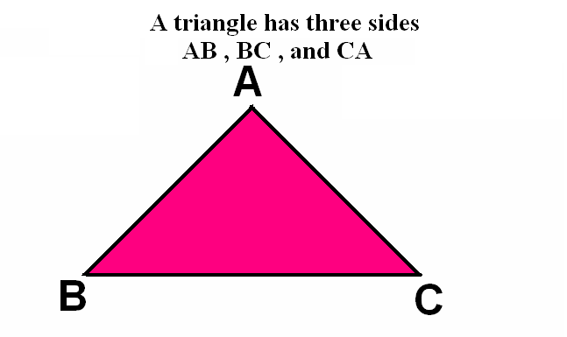
A triangle has three sides

Slide 8
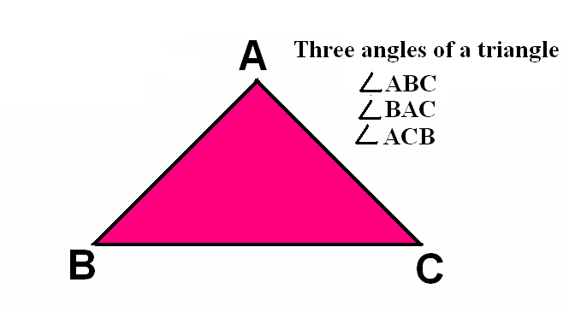
A triangle has three angles

Slide 9
TYPES OF TRIANGLES
Two Ways
On the basis of angles
On the basis of sides

Slide 11
On the basis of ANGLES
Three types
Acute angled triangle
Right angled triangle
Obtuse angled triangle

Slide 12
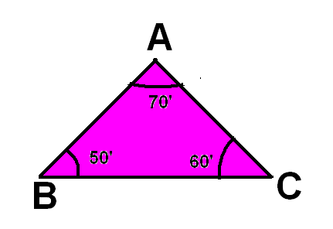
Acute angled triangle
A triangle whose all the angles are acute is called an ACUTE ANGLED TRIANGLE .

Slide 13
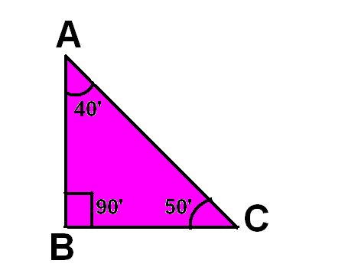
Right angled triangle
A triangle in which one of the angle is right angle is called RIGHT ANGLED TRIANGLE.

Slide 14
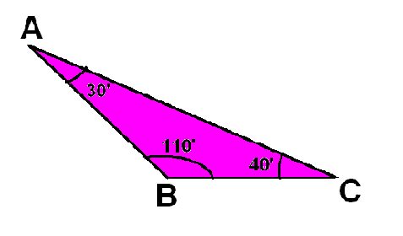
Obtused angled triangle
A triangle in which one of the angle is obtuse angle is called OBTUSED ANGLED TRIANGLE .

Slide 15
On the basis of sides
Three types
Equilateral triangle
Isosceles triangle
Scalene triangle

Slide 17
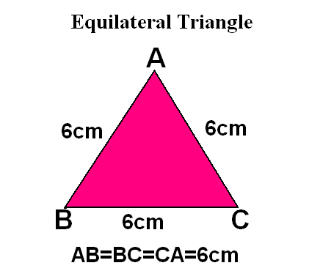
Equilateral triangle
A triangle whose all the sides are of equal length is called equilateral triangle.

Slide 18
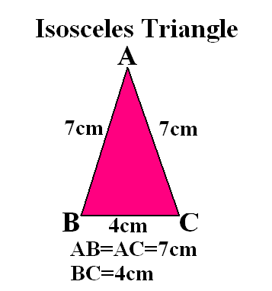
Isosceles triangle
A triangle whose any two sides are of equal measure is called scalene triangle.

Slide 19
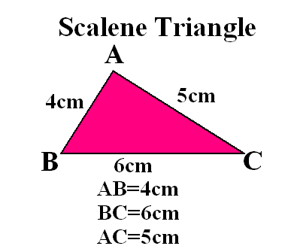
Scalene triangle
A triangle whose no two sides are of equal measure is called scalene triangle.

Slide 20
Recap
A closed figure formed by joining three non collinear points is called
A triangle whose all the sides are of equal length is called
A triangle whose no two sides are of equal length is called
A triangle whose one angle is 90 degree is called
A triangle whose all the angles are less than 90 degree is called

Slide 21
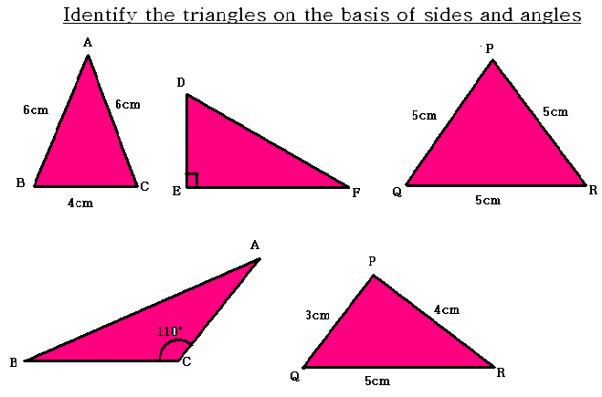

Slide 22
Isosceles Triangle
Has at least two congruent sides

Slide 24
Triangles
Cut any shape triangle out of a sheet of paper

Slide 25
Triangles
Tear off the corners. Piece them together by having the corners touch.

Slide 27
Triangles
The corners form what type of angle?

Slide 28
Triangles
The sum of the angles of a triangle is 180 degrees

Slide 29
Triangles
To find a missing angle, add up the 2 given angles

Slide 30
Triangles
Subtract the sum from 180 and you have the missing angle

Slide 31
Congruent Triangles

Slide 32
Congruent Triangles
Have the same SIZE
and the same SHAPE

Slide 33
Congruent Triangles
May be flipped and/or rotated

Slide 34
Congruent Triangles
BE CAREFUL
WHEN YOU NAME
THE SHAPE

Slide 35
Congruent Triangles
Name congruent CORRESPONDING
Parts (sides and angles)
IN ORDER

Slide 36
Congruent Triangles
Make sure the letters are in CORRESPONDING order

Slide 37
ABC is congruent DEF
B
F
E
D
A
C

Slide 38
One for you
Name the congruent triangles remembering to name the angles in order
F
E
Z
D
Y
X

Slide 39
Thank You

