Slide 1

General Mathematics
ADE 101
Unit 3
LECTURE No. 20
POLYGONS

Slide 2
Today’s Objectives
Students and Teachers will be able to
Learn about the Polygons
Understand the different types of Polygons

Slide 3
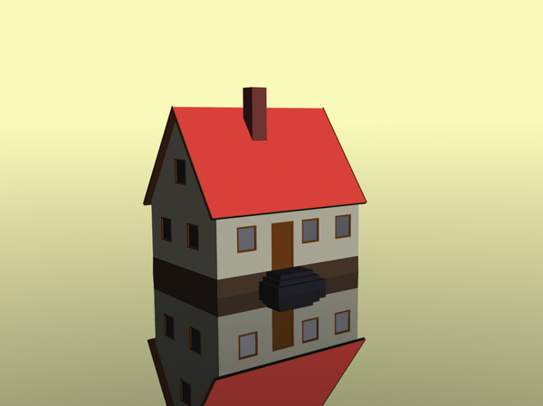

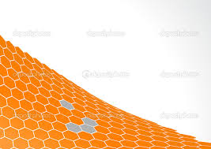
Knowledge Test

Slide 4
Polygons

Slide 5
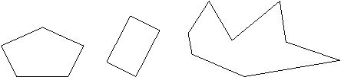
Polygon
A polygon is a closed figure made by joining line segments, where each line segment intersects exactly two others.

Slide 6
Polygons
Definition:
A closed figure formed by line segments so that each segment intersects exactly two others, but only at their endpoints.
These figures are not polygons
These figures are polygons

Slide 7
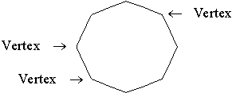
Vertex of a Polygon
The vertices of a polygon are the points where its sides intersect.

Slide 8
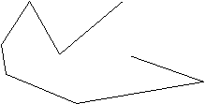
Q: Is this a polygon? Why or why not?
A: No…
Polygons are closed figures.

Slide 9
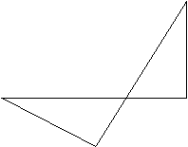
Q: Is this a polygon? Why or why not?
A: No…
Its sides do not intersect in
exactly two places each.

Slide 10
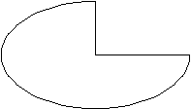
Q: Is this a polygon? Why or why not?
A: No…
It is not made of line segments.

Slide 11
Polygon
A closed figure with straight sides
Here are some polygons…..

Slide 12
These are not polygons
Do you know why????

Slide 13
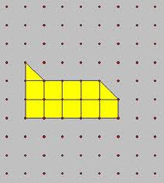
Activity – I

Slide 14
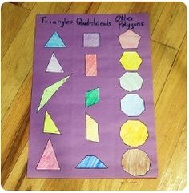
Activity – II

Slide 15
Classifications of a Polygon
Regular:
A convex polygon in which all interior angles have the same measure and all sides are the same length
Irregular:
Two sides (or two interior angles) are not congruent.

Slide 16
Regular Polygon
All angles are congruent
All sides are congruent

Slide 17
Regular Polygons
Regular polygons have:
  All side lengths congruent
  All angles congruent

Slide 18

Regular Polygons
A regular polygon is a polygon whose sides are all the same length, and whose angles are all the same. The sum of the angles of a polygon with n sides, where n is 3 or more, is 180° × (n - 2) degrees.

Slide 19
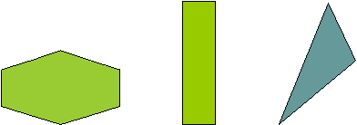
Are these regular polygons?
Why or why not?
A: No…
These sides are all the different lengths, and the angles are all different.

Slide 20
Irregular Polygons
Sides and angles are not congruent.

Slide 21
Polygon Names
3 sides
Triangle
4 sides
Quadrilateral
5 sides
Pentagon
6 sides
Hexagon
7 sides
Heptagon
8 sides
Octagon
9 sides
Nonagon
10 sides
Decagon
12 sides
Dodecagon
n sides
n-gon

Slide 22
Triangle
3 sides
3 angles

Slide 23
Quadrilateral
4 sides
4 angles

Slide 24

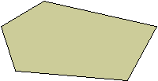
Pentagon
A five-sided polygon. The sum of the angles of a pentagon is 540 degrees.
A regular pentagon: | An irregular pentagon:

Slide 25

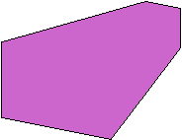
Hexagon
A six-sided polygon. The sum of the angles of a hexagon is 720 degrees.
A regular hexagon: | An irregular hexagon:

Slide 26

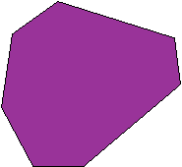
Heptagon
A seven-sided polygon. The sum of the angles of a heptagon is 900 degrees.
A regular heptagon: | An irregular heptagon:

Slide 27

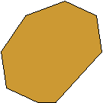
Octagon
An eight-sided polygon. The sum of the angles of an octagon is 1080 degrees.
A regular octagon: | An irregular octagon:

Slide 28

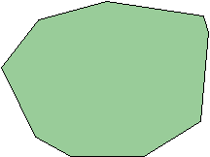
Nonagon
A nine-sided polygon. The sum of the angles of a nonagon is 1260 degrees.
A regular nonagon: | An irregular nonagon:

Slide 29
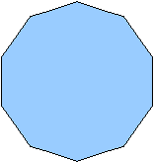

Decagon
A ten-sided polygon. The sum of the angles of a decagon is 1440 degrees.
A regular decagon: | An irregular decagon:

Slide 30
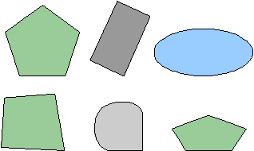
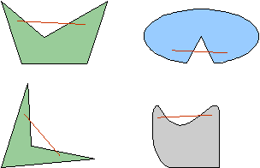
Convex
A figure is convex if every line segment drawn between any two points inside the figure lies entirely inside the figure. A figure that is not convex is called a concave figure.
Convex: | Concave:

Slide 31
Project

Slide 32
Thank You

