Slide 1
Today’s Objectives
Students and Teachers will be able to
Understand multiplication and division.
Know various models for arithmetic operations (multiplication, and division) with natural numbers.
Apply multiplication and division to solve word problems.

Slide 2
Knowledge Test
2+2 =
4
2+2+2 =
6
2+2+2+2 =
8

Slide 3
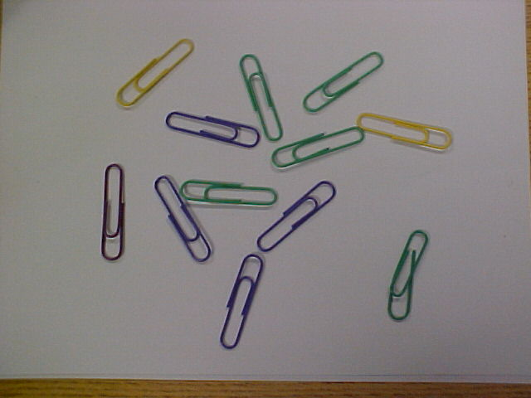
How many paper clips are here?
I could count them, but there is an easier way!

Slide 4
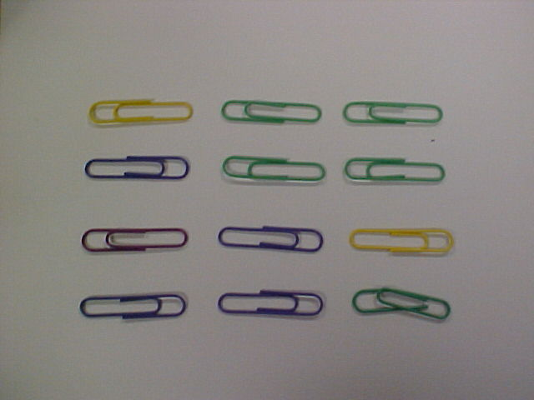
Now, how many paper clips are here?
I can count them by groups.
4 paper clips in each column
3 columns. That is 3 sets of 4. I can add 4 + 4 + 4 or
I could say 3 x 4. Now how many are there?

Slide 5
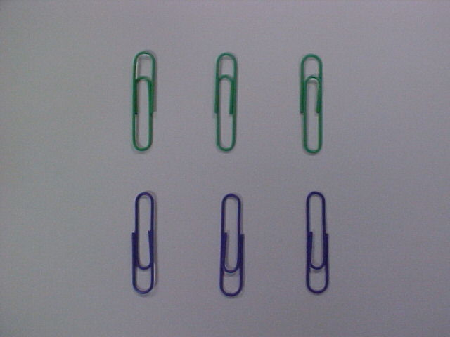
How many are here? What is the number sentence?
You could have said 3 + 3 or 2 + 2 + 2. Using multiplication
You might have said 2 x 3 or 3 x 2. The answer will be the same for all!

Slide 6
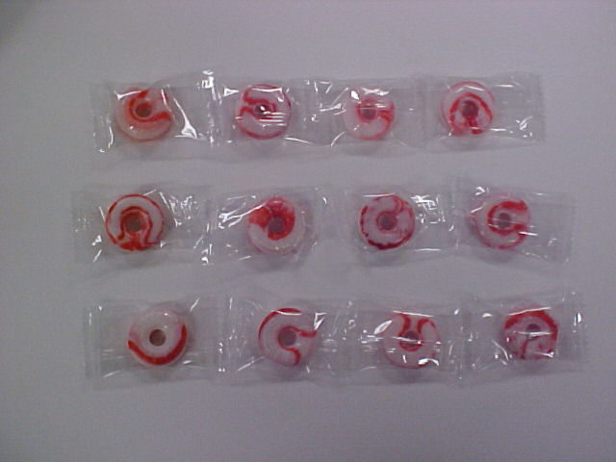
Try this one. What is the number sentence using multiplication?
If you said 3 x 4 or 4 x 3 you are correct. What is the answer?

Slide 7
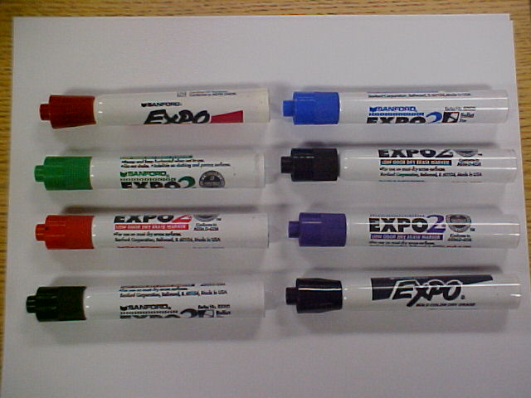
Now try this one. What is the multiplication fact?
Great! 2 x 4 or 4 x 2. What is the product?
(that means answer when you are multiplying!

Slide 8
I have 12 counters.
How could I arrange them into equal rows?

Slide 9
What number sentences could you write to go with this array?
2 x 6 = 12
6 x 2 = 12
6 + 6 = 12
2 + 2 + 2 + 2 + 2 + 2 = 12

Slide 10
Can you think of any other ways to arrange the counters?

Slide 11
What number sentences could you write to go with this array?
3 x 4 = 12
4 x 3 = 12
4 + 4 + 4 = 12
3 + 3 + 3 + 3 = 12

Slide 12
Could you arrange 20 counters?

Slide 13
What number sentences could you write to go with this array?
2 x 10 = 20
10 x 2 = 20
10 + 10 = 20
2 + 2 + 2 + 2 + 2 + 2 + 2 + 2 + 2 + 2 = 20
OR …

Slide 14
5 x 4 = 20
4 x 5 = 20
4 + 4 + 4 + 4 + 4 = 20
5 + 5 + 5 + 5 = 20

Slide 15
Now try doing this on your own.
6 counters
14 counters
15 counters
9 counters
8 counters
18 counters

Slide 16
6 Counters
2 x 3 = 6
3 x 2 = 6
3 + 3 = 6
2 + 2 + 2 = 6

Slide 17
14 counters
2 x 7 = 14
7 x 2 = 14
7 + 7 = 14
2 + 2 + 2 + 2 + 2 + 2 + 2 = 14

Slide 18
15 counters
5 x 3 = 15
3 x 5 = 15
3 + 3 + 3 + 3 + 3 = 15
5 + 5 + 5 = 15

Slide 19
9 Counters
3 x 3 = 9
3 x 3 = 9
3 + 3 + 3 = 9
3 + 3 + 3 = 9

Slide 20
8 Counters
2 x 4 = 8
4 x 2 = 8
4 + 4 = 8
2 + 2 + 2 + 2 = 8

Slide 21
18 Counters
2 x 9 = 18
9 x 2 = 18
9 + 9 = 18
2 + 2 + 2 + 2 + 2 + 2 + 2 + 2 + 2 = 18

Slide 22

Multiplication in Columns
1
2
3
4
4
5
6
4
X
3
=
12
7
8
9
10
11
12
3

Slide 23
Multiplication in Columns
1
2
3
4
3
5
6
7
8
9
10
11
12
4
3
X
4
=
12

Slide 24
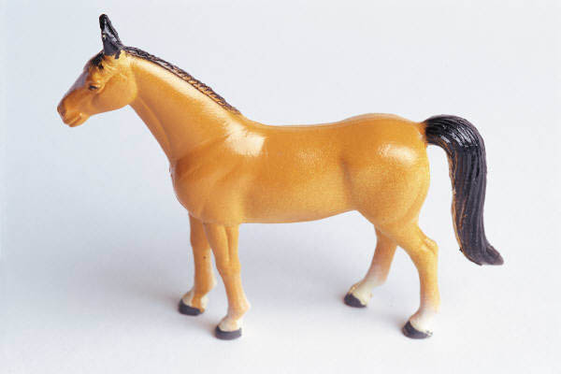


Multiplication by Zero
Tiger has no money. He has 0 money.
Horse has no money. He has 0 money.
Monkey has no money. He has 0 money.
0 + 0 + 0
=
3 x 0
0
=
3 x 0

Slide 25
Multiplying by Zero
Zero Property of Multiplication- any number times zero equals ________________.
5 x 0 = | 7 x 0 =
8 x 0 = | 22 x 0 =
17 x 0 = | 10 x 0 =
3 x 0 = | 100 x 0 =

Slide 26
Multiplying by One
Property of One for Multiplication- any number times one equals _______________.
3 x 1= 3 5 x1= 5

Slide 27
Multiplying by One
Complete the Problems Below:
5 x 1 = | 7 x 1 =
8 x 1 = | 22 x 1 =
17 x 1 = | 10 x 1 =
3 x 1 = | 100 x 1 =
70 x 1 = | 9 x 1 =

Slide 28
Multiplying by Eleven
Any number times 11 is times one doubled.
5 x 11 = | 7 x 11 =
2 x 11 = | 9 x 11 =
8 x 11 = | 4 x 11 =
3 x 11 = | 6 x 11 =

Slide 29
Multiplication Vocabulary
2 x 3 = 6

Slide 30
Multiply by Two
Multiplication is repeated ________________.
2 + 2 + 2 + 2 = ____
We have ____ groups of ____.
4 x 2 = ____
# of groups
# in each group

Slide 31
Multiply by Two
How many hearts?
2 + 2 + 2 = ____
We have ____ groups of ____.
____ x ____ = ____
# of groups
# in each group

Slide 32
Multiply by Two
How many sunflowers?
2 + 2 + 2 + 2 + 2 + 2 = ____
We have ____ groups of ____.
____ x ____ = ____
# of groups
# in each group

Slide 33
Multiplication Vocabulary
5 x 3 = 15

Slide 34
Multiply by Five
Multiplication is repeated ________________.
5 + 5 + 5 = ____
We have ____ groups of ____.
3 x 5 = ____
# of groups
# in each group

Slide 35
Multiplication Vocabulary
10 x 3 = 30

Slide 36
Multiplication Vocabulary
9 x 3 = 27

Slide 37
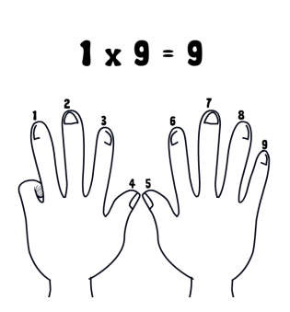
Multiply by Nine – The Finger Trick

Slide 38
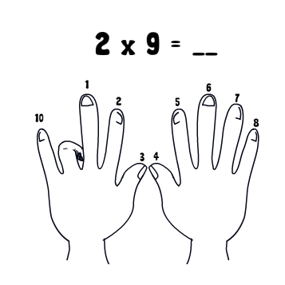
Multiply by Nine – The Finger Trick

Slide 39
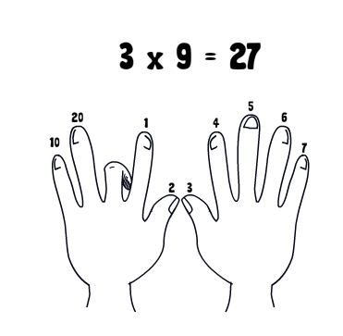
Multiply by Nine – The Finger Trick

Slide 40
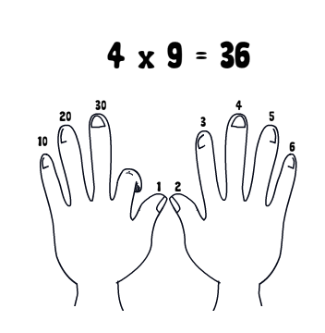
Multiply by Nine – The Finger Trick

Slide 41
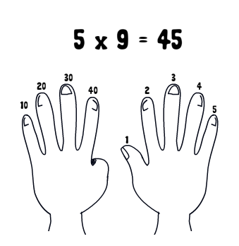
Multiply by Nine – The Finger Trick

Slide 42
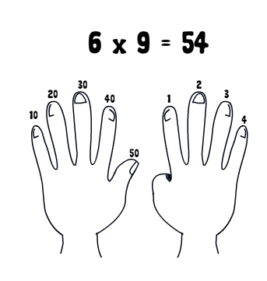
Multiply by Nine – The Finger Trick

Slide 43
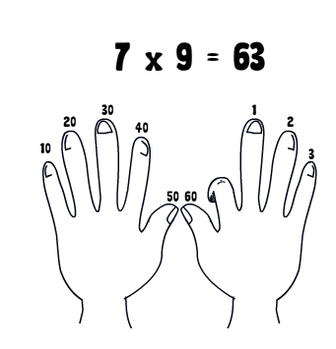
Multiply by Nine – The Finger Trick

Slide 44
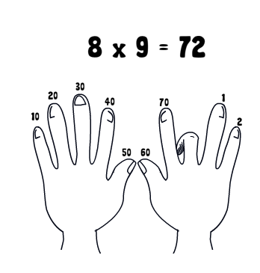
Multiply by Nine – The Finger Trick

Slide 45
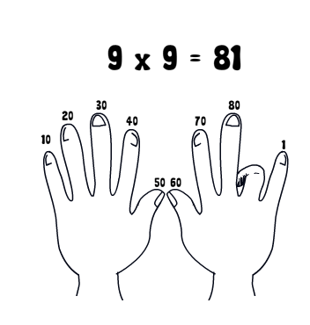
Multiply by Nine – The Finger Trick

Slide 46
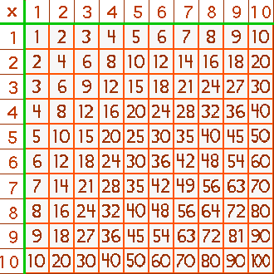

Slide 47
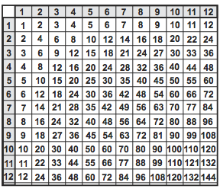
6 x 8 = 48

Slide 48
2 × 1 = 2 | 3 × 1 = 3 | 4 × 1 = 4 | 5 × 1 = 5
2 × 2 = 4 | 3 × 2 = 6 | 4 × 2 = 8 | 5 × 2 = 10
2 × 3 = 6 | 3 × 3 = 9 | 4 × 3 = 12 | 5 × 3 = 15
2 × 4 = 8 | 3 × 4 = 12 | 4 × 4 = 16 | 5 × 4 = 20
2 × 5 = 10 | 3 × 5 = 15 | 4 × 5 = 20 | 5 × 5 = 25
2 × 6 = 12 | 3 × 6 = 18 | 4 × 6 = 24 | 5 × 6 = 30
2 × 7 = 14 | 3 × 7 = 21 | 4 × 7 = 28 | 5 × 7 = 35
2 × 8 = 16 | 3 × 8 = 24 | 4 × 8 = 32 | 5 × 8 = 40
2 × 9 = 18 | 3 × 9 = 27 | 4 × 9 = 36 | 5 × 9 = 45
2 × 10 = 20 | 3 × 10 = 30 | 4 × 10 = 40 | 5 × 10 = 50

Slide 49
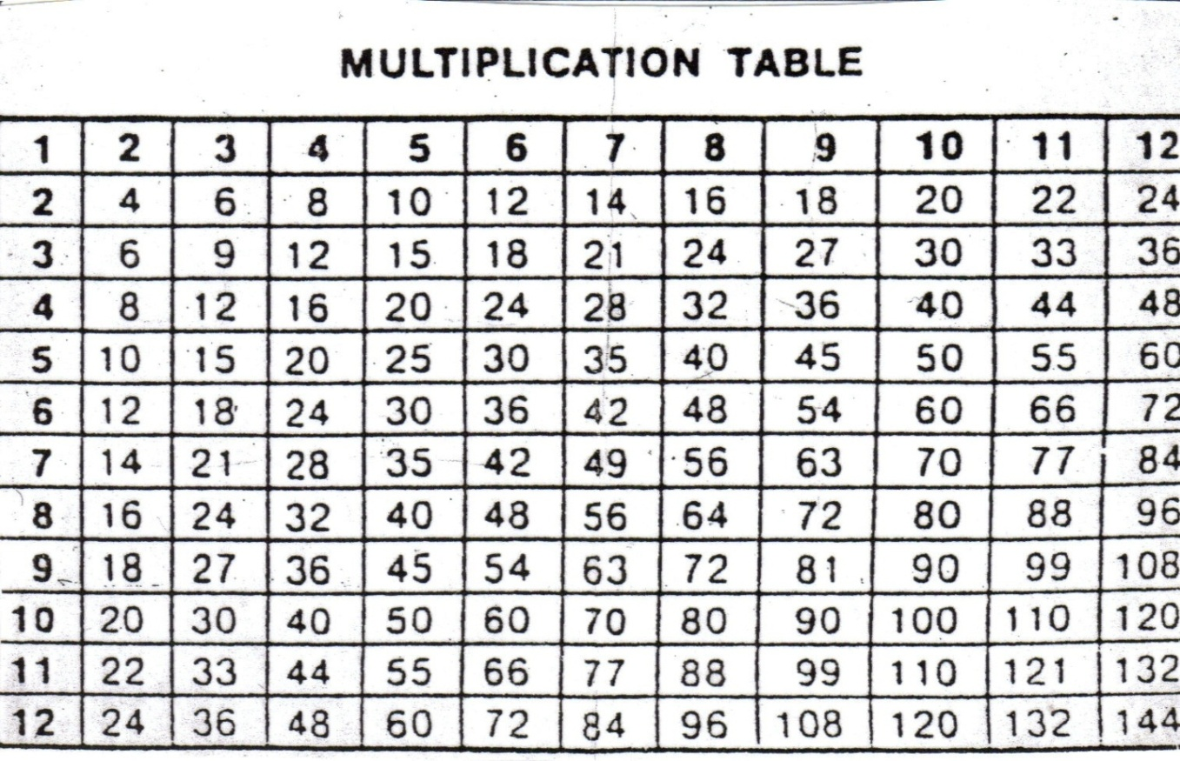
Multiply by Three
3 x 1 =
3 x 2 =

Slide 50
Multiply by Three
3 x 3 =
3 x 4 =

Slide 51
Multiply by Three
3 x 5 =
3 x 6 =

Slide 52
Multiply by Three
3 x 7 =
3 x 8 =

Slide 53
Multiply by Three
3 x 9 =
3 x 10 =

Slide 54
Multiply by Three
3 x 11 =
3 x 12 =

Slide 55
Multiply by Four
4 x 1 =
4 x 2 =

Slide 56
Multiply by Four
4 x 3 =
4 x 4 =

Slide 57
Multiply by Four
4 x 5 =
4 x 6 =

Slide 58
Multiply by Four
4 x 7 =
4 x 8 =

Slide 59
Multiply by Four
4 x 9 =
4 x 10 =

Slide 60
Multiply by Four
4 x 11 =
4 x 12 =

Slide 61
Multiply by Six
6 x 1 =
6 x 2 =

Slide 62
Multiply by Six
6 x 3 =
6 x 4 =

Slide 63
Multiply by Six
6 x 5 =
6 x 6 =

Slide 64
Multiply by Six
6 x 7 =
6 x 8 =

Slide 65
Multiply by Six
6 x 9 =
6 x 10 =

Slide 66
Multiply by Six
6 x 11 =
6 x 12 =

Slide 67
Multiply by Seven
7 x 1 =
7 x 2 =

Slide 68
Multiply by Seven
7 x 3 =
7 x 4 =

Slide 69
Multiply by Seven
7 x 5 =
7 x 6 =

Slide 70
Multiply by Seven
7 x 7 =
7 x 8 =

Slide 71
Multiply by Seven
7 x 9 =
7 x 10 =

Slide 72
Multiply by Seven
7 x 11 =
7 x 12 =

Slide 73
Multiply by Eight
8 x 1 =
8 x 2 =

Slide 74
Multiply by Eight
8 x 3 =
8 x 4 =

Slide 75
Multiply by Eight
8 x 5 =
8 x 6 =

Slide 76
Multiply by Eight
8 x 7 =
8 x 8 =

Slide 77
Multiply by Eight
8 x 9 =
8 x 10 =

Slide 78
Multiply by Eight
8 x 11 =
8 x 12 =

Slide 79
Multiply by Twelve
12 x 1 =
12 x 2 =

Slide 80
Multiply by Twelve
12 x 3 =
12 x 4 =

Slide 81
Multiply by Twelve
12 x 11=
12 x 12=

Slide 82
Multiply by Twelve
12 x 5 =
12 x 6 =

Slide 83
Multiply by Twelve
12 x 7 =
12 x 8 =

Slide 84
Multiply by Twelve
12 x 9 =
12 x 10=

Slide 85
Unit 4 Lesson 9 : Multiplying with a 10
Mixed Practice 2
SOLVE:
SOLVE:
8
7
3
6
x10
x5
4
3
5
9

Slide 86
Practice Questions
6
x 4
24
There are 6 flowers pots. Each flower pot has 4 flowers. How may flowers are there altogether.
8
x 7
56
Ali has 8 bowls with 7 goldfish in each bowl. How many fish are there altogether
7
x 6
42
7 jackets are hanging in the shop. Each jacket has 6 buttons. How many buttons in all.
86

Slide 87
Multiplication Converting Ones

Slide 88

Knowledge Test
1
2
3
4
5
6

Slide 89
12 bananas are shared equally between 3 chimpanzees. How many bananas does each chimpanzee get?
12 bananas are shared equally among 3 chimpanzees.
12 ÷ 3 =4
Each chimpanzee gets
4 bananas.

Slide 90
8 nuts are shared equally between 2 friends. How many nuts does each friend get?
8 nuts are shared equally among 2 friends.
8 ÷ 2 =4
Each friend gets
4 nuts.

Slide 91
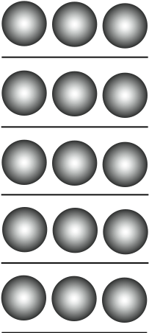
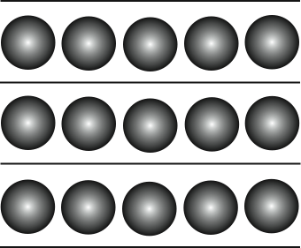
15 5 = 3
15 3 = 5

Slide 92
Division as inverse of multiplication

Slide 93
Another Form of Division
The number to be divided is called dividend.
The number which divides is called divisor.
The number which comes out at the end is called quotient.

Slide 94
Review Multiplication and Division
2 x 3 =
2 x 4 =
3 x 7 =
4 x 2 =
5 x 3 =
7 x 3 =
4 ÷ 2 =
8 ÷ 4 =
6 ÷ 2 =
10 ÷ 5 =
15 ÷ 3 =
12 ÷ 6 =

Slide 95
Thank You

