Slide 1

General Mathematics
ADE 101
Unit 3
LECTURE No. 18
Types & Measurements of Angles

Slide 2
Today’s Objectives
Students and Teachers will be able to
Learn about the types of angles
Measure the angles

Slide 3
Knowledge Test

Slide 4

What is An Angle?
When two lines meet or cross, they form an Angle.
Notes:
When two lines meet, they form an angle. These can be lines that are drawn on a piece of paper, they can be objects that form a line. Try this– Hold one arm straight above your head. While keeping that arm in place, stretch your arm straight out toward the wall. You have just made an angle and your head is right in the middle of it.
In the picture, you can see an angle drawn. The girl on the right is forming an angle with her arms. How many angles can you see around the room?

Slide 5

And More Basics of Angles
I’m a vertex.
All angles have a vertex.
The vertex is like the “elbow” of the angle.

Slide 6
Angles
An angle is the union of two rays that have a common endpoint. An angle can be named with the letter marking its vertex, and also with three letters:
the first letter names a point on the side; the second names the vertex; the third names a point on the other side.
A
Side
Vertex
B
Side
C

Slide 7
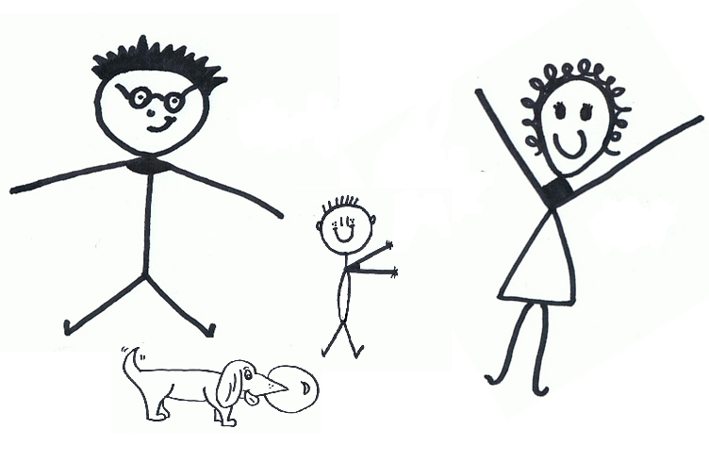
“Hi! We’re the Angles, we’re one family, but all very different, so let us tell you a bit about ourselves!”

Slide 8
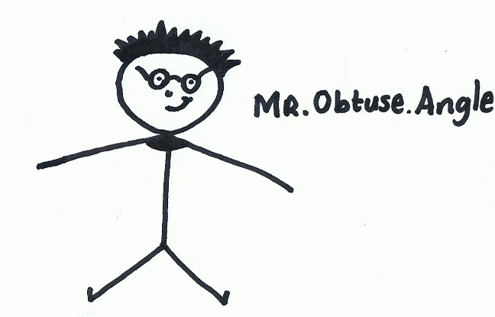
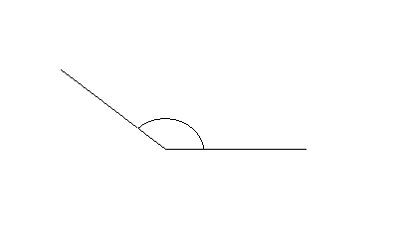
Mr. Obtuse Angle
This is Obtuse. He’s the husband of the family. He’s bigger than Right and Acute. He’s always inside, and he always measures between 90° and 180° (depending on how much dinner he’s eaten!)

Slide 9
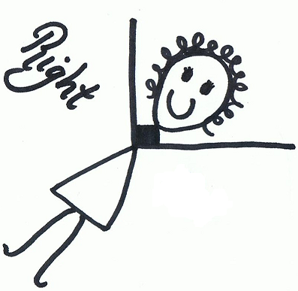
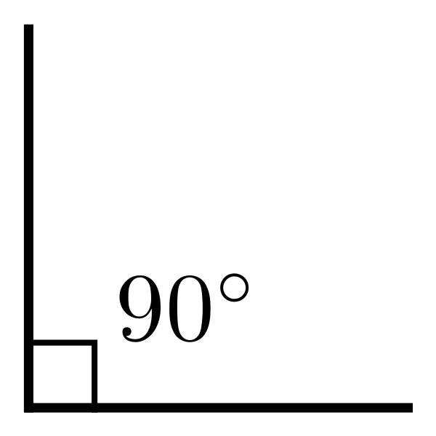
Mrs. Right Angle
This is me. I’m Mrs. Right Angle. I always measure 90°, my favourite shape is a square, and what's more, no matter what my husband tells you, I’m always right!

Slide 10
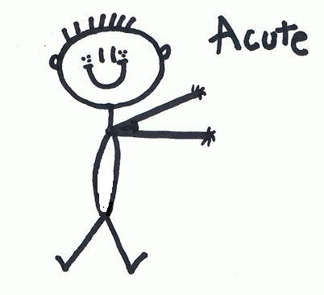
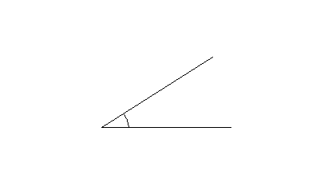
Baby Acute Angle
This is baby Acute angle. Isn’t he cute?! He loves a hug, and always has his arms out for cuddles! He’s the smallest of the family, measuring less than 90°.

Slide 11
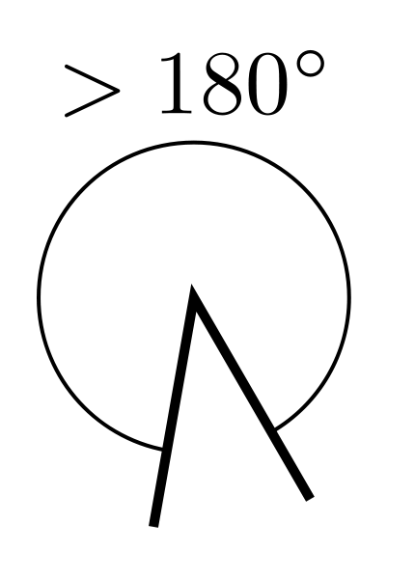
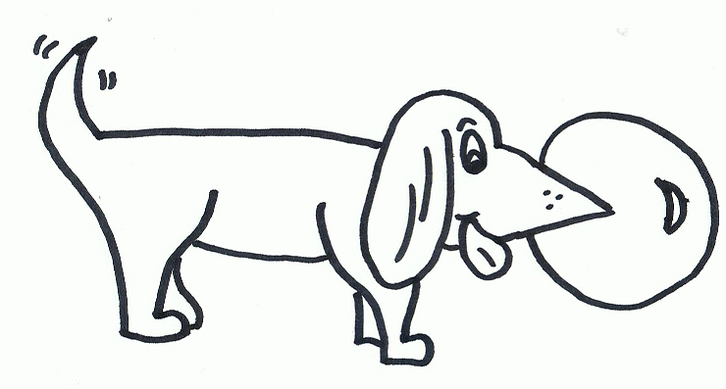
Reflex Angle
This is our pet dog, Reflex. He’s always outside. He’s only a pup at the moment so he measures 180°, but he can grow up to 360 °! So he’s definitely the biggest angle. You’ll never see him without that ball in his mouth either, horrid thing!

Slide 12
So, now you’ve met us, let’s see how well you know us...
Who am I?
I always measure less than 90°
I’m the smallest angle
I’m very cute!

Slide 13
I’m....

Slide 14
I’m....

Slide 15
Who’s left?
When two lines meet or cross, they form an Angle.

Slide 16
Angle Diagram
I’m a right angle.
This diagram shows the different types of angles from the starting point.
Red shows acute angles.
Green shows obtuse angles.
Purple shows reflex angles.
Yellow shows a right angle.
Obtuse
Acute
Starting Line
Reflex

Slide 17

Check out These Angles
Notes:
Here is a picture of the first day of school in our brand new school. Notice how all the lines that meet form angles? I put two of them in red. There are many many more. Look around the room where you are. How many angles can you find?

Slide 18
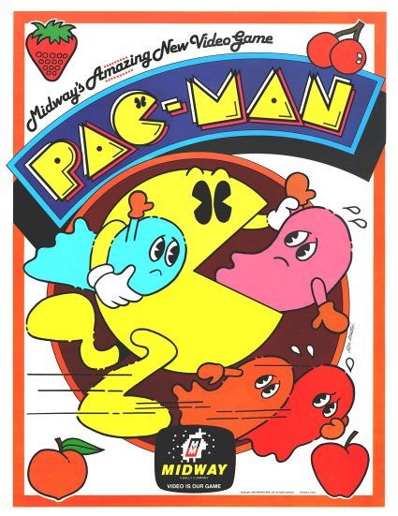


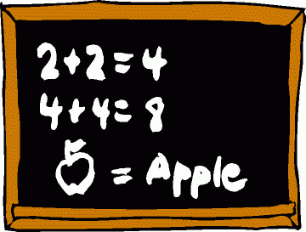
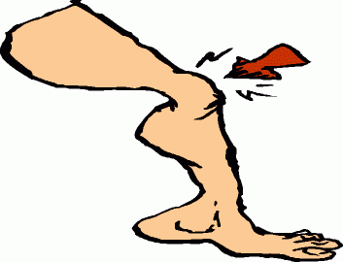
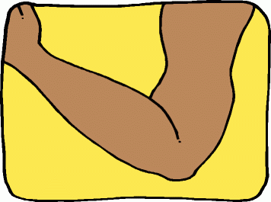

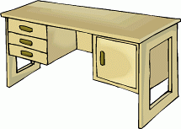
Right
Acute
Obtuse
Reflex

Slide 19
The Three Types of Angles
The Right Angle
The Acute Angle
The Obtuse Angle
Notes:
Angles have different types. Look at the first angle. It’s lines are half of a rectangle or a square. In fact, you could put two of those together and make a square. It is called a “right Angle”.
The second angle is smaller, isn’t it. Don’t you think it’s kind of cute? We call it an “acute angle”. Any angle that is smaller than a right angle is an acute angle.
The third angle, it’s real wide. It’s wider than a right angle, isn’t it. We call it an Obtuse angle.
Now, before you click to go on, study these angles very carefully. I’m going to ask you what each of them is. See if you can get a perfect score.

Slide 20
What is this Angle?
Click on the correct answer below
  A Right Angle
  An Acute Angle
  An Obtuse Angle
Notes:
Look at the angle in this picture. Is it a Right Angle? If so, click the number 1 choice. I is An Acute Angle? If so, click the number 2 choice. Or is it an Obtuse angle. If so, click the number 3 choice.

Slide 21
What is this Angle?
An Acute Angle
Click on the correct answer below
  A Right Angle
  An Acute Angle
  An Obtuse Angle
Notes:
Look at the angle in this picture. Is it a Right Angle? If so, click the number 1 choice. I is An Acute Angle? If so, click the number 2 choice. Or is it an Obtuse angle. If so, click the number 3 choice.

Slide 22
What is this Angle?
Click on the correct answer below
A Right Angle
An Acute Angle
An Obtuse Angle
Notes:
Look at the angle in this picture. Is it a Right Angle? If so, click the number 1 choice. I is An Acute Angle? If so, click the number 2 choice. Or is it an Obtuse angle. If so, click the number 3 choice.

Slide 23
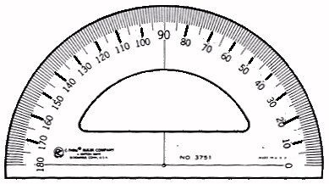
Let’s Measure Some Angles
To measure angles, we use a Protractor
Notes:
Now that you know the Right angles, acute angles, and obtuse angles, we are going to learn to measure them. Angles are measured in degrees. But these degrees have nothing to do with the temperature. To measure an angle in degrees, we use a tool called a protractor. Here is a picture of a protractor.

Slide 24
A Right Angle is 90°
Notes:
Protractors are usually made of clear plastic so that you can see right through them. You just lay the protractor on top of the angle that you wish to measure. Here’s our old friend, the right angle. The bottom line is directly over the zero. We get our reading from the tall line. It is right over the 90 degree line, isn’t it. So remember this- A right angle is 90 degrees.

Slide 25
An Acute Angle is less than 90°
Notes:
Here’s an acute angle. Do you see how we line up the tip of the angle with the center of the protractor? The bottom line is still directly over the zero. How many degrees is this angle? An acute angle is less than 90 degrees.

Slide 26
Here are more acute angles- both less than 90 degrees.
Notes:
Here are two more acute angles. One is much smaller than the other, but as long as they are less than 90 degrees which is the size of the right angle, they are acute.

Slide 27
An Obtuse Angle is more than 90°
Notes:
Here’s an obtuse angle. It is more than 90 degrees. It’s a bigger angle than the right angle.

Slide 28
Here are more obtuse angles- both more than 90 degrees.
Notes:
Here are two more acute angles. One is much smaller than the other, but as long as they are less than 90 degrees which is the size of the right angle, they are acute.

Slide 29
What are each of these? Acute, or Obtuse angles?
B
A
C
D
Notes:
When these two lines cross, four angles are made here, too. Look at them carefully. I have named the angles A, B, C, and D by putting the letters inside the angles. Two of them are small and two of them are larger. Which two are Acute Angles? Which two are Obtuse angles?

Slide 30
What are these?
Obtuse
B
A
Acute
C
Acute
Obtuse
D
Notes:
If you chose A and C as the Acute angles, you are right! And B and D are the large ones, or the Obtuse Angles. Pat yourself on the back.

Slide 31
Thank You

