Slide 1

General Mathematics
ADE 101
Unit 3
LECTURE No. 17
Point Line Plane
And Angles

Slide 2
Today’s Objectives
Students and Teachers will be able to
Understand the concept of point, line and plane
Learn about angles

Slide 3
Knowledge Test

Slide 4

Points
A Point is named by a capital letter and represented by a dot.
A point names a location and has no size
J Called Point J
All geometric figures are comprised of points.
A tiny seed is a physical model of a point.

Slide 6

Line Segment
A line segment consists of two points called endpoints of the segment and all the points between them.
A
D
H
A piece of spaghetti is a physical model of a line segment.

Slide 7
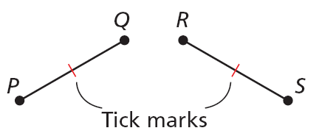
Congruent Segments
Congruent segments are segments that have the same measure or length.
In the diagram, PQ = RS, so you can write PQ ≅ RS. This is read as “segment PQ is congruent to segment RS.” Tick marks are used in a figure to
show congruent segments.
Notes:
C: Segment AB is congruent to Segment CD R: Deg congruent segments

Slide 8
Points, Lines, and Planes
Problem of the Day
Remove 4 of the segments to leave 5 equal squares.

Slide 9
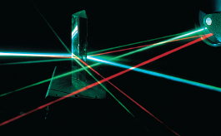
Rays
Part of a line that starts at an endpoint and extends forever in one direction
To name a ray, use its endpoint and any other point on the ray
A
D
H
A physical model of a ray are beams of light.

Slide 10
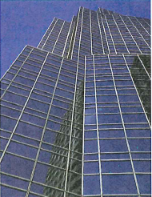
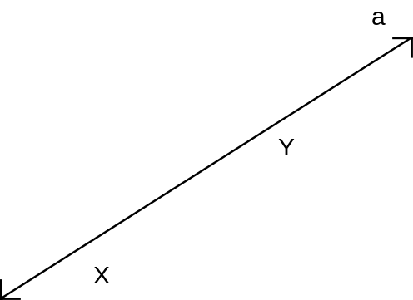
Lines
A line has no thickness or width. It is an infinite set of points (extends forever). A line is named by 2 points on the line and by placing the line symbol above the letters.
Example: Number Line

Slide 11
Parallel and Intersecting Lines
Parallel lines lie in the same plane and never meet.
Two distinct intersecting lines meet at a point.
Skew lines do not lie in the same plane and do not meet.
Parallel
Intersecting
Skew

Slide 12
Half-Line, Ray, and Line Segment
A point divides a line into two half-lines, one on each side of the point.
A ray is a half-line including an initial point.
A line segment includes two endpoints.

Slide 13
Half-Line, Ray, and Line Segment
Name | Figure | Symbol
Line AB or BA |  | AB or BA
Half-line AB |  | AB
Half-line BA |  | BA
Ray AB |  | AB
Ray BA |  | BA
Segment AB or segment BA |  | AB or BA
A B
A B
A B
A B
A B
A B

Slide 14
Collinear Points
Points that lie on the same line.
Non-collinear Points
Points that do not lie on the same line.
K L M
N

Slide 15
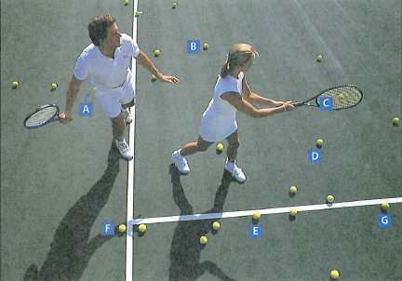
Example:
Name three collinear balls.
Name three non-collinear balls.

Slide 16
Example : Identifying Line Segments and Rays
Identify the figures in the diagram.
M
N
O
A. three rays
Name the endpoint of a ray first.
MN, NM, MO
B. two line segments
Use the endpoints in any order to name a segment.
MN, MO

Slide 17

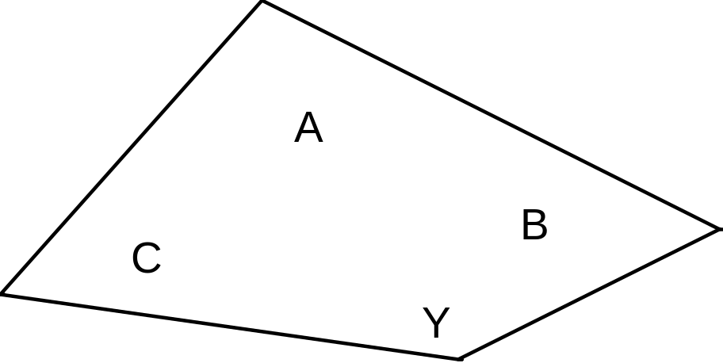
Plane
A flat surface that extends indefinitely in all directions (consists of an infinite set of points)
Named by 3 noncollinear points or a script capital letter.
T

Slide 18
Points, Lines, and Planes
A plane is a
perfectly flat
surface that
extends infinitely
in all directions.
Plane QRS
Use three points
in any order, not
on the same line,
to name a plane.
Q
S
R

Slide 19
The Geometry of Euclid
A point has no magnitude and no size.
A line has no thickness and no width and it extends indefinitely in two directions.
A plane is a flat surface that extends infinitely.

Slide 20
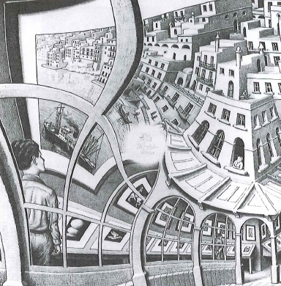
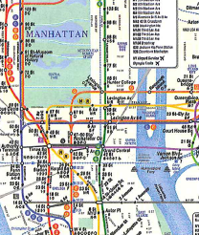
Activity 1
Points, Lines, and Planes

Slide 21
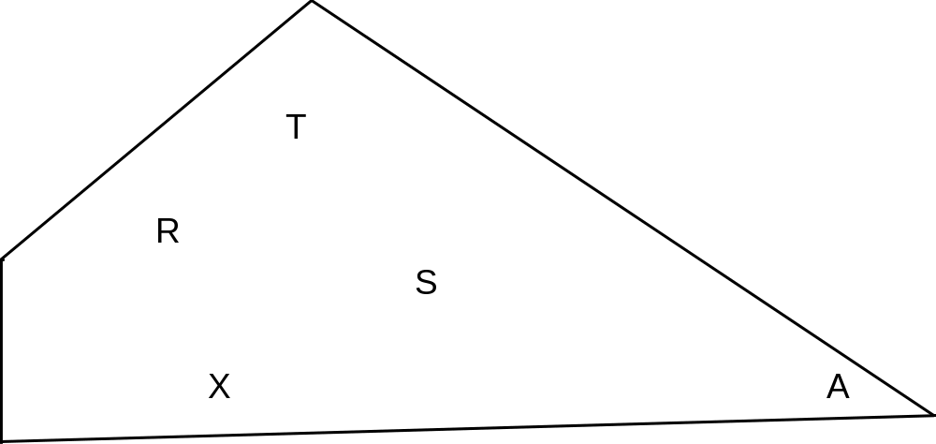
Name this plane
P
Notes:
Plane RTS or Plane TSX or Plane RXS or Plane P

Slide 22
Parallel and Intersecting Planes
Parallel planes never meet.
Two distinct intersecting planes meet and form a straight line.
Parallel
Intersecting

Slide 23
Points, Lines, and Planes
A capital letter usually represents a point. A line may named by two capital letters representing points that lie on the line or by a single letter such as l. A plane may be named by three capital letters representing points that lie in the plane or by a letter of the Greek alphabet such as
A
l
E
D

Slide 24
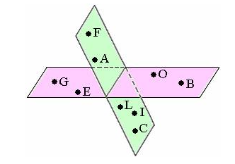
COPLANAR POINTS
Points that lie in the same plane.
NON-COPLANAR POINTS
Points that do not lie in the same plane.

Slide 25
Example : Identifying Points, Lines, and Planes
Identify the figures in the diagram.
D
E
F
A. three points
D, E, and F
Choose any two points on a line to name the line.
B. two lines
DE, DF
Choose any three points, not on the same line, in any order.
C. a plane
plane DEF

Slide 26
Try This: Example
Identify the figures in the diagram.
G
H
I
F
Choose any two points on a line to name the line.
A. four points
H, G, I, and F
B. two lines
IH, HF
Choose any three points, not on the same line, in any order.
C. a plane
plane IGF

Slide 27
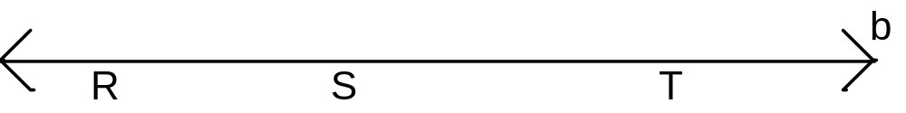
Name this line.
Notes:
Line RS or Line ST or Line RT or line b

Slide 28
Try This: Example
Identify the line segments that are congruent.
A
AB AC
One tick mark
BC DE
Two tick marks
B
C
BD CE
Three tick marks
D
E

Slide 29
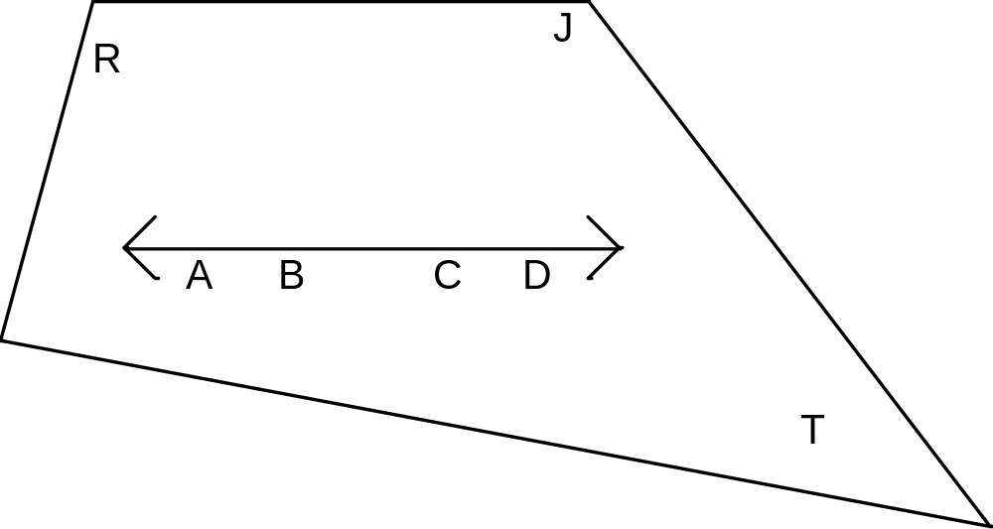
EXAMPLE
Name the plane in 3 different ways.
Give another name for Line AD.
P
Notes:
Some possible answers: Plane RAB, Plane RBC, Plane CDT, Plane BDT, Plane RCD, Plane TAB, Plane P

Slide 30
Try This: Example
Identify the figures in the diagram.
D
C
A. three rays
Name the endpoint of
a ray first.
B
A
BC, CA, BD
B. three line segments
Use the endpoints in any order to name a segment.
BA, CA, BD

Slide 31
Points, Lines, and Planes
Lesson Quiz
Use geometric notation to identify figures.
B
A
1. lines
C
AD, BE, CF
G
2. plane
F
E
D
Possible answer: plane ABG
3. three rays
Possible answer: GA, GB, GC
4. four line segments
Possible answer: AG, AD, DG, BG
5. How many planes, lines, and points are suggested by the sides, edges, and corners of an ordinary box?
6 planes, 12 lines, 8 points

Slide 32
Points, Lines, and Planes
Warm Up
What geometry term might you associate with each object?
1. one edge of a cardboard box
2. the floor
3. the tip of a pen
line segment or line
plane or rectangle
point
Notes:
If you chose A and C as the Acute angles, you are right! And B and D are the large ones, or the Obtuse Angles. Pat yourself on the back.

