Slide 1

General Mathematics
ADE 101
Unit 2
LECTURE No. 15
SIMULTANEOUS LINEAR EQUATIONS AND THEIR SOLUTION

Slide 2
Today’s Objectives
Students and Teachers will be able to
Understand the system of simultaneous linear equations.
Solve the system of simultaneous linear equations involving two variables .

Slide 3
Knowledge Test

Slide 4
Systems of Equations
A set of equations is called a system of equations.
The solutions must satisfy each equation in the system.
If all equations in a system are linear, the system is a system of linear equations, or a linear system.

Slide 5
Systems of Linear Equations:
A solution to a system of equations is an ordered pair that satisfy all the equations in the system.
A system of linear equations can have:
        1. Exactly one solution
        2. No solutions
        3. Infinitely many solutions

Slide 6
Systems of Linear Equations:
There are four ways to solve systems of linear equations:
      1. By graphing
      2. By substitution
      3. By addition (also called elimination)
      4. By multiplication

Slide 7
Solving Systems by Graphing:
When solving a system by graphing:
      Find ordered pairs that satisfy each of the equations.
      Plot the ordered pairs and sketch the graphs of both equations on the same axis.
      The coordinates of the point or points of intersection of the graphs are the solution or solutions to the system of equations.

Slide 8
Solving Systems by Graphing:
Consistent
Inconsistent
Dependent
One solution
Lines intersect
No solution
Lines are parallel
Infinite number of solutions
Coincide-Same line

Slide 9
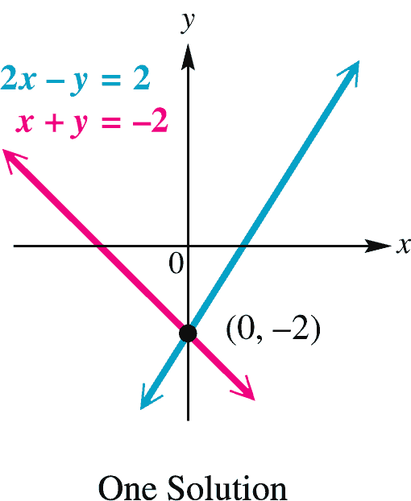
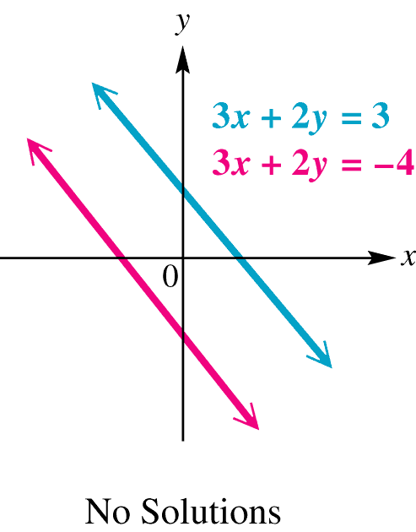
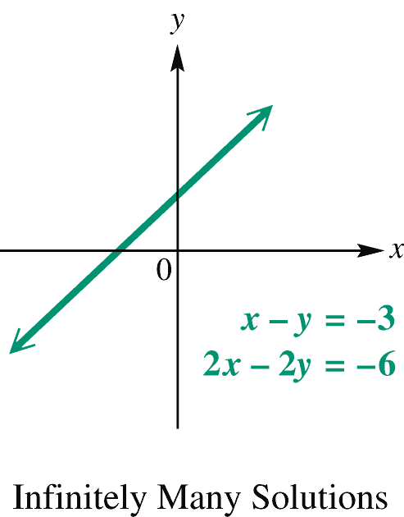
Linear System in Two Variables
Three possible solutions to a linear system in two variables:
One solution: coordinates of a point
No solutions: inconsistent case
Infinitely many solutions: dependent case

Slide 10
2x – y = 2
x + y = -2
2x – y = 2
-y = -2x + 2
y = 2x – 2
x + y = -2
y = -x - 2
Different slope, different intercept!

Slide 11
3x + 2y = 3
3x + 2y = -4
3x + 2y = 3
2y = -3x + 3
y = -3/2 x + 3/2
3x + 2y = -4
2y = -3x -4
y = -3/2 x - 2
Same slope, different intercept!!

Slide 12
x – y = -3
2x – 2y = -6
x – y = -3
-y = -x – 3
y = x + 3
2x – 2y = -6
-2y = -2x – 6
y = x + 3
Same slope, same intercept! Same equation!!

Slide 13
Determine Without Graphing:
There is a somewhat shortened way to determine what type (one solution, no solutions, infinitely many solutions) of solution exists within a system.
Notice we are not finding the solution, just what type of solution.
Write the equations in slope-intercept form: y = mx + b.
(i.e., solve the equations for y, remember that
m = slope, b = y - intercept).

Slide 14
Determine Without Graphing:
Once the equations are in slope-intercept form, compare the slopes and intercepts.
One solution – the lines will have different slopes.
No solution – the lines will have the same slope, but different intercepts.
Infinitely many solutions – the lines will have the same slope and the same intercept.

Slide 15
Determine Without Graphing:
Given the following lines, determine what type of solution exists, without graphing.
  Equation 1: 3x = 6y + 5
  Equation 2: y = (1/2)x – 3
Writing each in slope-intercept form (solve for y)
  Equation 1: y = (1/2)x – 5/6
  Equation 2: y = (1/2)x – 3
Since the lines have the same slope but different y-intercepts, there is no solution to the system of equations. The lines are parallel.

Slide 16
Substitution Method:
Procedure for Substitution Method
Solve one of the equations for one of the variables.
Substitute the expression found in step-1 into the other equation.
Now solve for the remaining variable.
Substitute the value from step-2 into the equation written in step-1, and solve for the remaining variable.

Slide 17
Substitution Method:
Solve the following system of equations by substitution.
Step 1 is already completed.
Step 2:Substitute x+3 into 2nd equation and solve.
Step 3: Substitute –4 into 1st equation and solve.
The answer: ( -4 , -1)

Slide 18
Solve the system using substitution
x + y = 5
y = 3 + x
Step 1: Solve an equation for one variable.
The second equation is
already solved for y!
Step 2: Substitute
x + y = 5
x + (3 + x) = 5
2x + 3 = 5
2x = 2
x = 1
Step 3: Solve the equation.

Slide 19
Solve the system using substitution
x + y = 5
y = 3 + x
x + y = 5
(1) + y = 5
y = 4
Step 4: Plug back in to find the other variable.
(1, 4)
(1) + (4) = 5
(4) = 3 + (1)
Step 5: Check your solution.
The solution is (1, 4). What do you think the answer would be if you graphed the two equations?

Slide 20
Solve the system using substitution
3y + x = 7
4x – 2y = 0
It is easiest to solve the
first equation for x.
3y + x = 7
-3y -3y
x = -3y + 7
Step 1: Solve an equation for one variable.
Step 2: Substitute
4x – 2y = 0
4(-3y + 7) – 2y = 0

Slide 21
Solve the system using substitution
3y + x = 7
4x – 2y = 0
-12y + 28 – 2y = 0
-14y + 28 = 0
-14y = -28
y = 2
Step 3: Solve the equation.
4x – 2y = 0
4x – 2(2) = 0
4x – 4 = 0
4x = 4
x = 1
Step 4: Plug back in to find the other variable.

Slide 22
Solve the system using substitution
3y + x = 7
4x – 2y = 0
(1, 2)
3(2) + (1) = 7
4(1) – 2(2) = 0
Step 5: Check your solution.

Slide 23
Solving Linear Systems of two variables by Method of Substitution.
Example 6: Solve the system : 4x + y = 5
2x - 3y =13
Step 1: Choose the variable y to solve for in the top equation:
y = -4x + 5
Step 2: Substitute this variable into the bottom equation
2x - 3(-4x + 5) = 13 2x + 12x - 15 = 13
Step 3: Solve the equation formed in step 2
14x = 28 x = 2
Step 4: Substitute the result of Step 3 into either of the original equations and solve for the other value. 4(2) + y = 5
y = -3
Solution Set: {(2,-3)}
Step 5: Check the solution and write the solution set.

Slide 24
Deciding whether an ordered pair is a solution of a linear system.
The solution set of a linear system of equations contains all ordered pairs that satisfy all the equations at the same time.
Example 1: Is the ordered pair a solution of the given system?
2x + y = -6 Substitute the ordered pair into each equation.
x + 3y = 2 Both equations must be satisfied.
A) (-4, 2) B) (3, -12)
2(-4) + 2 = -6 2(3) + (-12) = -6
(-4) + 3(2) = 2 (3) + 3(-12) = 2
-6 = -6 -6 = -6 2 = 2 -33 ≠ -6
∴ Yes ∴ No

Slide 25
Substitution Method
Example Solve the system.
Solution
(1)
(2)
Solve (2) for y.
Substitute y = x + 3 in (1).
Solve for x.
Substitute x = 1 in y = x + 3.
Solution set: {(1, 4)}

Slide 26
Solving Linear Systems of two variables by Method of Substitution.
Example 7:
Solve the system :
y = -2x + 2
-2x + 5(-2x + 2) = 22 -2x - 10x + 10 = 22
-12x = 12
x = -1 2(-1) + y = 2
y = 4
Solution Set: {(-1,4)}

Slide 27
Practice Questions
2x + 4y = 4
3x + 2y = 22
3x – y = 4
x = 4y - 17

Slide 28
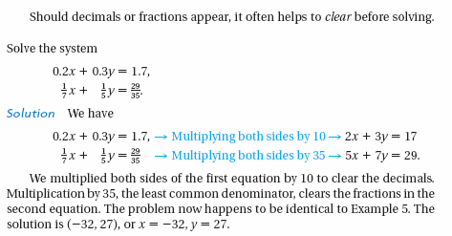
Clearing Fractions or Decimals

Slide 29
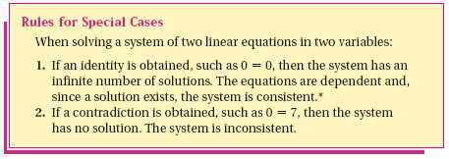
Systems without a Single Point Solution

Slide 30
Inconsistent Systems - how can you tell?
An inconsistent system
has no solutions.
(parallel lines)
Substitution Technique

Slide 31
Dependent Systems – how can you tell?
A dependent system has
infinitely many solutions.
(it’s the same line!)
Substitution Technique

Slide 32
Thank You

