Slide 1

General Mathematics
ADE 101
Unit 2
LECTURE No. 13
Slope
of
A linear Equation

Slide 2
Today’s Objectives
Students and Teachers will be able to
Understand Slope and its types.
Form the linear equations involving slopes of different situations.

Slide 3
Knowledge Test

Slide 4
What is a slope of a line?

Slide 5
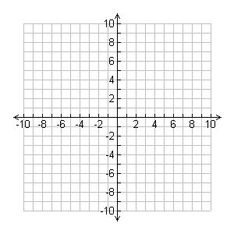
SLOPE
Slope is the ratio of the vertical rise to the horizontal run between any two points on a line. Usually referred to as the rise over run.
Run is 6 because we went to the right
Slope triangle between two points. Notice that the slope triangle can be drawn two different ways.
Rise is 10 because we went up
Rise is -10 because we went down
Run is -6 because we went to the left

Slide 6
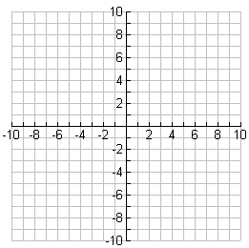

Slide 7
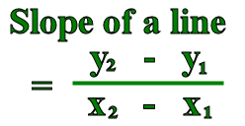
Remember, linear equations have constant slope. For a line on the coordinate plane, slope is the following ratio. This ratio is often referred to as “rise over run”.

Slide 10
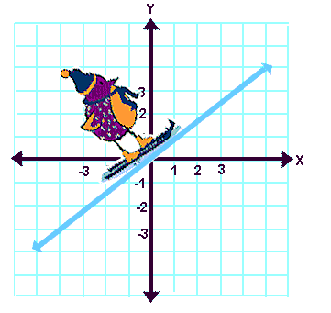
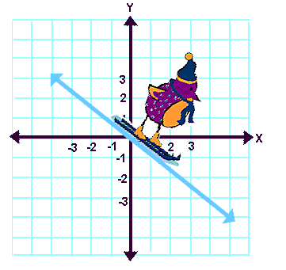
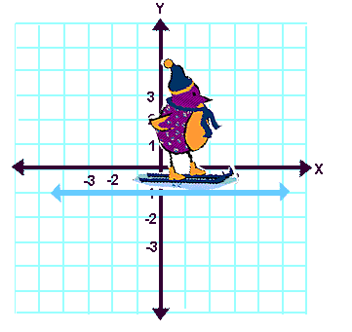
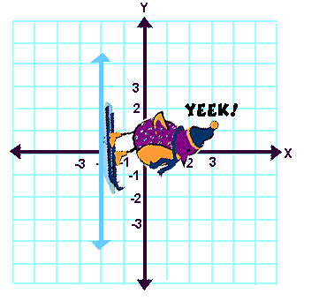
Slopes: positive, negative, no slope (zero), undefined.

Slide 11
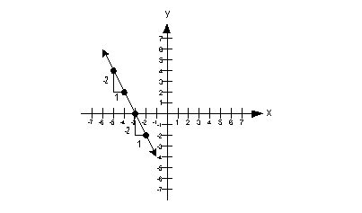
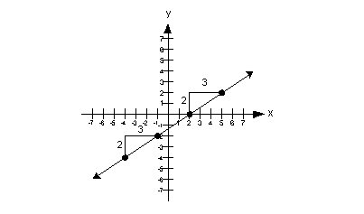
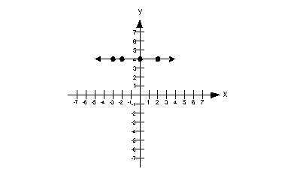
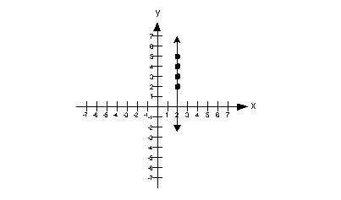
Finding slope (rate of change) using a graph and two points.

Slide 12
X AND Y INTERCEPTS
The x-intercept is the x-coordinate of a point where the graph crosses the x-axis.
The y-intercept is the y-coordinate of a point where the graph crosses the y-axis.
The x-intercept would be 4 and is located at the point (4, 0).
The y-intercept is 3 and is located at the point (0, 3).

Slide 13
SLOPE-INTERCEPT FORM
If the graph of an equation intersects the y -axis at the point
(0, b), then the number b is the y -intercept of the graph. To
find the y -intercept of a line, let x = 0 in an equation for the
line and solve for y.
The slope intercept form of a linear equation is
y = mx + b.
y
(0 , b)
x
m is the slope
y = mx + b
b is the y-intercept

Slide 14
SLOPE-INTERCEPT FORM
GRAPHING EQUATIONS IN SLOPE-INTERCEPT FORM
The slope-intercept form of an equation gives you a quick
way to graph the equation.
STEP 1
Write equation in slope-intercept form by solving for y.
STEP 2
Find y-intercept, use it to plot point where line crosses
y-axis.
STEP 3
Find slope, use it to plot a second point on line.
STEP 4
Draw line through points.

Slide 15
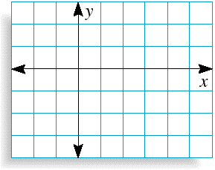
Graphing with the Slope-Intercept Form
Graph y = x – 2
3
4
(4, 1)
SOLUTION
The equation is already in slope-intercept form.
3
(0, – 2)
4
The y-intercept is – 2, so plot the point (0, – 2) where the line crosses the y -axis.
(0, – 2)
3
The slope is , so plot a second point on the line by moving
4 units to the right and 3 units up. This point is (4, 1).
4
(4, 1).
Draw a line through the two points.

Slide 16
Find the Equation of a Line
Given the Graph
Find the y-intercept from the graph.
Count the slope from the graph.
To write the equation of the line, substitute the slope and y-intercept in the slope-intercept form of the equation.

Slide 17
Example 1
b = -3
m =
y = x - 3
x
+2
+3
y

Slide 18
Example 2
b = 1
m =
y = x + 1
-2
+1
x
y

Slide 19
Example 3
b = 4
m = 0/1= 0
y = 0x + 4, y = 4
x
y

Slide 20
FORMULA FOR FINDING SLOPE
The formula is used when you know two points of a line.

Slide 21
Assignment
Write each equation in slope-intercept form.
Identify the slope and y-intercept.
2x + y = 10
-4x + y = 6
4x + 3y = 9
2x + y = 3
5y = 3x

Slide 22
Assignment
Write the equation of the line in slope-intercept form that passes through each pair of points.
(-1, -6) and (2, 6)
(0, 5) and (3, 1)
(3, 5) and (6, 6)
(0, -7) and (4, 25)
(-1, 1) and (3, -3)

Slide 23
Thank You

