Slide 1

General Mathematics
ADE 101
Unit 2
LECTURE No. 12
Liner Equations
and
Graph of Liner Equations

Slide 2
Today’s Objectives
Students and Teachers will be able to
To understand the Linear Equations.
To plot Linear Equations on the Cartesian Coordinate System.

Slide 3
Knowledge Test
Draw the graph of the equation x+2=y

Slide 4
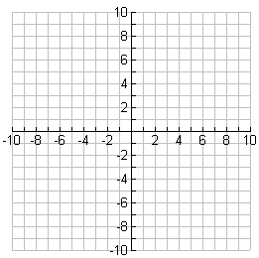

Slide 5
What is a Linear Equation?
A linear equation is an equation whose graph forms a straight line.
Linear equations are usually shown on a coordinate plane
Real life situations of linear equations include the stock market as well as the payments of a car.

Slide 9
Linear Equation in One Variable
A linear equation in one variable is an equation which can be written in the form:
ax + b = c
for a, b, and c real numbers with a ≠ 0.
Linear equations in one variable:
2x + 3 = 11
2(x − 1) = 8
can be rewritten 2x + (− 2) = 8.
can be rewritten x + 5 = − 7.
Not linear equations in one variable:
2x + 3y = 11
(x − 1)² = 8
Two variables
x is squared.
Variable in the denominator

Slide 10
Example: Solution
A solution of a linear equation in one variable is a real number
which, when substituted for the variable in the equation, makes
the equation true.
Example: Is 3 a solution of 2x + 3 = 11?
2x + 3 = 11
Original equation
2(3) + 3 = 11
Substitute 3 for x.
6 + 3 = 11
False equation
3 is not a solution of 2x + 3 = 11.
Example: Is 4 a solution of 2x + 3 = 11?
2x + 3 = 11
Original equation
2(4) + 3 = 11
Substitute 4 for x.
8 + 3 = 11
True equation
4 is a solution of 2x + 3 = 11.

Slide 11
Forms of Linear Equations
The forms of linear equations are the formats in which the information is written in.
These two forms are the most commonly used ways to write linear equations.
    1. Slope Intercept Form: y=mx+b
    2. Standard Form: Ax + By =C

Slide 12
Standard form of a linear equations in one variable

Slide 13
If the “y” is not all by itself, then we must first use the rules of algebra to isolate the “y” term.
For example in the equation:
2y = 8x + 10
You will notice that in order to get “y” all by itself we have to divide both sides by 2.
After you have done that, the equation becomes:
Y = 4x + 5
Only then can we determine the slope (4), and the y-intercept (+5)

Slide 14
Substitute m and b into y = mx + b
m = -3, b = 1
m = -2, b = -4
m = 0, b = 10
m = 1, b = 0
m = 0, b = 0
y = -3x + 1
y = -2x - 4
y = 0x + 10, y = 10
y = 1x + 0, y = x
y = 0x + 0, y = 0

Slide 18
STANDARD FORM
GRAPHING EQUATIONS IN STANDARD FORM
The standard form of an equation gives you a quick
way to graph the equation.
1
Write equation in standard form.
2
Find x-intercept by letting y = 0. Solve for x. Use
x-intercept to plot point where line crosses x-axis.
3
Find y-intercept by letting x = 0. Solve for y. Use
y-intercept to plot point where line crosses y-axis.
4
Draw line through points.

Slide 19

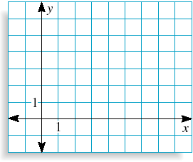
Drawing Quick Graphs
Graph 2x + 3y = 12
(0, 4)
SOLUTION
METHOD 1: USE STANDARD FORM
(6, 0)
2x + 3y = 12
Standard form.
2x + 3(0) = 12
Let y = 0.
x = 6
Solve for x.
The x-intercept is 6, so plot the point (6, 0).
2(0) + 3y = 12
Let x = 0.
y = 4
Solve for y.
The y-intercept is 4, so plot the point (0, 4).
Draw a line through the two points.

Slide 20
STANDARD FORM
HORIZONTAL AND VERTICAL LINES
HORIZONTAL LINES The graph of y = c is a horizontal line
through (0, c ).
VERTICAL LINES The graph of x = c is a vertical line
through (c , 0).

Slide 21
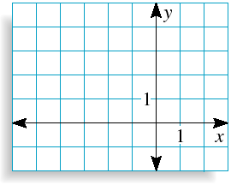
Graphing Horizontal and Vertical Lines
Graph y = 3 and x = –2
y = 3
SOLUTION
(0, 3)
The graph of y = 3 is a horizontal line that passes through the point (0, 3). Notice that every point on the line has a y-coordinate of 3.
x = –2
(–2, 0)
The graph of x = –2 is a vertical line that passes through the point (– 2, 0). Notice that every point on the line has an
x-coordinate of –2.

Slide 22
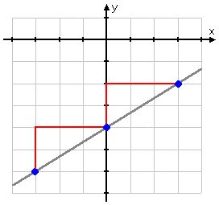
If an equation is linear, a constant change in the x-value produces a constant change in the y-value.
The graph to the right shows an example where each time the x-value increases by 2, the y-value increases by 3.

Slide 23
ASSIGNMENT

Slide 24
Thank You

