Slide 1

General Mathematics
ADE 101
Unit 2
LECTURE No. 11
Variables
and
Coordinates

Slide 2
Today’s Objectives
Students and Teachers will be able to
To understand the Cartesian Coordinate System.
To plot ordered pairs (points) on the Cartesian Coordinate System.

Slide 3
Example
Sitting Arrangement of a class

Slide 4

Knowledge Test
2
4
6
8
10
12

Slide 5
Ordered Pair

Slide 7
51
52
54
57

Slide 10

Coordinate Graphs
The Cartesian coordinate system was developed by a French mathematician, Rene Descartes.
Descartes lay in bed sick and saw a fly buzzing around on the ceiling. He realized that he could describe the position of the fly using the square ceiling tiles. After this experience he developed the coordinate plane.

Slide 11
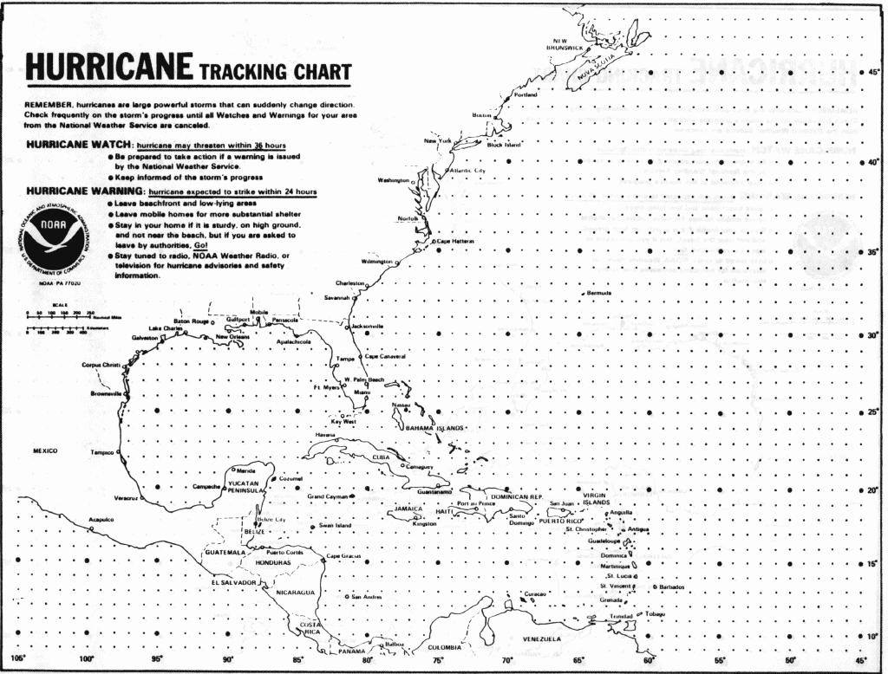
To explain Descartes method, first think of using a map. If you are trying to find a specific location you use reference points around the outside of the map and trace down and across to find your location.

Slide 12
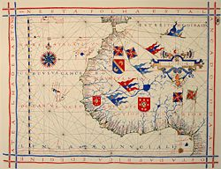
Cartography, the science of map making, is an application of graphing on a coordinate plane. Cartographers map a region of the surface of the earth onto part of a plane.

Slide 13
Example

Slide 14
Coordinate Graphs
Every point in the plane can be described by an ordered pair of values called coordinates.
  We refer to these ordered pairs as (x, y), (x-coordinate, y-coordinate).

Slide 15
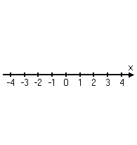
Coordinate Graphs
A coordinate graph is made up of two perpendicular number lines, called “axes”. The horizontal number line is the x-axis and the vertical number line is the y-axis.

Slide 16
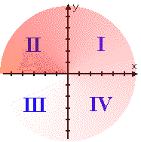
Coordinate Graphs
The two axes divide the plane into four sections called “quadrants”. The quadrants are labeled with Roman Numerals, starting in the upper right corner and going counterclockwise.

Slide 17
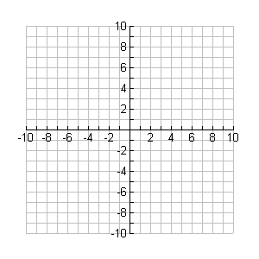

Slide 18
ORDER PAIRS – a pair of numbers used to locate a point on a coordinate plane.
COORDINATE PLANE – a plane formed by the intersection of a horizontal number line called the x-axis and a vertical line called the y-axis.
X-AXIS – the horizontal axis on a coordinate plane.
Y-AXIS – the vertical axis on a coordinate plane.
X-COORDINATE – the first number in an ordered pair; it tells the units to move right or left from the origin.
Y-COORDINATE – the second number in an ordered pair; it tells the units to move up or down from the origin

Slide 19
Origin – the point where the x-axis and the y-axis intersect on the coordinate plane.
Graph of an Equation – the set of all ordered pairs that are solutions of the equation.
Dependent Variable – the y-coordinate of an equation, which depends on what the x-value will be. (in the equation y = 2x, the y-value depends on what the value of x is.)
Independent Variable – the x-coordinate of an equation, which when substituted will determine what the y-value will be. (in the equation y = 2x, the value of x will determine what the value of y equals)

Slide 23
Coordinate Graphs
Rules for Plotting Ordered Pairs
Always begin at the origin, the intersection of the two axes.
The x-coordinate, is the first number of the pair and gives the direction of left or right along the x-axis or the horizontal number line.
The y-coordinate, is the second number of the pair and gives the direction of up or down along the y-axis or the vertical number line.

Slide 24
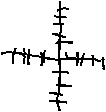
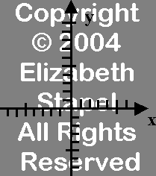
The good, the bad and the ugly.
When graphing you always use graph paper and draw neatly.
NO HAND DRAWN GRAPHS

Slide 25
Assignment – I
Complete the table of values to determine the ordered pairs. Graph the equation on a coordinate plane.

Slide 26
Assignment – II
Graph of the equation y = 2x + 3

Slide 27
Assignment – III
Make a table of values for the following equations and graph each on the coordinate graph.
y = x + 1 y = 3x y = 2x - 1

Slide 28
Thank You

